Slide 1


TOOLS · DECK 0
The Tools
Meet the Editor, Git Basics, AdvantageScope, Elastic and Choreo: the five tools every MARS/WARS programmer uses.
Notes:
Welcome to the Tools deck. Before we write robot code we need the tools: the editor, git, and three tools that show us what the robot is doing or tell it where to go. Everything here runs inside Scriptum, so nobody needs to install anything.

Slide 2





BY THE END OF THIS DECK
Five tools, five lessons
01
02
03
04
05
Meet the Editor
Git Basics
AdvantageScope
Elastic
Choreo
Make files and folders, find things fast, run a program
Commit, branch, merge, rebase, push, pull and stash
Graph and replay what the robot is doing
Build the dashboard drivers use in a match
Plan autonomous paths the robot can really follow
2
Notes:
Each of these is one Scriptum lesson in the Tools track. We'll cover them in this order, and each section ends with the checkpoints students verify in Scriptum.

Slide 3
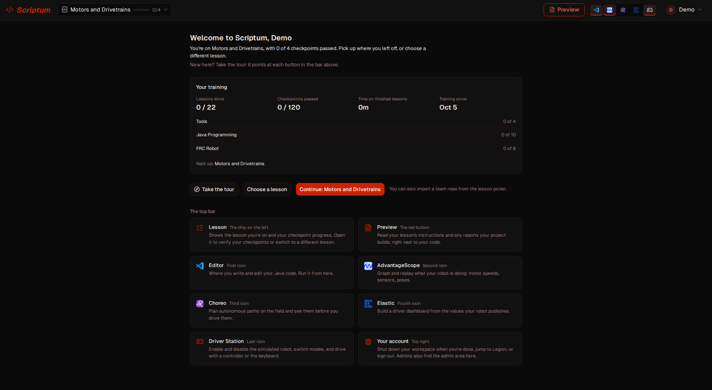
WHERE IT ALL HAPPENS
Everything runs in Scriptum
• Open it in a browser: nothing to install
• The lesson chip at the top holds your checkpoints
• Preview shows the lesson's instructions
• One icon per tool opens its pane
The Scriptum welcome page and its top bar
3
Notes:
Scriptum is our browser workspace. The welcome page shows your progress across the three tracks. The top bar has the lesson chip (checkpoints live there), Preview for the lesson instructions, and one icon per tool: editor, AdvantageScope, Choreo, Elastic, Driver Station.

Slide 4
01
Meet the Editor
Files, folders, finding things, and running a program
4
Notes:
No experience needed for this one. It's a tour of the editor and the things every programmer does all day.

Slide 5
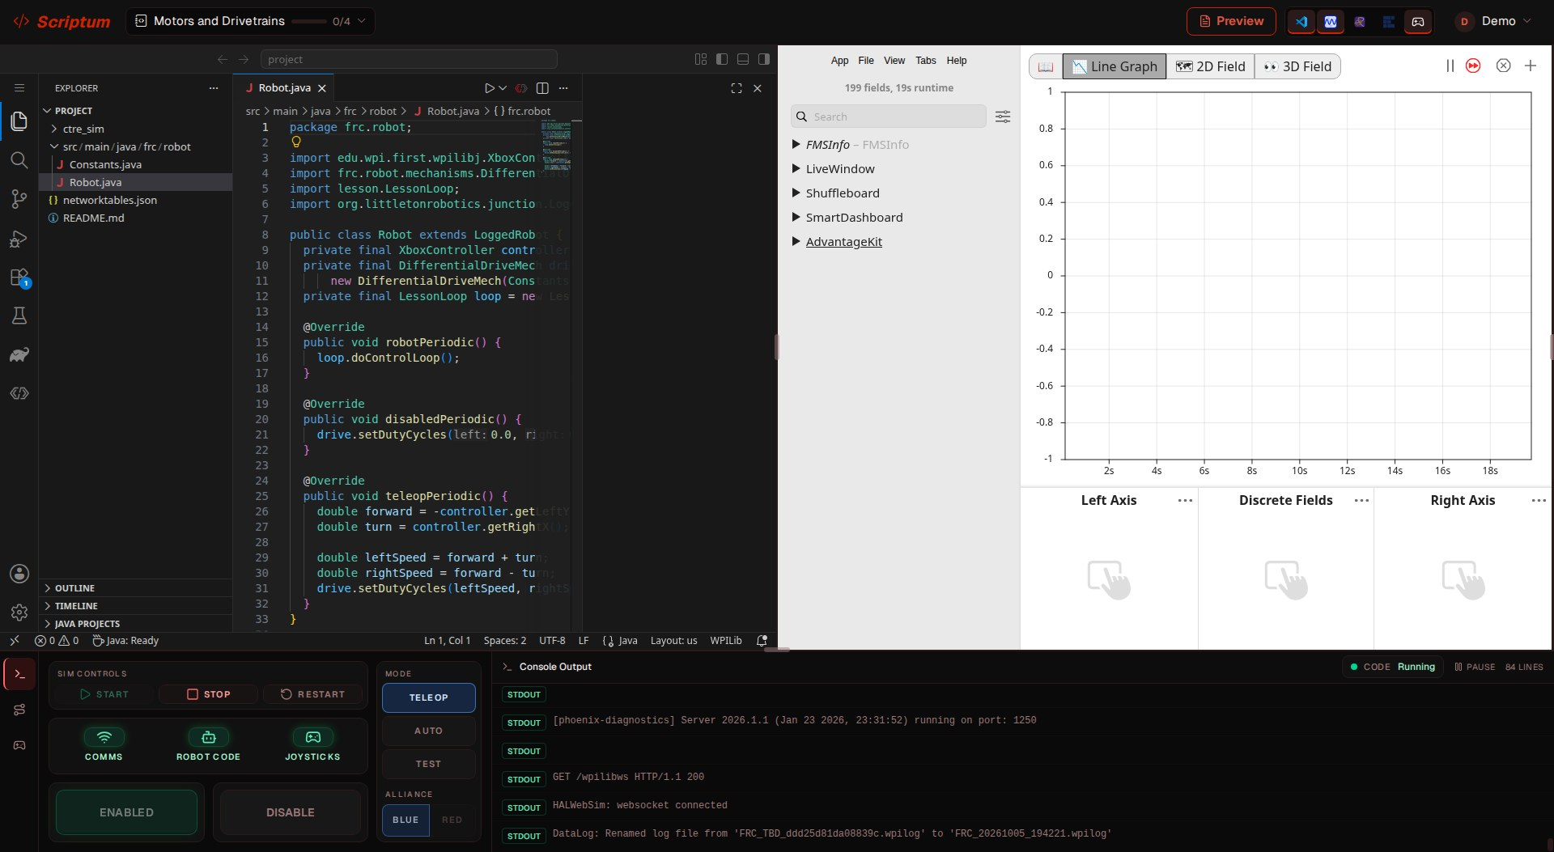
MEET THE EDITOR
Your workspace
3
1
Explorer
1
2
Your files and folders
2
Editor
Where you type code
3
Tool panes
AdvantageScope, Elastic, Choreo
4
Driver Station
4
Start, enable and drive the robot
5
Notes:
Point at each part as you go. 1 Explorer: the project's files and folders. 2 Editor: where you type. 3 Tool panes: AdvantageScope here, and Elastic and Choreo open in the same place. 4 Driver Station: Start builds and runs the robot code, Enable turns it on.

Slide 6
MEET THE EDITOR
Files, folders and paths
• A file has a name and an extension: Robot.java
• A folder holds files and other folders
• A project is one folder with everything inside
• A path is a file's address, folder by folder
src/main/java/frc/robot/Robot.java
Every robot lesson's code lives at this path
6
Notes:
A file has a name and an extension that says what kind of file it is. Folders hold files and other folders. A project is one folder with everything for a program. A path is a file's address. Robot code always lives at the same path, so students will see this one a lot.

Slide 7
MEET THE EDITOR
Find things fast
Ctrl+P
Open a file by typing part of its name
Ctrl+Shift+P
Find any command (the command palette)
Ctrl+Shift+F
Search for a word in every file
Ctrl+`
Open the terminal
Ctrl+F
Search in the file you're in
F2
Rename the selected file or folder
7
Notes:
These shortcuts save a lot of clicking. Have everyone try Ctrl+P with a file name. Click inside the editor first so it hears the keys.

Slide 8
MEET THE EDITOR
Run your first program
src/Main.java
public class Main {
public static void main(String[] args) {
System.out.println("Hello, my name is ...");
}
}
Replace the three dots with your name, then click Run (the triangle at the top right of the file).
8
Notes:
This is job 5. Open src/Main.java, swap the three dots for your name, and press Run, the triangle at the top right of the file. The output appears in the terminal at the bottom.

Slide 9

YOUR TURN
Meet the Editor
Open the lesson chip and press Verify after each job. You can't break anything.
CHECKPOINTS TO VERIFY
Make a folder called my-team
Make a file inside it: about.txt
Rename untitled.txt to team.txt
Delete delete-me.txt
Run a program: src/Main.java
In Scriptum: Tools › Meet the Editor
9
Notes:
Dozer's guides walk through every job. Stuck: F2 renames, Delete removes, and switching lessons away and back resets everything.

Slide 10
02
Git Basics
Save points, branches, and sharing work with the team
10
Notes:
Eight small exercises, each in its own folder that is its own git repository. Everything is done with Source Control's buttons; no terminal needed.

Slide 11
GIT BASICS
Unlimited save points
• A repository is a folder git is watching
• A commit is a saved snapshot, with a message
• Staging picks which changes go in the next commit
• The Graph is the history; commits stay forever
Source Control
The branch icon on the left side of the editor. Every git command has a button here.
11
Notes:
Git remembers every version of your work, like unlimited save points in a game. The Source Control icon on the left is git in the editor. The Graph is the history: who, when, and the message.

Slide 12
GIT BASICS
The everyday routine
01
02
03
04
05
Edit
Save
Stage
Message
Commit
Change a file
Ctrl+S
Press the +
Say what changed
Save the snapshot
Every button is in Source Control. The Graph shows your new commit on top.
12
Notes:
That's the whole routine. Edit, save with Ctrl+S, press + to stage, write a message that says what changed, press Commit. Do it often, with clear messages.

Slide 13
GIT BASICS
How our branches work
main
release
develop
merge
issue-12-add-turbo-boost
your commits
Branch off develop, merge back into develop. Nobody pushes straight to main or develop.
13
Notes:
main is production-ready. develop collects finished features. Each feature gets its own branch off develop, named issue-<number>-<description>, and merges back into develop when done. Nobody pushes straight to main or develop.

Slide 14
GIT BASICS
Resolving a merge conflict
Constants.java
1
Yours
<<<<<<< HEAD
What's on develop, the branch you're on
1
public static final double MAX_SPEED = 4.0;
=======
2
2
Incoming
public static final double MAX_SPEED = 5.0;
>>>>>>> issue-9-max-speed
What issue-9-max-speed changed
3
Pick one
Accept Current or Incoming, then save, stage with +, and commit
Two branches changed the same line. Git can't guess, so it asks you.
14
Notes:
Both develop and issue-9-max-speed changed MAX_SPEED to different numbers, so git stops and asks you. It's not an error. The editor shows Accept Current, Accept Incoming and Accept Both right above the conflict. Pick one, save, stage with +, and commit.

Slide 15
GIT BASICS
Merge or rebase?
Merge
Rebase
• Joins a finished branch into the one you're on
• Keeps both histories as they were
• Always safe: if unsure, merge
• Replays your commits on develop's newest one
• History becomes one straight line
• Rewrites commits: only on branches nobody shares
15
Notes:
Merge brings another branch's commits into the one you're on; stand on the branch that receives them. Rebase replays your commits on top of develop's newest commit for one straight line, but it rewrites commits, so only rebase a branch nobody else has copied. If you're not sure, merge.

Slide 16



GIT BASICS
Sharing work: push, pull, stash
Push
Pull
Stash
git push
git pull
git stash
Send your commits to the shared copy, origin
Bring a teammate's new commits into your copy
Shelve unfinished work so you can switch branches
In Source Control, the ... menu has Pull, Push and Stash.
16
Notes:
The remote is the shared copy on GitHub, usually called origin. Push sends your commits, pull brings teammates' commits in. Stash shelves unfinished work so you can switch branches, and stash pop brings it back. In this lesson origin lives on the same machine and acts like GitHub.

Slide 17
YOUR TURN
Git Basics
Eight numbered folders, one exercise each. Open each folder's README.md and do them in order.
CHECKPOINTS TO VERIFY
01 First commit
05 Rebase
02 Feature branch
06 Push
03 Merge
07 Pull
04 Merge conflict
08 Stash
In Scriptum: Tools › Git Basics
17
Notes:
Each folder has its own section in Source Control, so click the right one first. There's no GitHub login here. The team's GitHub docs page explains why we use git the way we do.

Slide 18
03
AdvantageScope
See what the robot is doing, live
18
Notes:
The robot code is already written and publishing data. This lesson is about the tool, not the code.

Slide 19
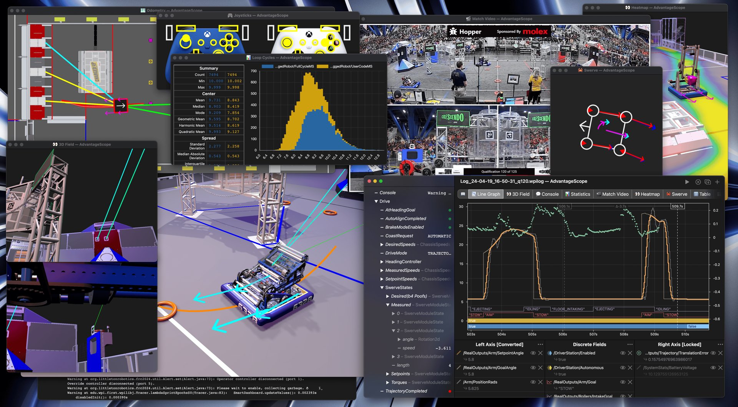
ADVANTAGESCOPE
See what the robot is doing
• Every value the robot publishes is a field
• Drag a field onto a tab to graph or draw it
• Live data: Start and Enable the robot first
• Search finds a field without digging
AdvantageScope: line graphs, fields, swerve and more
19
Notes:
Every value the robot publishes shows up as a field. Drag a field onto a tab to see it. In Scriptum it reads live data and connects by itself: press Start in the Driver Station, pick a mode, Enable, then open the Scope pane.

Slide 20

ADVANTAGESCOPE
Four tabs you'll set up
01
02
03
04
Line Graph
2D Field
3D Field
Swerve
Left and right axes, lock the range, Differentiate, discrete fields for true/false
Drag a Pose2d onto it; set the field to Evergreen
Same path with a 3D robot; Orbit Robot follows it
Each wheel's speed and angle, plus chassis speeds and heading
Tuning Mode The slider icon turns purple. Only values under /Tuning can be changed, like FlywheelTargetRPM.
20
Notes:
Line Graph: left axis with a locked range, right axis with Differentiate to show how fast the flywheel speed changes, and discrete fields for true/false values. 2D Field wants a Pose2d, 3D Field wants a Pose3d. Swerve shows each wheel. Tuning Mode, the slider icon, lets you write values under /Tuning only.

Slide 21
YOUR TURN
AdvantageScope
Start the robot, open the Scope pane, and build these views. Verify any time.
CHECKPOINTS TO VERIFY
Flywheel line graph
2D field pose
Locked axis scale
3D field pose
Differentiated flywheel RPM
Swerve tab
Game piece discrete field
Tuned flywheel target
In Scriptum: Tools › AdvantageScope
21
Notes:
Most checkpoints check the AdvantageScope layout. The tuning one needs the robot running and a value written through Tuning Mode.

Slide 22
04
Elastic
The dashboard drivers watch during a match
22
Notes:
Again the robot code is already written: it publishes one value for every Elastic widget type.

Slide 23
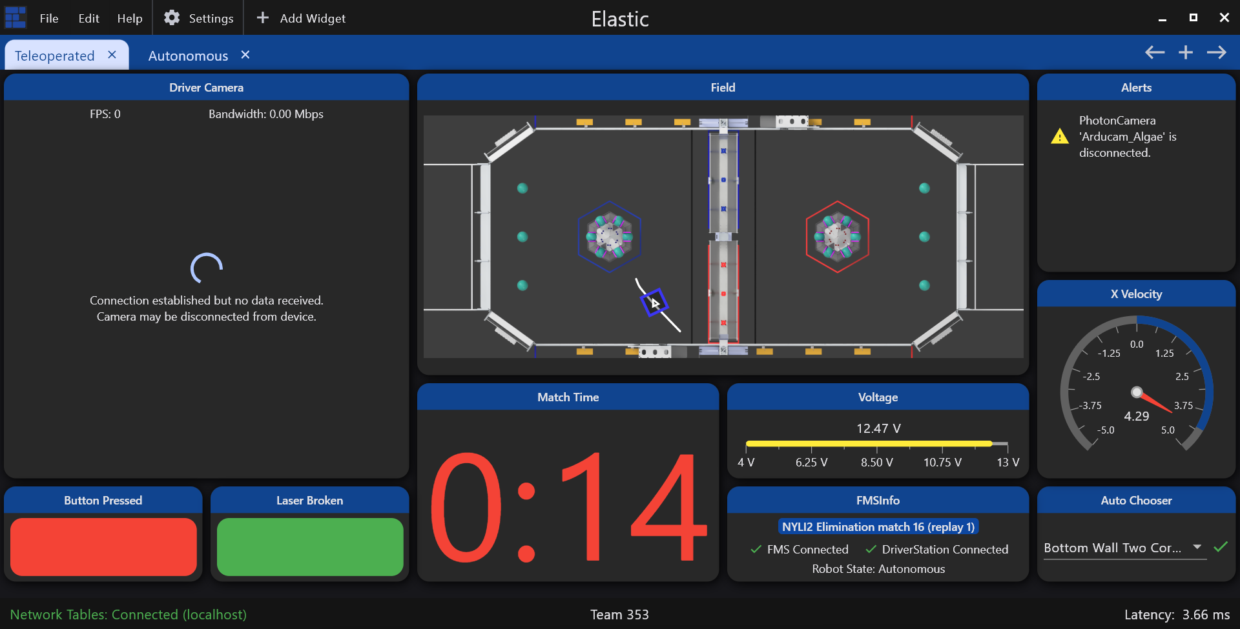
ELASTIC
The driver's dashboard
• Widgets show live robot values, called topics
• Start the robot; look for Connected
• Add Widget, then drag a topic onto the grid
• File > Save before you Verify
An Elastic match dashboard
23
Notes:
Elastic is the driver dashboard. Widgets bind to NetworkTables topics. It only shows live data, so press Start first and wait for Running; you don't need to Enable. The bottom left says Network Tables: Connected. Save with File > Save before Verify.

Slide 24
ELASTIC
Showing values, and sending them
Show
Send
Robot → driver
Driver → robot
• Text Display, Large Text Display
• Number Bar, Voltage View
• Radial Gauge, Graph, Match Time
• Boolean Box, Color Views
• Number Slider
• ComboBox and Split Button Choosers
• Text Display with a Submit button
• Toggle Button, Toggle Switch
24
Notes:
Most widgets only display a value the robot already computed. Six go the other way: the driver sets them and the robot reads the last value sent, the same way a real driver station works before a match. Nothing to arm first, unlike AdvantageScope's Tuning Mode.

Slide 25
YOUR TURN
Elastic
Bind each widget in the lesson's table to its topic. Send widgets need a live change too.
CHECKPOINTS TO VERIFY
Counter text display
Game piece boolean box
Status large text display
Status single color view
Climber speed number bar
LED strip multi color view
Battery voltage view
Shooter angle slider + live write
Gyro heading radial gauge
Auto routine choosers + live pick
Intake current graph
Auto delay text + live submit
Match time widget
Brake mode toggles
In Scriptum: Tools › Elastic
25
Notes:
19 checkpoints in Scriptum; the last four lines here group the live-write ones. If an old dashboard shows up, File > Open Layout and pick src/main/deploy/elastic-layout.json.

Slide 26
05
Choreo
Plan autonomous paths the robot can really follow
26
Notes:
No Java in this one: it's all inside the Choreo pane, with a starter project for a typical swerve robot.

Slide 27
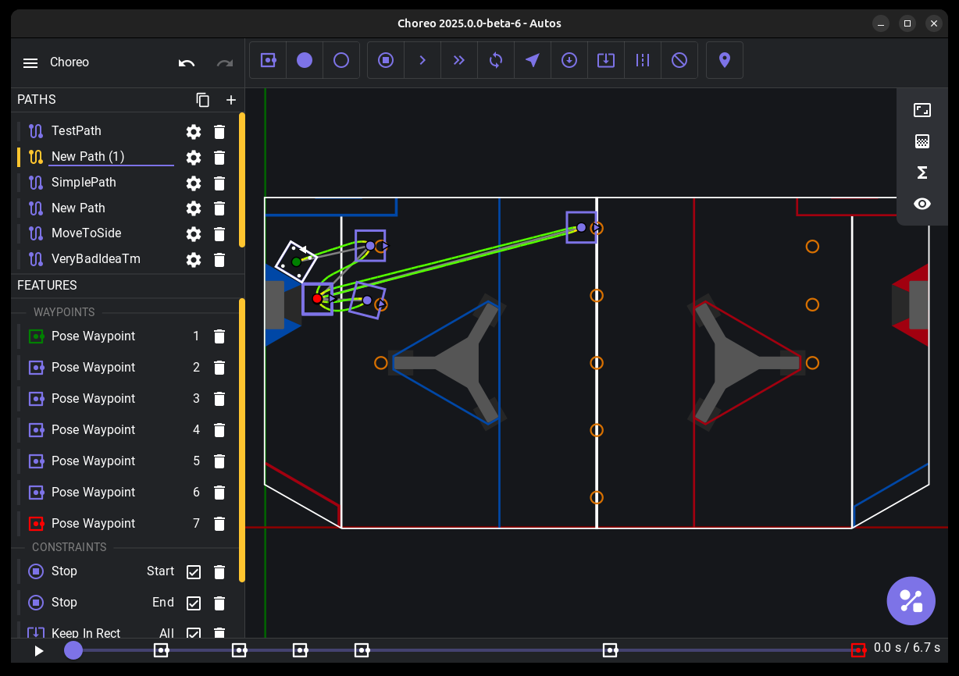
CHOREO
Plan autonomous paths
• Waypoints: points the path goes through
• Pose pins position and heading; Translation only position
• Constraints are rules, like Max Velocity
• Generate solves the fastest path and saves it
27
Notes:
A path is one trajectory. Pose waypoints pin position and heading; use them for the start and end. Translation waypoints pin only position. Constraints like Max Velocity are rules. Generate finds the fastest path that obeys everything and saves the .traj file.

Slide 28
CHOREO
From waypoints to a path
Waypoints
Constraints
Generate
.traj file
Where to go
Rules to obey
Solve with real limits
A path the robot follows
Won't generate? A constraint the robot can't meet leaves the path unsolved. Change the numbers or untick the constraint, then Generate again.
28
Notes:
Generate uses the robot's real limits. If no path can satisfy every waypoint and constraint, it stays unsolved. Fix it by editing the numbers or switching a constraint off with its checkbox, then Generate again.

Slide 29
YOUR TURN
Choreo
Build two different paths, each with at least four waypoints and a real constraint.
CHECKPOINTS TO VERIFY
Paths have waypoints
Two different paths
Path has a constraint
Path generates
In Scriptum: Tools › Choreo
29
Notes:
Exact positions don't matter. Keep In Rectangle doesn't count as the constraint, since every path usually has it. Both paths must actually generate.

Slide 30

RECAP
What you can do now
Make, rename and find files, and run a program
NEXT UP
Commit, branch, merge and resolve a conflict
Push, pull, rebase and stash
Motors and Drivetrains
Graph live robot data in AdvantageScope
The first FRC Robot lesson: tank drive, then arcade drive.
Build a driver dashboard in Elastic
Generate a Choreo path
30
Notes:
Quick recap before the robot lessons. Every robot deck after this uses these tools: the editor every time, AdvantageScope to check what the robot did, and Choreo again in Choreo Autonomous.

