Slide 1


FRC ROBOT · DECK 5
Mechanisms and Subsystems
How the team organizes robot code into layers, and your first shooter: a flywheel and a roller.
One file for the whole robot? Time to get organized!
Notes:
Welcome to Mechanisms and Subsystems. Until now the whole robot lived in one file. Real robots have a drivetrain, a shooter, an intake and more, so the team splits the code into layers: mechanisms that know how to run one device, subsystems that decide what to do, and a container that runs them all. Today we learn those layers, meet the mechanisms in MWLib, and build a shooter. The hands-on part is the Mechanisms and Subsystems lesson in Scriptum.

Slide 2






TODAY
From one file to many parts
01
02
03
04
05
Organizing robot code
MWLib mechanisms
Inside a mechanism
Subsystems
Building the shooter
Robot, subsystems and mechanisms
Roller, flywheel, arm and elevator
Read, write and log, real or simulated
Constants, inheritance and the loop
Buttons, if / else and registering it
By the end: the drivetrain runs from its own subsystem, and a button spins up your shooter.
MARS/WARS SOFTWARE TRAINING
2
Notes:
Five parts. First the big idea: why robot code is split into layers. Then the mechanisms MWLib gives us, what happens inside one, and how a subsystem uses them. Last, we build the shooter. Ask: what parts does last season's robot have? Write them on the board; we'll come back to the list.

Slide 3
01
Organizing robot code
I'm not one big machine. I'm a team of little ones!
One robot, many parts, one job per layer
MARS/WARS SOFTWARE TRAINING
3
Notes:
Big idea first: the robot is split into subsystems, and each subsystem is built from mechanisms.

Slide 4

ORGANIZING ROBOT CODE
Robot, subsystems, mechanisms
Robot RobotContainer
CONTAINER
SUBSYSTEMS
Drivetrain
Shooter
Intake
Climber
MECHANISMS
DifferentialDriveMech
FlywheelMech
RollerMech
ArmMech
RollerMech
ElevatorMech
HARDWARE
Motors and sensors: each one belongs to exactly one mechanism
Today: the drivetrain becomes a subsystem, and you build the shooter.
MARS/WARS SOFTWARE TRAINING
4
Notes:
A robot is a group of subsystems, usually one per physical part: drivetrain, shooter, intake, climber. Each subsystem is built from mechanisms, and each mechanism runs one device: a motor or two and their sensors. The robot container sits on top and keeps the list of subsystems. Today you build the red one, the shooter. Note: DifferentialDriveMech is one the lesson wrote itself; MWLib doesn't have it. Ask: which subsystem would a game piece sensor belong to? (The intake.)

Slide 5
ORGANIZING ROBOT CODE
Three layers, one job each
RobotContainer
1
1
Container: the list
Keeps every subsystem and runs them all, every loop
ShooterSubsystem
2
3
Subsystem: what and when
FlywheelMech
RollerMech
2
Decides from the driver's buttons. Owns its mechanisms
Flywheel motor
Roller motor
3
Mechanism: how
Runs one device. Takes orders, makes no decisions
MARS/WARS SOFTWARE TRAINING
5
Notes:
Three layers, and each has exactly one job. The mechanism knows how: how to spin a wheel at a power or move an elevator to a height. It never decides anything. The subsystem decides what and when: the button is held, so spin up. The container keeps the list of subsystems and runs them every loop. Analogy: the container is the front desk, the subsystem is the manager, the mechanism is the worker who does exactly what it's told. Ask: which layer would you open to fix 'the shooter spins when nobody pressed anything'? (The subsystem: that's a decision.)

Slide 6

ORGANIZING ROBOT CODE
A subsystem owns its parts, and nothing else
Intake
Drivetrain
• Owns its motors and sensors
subsystem
subsystem
• Nobody else touches them
Roller motor
Left motor
• Need something? Ask that subsystem
Pivot motor
Right motor
Distance sensor
Gyro
One owner: if a drive motor acts up, only the drivetrain subsystem could have done it.
MARS/WARS SOFTWARE TRAINING
6
Notes:
Each subsystem owns its own hardware and nothing more. The intake owns the intake motors; the drivetrain owns the drive motors. The intake never reaches over and spins a drive motor. If it needs the drivetrain to do something, it asks the drivetrain subsystem. This is what keeps bugs easy to find: if a drive motor misbehaves, only one class can have caused it. Ask: where does a distance sensor that sees game pieces in the intake belong? (In the intake subsystem, next to its roller, not inside the roller mechanism.)

Slide 7



ORGANIZING ROBOT CODE
How a button press travels
ORDERS GO THIS WAY →
Button
OI
Subsystem
Mechanism
Motor
Right bumper held
getShootButton()
updateLogic decides
setTargetDutyCycle
Spins the flywheel
Readings come back up: getCurrentVelocity()
Neighbors only. Subsystems ask OI for buttons, never the controller. They order mechanisms, never motors.
MARS/WARS SOFTWARE TRAINING
7
Notes:
Follow one button press through the layers. The driver holds the right bumper. OI reads it: getShootButton() returns true. The shooter subsystem's updateLogic sees that and gives the flywheel an order. The mechanism turns the order into motor power. Meanwhile readings travel back the other way: the flywheel's speed comes up through getCurrentVelocity() so the subsystem can check it. Every layer only talks to its neighbor. Activity: five students as the five boxes; pass the order right and a reading back left.

Slide 8





ORGANIZING ROBOT CODE
Why bother with layers?
Swap hardware
Reuse
Teamwork
Simulation
New motor? Only the mechanism changes. The subsystem never notices.
The same FlywheelMech runs this year's shooter and next year's.
Two people can work on two layers at the same time.
The same subsystem code runs in the simulator and on the robot.
Bonus: when something breaks, you know which layer to open first.
MARS/WARS SOFTWARE TRAINING
8
Notes:
Why go to all this trouble? Four reasons. Swap hardware: if the team changes the shooter motor, only the mechanism changes and the subsystem never notices. Reuse: the same FlywheelMech runs this year's shooter and next year's. Teamwork: one student writes the subsystem while another tunes the mechanism. Simulation: the mechanism can swap real motors for simulated ones, so the same subsystem code runs in Scriptum and on the robot. Ask: which reason matters most at 11 pm before a competition? (Finding bugs fast.)

Slide 9
02
MWLib mechanisms
If a robot has no rollers, go check it's really a robot.
The four parts almost every robot is built from
MARS/WARS SOFTWARE TRAINING
9
Notes:
MWLib is the team's library. It already has code for the mechanisms that show up every season.

Slide 10


MWLIB MECHANISMS
FRC is cyclical
2018
2019
2020/21
2022
2023
2024
2025
Power Up
Deep Space
Infinite Recharge
Rapid React
Charged Up
Crescendo
Reefscape
Elevator
Elevator
Flywheel
Flywheel
Elevator
Flywheel
Elevator
Arm
Arm
Arm
Arm
Arm
Arm
Question: one mechanism is on every robot, every season, no matter the game. Which one?
MARS/WARS SOFTWARE TRAINING
10
Notes:
Every FRC game has new game pieces and scoring spots, but the parts that score them repeat year after year. Elevators, arms and flywheels keep coming back. That's why MWLib can have ready-made code for them. Ask the question on the slide before showing the next one. Answer: rollers. Every intake, indexer and grabber uses them.

Slide 11
MWLIB MECHANISMS
Four mechanisms
Roller
Flywheel
Arm
Elevator
RollerMech
FlywheelMech
ArmMech
ElevatorMech
Spins to pull pieces in or push them through
Spins fast to launch pieces
Pivots to an angle
Slides to a height
MARS/WARS SOFTWARE TRAINING
11
Notes:
Here are the four mechanisms in MWLib. And the answer to the question: rollers! Two of them spin: a roller pulls game pieces in or pushes them through, a flywheel spins fast to launch them. Two of them move to a spot: an arm pivots to an angle, an elevator slides to a height. Each one is a class in MWLib: RollerMech, FlywheelMech, ArmMech, ElevatorMech. (There's also TurretMech, which is a RollerMech set up to aim.) Ask: which ones would you need to pick up a ball from the floor and shoot it?

Slide 12
MWLIB MECHANISMS
Things that spin: roller and flywheel
Roller
RollerMech
Flywheel
FlywheelMech
spins
launched
robot
hood
game piece
• Used for intakes, indexers, conveyors
• Used for shooters and launchers
• Usually a power: setTargetDutyCycle(0.5)
• Cares about speed, in rad/s: getCurrentVelocity()
MARS/WARS SOFTWARE TRAINING
12
Notes:
Rollers and flywheels both spin, but they do different jobs. A roller grabs game pieces: intakes, indexers that feed pieces along, conveyors. Usually you just give it a power with setTargetDutyCycle. A flywheel is a heavy wheel spun fast; the spinning wheel throws the game piece. What matters for a flywheel is its speed, in radians per second, read with getCurrentVelocity. Our shooter today has one of each: the roller feeds, the flywheel launches. Ask: why make a flywheel heavy? (A heavy wheel keeps its speed when a ball hits it.)

Slide 13
MWLIB MECHANISMS
Things that go to a spot: arm and elevator
Arm
ArmMech
Elevator
ElevatorMech
angle
height
• Position is an angle, in radians
• Position is a height, in meters
• Used for intake pivots, hoods, climbers
• Used for lifts and climbers
Both: say where to go with setTargetPosition(...). MWLib works out the power.
MARS/WARS SOFTWARE TRAINING
13
Notes:
Arms and elevators move to a spot and hold it. An arm pivots around one point, so its position is an angle, in radians. Think intake pivots, shooter hoods, climber arms. An elevator slides along rails, so its position is a height, in meters. For these you usually say where to go with setTargetPosition, and MWLib works out the motor power to get there and fight gravity. Ask: how many radians is straight up from horizontal? (About 1.57, a quarter turn.)

Slide 14
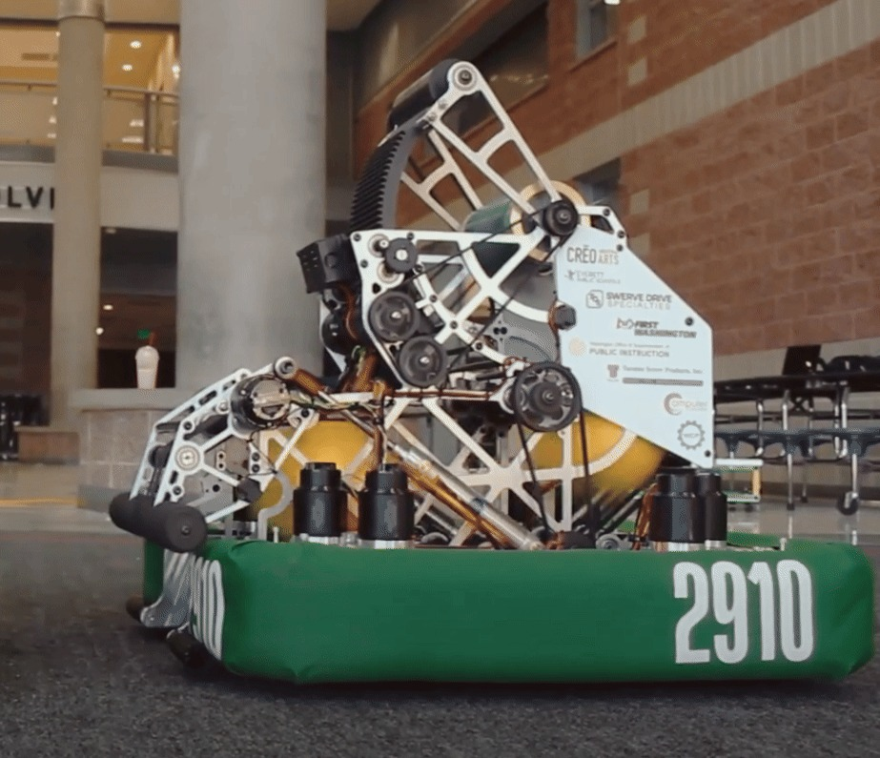
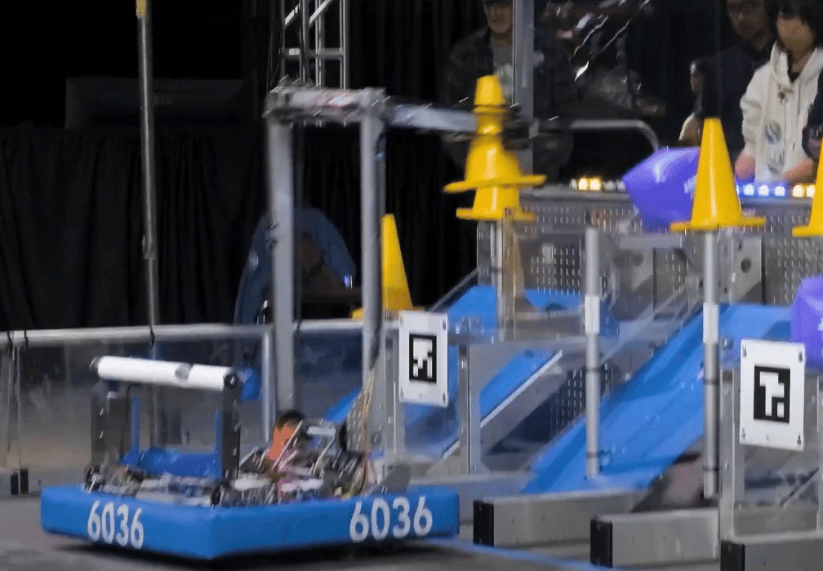
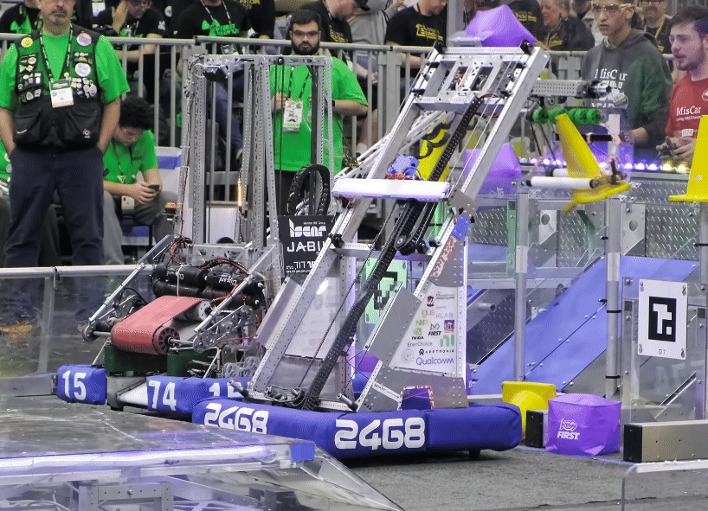
MWLIB MECHANISMS
On real robots
Flywheel
Arm
Elevator
Team 2910's shooter
Team 6036's intake pivot
Team 2468's elevator
FlywheelMech
ArmMech
ElevatorMech
MARS/WARS SOFTWARE TRAINING
14
Notes:
These are real FRC robots from the docs pages. Team 2910's shooter: you can see the flywheels at the top. Team 6036's arm pivots its intake. Team 2468's elevator lifts its scoring mechanism. Each one would be a FlywheelMech, an ArmMech and an ElevatorMech in our code. The docs pages have the moving versions (GIFs). Ask: spot the rollers in each picture.

Slide 15

MWLIB MECHANISMS
Three ways to give an order
Mechanism
Duty cycle
Velocity
Position
setTargetDutyCycle()
setTargetVelocity()
setTargetPosition()
Roller
Flywheel
none
Arm
Elevator
Today: duty cycle only. The next deck makes the flywheel hold an exact speed.
MARS/WARS SOFTWARE TRAINING
15
Notes:
Every mechanism takes orders the same three ways. Duty cycle: a share of full power, -1.0 to 1.0, like your drive code. Velocity: a speed to hold. Position: a spot to go to. A flywheel has no position order: nobody cares where a spinning wheel is pointing. The method names are the same in every mechanism, so once you know one you know them all. Today we only use duty cycle; the next deck makes the flywheel hold an exact speed. Ask: which order would you give an elevator to reach the top shelf? (Position.)

Slide 16
03
Inside a mechanism
Tell me what to do. I'll handle the motors. Deal?
Read, write, log: the same code, real or simulated
MARS/WARS SOFTWARE TRAINING
16
Notes:
You won't write a mechanism today, but knowing what happens inside one makes the subsystem make sense.

Slide 17


INSIDE A MECHANISM
A mechanism is an IO container
SETTERS: ORDERS IN
GETTERS: READINGS OUT
FlywheelMech
setTargetDutyCycle(0.5)
getCurrentVelocity()
Motor
setTargetVelocity(300)
Output: power out
getCurrentPosition()
setTargetPosition(1.2)
Sensor
Input: speed and position
Getters and setters only. Nothing outside the mechanism touches its motor.
MARS/WARS SOFTWARE TRAINING
17
Notes:
A mechanism is an IO container: it holds the inputs (sensors) and outputs (motors) for one part. The only way in or out is its methods. Setters give it orders: setTargetDutyCycle, setTargetVelocity, setTargetPosition. Getters ask it questions: getCurrentVelocity, getCurrentPosition. You never reach inside and grab the motor. That's on purpose: if only the mechanism touches the motor, nothing else can send it a surprise order. Ask: why might two pieces of code both setting the same motor be a problem? (They fight, and the motor twitches.)

Slide 18
INSIDE A MECHANISM
Read, think, write: every 20 ms
readInputs
updateLogic
writeOutputs
logData
Mechanism reads sensors
Your code decides
Mechanism sends orders
Mechanism logs it all
SubsystemManager.java (MWLib, simplified)
1
Read
for (MwSubsystemBase subsystem : subsystems) {
Fresh sensor values first
List<SubsystemIoBase> ios = subsystem.getIos();
1
for (SubsystemIoBase io : ios) io.readInputs(t);
2
Think
subsystem.update(t); // runs your updateLogic
2
for (SubsystemIoBase io : ios) {
Your updateLogic
3
io.writeOutputs(t);
io.logData();
Write
}
3
}
Orders go to the motors
MARS/WARS SOFTWARE TRAINING
18
Notes:
Every loop, every 20 ms, MWLib does the same four steps for each registered subsystem. First every mechanism reads its sensors (readInputs). Then the subsystem's updateLogic runs: that's your code, and it uses those fresh readings. Then every mechanism sends its newest order to the motor (writeOutputs) and logs what happened (logData). Your code never reads a sensor or writes a motor itself; it only uses getters and setters. This is the read, think, write loop. Ask: in which step does a setter's new order actually reach the motor? (writeOutputs.)

Slide 19
INSIDE A MECHANISM
Same code, real robot or simulator
Real robot
Kraken motors and their sensors
ShooterSubsystem
FlywheelMech
IS_SIM = false
Your code. Same either way.
checks IS_SIM
Simulator
A physics model of the wheel
IS_SIM = true
In Scriptum: the robot you drive is the simulator side. On the team's robot, the same subsystem drives real motors.
MARS/WARS SOFTWARE TRAINING
19
Notes:
This is why the team built mechanisms this way. Your subsystem talks to the mechanism through the same getters and setters either way. Inside, the mechanism checks one flag, IS_SIM. On the robot it reads and drives real Krakens. In simulation it feeds the motor order into a physics model of the wheel and reads the model back. Scriptum's robot is the simulation side. The subsystem code you write today would run unchanged on a real shooter. Ask: what would you still have to check on the real robot? (Motor IDs, inversion, gear ratio: the numbers in Constants.)

Slide 20
INSIDE A MECHANISM
Every mechanism logs itself
logData()
NetworkTables
AdvantageScope
Every loop
Live, while it runs
Graph it
WHAT A MECHANISM LOGS
THE SHOOTER ADDS ITS OWN
• Orders: target duty cycle, speed, position
Subsystem/Shooter/FlywheelVelocity
• Readings: actual speed, position
Subsystem/Shooter/RollerDuty
• Health: voltage, current, temperature
These two are what Verify checks in today's lesson.
MARS/WARS SOFTWARE TRAINING
20
Notes:
Every mechanism logs itself in logData, every loop: the order it was given, what the sensors read, and the motor's health, like voltage, current and temperature. It goes two places: NetworkTables, for live graphs while the robot runs, and a log file you can open after a match. Both show up in AdvantageScope. The subsystem can log extra numbers too: the shooter logs FlywheelVelocity and RollerDuty, which is what Verify checks today. Ask: why log the motor temperature? (A hot motor is weak and can shut down; the log shows it before it fails.)

Slide 21
04
Subsystems
Every subsystem looks the same. Learn one, read them all!
Constants, inheritance, one copy, and three methods
MARS/WARS SOFTWARE TRAINING
21
Notes:
Now the layer you write. Every subsystem in the team's code has the same shape, so once you know one you can read them all.

Slide 22


SUBSYSTEMS
Where the code lives
frc/robot/
One folder per subsystem
subsystems/
Its Constants and its Subsystem side by side
drive/
DrivetrainSubsystem.java
OI.java
DrivetrainConstants.java
Everything the drivers press
DriveMath.java
shooter/
RobotContainer.java
ShooterSubsystem.java
The list of subsystems that run
ShooterConstants.java
OI.java
RobotContainer.java
Robot.java
Robot.java
Just connects things. Leave it alone
MARS/WARS SOFTWARE TRAINING
22
Notes:
Here's where everything lives in the lesson project. Each subsystem gets its own folder with two files: a Constants class with every number about that part, and the Subsystem class with the logic. Constants.java from earlier lessons is gone; DriveMath moved into the drive folder. OI reads the controller, RobotContainer registers the subsystems, and Robot just connects things. Activity: open the project and find each file with Ctrl+P.

Slide 23
SUBSYSTEMS
ShooterConstants: every number in one place
ShooterConstants.java
1
States
public class ShooterConstants extends MwConstants {
The modes it can be in. Today: MANUAL
1
public enum ShooterStates { MANUAL }
public final int FLYWHEEL_MOTOR_ID = 20;
2
Numbers
2
public final double FLYWHEEL_GEAR_RATIO = 1.0;
IDs, ratios, sizes, powers
public final double SHOOT_DUTY_CYCLE = 0.5;
3
public final MotorConfig FLYWHEEL_MOTOR_CONFIG =
flywheelConfig(FLYWHEEL_MOTOR_ID);
3
Motor config
4
CAN ID and motor type, built by a helper
public final MotorConfig ROLLER_MOTOR_CONFIG =
rollerConfig(ROLLER_MOTOR_ID);
public final double INDEX_DUTY_CYCLE = 0.5;
4
Yours
The roller's config and its power
No magic numbers: name it in Constants. The only bare number is 0.0 for stop.
MARS/WARS SOFTWARE TRAINING
23
Notes:
The constants class holds every number about the shooter: motor IDs, gear ratios, sizes and the powers it runs at. Code then says CONSTANTS.SHOOT_DUTY_CYCLE instead of 0.5, so changing the robot means editing one file and the name explains the number. 1: the enum lists the states the shooter can be in; today there's just MANUAL. 2: the flywheel's numbers. 3: its motor settings, built by a helper. 4: your job, the roller's config and INDEX_DUTY_CYCLE = 0.5, copied from the flywheel's pattern. Ask: why is 0.5 better as INDEX_DUTY_CYCLE than as a bare 0.5? (The name says what it's for, and you change it in one place.)

Slide 24

SUBSYSTEMS
extends: the shooter is a subsystem
public class ShooterSubsystem extends MwSubsystem<ShooterStates, ShooterConstants> {
this class
is a
the parent
its states
its constants
MwSubsystem
Gives: the loop, CONSTANTS, system_state_, getSubsystemKey()
extends
DrivetrainSubsystem
ShooterSubsystem
Fills in: updateLogic, getIos, reset
Fills in: updateLogic, getIos, reset
Java: Inheritance
MARS/WARS SOFTWARE TRAINING
24
Notes:
extends means 'is a'. ShooterSubsystem extends MwSubsystem, so the shooter is a subsystem and gets everything every subsystem has for free: the loop that calls it, CONSTANTS, system_state_, getSubsystemKey for logging. In return it has to fill in three methods, each marked @Override. The two names in angle brackets tell MwSubsystem which states enum and which constants class this subsystem uses. The drivetrain works exactly the same way. Ask: what does DrivetrainSubsystem get for free? (The same list.)

Slide 25
SUBSYSTEMS
getInstance(): exactly one shooter
ShooterSubsystem.java
1
The one copy
1
private static ShooterSubsystem instance_ = null;
Starts out empty: null
public static ShooterSubsystem getInstance() {
2
First time only
2
if (instance_ == null) {
instance_ = new ShooterSubsystem();
Build it
}
3
return instance_;
3
Everyone after
}
Gets the same one
4
private ShooterSubsystem() { ... }
4
private
Nobody else can use new
RobotContainer
Auto code
Another subsystem
ShooterSubsystem
getInstance()
the one and only copy
Java: Classes & Objects
MARS/WARS SOFTWARE TRAINING
25
Notes:
A robot has one shooter, so the whole program must share one ShooterSubsystem object. Two things make that happen. The constructor is private, so nobody can write new ShooterSubsystem() outside the class. And getInstance() hands out the one copy, building it the first time it's asked. This pattern is called a singleton. Anywhere in the code, ShooterSubsystem.getInstance() gives you the same object. Ask: what would go wrong with two ShooterSubsystem objects? (Both would order the same motor.)

Slide 26
SUBSYSTEMS
The constructor builds the mechanisms
ShooterSubsystem.java
1
super(...)
private ShooterSubsystem() {
Start state and constants. CONSTANTS works after this
1
super(ShooterStates.MANUAL, new ShooterConstants());
flywheel_ =
2
new FlywheelMech
2
new FlywheelMech(
Creates one mechanism
3
getSubsystemKey(),
"Flywheel",
4
List.of(CONSTANTS.FLYWHEEL_MOTOR_CONFIG),
CONSTANTS.FLYWHEEL_GEAR_RATIO,
3
Name for the logs
CONSTANTS.FLYWHEEL_INERTIA,
Logged under the subsystem
CONSTANTS.FLYWHEEL_RADIUS);
}
4
From Constants
Motors, gear ratio, size for the simulator
Your turn: build the roller the same way with RollerMech: key, name, motors, gear ratio, inertia.
MARS/WARS SOFTWARE TRAINING
26
Notes:
The constructor builds the subsystem once. 1: super(...) runs MwSubsystem's constructor first, with the starting state and a new ShooterConstants. After that line, CONSTANTS works. 2: new FlywheelMech creates the flywheel mechanism. 3: getSubsystemKey() and a name tell it where to log. 4: the rest comes from Constants: the motor config in a list (more motors means more items, the first one leads), the gear ratio, and the wheel's size for the simulator. Your job is the roller, built the same way with RollerMech.

Slide 27

SUBSYSTEMS
The three methods you fill in
updateLogic()
getIos()
reset()
Every 20 ms: decide what each mechanism does.
The list of mechanisms. MWLib only runs these.
Back to a known state.
@Override
@Override
@Override
public void updateLogic(
public List<SubsystemIoBase>
public void reset() {
double timestamp) {
getIos() {
// start over
// decide
return List.of(
}
}
flywheel_, roller_);
}
Miss one? It won't compile. Every subsystem must fill in all three.
MARS/WARS SOFTWARE TRAINING
27
Notes:
Every subsystem fills in three methods. updateLogic runs every 20 ms and decides what the mechanisms do: it's where today's if / else goes. getIos returns the list of mechanisms the subsystem owns; MWLib only reads and writes the mechanisms on this list. reset puts the subsystem back to a known state, for example when the robot is enabled. Ask: what happens if getIos returns an empty list? (No mechanism ever reads or writes: nothing moves.)

Slide 28
SUBSYSTEMS
Step 1: the drivetrain drives itself
DrivetrainSubsystem.java
1
updateLogic
@Override
Runs every 20 ms
public void updateLogic(double timestamp) {
1
drive_.arcadeDrive(OI.getForward(), OI.getTurn());
2
}
2
arcadeDrive
Forward and turn from OI
OI.java
3
OI does the rest
public static double getForward() {
Flips the stick and applies the deadband
return MathUtil.applyDeadband(
3
-driver_controller_.getLeftY(), 0.1);
}
MARS/WARS SOFTWARE TRAINING
28
Notes:
Step 1 of the lesson. The drive code moves out of Robot.java and into DrivetrainSubsystem's updateLogic. One line: drive_.arcadeDrive(OI.getForward(), OI.getTurn()). It runs every 20 ms, so the robot keeps following the sticks. Notice it asks OI for the sticks. OI is the one class that touches the controller: it flips the Y axis and applies the deadband, so every subsystem gets clean numbers. Ask: if the team switches to a different controller, how many files change? (Only OI.)

Slide 29
05
Building the shooter
Hold the bumper, spin the wheel. Let go, it coasts.
Two buttons, one if / else, and the step everyone forgets
MARS/WARS SOFTWARE TRAINING
29
Notes:
Now the new part: the shooter. A roller feeds game pieces into a flywheel, which launches them.

Slide 30
BUILDING THE SHOOTER
One shooter, two mechanisms
Roller feeds
Left bumper · E
runs at INDEX_DUTY_CYCLE
Flywheel launches
FlywheelMech
Right bumper · U
RollerMech
robot
runs at SHOOT_DUTY_CYCLE
MARS/WARS SOFTWARE TRAINING
30
Notes:
This is the shooter you'll build, seen from the side. The roller, a RollerMech, pushes the game piece into the flywheel when the driver holds the left bumper. The flywheel, a FlywheelMech, spins while the driver holds the right bumper, and throws the piece out. In Scriptum the keyboard stands in: U is the right bumper, E is the left. Real drivers spin the flywheel up first, then feed: why? (A piece fed into a slow wheel falls short.)

Slide 31
BUILDING THE SHOOTER
Buttons are true or false
OI.java
1
boolean
public static boolean getShootButton() {
1
Returns true or false
return driver_controller_.getRightBumperButton();
2
}
2
Right bumper
public static boolean getIndexButton() {
Held? true. Shoot
return driver_controller_.getLeftBumperButton();
3
}
3
Left bumper
Held? true. Index
held
true
not held
false
MARS/WARS SOFTWARE TRAINING
31
Notes:
A button is either held or not held: true or false. A method that answers a yes or no question returns a boolean. In OI, getShootButton returns whether the right bumper is held right now, and getIndexButton the left bumper. The starter code returns false; you change each to read the bumper. Everything else asks OI, so the shooter never needs to know which button it is. Ask: the drive team wants shoot on the A button instead. Which file changes? (Only OI.)

Slide 32
BUILDING THE SHOOTER
The shoot button logic
ShooterSubsystem.java
1
Ask OI
public void updateLogic(double timestamp) {
Is the shoot button held?
1
if (OI.getShootButton()) {
2
flywheel_.setTargetDutyCycle(CONSTANTS.SHOOT_DUTY_CYCLE);
} else {
2
Yes
3
flywheel_.setTargetDutyCycle(0.0);
Run at the shooting power
}
double roller_duty =
3
No
4
OI.getIndexButton() ? CONSTANTS.INDEX_DUTY_CYCLE : 0.0;
roller_.setTargetDutyCycle(roller_duty);
0.0: coast to a stop
}
4
Same idea, short
? picks the first value if true
Forget the else? The last order sticks. The flywheel never stops.
MARS/WARS SOFTWARE TRAINING
32
Notes:
The heart of the lesson: the shoot button logic. An if runs its block only when the question in the parentheses is true: is the shoot button held right now? Then the flywheel gets SHOOT_DUTY_CYCLE. The else block runs the rest of the time and sets 0.0, so the wheel coasts to a stop. Because updateLogic runs every 20 ms, the flywheel starts the moment the button goes down and stops the moment it comes up. The roller uses the short form: condition ? this : that. Ask: what if you forget the else? (The flywheel never stops: the last order sticks.)

Slide 33
BUILDING THE SHOOTER
Watching the flywheel
shoot button
Spins up
true
1
false
Button down: half power on
rad/s
400
2
2
Levels off
300
About 300 rad/s at 0.5
200
1
3
3
Coasts down
Button up: the order is 0.0
100
0
0 s
2 s
4 s
6 s
8 s
Subsystem/Shooter/FlywheelVelocity
MARS/WARS SOFTWARE TRAINING
33
Notes:
What you'll see in AdvantageScope. Top: the shoot button, true while you hold U. Bottom: Subsystem/Shooter/FlywheelVelocity in radians per second. 1: the button goes down and the wheel spins up. A heavy wheel takes a moment. 2: it levels off around 300 rad/s at half power. 3: the button comes up, the order becomes 0.0 and it coasts down slowly. Verify checks the top speed lands between 250 and 340. The exact curve depends on the simulator; the shape is what matters.

Slide 34

BUILDING THE SHOOTER
Nothing happens? Check the two lists
1. getIos lists every mechanism
ShooterSubsystem.java
Left off the list: that mechanism never moves.
@Override
public List<SubsystemIoBase> getIos() {
return List.of(flywheel_, roller_);
}
2. RobotContainer registers it
RobotContainer.java
Not registered: the subsystem never runs at all.
public RobotContainer() {
super(BuildConstants.class);
registerSubsystem(DrivetrainSubsystem.getInstance());
registerSubsystem(ShooterSubsystem.getInstance());
}
MARS/WARS SOFTWARE TRAINING
34
Notes:
The two most common bugs in this lesson both look the same: you hold the button and nothing happens. First list: getIos. MWLib only reads and writes the mechanisms in it, so a roller left off the list never moves, even though the code orders it to. Second list: RobotContainer. A subsystem that isn't registered never runs at all: no updateLogic, no logs. When nothing happens, check both lists first. Ask: the shooter's numbers show up in AdvantageScope and RollerDuty changes when you hold E, but the roller never turns. Which list? (getIos: the subsystem runs, so it's registered, but the roller isn't on its list.)

Slide 35
BUILDING THE SHOOTER
Bonus: you pick a power, not a speed
rad/s
700
• Change SHOOT_DUTY_CYCLE: a different top speed
600
1.0
• A ball or a weak battery slows it, and nothing pushes it back
500
400
• Next deck: hold an exact speed
300
0.5
200
0.3
100
0
0 s
1 s
2 s
3 s
4 s
MARS/WARS SOFTWARE TRAINING
35
Notes:
A bonus from the lesson: change SHOOT_DUTY_CYCLE and watch the top speed. 0.3 tops out around 190 rad/s, 0.5 around 310, 1.0 around 620. Notice what you chose: a power, not a speed. If a game piece hits the wheel and slows it, or the battery sags, nothing pushes it back to the speed you wanted. That's the next deck: Control Theory makes the flywheel hold an exact speed. Ask: a shot that worked at full battery falls short at the end of a match. Why? (Same power, lower voltage: a slower wheel.)

Slide 36

YOUR TURN
Mechanisms and Subsystems
Move the drivetrain into its subsystem, then build the shooter: a flywheel and a roller. Press Verify on each checkpoint.
6 CHECKPOINTS
Shooter registered
RobotContainer registers the ShooterSubsystem
Shooter buttons
OI reads the right and left bumpers
Shoot button logic
Flywheel runs while the button is held, else stops
Drive from the subsystem
Left stick forward drives the robot
Flywheel spins up
Hold the shoot button: it reaches speed
Roller runs
Hold the index button: INDEX_DUTY_CYCLE
Bonus: try other SHOOT_DUTY_CYCLE values, add a Y button that runs the roller backward
In Scriptum: FRC Robot › Mechanisms and Subsystems
MARS/WARS SOFTWARE TRAINING
36
Notes:
This is the hands-on part: the Mechanisms and Subsystems lesson in Scriptum's FRC Robot track. Three checkpoints check your code; three drive the robot and watch the numbers. Order that works: drivetrain updateLogic, ShooterConstants, ShooterSubsystem (roller, getIos, if / else), OI buttons, RobotContainer, then try it. Stuck? Press the Dozer button in the top bar for a step-by-step guide. Bonuses are optional.

Slide 37
RECAP
What you can do now
Explain robot, subsystem, mechanism
RELATED JAVA TRAINING
NEXT UP
Name the four MWLib mechanisms
Classes & Objects
Control Theory
Describe read, think, write
Inheritance
Hold the flywheel at speed three ways: bang-bang, feedforward and PID.
Read a subsystem: extends, getInstance
Write button logic with if / else
Register a subsystem and list its mechanisms
Optional practice in Scriptum's Java track.
MARS/WARS SOFTWARE TRAINING
37
Notes:
Wrap up. You split the robot into layers, used two MWLib mechanisms, and built a subsystem from scratch. Every subsystem on the team's real robots has this same shape. The Java lessons on the right cover classes, constructors and extends in more depth. Next time: the flywheel spins at a power, but we want it to hold a speed. That's Control Theory.

