Slide 1

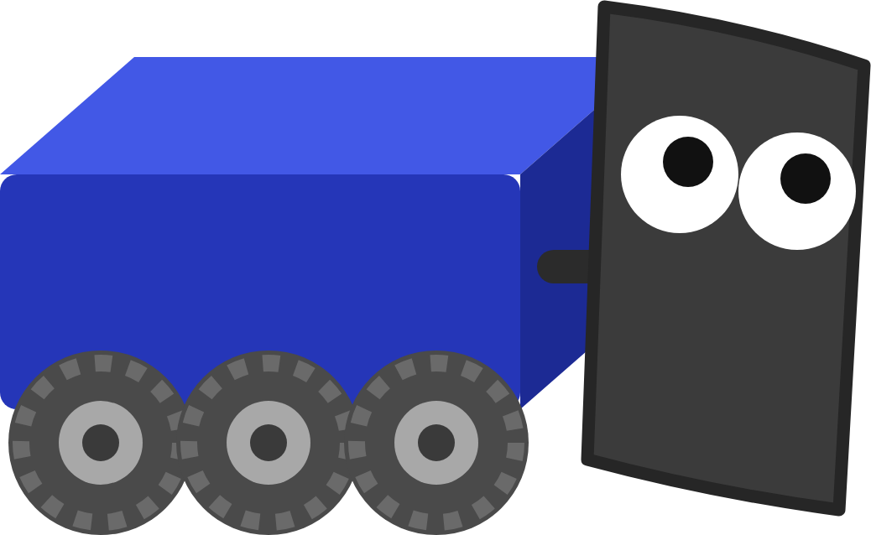
FRC ROBOT · DECK 9
Choreo Autonomous
Draw the paths, then write the routine that drives them, aims at the goal and shoots.
Hands off the controller. I've got this one!
Notes:
Welcome to the last FRC Robot deck. Everything so far gets used here: the drivetrain, the pose estimate from the Computer Vision lesson, your aim command, and the Choreo app from the Tools deck. Today the robot drives itself: it follows two paths you draw, aims at the goal and shoots, with nobody touching a controller. The hands-on part is the Choreo Autonomous lesson in Scriptum.

Slide 2





TODAY
From a drawn path to a scored shot
01
02
03
04
05
Autonomous
Following a path
Commands
The routine
Run and check
15 seconds, no driver, and the plan for the field
How a trajectory becomes wheel speeds
Start, run, finish, and the dots that change them
Load the paths, list the commands
Watch it in AdvantageScope, read a failure
By the end: the robot drives to a game piece, drives to a scoring spot, aims and shoots, all on its own.
MARS/WARS SOFTWARE TRAINING
2
Notes:
Five parts. First what autonomous is and the plan for this lesson's field. Then how robot code follows a trajectory, which is the new idea today. Then commands, the building blocks of a routine, and the routine itself. Last, running it and reading the graphs. Ask: what's the difference between a path and a trajectory? (A trajectory adds timing. Answer comes in part 2.)

Slide 3
01
Autonomous
Nobody can grab the controller to fix my mistakes. So plan well!
Fifteen seconds with nobody driving
MARS/WARS SOFTWARE TRAINING
3
Notes:
What autonomous is, why it has to be repeatable, and the plan for this lesson's field.

Slide 4
AUTONOMOUS
What is autonomous?
• The first 15 seconds of every match
15
• Drivers stand behind the line, hands off
seconds
• The robot runs a routine planned ahead
with nobody driving
• It must do the same thing every match
• Auto points often decide matches
Auto
Teleop: drivers in control
0:15
2:30
A match: 15 s of auto, then 2 min 15 s of teleop.
MARS/WARS SOFTWARE TRAINING
4
Notes:
Every match starts with autonomous: about 15 seconds where the drivers stand behind the line and can't touch the controllers. The robot runs a routine that was planned ahead of time. Whatever it does, it has to do the same way every match, because nobody can fix a mistake. Points in auto are often worth more than the same action in teleop, so a good auto can decide a match. Ask: what could go wrong if the robot just drove at full speed for 2 seconds and hoped? (Battery level, wheel slip and carpet change how far it goes.)

Slide 5

AUTONOMOUS
Accuracy vs precision
Accurate, not precise
Precise, not accurate
Both: what auto needs
Lands around the spot, but all over the place.
Lands in the same place every time. The wrong place.
On the spot, the same way every match.
The fix: know where the robot really is, and correct every loop. That's what a path follower does.
MARS/WARS SOFTWARE TRAINING
5
Notes:
From the old Autonomous training: what's the difference between accuracy and precision? Accurate means on average you hit the spot, even if each try lands somewhere different. Precise means every try lands in the same place, even if that place is wrong. Ask: which do we want for auto? (Both: hit the spot, the same way every match.) A robot that drives on wheel counts alone drifts a bit differently each time. The fix is to know where the robot really is and correct every loop, which is exactly what the path follower does with the pose estimate.

Slide 6


AUTONOMOUS
Two jobs: paths, then a sequence
1 Draw the paths
2 Write the sequence
In Choreo. Where the robot drives, and how fast.
In Java. In what order: drive, wait, drive, aim, shoot.
ToPickup.traj ToScore.traj
Autos.java
The paths say where. The sequence says in what order.
MARS/WARS SOFTWARE TRAINING
6
Notes:
The team builds every autonomous routine in two jobs. First draw the paths in Choreo: where the robot drives and how fast. Choreo saves each one as a .traj file. Then write the sequence in Java: which path to drive, when to wait, when to aim, when to shoot. The paths say where; the sequence says in what order. In today's lesson you do both. On the real robot it's the same: Choreo on a laptop for the paths, VS Code for the Java, and the .traj files deploy with the code.

Slide 7
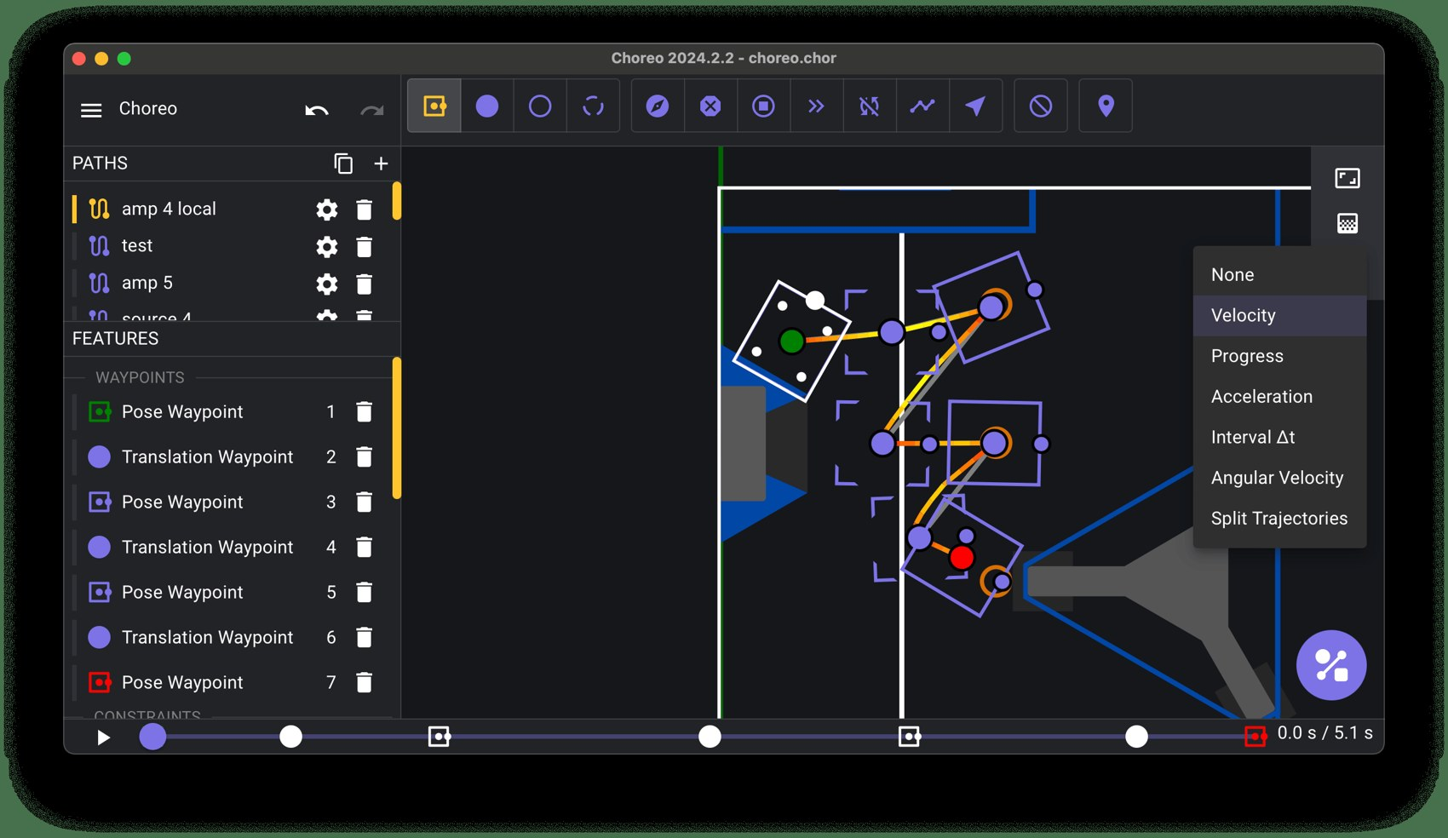
RECAP: CHOREO
Choreo makes the trajectory
1
Waypoints
Pose pins place and heading. Translation pins only place.
2
Constraints
Rules the path obeys, like Max Velocity 1.8 m/s
3
Generate
Solves the fastest path the robot can really drive
4
Drive Type
Differential for this robot, not the default Swerve
MARS/WARS SOFTWARE TRAINING
7
Notes:
A quick recap of the Tools deck, no need to re-teach the app. Waypoints are the points the path goes through: pose waypoints pin position and heading, translation waypoints pin only position. Constraints are rules like a Max Velocity. Generate solves the fastest trajectory the robot can really drive and saves it as a .traj file in src/main/deploy/choreo, which deploys with the code. One new setting today: this lesson's robot is a Differential drive (tank), so Document Settings, Robot Config must say Differential, not Swerve. Screenshot from the Choreo docs.

Slide 8


AUTONOMOUS
The plan for this lesson's field
8
Named pose
x
y
heading
Start
1.5
1.5
0°
6
ScoreSpot
Pickup
5.5
2.5
0°
Goal
ScoreSpot
6.5
5.0
90°
4
Goal
4.0
4.0
aim here
ToScore
2
Pose waypoint
The join: both paths meet here
Pickup
Translation waypoint
Start
ToPickup
Meters from the blue wall (x) and the side of the field (y). Heading 0° points down the field.
0
2
4
6
8
MARS/WARS SOFTWARE TRAINING
8
Notes:
This is the lesson's field, drawn from the real solution paths. The project already has four named poses. The robot starts on Start. ToPickup drives to Pickup, where the game piece is. ToScore carries on to ScoreSpot, finishing pointed up the field. Goal is what the robot aims at; it isn't on a path. Each path has a pose waypoint at each end and a translation waypoint in the middle. Activity: have students read the coordinates off the grid and match them to the table.

Slide 9




AUTONOMOUS
Four rules for the two paths
Exact names
They join up
Three waypoints
Differential first
ToPickup and ToScore. Java loads them by name, and capitals count.
ToScore starts where ToPickup ended: on Pickup, within 15 cm.
Pose at the start, translation in the middle, pose at the end.
Set Drive Type and the robot's numbers before you draw.
Verify checks: the names, each end within about 30 cm, and the join within 15 cm.
MARS/WARS SOFTWARE TRAINING
9
Notes:
Four rules the checks look for. Names: Java loads each path by its name, so ToPickup and ToScore must be spelled exactly, capitals too; rename it in Choreo, not by renaming the file. Join: when ToScore begins the robot is standing on Pickup, so ToScore's first waypoint must be exactly where ToPickup ended. Three waypoints each: pose, translation, pose. Differential: set the Drive Type first, or Choreo makes swerve paths this robot can't follow. Ask: what happens if ToScore starts half a meter away from Pickup? (The robot lurches to catch up, or the check fails.)

Slide 10
02
Following a path
The path is my schedule. I check it 50 times a second.
How a trajectory turns into wheel speeds
MARS/WARS SOFTWARE TRAINING
10
Notes:
This is the code you don't write but should understand: how the robot plays a path back. It's provided and tuned in DifferentialPathFollower.java, and it's worth reading.

Slide 11

FOLLOWING A PATH
A trajectory is a schedule
ONE SAMPLE
t = 2.48 s
t
1.52 s
t = 1.52 s
Pickup
x
3.75 m
y
2.10 m
heading
21°
t = 0.51 s
left wheel
1.81 m/s
Start
right wheel
1.79 m/s
Read the dots: bunched up where the robot is slow, spread out where it's fast. Samples are about 0.05 s apart.
MARS/WARS SOFTWARE TRAINING
11
Notes:
When you press Generate, Choreo doesn't just save a line. It saves a list of samples, each a moment in time: where the robot should be, which way it faces, and how fast each wheel should turn. These dots are the real samples of the lesson's ToPickup path, about 0.05 seconds apart. Where the dots bunch up the robot is slow (starting and stopping); where they spread out it's fast. Ask: where on this path is the robot fastest? (The straight middle part.) This is the difference between a path (the route) and a trajectory (the route plus timing).

Slide 12

FOLLOWING A PATH
The follower, every 20 ms
1
2
3
4
Where should I be?
Where am I?
Close the gap
Speed to power
The path's sample for right now
The pose estimate
Feedback nudges the speeds
Feedforward: kS + kV × speed
every 20 ms
Provided: DifferentialPathFollower.java does this, already tuned. Read it, don't change it.
MARS/WARS SOFTWARE TRAINING
12
Notes:
followPath plays the trajectory back. Every 20 ms it does four things. Where should I be? It looks up the sample for this moment on the path's clock, blending the two samples around it. Where am I? It reads the pose estimate. Close the gap: a path-following controller (LTV unicycle, built for tank drives) nudges the speeds so the robot drifts back onto the line. Speed to power: wheel speeds in meters per second become duty cycles. All of this is DifferentialPathFollower.java, provided and tuned. Activity: one student is the path's clock calling out times, another walks the line.

Slide 13
FOLLOWING A PATH
Should be here, is there: close the gap
1
Path says
Be here now, at these wheel speeds
1
DesiredPose
2
Robot is
A little behind, and off to the side
3
3
Nudge
2
Pose
Change the left and right speeds to steer back on the line
MARS/WARS SOFTWARE TRAINING
13
Notes:
The robot is never exactly where the path says. DesiredPose is where the path says the robot should be right now; Pose is where the robot thinks it is. The controller compares them and changes the left and right speeds a little: a bit more on one side steers the robot back toward the line, a bit more on both catches it up. It does this every loop, so small errors never get big. You can watch both in AdvantageScope: Subsystem/Drivetrain/Choreo/DesiredPose and the Localization pose. Ask: why can't a tank drive just slide sideways back onto the line? (Its wheels only roll forward and back, so it has to steer.)

Slide 14
FOLLOWING A PATH
Speed to power: feedforward
duty cycle
1
kS: break loose
1
A little power just to start the wheels: 0.25 V of 12
4
0.75
2
2
kV: power per speed
Twice the speed, twice the power
0.5
At 1.8 m/s
3
3
About 0.34: a third of full power
1.8 m/s → 0.34
0.25
4
Top speed
1
About 5.7 m/s at full power (1.0)
0
0
1
2
3
4
5
6
wheel speed (m/s)
MARS/WARS SOFTWARE TRAINING
14
Notes:
The last step turns wheel speed into motor power. This is feedforward: power you know you'll need before any error shows up. kS is a small push just to break the wheels loose, 0.25 volts out of 12. kV is power per meter per second: twice the speed, twice the power, so full power (1.0) is the robot's top speed of about 5.7 m/s (a Kraken at 6000 RPM through an 8.45 to 1 gearbox on 3 inch wheels). At the lesson's suggested 1.8 m/s cap that's about a third of full power. Turning adds a little extra because the wheels scrub sideways. Ask: why cap the speed at 1.8 if the robot can do 5.7? (A gentler robot is easier to keep on the line.)

Slide 15
FOLLOWING A PATH
Wait, settle, arrive
Follow
Wait
Settle
Arrived
The clock runs. Drive the sample for now.
More than 0.5 m behind? The clock pauses.
Clock done. Face the end point, drive at it.
Within 0.15 m and slower than 0.15 m/s.
DrivetrainCommands.java · followPath
followPath ends when the robot has arrived, or after 10 s so a stuck robot can't hold up the routine.
.until(drive::isAtChoreoSetpoint) // arrived
.withTimeout(10.0) // or stuck: give up
MARS/WARS SOFTWARE TRAINING
15
Notes:
Two details that make following reliable. Waiting: the path's clock keeps running, so if the robot falls more than half a meter behind the sample, the clock pauses until it catches up, instead of running away without it. Settling: when the clock runs out, the robot may be a little short. A tank drive can't slide sideways, so it turns to face the end point and drives at it, slowly. followPath finishes when the robot is within 15 cm of the end and slower than 0.15 m/s; that's isAtChoreoSetpoint. And if it gets stuck, followPath gives up after 10 seconds so the routine carries on.

Slide 16
FOLLOWING A PATH
The robot only estimates where it is
estimate (dashed)
Pose estimate
true pose (Dozer)
Subsystem/Localization/Pose
AprilTag
Wheels plus AprilTag cameras. The follower, aim() and isAimed() use it.
True pose
Drive/TruePose
Only the simulator knows it. The Verify checks use it.
Gap exaggerated: really a few centimeters.
About 1 to 9 cm apart while driving, about 1 cm once stopped.
MARS/WARS SOFTWARE TRAINING
16
Notes:
The follower steers by the pose estimate from your Localization subsystem: the wheels give the movement and the AprilTag cameras correct the drift. It's close but never exact. In the simulator we also know the true pose, Drive/TruePose. While driving they're about 1 to 9 centimeters apart, and about 1 centimeter once the robot stops. The gap in the drawing is exaggerated so you can see it. The lesson's checks use the true pose, so a small error in the estimate can't fool them. Ask: on the real robot, which pose do we have? (Only the estimate.)

Slide 17
03
Commands
Every command needs a way to finish. Or I'll do it forever!
Actions with a start and a finish
MARS/WARS SOFTWARE TRAINING
17
Notes:
A routine is a list of commands, so it's worth knowing exactly how one starts, runs and stops. The lesson's Dozer guides cover this too: Inside a command, Kinds of commands, Dots that change commands.

Slide 18
COMMANDS
The life of a command
Running
every 20 ms
Waiting
initialize()
execute()
isFinished()?
yes
Finished
not started yet
once
end(false), once
no
Cut off early? A timeout or another command stops it: end(true) runs instead. end always runs.
MARS/WARS SOFTWARE TRAINING
18
Notes:
A command is one action with a clear start and a clear finish: drive 2 meters, turn to 90 degrees, shoot. You don't call it yourself; you hand it to WPILib and it runs it. Read it as a story: initialize once. Then a loop: execute, then ask isFinished. No? execute again. Yes? end(false) once, and the command is finished. If something cuts it off early (a timeout, a button let go, another command), end(true) runs instead. end always runs. Activity: one student is the command, the class is WPILib calling out execute and isFinished every 20 ms.

Slide 19
COMMANDS
A command you write as a class
TurnToAngleCommand.java (trimmed)
1
extends Command
1
A class you write: the most flexible way
public class TurnToAngleCommand extends Command {
public void execute() {
2
double turn = -CONSTANTS.TURN_KP * errorRadians();
execute()
drive_.setCommandedSpeeds(0.0, turn);
2
}
Every loop: turn toward the heading
public boolean isFinished() {
3
return on_target && Math.abs(drive_.getAngularSpeed()) < 0.15;
}
3
isFinished()
public void end(boolean interrupted) {
The condition: on target and barely spinning
4
drive_.setCommandedSpeeds(0.0, 0.0);
}
}
4
end(interrupted)
Once: stop the motors, however it ended
Java: Classes & Objects
MARS/WARS SOFTWARE TRAINING
19
Notes:
This is the lesson's TurnToAngleCommand, trimmed (the full file computes on_target in isFinished and clamps the turn speed). It's a class that extends Command and fills in the methods WPILib calls. execute runs every loop: work out how far off the heading is and turn by that much. isFinished is the condition: on target and barely spinning. Without the spinning check the robot would coast past. end stops the motors, however the command ended. There's no initialize here because it has nothing to remember at the start; DriveDistanceCommand uses initialize to save its starting pose.

Slide 20

COMMANDS
Commands in one line
Helper
Finishes when
Pick it for
Commands.runOnce(...)
Right away
One quick action
Commands.run(...)
Never, by itself
Something that keeps updating
Commands.startEnd(a, b)
Never, by itself
On, then off: aim() and shoot()
Commands.waitSeconds(0.5)
After the time
A pause in a routine
new FunctionalCommand(...)
Your own isFinished
A small custom command
aim() and shoot() are startEnd commands: on while they run, off when stopped.
MARS/WARS SOFTWARE TRAINING
20
Notes:
Writing a class is a lot of typing for something small, so WPILib's Commands helpers build common commands in one line. Each is a command class already written, with a different answer to: when is it finished? runOnce is done right away. run never finishes by itself. startEnd runs one note at the start and one at the end and never finishes by itself either: perfect for a held button. waitSeconds finishes after its time. FunctionalCommand takes all four parts inline. Ask: which one would you use to pause between two paths? (waitSeconds.)

Slide 21

COMMANDS
aim() and shoot() never finish by themselves
DrivetrainCommands.java
1
startEnd
public static Command aim() {
Two notes and nothing in between
DrivetrainSubsystem drive = DrivetrainSubsystem.getInstance();
return Commands.startEnd(
1
2
Start note
() -> drive.setWantedState(DriveStates.AIM),
2
Switch the drivetrain to AIM
() -> drive.setWantedState(DriveStates.ARCADE));
3
}
3
End note
Back to driving with the sticks
shoot() is the same shape: SHOOT at the start, IDLE at the end.
Java: Methods
In a routine: give each one an end with .until(...) or .withTimeout(...).
MARS/WARS SOFTWARE TRAINING
21
Notes:
Your aim command from the Computer Vision lesson is a startEnd command. The start note switches the drivetrain into its AIM state; the end note puts it back to driving with the sticks. In between it does nothing itself: the drivetrain's state machine does the aiming every loop. shoot() is built the same way: SHOOT at the start, IDLE at the end. That's great for a held bumper in teleop, but in a routine there's no button to let go. Ask: what happens if you put aim() in a routine with nothing to end it? (The routine sits there aiming forever and never shoots.)

Slide 22
COMMANDS
Dots that change when a command stops
shoot()
never finishes
shoot().withTimeout(2.0)
stops after 2 s
2 s
aim().until(...isAimed)
stops when the condition is true
isAimed
a.andThen(b)
a
b
one, then the other
a.alongWith(b)
a
both at once, ends when both are done
b
both done
0 s
1 s
2 s
3 s
4 s
5 s
MARS/WARS SOFTWARE TRAINING
22
Notes:
Decorators are methods you add with a dot. They don't change the original; they wrap it in a new command that behaves differently, mostly by changing when it finishes or what runs with it. withTimeout adds a time limit. until adds your own condition. andThen runs one after the other. alongWith runs both at once and ends when both are done (raceWith ends when the first does). Read a chain left to right and ask each time: when does this stop? Activity: show shoot().withTimeout(2.0).andThen(aim()) and have students say when each part stops. (Trick: aim never stops.)

Slide 23
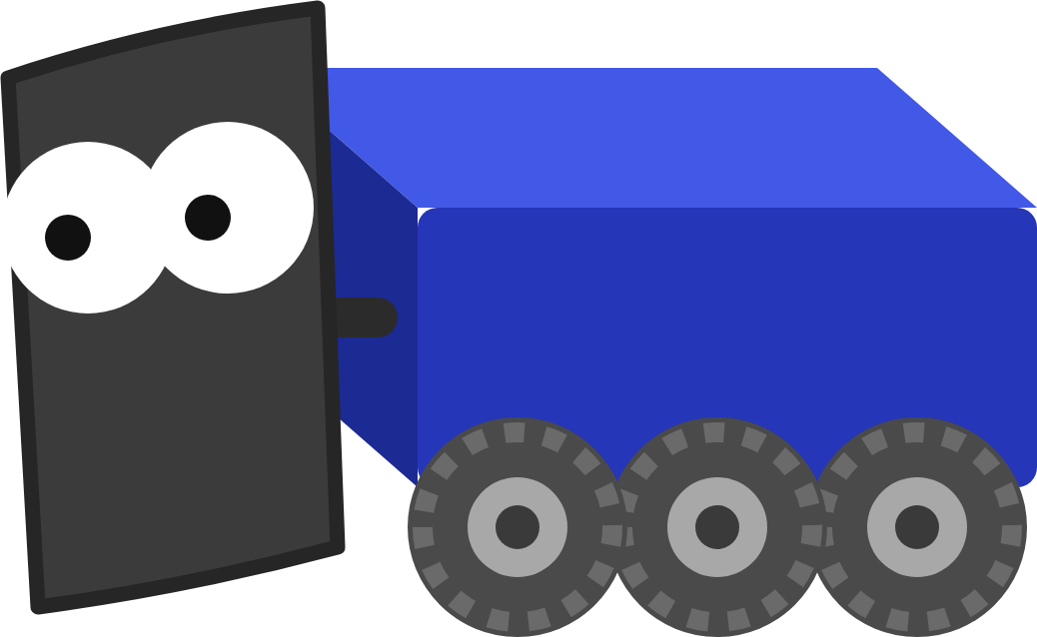
COMMANDS
Hand over the question, not the answer
.until(DrivetrainSubsystem.getInstance()::isAimed)
Hands over the method: asked again every loop.
.until(() -> DrivetrainSubsystem.getInstance().isAimed())
The same thing, written as a lambda.
.until(DrivetrainSubsystem.getInstance().isAimed())
Asks once, right now: one true or false. Java won't accept it.
MARS/WARS SOFTWARE TRAINING
23
Notes:
A common slip. until needs a question it can ask again and again, every loop. The double colon hands over the method itself: DrivetrainSubsystem.getInstance()::isAimed means 'here's how to ask, call it whenever you need'. The lambda version, () -> ...isAimed(), means exactly the same. Writing isAimed() with brackets calls it once, right now, and passes a single true or false; Java won't even accept it here, because until wants a question, not an answer. Ask: why would a single answer be useless? (At the moment the routine is built, the robot isn't aimed, so it would be false forever.)

Slide 24
04
The routine
Order matters: aim first, then shoot!
Load the paths, list the commands
MARS/WARS SOFTWARE TRAINING
24
Notes:
Now put it together in Autos.java, the only Java file you edit in this lesson. Two TODOs: load the paths, then list the commands.

Slide 25
THE ROUTINE
A routine extends Auto
Autos.java
1
extends Auto
public static class PickupAndScore extends Auto {
A list of commands that run in order
1
public PickupAndScore() {
loadTrajectory("ToPickup");
2
2
loadTrajectory
loadTrajectory("ToScore");
Get each path ready, by its Choreo name
addCommands(
3
DrivetrainCommands.followPath(getTrajectory("ToPickup")),
4
3
addCommands
// ...the rest of the routine
The steps, one after another
);
}
}
4
getTrajectory
Hand a loaded path to a command
Java: Classes & Objects
Capitals count: toPickup is not ToPickup.
MARS/WARS SOFTWARE TRAINING
25
Notes:
A routine is a class that extends Auto. Auto comes from MWLib and is a SequentialCommandGroup: a list of commands that run one after another. In the constructor, first name the paths with loadTrajectory, spelled exactly like the path in Choreo. Then addCommands lists the steps. Inside, getTrajectory hands a loaded path to a command. Capital letters count: toPickup is not ToPickup. Ask: what does extends mean here? (PickupAndScore is a kind of Auto, so it gets loadTrajectory, getTrajectory and addCommands for free.)

Slide 26
THE ROUTINE
The sequence: path, wait, path, aim, shoot
Autos.java
1
Drive ToPickup
Finishes when the robot arrives
addCommands(
DrivetrainCommands.followPath(getTrajectory("ToPickup")),
1
2
Wait 0.5 s
Commands.waitSeconds(0.5),
2
Stands in for picking up
DrivetrainCommands.followPath(getTrajectory("ToScore")),
3
DrivetrainCommands.aim()
4
3
Drive ToScore
.until(DrivetrainSubsystem.getInstance()::isAimed)
Starts where ToPickup ended
.withTimeout(3.0),
ShooterCommands.shoot().withTimeout(2.0));
5
4
Aim until aimed
Gives up after 3 s if it can't
• Commas between commands. None after the last.
5
Shoot
• Red names? Hover and use the quick fix to import.
2 s, then the routine is over
MARS/WARS SOFTWARE TRAINING
26
Notes:
This is the lesson's solution for TODO 2. Five commands, run one after another. 1: drive ToPickup; followPath finishes when the robot has arrived. 2: wait half a second, standing in for picking up the game piece. 3: drive ToScore. 4: aim at the goal, ended as soon as isAimed is true, and give up after 3 seconds so a robot that can't aim can't hold up the routine. 5: shoot for 2 seconds; the timeout ends the routine. Commas separate commands, and there's no comma after the last one. Then add the four imports with the quick fix. Ask: what happens if you swap 4 and 5? (It shoots before aiming and misses; the Aims before it shoots check fails.)

Slide 27
THE ROUTINE
The routine on a clock
1
ToPickup
arrived
2
Wait
0.5 s
3
ToScore
arrived
4
Aim
isAimed (3 s max)
5
Shoot
2 s timeout
auto ends at 15 s
0 s
3 s
6 s
9 s
12 s
15 s
About 9 seconds in the simulator: room to spare in a 15 second auto.
MARS/WARS SOFTWARE TRAINING
27
Notes:
The same routine on a clock. Each step starts when the one before finishes, and each one has its own way of finishing: arriving, a time, a condition. These times are roughly what the lesson's solution does in the simulator: each path takes about 2.5 to 3 seconds including the settle, aiming takes a second or so. The whole thing is about 9 seconds, well inside the 15 second autonomous period. Ask: where could you save time? (Spin the shooter up with alongWith while driving ToScore; that's a stretch idea in the README.)

Slide 28
THE ROUTINE
The routine on the field
8
1
Drive ToPickup
From Start to the game piece
4
2
Wait on Pickup
6
Half a second to pick it up
Goal
3
Drive ToScore
4
5
Arrives facing up the field
3
4
Aim
1
Turns about 110° left to face the goal
2
2
5
Shoot
Start
Only once it's aimed
0
2
4
6
8
MARS/WARS SOFTWARE TRAINING
28
Notes:
The same five steps on the field, using the real solution paths. 1: ToPickup from Start to Pickup. 2: wait on Pickup. 3: ToScore up to ScoreSpot, arriving pointed up the field (90 degrees). 4: aim: the goal is behind and to the left, so the robot turns about 110 degrees in place. 5: shoot at the goal. Ask: why does the robot need to turn so far? (ScoreSpot's heading is 90 degrees, but the goal is down and to the left of it.)

Slide 29
THE ROUTINE
Inside followPath: the same pieces
DrivetrainCommands.java (trimmed)
1
sequence
Two steps, in order
return Commands.sequence(
1
// 1. Pick the path.
2
Pick the path
drive.setDesiredChoreoTrajectoryCommand(trajectory),
2
Restarts the path's clock at zero
// 2. Follow it until the robot has arrived.
Commands.startEnd(
3
3
startEnd
() -> drive.setWantedState(DriveStates.CHOREO_PATH),
Follow the path, then stop the motors
() -> { /* stop the motors */ })
.until(drive::isAtChoreoSetpoint)
4
4
until
.withTimeout(10.0));
5
Ends when the robot has arrived
5
withTimeout
Gives up after 10 s if stuck
The competition robot's swerve autos use this same shape.
MARS/WARS SOFTWARE TRAINING
29
Notes:
followPath is provided, but it's built from exactly the pieces you just learned. It's a sequence of two commands. First a runOnce that picks the path and restarts its clock. Then a startEnd: the start note switches the drivetrain into its CHOREO_PATH state, where the follower runs every loop; the end note stops the motors. That startEnd would never finish by itself, so until ends it when isAtChoreoSetpoint says the robot has arrived, and withTimeout gives up after 10 seconds. The competition robot's swerve autos use this same shape.

Slide 30
THE ROUTINE
Picking the routine before the match
RobotContainer.java
Auto Choices
auto_chooser_.setDefaultOption("Do Nothing", Commands.none());
Pickup And Score
▾
auto_chooser_.addOption("Pickup And Score", Autos.pickupAndScore());
SmartDashboard.putData("Auto Choices", auto_chooser_);
Do Nothing
Pickup And Score
Elastic: ComboBox Chooser
WHEN AUTO IS ENABLED: AUTONOMOUSINIT()
Pick
Load
Reset
Schedule
The chosen routine
Its paths, by name
Pose = first path's start
WPILib runs it
MARS/WARS SOFTWARE TRAINING
30
Notes:
How does the robot know which routine to run? RobotContainer puts every routine in a SendableChooser, a drop-down that Elastic shows as the Auto Choices widget (a ComboBox Chooser). The drive team picks one before the match, no redeploy needed. When Auto is enabled, autonomousInit loads the chosen routine's paths, resets the robot's pose to where the first path starts, and schedules it. Ask: why is the default Do Nothing? (If nobody picks, the robot sits still instead of surprising anyone. In the lesson you must pick Pickup And Score or nothing happens.)

Slide 31
THE ROUTINE
On the competition robot
Event markers: actions partway along a path
Swerve, same shape
Shoot
Set the path, switch to CHOREO_PATH, wait until isAtChoreoSetpoint.
Event markers
getChoreoEventTimeTrigger("Shoot").onTrue(...) runs an action as the path passes the marker.
Intake Out
Drawn for blue
Paths are drawn once. The code flips them for the red alliance.
MARS/WARS SOFTWARE TRAINING
31
Notes:
On the competition robot it's the same idea, bigger. It's swerve, so it uses SwerveSubsystem, but the shape is the same: set the path, switch to CHOREO_PATH, wait until isAtChoreoSetpoint. Two extras. Event markers: named points you put on a path in Choreo, like Intake Out or Shoot. A trigger turns true when the path passes the marker, so actions happen while the robot drives, not only between paths. And paths are drawn once, for the blue alliance; the code flips them for red. This robot has getChoreoEventTimeTrigger too: adding a marker is a stretch idea in the lesson. Details on docs.marswars.org, Software, Autonomous.

Slide 32
05
Run and check
Watch me on the 2D field. Am I on the line?
Watch it drive, read what the checks say
MARS/WARS SOFTWARE TRAINING
32
Notes:
The last four checkpoints read a running simulation, so you have to run the routine in Auto before Verify.

Slide 33

RUN AND CHECK
Running the routine
Start
Pick
Enable
Hands off
Wait for Running
Elastic: Auto Choices, Pickup And Score
Driver Station: Auto, then Enable
It drives itself, about 10 s
In training
On the real robot
Scriptum's Start button, its Elastic pane and its Driver Station panel. Changed the code? Press Start again.
Deploy from VS Code. Pick the routine in Elastic on the drive laptop. The FRC Driver Station, or the field in a match, runs Auto.
MARS/WARS SOFTWARE TRAINING
33
Notes:
Running the routine in training: press Start and wait for Running. In Elastic, add the Auto Choices widget (under SmartDashboard) as a ComboBox Chooser and pick Pickup And Score. In the Driver Station panel pick Auto and press Enable, then hands off. On the real robot it's the same steps with real tools: deploy from VS Code, pick the routine in Elastic on the drive laptop, and the FRC Driver Station (or the field, in a match) enables Auto. Remember to yell ENABLING before you enable a real robot.

Slide 34
RUN AND CHECK
Reading the distances in AdvantageScope
7
1
Pickup dips
Under 0.4 m: Reaches the pickup
6
5
2
ScoreSpot dips
Under 0.4 m: Reaches the scoring spot
4
3
3
Flat at the end
3
Standing still: aiming, then shooting
2
1
2
1
0.4 m
4
Also plot
0
TrueAimErrorDegrees: near 0 before the shot
0 s
2 s
4 s
6 s
8 s
10 s
Drive/DistanceToPickup
Drive/DistanceToScoreSpot
MARS/WARS SOFTWARE TRAINING
34
Notes:
Plot Drive/DistanceToPickup and Drive/DistanceToScoreSpot in AdvantageScope. These are true distances in meters. This graph was worked out from the lesson's real solution paths, so yours will look very close. The pickup line falls to nearly zero first: that's Reaches the pickup (under 0.4 m). Then it rises as the robot leaves, and the scoring spot line falls to nearly zero: Reaches the scoring spot. After that both are flat while the robot aims and shoots. Also plot Drive/TrueAimErrorDegrees: it should swing to about zero before the shot. Activity: before showing the graph, have students sketch what they expect.

Slide 35
RUN AND CHECK
When a check fails, it's a clue
Check that failed
Look at
Reaches the pickup
The first path or its followPath: name, generated, in the list?
Reaches the scoring spot
The second path never ran, or doesn't start where the first ended
Aims before it shoots
Aim is missing, comes after the shot, or has no .until(...isAimed)
Shoots
The routine ended, or got stuck, before shoot()
After a fix, press Start again. The checks remember the best run since Start.
MARS/WARS SOFTWARE TRAINING
35
Notes:
When a run check fails, read it as a clue about which step broke. The run checks remember the best the robot did since you pressed Start, so after a fix press Start again for a clean run. Activity: read out a symptom (the robot shoots facing the wrong way) and have students name the cause (no .until(...isAimed), or aim comes after shoot).

Slide 36
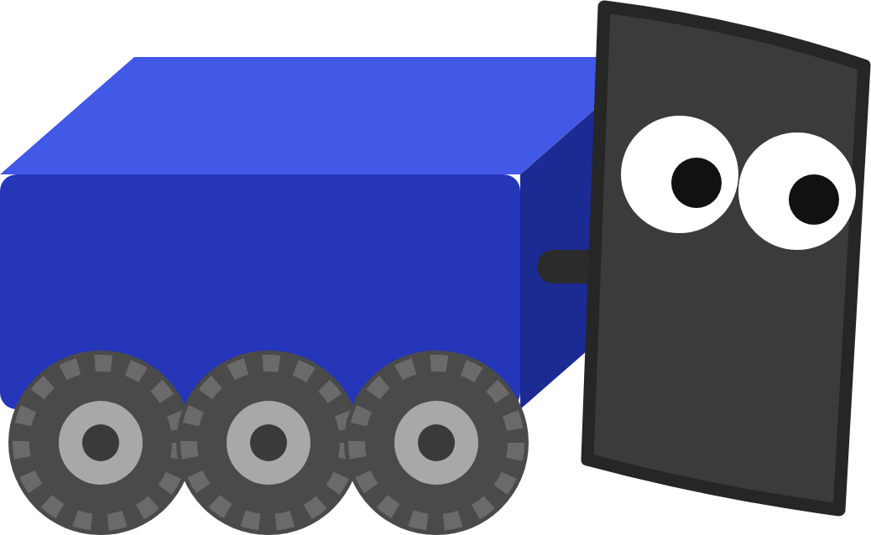
YOUR TURN
Choreo Autonomous
Draw ToPickup and ToScore, write the routine in Autos.java, run it in Auto and press Verify on each checkpoint.
8 CHECKPOINTS
Two paths drawn
Reaches the pickup
Generated, three waypoints each
Within 0.4 m of Pickup
Paths named ToPickup and ToScore
Reaches the scoring spot
And Autos.java loads both
Within 0.4 m of ScoreSpot
Paths go where they should
Aims before it shoots
Start to Pickup, Pickup to ScoreSpot
Facing the goal within 5°
Autonomous sequence written
Shoots
Path, path, aim until aimed, shoot
At least once
Bonus: an event marker, spin up with alongWith, change Max Velocity, a third path home
In Scriptum: FRC Robot › Choreo Autonomous
MARS/WARS SOFTWARE TRAINING
36
Notes:
This is the hands-on part: the Choreo Autonomous lesson in Scriptum's FRC Robot track. Part 1 draws the two paths in the Choreo pane, part 2 writes Autos.java, part 3 runs it. The first four checkpoints read your paths and code; the last four read a running simulation, so run Pickup And Score in Auto before you press Verify. Press the Dozer button for his guides, including 'Teach me, step by step'. Nothing is graded and you can verify as many times as you like.

Slide 37

RECAP
What you can do now
Explain a trajectory as a schedule
RELATED JAVA TRAINING
WHAT'S NEXT
Describe how the follower closes the gap
Methods
Build season
Trace a command from start to finish
Join a subsystem team and write real robot code.
Classes & Objects
End commands with until and withTimeout
Write an Auto that follows two paths
Aim, shoot, and check it in AdvantageScope
Optional practice in Scriptum's Java track.
MARS/WARS SOFTWARE TRAINING
37
Notes:
Wrap up, and the end of the FRC Robot track. Today: a trajectory is a schedule, the follower checks it every 20 ms and closes the gap, commands start, run and finish, decorators decide when, and a routine is a list of commands in order. What's next is build season: join a subsystem team and write real robot code with the same tools and the same patterns. The Java lessons on the right are optional practice for today's ideas.

