Slide 1


TOOLS · DECK 0
The Tools
Meet the Editor, Git Basics, AdvantageScope, Elastic and Choreo: the five tools every MARS/WARS programmer uses.
Hi! I'm Dozer. I'll show you around the tools.
Notes:
Welcome. This deck covers the tools every programmer on the team uses before we touch robot code: the editor, git, AdvantageScope, Elastic and Choreo. Each section teaches the ideas; the hands-on practice is the matching Scriptum lesson, listed at the end.

Slide 2
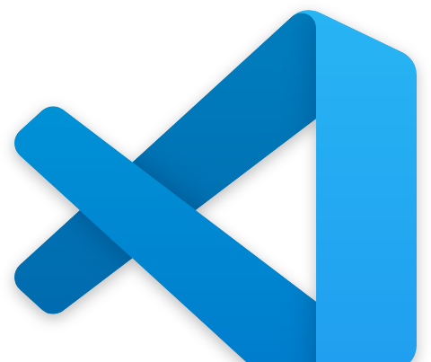




TODAY
Five tools, five lessons
01
02
03
04
05
Meet the Editor
Git Basics
AdvantageScope
Elastic
Choreo
Where code gets written, organized and run
Saving versions and working as a team
Seeing what the robot is doing
The dashboard drivers use in a match
Planning autonomous paths
MARS/WARS SOFTWARE TRAINING
2
Notes:
Five sections. The first two are about writing and saving code. The last three are about seeing and steering the robot.

Slide 3
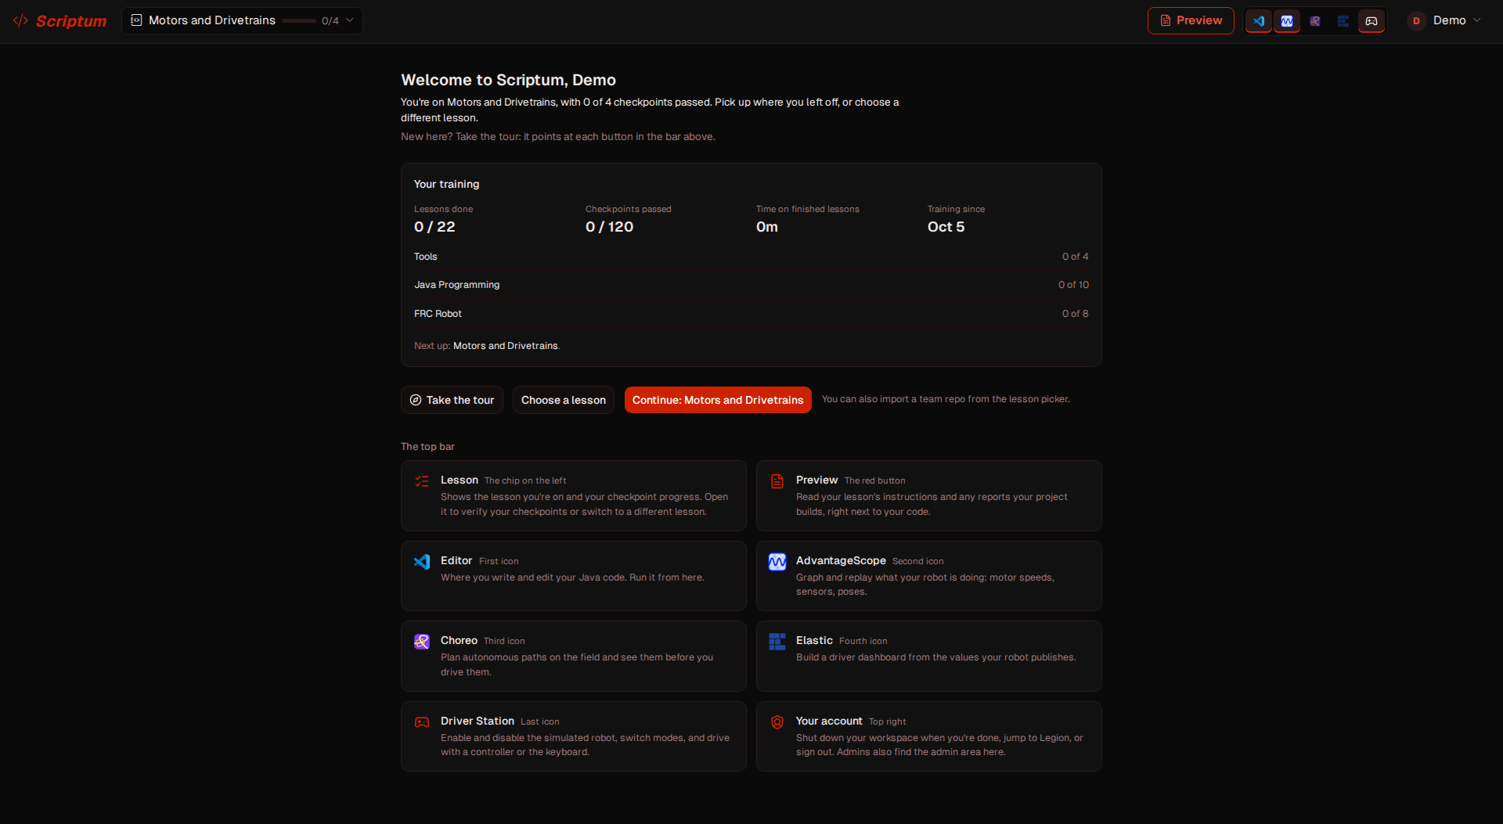
WHERE THESE TOOLS LIVE
Team laptops and training
ON THE TEAM LAPTOPS
IN TRAINING
Separate desktop apps
Scriptum
VS Code + WPILib
AdvantageScope
Elastic
Choreo
What you use on the real robot
The same tools in one browser window, with a simulated robot
MARS/WARS SOFTWARE TRAINING
3
Notes:
On the team laptops each tool is its own desktop app: VS Code with the WPILib extension, AdvantageScope, Elastic, Choreo, plus the FRC Driver Station. That's what you'll use on the real robot. For training we use Scriptum, a browser workspace that bundles the same tools next to a simulated robot, so you can practice without a laptop or a robot.

Slide 4
01
Meet the Editor
Save early, save often. Unsaved code can't run!
Files, folders, the terminal, and running a program
MARS/WARS SOFTWARE TRAINING
4
Notes:
No experience needed. These are the things every programmer does all day.

Slide 5
MEET THE EDITOR
What is a code editor?
• A text editor made for writing code
• Colors the code so it's easier to read
• Catches mistakes before you run anything
• Extensions add features, like WPILib for robots
VS Code
On every team laptop, with the WPILib extension. Scriptum uses the same editor.
MARS/WARS SOFTWARE TRAINING
5
Notes:
A code editor is a text editor built for code. It colors the code, points out mistakes before you run it, and lets you add extensions. The WPILib extension is what lets us build and deploy robot code. The team laptops run VS Code; Scriptum's training editor is VSCodium, the open-source build of the same editor, so everything here works the same on a laptop.

Slide 6
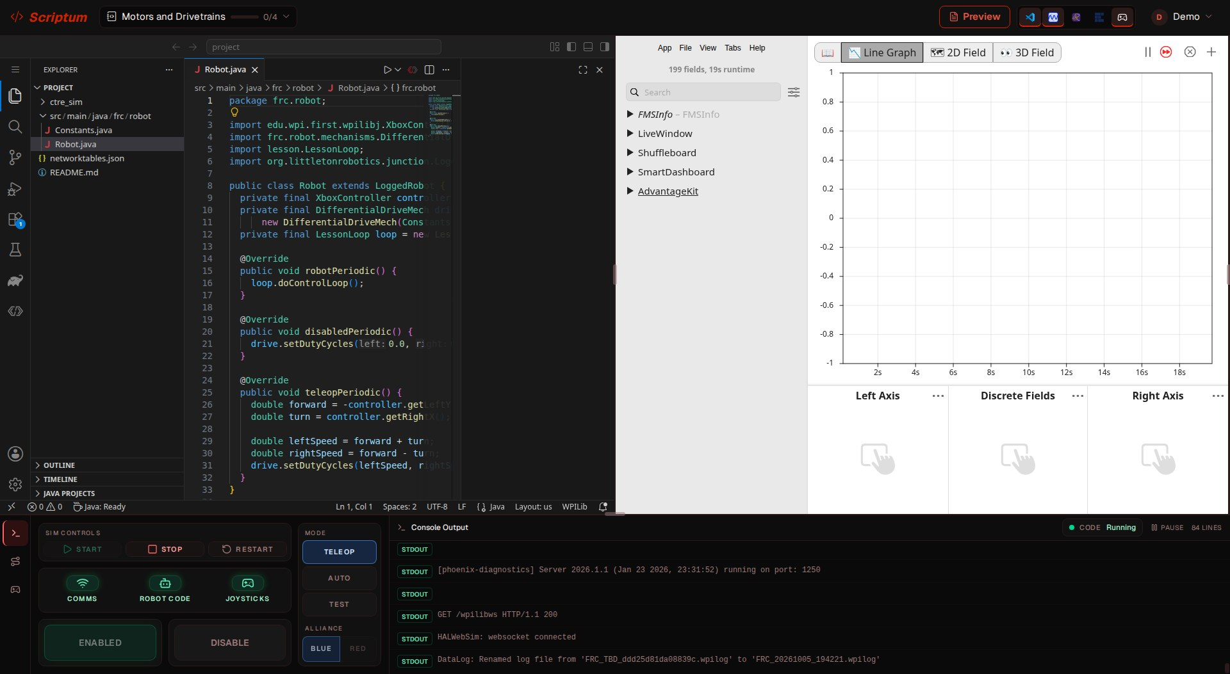
MEET THE EDITOR
A tour of the training workspace
3
1
Explorer
1
2
Your files and folders
2
Editor
Where you type code
3
Tool panes
AdvantageScope, Elastic, Choreo
4
Driver Station
4
Start, enable and drive the robot
MARS/WARS SOFTWARE TRAINING
6
Notes:
This is Scriptum, the training workspace. On a laptop, the editor is VS Code and the tool panes and Driver Station are separate app windows. Point at each part. 1 Explorer: the project's files. 2 Editor: where you type. 3 Tool panes: AdvantageScope here; Elastic and Choreo open in the same spot. 4 Driver Station: Start builds and runs the robot code, Enable turns it on, Teleop/Auto/Test pick the mode.

Slide 7
MEET THE EDITOR
Files and extensions
• A file is one saved thing, with a name
.java
Java code: the robot program
• The extension after the dot says what kind
• A folder holds files and other folders
.json
Settings and data
.md
Notes and instructions (Markdown)
.gradle
How to build the project
MARS/WARS SOFTWARE TRAINING
7
Notes:
Code isn't magic: it's words typed into files. The extension after the dot tells you and the computer what kind of file it is. These four show up in every robot project.

Slide 8
MEET THE EDITOR
Projects and paths
• A project is one folder with everything inside
project/
src/
• A path is a file's address, folder by folder
main/
• Slashes separate the folders
java/
frc/
robot/
Robot.java
Constants.java
src/main/java/frc/robot/Robot.java
build.gradle
README.md
MARS/WARS SOFTWARE TRAINING
8
Notes:
A project is one folder with everything for a program. A path is a file's address: the folders you walk through to reach it. Every robot lesson's code is at this same path. Activity: ask students to read the path out loud as directions.

Slide 9

MEET THE EDITOR
The terminal: typing commands
pwd
Where am I? Prints the folder you're in
ls
What's here? Lists files and folders
Two tricks
cd robot
Move into a folder
• Up arrow brings back your last command
cat notes.txt
Show what's in a file
• Tab finishes a file name for you
• Ctrl+` opens the terminal
mkdir practice
Make a new folder
MARS/WARS SOFTWARE TRAINING
9
Notes:
The terminal is another way to work with the same files: type a command, press Enter. Have everyone open it with Ctrl+` and run pwd and ls. Up arrow repeats the last command; Tab finishes a name for you.

Slide 10
MEET THE EDITOR
Find things fast
Ctrl+P
Open a file by typing part of its name
Ctrl+Shift+P
Find any command (the command palette)
Ctrl+Shift+F
Search for a word in every file
Ctrl+S
Save the file
Ctrl+F
Search in the file you're in
F2
Rename the selected file or folder
MARS/WARS SOFTWARE TRAINING
10
Notes:
Shortcuts save a lot of clicking. Click inside the editor first so it hears the keys.

Slide 11
MEET THE EDITOR
Editor power moves
Alt+Click
Add another cursor: edit many lines at once
Ctrl+Click
Jump to where a method or variable is defined
Ctrl+D
Select the next match of the same word
Ctrl+Shift+P
Run a command, like WPILib: Build Robot Code
Build failed? Read the terminal. The compiler usually says what went wrong and on which line.
MARS/WARS SOFTWARE TRAINING
11
Notes:
Cole's tech tips. Try each live: Alt+click three lines and type; select a word and press Ctrl+D a few times; Ctrl+click a method name to jump to it. The command palette runs every WPILib command: type WPILib to see Build and Deploy. GitLens (an extension) shows who last changed each line, called blame.

Slide 12
MEET THE EDITOR
What happens when you press Run
Main.java
Compile
Run
Output
The code you typed
Check it and translate it
The computer follows it
Printed in the terminal
public class Main {
OUTPUT
public static void main(String[] args) {
Hello, my name is Ava
System.out.println("Hello, my name is ...");
}
A typo? Compiling stops and points at the line.
}
MARS/WARS SOFTWARE TRAINING
12
Notes:
When you press Run, the editor first compiles the Java: it checks it and turns it into instructions the computer can run. If there's a mistake, it stops and tells you where. Then the program runs and anything it prints shows in the terminal. Robot code works the same way, except the program keeps running in a loop.

Slide 13
02
Git Basics
Commit small steps. Future you will say thanks.
Version control: saving history and working as a team
MARS/WARS SOFTWARE TRAINING
13
Notes:
Git is how the whole team works on the same robot code without overwriting each other.

Slide 14

GIT BASICS
What is version control?
• Remembers every version of your code
WITHOUT GIT
• Undo back to any earlier save point
robot-code-v1
• Many people work at once without overwriting
robot-code-v2
• Built on three ideas: repositories, commits, branches
robot-code-final
robot-code-final-2
robot-code-final-really
...emailed around, on a thumb drive
MARS/WARS SOFTWARE TRAINING
14
Notes:
Without version control, people email files around and overwrite each other's work. Git remembers every version, like unlimited save points in a game, and lets many people work at once. Ask: who has ever lost work because they saved over something?

Slide 15
GIT BASICS
Repositories
• A repo is a project folder git is watching
RobotCode/
• Each project is usually its own repo
.git/
• The history lives in a hidden .git folder
src/
build.gradle
README.md
the .git folder holds every version
MARS/WARS SOFTWARE TRAINING
15
Notes:
A repository is a project folder git is watching. Each programming project is usually its own repo: the robot code, MWLib, this year's vision code. Every repo keeps its whole history inside a hidden .git folder.

Slide 16
GIT BASICS
Commits: save points with a message
Created Arm subsystem
GOOD MESSAGES
• Say what changed
Added arm motors
• One small step each
• Fit in 52 characters, or the commit is too big
Added arm PID controller
Tuned arm PID controller
NOT HELPFUL
"stuff"
"fixed it"
"asdf"
Each commit gets an ID (a SHA), shortened to 7 characters: 2c37172
MARS/WARS SOFTWARE TRAINING
16
Notes:
A commit is a saved snapshot with a message. Keep commits small so each one is one step. They act as breadcrumbs for your work, so a teammate (or you, next week) can see exactly what changed and when. Activity: have students rewrite the bad messages.

Slide 17
GIT BASICS
Four places your code lives
git add
git commit
git push
Working
Staged
Local repo
Remote
Files you edit and save
Picked for the next commit
Commits on your computer
The team's copy on GitHub
THE EVERYDAY ROUTINE
1 Edit
2 Save
3 Stage +
4 Message
5 Commit
In the editor, every step is a button in Source Control (the branch icon on the left).
MARS/WARS SOFTWARE TRAINING
17
Notes:
Your code moves through four places. You edit in the working directory. git add (the + button) stages a change: picks it for the next commit, like putting items in a box before you seal it. git commit seals the box into your local repository. git push sends it to the remote on GitHub. Edit, save, stage, message, commit is the routine every time.

Slide 18
GIT BASICS
Branches: parallel lines of work
• Your own line of work
• Starts from a commit on another branch
older
newer
main
• Always branch for a new feature
• Lets people work in parallel
bugfix
new-feature
MARS/WARS SOFTWARE TRAINING
18
Notes:
A branch is your own line of work that doesn't disturb anyone else's. Always branch for a new feature. Here a bugfix and a new feature both started from main and grow side by side: neither one sees the other's commits until they're merged.

Slide 19
GIT BASICS
How our team uses branches
competition-ready
release
main
develop
issue-12-turbo-boost
pull request
• main is production-ready. develop collects finished features.
• Name branches issue-<number>-<description>, starting from develop
• Nobody pushes straight to main or develop
MARS/WARS SOFTWARE TRAINING
19
Notes:
Our conventions: main is production-ready. develop collects finished features. Every feature branch starts from develop, is named issue-<number>-<description> after its GitHub issue, and merges back into develop through a pull request. When develop is ready for competition it's merged into main. Nobody pushes straight to main or develop.

Slide 20
GIT BASICS
Merging: bringing work together
• Combines two branches into one
• Stand on the branch that receives the work
teammate's commit
merge commit
develop
• Makes a merge commit with two parents
• On the team, merges go through a pull request
shooter
git checkout develop
git merge shooter
MARS/WARS SOFTWARE TRAINING
20
Notes:
Merging brings another branch's commits into the one you're on. Stand on the branch that receives the work: here we're on develop and merge shooter into it. The merge commit (the solid dot) has two parents, so develop now has the teammate's commit and all of shooter's. On the team, merges happen through pull requests on GitHub so someone reviews the code first.

Slide 21
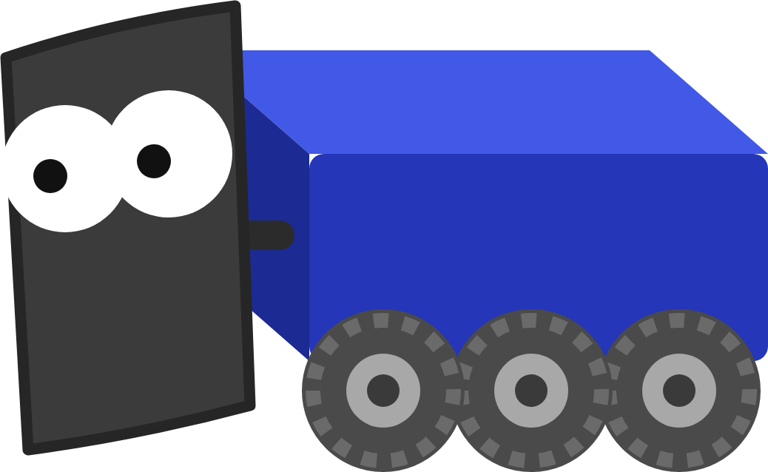
GIT BASICS
Merge conflicts: when git has to ask
Constants.java
1
Yours
<<<<<<< HEAD
What's on the branch you're on
1
public static final double MAX_SPEED = 4.0;
=======
2
2
Incoming
public static final double MAX_SPEED = 5.0;
>>>>>>> issue-9-max-speed
What the other branch changed
3
You decide
Keep one, save, stage with +, commit
Why? Two branches changed the same line, so git can't pick. That's normal, not an error.
MARS/WARS SOFTWARE TRAINING
21
Notes:
If two branches changed the same line, git can't guess which one is right, so it stops and asks you. It's not an error. Analogy: two people edit the same line of a recipe, one to 2 cups and one to half a cup. The editor shows Accept Current, Accept Incoming and Accept Both above the conflict.

Slide 22
GIT BASICS
Rebase: replay your work on top
BEFORE
Merge or rebase?
new on develop
develop
• Rebase: one straight line, but your commits get new IDs
my-feature
• Merge: keeps history exactly as it was, always safe
A
B
AFTER git rebase develop
• Only rebase branches nobody else has
develop
• Not sure? Merge.
my-feature
A'
B'
MARS/WARS SOFTWARE TRAINING
22
Notes:
Rebase picks up your commits and puts them back down on top of develop's newest commit, as if you had just started. A and B become new commits A' and B' (new IDs), and history becomes one straight line. Because it rewrites your commits, only rebase a branch nobody else has copied. If you're not sure, merge: it's always safe.

Slide 23




GIT BASICS
Local and remote: push and pull
push: send your commits
Local
Remote (origin)
Your copy, on your computer
The shared copy on GitHub
pull: get teammates' commits
Golden rule: pull when you start a session, push when you finish. Use Push and Pull, not Sync Changes.
Stash Shelve unfinished work so you can switch branches. Stash pop brings it back.
MARS/WARS SOFTWARE TRAINING
23
Notes:
Your project folder is the local copy. The team's shared copy lives on GitHub and is called the remote, usually named origin. Push sends your commits up; pull brings teammates' commits down. Stash puts unfinished work on a shelf so you can switch branches, and stash pop brings it back.

Slide 24


GIT BASICS
GitHub: how the team works together
Pull requests
Issues
Projects
Ask to merge a branch. Teammates review the code first.
One task or bug each. The number goes in your branch name.
A board of issues by status, from Backlog to Done.
All our code lives at github.com/FRC-Team-4143
MARS/WARS SOFTWARE TRAINING
24
Notes:
GitHub is where the team stores every project online (github.com/FRC-Team-4143). Beyond storage it gives us pull requests for code review, issues to track work, and project boards to see who is doing what. Feature branch names come from issue numbers.

Slide 25
GIT BASICS
The team workflow
01
02
03
04
05
06
Issue
Branch
Commit
Pull request
Review
Merge
Find it, assign yourself
issue-12-turbo-boost
Small steps, update the issue
Linked to the issue
Teammate or mentor
Then delete the branch
THE PROJECT BOARD
Backlog
Ready
In progress
In review
Done
MARS/WARS SOFTWARE TRAINING
25
Notes:
This is how every task on the team flows, start to finish. Find or make the issue and assign yourself. Branch from develop named after the issue. Commit small steps and comment on the issue as you go. Open a pull request linked to the issue, ask a teammate or mentor to review, merge once it's approved, then delete the branch. The project board columns follow along.

Slide 26
03
AdvantageScope
You can't see inside me, so graph what I'm thinking.
Telemetry: seeing what the robot is doing
MARS/WARS SOFTWARE TRAINING
26
Notes:
You can't see inside a robot. Telemetry is how the robot tells us what it's doing.

Slide 27
ADVANTAGESCOPE
What is telemetry?
Robot code
NetworkTables
AdvantageScope
Elastic
Publishes values every loop
Sends them to the laptop
Graphs and draws them
Shows drivers what matters
• Telemetry: data the robot reports about itself
• Sent about 50 times a second while it runs
• Live while running, or saved to a log file to replay later
MARS/WARS SOFTWARE TRAINING
27
Notes:
Every loop (about 50 times a second) the robot code can publish values: speeds, sensor readings, where it thinks it is. Those values travel over NetworkTables to tools on the laptop. AdvantageScope graphs and draws them; Elastic shows them to drivers. AdvantageKit can also save them to a log file to replay after a match.

Slide 28
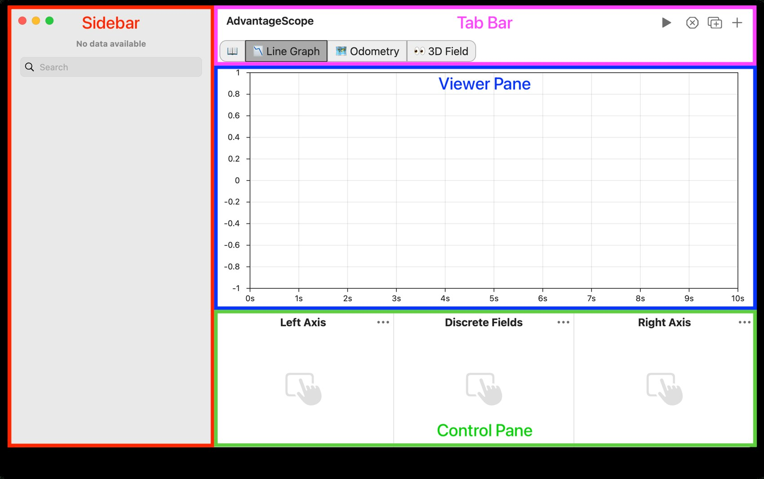
ADVANTAGESCOPE
A tour of the window
1
Sidebar
Every field the robot publishes
2
Tab bar
One tab per view; + adds one
3
Viewer
The graph or field itself
4
Control pane
Which fields show, on which axis
MARS/WARS SOFTWARE TRAINING
28
Notes:
This is the real AdvantageScope window. Sidebar: every field the robot publishes, in folders; drag one into the view. Tab bar: one tab per view (Line Graph, 2D Field, 3D Field, Swerve and more); add tabs with +. Viewer: the graph or field itself. Control pane: which fields this tab shows and on which axis. Screenshot from the AdvantageScope docs.

Slide 29
ADVANTAGESCOPE
Fields and their types
TYPE
EXAMPLE FIELD
SHOWN AS
Number
FlywheelRPM
A line on a graph
Boolean
GamePieceLoaded
Colored true/false bands
Pose2d
RobotPose2d
The robot on a 2D field
Pose3d
RobotPose3d
The robot in 3D
SwerveModuleState[]
SwerveModuleStates
Wheel arrows on the Swerve tab
MARS/WARS SOFTWARE TRAINING
29
Notes:
Each published value is a field with a name and a type. The type decides how AdvantageScope can show it: numbers on a line graph, true/false as colored bands, poses on a field. Ask: what type would the battery voltage be? Is a game piece loaded?

Slide 30

ADVANTAGESCOPE
Reading a line graph
2
4
Two axes
RPM
VOLTS
1
6,000
13
Left and right each have their own scale
t = 4.2 s
4,000
5,790 RPM 12.3 V
12
2
Lock the range
The lock stops the scale from jumping
2,000
11
1
3
Discrete fields
0
10
true/false and text as colored bands
GamePieceLoaded
3
false
true
false
4
Hover and zoom
time →
Read exact values; scroll to zoom in time
MARS/WARS SOFTWARE TRAINING
30
Notes:
Line graphs plot values over time. 1: the left and right axes each have their own scale, so RPM (thousands) and battery voltage (about 12) fit on one graph. 2: lock an axis range with the lock icon so the scale stops jumping. 3: discrete fields show true/false and text as colored bands under the graph. 4: hover to read exact values at one moment; scroll to zoom in time. Ask: why does the voltage dip when the flywheel spins up?

Slide 31
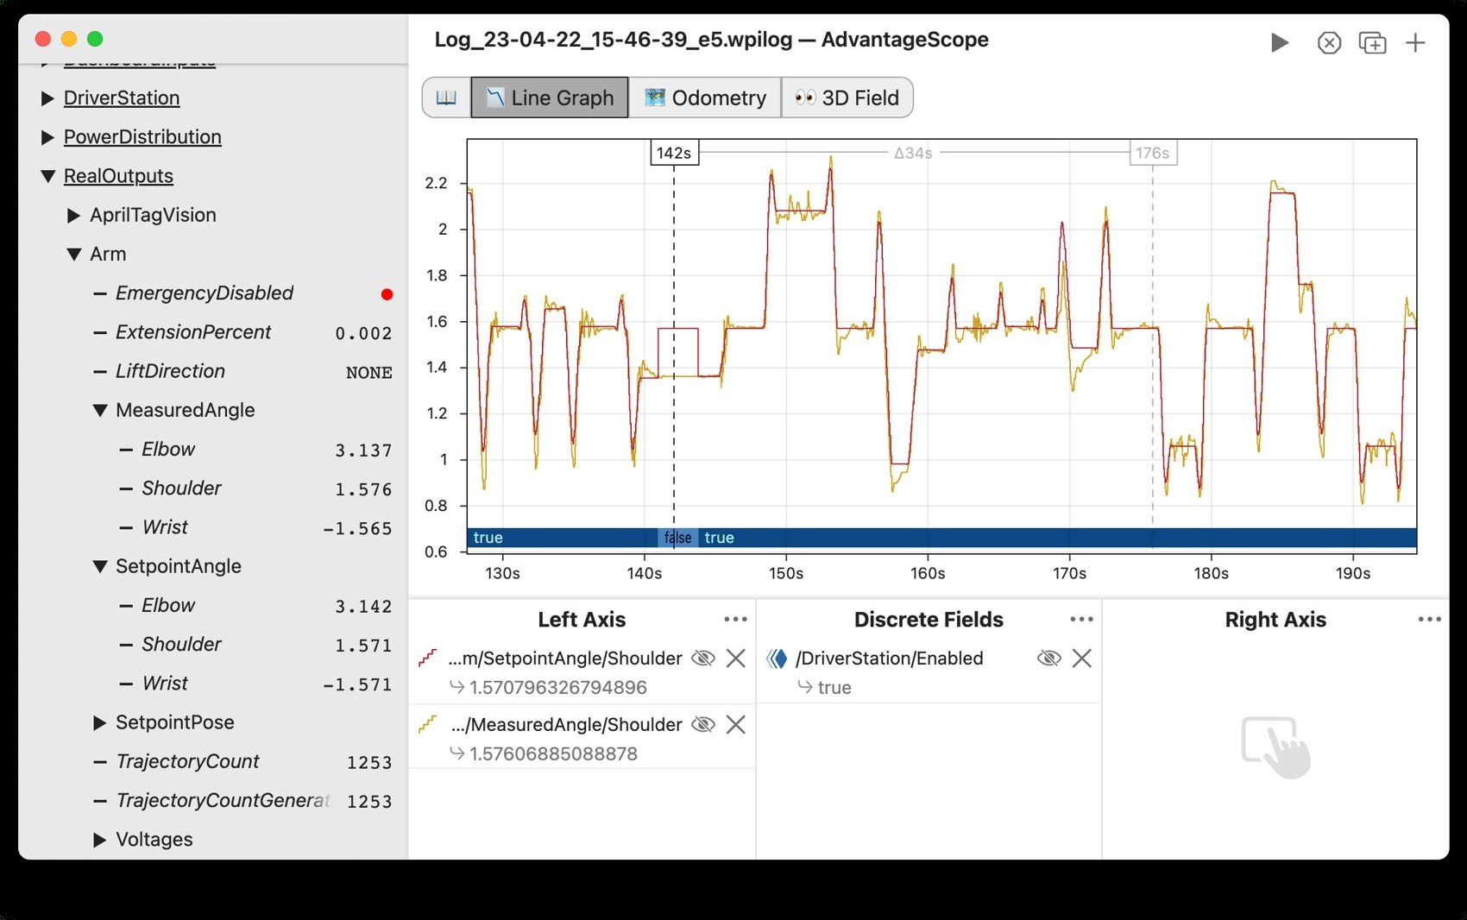
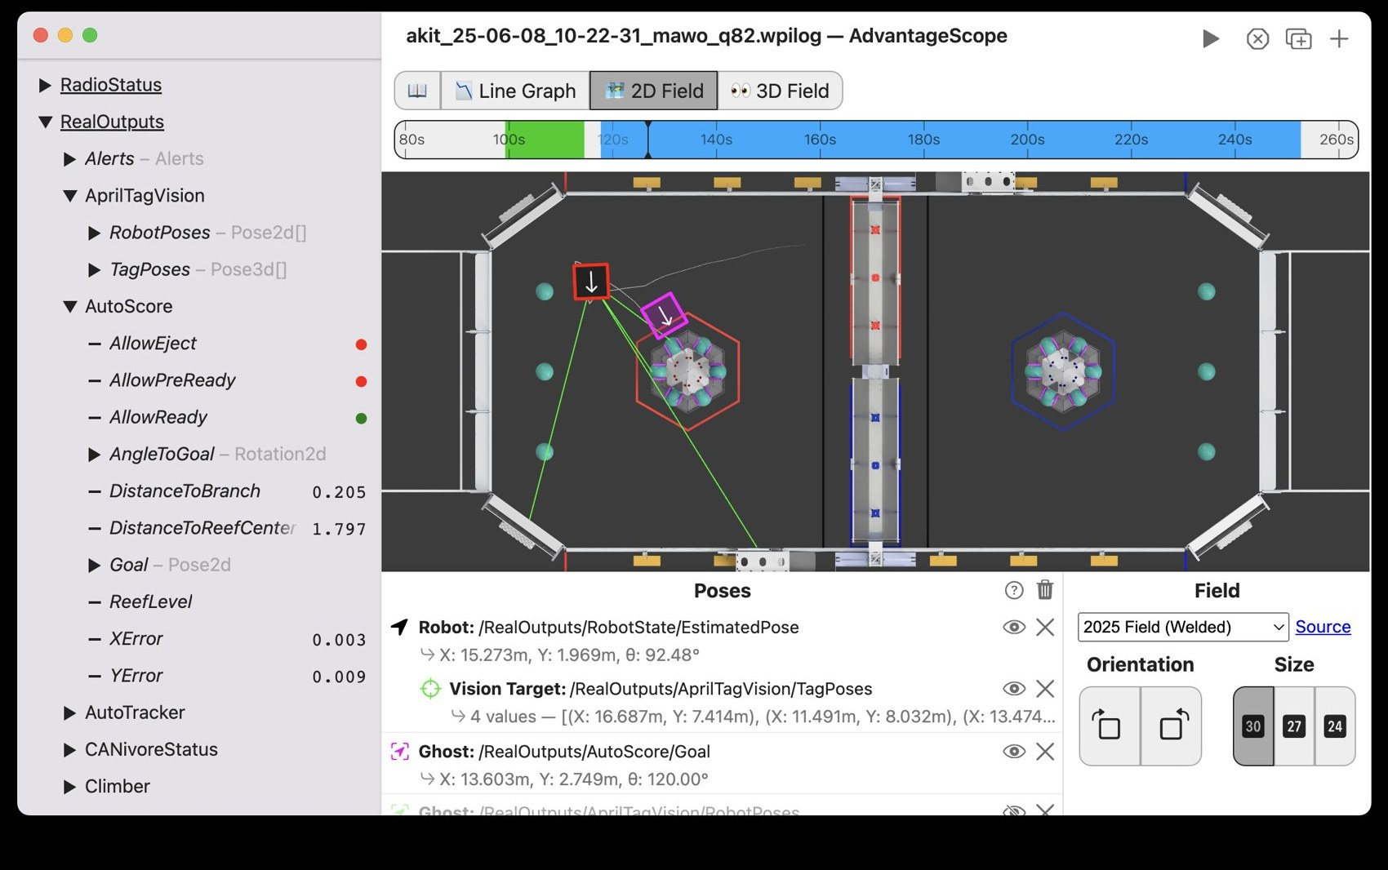
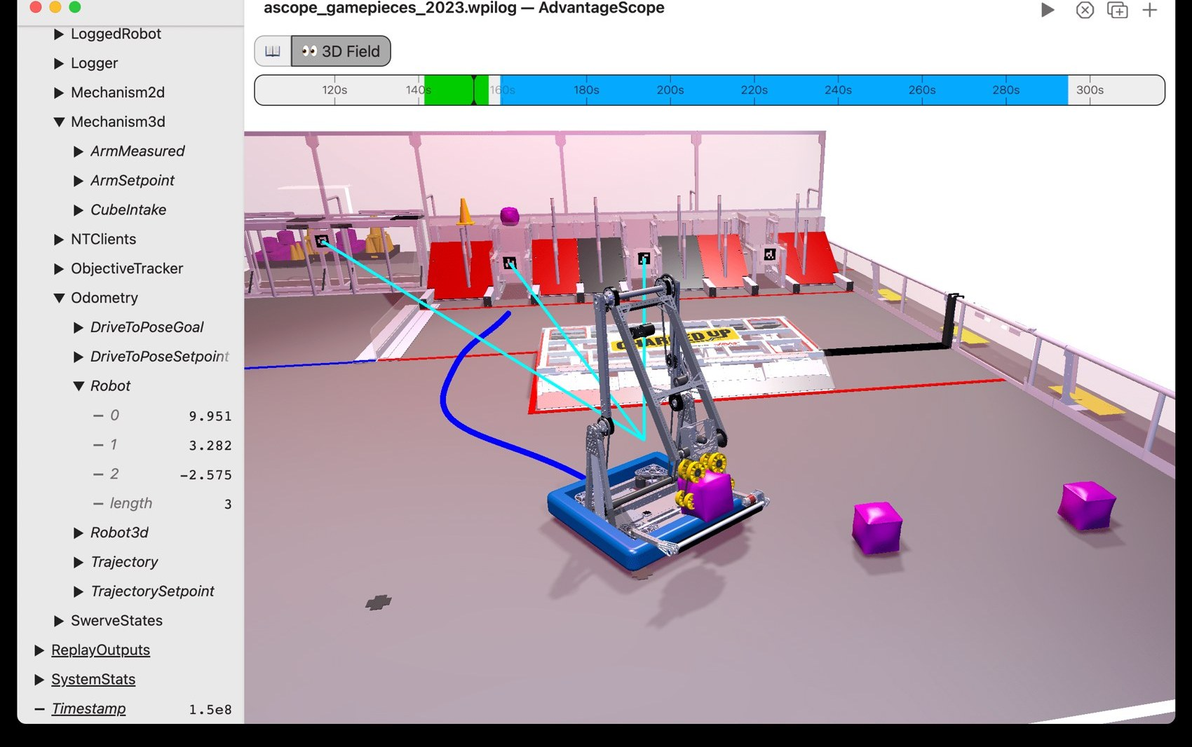
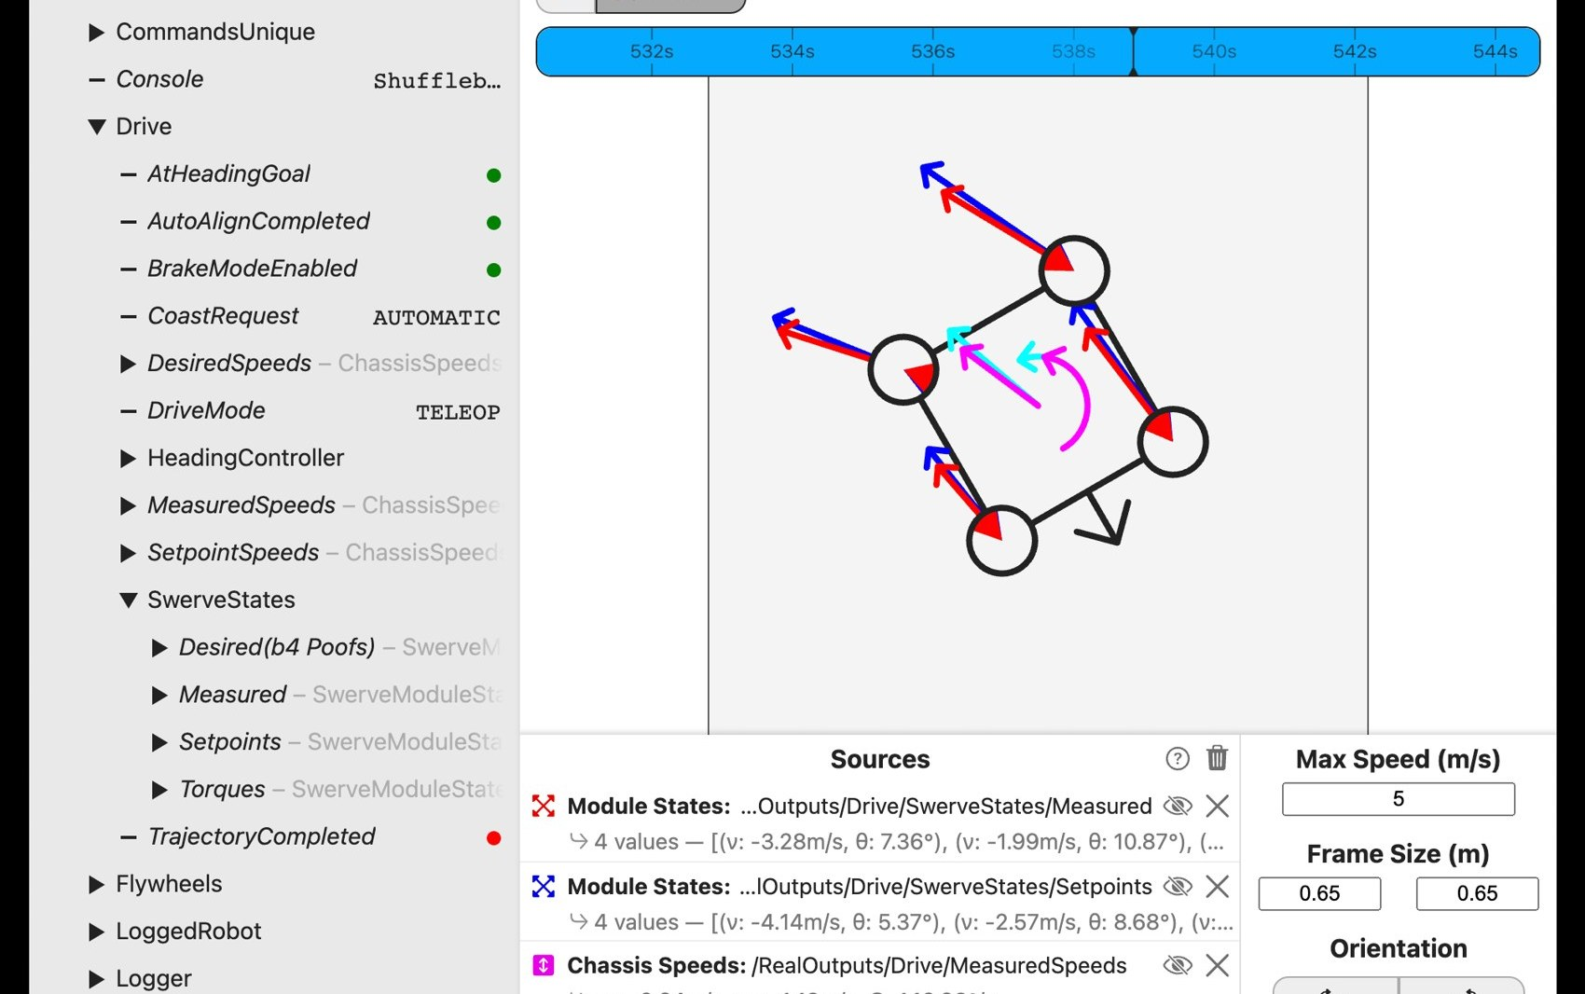
ADVANTAGESCOPE
A tab for every job
Line Graph
2D Field
Numbers and true/false over time
Where the robot is, from above
3D Field
Swerve
The whole robot and its mechanisms
Each wheel's speed and direction
MARS/WARS SOFTWARE TRAINING
31
Notes:
Each tab shows data a different way. Line Graph for numbers over time. 2D Field for where the robot is. 3D Field to watch the whole robot and its mechanisms. Swerve for each wheel's speed and direction. Screenshots from the AdvantageScope docs.

Slide 32
ADVANTAGESCOPE
Differentiate: how fast is it changing?
SPINNING UP
HOLDING SPEED
SLOWING DOWN
derivative is big
derivative is zero
derivative is negative
FlywheelRPM
differentiated
0
MARS/WARS SOFTWARE TRAINING
32
Notes:
Differentiate shows how fast a value is changing. Flywheel RPM differentiated is how fast the flywheel is speeding up: big while it spins up, zero once it holds speed, negative as it slows. Same idea as speed and acceleration: a car at a steady 60 mph has zero acceleration.

Slide 33

ADVANTAGESCOPE
Poses: where is the robot?
x
Meters from the blue alliance wall
y
x = 5.5 m
Meters from the side of the field
θ = 30°
y = 3.0 m
Rotation
Which way it faces, counterclockwise
start
(0, 0)
x →
Pose3d
new Pose2d(5.5, 3.0, Rotation2d.fromDegrees(30))
Adds height, tilt and roll
MARS/WARS SOFTWARE TRAINING
33
Notes:
A pose is where the robot is and which way it faces: x and y in meters from the field's origin corner (the blue alliance side), plus a rotation measured counterclockwise from the x axis. A Pose2d is flat; a Pose3d adds height, tilt and roll. The 2D and 3D Field tabs draw it so you can watch the robot drive. Ask: what happens to x as the robot drives toward the red alliance?

Slide 34


ADVANTAGESCOPE
Live data or log files
Live
Log files
While the robot or sim runs
After a test or a match
• Anything published to NetworkTables
• .wpilog .hoot .dslog
• File > Connect to Robot
• File > Open Log(s)
• or Connect to Simulator
• Replay exactly what happened
For the pits, not the match. Drivers use Elastic. Load the team's layouts with File > Import Layout.
MARS/WARS SOFTWARE TRAINING
34
Notes:
AdvantageScope was built by Team 6328. It reads two kinds of source. Live: anything on NetworkTables, from the robot or the simulator (File > Connect to Robot / Connect to Simulator). Logs: files recorded during testing and matches, opened with File > Open Log(s). It's a big app for development and match review, not for driving during competition; that's Elastic's job. The team keeps layout templates (tuning, match review) you load with File > Import Layout.

Slide 35
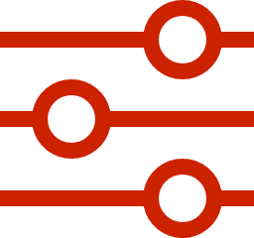
ADVANTAGESCOPE
Tuning Mode: changing values live
• Most fields are read-only
• Tuning Mode (the slider icon) lets you type new values
• Only for values under /Tuning
• Tune things like flywheel speed without redeploying
/Tuning/FlywheelTargetRPM
Writable, because it's published under /Tuning
MARS/WARS SOFTWARE TRAINING
35
Notes:
Most values are read-only: AdvantageScope just shows them. Tuning Mode, the slider icon, lets you type new values, but only for values the code publishes under /Tuning. That's how we'll tune things like flywheel speed without redeploying code.

Slide 36
04
Elastic
Drivers glance, they don't read. Keep it big and simple.
Dashboards: what drivers see during a match
MARS/WARS SOFTWARE TRAINING
36
Notes:
AdvantageScope is for programmers digging into data. Elastic is for drivers glancing at a screen.

Slide 37
ELASTIC
Dashboard or analysis tool?
AdvantageScope
Elastic
For programmers
For drivers
• Graphs, fields, replays
• Big, simple widgets
• Digging into what happened
• Read in a glance during a match
• Used in the pits and while testing
• Set options like the auto routine
MARS/WARS SOFTWARE TRAINING
37
Notes:
Both tools read the same robot data. AdvantageScope is the analysis tool: graphs, replays, deep dives after a match. Elastic is the driver dashboard: big, simple widgets a driver can read in a glance, and controls they can set before a match. Elastic was built by Team 353 and replaces the older SmartDashboard and Shuffleboard.

Slide 38
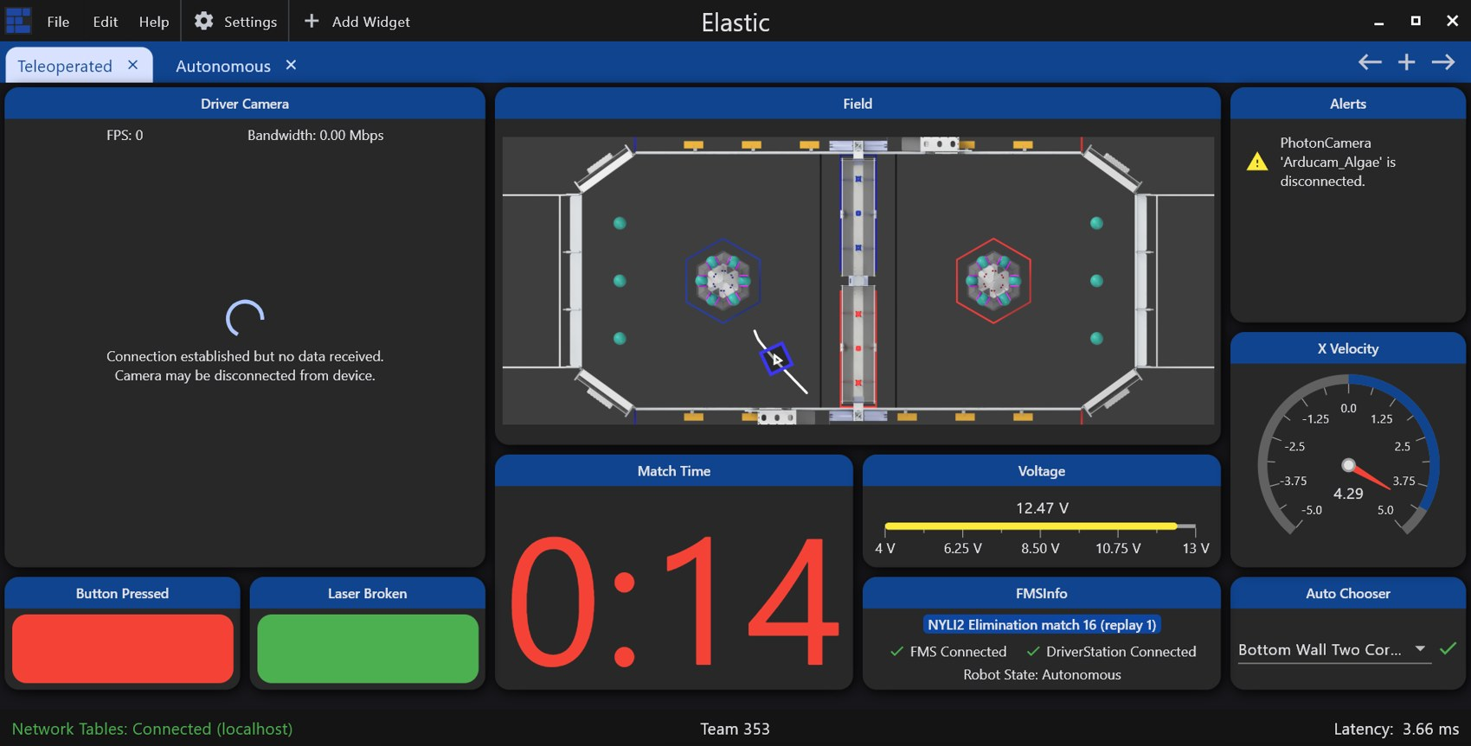
ELASTIC
What a match dashboard looks like
1
Field
Where the robot thinks it is
2
Match time
Huge, so drivers see it in a glance
3
Gauges
Battery voltage, gyro heading
4
Auto chooser
Picked before the match starts
MARS/WARS SOFTWARE TRAINING
38
Notes:
A real competition dashboard from the Elastic docs. Everything is big and readable at a glance: the field with the robot's pose, match time, battery voltage, gyro heading, and the auto chooser the drive team sets before the match. Ask: what would you want to see in the half second you look away from the robot?

Slide 39
ELASTIC
Topics: values with names
Robot
NetworkTables
Elastic
Publishes ClimberSpeed
A shared table of topics
Subscribes by name
ClimberSpeed
0.65
BatteryVoltage
12.4
GamePieceLoaded
true
AutoRoutine
"Left, shoot 2"
MARS/WARS SOFTWARE TRAINING
39
Notes:
NetworkTables is a shared table of named values. The robot publishes a topic, like ClimberSpeed; any dashboard can subscribe to it by name. It also works the other way: a dashboard can publish a value and the robot reads it.

Slide 40
ELASTIC
Widgets match the data
Boolean Box
Radial Gauge
Game piece loaded? · true / false
Gyro heading · number in degrees
Number Bar
Match Time
Climber speed · number in a range
Time left · number of seconds
Voltage View
Field
Battery voltage · number
Robot pose · Pose2d
MARS/WARS SOFTWARE TRAINING
40
Notes:
Pick the widget that matches the data and what the driver needs to know. A boolean as a big green/red box is readable from across the room; a number bar shows a value against its range. To add one, click + Add Widget and drag a topic onto the grid; Elastic picks a widget from the topic's type, and right-click > Edit Properties changes it.

Slide 41
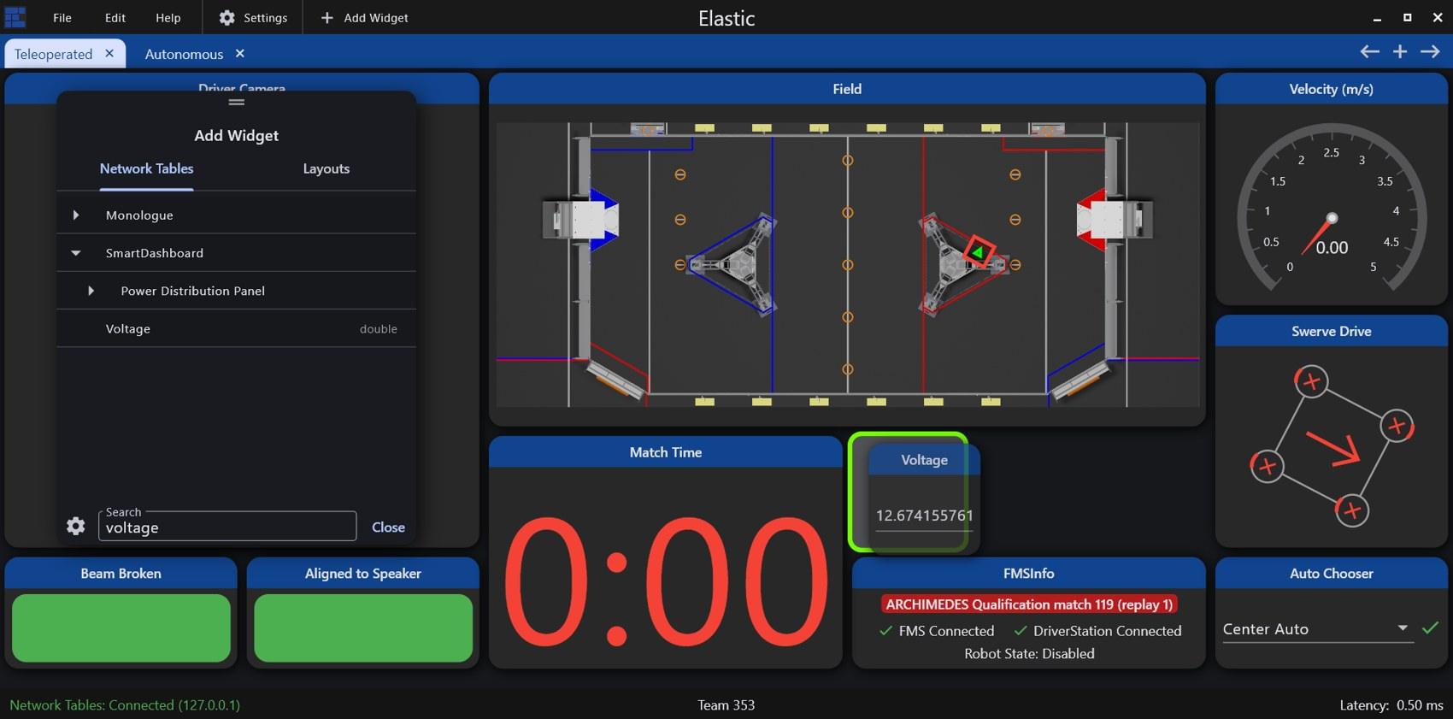
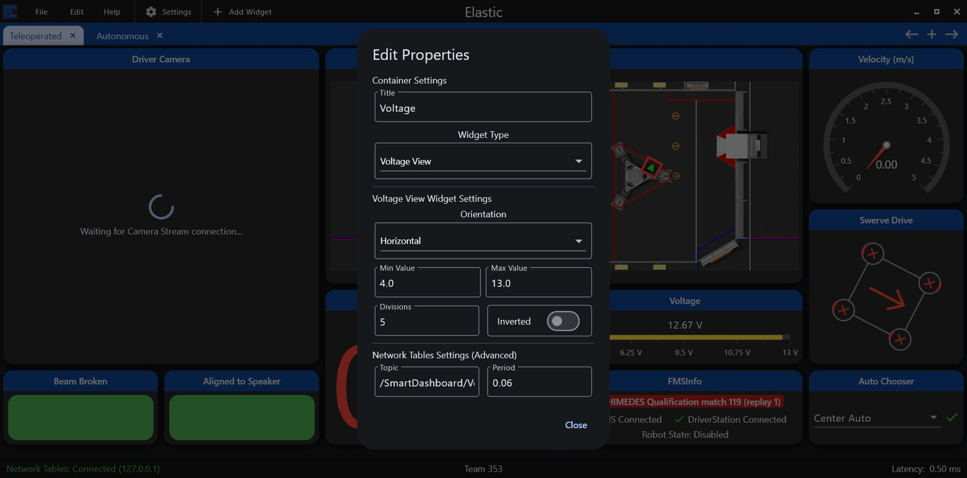
ELASTIC
Adding a widget
1
Drag a topic in
2
Edit its properties
+ Add Widget, then drag a topic onto the grid
Right-click > Edit Properties: type, title, range
MARS/WARS SOFTWARE TRAINING
41
Notes:
Two steps to every widget. Click + Add Widget, find the topic in the list (search helps), and drag it onto the grid. Elastic picks a widget that fits the data type. Then right-click it and choose Edit Properties to change the widget type, its title, or its range. Screenshots from the Elastic docs.

Slide 42
ELASTIC
Showing values, and sending them
Show
Send
Robot → driver
Driver → robot
• Text Display, Number Bar
• Number Slider, Toggle Button
• Voltage View, Radial Gauge
• Choosers: pick the auto routine
• Graph, Match Time, Boolean Box
• Text with a Submit button
Tabs and layouts: a few tabs for competition, the rest for debugging. Use File > Save.
MARS/WARS SOFTWARE TRAINING
42
Notes:
Most widgets only display. Some send values to the robot: sliders, choosers, toggles, text with a submit button. The robot reads whatever was last sent. This is how drivers pick the auto routine before a match. Elastic layouts are saved to a file, so use File > Save.

Slide 43
05
Choreo
Nobody drives me in auto. I just follow the plan!
Planning paths for autonomous
MARS/WARS SOFTWARE TRAINING
43
Notes:
In autonomous nobody is driving: the robot follows the plan we give it.

Slide 44
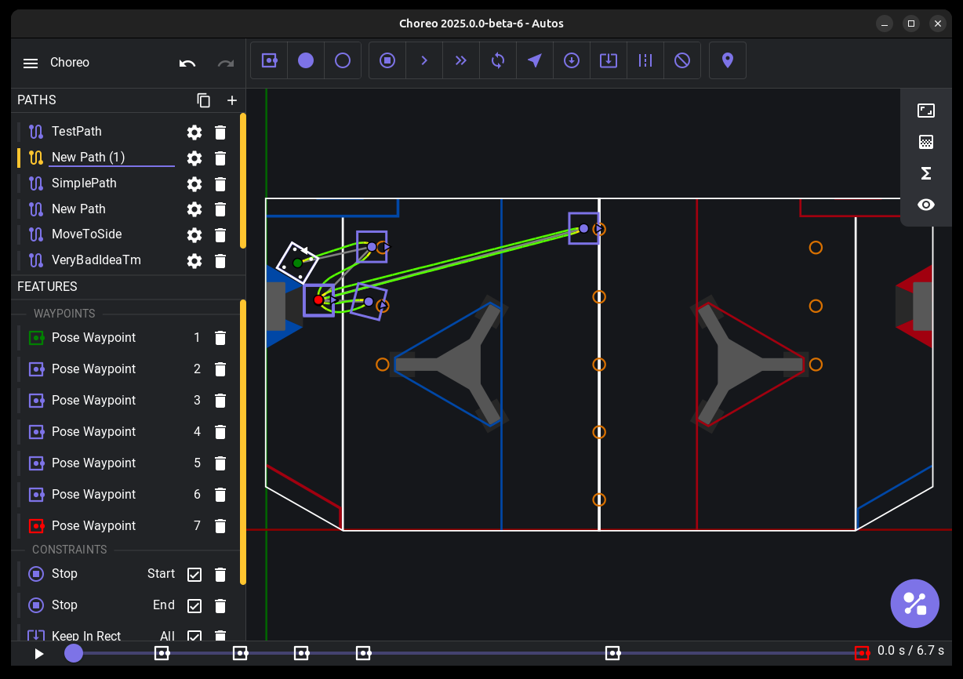
CHOREO
What is autonomous?
• The start of every match
• No driver: the robot follows a plan
• Points scored here often decide matches
• Choreo makes the plan: a trajectory
MARS/WARS SOFTWARE TRAINING
44
Notes:
Every match starts with an autonomous period: the robot drives itself with no driver input. It needs a plan of exactly where to go and how fast. Choreo is the tool we use to make that plan.

Slide 45



CHOREO
Path vs trajectory
Path
Trajectory
The route: the points the robot drives through.
The route plus timing: position, heading and speed at every moment.
Robot code follows the trajectory, checking every loop where it should be right now.
MARS/WARS SOFTWARE TRAINING
45
Notes:
A path is just the route. A trajectory adds timing: at every moment, where the robot should be, which way it faces and how fast it's moving. That's what the robot code follows.

Slide 46
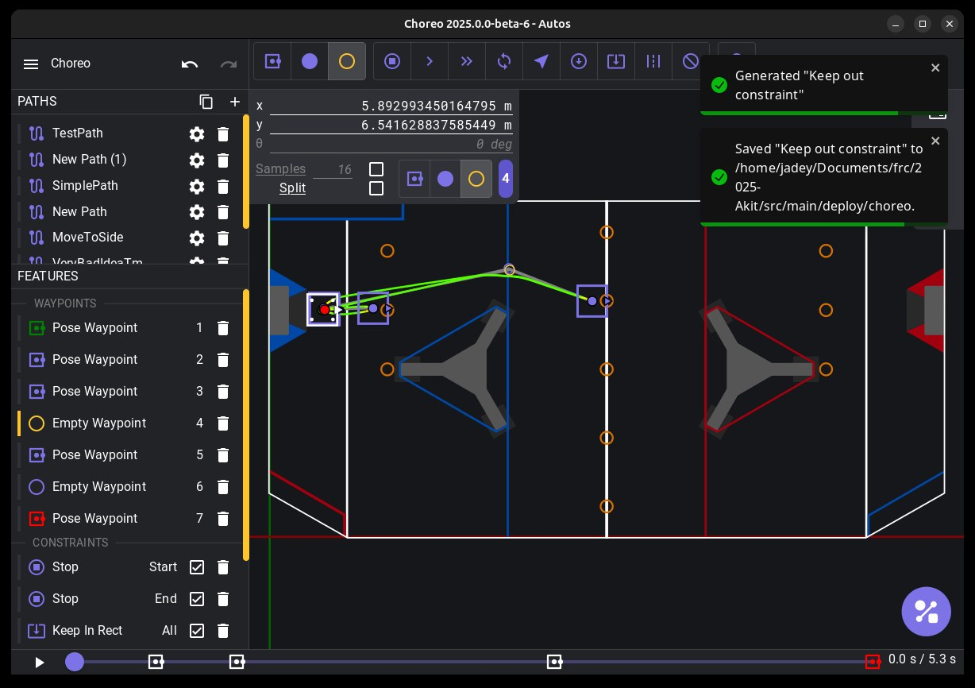
CHOREO
Waypoints and constraints
Pose waypoint
Pins position and heading. Use for start and end.
Translation waypoint
Pins only position. Choreo picks the heading.
Constraint
A rule the path obeys, like Max Velocity in one zone.
Starter rule
Every path begins with Stop at the start and end.
MARS/WARS SOFTWARE TRAINING
46
Notes:
Waypoints are points the path goes through. Pose waypoints pin position and heading; use them at the start and end. Translation waypoints pin only position and let Choreo pick the heading. Constraints are rules, like a max velocity in one zone. Every path starts with Stop at the start and end. Screenshot from the Choreo docs.

Slide 47
CHOREO
Generate: solving for the fastest path
Waypoints
Constraints
Generate
.traj file
Where to go
Rules to obey
Solve with real limits
The robot follows it
Won't generate? A rule the robot can't meet leaves it unsolved. Change the numbers or untick the constraint.
You'll make robots follow these in the Choreo Autonomous lesson.
MARS/WARS SOFTWARE TRAINING
47
Notes:
Generate works out the fastest trajectory through every waypoint that obeys every constraint, using the robot's real limits (motor speed, mass, wheel grip). If no such path exists, it fails. Fix it by changing the numbers or switching a constraint off, then generate again.

Slide 48
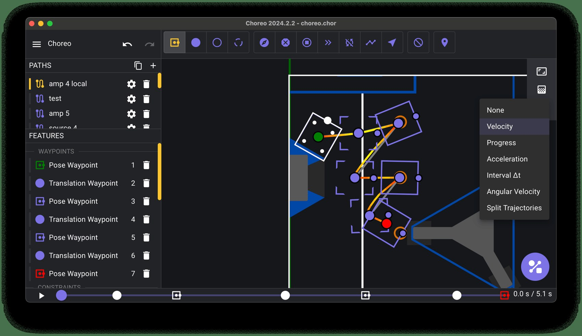
CHOREO
Reading a generated path
1
Color = speed
See where the robot slows for a turn
2
Timeline
Press play or drag to watch it drive
3
.traj file
What the robot code loads in auto
MARS/WARS SOFTWARE TRAINING
48
Notes:
After Generate, Choreo draws the trajectory on the field. Color along the path shows speed, so you can see where the robot slows for a turn. Press play or drag the timeline to watch it drive. Choreo saves it as a .traj file that the robot code loads. Screenshot from the Choreo docs.

Slide 49

PRACTICE IN SCRIPTUM
Lesson checkpoints
5
8
8
19
4
CHECKPOINTS
CHECKPOINTS
CHECKPOINTS
CHECKPOINTS
CHECKPOINTS
Meet the Editor
Git Basics
AdvantageScope
Elastic
Choreo
• Make a folder and a file
• First commit, feature branch
• Line graph, locked axis, differentiate
• Ten display widgets
• Waypoints on two paths
• Sliders, choosers and toggles
• A real constraint
• Rename and delete files
• Merge and a merge conflict
• Discrete field, 2D and 3D field
• Both paths generate
• Run src/Main.java
• Live writes to the robot
• Rebase, push, pull, stash
• Swerve tab, tuned value
In Scriptum: Tools track · open the lesson chip and press Verify
MARS/WARS SOFTWARE TRAINING
49
Notes:
This is the hands-on part. Each tool has a Scriptum lesson in the Tools track; open the lesson chip and press Verify on each checkpoint. Nothing is graded and you can verify as many times as you like.

Slide 50



RECAP
What you can do now
Find your way around the editor and run a program
NEXT UP
Commit, branch, merge and resolve a conflict
Push and pull with the team's GitHub
Motors and Drivetrains
Read robot telemetry in AdvantageScope
The first FRC Robot lesson: tank drive, then arcade drive.
Build a driver dashboard in Elastic
Plan and generate a Choreo path
MARS/WARS SOFTWARE TRAINING
50
Notes:
Wrap up. Everything after this uses these tools: the editor every time, git for every change, AdvantageScope to check what the robot did, and Choreo again in Choreo Autonomous.

