Slide 1


FRC ROBOT · DECK 2
Sensors and Feedback
Turn encoder readings into speed and distance, ignore stick drift, then drive exactly 2 meters by itself.
I can drive. Now let me feel how far I went!
Notes:
Welcome back. Last time the robot drove, but it had no idea how far or how fast it was going. Today it learns to feel: every drive motor has a sensor inside it, and we turn its readings into meters, speeds and distance. Then we use if statements twice: to ignore stick drift, and to drive exactly 2 meters on its own. The hands-on part is the Sensors and Feedback lesson in Scriptum.

Slide 2







TODAY
Teaching the robot to feel
01
02
03
04
05
06
Sensors
Encoders and meters
Speed and distance
Logging
Deadband
Bang-bang
What the robot can feel
Counting wheel turns
From two sides to one robot
Recording what the code thinks
Constants and if statements
Driving exactly 2 meters
By the end: the robot measures its own speed and distance, and drives 2 meters by itself.
MARS/WARS SOFTWARE TRAINING
2
Notes:
Six parts. First what sensors are, then the encoder in each drive motor and how to turn its radians into meters. Then speed and distance for the whole robot, logging those numbers so you can see them, a deadband with an if statement, and finally bang-bang control to drive 2 meters with nobody touching the keys. Ask: what does your phone sense? (Tilt, light, touch, location, sound.)

Slide 3
01
Sensors
Without sensors I'm driving with my eyes closed!
What the robot can feel
MARS/WARS SOFTWARE TRAINING
3
Notes:
A robot without sensors is driving with its eyes closed. This part is the big picture: why sensors matter, the two kinds, and the ones on our robots.

Slide 4

SENSORS
Open loop vs closed loop
Code
Motor
Robot moves
?
Open loop
Send a command and hope
Code
Motor
Robot moves
Sensor
Closed loop
Measure and react
feedback: what really happened
Today: the encoder is the sensor, and your code closes the loop.
MARS/WARS SOFTWARE TRAINING
4
Notes:
Two ways to control anything. Open loop: the code sends a command and hopes. Last deck was open loop: set 0.5 and the robot goes, but the code has no idea how far. Closed loop: a sensor measures what really happened and the code reacts to it. That return path is called feedback. Activity: one student walks to a line on the floor with eyes closed after looking once; another walks with eyes open. Who stops closer? Eyes open is closed loop.

Slide 5
SENSORS
Two kinds of sensor
Digital
Analog
Yes or no. true or false.
A number from a range.
true
max
false
0
time
time
Limit switch
Beam break
Hall effect
Encoder
Distance sensor
Gyro
MARS/WARS SOFTWARE TRAINING
5
Notes:
Sensors come in two kinds. Digital sensors answer yes or no: is the beam broken, is the switch pressed, is the magnet there. Analog sensors give a number from a range: how far, how fast, what angle. Some sensors are digital inside, like an encoder counting pulses, but the software turns them into a number for us. Ask: is a light switch digital or analog? A dimmer? (Digital; analog.)

Slide 6
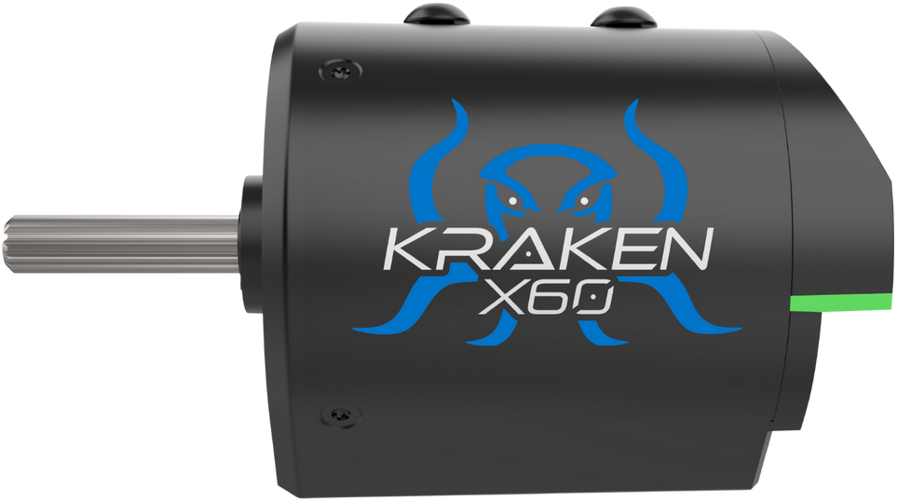
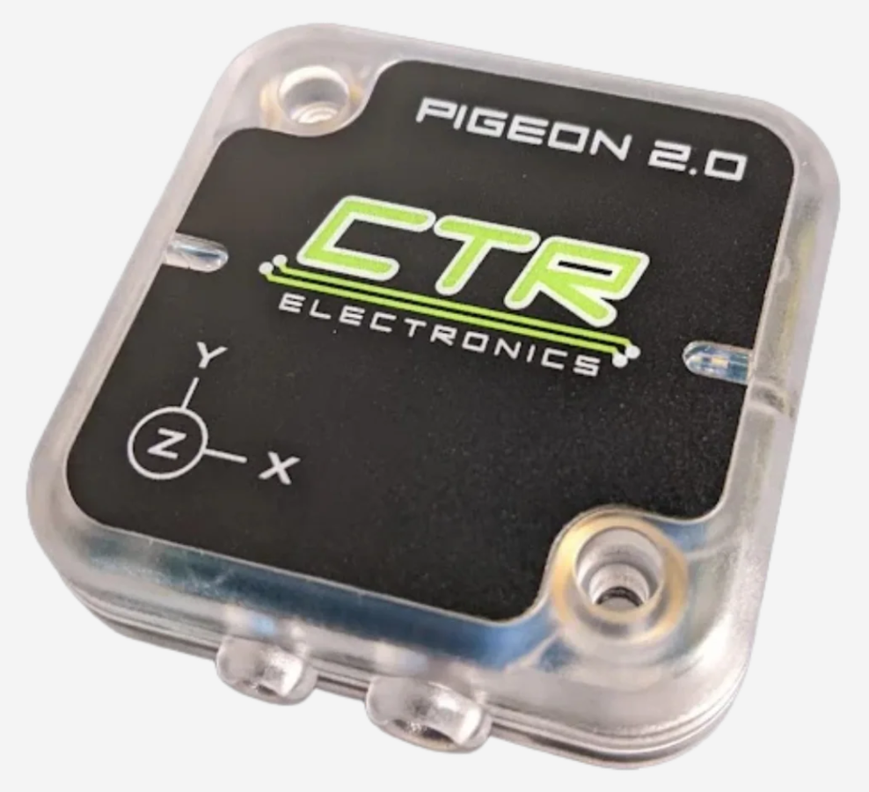


SENSORS
Sensors on our robots
Encoder
Gyro
Beam break
Limit switch
Built into every Kraken. Counts how far the motor turned.
A Pigeon 2.0. Knows which way the robot is facing.
Is a game piece here? A light beam is blocked or not.
Has the arm reached the end? Pressed or not.
plugs in: in the motor
plugs in: on CAN
plugs in: roboRIO DIO
plugs in: roboRIO DIO
MARS/WARS SOFTWARE TRAINING
6
Notes:
Four sensors you'll meet on our robots. The encoder is built into every Kraken: it's today's sensor. The Pigeon 2.0 is a gyro: it knows which way the robot faces, and talks over CAN. Beam breaks and limit switches answer yes or no and plug into the roboRIO's DIO ports. Rule of thumb: sensors about a mechanism's position or speed (elevator height, wrist angle) live with the motor controller; sensors about the robot's status (do we have a game piece?) go to the roboRIO. Ask: where would you put a sensor that says the intake has a ball?

Slide 7
02
Encoders and meters
Every turn of my wheels gets counted. Nothing escapes!
Counting wheel turns, then turning them into meters
MARS/WARS SOFTWARE TRAINING
7
Notes:
The encoder is the sensor this whole lesson uses. Three ideas: what it counts, what it's attached to, and how to change its radians into meters.

Slide 8

ENCODERS AND METERS
How an encoder counts
sensor
1
2
3
4
5
6
7
8
one pulse each time a slot passes the sensor
1
Count the pulses
How far it turned
2
Time the pulses
12 slots = 12 counts per turn
How fast it turns
In a Kraken: a magnet instead of slots, and thousands of counts per turn. Same idea.
MARS/WARS SOFTWARE TRAINING
8
Notes:
The idea behind an encoder: a disk with slots spins with the shaft. A sensor watches the slots go by and makes one pulse per slot. Count the pulses and you know how far it turned; count how fast they come and you know the speed. Real encoders like the one in the Kraken use a magnet instead of slots, but the idea is the same, and with thousands of counts per turn. The motor controller does the counting, and our mechanism code hands you the answer in radians. Activity: tape a mark on a wheel and have a student count turns while another rolls it.

Slide 9
ENCODERS AND METERS
Relative vs absolute
Relative
Absolute
0
radians
angle in one turn
20.4
1.57
3π/2
π/2
0 → 2π → 4π → 6π → ...
always 0 to 2π
π
Counts from where it started. Zero at power on or reset, then keeps counting, turn after turn.
Always knows the angle inside one turn, from 0 to 2π rad. Even right after power on.
Use it for: distance driven. Our drive motors.
Use it for: arm angles, swerve wheel direction.
MARS/WARS SOFTWARE TRAINING
9
Notes:
Two kinds of encoder. A relative encoder counts from wherever it started: it reads zero at power on or after a reset, and counts up or down from there, past one turn and on. Great for distance. The encoder in our drive motors is relative, so the lesson resets it at the start of Auto. An absolute encoder always knows the shaft's angle inside one turn, even right after power on, from 0 to 2 pi radians. Great for an arm or a swerve wheel's direction. The CANcoder can do both. Ask: which kind for an arm that must know where it is the moment the robot turns on? (Absolute.)

Slide 10

ENCODERS AND METERS
It measures the motor, not the wheel
encoder
Motor
Gearbox
Wheel
Kraken X60
Ratio 8.45 : 1
Touches the floor
8.45 rad
1 rad
motor radians ÷ gear ratio = wheel radians
84.5 ÷ 8.45 = 10.0 The sensor says 84.5. What you care about: 10.
Done for you: the drivetrain's methods already divide by the gear ratio. You get wheel radians.
MARS/WARS SOFTWARE TRAINING
10
Notes:
The encoder sits inside the motor, so it measures the motor, not the wheel. Between them is a gearbox: our drivetrain's gear ratio is 8.45, so the motor turns 8.45 radians for every 1 radian the wheel turns. What the sensor measures and what you care about are different, so you always convert. Good news: the drivetrain's methods already divide by the gear ratio, so the numbers you get are wheel radians. Ask: the encoder read 84.5 radians at the motor. How far did the wheel turn? (10 radians.)

Slide 11

ENCODERS AND METERS
What the drivetrain tells you
DifferentialDriveMech methods
1
Position
How far each side's wheels turned, in radians
// How far, in wheel radians. Forward is positive.
drive_.getLeftPositionRad()
1
drive_.getRightPositionRad()
2
Velocity
// How fast, in radians per second.
How fast, in radians per second (rad/s)
drive_.getLeftVelocityRadPerSec()
2
drive_.getRightVelocityRadPerSec()
// Back to zero: the distance starts over.
3
Reset
drive_.resetEncoders()
3
Set both positions back to 0
Java: Methods
Where from? on the robot, the Krakens over CAN. In Scriptum, the simulation, with a little slip.
MARS/WARS SOFTWARE TRAINING
11
Notes:
This is what the drivetrain gives you in this lesson, straight from the README. Two methods for how far each side's wheels have turned, in radians, forward positive. Two for how fast, in radians per second. And resetEncoders, which sets both positions back to zero. On the real robot these come from the Krakens over CAN; in Scriptum, from the simulation, which even adds a little wheel slip and jitter like real sensors.

Slide 12



ENCODERS AND METERS
We work in metric
Distance
Speed
Angle
Turning speed
meters (m)
meters per second (m/s)
radians (rad)
degrees only to talk
radians per second (rad/s)
Inches come in once, at the top, and get converted:
WHEEL_RADIUS_METERS = Units.inchesToMeters(3.0); // 0.0762 m
MARS/WARS SOFTWARE TRAINING
12
Notes:
Sensors don't care about units: the motor controller just counts how far the shaft turned. Our mechanisms pick the units, and the team uses metric everywhere: meters, meters per second, radians and radians per second. All the math uses radians; saying degrees out loud to a person is fine. Inches and feet make the math full of odd conversion numbers. The lesson's Constants.java even converts the wheel radius from inches once, with Units.inchesToMeters, so everything after it is in meters. Ask: why is it risky to mix inches and meters? (Mars Climate Orbiter, 1999: lost because of a units mix-up.)

Slide 13
ENCODERS AND METERS
Radians × radius = meters
roll 2π rad (one turn)
r
0.479 m
meters = radians × r r = 0.0762 m, so 2π rad ≈ 0.479 m
MARS/WARS SOFTWARE TRAINING
13
Notes:
This is the key idea of the lesson. A radian is the angle where the arc along the wheel's edge is exactly one radius long. So when the wheel turns some number of radians, the robot rolls that many radiuses: meters = radians times the radius. Our wheel's radius is 0.0762 meters. One full turn is 2 pi radians, about 6.28, so it rolls about 0.479 meters, the circumference. Activity: roll a real wheel with a tape mark along the floor for one turn, then measure it with a tape measure.

Slide 14

ENCODERS AND METERS
Working the numbers
radians
× 0.0762
= meters
FULL SPEED
1
→
0.0762
74.3
wheel radians per second
6.28
→
0.479
× 0.0762
10
→
0.762
≈ 5.7
meters per second
26.2
→
2.00
The checkpoint expects about 5.5 m/s.
Speed works the same way: rad/s × 0.0762 = m/s.
Challenge: how many wheel radians to drive 2 meters? (Answer in the table.)
MARS/WARS SOFTWARE TRAINING
14
Notes:
Work the numbers by hand before coding. Multiply radians by the radius, 0.0762, to get meters. Speed works the same way: radians per second times 0.0762 is meters per second. A Kraken's free speed is about 628 rad/s at the motor; divided by the 8.45 gear ratio that's about 74.3 rad/s at the wheel, which is about 5.7 meters per second: the lesson's checkpoint expects about 5.5, since the real robot never quite reaches free speed. Activity: cover the meters column and have students fill it in. Then the challenge: how many radians to drive 2 meters? 2 divided by 0.0762 is about 26.2.

Slide 15
ENCODERS AND METERS
STEP 1: radians into meters
Robot.java
1
Wheel radius
In meters, from Constants
public void robotPeriodic() {
1
double radius = Constants.WHEEL_RADIUS_METERS;
2
Position
2
double left_meters =
Radians × radius = meters
drive_.getLeftPositionRad() * radius;
3
double left_meters_per_second =
drive_.getLeftVelocityRadPerSec() * radius;
3
Speed
4
// ...and the same for the right side
rad/s × radius = m/s
}
4
Right side
Java: Methods
Same, with Right
MARS/WARS SOFTWARE TRAINING
15
Notes:
STEP 1 in robotPeriodic. Grab the wheel radius from Constants once. Then multiply each reading by it: radians become meters and radians per second become meters per second. The right side is the same with Right in the method name. Ask: why is there no 2 times pi here? (The readings are already in radians, and radians times the radius is the distance. 2 pi only shows up when you count full turns.)

Slide 16
03
Speed and distance
Two sides, one Dozer. Let's average me out!
From two sides to one robot
MARS/WARS SOFTWARE TRAINING
16
Notes:
Each side has its own speed and distance. We want three numbers for the whole robot: how fast it's going, how fast it's turning, and how far it has gone.

Slide 17

SPEED AND DISTANCE
Linear speed: the average
4.0
linear = (left + right) / 2
left
right
linear
3.0 5.0 4.0
Curving left
3.0
5.0
4.0 4.0 4.0
Straight ahead
2.0 -2.0 0.0
Spinning in place
m/s: left side, middle, right side
MARS/WARS SOFTWARE TRAINING
17
Notes:
The robot's forward speed is the average of its two sides: add them and divide by 2. If the left does 3 m/s and the right does 5, the middle of the robot moves at 4. Both at 4: 4, straight ahead. Spinning in place, 2 and -2: the middle doesn't go anywhere, 0. Activity: two students as the wheels walk at different paces while a third walks between them; the middle one's pace is the average.

Slide 18
SPEED AND DISTANCE
Angular speed: the difference
turning left
angular = (right - left)
/ track width
(1.5 - (-1.5)) / 0.61 ≈ 4.9 rad/s
-1.5
1.5
• Positive = turning left (counterclockwise)
• Same speeds = 0, no turning
• A full turn is 2π ≈ 6.28 radians
track width 0.61 m
MARS/WARS SOFTWARE TRAINING
18
Notes:
Turning happens when the sides go different speeds. Angular speed is the difference, right minus left, divided by the track width: how far apart the wheels are, 0.61 meters on our robot. Positive means turning left, counterclockwise seen from above, which is the math and WPILib convention. Radians: one radian is the angle where the arc is as long as the radius; a full turn is 2 pi, about 6.28. So 4.9 rad/s is a bit less than one full turn each second. Ask: left 2, right 2. Angular speed? (0: straight.)

Slide 19
SPEED AND DISTANCE
Distance: how far the middle went
2.0
2.0
-0.5
0.5
2.4
1.6
Straight: 2.0 m
Spin: 0.0 m
Curve: 2.0 m
Both sides 2.0 m
They cancel: spinning isn't progress
The middle went the average
distance = (left meters + right meters) / 2
MARS/WARS SOFTWARE TRAINING
19
Notes:
Distance is the average of the two sides' positions, just like linear speed. Drive straight 2 meters: both sides 2, distance 2. Spin in place: one side goes forward and one back, so they cancel and the distance stays 0. Spinning isn't progress! Curve: the outside wheel goes farther, but the middle of the robot still went the average. Ask: left 2.4, right 1.6. Distance? (2.0.)

Slide 20

SPEED AND DISTANCE
STEP 2: the whole robot
Robot.java · robotPeriodic()
1
Linear speed
Average of the two sides, m/s
double linear_speed =
1
(left_meters_per_second + right_meters_per_second) / 2.0;
double angular_speed =
2
Angular speed
2
(right_meters_per_second - left_meters_per_second)
Difference ÷ track width, rad/s
/ Constants.TRACK_WIDTH_METERS;
3
distance_meters_ = (left_meters + right_meters) / 2.0;
3
Distance
MwLog.log("Robot/LinearSpeed", linear_speed);
A field, kept so Auto can use it
4
MwLog.log("Robot/AngularSpeed", angular_speed);
MwLog.log("Robot/Distance", distance_meters_);
4
Log it
Shows up in AdvantageScope
No double in front of distance_meters_: it's declared at the top of the class, so it lasts.
MARS/WARS SOFTWARE TRAINING
20
Notes:
STEP 2, right under STEP 1. Three lines turn the four side readings into three robot numbers. Notice distance_meters_ has no double in front: it's declared at the top of the class, outside the method, so it keeps its value between loops and autonomousPeriodic can read it later. The underscore at the end is the team's style for those. Then MwLog.log sends each number to AdvantageScope under a name.

Slide 21
SPEED AND DISTANCE
Measure in robotPeriodic, act in autonomousPeriodic
Disabled
Auto
Teleop
robotPeriodic()
measure, every mode
autonomousInit()
once, when Auto starts
autonomousPeriodic()
decide: drive or stop
teleopPeriodic()
the driver's sticks
distance_meters_ is written by robotPeriodic and read by autonomousPeriodic.
MARS/WARS SOFTWARE TRAINING
21
Notes:
Where does each piece of code go? robotPeriodic runs every 20 ms in every mode, even disabled, so it's the right place to measure: the numbers are always fresh. autonomousInit runs once when Auto starts: that's where the reset lives. autonomousPeriodic runs every 20 ms during Auto only: that's where the robot decides to drive or stop. teleopPeriodic is for the driver. Because distance_meters_ is a field, robotPeriodic writes it and autonomousPeriodic reads it. Ask: why not measure inside autonomousPeriodic? (You'd have no numbers in teleop or while disabled.)

Slide 22
04
Logging
If it isn't logged, nobody can prove it happened. Not even me!
Recording what the robot was thinking
MARS/WARS SOFTWARE TRAINING
22
Notes:
You just wrote MwLog.log three times. This section is about what that line does, and how to log anything you want to see.

Slide 23

LOGGING
Why log?
Live
Recorded
Replayed
See values now, in AdvantageScope or Elastic, while the robot runs.
Every logged value, every loop, saved to a log file on the robot.
Open the log after a match and scrub through what happened.
A video shows what the robot did. A log shows what the code was thinking.
MARS/WARS SOFTWARE TRAINING
23
Notes:
A match video shows what the robot did. It can't show what the code was thinking: what speed it measured, which state it was in, why it stopped. Logging records those numbers. Live, they show up in AdvantageScope and Elastic while the robot runs. Recorded, every logged value from every loop is saved to a log file on the robot's USB stick, so after a match you can open it and scrub through. And because our logging is built on AdvantageKit, a log can even be replayed through the code to find a bug. Ask: the robot stopped short in auto at an event. What would you want to know? (Its distance, its speed, what state it was in, the battery voltage.)

Slide 24

LOGGING
One line: MwLog.log
MwLog.log(
"Robot/LinearSpeed",
linear_speed);
1
2
3
1
The method
2
The key
3
The value
MwLog.log records one value
A name in quotes. Slashes make folders
What to record, every loop
Use MwLog. Not SmartDashboard or DogLog from older code: MwLog records to the log and shows it live.
MARS/WARS SOFTWARE TRAINING
24
Notes:
Logging a value is one line. MwLog is MW-Lib's logging class. 1: log is the method. 2: the key, a name in quotes. Slashes group keys into folders, so Robot/LinearSpeed lands in a Robot folder. 3: the value to record, here a variable. Put the line where the value is fresh, usually in robotPeriodic, and it's recorded every 20 ms. Always log with MwLog. Older code you find online may use SmartDashboard or DogLog; MwLog replaces both on our robots.

Slide 25

LOGGING
Keys make folders
ADVANTAGESCOPE: THE LOG TREE
WHAT YOU CAN LOG
Robot
you log these
double
linear_speed
LinearSpeed
boolean
isAtSpeed()
AngularSpeed
Distance
String
"ready"
Drive
logged for you
LeftOutput
enum
system_state_
RightOutput
Pose2d
pose_
TruePose
MARS/WARS SOFTWARE TRAINING
25
Notes:
Keys become folders in AdvantageScope. Everything you log with Robot/ at the front is in the Robot folder. You don't log everything yourself: the drivetrain logs its own outputs and true position under Drive, and later the subsystems log their state under Subsystem. And it's not only numbers: you can log a true/false, text, a state from an enum, or a Pose2d, which AdvantageScope can draw on the field. Ask: where would you look for the left motor's output? (Drive, LeftOutput.)

Slide 26
LOGGING
Checking it in AdvantageScope
m/s
rad/s
1
Drive forward
6
6
Linear speed climbs to about 5.5 m/s
drive forward
spin left
4
1
2
Spin in place
Angular jumps up, linear stays near 0
2
2
Spinning left (A key)? Angular speed should be positive. Negative means left and right are swapped.
0
0
0
2
4
6
8
10
12
time (s)
Robot/LinearSpeed
Robot/AngularSpeed
MARS/WARS SOFTWARE TRAINING
26
Notes:
Check STEP 1 and 2 in AdvantageScope. In Scriptum it's built in; on the real robot it's the desktop app on the laptop. Graph Robot/LinearSpeed on the left axis and Robot/AngularSpeed on the right. Drive forward flat out: linear speed climbs to about 5.5 m/s and levels off. Then spin in place: linear speed drops to about zero while angular speed jumps up. Spinning left (A key) should make it positive. If it's negative, right and left are swapped in the subtraction.

Slide 27
LOGGING
Stuck? Log it and look
Robot.java · robotPeriodic() · the lesson's bonus
MwLog.log("Robot/LeftSpeed", left_meters_per_second);
MwLog.log("Robot/RightSpeed", right_meters_per_second);
Surprise
Log it
Run again
Look
The robot does something odd
The numbers it decides with
Same test, same steps
Graph it in AdvantageScope
On the robot: every run is saved on the USB stick in /U/logs. Open it in AdvantageScope after the match.
MARS/WARS SOFTWARE TRAINING
27
Notes:
Logging is how you debug a robot. When it does something you don't expect, log the numbers it decides with, run it again, and look. The lesson's bonus is a good habit: log each side's speed on its own, so a slow side shows up right away. Where do the logs go? On the real robot every run is saved to a log file on the USB stick in the roboRIO, in /U/logs; copy it to a laptop and open it in AdvantageScope after the match. In Scriptum, AdvantageScope reads the simulated robot live. Ask: the robot drifts left in auto. What would you log? (Left and right speeds, and the outputs.)

Slide 28
05
Deadband
Hands off the stick and I still creep? Not anymore!
Constants and if statements
MARS/WARS SOFTWARE TRAINING
28
Notes:
Your first if statement. Real sticks never rest at exactly zero, so we teach the code to ignore tiny pushes. Along the way: named constants and comparisons.

Slide 29
DEADBAND
Sticks never rest at zero
creeping...
Nobody's touching it, but the robot slowly drives off.
hands off: reads 0.03
Deadband: if the stick is pushed only a tiny bit, pretend it's zero.
MARS/WARS SOFTWARE TRAINING
29
Notes:
Gamepad sticks are springs and plastic: let go and they come back close to the middle, but rarely exactly. A stick at rest might read 0.03 instead of 0.0. Send that to the motors and the robot slowly creeps across the floor with nobody touching it, which is annoying in a match and unsafe on a bench. A deadband fixes it: if the stick is pushed only a tiny bit, pretend it's zero. Activity: if you have a gamepad, plug it into the Driver Station and read the axes with hands off.

Slide 30
DEADBAND
The flat zone
sent to motors
1
Flat zone
1
From -0.1 to 0.1, everything becomes 0
2
0.5
2
Outside
1
The stick passes straight through
0
3
The edge
3
-0.5
A tiny jump. Drivers don't notice it
-1
Width of the zone: DEADBAND = 0.1
-1
-0.5
0
0.5
1
stick reads
MARS/WARS SOFTWARE TRAINING
30
Notes:
This graph is the deadband. Across the bottom: what the stick reads. Up the side: what we send to the motors. Inside the flat zone, from -0.1 to 0.1, everything becomes 0: tiny pushes and drift are ignored. Outside it, the stick passes straight through unchanged. At the edge there's a small jump from 0 to 0.1, too small for a driver to notice. Ask: the stick reads -0.07. What goes to the motors? (0.) And -0.4? (-0.4.)

Slide 31
DEADBAND
A constant: a number with a name
public static final double DEADBAND = 0.1;
public
static
final
type
name
value
public
static
final
Other files can use it.
It belongs to the class: Constants.DEADBAND
It never changes while the robot runs.
Constants.java
Robot.java
DEADBAND = 0.1;
Constants.DEADBAND
Change it in one place and the whole project follows. No magic numbers.
MARS/WARS SOFTWARE TRAINING
31
Notes:
The deadband size is a number we might want to tune, so it gets a name. public static final double DEADBAND = 0.1. public: other files can use it. static: it belongs to the Constants class itself, so you write Constants.DEADBAND. final: it can never change while the robot runs. ALL_CAPS is the naming style for constants. A 0.1 sitting in the middle of Robot.java is a magic number: nobody knows what it means or where else it's used. Ask: if the drivers want a bigger deadband, how many lines change? (One.)

Slide 32
DEADBAND
Comparing: true or false
<
less than
0.05 < 0.1
true
MATH.ABS: SIZE WITHOUT THE SIGN
>
greater than
2.4 > 2.0
true
Math.abs(-0.05) → 0.05
<=
at most
3 <= 2
false
Math.abs(0.05) → 0.05
>=
at least
2.0 >= 2.0
true
Math.abs(-0.8) → 0.8
==
equal (two!)
4 == 4
true
One check covers pushing forward and pulling back.
!=
not equal
1 != 1
false
Java: Conditions
MARS/WARS SOFTWARE TRAINING
32
Notes:
To decide, the code compares. A comparison gives back a boolean: true or false. Less than, greater than, at most, at least, equal, not equal. Careful: equal is two equals signs; one equals sign means store. Math.abs gives the size of a number without its sign, so one check covers pushing the stick forward and pulling it back. Activity: call out comparisons and have the class shout true or false: 0.05 < 0.1, -0.8 < 0.1, Math.abs(-0.8) < 0.1.

Slide 33
DEADBAND
The if statement
read the stick
|forward| < DEADBAND ?
if (condition) {
false
// runs only when it's true
}
// always runs next
true
skip it
• ( ) holds the condition: true or false
forward = 0.0;
• { } holds the code that may run
• No semicolon after the )
drive the motors
Java: Conditions
MARS/WARS SOFTWARE TRAINING
33
Notes:
An if statement runs a block of code only when its condition is true. Java checks the condition in the parentheses. True: run what's inside the curly braces. False: skip it. Either way, the code after the if runs next. Here, if the forward stick is smaller than the deadband, set forward to 0.0, as if it never moved. Ask: what if forward is 0.5? (Condition false, forward stays 0.5.)

Slide 34
DEADBAND
STEP 4: deadband both sticks
Robot.java
1
Read
Arcade drive, from last lesson
public void teleopPeriodic() {
1
double forward = -controller_.getLeftY();
double turn = controller_.getLeftX();
2
Forward
2
if (Math.abs(forward) < Constants.DEADBAND) {
Tiny? Make it 0.0
forward = 0.0;
}
3
3
Turn
if (Math.abs(turn) < Constants.DEADBAND) {
turn = 0.0;
Same check, second if
}
4
drive_.setDutyCycles(forward + turn, forward - turn);
}
4
Drive
Then mix and send, as before
Java: Conditions
MARS/WARS SOFTWARE TRAINING
34
Notes:
STEP 4 in teleopPeriodic. Arcade drive from last lesson is already there. Add two ifs between reading the stick and driving: one for forward, one for turn. Each asks whether the size of the value is less than Constants.DEADBAND, and if so sets it to 0.0. Then the same setDutyCycles line as before. Don't forget to add DEADBAND to Constants.java first, or Robot.java won't build.

Slide 35

DEADBAND
Gotcha: forgetting Math.abs
if (forward < Constants.DEADBAND) { // no Math.abs!
forward
< 0.1 ?
becomes
0.05
true
0.0
Drift ignored
-0.05
true
0.0
Drift ignored
-0.8
true
0.0
Can't drive backward!
Also: if (...); A semicolon there ends the if. The block always runs.
MARS/WARS SOFTWARE TRAINING
35
Notes:
The common bug: leaving out Math.abs. forward < DEADBAND is true for every negative number, so pulling the stick back, even all the way to -1.0, gets set to 0. The robot drives forward but never backward. Walk the table: 0.05 and -0.05 both become 0, correct. -0.8 becomes 0 too: wrong. Second bug: a semicolon right after the parentheses ends the if right there, so the block below always runs. Ask: how would you spot the first bug in AdvantageScope? (Pulling back, the output stays 0.)

Slide 36
06
Bang-bang
Look, no hands! I'll stop at 2 meters. Mostly.
Driving exactly 2 meters by itself
MARS/WARS SOFTWARE TRAINING
36
Notes:
Now the robot closes the loop on its own: measure the distance, compare it to the target, drive or stop. The simplest feedback controller there is.

Slide 37


BANG-BANG
The feedback loop
Target
Compare
Motors
2.0 m
distance < 2.0 ?
0.4 or 0.0
Like a thermostat
Too cold? Heater on.
Warm enough? Heater off.
Measure, compare, act. Again and again.
every 20 ms
Encoders measure
Robot moves
→ distance
wheels roll
Negative feedback: every reaction pushes toward the target. That's the good kind.
MARS/WARS SOFTWARE TRAINING
37
Notes:
This is the feedback loop the lesson builds. The target is 2.0 meters. Every 20 ms: the encoders measure, robotPeriodic turns that into distance, autonomousPeriodic compares it to the target and sets the motors, and the robot moves, which changes what the encoders measure next time. Round and round. A thermostat does the same thing: below 20 degrees the heater is on, otherwise off. This is negative feedback, the good kind: the reaction always pushes toward the target. Positive feedback pushes away, like a microphone squealing next to its speaker.

Slide 38

BANG-BANG
if / else: one or the other
every 20 ms
distance < 2.0 ?
if (condition) {
true
false: else
// when it's true
} else {
// when it's false
}
• Bang-bang: only on or off
Drive
Stop
• Like a light switch
0.4, 0.4
0.0, 0.0
Java: Conditions
Each loop: exactly one of the two blocks runs. Never both, never neither.
MARS/WARS SOFTWARE TRAINING
38
Notes:
Bang-bang control: full effort until you're there, then stop completely. Only two choices, on or off, like a light switch. In code that's an if with an else: if the distance is less than 2.0, drive at 0.4; otherwise, stop. Exactly one of the two blocks runs each loop, never both and never neither. Ask: what does the robot do if we start it already 3 meters along? (Stops: the else runs.)

Slide 39
BANG-BANG
Bang-bang in code: drive 2 meters
Robot.java
1
Reset
Once, when Auto starts: count from 0
public void autonomousInit() {
drive_.resetEncoders();
1
}
2
Compare
Measured distance vs the 2.0 m target
public void autonomousPeriodic() {
if (distance_meters_ < 2.0) {
3
Not there yet
2
drive_.setDutyCycles(0.4, 0.4);
Drive at 0.4
3
} else {
drive_.setDutyCycles(0.0, 0.0);
4
4
Arrived
}
Stop
}
MARS/WARS SOFTWARE TRAINING
39
Notes:
The lesson's bang-bang code, in two methods. autonomousInit runs once when Auto starts: it resets the encoders so the distance counts from zero. autonomousPeriodic runs every 20 ms in Auto: if the distance from robotPeriodic is under 2.0, drive both sides at 0.4; otherwise stop. Nobody touches the keys. In Scriptum: choose Auto, then Enable.

Slide 40
BANG-BANG
It stops past 2.0 meters
Robot/Distance (m)
1
Motors on
3
0.4 while the distance is under 2.0
3
2
2
target 2.0
2
Crosses 2.0
The else runs: motors off
1
1
3
Coasts
Keeps rolling to about 2.4
0
0.0
0.5
1.0
1.5
2.0
Think about it: at 0.2 it overshoots less but takes longer. PID, later, slows down near the target.
motors
0.4
0.0
time (s)
MARS/WARS SOFTWARE TRAINING
40
Notes:
Run Auto and watch Robot/Distance. The motors run at 0.4 until the distance passes 2.0, then switch off. But the robot doesn't stop instantly: it keeps rolling, like a bike when you stop pedaling. In the simulation it ends up around 2.4 to 2.5 meters. Bang-bang can't slow down smoothly as it gets close. Think about it: at 0.2 instead of 0.4 it overshoots less, but takes longer. A later lesson, PID, fixes this by slowing down as it gets close. (Graph is a simple model of the run, not a recording.)

Slide 41
BANG-BANG
Why reset at the start of Auto
Without a reset
With resetEncoders()
3
3
2
2
1
1
0
0
Auto run 1
disabled
Auto run 2
Auto run 1
disabled
Auto run 2
Starts at 2.4: already “there”. Never moves.
Back to 0 every run. Drives 2 m again.
Reset means: forget everything driven so far and start counting from zero again.
MARS/WARS SOFTWARE TRAINING
41
Notes:
Why resetEncoders in autonomousInit? Relative encoders keep counting from wherever they started. After one Auto run the distance reads about 2.4. Without a reset, the next run starts at 2.4: the if is already false, so the robot thinks it has arrived and never moves. With the reset, distance jumps back to 0 at the start of every run, and the simulated robot goes back to its starting spot. Distance should never go negative. Activity: run Auto twice and watch Robot/Distance drop to 0 and climb again.

Slide 42

YOUR TURN
Sensors and Feedback
Turn radians into meters, log speed and distance, add a deadband, then drive 2 meters in Auto. Press Verify on each checkpoint.
4 CHECKPOINTS
Deadband and ifs
DEADBAND constant, an if on each stick, if / else in Auto
Linear speed
Full speed forward: about 5.5 m/s
Angular speed
Spin left in place: positive
Drive 2 meters
Run Auto: Robot/Distance about 2 (it coasts a bit past)
Bonus: drive backward 2 m, try 0.2 instead of 0.4, log each side's speed
In Scriptum: FRC Robot › Sensors and Feedback
MARS/WARS SOFTWARE TRAINING
42
Notes:
The hands-on part: the Sensors and Feedback lesson in Scriptum's FRC Robot track. Suggested pace for the 3 hour session: STEP 1 and 2 about 35 minutes, checking in AdvantageScope 25, the deadband 35, bang-bang 40 with the think-about-it discussion. Press Verify on each checkpoint. The first checks your code; the others read the robot's logged numbers while you drive. Nothing is graded and you can verify as many times as you like.

Slide 43
RECAP
What you can do now
Explain open and closed loop
RELATED JAVA TRAINING
NEXT UP
Say what an encoder counts
Drive Math and Methods
Conditions
Turn radians into meters
Methods
Move the drive math into reusable methods, and average with an array and a for loop.
Find speed, turn rate and distance
Log a value with MwLog.log
Ignore drift with a deadband
Optional practice in Scriptum's Java track.
Drive 2 meters with bang-bang
MARS/WARS SOFTWARE TRAINING
43
Notes:
Wrap up. The robot can now measure itself and act on what it measures: that's feedback, and every autonomous routine from here on is built on it. Next deck moves this drivetrain math into methods you can reuse. The Java lessons on the right are optional practice for today's ideas.

