Slide 1

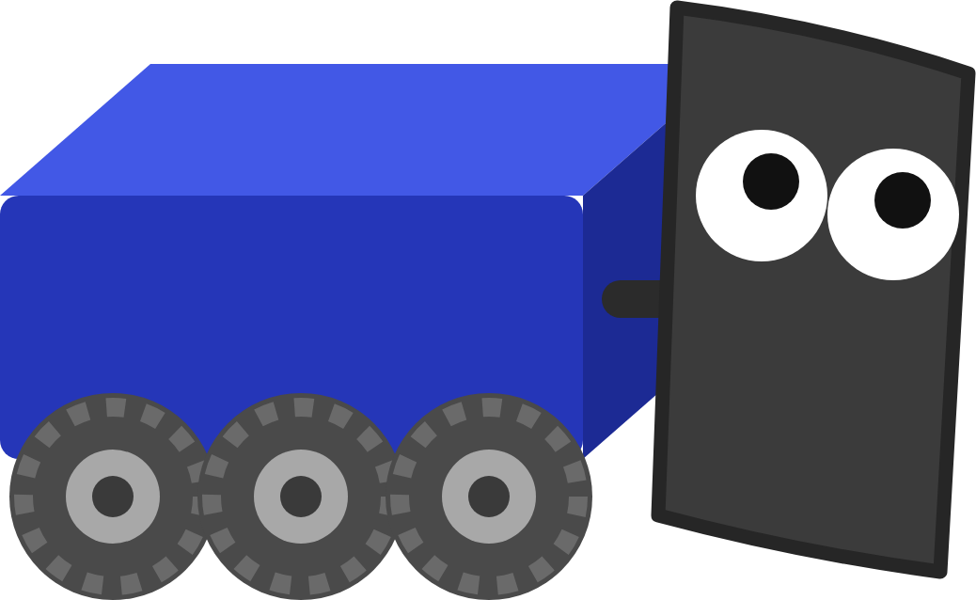
FRC ROBOT · DECK 9
Autonomous
Draw the paths in Choreo, then build the routine as a behavior tree in Arbor: drive, aim and shoot.
Hands off the controller. I've got this one!
Notes:
Welcome to the last FRC Robot deck. Everything so far gets used here: the drivetrain, the pose estimate from the Computer Vision lesson, your aim command and the robot states from Deck 7. Two new tools today: Choreo to draw the paths and Arbor to build the routine. Today the robot drives itself: it follows two paths you draw, aims at the goal and shoots, with nobody touching a controller. The routine is a behavior tree, built in Arbor. The hands-on part is the Autonomous lesson in Scriptum.

Slide 2




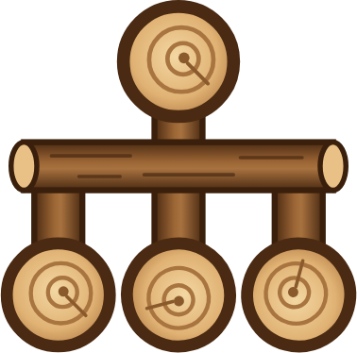

TODAY
From a drawn path to a scored shot
01
02
03
04
05
06
Autonomous
Choreo
Following a path
Behavior trees
Arbor
Run and check
15 seconds, no driver, two jobs
Draw the paths for this field
How a trajectory becomes wheel speeds
Ticks, Sequence, Fallback, Timeout
Build the tree from robot states
Watch it run, read a failure
By the end: the robot drives to a game piece, drives to a scoring spot, aims and shoots, all on its own.
MARS/WARS SOFTWARE TRAINING
2
Notes:
Six parts. First what autonomous is. Then Choreo, the app that draws the paths, and the plan for this lesson's field. Then how robot code follows a trajectory. Then behavior trees, the new idea today, and Arbor, the app we build them in, with how our robot runs one. Last, running it and reading the graphs. Ask: what's the difference between a path and a trajectory? (A trajectory adds timing. Answer comes in parts 2 and 3.)

Slide 3
01
Autonomous
Nobody can grab the controller to fix my mistakes. So plan well!
Fifteen seconds with nobody driving
MARS/WARS SOFTWARE TRAINING
3
Notes:
What autonomous is, why it has to be repeatable, and the plan for this lesson's field.

Slide 4
AUTONOMOUS
What is autonomous?
• The first 15 seconds of every match
15
• Drivers stand behind the line, hands off
seconds
• The robot runs a routine planned ahead
with nobody driving
• It must do the same thing every match
• Auto points often decide matches
Auto
Teleop: drivers in control
0:15
2:30
A match: 15 s of auto, then 2 min 15 s of teleop.
MARS/WARS SOFTWARE TRAINING
4
Notes:
Every match starts with autonomous: about 15 seconds where the drivers stand behind the line and can't touch the controllers. The robot runs a routine that was planned ahead of time. Whatever it does, it has to do the same way every match, because nobody can fix a mistake. Points in auto are often worth more than the same action in teleop, so a good auto can decide a match. Ask: what could go wrong if the robot just drove at full speed for 2 seconds and hoped? (Battery level, wheel slip and carpet change how far it goes.)

Slide 5

AUTONOMOUS
Accuracy vs precision
Accurate, not precise
Precise, not accurate
Both: what auto needs
Lands around the spot, but all over the place.
Lands in the same place every time. The wrong place.
On the spot, the same way every match.
The fix: know where the robot really is, and correct every loop. That's what a path follower does.
MARS/WARS SOFTWARE TRAINING
5
Notes:
From the old Autonomous training: what's the difference between accuracy and precision? Accurate means on average you hit the spot, even if each try lands somewhere different. Precise means every try lands in the same place, even if that place is wrong. Ask: which do we want for auto? (Both: hit the spot, the same way every match.) A robot that drives on wheel counts alone drifts a bit differently each time. The fix is to know where the robot really is and correct every loop, which is exactly what the path follower does with the pose estimate.

Slide 6


AUTONOMOUS
Two jobs: paths, then a tree
1 Draw the paths
2 Build the tree
In Choreo. Where the robot drives, and how fast.
In Arbor. In what order: drive, wait, drive, aim, shoot.
ToPickup.traj ToScore.traj
trees/PickupAndScore.xml
The paths say where. The tree says in what order, and what to do if a step fails.
MARS/WARS SOFTWARE TRAINING
6
Notes:
The team builds every autonomous routine in two jobs. First draw the paths in Choreo: where the robot drives and how fast. Choreo saves each one as a .traj file. Then build the routine in Arbor, as a behavior tree: which path to drive, when to wait, when to aim, when to shoot, and what to do if a step fails. The paths say where; the tree says in what order. In today's lesson you do both. On the real robot it's the same: Choreo and Arbor on a laptop, and the .traj and .xml files deploy with the code.

Slide 7
02
Choreo
Nobody drives me in auto. I just follow the plan!
Drawing the paths the robot follows
MARS/WARS SOFTWARE TRAINING
7
Notes:
The first of today's two new tools. Choreo plans where the robot drives in auto, and how fast. It's new in this deck on purpose: now that you know drivetrains, odometry and poses, a path on the field makes sense.

Slide 8
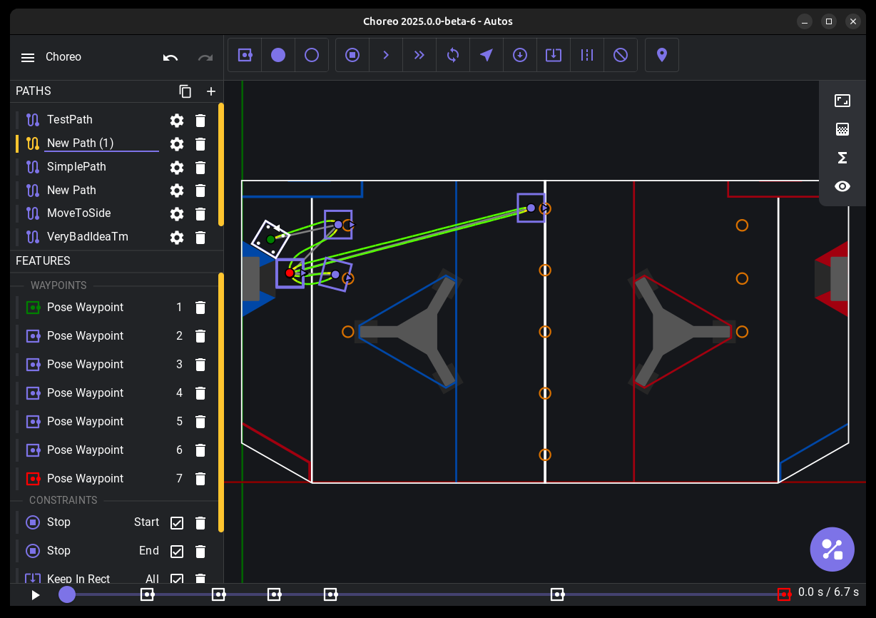
CHOREO
What is Choreo?
• The app that plans our auto paths
• Place waypoints on a map of the field
• It solves the fastest path the robot can drive
• Saved as a .traj file the robot follows
MARS/WARS SOFTWARE TRAINING
8
Notes:
Choreo is the app we use to plan autonomous paths. You place waypoints on a map of the field and Choreo works out the fastest path the robot can really drive, using its real limits. On the team laptops it's a desktop app; in training it's the Choreo pane in Scriptum. Each plan is saved as a .traj file in src/main/deploy/choreo, which deploys with the code. How the robot follows one is part 3. Screenshot from the Choreo project.

Slide 9
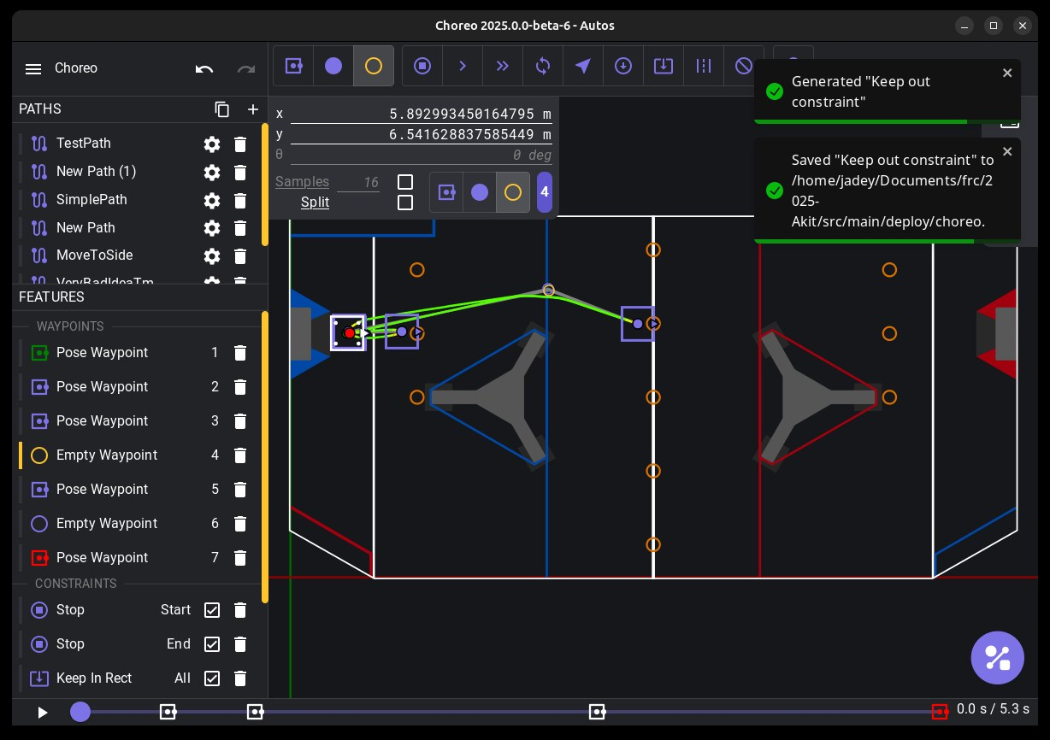
CHOREO
Waypoints and constraints
Pose waypoint
Pins position and heading. Use for start and end.
Translation waypoint
Pins only position. Choreo picks the heading.
Constraint
A rule the path obeys, like Max Velocity in one zone.
Starter rule
Every path begins with Stop at the start and end.
MARS/WARS SOFTWARE TRAINING
9
Notes:
Waypoints are points the path goes through. Pose waypoints pin position and heading; use them at the start and end. Translation waypoints pin only position and let Choreo pick the heading. Constraints are rules, like a max velocity in one zone. Every path starts with Stop at the start and end. Screenshot from the Choreo docs.

Slide 10


CHOREO
Generate: solving for the fastest path
Waypoints
Constraints
Generate
.traj file
Where to go
Rules to obey
Solve with real limits
The robot follows it
Won't generate? A rule the robot can't meet leaves it unsolved. Change the numbers or untick the constraint.
How the robot follows the .traj file is part 3 of this deck.
MARS/WARS SOFTWARE TRAINING
10
Notes:
Generate works out the fastest trajectory through every waypoint that obeys every constraint, using the robot's real limits (motor speed, mass, wheel grip). If no such path exists, it fails. Fix it by changing the numbers or switching a constraint off, then generate again.

Slide 11
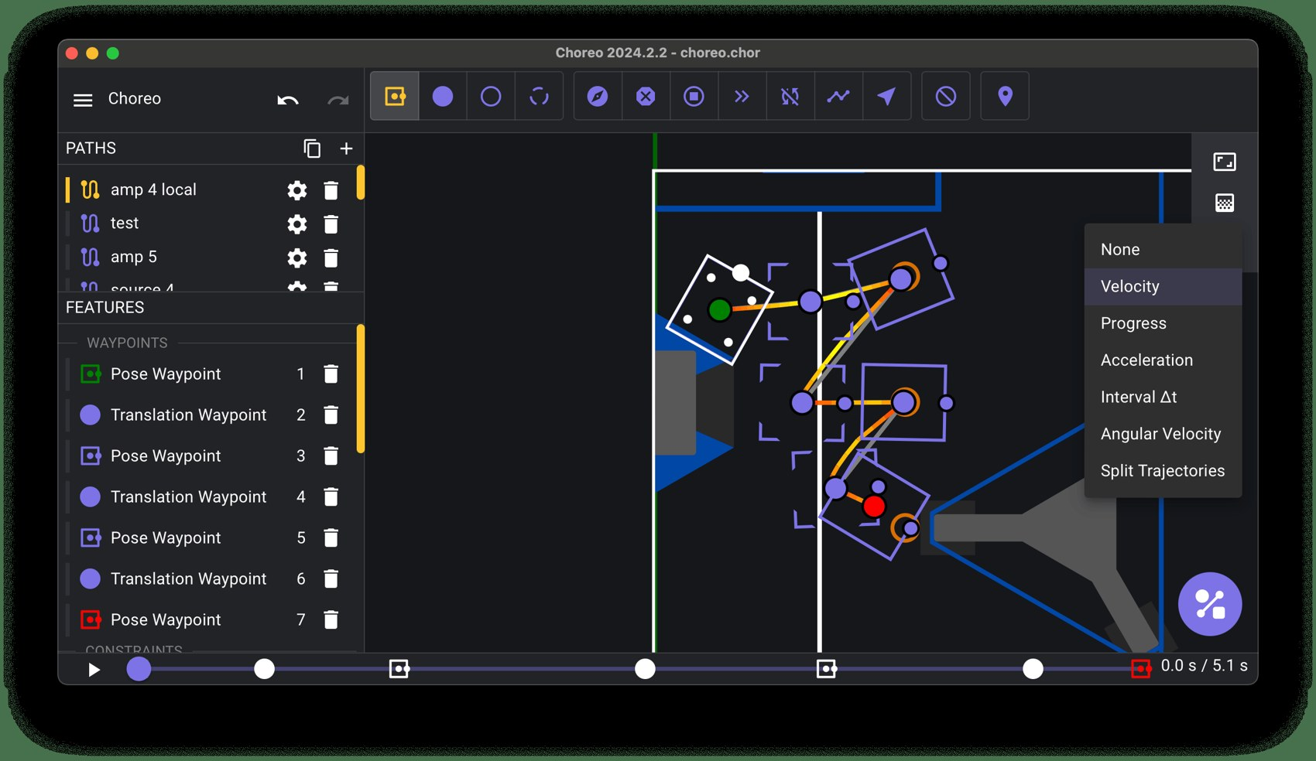
CHOREO
Reading a generated path
1
Color = speed
See where the robot slows for a turn
2
Timeline
Press play or drag to watch it drive
3
.traj file
What the robot code loads in auto
4
Drive Type
Differential for this robot, not the default Swerve
MARS/WARS SOFTWARE TRAINING
11
Notes:
After Generate, Choreo draws the trajectory on the field. Color along the path shows speed, so you can see where the robot slows for a turn. Press play or drag the timeline to watch it drive. Choreo saves it as a .traj file in src/main/deploy/choreo, which deploys with the code. One setting matters for this lesson: its robot is a Differential drive (tank), so Document Settings, Robot Config must say Differential, not the default Swerve. Screenshot from the Choreo docs.

Slide 12


CHOREO
The plan for this lesson's field
8
Named pose
x
y
heading
Start
1.5
1.5
0 rad
6
ScoreSpot
Pickup
5.5
2.5
0 rad
Goal
ScoreSpot
6.5
5.0
π/2 rad
4
Goal
4.0
4.0
aim here
ToScore
2
Pose waypoint
The join: both paths meet here
Pickup
Translation waypoint
Start
ToPickup
Meters from the blue wall (x) and the side of the field (y). Heading 0 rad points down the field; π/2 rad points up it.
0
2
4
6
8
MARS/WARS SOFTWARE TRAINING
12
Notes:
This is the lesson's field, drawn from the real solution paths. The project already has four named poses. The robot starts on Start. ToPickup drives to Pickup, where the game piece is. ToScore carries on to ScoreSpot, finishing pointed up the field. Goal is what the robot aims at; it isn't on a path. Each path has a pose waypoint at each end and a translation waypoint in the middle. Activity: have students read the coordinates off the grid and match them to the table.

Slide 13




CHOREO
Four rules for the two paths
Exact names
They join up
Three waypoints
Differential first
ToPickup and ToScore. The tree names them, and capitals count.
ToScore starts where ToPickup ended: on Pickup, within 15 cm.
Pose at the start, translation in the middle, pose at the end.
Set Drive Type and the robot's numbers before you draw.
Verify checks: the names, each end within about 30 cm, and the join within 15 cm.
MARS/WARS SOFTWARE TRAINING
13
Notes:
Four rules the checks look for. Names: the tree names each path, so ToPickup and ToScore must be spelled exactly, capitals too; rename it in Choreo, not by renaming the file. Join: when ToScore begins the robot is standing on Pickup, so ToScore's first waypoint must be exactly where ToPickup ended. Three waypoints each: pose, translation, pose. Differential: set the Drive Type first, or Choreo makes swerve paths this robot can't follow. Ask: what happens if ToScore starts half a meter away from Pickup? (The robot lurches to catch up, or the check fails.)

Slide 14
03
Following a path
The path is my schedule. I check it 50 times a second.
How a trajectory turns into wheel speeds
MARS/WARS SOFTWARE TRAINING
14
Notes:
This is the code you don't write but should understand: how the robot plays a path back. It's provided and tuned in DifferentialPathFollower.java, and it's worth reading.

Slide 15

FOLLOWING A PATH
A trajectory is a schedule
ONE SAMPLE
t = 2.48 s
t
1.52 s
t = 1.52 s
Pickup
x
3.75 m
y
2.10 m
heading
0.37 rad
t = 0.51 s
left wheel
1.81 m/s
Start
right wheel
1.79 m/s
Read the dots: bunched up where the robot is slow, spread out where it's fast. Samples are about 0.05 s apart.
MARS/WARS SOFTWARE TRAINING
15
Notes:
When you press Generate, Choreo doesn't just save a line. It saves a list of samples, each a moment in time: where the robot should be, which way it faces, and how fast each wheel should turn. These dots are the real samples of the lesson's ToPickup path, about 0.05 seconds apart. Where the dots bunch up the robot is slow (starting and stopping); where they spread out it's fast. Ask: where on this path is the robot fastest? (The straight middle part.) This is the difference between a path (the route) and a trajectory (the route plus timing).

Slide 16

FOLLOWING A PATH
The follower, every 20 ms
1
2
3
4
Where should I be?
Where am I?
Close the gap
Speed to power
The path's sample for right now
The pose estimate
Feedback nudges the speeds
Feedforward: kS + kV × speed
every 20 ms
Provided: DifferentialPathFollower.java does this, already tuned. Read it, don't change it.
MARS/WARS SOFTWARE TRAINING
16
Notes:
The FollowPath step plays the trajectory back. Every 20 ms it does four things. Where should I be? It looks up the sample for this moment on the path's clock, blending the two samples around it. Where am I? It reads the pose estimate. Close the gap: a path-following controller (LTV unicycle, built for tank drives) nudges the speeds so the robot drifts back onto the line. Speed to power: wheel speeds in meters per second become duty cycles. All of this is DifferentialPathFollower.java, provided and tuned. Activity: one student is the path's clock calling out times, another walks the line.

Slide 17
FOLLOWING A PATH
Should be here, is there: close the gap
1
Path says
Be here now, at these wheel speeds
1
DesiredPose
2
Robot is
A little behind, and off to the side
3
3
Nudge
2
Pose
Change the left and right speeds to steer back on the line
MARS/WARS SOFTWARE TRAINING
17
Notes:
The robot is never exactly where the path says. DesiredPose is where the path says the robot should be right now; Pose is where the robot thinks it is. The controller compares them and changes the left and right speeds a little: a bit more on one side steers the robot back toward the line, a bit more on both catches it up. It does this every loop, so small errors never get big. You can watch both in AdvantageScope: Subsystem/Drivetrain/Choreo/DesiredPose and the Localization pose. Ask: why can't a tank drive just slide sideways back onto the line? (Its wheels only roll forward and back, so it has to steer.)

Slide 18
FOLLOWING A PATH
Speed to power: feedforward
duty cycle
1
kS: break loose
1
A little power just to start the wheels: 0.25 V of 12
4
0.75
2
2
kV: power per speed
Twice the speed, twice the power
0.5
At 1.8 m/s
3
3
About 0.34: a third of full power
1.8 m/s → 0.34
0.25
4
Top speed
1
About 5.7 m/s at full power (1.0)
0
0
1
2
3
4
5
6
wheel speed (m/s)
MARS/WARS SOFTWARE TRAINING
18
Notes:
The last step turns wheel speed into motor power. This is feedforward: power you know you'll need before any error shows up. kS is a small push just to break the wheels loose, 0.25 volts out of 12. kV is power per meter per second: twice the speed, twice the power, so full power (1.0) is the robot's top speed of about 5.7 m/s (a Kraken at about 628 rad/s through an 8.45 to 1 gearbox is 74.3 rad/s at the wheel, times a 0.0762 m wheel radius). At the lesson's suggested 1.8 m/s cap that's about a third of full power. Turning adds a little extra because the wheels scrub sideways. Ask: why cap the speed at 1.8 if the robot can do 5.7? (A gentler robot is easier to keep on the line.)

Slide 19
FOLLOWING A PATH
Wait, settle, arrive
Follow
Wait
Settle
Arrived
The clock runs. Drive the sample for now.
More than 0.5 m behind? The clock pauses.
Clock done. Face the end point, drive at it.
Within 0.15 m and slower than 0.15 m/s.
SUCCESS
FollowPath answers SUCCESS once the robot has arrived (isAtChoreoSetpoint). A robot stuck for 10 s gives up, so it can't hold up the auto.
▶ FollowPath
trajectory = ToPickup
MARS/WARS SOFTWARE TRAINING
19
Notes:
Two details that make following reliable. Waiting: the path's clock keeps running, so if the robot falls more than half a meter behind the sample, the clock pauses until it catches up, instead of running away without it. Settling: when the clock runs out, the robot may be a little short. A tank drive can't slide sideways, so it turns to face the end point and drives at it, slowly. FollowPath finishes when the robot is within 15 cm of the end and slower than 0.15 m/s; that's isAtChoreoSetpoint. And if it gets stuck, FollowPath gives up after 10 seconds so the routine carries on.

Slide 20
FOLLOWING A PATH
The robot only estimates where it is
estimate (dashed)
Pose estimate
true pose (Dozer)
Subsystem/Localization/Pose
AprilTag
Wheels plus AprilTag cameras. The follower, the aim and isAimed() use it.
True pose
Drive/TruePose
Only the simulator knows it. The Verify checks use it.
Gap exaggerated: really a few centimeters.
About 1 to 9 cm apart while driving, about 1 cm once stopped.
MARS/WARS SOFTWARE TRAINING
20
Notes:
The follower steers by the pose estimate from your Localization subsystem: the wheels give the movement and the AprilTag cameras correct the drift. It's close but never exact. In the simulator we also know the true pose, Drive/TruePose. While driving they're about 1 to 9 centimeters apart, and about 1 centimeter once the robot stops. The gap in the drawing is exaggerated so you can see it. The lesson's checks use the true pose, so a small error in the estimate can't fool them. Ask: on the real robot, which pose do we have? (Only the estimate.)

Slide 21
04
Behavior trees
Every tick I ask each step: still going, done, or failed?
How the robot works through a routine, one tick at a time
MARS/WARS SOFTWARE TRAINING
21
Notes:
Our autos are behavior trees, built in Arbor. Before building one, learn exactly how the robot runs one. The Arbor lesson's Dozer guides step through the same examples tick by tick.

Slide 22
BEHAVIOR TREES
What is a behavior tree?
THE PLAN, IN WORDS
THE SAME PLAN, AS A TREE
1
Drive to the game piece
→ Sequence
in order
2
Drive to the scoring spot
3
Aim at the goal
▶ FollowPath
▶ FollowPath
▶ SetWantedState
▶ SetWantedState
ToPickup
ToScore
AIM
SHOOT
4
Shoot
1
2
3
4
A plan drawn as a tree: the steps are at the bottom; the boxes above them say how to run them.
MARS/WARS SOFTWARE TRAINING
22
Notes:
Before how the robot runs a tree, what one is. A behavior tree is a plan drawn as a tree. On the left is an auto in plain words: four steps, in order. On the right is the same plan as a tree. The four steps are the boxes at the bottom, the leaves, left to right in the order they happen. The box on top, the Sequence, holds them and says how to run them: in order, one after another. Every tree you'll see today is built this way: steps at the bottom, boxes above them that decide how to run them. Ask: where would a fifth step, Shoot again, go? (A fifth leaf, at the right end.)

Slide 23



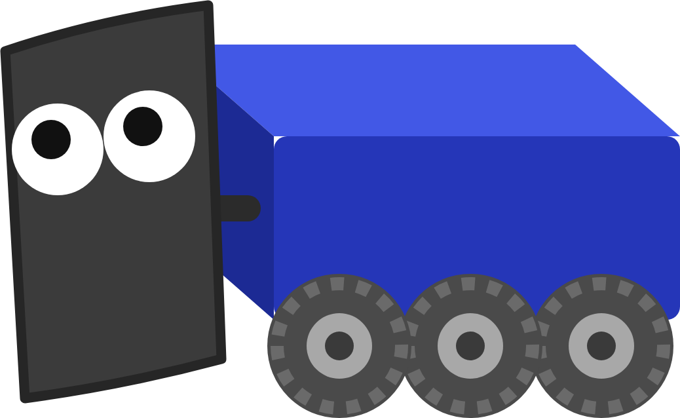
BEHAVIOR TREES
Why we use trees for autos
Easy to read
Easy to change
Plan B built in
Watch it run
The whole auto is one picture.
Edit in Arbor and save. No Java to rebuild.
Time limits and backups for when a step goes wrong.
Live in Arbor, and replayed after the match.
Same states as teleop: the tree asks the robot for states, just like the driver's buttons.
MARS/WARS SOFTWARE TRAINING
23
Notes:
Why do we write autos as trees, and not as one long piece of Java? Four reasons. Easy to read: the whole auto is one picture, so the drive team can check it too. Easy to change: you edit it in Arbor and save; the robot reads the file, so there's no Java to rebuild. Plan B is built in: Timeouts and Fallbacks say what to do when a step takes too long or doesn't work, which happens a lot in a real match. Watch it run: Arbor shows the tree live, and replays it after a match, so you can see exactly where an auto went wrong. And the tree doesn't drive motors itself: it asks the robot for the same states the driver's buttons do.

Slide 24
BEHAVIOR TREES
The parts of a tree
Root
root
→ Sequence
The top. Every tick starts here
Control nodes
Hold children, decide how to run them
▶ FollowPath
▶ SetWantedState
⏱ Timeout
▶ SetWantedState
ToScore
AIM
3000 ms
SHOOT
Actions
Do the work: drive, ask for a state
↻ Retry
Conditions
until success
Check something. Never move the robot
● IsSystemState
Read it
AIM
Top to bottom, children left to right
MARS/WARS SOFTWARE TRAINING
24
Notes:
The parts, and their colours as Arbor shows them. The root is the top node; the robot always starts there. Grey nodes are control nodes: they hold other nodes, their children, and decide how to run them. Sequence runs its children in order. Timeout gives its child a time limit. Retry tries its child again until it works. Teal nodes are actions: they do the work, like driving a path or asking the robot for a state. Purple nodes are conditions: they check something, like is the robot in AIM, and never move the robot. Read a tree top to bottom, children left to right. Ask: which node here is the only one that moves the robot? (Trick question: FollowPath drives; SetWantedState only asks.)

Slide 25

BEHAVIOR TREES
Every node answers its parent
Actions
→ Sequence
SUCCESS when the job is done, FAILURE if it couldn't be
the parent
SUCCESS
Conditions
run
Answer at once: SUCCESS if true, FAILURE if not
FAILURE
▶ FollowPath
Control nodes
trajectory = ToScore
Answer for their children. Sequence: all must succeed. Fallback: one is enough
Still working? a node can also say RUNNING. How that works: ticks, next.
MARS/WARS SOFTWARE TRAINING
25
Notes:
How do the parts work together? A parent asks a child to run, and the child answers: SUCCESS, it worked, or FAILURE, it didn't. Actions answer when their job is done: FollowPath succeeds when it arrives. Conditions answer at once: IsSystemState AIM is SUCCESS if the robot is in AIM right now, FAILURE if not. Control nodes answer for their children: a Sequence succeeds only if every child does, a Fallback as soon as one does. The answer keeps going up until it reaches the root, and the root's answer is the whole auto's answer. While a step is still working it says RUNNING, and that's where ticks come in, next.

Slide 26
BEHAVIOR TREES
Ticks, and three answers
Tick
Go down
Answer
Go back up
Every loop, about 50 times a second
From the root, to the step that's active
Each node says how it's doing
Parents decide what's next
RUNNING
SUCCESS
FAILURE
Not done yet. Ask me again next tick.
Done, and it worked.
Done, and it didn't work.
Colours as Arbor shows them: orange running, green success, red failure.
MARS/WARS SOFTWARE TRAINING
26
Notes:
A behavior tree is a tree of small steps. About fifty times a second, every robot loop, the robot ticks the tree: it starts at the root and goes down. Every node answers with one of three things. RUNNING: not done yet, ask me again next tick. SUCCESS: done, it worked. FAILURE: done, it didn't. The answers travel back up, and each control node (Sequence, Fallback, Timeout) uses its children's answers to decide what to do next. Activity: one student is the tree, the class calls out 'tick' and the student answers running, success or failure.

Slide 27

BEHAVIOR TREES
Sequence: do these in order
Tick 1
Tick 3
Tick 5
RUNNING
RUNNING
SUCCESS
→ Sequence
→ Sequence
→ Sequence
RUNNING
SUCCESS
RUNNING
SUCCESS
SUCCESS
SUCCESS
▶ Drive
▶ Aim
▶ Shoot
▶ Drive
▶ Aim
▶ Shoot
▶ Drive
▶ Aim
▶ Shoot
Remembers its place: a RUNNING child is resumed next tick. SUCCESS moves on in the same tick.
MARS/WARS SOFTWARE TRAINING
27
Notes:
A Sequence does its children one after another. Tick 1: Drive path starts, it takes a while, so it answers RUNNING and so does the Sequence. Next tick the Sequence goes straight back to the child that was running, not to the start. Tick 3: Drive path succeeds, and in the same tick the Sequence moves on and starts Aim. Tick 5: every child succeeded, so the Sequence succeeds. Yellow lines show where each tick went. Ask: on tick 4, which node does the Sequence tick first? (Aim, the one that was running.)

Slide 28
BEHAVIOR TREES
Sequence: stops at the first failure
Tick 2
AND
FAILURE
Every child must succeed. The first FAILURE stops the Sequence.
→ Sequence
SUCCESS
FAILURE
▶ Drive path
▶ Aim
▶ Shoot
Shoot: never ticked
MARS/WARS SOFTWARE TRAINING
28
Notes:
Same tree, but this time Aim fails: no target in view. Tick 1: Drive path is running. Tick 2: Drive path succeeds, Aim answers FAILURE, and the Sequence stops right there and answers FAILURE too. Shoot was never ticked. That's the point: a Sequence gives up at the first failure, so Shoot can rely on Aim having worked. A Sequence is an AND: every step must work. Ask: is it good that Shoot never ran? (Yes: shooting without aiming wastes the game piece.)

Slide 29
BEHAVIOR TREES
Fallback: plan B
Tick 3
→ Sequence
SUCCESS
AND
? Fallback
Stops at the first FAILURE
? Fallback
FAILURE
SUCCESS
▶ Aim: vision
▶ Aim: manual
▶ Skip the shot
OR
Stops at the first SUCCESS
Skip the shot: never tried
MARS/WARS SOFTWARE TRAINING
29
Notes:
A Fallback is the mirror image of a Sequence. It tries its children in order and stops at the first one that succeeds. It only fails if every child failed. Here: aim with vision; that fails, so try aiming by hand; that works, so the Fallback succeeds and Skip the shot is never tried. A Sequence is an AND, all must work. A Fallback is an OR, any one is enough. Put them together and you can say 'do A, then B, and if B doesn't work out, do C'. Ask: when does this Fallback fail? (Only if all three fail.)

Slide 30
BEHAVIOR TREES
Timeout: don't hang forever
At 3.0 s
THE CLOCK
RUNNING
? Fallback
Aim
FAILURE
RUNNING
Backup path
⏱ Timeout
▶ Backup path
3000 ms
▶ Aim
0 s
1 s
2 s
3 s
4 s
5 s
Time's up: Aim halted, Timeout FAILURE
Timeout + Fallback: a step that hangs can no longer stall the whole auto.
MARS/WARS SOFTWARE TRAINING
30
Notes:
A Timeout wraps one step and gives it a time limit in milliseconds. If the step is still RUNNING when time is up, the Timeout halts it and answers FAILURE. That turns 'might never finish' into 'fails after 3 seconds', and a Fallback turns that into plan B. Read the clock: at 0 s Aim starts. At 1.5 s it's still running. At 3 s time is up: Aim is halted, the Timeout fails, and the Fallback starts Backup path. At 5 s the backup path succeeds, so the Fallback succeeds. Timeout plus Fallback is the most useful pattern in an auto.

Slide 31
BEHAVIOR TREES
ParallelDeadline: two things at once
1
All children together
RUNNING
Every tick, every child
⇉ ParallelDeadline
2
The first is the deadline
When it ends, the rest are halted
RUNNING
RUNNING
▶ FollowPath
▶ Intake on event
the deadline
Intake Out
3
Its answer counts
The node answers with the deadline's result
Both tick together. When FollowPath finishes, Intake on event is halted.
MARS/WARS SOFTWARE TRAINING
31
Notes:
A ParallelDeadline ticks all its children together. The first child is the deadline: when it finishes, the others are halted and the node answers with the deadline's result. 'Drive this path, and drop the intake when the robot passes the Intake Out marker' is exactly this: the path is the deadline, the intake step waits for the marker. If the marker never comes, the intake step is simply halted when the path ends. The competition robot uses this in nearly every auto. There's also a ReactiveSequence, which re-checks earlier steps every tick, for 'keep driving only while we hold a game piece'.

Slide 32
05
Arbor
The tree asks. RobotContainer does the work. Teamwork!
Building the tree: it asks the robot for states, and drives the paths
MARS/WARS SOFTWARE TRAINING
32
Notes:
The second new tool. Now that you know how a behavior tree runs, meet Arbor, the app we build them in, and see how our robot uses a tree to run an auto: the PickupAndScore tree you build in the lesson.

Slide 33
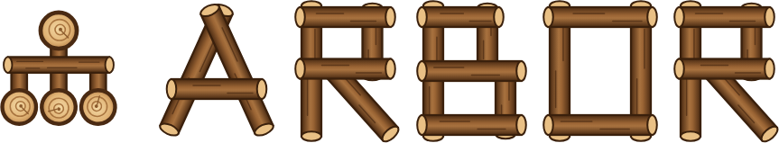
ARBOR
What is Arbor?
• The editor for our autonomous routines
• An auto is a behavior tree: steps the robot works through
• Saved as an XML file the robot runs
• Watch it run live, and replay a run afterwards
Choreo
Arbor
Robot
Draws the paths
Builds the routine
Runs the XML file
MARS/WARS SOFTWARE TRAINING
33
Notes:
Arbor is the editor for our autonomous routines. Choreo gives us the paths; Arbor puts the whole routine together: drive this path, aim, shoot, and what to do if something goes wrong. The routine is the behavior tree you just learned to read. Arbor saves it as an XML file in the robot project, and the robot runs that file. No Java to write for a new auto. On the team laptops Arbor is a desktop app; in Scriptum it's the Arbor pane. Ask: why might it help that a new auto is just a file? (You can change the order of steps or a wait time without rebuilding the code.)

Slide 34
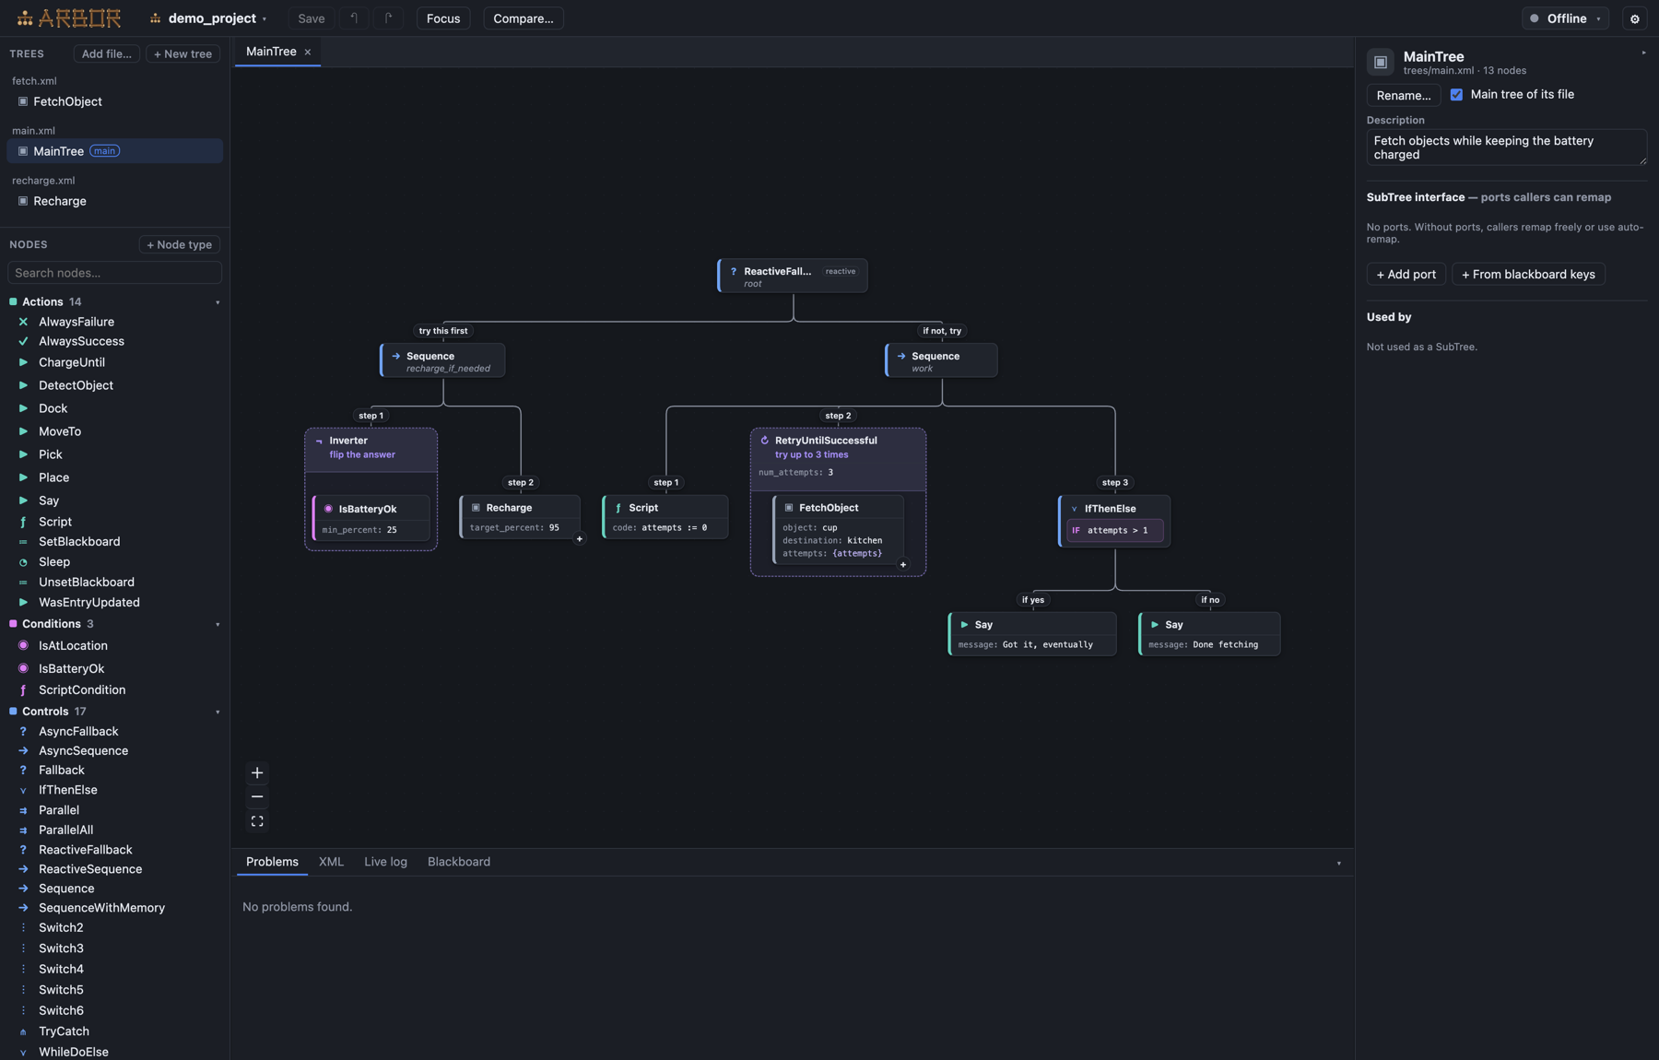
ARBOR
The Arbor window
1
1
Trees
Your tree files. + New tree makes one
4
2
3
2
Nodes
Every step you can use
3
Canvas
The tree. Click a node to select it
4
Ports
The selected node's settings
5
5
Problems, XML, Live log
Mistakes, the saved file, the robot
MARS/WARS SOFTWARE TRAINING
34
Notes:
The Arbor window. 1: Trees, every tree file in the project; + New tree makes your own. 2: Nodes, every step you can use, with a search box. The robot's own steps (SetWantedState, FollowPath) are listed with the built-in ones. Drag one onto the canvas, or right-click a node and choose Add child. 3: the canvas, the tree itself; click a node to select it. 4: the selected node's settings, called ports. 5: Problems, the XML Arbor will save, and the live log. Screenshot from the Arbor project.

Slide 35
ARBOR
Ports: a node's settings
▶ SetWantedState
Which robot state to ask for
TUNABLE VALUES
state = AIM
Declare an input port on the tree, then use its name in braces:
▶ FollowPath
A Choreo path, by its exact name
trajectory = ToScore
▶ Sleep
msec = {wait_msec}
▶ Sleep
How long to wait, in milliseconds
On the robot it appears on the dashboard. Change it at the field, no rebuild.
msec = 500
Spelling counts. A path name or tunable that doesn't match stops the auto from loading. Check Arbor's Problems tab.
MARS/WARS SOFTWARE TRAINING
35
Notes:
A node's settings are called ports, and you fill them in on the right. SetWantedState needs the robot state to ask for. FollowPath needs the name of a Choreo path, spelled exactly. Sleep needs how many milliseconds to wait. Any number can be tunable: declare an input port on the tree with a default, then write its name in braces, like {wait_msec}. On the robot it shows up on the dashboard, so the drive team can change it at the field without rebuilding. Ask: why would you want the wait time tunable? (To wait for a partner robot to get out of the way.)

Slide 36
ARBOR
The tree asks the robot, like a button does
▶ SetWantedState
setWantedState(AIM)
SUCCESS
1
Ask: SetWantedState
state = AIM
Instant, like a button press
at once, like a button
● IsSystemState
robot in AIM?
SUCCESS
2
Check: IsSystemState
state = AIM
FAILURE
SUCCESS only while the robot is in that state
yes / not yet
TO WAIT FOR A STATE
3
Wait: retry the check
Inside a Timeout, so it can't stall the auto
⏱ Timeout
↻ RetryUntilSuccessful
● IsSystemState
3000 ms
until it works
state = AIM
Each arrow means "holds": the Timeout holds the retry, the retry holds the check.
MARS/WARS SOFTWARE TRAINING
36
Notes:
Remember the super state machine from Deck 7: buttons ask RobotContainer for a robot state. The tree does exactly the same. SetWantedState AIM calls setWantedState(AIM) on RobotContainer and answers SUCCESS in the same tick, just like a button press: it asks, it doesn't wait. To wait until the robot is really there, the tree checks with IsSystemState AIM, a condition: SUCCESS if the robot is in AIM right now, FAILURE if not. Wrap it in RetryUntilSuccessful and it checks again every tick until it succeeds. Put a Timeout around that, and a robot that never gets there can't stall the auto. FollowPath asks for the path and drives it. AUTO is the hands-off state between steps.

Slide 37
ARBOR
The lesson's tree: PickupAndScore
→ Sequence
PickupAndScore
▶ FollowPath
▶ Sleep
▶ FollowPath
▶ SetWantedState
⏱ Timeout
▶ SetWantedState
▶ Sleep
▶ SetWantedState
ToPickup
500
ToScore
AIM
3000
SHOOT
2000
AUTO
1
Drive, wait, drive
↻ Retry
3
Shoot for 2 s, then hand back
until success
● IsSystemState
AIM
2
Ask for AIM, wait up to 3 s
MARS/WARS SOFTWARE TRAINING
37
Notes:
This is the PickupAndScore tree you build in Arbor. The lesson's starting tree already drives ToPickup; you add the rest, in order. Sleep half a second, standing in for picking up the game piece. FollowPath ToScore. SetWantedState AIM asks for AIM; then a Timeout of 3 seconds around a retried IsSystemState AIM waits until the robot is aimed, so a bad aim can't stall the auto. Then SetWantedState SHOOT, a Sleep of 2 seconds while it shoots, and SetWantedState AUTO to hand the robot back to the tree. Ask: what happens if aiming takes 4 seconds? (The Timeout fails, so the Sequence fails, and the robot never shoots. A Fallback could add a plan B.)

Slide 38
ARBOR
What Arbor writes
deploy/autos/trees/PickupAndScore.xml
1
Names match
<root BTCPP_format="4" main_tree_to_execute="PickupAndScore">
File, main_tree_to_execute and ID
<BehaviorTree ID="PickupAndScore">
<Sequence>
<FollowPath trajectory="ToPickup"/>
<Sleep msec="500"/>
Ask, then wait
<FollowPath trajectory="ToScore"/>
2
<SetWantedState state="AIM"/>
SetWantedState asks; the retry waits
<Timeout msec="3000">
<RetryUntilSuccessful num_attempts="-1">
<IsSystemState state="AIM"/>
</RetryUntilSuccessful>
3
No Java
</Timeout>
The robot reads it when you pick the auto
<SetWantedState state="SHOOT"/>
<Sleep msec="2000"/>
<SetWantedState state="AUTO"/>
MARS/WARS SOFTWARE TRAINING
38
Notes:
Save in Arbor (Ctrl+S) and this is the file it writes, in deploy/autos/trees. It's plain text, so git tracks it like any code. Open it in the editor and read it once: one tag per node, ports as attributes, and the nesting is the tree. The file name, main_tree_to_execute and the BehaviorTree ID are all the auto's name, and that's the name in the Auto Chooser. The nesting is the tree: the Timeout holds the retry, the retry holds IsSystemState. No Java to compile: the robot reads the XML when you pick the auto. Ask: how would you make the pickup wait tunable? (Declare an input port, then write {pickup_wait_msec} in the Sleep.)

Slide 39

ARBOR
Finish the aim step
RobotContainer.java · handleStateTransition (sketch)
WHAT ISSYSTEMSTATE AIM SEES
case AIM:
loop 1
AIMING
if (drive_.isAimed()) {
FAILURE
1
system_state_ = RobotStates.AIM; // aimed: done
} else {
loop 2
AIMING
system_state_ = RobotStates.AIMING; // still turning
FAILURE
2
}
break;
loop n
AIM
SUCCESS
Each FAILURE means: retry next tick. The Timeout stops it after 3 s.
Java: Conditions
MARS/WARS SOFTWARE TRAINING
39
Notes:
The one bit of Java in this lesson. Run the tree first and watch: it shoots without turning. Why? The robot reaches AIM the moment it's asked, so IsSystemState AIM succeeds at once. The fix is a step state. In RobotContainer's handleStateTransition, the AIM case puts the robot in AIMING while it turns, and in AIM only once the drivetrain isAimed(). Now IsSystemState AIM fails while the robot is AIMING, so the retry keeps the auto waiting until the robot is really aimed. The left bumper asks for the same AIM, so teleop gets the fix too. This is a sketch of the idea; the lesson's comments give the exact names.

Slide 40
ARBOR
The tree on a clock
1
ToPickup
arrived
2
Sleep
0.5 s
3
ToScore
arrived
4
AIM
aimed (Timeout 3 s)
5
SHOOT
Sleep 2 s, then AUTO
auto ends at 15 s
0 s
3 s
6 s
9 s
12 s
15 s
About 9 seconds in the simulator: room to spare in a 15 second auto.
MARS/WARS SOFTWARE TRAINING
40
Notes:
The same tree on a clock. The Sequence starts each step when the one before succeeds, and each one has its own way of finishing: arriving, a time, a condition. These times are roughly what the lesson's solution does in the simulator: each path takes about 2.5 to 3 seconds including the settle, aiming takes a second or so. The whole thing is about 9 seconds, well inside the 15 second autonomous period. Ask: where could you save time? (Spin the shooter up while driving ToScore, with a ParallelDeadline.)

Slide 41
ARBOR
The tree on the field
8
1
FollowPath ToPickup
From Start to the game piece
4
2
Sleep on Pickup
6
Half a second to pick it up
Goal
3
FollowPath ToScore
4
5
Arrives facing up the field
3
4
SetWantedState AIM
1
Turns about 1.95 rad (112°) left to the goal
2
2
5
SetWantedState SHOOT
Start
Once IsSystemState says AIM
0
2
4
6
8
MARS/WARS SOFTWARE TRAINING
41
Notes:
The same five steps on the field, using the real solution paths. 1: ToPickup from Start to Pickup. 2: wait on Pickup. 3: ToScore up to ScoreSpot, arriving pointed up the field (π/2 rad, about 1.57). 4: aim: the goal is behind and to the left, so the robot turns about 1.95 rad (about 112 degrees) in place. 5: shoot at the goal. Ask: why does the robot need to turn so far? (ScoreSpot's heading is π/2 rad, but the goal is down and to the left of it.)

Slide 42

ARBOR
Picking and running the auto
Auto Chooser
PickupAndScore
▾
Boot check
Pick
Tick
Broken autos left out, with an alert
Paths loaded while disabled
Once per loop, before the robot runs
Do Nothing
PickupAndScore
Robot.java · robotPeriodic()
Elastic: one option per auto that passed the boot check
AutoManager.getInstance().periodic(); // tick the tree
robot_container_.doControlLoop(); // then the robot
No rebuild: changing a tree is a file save. Deploy it and pick the auto again.
MARS/WARS SOFTWARE TRAINING
42
Notes:
How does the robot pick and run a tree? Every file in deploy/autos/trees is an option in Elastic's Auto Chooser, named after the file. At boot the robot checks every auto in the background: the XML, every path file and every event name. A broken auto is left out of the chooser and raises a dashboard alert. When the drive team picks one, the robot prepares it while disabled, loading and flipping its Choreo paths, so nothing loads when Auto starts. When Auto is enabled, the robot goes to AUTO and the tree starts. Every loop, AutoManager ticks the tree once, just before RobotContainer and the subsystems run, so a state the tree asks for is acted on in the same loop. Ask: you changed a Sleep in the XML. What do you need to do? (Deploy the file and pick the auto again. No rebuild of the Java.)

Slide 43

ARBOR
On the competition robot
trees/CitrusSynergy.xml (2026 robot, trimmed)
1
Path + event
<Sequence>
Intake drops as the path passes a marker
1
<ParallelDeadline>
<FollowTrajectory trajectory="SynergyP1"/>
<SubTree ID="IntakeOnEvent" event="Intake Out"/>
2
Tunable wait
</ParallelDeadline>
{middle_wait_msec}, changed on the dashboard
2
<Delay delay_msec="{middle_wait_msec}">
<FollowTrajectory trajectory="SynergyP2"/>
</Delay>
3
<SubTree ID="ShootFor" duration_msec="2000"/>
3
Shared sub-tree
</Sequence>
ShootFor lives in common.xml
Drawn once: paths are drawn for one alliance and flipped for the other automatically.
MARS/WARS SOFTWARE TRAINING
43
Notes:
On the 2026 competition robot the trees are bigger but read the same way. This is part of a real auto. 1: ParallelDeadline drives the first path, and the IntakeOnEvent sub-tree drops the intake when the path passes the Intake Out marker drawn in Choreo. 2: Delay waits a tunable time, middle_wait_msec, which the drive team can change on the dashboard to stay out of a partner's way. 3: ShootFor is a shared sub-tree from common.xml: SHOOT for a time, then back to AUTO. The swerve node there is FollowTrajectory. It gives up if the robot is stuck for 3 seconds (max_paused_sec), so a stuck robot can't stall the auto. Paths are drawn once and flipped for the red alliance automatically. Details on docs.marswars.org, Software, Autonomous.

Slide 44
06
Run and check
Watch me on the 2D field. Am I on the line?
Watch it drive, read what the checks say
MARS/WARS SOFTWARE TRAINING
44
Notes:
The last four checkpoints read a running simulation, so you have to run the routine in Auto before Verify.

Slide 45

RUN AND CHECK
Running the routine
Start
Pick
Enable
Hands off
Wait for Running
Elastic: Auto Chooser, PickupAndScore
Driver Station: Auto, then Enable
It drives itself, about 10 s
In training
On the real robot
Scriptum's Start button, its Elastic, Arbor and Driver Station panes. Changed the Java? Press Start again.
Deploy from VS Code. Pick the auto in Elastic on the drive laptop. The FRC Driver Station, or the field in a match, runs Auto.
MARS/WARS SOFTWARE TRAINING
45
Notes:
Running the routine in training: press Start and wait for Running. In Elastic, pick PickupAndScore in the Auto Chooser. In the Driver Station panel pick Auto and press Enable, then hands off. On the real robot it's the same steps with real tools: deploy from VS Code, pick the routine in Elastic on the drive laptop, and the FRC Driver Station (or the field, in a match) enables Auto. Remember to yell ENABLING before you enable a real robot.

Slide 46
RUN AND CHECK
Watch the tree run in Arbor
LIVE VIEW, PARTWAY THROUGH THE AUTO
1
Live
RUNNING
Connect Arbor to the robot or simulator
→ Sequence
SUCCESS
SUCCESS
RUNNING
2
Replay
▶ FollowPath
▶ SetWantedState
⏱ Timeout
▶ SetWantedState
.btlog files in logs/bt, or /U/logs/bt on the robot
ToScore
AIM
3000
SHOOT
RUNNING
↻ Retry
3
AdvantageScope
until success
BehaviorTree/Active and .../Transitions
FAILURE
● IsSystemState
AIM
RUNNING
SUCCESS
FAILURE
MARS/WARS SOFTWARE TRAINING
46
Notes:
While the auto runs, open the Arbor pane and connect: the tree lights up node by node, orange while running, green for success, red for failure. If the auto stops somewhere unexpected, look for the red node, or the one that stayed orange. Here the robot is still turning: IsSystemState AIM goes red each tick, and the retry above it stays orange, waiting. Every run is also recorded as a .btlog file, in logs/bt in simulation and /U/logs/bt on the robot's USB stick, so you can replay it in Arbor after a match. AdvantageScope has the tree too: BehaviorTree/Active is the running auto and BehaviorTree/PickupAndScore/Transitions lists every status change. Ask: the robot never shot. Where do you look first? (Arbor: which node went red.)

Slide 47
RUN AND CHECK
Reading the distances in AdvantageScope
7
1
Pickup dips
Under 0.4 m: Reaches the pickup
6
5
2
ScoreSpot dips
Under 0.4 m: Reaches the scoring spot
4
3
3
Flat at the end
3
Standing still: aiming, then shooting
2
1
2
1
0.4 m
4
Also plot
0
TrueAimErrorRad: near 0 before the shot
0 s
2 s
4 s
6 s
8 s
10 s
Drive/DistanceToPickup
Drive/DistanceToScoreSpot
MARS/WARS SOFTWARE TRAINING
47
Notes:
Plot Drive/DistanceToPickup and Drive/DistanceToScoreSpot in AdvantageScope. These are true distances in meters. This graph was worked out from the lesson's real solution paths, so yours will look very close. The pickup line falls to nearly zero first: that's Reaches the pickup (under 0.4 m). Then it rises as the robot leaves, and the scoring spot line falls to nearly zero: Reaches the scoring spot. After that both are flat while the robot aims and shoots. Also plot Drive/TrueAimErrorRad: it should swing to about zero before the shot. Activity: before showing the graph, have students sketch what they expect.

Slide 48
RUN AND CHECK
When a check fails, it's a clue
What you see
Look at
Never reaches the pickup
The first FollowPath: path name, generated, spelled the same?
Never reaches the scoring spot
ToScore never ran, or doesn't start where ToPickup ended
Shoots without turning
The AIM step in RobotContainer, or AIM after SHOOT in the tree
Never shoots
A step failed before SHOOT: find the red node in Arbor
After a fix, press Start again. The checks remember the best run since Start.
MARS/WARS SOFTWARE TRAINING
48
Notes:
When a run check fails, read it as a clue about which step broke. The run checks remember the best the robot did since you pressed Start, so after a fix press Start again for a clean run. Arbor's live view usually points straight at the broken step. Activity: read out a symptom (the robot shoots facing the wrong way) and have students name the cause (the AIM step isn't finished in RobotContainer, or AIM comes after SHOOT in the tree).

Slide 49
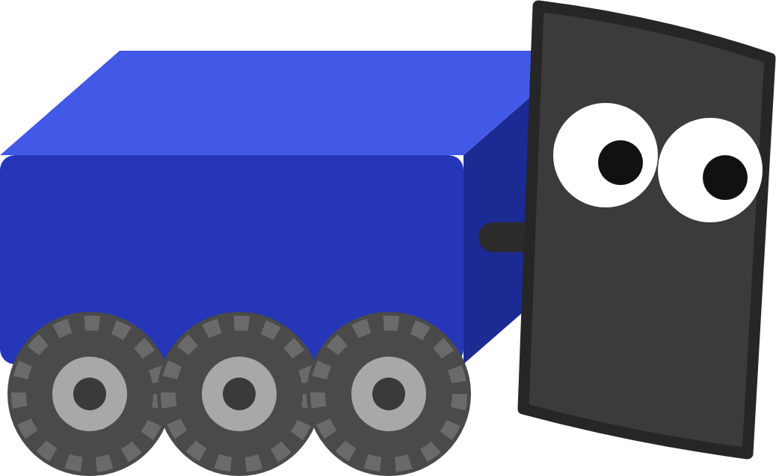
YOUR TURN
Autonomous
Draw two paths, build the tree in Arbor, finish the aim step, then run it in Auto and press Verify.
FOUR PARTS
1
Draw the paths
3
Finish the aim step
Choreo: ToPickup and ToScore, Differential
RobotContainer: AIMING until isAimed()
2
Build the tree
4
Run it
Arbor: PickupAndScore, with a Timeout on AIM
Auto Chooser, Auto, watch it in Arbor
Bonus: replay the run's .btlog in Arbor, make the pickup wait a tunable
In Scriptum: Tools › Choreo, Arbor then FRC Robot › Autonomous
MARS/WARS SOFTWARE TRAINING
49
Notes:
This is the hands-on part: the Autonomous lesson in Scriptum's FRC Robot track. Do the Choreo and Arbor lessons in the Tools track first: they practice the two apps from this deck. Draw the two paths in the Choreo pane, build the tree in the Arbor pane, finish the AIM step in RobotContainer, then run it. Some checkpoints read a running simulation, so run PickupAndScore in Auto before you press Verify. Press the Dozer button for his guides, including 'Teach me, step by step'. Nothing is graded and you can verify as many times as you like.

Slide 50

RECAP
What you can do now
Plan and generate a Choreo path
RELATED JAVA TRAINING
WHAT'S NEXT
Explain a trajectory as a schedule
Build season
Conditions
Describe how the follower closes the gap
Join a subsystem team and write real robot code.
Classes & Objects
Trace a tree tick by tick
Use Sequence, Fallback and Timeout
Build an auto in Arbor from robot states
Optional practice in Scriptum's Java track.
Watch it run, and replay it
MARS/WARS SOFTWARE TRAINING
50
Notes:
Wrap up, and the end of the FRC Robot track. Today: a trajectory is a schedule, the follower checks it every 20 ms and closes the gap, a behavior tree is ticked every loop and answers running, success or failure, and our trees ask RobotContainer for the same states the buttons do. What's next is build season: join a subsystem team and write real robot code with the same tools and the same patterns. The Java lessons on the right are optional practice for today's ideas.

