Slide 1

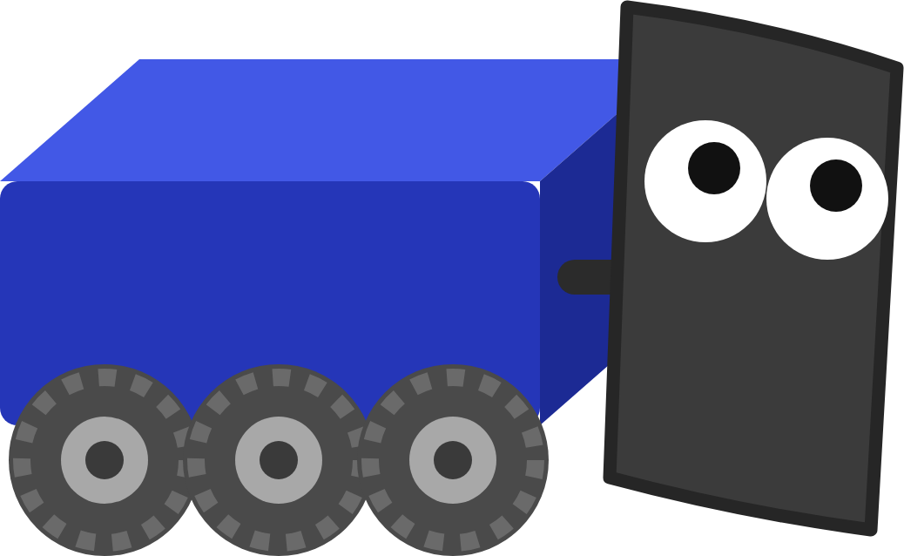
FRC ROBOT · DECK 4
Objects and Odometry
Organize code with classes and objects, then teach the robot where it is on the field.
Where am I? Let's teach me to keep track!
Notes:
Welcome to Objects and Odometry. Two big ideas today. First, classes and objects: how Java code is organized, and how you've been using objects since the first lesson. Second, odometry: the robot works out where it is on the field by adding up how its wheels move. The hands-on part is the Objects and Odometry lesson in Scriptum. Ask: if you closed your eyes and walked ten steps, could you point to where you ended up?

Slide 2






TODAY
From blueprints to a robot that knows where it is
01
02
03
04
05
Classes and objects
Static and OI
WPILib's classes
Kinematics and yaw
Odometry
Blueprints, new, fields and methods
One class that owns the controls
Rotation2d, Pose2d, ChassisSpeeds
Wheel speeds to robot speed and heading
Adding up moves to find the pose
By the end: the robot drives itself to x = 3 meters, using its own idea of where it is.
MARS/WARS SOFTWARE TRAINING
2
Notes:
Five parts. The first two are Java: classes, objects, static and the OI class. The last three use WPILib's ready-made classes to work out the robot's speed, heading and position. By the end of the lesson the robot drives itself to a spot 3 meters away using its own position.

Slide 3
01
Classes and objects
I'm an object too! Built from a blueprint, just like the gamepad.
Blueprints, and the things you build from them
MARS/WARS SOFTWARE TRAINING
3
Notes:
Everything in Java lives in a class, and the robot is full of objects: the gamepad, the drivetrain, the motors. This part explains what those words mean so the rest of the deck makes sense.

Slide 4

CLASSES AND OBJECTS
The problem: lots of robots
One robot
3
1 robot
int team_number = 4143;
variables, each with its own name
int balls_scored = 20;
int endgame_points = 15;
18
6 robots in a match
variables, each with its own name
Three variables for one robot. Fine so far.
150
50 robots at an event
variables, each with its own name
Better: describe a robot once, then make as many as you need. That description is a class.
MARS/WARS SOFTWARE TRAINING
4
Notes:
Start with a problem from the old training. Say we track robots in a match: team number, balls scored, endgame points. For one robot that's three variables. For a match it's 18, and for a whole event 150, each with its own made-up name. Add more facts per robot and it gets worse. Ask: what would you name the variables for the third robot on the red alliance? Let them feel the mess.

Slide 5

CLASSES AND OBJECTS
Class vs object: blueprint vs built thing
CLASS: THE BLUEPRINT
mars
class Team
team_number_ = 4143
balls_scored_ = 20
team_number_
a number
citrus
balls_scored_
a number
new
team_number_ = 1678
balls_scored_ = 12
scoreBall()
something it can do
poofs
team_number_ = 254
Says what every team has.
balls_scored_ = 17
Objects: built from it, each with its own data.
MARS/WARS SOFTWARE TRAINING
5
Notes:
A class is a blueprint, like the plans for a house. It says what every house has, but you can't live in plans. The word new builds a real house from the plans: that's an object. One blueprint, as many houses as you want, and each house has its own furniture. Here the class Team says every team has a number and a score; each object holds its own values. Activity: hand out an index card 'blueprint' with two blank fields, and have three students each fill in a copy.

Slide 6

CLASSES AND OBJECTS
Inside a class
Team.java
1
Fields
public class Team {
What each object remembers. Ours end in an underscore
1
private int team_number_;
private int balls_scored_;
2
2
Constructor
public Team(int number) {
team_number_ = number;
Runs once, when new builds the object. Same name as the class, no return type
balls_scored_ = 0;
}
3
public void scoreBall() {
3
Methods
balls_scored_ = balls_scored_ + 1;
What each object can do
}
}
Java: Classes & Objects
MARS/WARS SOFTWARE TRAINING
6
Notes:
Here's the Team class written out. 1: fields are the variables every object carries around. The team's style: fields end in an underscore. 2: the constructor runs once, when new builds the object. It has the class's name and no return type, and here it takes the team number as an input. 3: methods are what an object can do; scoreBall changes that object's own score. Ask: what does a new team's balls_scored_ start at? (0, the constructor sets it.)

Slide 7
CLASSES AND OBJECTS
Building an object with new
Team mars = new Team(4143);
type
name
build it
constructor
input
mars
• The class is the type, like double or int
a Team
team_number_
4143
• new builds a fresh object
• The inputs go to the constructor
balls_scored_
0
• The variable holds the object, ready to use
Java: Classes & Objects
MARS/WARS SOFTWARE TRAINING
7
Notes:
Building an object reads like making a variable, because it is one. Team is the type: the class name. mars is the variable's name. new builds a fresh object, and the values in the parentheses go to the constructor. After this line, mars holds a Team with number 4143 and a score of 0. Ask: how would you make a Team for 254? (Team poofs = new Team(254);)

Slide 8
CLASSES AND OBJECTS
Each object keeps its own data
Somewhere in the code
mars
Team mars = new Team(4143);
team_number_
4143
Team citrus = new Team(1678);
balls_scored_
2
mars.scoreBall();
mars.scoreBall();
citrus
The dot means “this object, do this”. Only mars was asked.
team_number_
1678
balls_scored_
0
Same blueprint, separate data.
MARS/WARS SOFTWARE TRAINING
8
Notes:
Two objects from the same class don't share data. Call scoreBall on mars twice and only mars's score changes; citrus is still at 0. The dot means: this object, do this. Activity: two students are mars and citrus holding score cards; call out method calls and they update only when their name is called.

Slide 9
CLASSES AND OBJECTS
You've been using objects all along
Robot.java
1
Robot
A class. Every Java file holds one
1
public class Robot extends LoggedRobot {
private final XboxController controller_ =
2
new XboxController(0);
2
controller_
private final DifferentialDriveMech drive_ =
An object, built from WPILib's XboxController
3
new DifferentialDriveMech(
Constants.LEFT_MOTORS, Constants.RIGHT_MOTORS);
3
drive_
@Override
An object, built from the lesson's own class
public void teleopPeriodic() {
4
drive_.arcadeDrive(/* forward, turn */);
}
4
arcadeDrive
}
A method of drive_
MARS/WARS SOFTWARE TRAINING
9
Notes:
You've used objects since the first lesson. Robot is a class. controller_ is an object built from WPILib's XboxController class. drive_ is an object built from the lesson's DifferentialDriveMech class, and arcadeDrive is one of its methods. The constructor inputs for the drivetrain are the motor lists from Constants. Ask: find another object in Robot.java. (loop_, the LessonLoop.)

Slide 10
CLASSES AND OBJECTS
extends: building on another class
LoggedRobot
MechBase
From AdvantageKit. Runs the loop and calls teleopPeriodic() for you.
From MWLib. Calls readInputs(), writeOutputs() and logData() every loop.
extends
extends
Robot
DifferentialDriveMech
Fills in teleopPeriodic() and autonomousPeriodic().
Fills them in for the drivetrain.
@Override means “I'm writing my own version of the parent's method.”
Java: Inheritance
MARS/WARS SOFTWARE TRAINING
10
Notes:
Notice 'extends' on Robot. A class can build on another class and get everything it has: that's inheritance. LoggedRobot (from AdvantageKit) already runs the robot loop and calls teleopPeriodic for you; Robot only fills in its own versions, marked @Override. The drivetrain does the same with MWLib's MechBase: MWLib calls readInputs, writeOutputs and logData every loop. Ask: why not write the loop yourself? (Someone already did, and tested it.)

Slide 11

CLASSES AND OBJECTS
public and private
DifferentialDriveMech
getPose()
private: only this class
Robot
asks the drivetrain things
resetPose()
pose_
pose_estimator_
arcadeDrive()
kinematics_
public: anyone can call
Naming style
Team, Pose2d
Classes: PascalCase
getPose()
Methods: camelCase
pose_
Fields: trailing underscore
MARS/WARS SOFTWARE TRAINING
11
Notes:
public and private decide who can touch what. Private fields can only be used inside their own class, so nothing else can mess up the drivetrain's pose by accident. Public methods are the doors: Robot asks drive_.getPose() and gets the answer. That's called encapsulation. The naming style helps you read it: classes in PascalCase, methods in camelCase, fields with a trailing underscore. Ask: why make pose_ private instead of letting Robot change it directly?

Slide 12
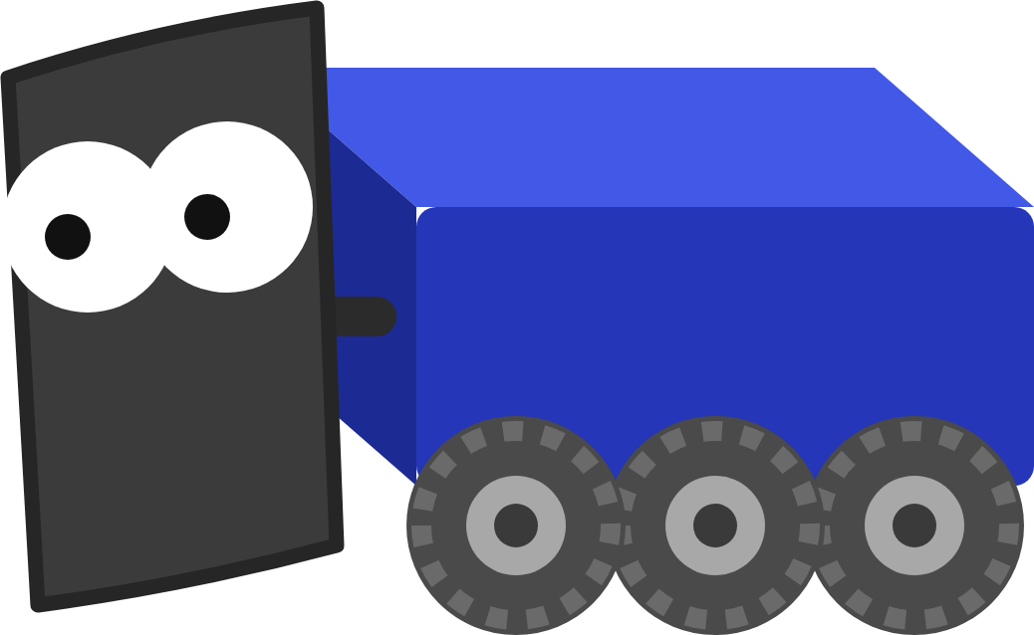
CLASSES AND OBJECTS
import: where a class lives
Top of the file
GOTCHA
import edu.wpi.first.math.geometry.Pose2d;
cannot find symbol
import edu.wpi.first.math.geometry.Rotation2d;
import edu.wpi.first.math.kinematics.ChassisSpeeds;
Java doesn't know which Pose2d you mean. Add the import line.
Pose2d
geometry
In VS Code: hover the red squiggle, pick the quick fix.
edu.wpi.first.math
Rotation2d
ChassisSpeeds
kinematics
DifferentialDriveKinematics
Packages are folders of classes.
MARS/WARS SOFTWARE TRAINING
12
Notes:
WPILib's classes live in packages, which work like folders. Java can't find Pose2d until you tell it where it lives with an import line at the top of the file, like the address on an envelope. Forget it and the build fails with 'cannot find symbol'. VS Code can add imports for you: hover the red squiggle and pick the quick fix. In the lesson you add the import for DifferentialDriveWheelSpeeds yourself.

Slide 13
02
Static and OI
Ask OI, not the gamepad. OI knows which stick is which.
One class that owns the controls
MARS/WARS SOFTWARE TRAINING
13
Notes:
Now a special kind of class: one you never build objects from. The OI class is the first thing you write in the lesson.

Slide 14
STATIC AND OI
static: belongs to the class
static
Not static
Call it on the class name
Call it on an object
OI.getForward()
drive_.getPose()
which drivetrain?
Math.abs(-0.5)
mars.scoreBall()
which team?
MathUtil.applyDeadband(x, 0.1)
controller_.getLeftY()
which controller?
Units.inchesToMeters(24.0)
abstract class OI: nobody ever writes new OI(). Everything in it is static, so there's nothing to build.
MARS/WARS SOFTWARE TRAINING
14
Notes:
Most methods belong to an object: drive_.getPose() needs to know which drivetrain. A static method belongs to the class itself, so you call it on the class name, no object needed. You've used some already: Math.abs, MathUtil.applyDeadband, Units.inchesToMeters. The OI class is all static, and it's marked abstract: nobody ever writes new OI(). Ask: is controller_.getLeftY() static? (No: it asks one particular controller.)

Slide 15



STATIC AND OI
OI: one place for the controls
Robot.java
OI
Gamepad
forward?
OI.getForward()
The only class that knows the gamepad
asks a question
getLeftY() getLeftX()
0.8
One place to change
Reads like English
Like our real robots
Swap a stick or a controller: edit OI.java only.
OI.getForward() says what, not which stick.
Our competition code keeps every controller in OI.
MARS/WARS SOFTWARE TRAINING
15
Notes:
OI stands for Operator Interface: the human's controls. It's the only class that knows about the gamepad. The rest of the robot asks it questions like 'how hard is the driver pushing forward?' and never cares which stick that is. It's like asking the receptionist instead of walking down the hall. Our competition code keeps every controller in OI too. Ask: next season the drivers want forward on the right stick. How many files change? (One: OI.java.)

Slide 16
STATIC AND OI
Writing OI.java
OI.java
1
abstract
Nobody writes new OI()
1
public abstract class OI {
private static final XboxController driver_controller_ =
2
new XboxController(0);
2
One controller
3
Private and static: only OI touches it
public static double getForward() {
return MathUtil.applyDeadband(-driver_controller_.getLeftY(), 0.1);
}
getForward()
3
4
Left stick Y, minus sign, deadband
public static double getTurn() {
return MathUtil.applyDeadband(driver_controller_.getLeftX(), 0.1);
}
}
4
getTurn()
Left stick X. No minus sign
Java: Classes & Objects
MARS/WARS SOFTWARE TRAINING
16
Notes:
The finished OI class. 1: abstract, so nobody makes an OI object. 2: the one XboxController, private and static, on port 0. 3: getForward is public so anyone can call it, static so you call it on the class, and double because it hands back a number. The minus sign makes forward positive, and the deadband ignores tiny pushes. 4: getTurn is the same with the X axis and no minus sign. Ask: why no minus on getTurn? (Pushing right is already positive.)

Slide 17

STATIC AND OI
Robot.java asks OI
BEFORE
ALSO DELETE
drive_.arcadeDrive(
• The controller_ field
MathUtil.applyDeadband(-controller_.getLeftY(), 0.1),
MathUtil.applyDeadband(controller_.getLeftX(), 0.1));
• The XboxController import
• The unused MathUtil import
AFTER
Verify looks for the word XboxController anywhere in Robot.java.
drive_.arcadeDrive(OI.getForward(), OI.getTurn());
Same robot, same driving. Only now OI owns the controller.
MARS/WARS SOFTWARE TRAINING
17
Notes:
Then Robot.java stops reading the controller itself. Before: three lines that know about sticks and deadbands. After: one line that asks OI. Same robot, same driving. Also delete the controller_ field and the XboxController import at the top: the Verify check looks for the word XboxController anywhere in Robot.java, and an unused MathUtil import can go too.

Slide 18
STATIC AND OI
The deadband, WPILib's way
value out
3
MathUtil.applyDeadband(value, 0.1)
2
1
Ignore tiny pushes
1
A resting stick reads a little off zero. Now it's exactly 0
-1
1
2
Stretch the rest
-0.1 to 0.1
Just past 0.1 starts again from 0
counts as 0
3
Full push stays full
1.0 in gives 1.0 out
stick in
MARS/WARS SOFTWARE TRAINING
18
Notes:
Why the deadband? A stick never rests at exactly zero: let go and it might read 0.03, and the robot creeps. MathUtil.applyDeadband(value, 0.1) treats anything between -0.1 and 0.1 as zero. Past that it stretches the rest back out, so a full push still gives 1.0. You wrote one by hand earlier; this is WPILib's built-in, static version. Ask: what does applyDeadband(0.05, 0.1) return? (0.0.)

Slide 19
03
WPILib's classes
Why build it yourself when WPILib already did? Use the toolbox!
Ready-made blueprints for angles, positions and speeds
MARS/WARS SOFTWARE TRAINING
19
Notes:
Last lesson you did the drive math by hand. WPILib, the robot toolkit, has classes for all of it. Don't reinvent the wheel.

Slide 20
WPILIB'S CLASSES
Today's toolbox
Rotation2d
geometry
An angle: which way the robot faces
Pose2d
geometry
Where on the field, and which way it faces
ChassisSpeeds
kinematics
How fast the whole robot moves and turns
DifferentialDriveKinematics
kinematics
Turns wheel speeds into robot speeds
DifferentialDrivePoseEstimator
estimator
Adds up every move to track the pose
All from WPILib, under edu.wpi.first.math. Each one: new to build it, a dot to use it.
MARS/WARS SOFTWARE TRAINING
20
Notes:
WPILib is full of classes for common robot jobs. Today's five. Rotation2d is an angle. Pose2d is a spot on the field plus a heading. ChassisSpeeds is how fast the whole robot moves. DifferentialDriveKinematics turns wheel speeds into robot speeds. DifferentialDrivePoseEstimator keeps track of the pose. In the old training this slide was titled 'Now don't get mad': almost all the math you did by hand is already in WPILib.

Slide 21

WPILIB'S CLASSES
Rotation2d: an angle
counterclockwise +
90°
Rotation2d turned = new Rotation2d(0.5);
1
Rotation2d tilt = Rotation2d.fromDegrees(30);
2
double deg = turned.getDegrees(); // 28.6
3
0.5 rad
180°
0°
1
From radians
new, with the angle in radians
2
From degrees
A static method on the class
3
Ask for either unit
-90°
getDegrees() or getRadians()
1 radian ≈ 57.3°. A full turn is 2π ≈ 6.28.
MARS/WARS SOFTWARE TRAINING
21
Notes:
Rotation2d is an angle object. Build it from radians with new, or from degrees with Rotation2d.fromDegrees (a static method). Ask it for either unit with getDegrees or getRadians. Angles are counterclockwise positive: 0 is facing along the field's x axis, 90 degrees is facing left. One radian is about 57.3 degrees; a full turn is 2 pi, about 6.28. Ask: is 0.5 radians more or less than 45 degrees? (Less: about 28.6.)

Slide 22
WPILIB'S CLASSES
Pose2d: where is the robot?
blue alliance
red alliance
x
Meters along the field, from the blue wall
θ = 0.5 rad
y
y = 4.0
Meters across the field
Rotation2d
Which way it faces, counterclockwise
(0, 0)
x = 2.0
x (meters) →
getX()
Pose2d start = new Pose2d(2.0, 4.0, turned);
Ask the pose for its x
double x = start.getX(); // 2.0
MARS/WARS SOFTWARE TRAINING
22
Notes:
A pose is where the robot is and which way it faces: x and y in meters from the field's origin corner, plus a Rotation2d. x runs along the field away from the blue alliance wall; y runs across it. This is the lesson's example: new Pose2d(2.0, 4.0, turned), with turned being 0.5 radians. getX asks the pose for its x. Ask: the robot drives straight toward the red alliance. Which number changes? (x.)

Slide 23
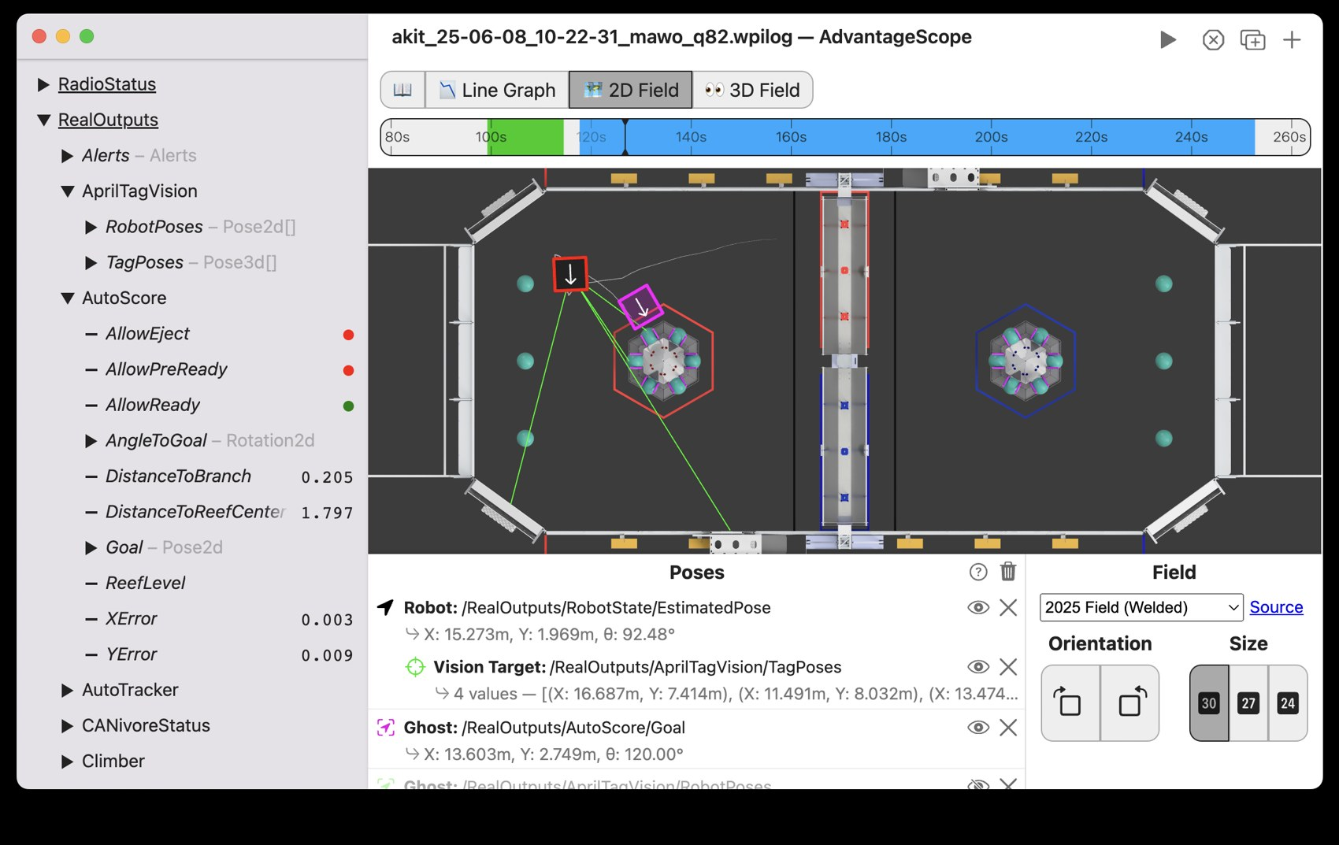
WPILIB'S CLASSES
Poses in AdvantageScope
1
The robot
Drawn at its pose, arrow pointing the way it faces
1
The numbers
2
X and Y in meters, and θ, the heading
3
In the lesson
Drag Drive/Pose and Drive/TruePose onto one field
2
On the team's robots: AdvantageScope runs on the laptop.
MARS/WARS SOFTWARE TRAINING
23
Notes:
This is what a pose looks like in AdvantageScope, the desktop app we use on the laptops. The 2D Field tab draws the field from above. 1: drag any Pose2d onto the Poses list and a robot appears at that spot, with an arrow for its heading. 2: the list shows its X, Y and angle. In the lesson you drag Drive/Pose (your estimate) and Drive/TruePose (the simulator's truth) onto the same field. Screenshot from the AdvantageScope docs.

Slide 24
WPILIB'S CLASSES
ChassisSpeeds: how the robot moves
vx forward
ChassisSpeeds speeds = getChassisSpeeds();
speeds.vxMetersPerSecond // forward
speeds.vyMetersPerSecond // sideways
speeds.omegaRadiansPerSecond // turning
Tank
Swerve
vy sideways
0 on tank
omega turning
+ is left
vx and omega. vy is always 0.
All three. Our competition robots.
One object instead of three loose variables.
MARS/WARS SOFTWARE TRAINING
24
Notes:
ChassisSpeeds bundles the robot's speeds into one object: vx is forward speed in meters per second, vy is sideways speed, and omega is turning speed in radians per second, positive to the left. A tank drive can't slide sideways, so vy is always 0 here. Swerve uses all three: that's why our competition robots use the same class. The old training called this kind of class a struct: a container for several values.

Slide 25
04
Kinematics and yaw
Right side faster than the left? I'm turning left!
From wheel speeds to robot speed and heading
MARS/WARS SOFTWARE TRAINING
25
Notes:
Kinematics turns what the wheels do into what the robot does. Then yaw: which way the robot faces.

Slide 26
KINEMATICS AND YAW
Kinematics: wheel speeds in, robot speeds out
WHEEL SPEEDS
CHASSISSPEEDS
vx
4.0
DifferentialDrive-
Kinematics
m/s forward
Knows the track width: 0.61 m
omega
3.3
rad/s, turning left
left 3.0 m/s
right 5.0 m/s
forward
(left + right) / 2 = (3.0 + 5.0) / 2 = 4.0 m/s
turning
(right - left) / track width = (5.0 - 3.0) / 0.61 ≈ 3.3 rad/s
MARS/WARS SOFTWARE TRAINING
26
Notes:
Kinematics: wheel speeds in, robot speeds out. Say the left side does 3.0 meters per second and the right 5.0. The robot moves forward at the average, 4.0, and turns at the difference divided by the track width (the distance between the left and right wheels, 24 inches or about 0.61 m on this robot): 2.0 / 0.61 is about 3.3 radians per second, to the left. It's the same math as your DriveMath from last lesson; WPILib's class does it for you. Ask: left 4, right 4? (Forward 4, turning 0.)

Slide 27
KINEMATICS AND YAW
Writing getChassisSpeeds()
mechanisms/DifferentialDriveMech.java
1
Already built
1
The kinematics object, made from the track width
private final DifferentialDriveKinematics kinematics_ =
new DifferentialDriveKinematics(Constants.TRACK_WIDTH_METERS);
public ChassisSpeeds getChassisSpeeds() {
2
Bundle
2
DifferentialDriveWheelSpeeds wheels =
Both wheel speeds in one object, with new
new DifferentialDriveWheelSpeeds(
getLeftMetersPerSecond(), getRightMetersPerSecond());
3
return kinematics_.toChassisSpeeds(wheels);
}
3
Convert
toChassisSpeeds() hands back the robot's speeds
Java: Classes & Objects
Don't forget: import edu.wpi.first.math.kinematics.DifferentialDriveWheelSpeeds;
MARS/WARS SOFTWARE TRAINING
27
Notes:
In the lesson, the kinematics object is already built in DifferentialDriveMech, from the track width in Constants. You write getChassisSpeeds in two moves. Bundle: put the two wheel speeds into one DifferentialDriveWheelSpeeds object with new. Convert: hand the bundle to kinematics_.toChassisSpeeds and return what comes back. Remember the import for DifferentialDriveWheelSpeeds, and replace the placeholder return: a method can only return once.

Slide 28
KINEMATICS AND YAW
Two routes, one answer
6
1
On top of each other
m/s
WPILib's answer matches your DriveMath
about 5 m/s
2
4
2
Full stick: about 5 m/s
1
That's the Chassis speeds checkpoint
2
3
Lines disagree?
Check the two lines in getChassisSpeeds()
0
0 s
1 s
2 s
3 s
4 s
5 s
6 s
Drive/LinearSpeed
Drive/LinearSpeedByHand
MARS/WARS SOFTWARE TRAINING
28
Notes:
To check it, graph two values in AdvantageScope. Drive/LinearSpeed is WPILib's answer from your getChassisSpeeds. Drive/LinearSpeedByHand is your own DriveMath from last lesson. Same wheels, two routes, so the lines should sit right on top of each other. Hold the stick full forward and the speed climbs to about 5 meters per second: that's the Chassis speeds checkpoint. This is a drawn mock, not a real log.

Slide 29
KINEMATICS AND YAW
Yaw: which way it faces, from the wheels
Turned 1 radian ≈ 57° left
THE MATH
(right - left)
/ track width
(1.6 - 1.0) / 0.6
= 1.0 radian
right 1.6 m
left 1.0 m
• Right farther than left: turned left, yaw goes up
start
• Comes out in radians
MARS/WARS SOFTWARE TRAINING
29
Notes:
Yaw is which way the robot faces. This robot works it out from the wheels: when it turns left, the right wheels roll farther than the left ones. The angle, in radians, is the difference divided by the track width. The lesson's example: left 1.0 m, right 1.6 m, wheels 0.6 m apart: (1.6 - 1.0) / 0.6 = 1 radian, about 57 degrees to the left. Activity: two students side by side holding a meter stick walk a left turn; the outside one walks farther.

Slide 30
KINEMATICS AND YAW
Writing getYaw()
mechanisms/DifferentialDriveMech.java
1
Right minus left
public Rotation2d getYaw() {
Over the track width. Radians
double radians =
(getRightMeters() - getLeftMeters()) / Constants.TRACK_WIDTH_METERS;
1
return new Rotation2d(radians);
Wrap it
2
2
}
A new Rotation2d, built from the radians
CHECKPOINT
Spin left
Spin right
Spin left: Drive/PoseYawDeg goes clearly positive.
+ yaw
- yaw
counterclockwise
clockwise
MARS/WARS SOFTWARE TRAINING
30
Notes:
getYaw in code: subtract left from right, divide by the track width, and wrap the radians in a Rotation2d, because WPILib passes angles around as Rotation2d objects. Get the order right: left minus right would make left turns negative. The checkpoint: spin the robot counterclockwise (left) and Drive/PoseYawDeg goes clearly positive. Yaw only shows up once the pose estimator, in the next part, uses it.

Slide 31


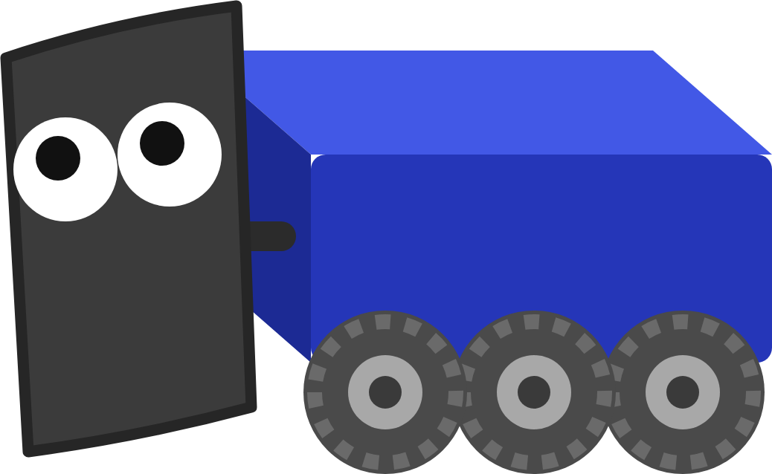
KINEMATICS AND YAW
Real robots use a gyro
From the wheels
From a gyro
What this lesson does. Free, but wheels slide when the robot turns, and every slip becomes a heading error.
Measures rotation directly. Our swerve robots use a CTRE Pigeon 2 on the CAN bus.
Heading matters most. A heading off by 5° puts you about 0.9 m sideways after 10 m of driving.
MARS/WARS SOFTWARE TRAINING
31
Notes:
Working out yaw from the wheels is free, but it's the weakest part of odometry: wheels slide sideways across the carpet when the robot turns, and every slip becomes a heading error that sends every later meter the wrong way. Real robots measure yaw directly with a gyro. Our swerve robots use a CTRE Pigeon 2 on the CAN bus, and MWLib's swerve code only falls back to working yaw out from the wheels if the gyro disconnects. The lesson's robot has no gyro, so you can see what drift looks like.

Slide 32
05
Odometry
I count every wheel turn. 50 times a second!
Adding up every little move to find the pose
MARS/WARS SOFTWARE TRAINING
32
Notes:
Odometry is dead reckoning: no landmarks, just adding up how the wheels moved. The pose estimator does it every loop.

Slide 33
ODOMETRY
Dead reckoning: start, then add up the moves
y ↑
1
Start
(0, 0), facing 0°
(1, 1) 90°
2
Drive 1 m
(1, 0), facing 0°
1 m
3
Turn left, drive 1 m
(1, 1), facing 90°
turn left
1 m
Like counting your steps with your eyes closed.
x →
(0, 0) 0°
(1, 0) 0°
MARS/WARS SOFTWARE TRAINING
33
Notes:
Dead reckoning: you know where you started, and you add up every move. Sailors did this before GPS. Start at (0, 0) facing along x. Drive 1 m forward: (1, 0), still facing 0 degrees. Turn left and drive 1 m: (1, 1), facing 90 degrees. The pose estimator does exactly this, from the encoders and the yaw. Activity: one student closes their eyes; the class calls out moves; they say their x and y after each one, then open their eyes and check.

Slide 34
ODOMETRY
Fifty tiny steps a second
Read
Work out
Add
left and right meters, and the yaw
the tiny move since last loop
it to the pose
each dot: one loop
100 ms
start
MARS/WARS SOFTWARE TRAINING
34
Notes:
The estimator doesn't wait for big moves. Every loop, every 20 milliseconds, it reads how far each side has rolled and the yaw, works out the tiny move since last time, and adds it to the pose. Fifty tiny steps a second add up to a smooth path. Ask: if each step had a 1 mm error, how big could the error be after a 2 minute 30 second match? (7,500 steps: up to 7.5 m if they all went the same way.)

Slide 35

ODOMETRY
Writing updatePose()
mechanisms/DifferentialDriveMech.java
1
Built once
private final DifferentialDrivePoseEstimator pose_estimator_ =
From kinematics_, starting at the origin
1
new DifferentialDrivePoseEstimator(
kinematics_, new Rotation2d(), 0.0, 0.0, new Pose2d());
private Pose2d pose_ = new Pose2d();
2
Update
Hand it the yaw and both distances
private void updatePose() {
pose_estimator_.update(getYaw(), getLeftMeters(), getRightMeters());
2
pose_ = pose_estimator_.getEstimatedPosition();
3
Read
3
}
Its best guess, kept in pose_
Order matters. Update first, then read. Read first and you get last loop's pose.
MARS/WARS SOFTWARE TRAINING
35
Notes:
The pose estimator is a field in DifferentialDriveMech. 1: built once from the kinematics object, a starting yaw, starting distances and a starting pose (the origin). 2: update hands it the latest yaw and how far each side has driven. 3: getEstimatedPosition reads back its best guess into pose_. Order matters: read before update and you get last loop's answer. getPose() passes pose_ to the rest of the robot and the logs. The loop calls updatePose every 20 ms for you.

Slide 36
ODOMETRY
Drift: the estimate wanders off
Wheel size
Never exactly what the code thinks
Slip
Wheels skid a little, most when turning
drift
Jitter
Every reading is a hair off
start
Tiny errors that never cancel out. They pile up.
Drive/TruePose: where it really is
Drive/Pose: your estimate
MARS/WARS SOFTWARE TRAINING
36
Notes:
The catch: the estimate drifts. Real wheels are never exactly the size the code thinks, they slip a little as they roll, and sensors jitter. Each error is tiny, but they never cancel out; they pile up with every step. The simulator copies this on purpose: the left wheels read 0.4% too far, the right 0.3% too short, plus random slip. In the lesson, drag Drive/Pose and Drive/TruePose onto the 2D field, drive a long way and watch them separate. A real robot has no TruePose. Ask: why not?

Slide 37

ODOMETRY
How real robots stop the drift
Wheel encoders
Every 20 ms. Smooth, but drifts
Gyro
Pose estimator
Pose2d
The heading, measured directly
Blends them into one best guess
x, y, heading
Cameras + AprilTags
Now and then. Snaps it back
In this lesson: wheels only, so the drift is easy to see. Competition robots use all three.
MARS/WARS SOFTWARE TRAINING
37
Notes:
How real robots fix drift. Wheel odometry is the base: every 20 ms, smooth, but it drifts. A gyro gives the heading directly, which removes the biggest source of error. Cameras that see AprilTags on the field now and then work out where the robot is from scratch, and the pose estimator blends that in and pulls the estimate back to the truth. That blending is why WPILib calls it a pose estimator, not just odometry. In this lesson it's wheels only, so the drift is easy to see.

Slide 38
ODOMETRY
Using the pose: drive to x = 3 m
Robot.java
Drive/PoseX (m)
4
public void autonomousInit() {
3
1
drive_.resetPose();
}
3
x = 3.0
public void autonomousPeriodic() {
2
if (drive_.getPose().getX() < 3.0) {
2
drive_.arcadeDrive(0.4, 0.0);
} else {
2
3
drive_.arcadeDrive(0.0, 0.0);
1
}
}
1
0
0 s
2 s
4 s
6 s
1 reset 2 drive while x < 3.0 3 stop
Stops a little past 3 m: the robot coasts after the power is cut.
MARS/WARS SOFTWARE TRAINING
38
Notes:
Now use the pose. autonomousInit resets the pose to the origin. autonomousPeriodic is the same if and else as the bang-bang lesson, but the question is now the pose: while x is less than 3.0, drive forward at 0.4; otherwise stop. Watch Drive/PoseX: it climbs to 3 and goes flat. It stops a little past 3, because the robot keeps rolling after the power is cut. The checkpoint accepts 2.95 to 3.9 m. Ask: how could you make it stop closer to 3.0? (Slow down as it gets close.)

Slide 39
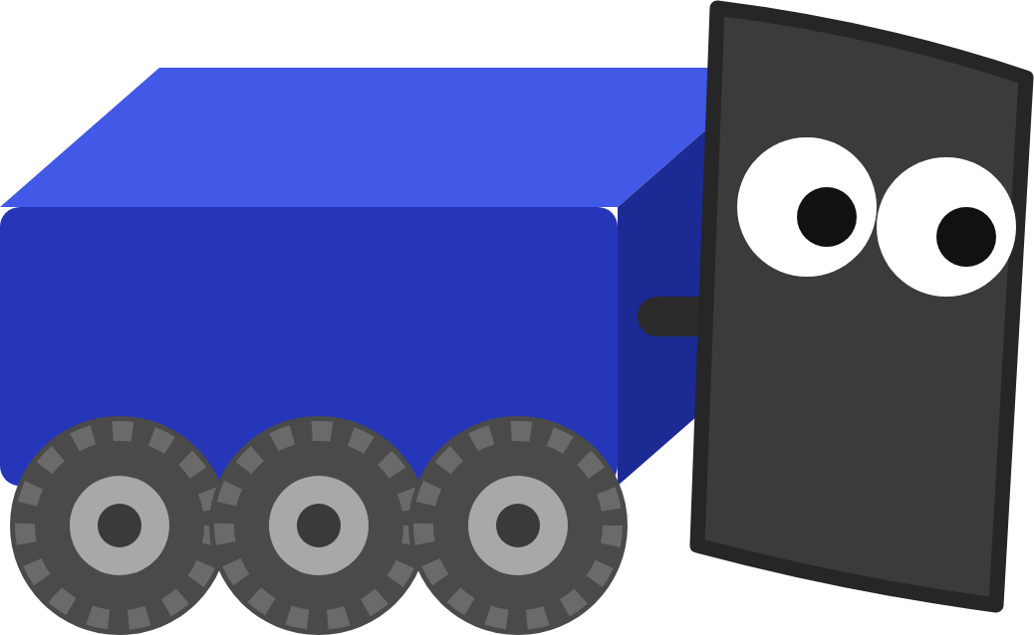
YOUR TURN
Objects and Odometry
Write the OI class, then kinematics, yaw and the pose estimator. Drive to x = 3 m in Auto and press Verify on each checkpoint.
4 CHECKPOINTS
OI class
Static getForward() and getTurn(); Robot.java uses them
Chassis speeds
Full speed forward: Drive/LinearSpeed about 5 m/s
Yaw
Spin left: Drive/PoseYawDeg clearly positive
Drive to x = 3 m
Run Auto: Drive/PoseX ends near 3 m
Bonus: getSlowMode() on a bumper in OI; reset the pose to (2.0, 4.0) at the start of Auto
In Scriptum: FRC Robot › Objects and Odometry
MARS/WARS SOFTWARE TRAINING
39
Notes:
This is the hands-on part: the Objects and Odometry lesson in Scriptum's FRC Robot track, about three hours. Press Verify on each checkpoint as you go. The first reads your code; the others watch the robot's logged values. Dozer's guides in the top bar explain each idea and can walk you through every job. Bonuses are optional.

Slide 40
RECAP
What you can do now
Tell a class from an object
RELATED JAVA TRAINING
NEXT UP
Build objects with new, use them with a dot
Classes & Objects
Mechanisms and Subsystems
Write static methods in an OI class
Inheritance
Move the drivetrain into a subsystem, then build a shooter from a flywheel and a roller.
Use Rotation2d, Pose2d and ChassisSpeeds
Turn wheel speeds into speed and yaw
Track the pose and use it in Auto
Optional practice in Scriptum's Java track.
MARS/WARS SOFTWARE TRAINING
40
Notes:
Wrap up. Classes and objects are how all robot code is organized, so you'll see them in every lesson from here. The pose is how the robot plans autonomous paths later. Next deck: the drivetrain moves into a subsystem, and you build a shooter from mechanisms. The Java lessons on the right are optional practice for today's ideas.

