Slide 1

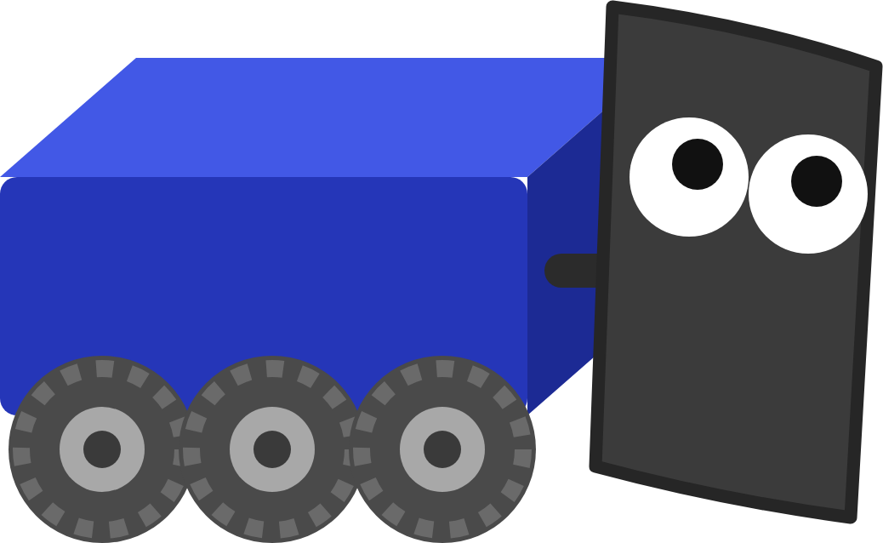
FRC ROBOT · DECK 1
Motors and Drivetrains
How code turns into motion, and your first drive code: tank drive, then arcade drive.
Let's get me moving! First stop: the motors.
Notes:
Welcome to the first FRC Robot deck. Today: how the robot turns a number in your code into a spinning wheel, how to run the robot safely from the Driver Station, just enough Java to write drive code, and then tank drive and arcade drive. The hands-on part is the Motors and Drivetrains lesson in Scriptum.

Slide 2






TODAY
From motor to driving
01
02
03
04
05
How a robot moves
Driver Station and modes
Your first Java
Drivetrains
Tank and arcade
Controllers, motors and the CAN bus
Enabling safely and when code runs
Objects, methods, variables, math
Tank, mecanum and swerve
Writing the drive code
By the end: you drive the robot with a gamepad, first with two sticks, then with one.
MARS/WARS SOFTWARE TRAINING
2
Notes:
Five parts. By the end of the lesson you drive the simulated robot with a gamepad, first with two sticks (tank) and then with one (arcade). Ask: who has driven an RC car? Which kind of controls did it have?

Slide 3
01
How a robot moves
Your code never touches a motor. It sends a number down the line.
From a number in your code to a spinning wheel
MARS/WARS SOFTWARE TRAINING
3
Notes:
This part is hardware: what's on the robot and how a command reaches a motor. You won't wire anything today, but knowing the chain makes debugging much easier.

Slide 4



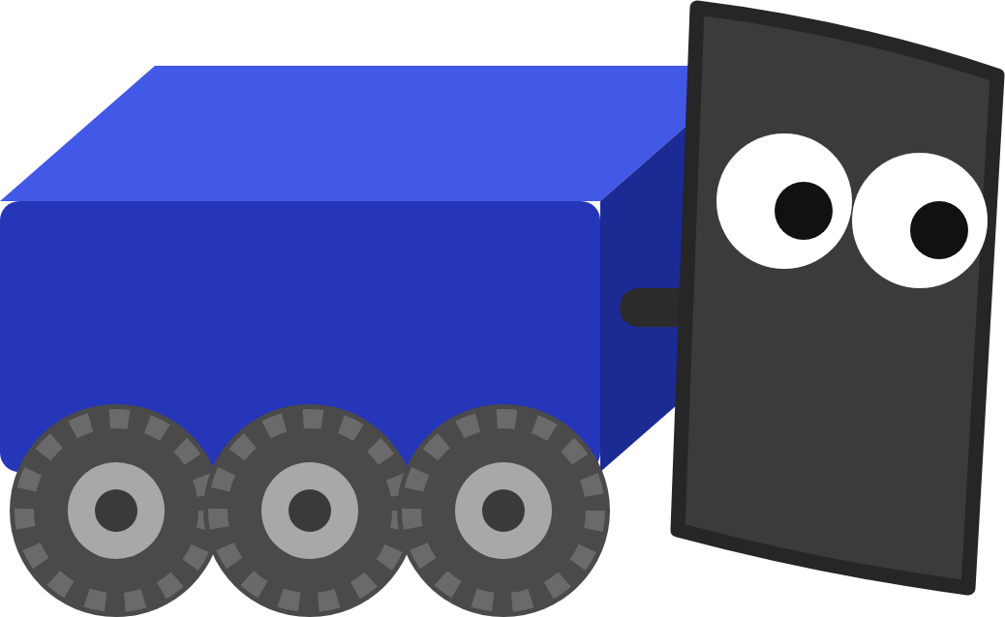
HOW A ROBOT MOVES
The control chain
Gamepad
Driver Station
Radio
roboRIO
CAN bus
Motor controller
Driver moves a stick
Laptop sends it
Wi-Fi to the robot
Your code runs here
Carries the number
Lets power through
...and the motor spins
Your code runs on the roboRIO. Everything else carries its numbers in or out.
MARS/WARS SOFTWARE TRAINING
4
Notes:
Follow one command. The driver moves a stick on the gamepad plugged into the Driver Station laptop. The laptop sends it over Wi-Fi to the robot's radio, which passes it to the roboRIO. Your code runs on the roboRIO: it reads the stick and decides on a number. That number travels over the CAN bus to a motor controller, which lets the right amount of battery power through to the motor. Activity: have six students stand in a line as the six boxes and pass a sticky note.

Slide 5
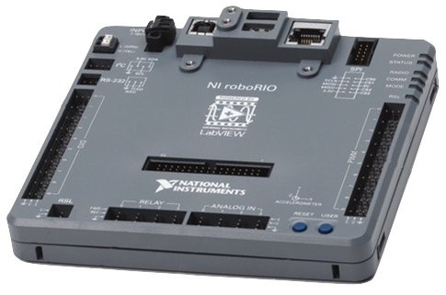
HOW A ROBOT MOVES
The roboRIO: the robot's brain
• Runs your robot code every 20 ms
• Talks to motor controllers over CAN
• Has ports for sensors: 10 DIO, 4 analog, 10 PWM
• Lives at 10.41.43.2 (Varsity) and 10.44.23.2 (JV)
NI roboRIO
MARS/WARS SOFTWARE TRAINING
5
Notes:
The roboRIO is a small computer made for FRC robots. Your Java runs on it. It talks to the motor controllers over CAN, and has ports for sensors and simpler devices. Its address on the robot network is 10.TE.AM.2, so 10.41.43.2 on Varsity and 10.44.23.2 on JV. Ask: why would the robot need its own computer instead of running code on the laptop?

Slide 6

HOW A ROBOT MOVES
Motors and motor controllers
roboRIO
CAN: 0.5
Battery
power
Motor controller
power
Motor
12 volts
How much to let through
Spins the wheel
The controller lets through the share of battery power your number asks for.
MARS/WARS SOFTWARE TRAINING
6
Notes:
A motor only knows how to spin when power flows through it. The motor controller sits between the battery and the motor and decides how much of the battery's 12 volts to let through, based on the number it gets from the roboRIO. Ask: what would happen if a motor were wired straight to the battery? (It would run flat out with no way to stop it.)

Slide 7
HOW A ROBOT MOVES
Brushed vs brushless
Brushed
Brushless
Carbon brushes switch the current inside the motor. Simple and cheap, but the brushes wear and there's no built-in sensor.
Seen on old robots: CIM, 775pro with Victor SPX or Talon SRX.
The controller's electronics switch the current. Stronger and more efficient, and it measures its own speed and position.
What we use: Kraken X60, NEO, NEO Vortex.
On our robots: brushless, every time. You'll still meet brushed motors on old robots.
MARS/WARS SOFTWARE TRAINING
7
Notes:
Two kinds of motor. Brushed motors switch their own current with small carbon brushes, so they're simple but wear out and have no built-in sensor. Brushless motors let the controller's electronics do the switching: stronger, more efficient, and they report their own position and speed. The team drives with brushless motors. Older brushed motors (CIM, 775pro) used controllers like the Victor SPX and Talon SRX; you'll still see them on old robots.

Slide 8

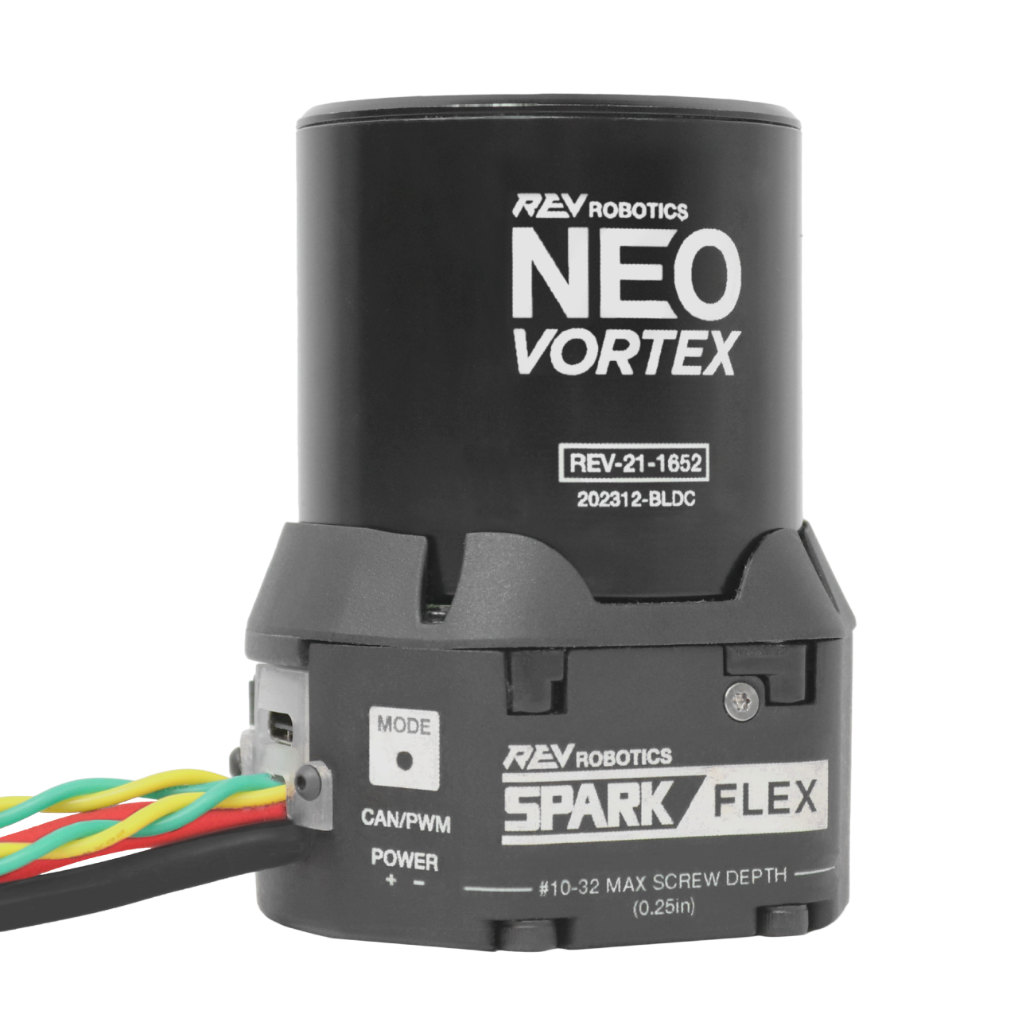
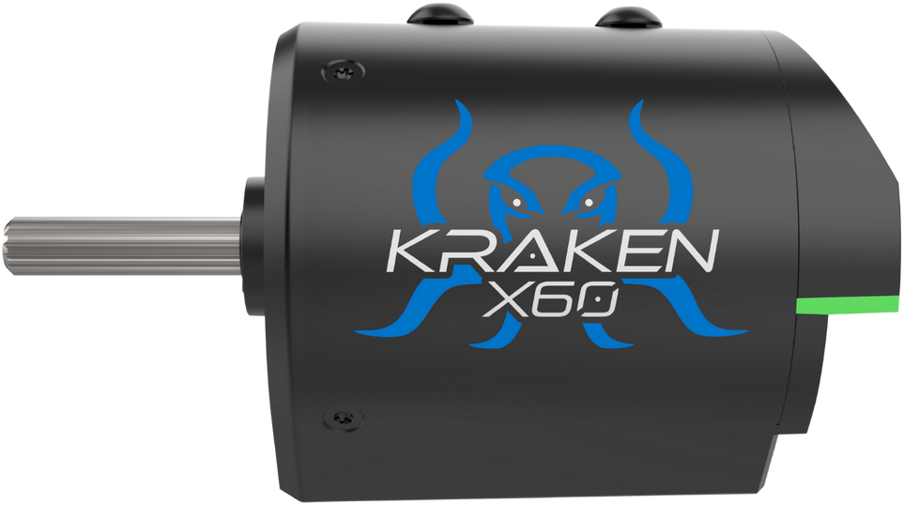
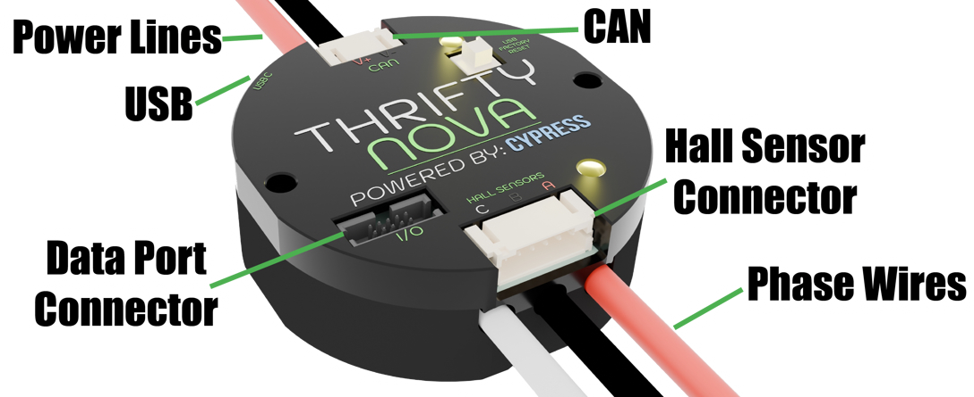
HOW A ROBOT MOVES
What's on our robots
Kraken X60
Spark MAX
Spark Flex
Thrifty Nova
Motor with a Talon FX controller built in. Our drive motor.
REV's controller, paired with a NEO motor.
REV's controller that docks onto a NEO Vortex.
A small brushless controller from The Thrifty Bot.
MARS/WARS SOFTWARE TRAINING
8
Notes:
The controllers and motors on our robots. The Kraken X60 is a brushless motor with a Talon FX controller built in, so there's nothing extra to wire: it's what the lesson's drivetrain uses. REV's Spark MAX drives a NEO; the Spark Flex docks right onto a NEO Vortex. The Thrifty Nova is another small brushless controller. All of them connect to the roboRIO over CAN. Pass real ones around if you have them.

Slide 9
HOW A ROBOT MOVES
Kraken X60 and Kraken X44
Kraken X60
Kraken X44
The bigger one, with the most power. Our drive motor.
Smaller and lighter, with the same shaft and length. For shooters, hoods and intakes where space is tight.
motor_type = TalonMotorType.X60
motor_type = TalonMotorType.X44
Both have a Talon FX built in, so code drives them the same way. Only the motor type changes.
MARS/WARS SOFTWARE TRAINING
9
Notes:
Two Krakens. The X60 is the bigger one: the most power, and what our drivetrain uses. The X44 has a smaller diameter and weighs less, but keeps the same shaft, mounting and length, so it can drop into most of the same places. WCP built it for spots where space is tight: shooters, hoods and intakes. Both have a Talon FX built in, so code talks to them the same way; in MWLib only the motor type in the config changes. Ask: where on last season's robot would a smaller motor have helped?

Slide 10
HOW A ROBOT MOVES
The CAN bus
roboRIO
Talon FX
Talon FX
Spark MAX
Gyro
start of bus
ID 1
ID 2
ID 3
ID 4
120 Ω
CAN High
CAN Low
end of bus
Daisy chain
Unique IDs
Terminate both ends
Each device connects to the next. A loose plug cuts off everything after it.
Every device has its own number. The code finds a motor by its ID.
120 Ω at each end. The roboRIO has one built in.
MARS/WARS SOFTWARE TRAINING
10
Notes:
CAN is the wire that connects the roboRIO to every motor controller and many sensors. It's a twisted pair: yellow is CAN High, green is CAN Low. Devices are daisy-chained, one to the next, and each end of the chain needs a 120 ohm terminating resistor (the roboRIO has one built in). Every device has an ID number so the roboRIO can talk to one at a time. Ask: if one connector in the middle comes loose, which devices stop working? (Everything after it.)

Slide 11

HOW A ROBOT MOVES
Setting CAN IDs
Constants.java
// Each side of the drivetrain: one Kraken X60
Phoenix Tuner X
REV Hardware Client
LEFT_MOTORS = List.of(motor(1, false));
For CTRE devices: Talon FX, Kraken X60, CANcoder, Pigeon.
For REV devices: Spark MAX, Spark Flex.
RIGHT_MOTORS = List.of(motor(2, true));
The number is the CAN ID. The true on the right side is inversion: more on that soon.
Rule: no two devices share an ID.
MARS/WARS SOFTWARE TRAINING
11
Notes:
Every device on the bus needs its own ID. CTRE devices like the Talon FX inside a Kraken are set with Phoenix Tuner X; REV devices like the Spark MAX with the REV Hardware Client. Two devices with the same ID fight over the same messages, and neither works right. The code then refers to each motor by the ID you set. In the lesson project, Constants.java says the left motor is ID 1 and the right is ID 2.

Slide 12
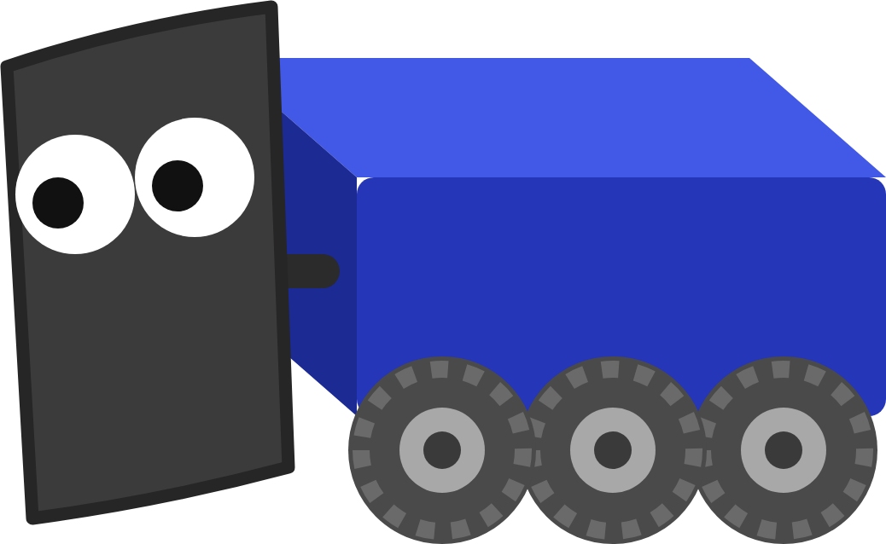
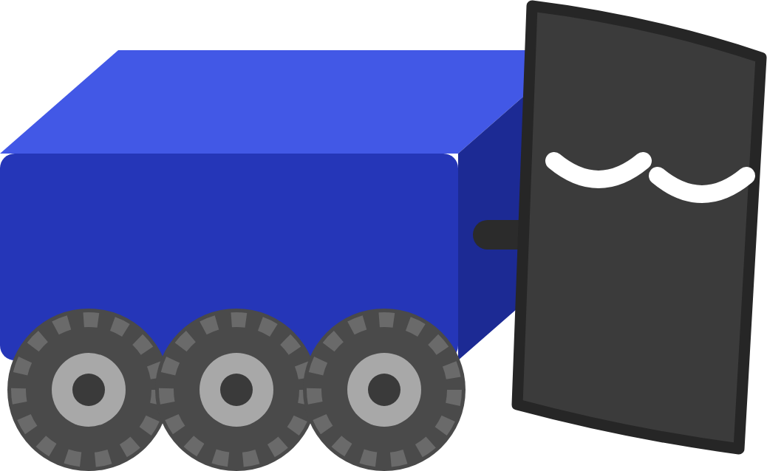
HOW A ROBOT MOVES
One number: the duty cycle
0.5 = half speed forward
-1.0
-0.5
0.0
0.5
1.0
full backward
stop
full forward
Past 1.0? It's clipped: 1.5 acts like 1.0, and -3 acts like -1.0.
MARS/WARS SOFTWARE TRAINING
12
Notes:
Your code tells a motor controller how hard to push with one number from -1.0 to 1.0, called the duty cycle. 1.0 is full forward, -1.0 is full backward, 0 is stop, and 0.5 is half. Anything past 1.0 is clipped, so 1.5 acts like 1.0. Activity: call out numbers and have the class point which way and how fast: 0.25, -1.0, 0, 2.0.

Slide 13
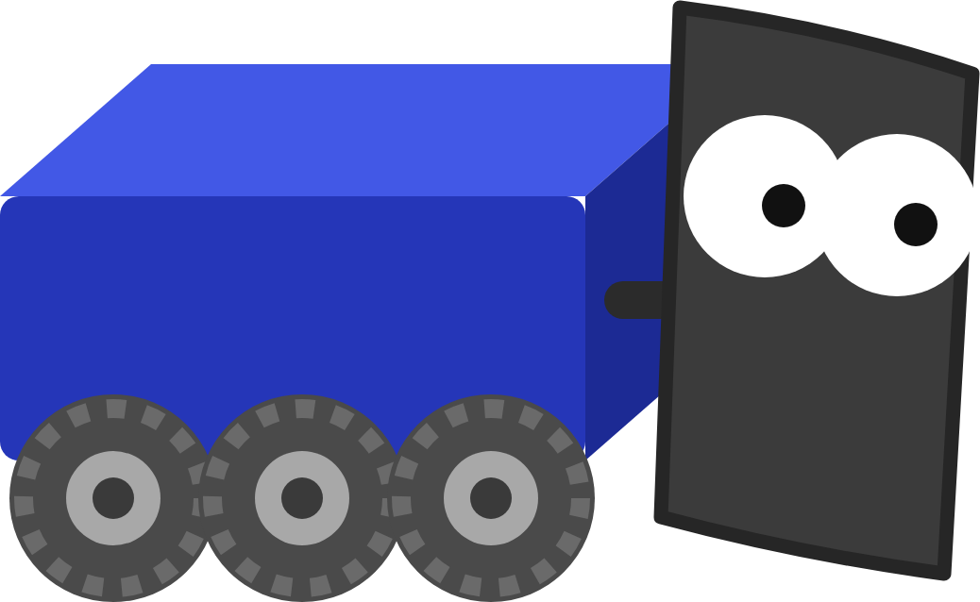


HOW A ROBOT MOVES
Inversion: mirror-image sides
Not inverted
Right side inverted
0.5
0.5
0.5
0.5
Both get 0.5, but the right side spins backward: the robot turns in place.
Both get 0.5 and both push forward: the robot drives straight.
In our code, Constants.java inverts the right side, so positive always means forward. A second motor on a side is a follower: it copies the first.
MARS/WARS SOFTWARE TRAINING
13
Notes:
The two sides of a drivetrain are mirror images: the right motor faces the opposite way from the left. Give both the same positive number and they spin the same way as seen from the motor, which turns the robot in place. Inverting one side flips its direction so positive means forward on both. In our code, Constants.java marks the right side inverted and MWLib takes care of it, so in your code positive always means forward. Followers: when a side has two motors, one follows the other and copies its output.

Slide 14
02
Driver Station and modes
Say “ENABLING!” out loud before you press Enable. Every time.
Turning the robot on safely, and when your code runs
MARS/WARS SOFTWARE TRAINING
14
Notes:
The Driver Station is how a person controls the robot. Safety habits start here.

Slide 15
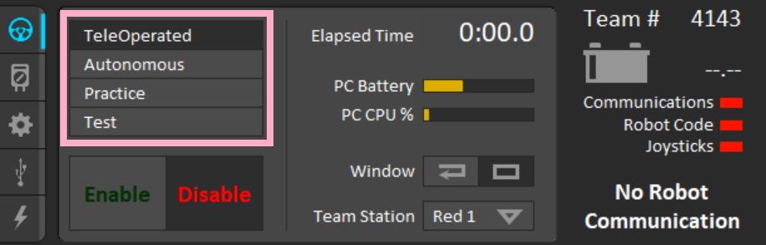
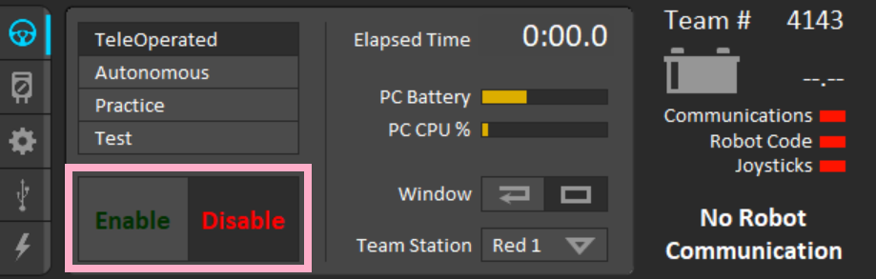

DRIVER STATION AND MODES
The FRC Driver Station
1
2
Pick a mode
Enable and Disable
TeleOperated, Autonomous, Practice or Test
Only after the lights on the right are all green
[ ] \
Enable
Enter
Disable
Space
Emergency stop
MARS/WARS SOFTWARE TRAINING
15
Notes:
The FRC Driver Station runs on the drive laptop. On the left, pick the mode: TeleOperated, Autonomous, Practice or Test. Under it, Enable and Disable. On the right, check the three lights: Communications, Robot Code and Joysticks all need to be green before you can enable. Keyboard shortcuts: press [ ] and \ together to enable, Enter to disable, Space for emergency stop. Screenshots from the MARS/WARS docs.

Slide 16



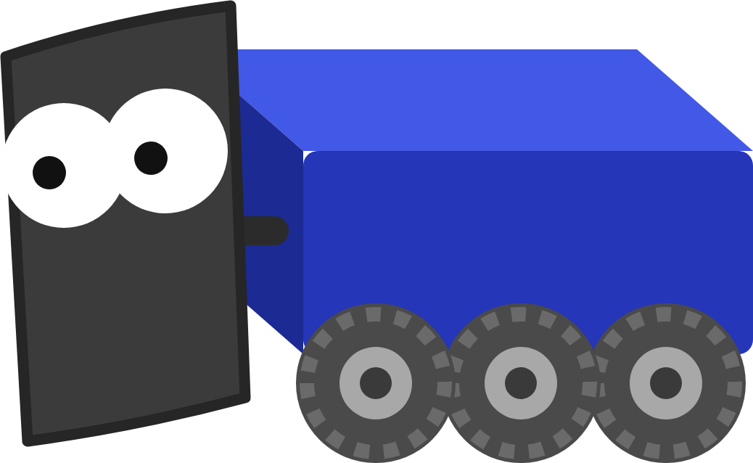
DRIVER STATION AND MODES
Safety first
Say “ENABLING!”
Hands clear
Know the stops
Watch the light
Out loud, before every enable, so everyone near the robot hears it.
Nobody touching the robot. Wheels up on a cart when testing on a bench.
Enter disables. Space is an emergency stop, then the robot needs a reboot.
The robot signal light is solid when on and flashing when enabled.
If you're not sure the robot is safe to enable, it isn't.
MARS/WARS SOFTWARE TRAINING
16
Notes:
A robot can move fast and without warning. Before enabling, yell ENABLING so everyone near the robot hears it, and only enable when hands are clear. Know the stops by heart: Enter disables, Space is an emergency stop (the robot then needs a reboot). The robot signal light (RSL) tells anyone looking: solid means powered on, flashing means enabled. Practice: have the class shout ENABLING before every enable today.

Slide 17
DRIVER STATION AND MODES
Robot modes
Mode
Init
Periodic
Exit
Robot
robotInit()
robotPeriodic()
Always
Disabled
disabledInit()
disabledPeriodic()
disabledExit()
Nothing moves
Autonomous
autonomousInit()
autonomousPeriodic()
autonomousExit()
Robot drives itself
Teleop
teleopInit()
teleopPeriodic()
teleopExit()
Drivers control it
Test
testInit()
testPeriodic()
testExit()
Checking mechanisms
Your drive code goes in teleopPeriodic(): it runs over and over while you drive.
MARS/WARS SOFTWARE TRAINING
17
Notes:
WPILib runs your code in modes. Disabled: nothing moves. Autonomous: the robot drives itself. Teleop: drivers control it. Test: for checking mechanisms. Each mode has three methods WPILib calls for you: Init once when the mode starts, Periodic over and over while it's on, Exit once when it ends. robotPeriodic runs in every mode. Today's code goes in teleopPeriodic. Ask: which method would you use to reset a timer at the start of auto?

Slide 18


DRIVER STATION AND MODES
teleopPeriodic runs 50 times a second
Read
Compute
Set
every 20 ms
the sticks
left and right speeds
the motors
run
run
run
run
run
run
run
run
0 ms
20 ms
40 ms
60 ms
80 ms
100 ms
120 ms
140 ms
160 ms
Keep it quick. No long loops or waits inside: the next run can't start until this one ends.
MARS/WARS SOFTWARE TRAINING
18
Notes:
teleopPeriodic isn't called once: WPILib calls it every 20 milliseconds, about 50 times a second, for as long as the robot is enabled in teleop. Each run does three things: read the sticks, do the math, set the motors. Because it runs so often, the robot reacts to the sticks right away. Never put a long loop or a wait inside it: the next run can't start until this one ends, and the robot stops responding. Ask: how many times does it run in a 2 minute 15 second match? (About 6,750.)

Slide 19
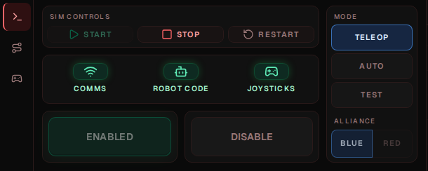
DRIVER STATION AND MODES
Driving in training
NO GAMEPAD? USE THE KEYBOARD
W S
Left stick up / down
getLeftY()
A D
Left stick left / right
getLeftX()
1
Start builds and runs your code
↑ ↓
Right stick up / down
2
Pick Teleop
getRightY()
3
Enable
On the real robot: an Xbox controller.
MARS/WARS SOFTWARE TRAINING
19
Notes:
In training there's no real robot or Driver Station: Scriptum has its own Driver Station panel next to a simulated robot. Press Start to build and run your code, pick Teleop, then Enable. No gamepad? The keyboard stands in: W and S are the left stick up and down, A and D are left and right, the arrow keys are the right stick up and down. On the real robot you use the FRC Driver Station and an Xbox controller instead.

Slide 20
03
Your first Java
I do exactly what your code says. Even when it's wrong!
Just enough to write drive code
MARS/WARS SOFTWARE TRAINING
20
Notes:
Four ideas: objects with methods, variables, comments and operators. The Java track in Scriptum goes deeper on each; it's listed on the last slide.

Slide 21
YOUR FIRST JAVA
Where your code goes
Robot.java
1
controller_
public class Robot extends LoggedRobot {
The gamepad, port 0
1
XboxController controller_ =
new XboxController(0);
2
DifferentialDriveMech drive_ =
2
drive_
new DifferentialDriveMech(/* ... */);
The drivetrain: left and right motors
@Override
3
public void teleopPeriodic() {
// Your drive code goes here
3
teleopPeriodic()
}
Your code. Runs every 20 ms in teleop
}
Java: Hello, World
MARS/WARS SOFTWARE TRAINING
21
Notes:
This is the lesson's Robot.java, trimmed. 1: controller_ is the gamepad, made once when the robot starts. 2: drive_ is the drivetrain, built from the motor list in Constants. 3: teleopPeriodic is where your code goes; WPILib calls it for you. Everything else in the file is already done. The underscore at the end of a name is the team's style for things the robot keeps around.

Slide 22
YOUR FIRST JAVA
Objects and methods
drive_
.setDutyCycles
(0.5, 0.5)
;
Does something: the motors move
object
method
inputs
controller_
.getLeftY
()
;
Gives back a number: how far the stick is pushed
object
method
no inputs
Java: Methods
MARS/WARS SOFTWARE TRAINING
22
Notes:
An object is a thing in the program, like the gamepad or the drivetrain. A method is something it can do. You call a method with a dot and parentheses; the values inside the parentheses are its inputs. Some methods do something (setDutyCycles makes the motors move); some give back an answer (getLeftY returns how far the stick is pushed). Ask: what do you think controller_.getRightX() returns?

Slide 23
YOUR FIRST JAVA
Variables: named boxes
double forward = -controller_.getLeftY();
type
name
store
value
forward
• double: a number with a decimal point
0.8
• forward: the name you pick
• = means store, not “is equal”
• Use the name later instead of the number
double
Java: Variables
MARS/WARS SOFTWARE TRAINING
23
Notes:
A variable is a named box that holds a value. double is the type: a number that can have a decimal point. forward is the name. The equals sign means store, not equals: put the right side into the box. After this line, anywhere you write forward, Java uses the number inside. Variables made inside teleopPeriodic are made fresh every run. Ask: why does the stick value need its own name? (So the math reads like English.)

Slide 24
YOUR FIRST JAVA
Comments: notes for people
// One line: Java ignores everything after the slashes
double forward = -controller_.getLeftY(); // flip it: up is negative
/* A longer note can span
several lines like this. */
For people, not the robot
Say why, not what
Java skips comments completely.
“Flip it: up is negative” beats “make it negative”.
MARS/WARS SOFTWARE TRAINING
24
Notes:
Comments are notes for people. Java ignores everything after // on a line, and everything between /* and */. Write comments that say why, not what: the code already says what. The lesson's starter code is full of comments telling you what to do; read them.

Slide 25
YOUR FIRST JAVA
Operators: the math
+
add
forward + turn
GOTCHA
1 / 2 is 0
-
subtract, or flip the sign
-controller_.getLeftY()
Two whole numbers give a whole number. The .5 is dropped.
*
multiply
forward * 0.5
1.0 / 2 is 0.5
/
divide
speed / 2.0
Java: Operators
MARS/WARS SOFTWARE TRAINING
25
Notes:
The four math operators work the way you expect: + - * /. The minus sign also flips a number's sign, which you'll use on the stick. Watch out for whole numbers: 1 / 2 in Java is 0, because two ints give an int and the fraction is dropped. Write 1.0 / 2 to get 0.5. Activity: have students predict each result before revealing it.

Slide 26
YOUR FIRST JAVA
Reading the stick: up is negative!
up = -1.0
double forward = -controller_.getLeftY();
The minus sign flips it, so pushing up means forward.
left = -1.0
right = 1.0
getLeftX()
Forgot the minus? The robot drives backward when you push up. It's the most common bug in this lesson.
getLeftY()
down = 1.0
MARS/WARS SOFTWARE TRAINING
26
Notes:
A gamepad stick gives two numbers, each from -1.0 to 1.0. getLeftX is left to right. getLeftY is up and down, and here's the surprise: pushing up gives a negative number. It's a leftover from flight sticks. So forward = -controller_.getLeftY() flips it so up means forward. Forgetting the minus sign is the most common bug in this lesson: the robot drives backward. Ask: what does the stick read when you let go? (0, roughly.)

Slide 27
04
Drivetrains
Turn without a steering wheel? Spin one side faster!
How the wheels are arranged decides how the robot moves
MARS/WARS SOFTWARE TRAINING
27
Notes:
Three common drivetrains in FRC. We compete with swerve; we learn with tank.

Slide 28
DRIVETRAINS
Three ways to arrange wheels
Tank
Mecanum
Swerve
Ours since 2014
Two fixed sides. Turns by running them at different speeds. What we learn on.
Angled rollers let it slide sideways too.
Every wheel steers. Drives any direction, facing any direction.
MARS/WARS SOFTWARE TRAINING
28
Notes:
Tank (also called differential or skid steer): wheels in two fixed rows. It turns by running the sides at different speeds, like a tank or a bulldozer. Mecanum: four wheels with angled rollers, so it can also slide sideways. Swerve: every wheel steers on its own, so it can drive any direction while facing any direction. MARS/WARS has run swerve on every robot since 2014. We learn on tank because it's the simplest: the ideas (motors, inputs, math) carry straight over to swerve.

Slide 29
DRIVETRAINS
Steering by speed
L +0.5
R +0.5
L +0.5
R -0.5
L +0.6
R +0.3
Straight
Spin
Curve
Same speed both sides
Opposite speeds
Left faster: curves right
MARS/WARS SOFTWARE TRAINING
29
Notes:
This is the whole idea behind tank drive. Same speed on both sides: straight. Opposite speeds: spin in place. One side faster: curve toward the slower side. Activity: two students hold hands side by side as the left and right wheels and walk these three moves.

Slide 30
05
Tank and arcade
Tank uses two sticks. Arcade uses one. Try both!
Writing the drive code
MARS/WARS SOFTWARE TRAINING
30
Notes:
Both drive styles fit in three to five lines of code. The lesson walks through each.

Slide 31
TANK AND ARCADE
Tank drive: one stick per side
Robot.java
1
Left stick
Up and down, flipped: the left side
public void teleopPeriodic() {
double left = -controller_.getLeftY();
1
double right = -controller_.getRightY();
2
2
Right stick
drive_.setDutyCycles(left, right);
3
Up and down, flipped: the right side
}
3
Send it
Push both sticks up to drive straight. One up and one down to spin.
Both numbers go to the motors
Java: Variables
MARS/WARS SOFTWARE TRAINING
31
Notes:
Tank drive: the left stick drives the left side and the right stick drives the right side. Read both Y axes, flip them so up is forward, and send them to the motors. Three lines. Push both sticks up: straight. One up, one down: spin. Ask: what happens if you only flip one of them?

Slide 32
TANK AND ARCADE
Arcade drive: one stick does it all
Robot.java
1
Forward
Left stick up and down, flipped
public void teleopPeriodic() {
double forward = -controller_.getLeftY();
1
double turn = controller_.getLeftX();
2
Turn
2
double left_speed = forward + turn;
Left stick left and right. Not flipped
3
double right_speed = forward - turn;
drive_.setDutyCycles(left_speed, right_speed);
4
3
Mix
}
Left gets forward + turn; right gets forward - turn
4
Send it
Same method as tank
Java: Operators
MARS/WARS SOFTWARE TRAINING
32
Notes:
Arcade drive: one stick does everything. Up and down is forward; left and right is turn. Mix them: the left side gets forward plus turn, the right side gets forward minus turn. Pushing right makes the left side faster and the right side slower, so the robot turns right. This is the lesson's solution.

Slide 33
TANK AND ARCADE
Working the arcade math
forward
turn
left = f + t
right = f - t
Robot
0.5
0.0
0.5
0.5
Straight, half speed
0.0
0.5
0.5
-0.5
Spins right in place
0.5
0.5
1.0
0.0
Curves right
1.0
0.5
1.5 → 1.0
0.5
Curves right, left side clipped
Past 1.0? The motor clips it to 1.0, so the turn is gentler than the math says.
MARS/WARS SOFTWARE TRAINING
33
Notes:
Work the arcade math by hand. Cover the last two columns and have students fill them in, then predict what the robot does. The last row shows clipping: 1.5 is past 1.0, so the left side just runs at full speed and the curve is less sharp than the math says.

Slide 34
TANK AND ARCADE
Bonus: making it drive nicer
motor
Squared sticks
forward * Math.abs(forward)
Small pushes get gentler. Full push stays full.
0.5 → 0.25
Speed limit
left_speed * 0.5
Half speed for new drivers.
Backwards robot
plain
squared
-forward
The back becomes the front.
stick
MARS/WARS SOFTWARE TRAINING
34
Notes:
Three bonus ideas from the lesson. Speed limit: multiply both speeds by 0.5 so new drivers can't go full speed. Backwards robot: flip the signs so the back becomes the front. Squared sticks: multiply the stick by its own size, forward * Math.abs(forward). Small pushes get much smaller, full pushes stay full, so fine control is easier. Math.abs keeps the sign so backward stays backward. Ask: what's 0.5 squared this way? (0.25.)

Slide 35
TANK AND ARCADE
Checking it in AdvantageScope
1
1
Straight
The two lines sit on top of each other
0.5
2
Spin
Mirror images around zero
0
3
Curve
One higher than the other
-0.5
4
Wrong way?
A sign is flipped somewhere
-1
straight
spin
curve
Drive/LeftOutput
Drive/RightOutput
MARS/WARS SOFTWARE TRAINING
35
Notes:
To check your code, open AdvantageScope and graph Drive/LeftOutput and Drive/RightOutput. Driving straight, the two lines sit on top of each other. Spinning, they're mirror images around zero. Curving, one is higher than the other. If a line goes the wrong way, a sign is flipped. This mock shows one short drive: stop, straight, spin, curve.

Slide 36

YOUR TURN
Motors and Drivetrains
Write tank drive, then arcade drive, in teleopPeriodic. Drive the robot and press Verify on each checkpoint.
4 CHECKPOINTS
Your drive code
teleopPeriodic sends speeds to the motors
Drives forward
Push up and the robot goes forward
Drives backward
Pull down and it goes backward
Turns in place
Opposite speeds spin it around
Bonus: speed limit, backwards robot, squared sticks
In Scriptum: FRC Robot › Motors and Drivetrains
MARS/WARS SOFTWARE TRAINING
36
Notes:
This is the hands-on part: the Motors and Drivetrains lesson in Scriptum's FRC Robot track. Press Verify on each checkpoint as you go. The first checks your code; the other three drive the robot and check it moved the right way. Bonuses are optional. Nothing is graded and you can verify as many times as you like.

Slide 37
RECAP
What you can do now
Follow a command from stick to motor
RELATED JAVA TRAINING
NEXT UP
Explain CAN IDs and inversion
Hello, World
Sensors and Feedback
Enable a robot safely
Variables
Encoders, deadbands and if statements: driving exactly 2 meters.
Know when teleopPeriodic runs
Operators
Read the sticks into variables
Methods
Write tank and arcade drive
Optional practice in Scriptum's Java track.
MARS/WARS SOFTWARE TRAINING
37
Notes:
Wrap up. Everything later builds on this: the next deck adds sensors so the robot knows how far it's gone. The Java lessons on the right are optional practice for the ideas used today.

