Slide 1
FRC Parts Exchange
Guide to the site

Slide 2
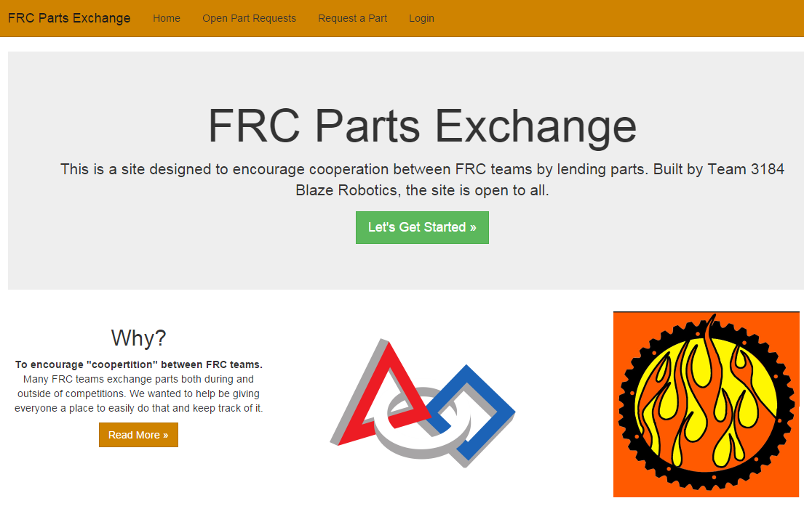
Introduction
Why?
The FRC Parts Exchange website is designed to make sharing parts and tools between teams easier. This encourages a spirit of “coopertition” between First Robotics Competition teams.

Slide 3
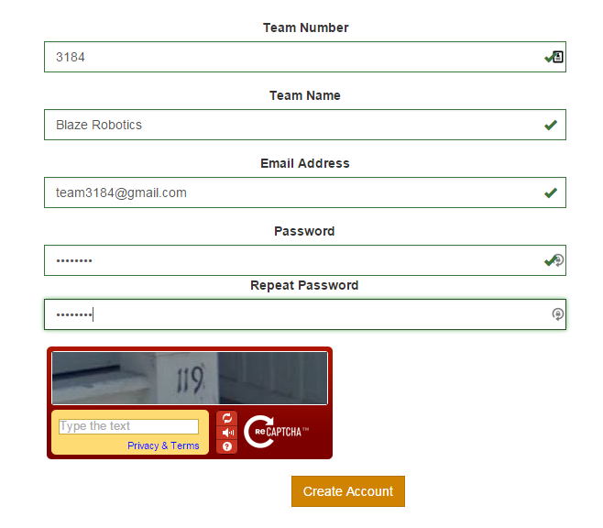
Create Account
First, you’ll need to create an account for your team. This will allow you to request parts that you need.
Create An Account

Slide 4
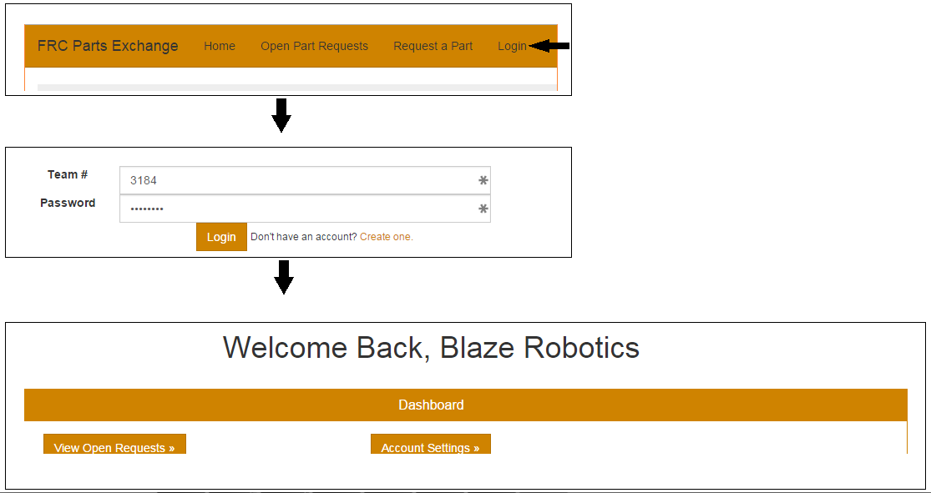
Login
Now that your account is created, you will need to log into your account home page.

Slide 5
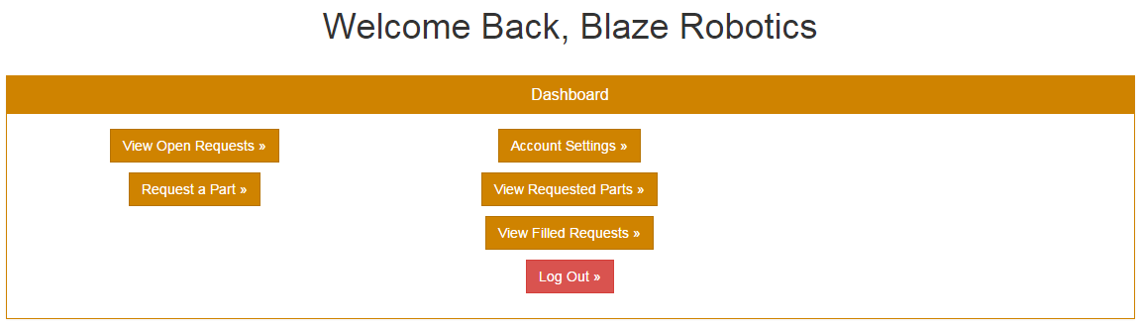
Team Dashboard
From your team dashboard, you can select:
Account Settings
Request a Part
View Open Requests
View Requested Parts
View Filled Requests
Log Out

Slide 6
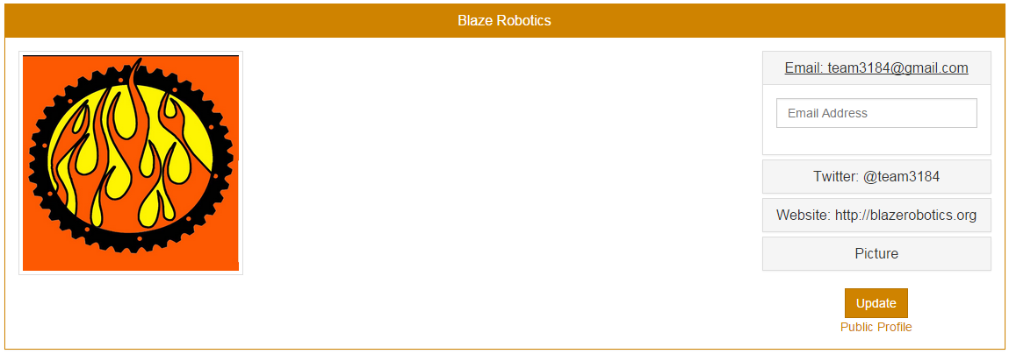
Account Settings
Now that your account is created, you can enter your team information under Account Settings.
Select any of the fields to the right side to add your team information. You can also add you team logo.

Slide 7
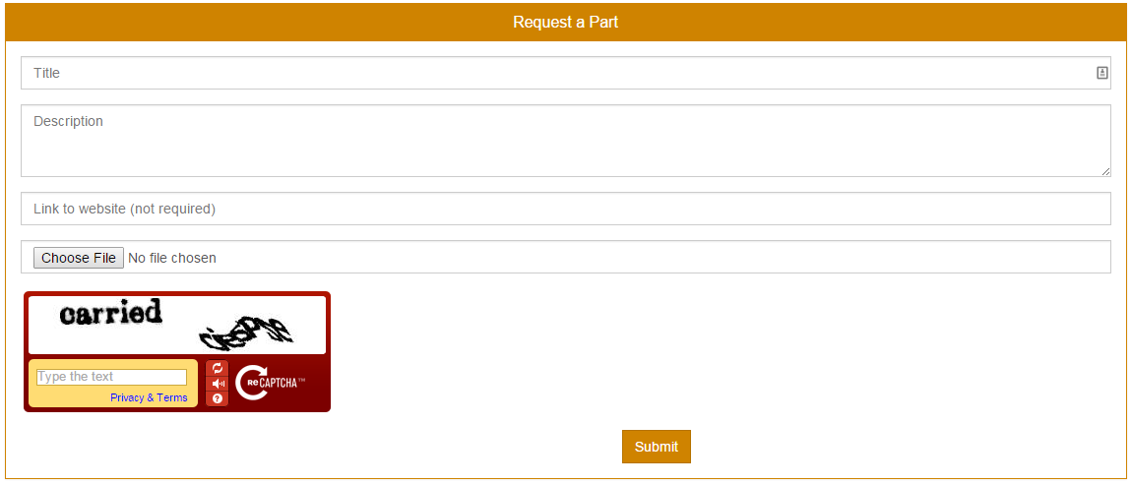
Request a Part
On the request page, there are 4 fields to fill out: Title, description of the part, a URL field for a link to the part’s web page, and a file upload form to upload an image of a part. Only the title is required, but the more information you can provide, the easier it will be for a team to fill the request.

Slide 8
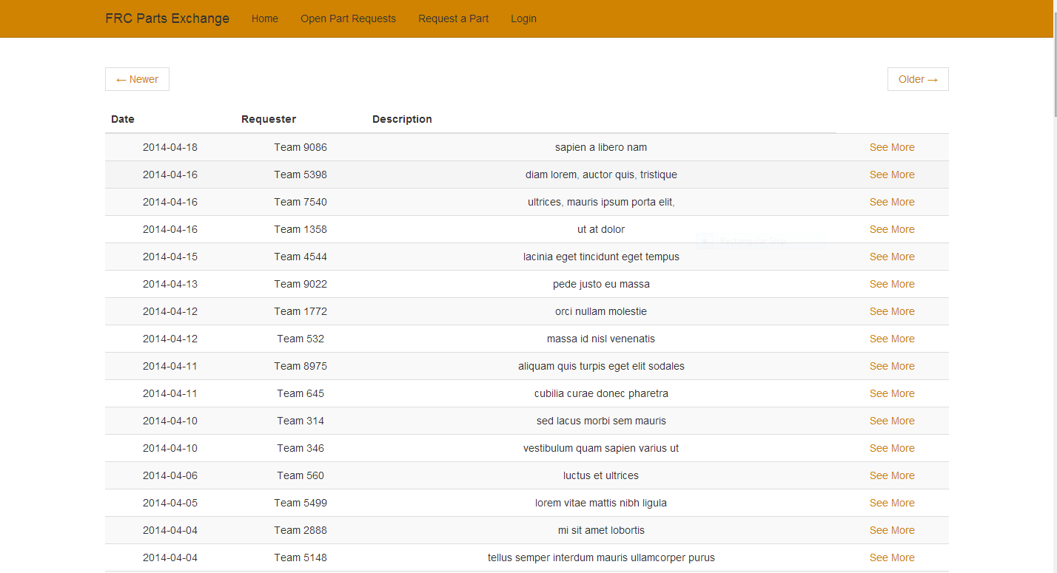
View Open Requests
The Open Part Requests page will allow you to see your parts request list. Clicking on See More to the right of a request will give you a more detailed description.

Slide 9
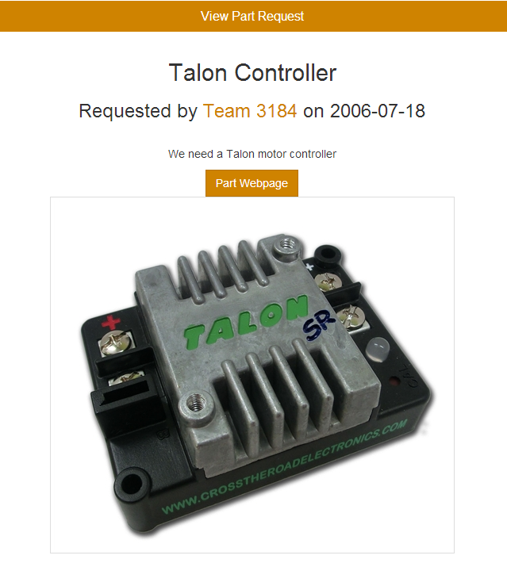
View Part Request (Detailed)
This is a more detailed description of a part. It has a title, description, web page, and image. If you had a spare Talon, you could then contact Team 3184 and arrange an exchange.

Slide 10
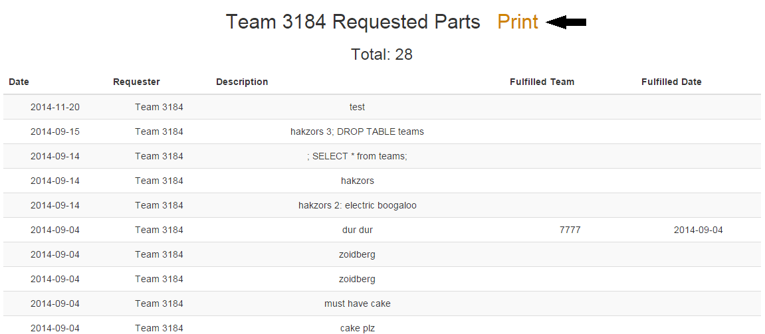
View Requested Parts/View Filled Requests
These pages will provide a list of all the parts you have requested/filled, the team you collaborated with, description, and the date fulfilled/filled for the current season. You will be able to print these lists for your records to show your coorpertition to the community.

