Slide 1
A Guide to GitHub for Huskie Robotics
Last updated 2013/01/12
Team 3061
2013 Season
Brian Truong

Slide 2
Introduction to Git and GitHub
Git
GitHub
Git is a source control system that is free and open source
Git is local to a computer and must be installed
Git can be used with only a local repository (without GitHub or any other equivalent)
GitHub is a website that hosts Git repositories
Hosts both private and public (open source) repos
Private repos typically require monthly payment, but FIRST teams are offered free private repos
Accessible wherever there is internet access (Git doesn’t necessarily need to be installed)

Slide 3
Pros/Cons to Git & GitHub
Pros
Cons
Revision History
Revision History
Revision History
Ability to easily work on project simultaneously
Access to code wherever there is internet
Ability to branch development
More overhead means more time wasted
Many unneeded features add unneeded complexity
Originally intended for text programs, not LabView
Obviously the pros outweigh the cons 2 to 1

Slide 4
LabView and GitHub
Although Git was designed for text files (.txt, .c, .h, .java, etc.), its main features will work with any file of any type
It looks at the binary data of the file (1’s and 0’s) so it will always be able to detect any changes. It just won’t know what the changes are with LabView’s .vi files.
It might not be able to smoothly merge two modifications to the same .vi file (merge) or easily compare differences between two different versions of a .vi files (diff).
However, this is all assuming our version of LabView will not have merge/diff features. Even if it does, they will not be integrated with Git (afaik). In other words, Git will not be able to merge LabView files automagically.
As of 11/25/2012

Slide 5
Nature of Git repositories
Unlike some other source controls, Git does not have an all-powerful central server
Git still has a remote repo stored in a central location (GitHub), but…
Git maintains a local repository on every computer
Git creates this local repo by cloning the entire remote repo, history included
Even without a connection to the remote repo on GitHub, you can checkout the entire directory back to the very first commit
You can also continue working and making commits without an internet connection, then push to the remote repo later

Slide 6
Basic Terminology
Repo: short for repository
Repository: a project directory and additional data (commits, tags, and other Git inner-clockwork stuff)
Remote repository: the repo that is on a server (GitHub)
Local repository: the repo that is on each computer
Commit: a snapshot of the entire project directory
Can also be used as a verb: to commit means to create a new commit
Every commit will have a message describing the new changes
Commits are made offline to your local repository
Then are later pushed to the remote repository
Tag: a mark applied to a commit for easy access later
Commits do not have human-readable names, but tags do
Tags allow us to remember a certain commit as important

Slide 7
Remote Repos Terminology
Push: to copy all of your commits (and possibly tags) to the remote repository
Git will also check if the remote repo has new commits applied by someone else that you didn’t have when making your commits
In that case, Git will try to merge on the remote repo. If it fails, it will prompt you to fetch & merge them yourself on your local repo
Fetch: the opposite of push (sort of)
Downloads objects and references from a remote repo
Does not alter your working directory
In other words, check for updates from the remote repo w/o altering your own local repo
Pull: a fetch followed by a merge
The merge following the fetch will alter your working directory

Slide 8
Branching
A branch is a separate line of development that allows parallel work on the same project
Technically, it is a tag that is always set to the newest commit made on that branch
Every repo has a main branch (typically called master)
When you make a commit, your commit is only added to the current branch and not any others
If you checkout a branch, your working directory will be reset to the current state of the branch’s directory
Branches (much like commits & tags) must be pushed to a remote repo
When you push to a remote repo, Git is actually pushing your current branch to the branch of the same name on the remote repo

Slide 9
Branching Terminology
Checkout: to switch your working directory with the directory loaded from a branch, commit, or tag
Will not allow you to checkout if changes are not committed
When you checkout a branch, you are switching over to that branch as well as changing your working directory
When you checkout a commit/tag, you will enter a headless (branchless) state
Any commits you make will not be saved (since you are not on any branch)
If you want to save those commits, make a new branch
To get back on a branch, simply checkout a branch
You can also checkout a specific file from any commit/tag/branch (assuming you know its name)
Note: You can only do a checkout through the Git Bash
You can also download a directory/file from any branch/commit/tag from GitHub (not technically a checkout since it does not replace your working directory)

Slide 10
Branching Terminology
Merge: adds the commits from one branch into another branch
A very common & cheap operation in Git (unlike in other source controls)
A merge takes the new commits from one branch and attempts to put them into the destination branch
Note: a merge doesn’t combine the two branches into one
The origin branch is unchanged, only the destination branch is affected
If all modified files in the origin branch’s new commits were not modified in any of the destination branch’s new commits:
Git will have no issues merging
Otherwise, a manual merge will have to be done

Slide 11
Branching Terminology
Pull Request: a request to merge one branch into another
Warning: not the same as a pull (copy branches/tags/commits from a remote repo to local repo)
Refers to “pulling a secondary branch into the master branch”
This is a GitHub feature (not Git), and should be done on GitHub site
GitHub actually sets up a whole discussion board for all developers to discuss together
If only few admin developers have push access to repo, a non-admin developer can make a pull request to notify admins of new changes
Typical work flow:
A branch is created for a certain issue/subsection
Developers work on that branch while normal development continues on other branches
When ready, they make a pull request to merge their own branch to the master
Others can look over changes
Developers with push access continue with merge

Slide 12
Software we will use
GitHub’s website (remote repo)
Can download/see entire directory from any commit/tag/branch
Can see entire commit history for any branch
Can see entire branching history (merging/diverging branches)
Can make pull requests (and merge on remote repo if no conflicts)
Can discuss and comment on pull requests and commits
Can create our own wiki (don’t go overboard)
Cannot create/delete tags
Cannot create commits with LabView files (afaik)

Slide 13
Software we will use
GitHub for Windows (local repo)
Can easily integrate with GitHub account
Can make commits and view commit history for any branch
Can sync with remote repo (push and pull together automagically)
Can merge/manage branches
Cannot make pull requests
Cannot create/delete/see tags
Cannot checkout working directory to previous commit (w/o making another commit)

Slide 14
Software we will use
Git Bash (local repo)
Basically the Linux Bash (command prompt) ported to Windows with Git installed
If you are more familiar with Power Shell or Cmd, you can use those too
Comes with GitHub for Windows and intended for use in conjunction
Can checkout directory to previous commits/tags
Can create/delete/see tags
Can make commits and view commit history
Can do anything GitHub for Windows and GitHub can’t
Cannot be used without knowing some Linux terminal commands and Git commands

Slide 15
Workflow
Multiple branches: each branch responsible for different tasks (drive, autonomous, etc.)
When a branch is ready for release (merge into master branch), make a pull request
Admins and rest of team then decide to accept or reject
If accepted, GitHub can attempt a merge on the remote repo
If unable because modified files in common, then manually merge on local repo’s master branch, then push to remote repo
After merged, pull request is closed
If rejected, then pull request will be closed w/o any merging
Branch continues developing until ready for release again

Slide 16
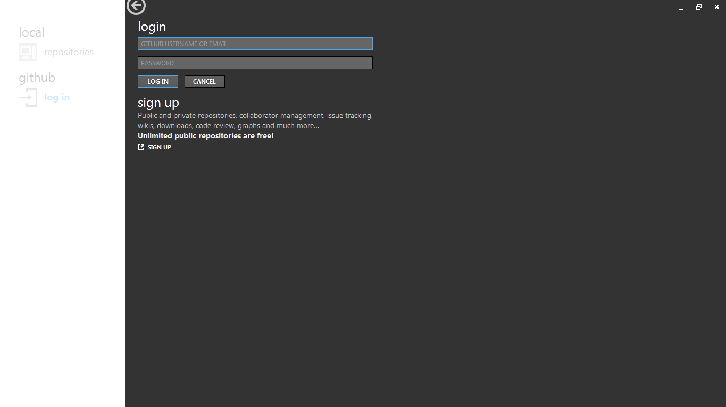
How to set up GitHub for Windows
Sign in with your GitHub account

Slide 17
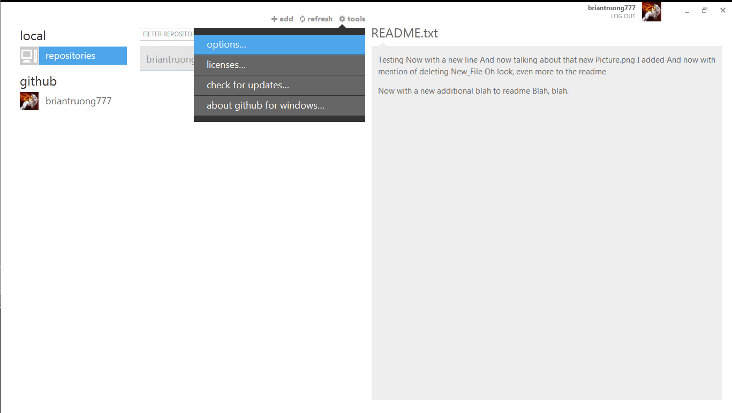
Repository List
Choose tools, then options

Slide 18
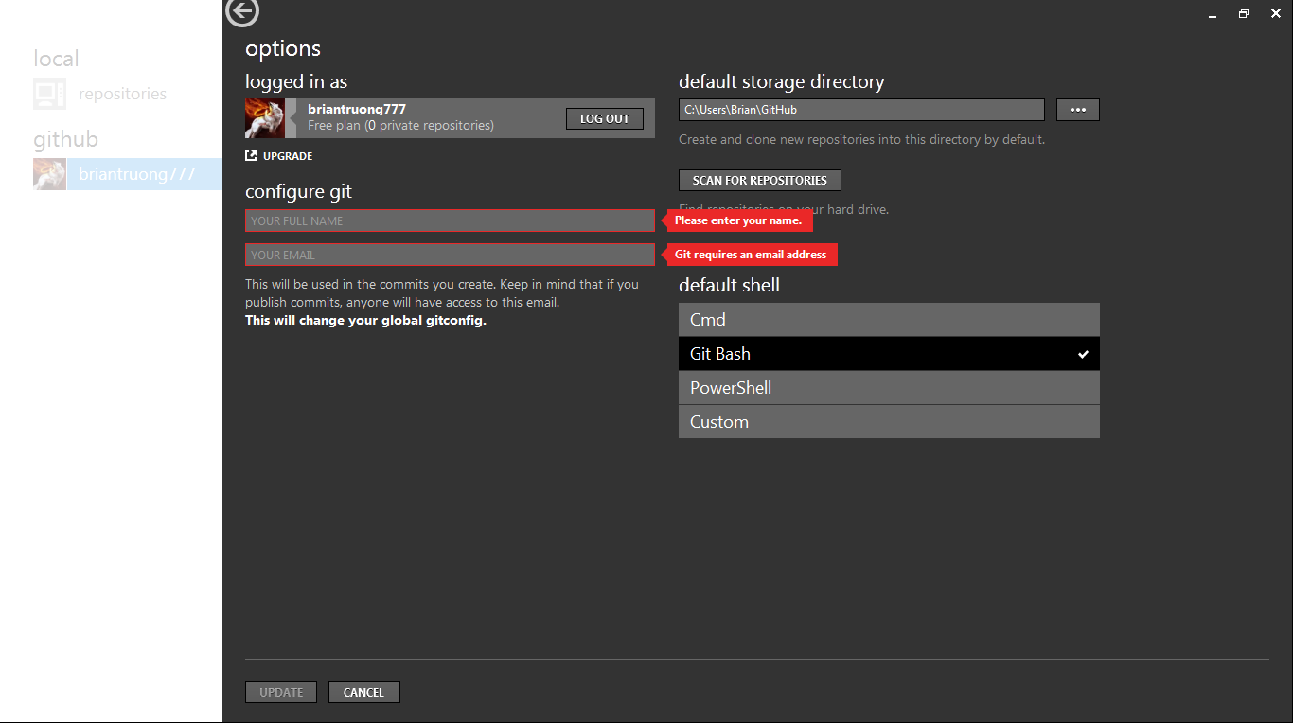
User Options
Choose where to store repos on your computer
Fill in a name & email to be attached to every commits you make
Choose whatever command line interface you want (Git Bash if unsure)

Slide 19
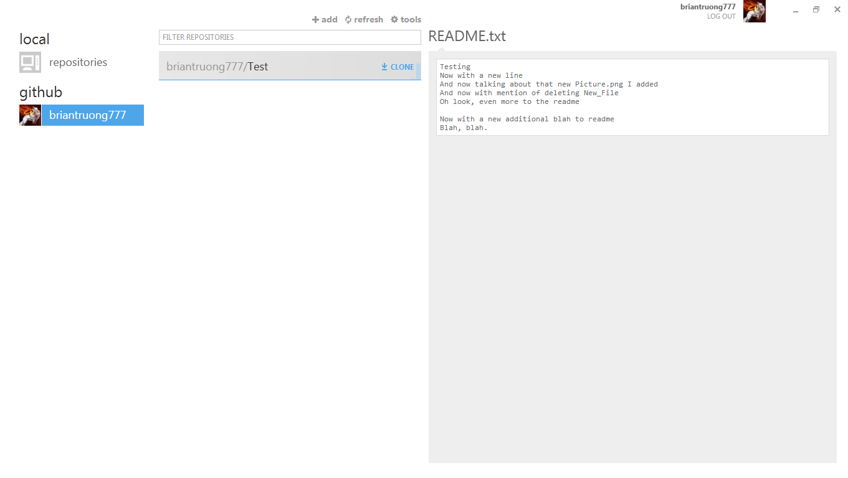
Repository List
First select a GitHub organization, then click clone on the remote repo you want to clone
You will now have a copy of that repo stored as a local repo on this computer

Slide 20
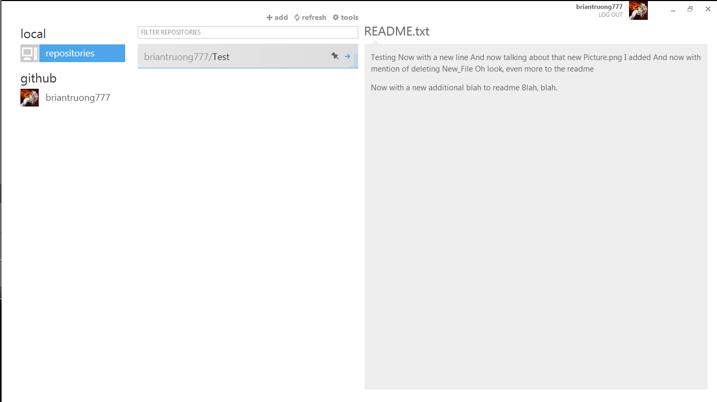
Local Repository List
Double click on a repository to access it
Click here to see your local repos

Slide 21
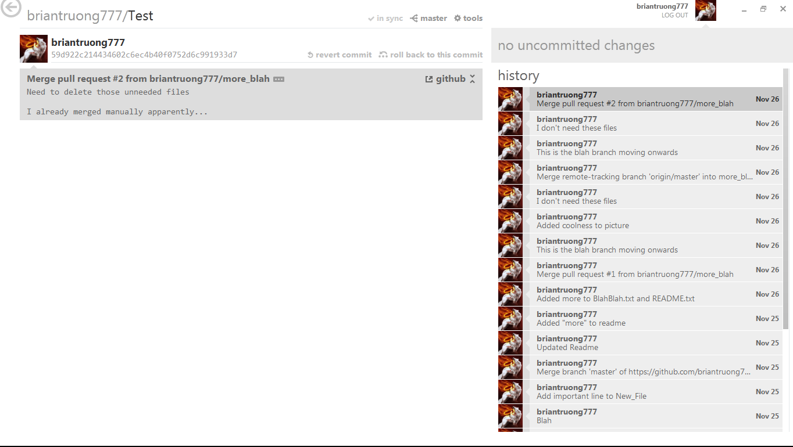
Repository View
Sync button is equivalent to push & pull
Branch switching/managing
Information on selected commit
History of all commits on this branch

Slide 22
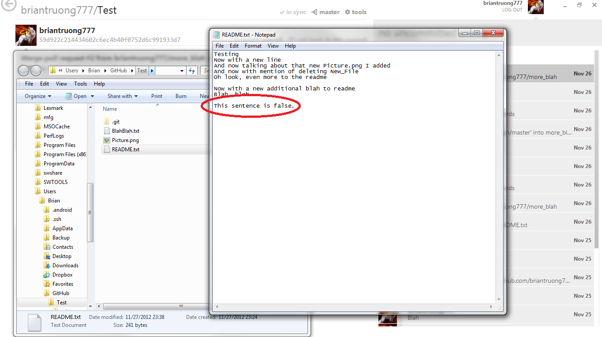
How to commit
Make changes to files

Slide 23
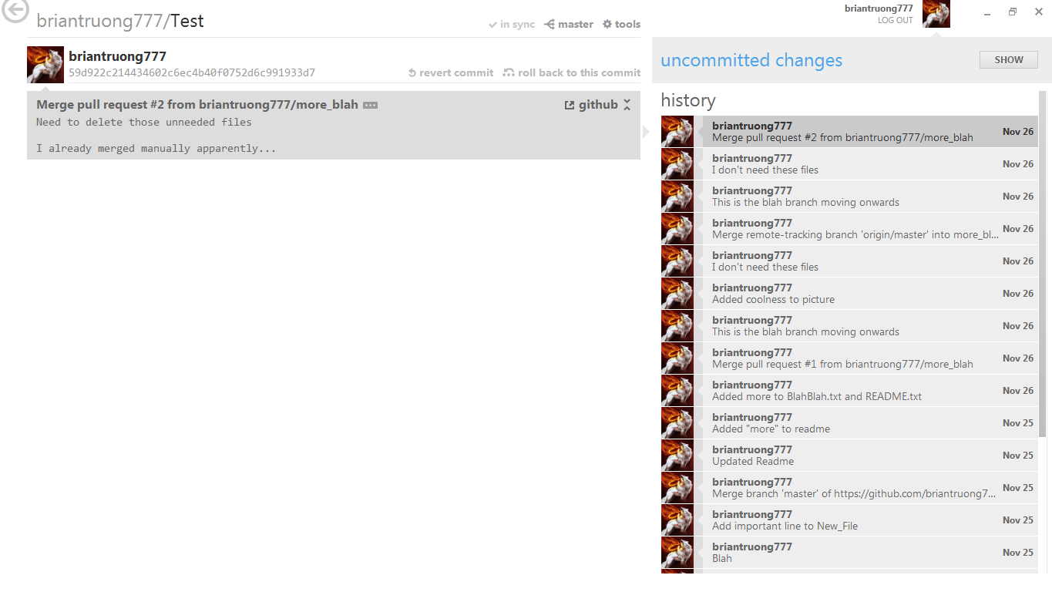
How to commit
GitHub for Windows will detect the changes
Click show to see what files will be in the next commit

Slide 24
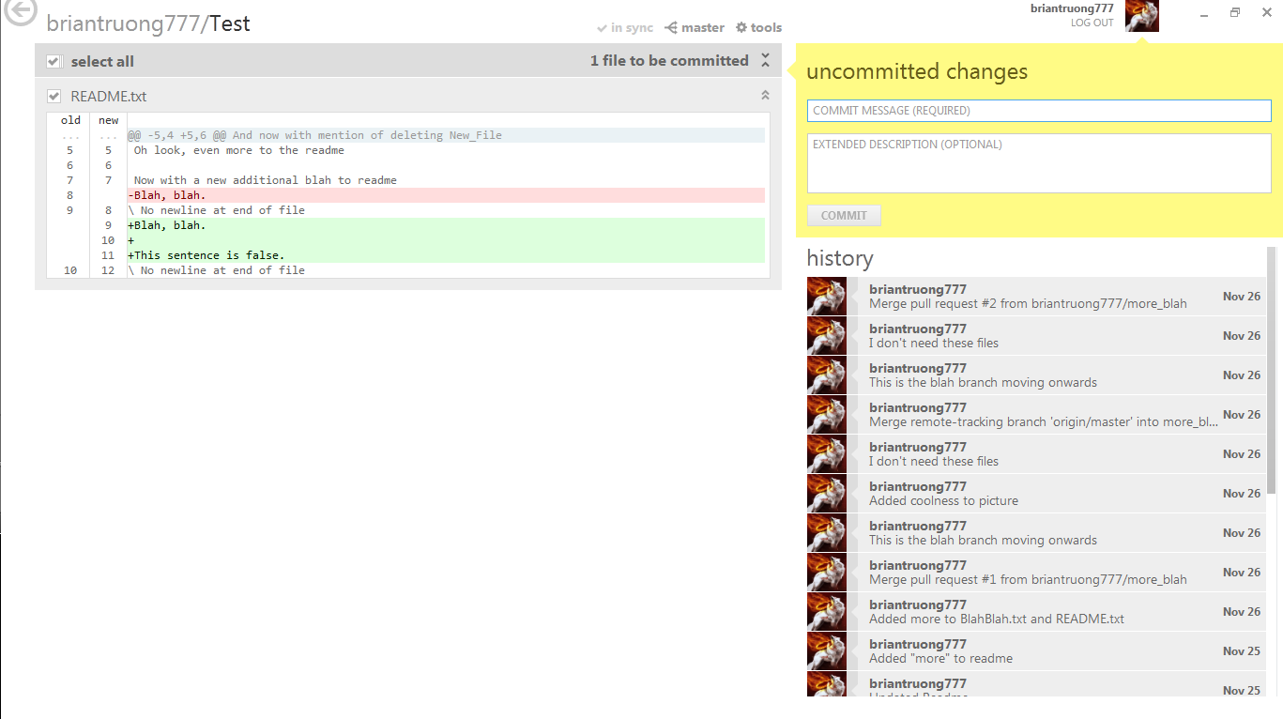
How to commit
Every commit must have a commit message
Files in next commit
(No fancy diff for LabView though)
You can unselect a file to prevent it from being committed

Slide 25
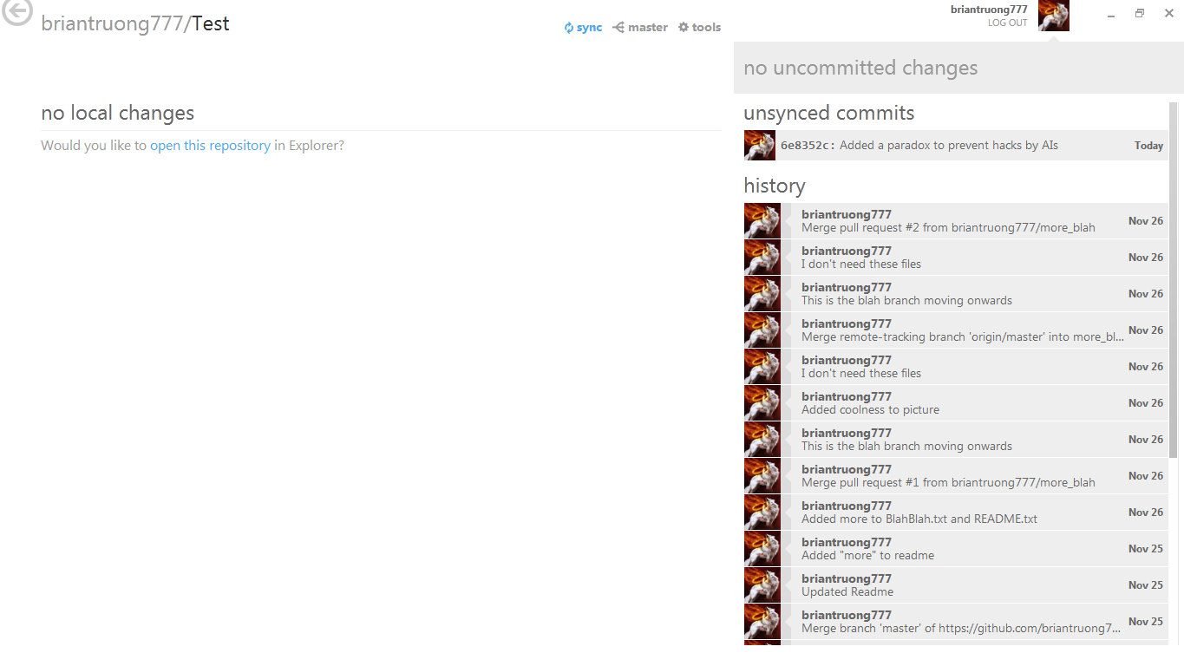
How to commit
Notice the sync button changes to bold blue when there are unsynced commits
Click the sync button to push your commits to the remote repo
Remember: you can make multiple commits to your local repo, and then later sync (push) to the remote repo

Slide 26
More Information
Git Hub for Windows download link:
http://windows.github.com/
GitHub is intuitive enough that it doesn’t really need a guide
Just know the basics of how Git works
Guide on pull requests: https://help.github.com/articles/using-pull-requests
Git Bash requires the use of a command line interface
Good reference to Git commands: http://git-scm.com/docs
You can always do git help <command> to see a local html man page on the command
Slightly more complicated guide to Git: http://git-scm.com/book

