Slide 1
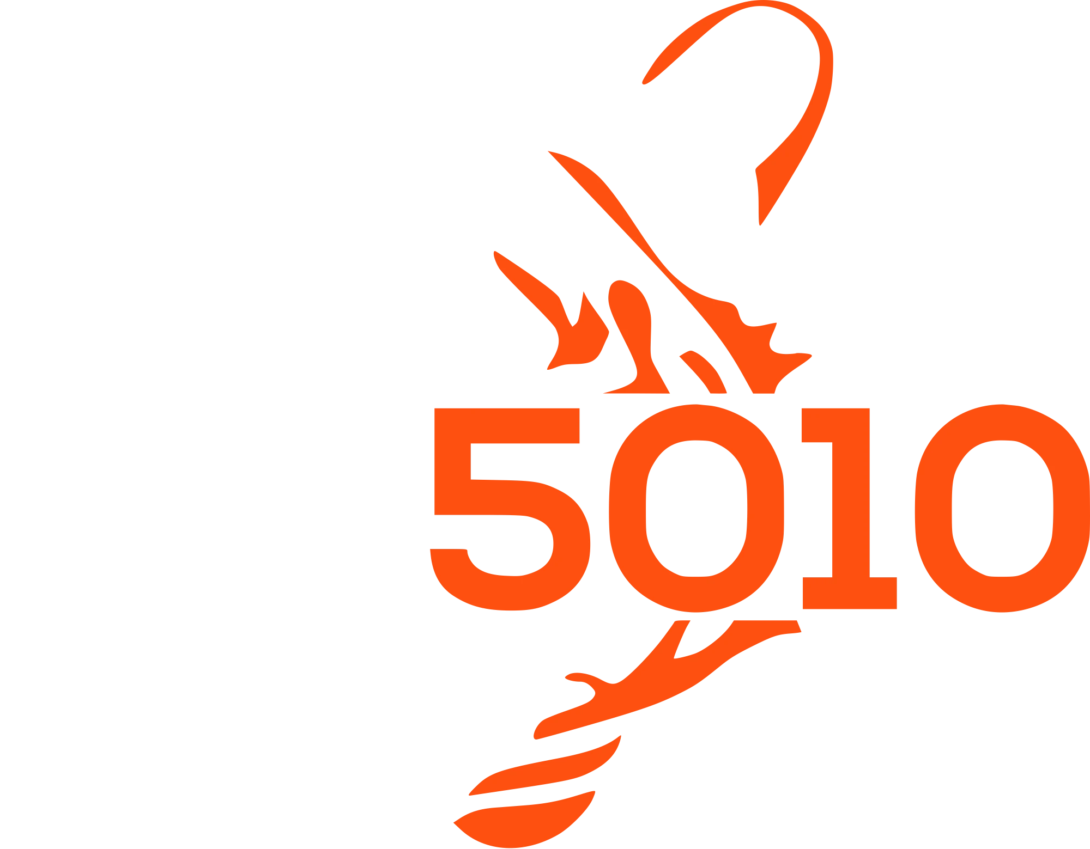
LEARN JAVA + ROBOT PROGRAMMING
LESSON 14
The Pose Estimator
A localizer fed by many sources
WPILib 2027 Alpha · Commands V3
Notes:
Lesson 11's Try It had you drive a square and watch the reported pose come home slightly wrong — drift, and it's worth understanding why it's unfixable from the inside. This lesson moves pose tracking out of the drivetrain into its own localization class that fuses a pose estimator with any number of registered pose providers — the drivetrain's wheel odometry first, a camera second — and proves it works by injecting fake "camera sightings" and watching the pose snap back to truth.

Slide 2




THE GOAL
Fuse odometry with corrections, in its own class
Move pose tracking out of the drivetrain into a Localizer that fuses a pose estimator with any number of registered pose providers — wheel odometry first, a camera second.
NEW JAVA CONCEPTS
NEW ROBOT CONCEPTS
An interface for extensibility — many classes, one contract
A registry — a List you add sources to, then loop over
Timestamps — data that says when it was true
Why dead reckoning drifts, and why no math fixes it
SwerveDrivePoseEstimator — odometry plus corrections
Localization pulled into its own class
addVisionMeasurement and measurement trust
LEARN JAVA + ROBOT PROGRAMMING · POSE ESTIMATOR
2
Notes:
Odometry adds up thousands of tiny measured steps, and every step carries a tiny error — addition never forgets. What fixes drift is an outside reference: something that occasionally says "actually, you are here," anchored to the world instead of your own history.

Slide 3

SECTION 1 · ODOMETRY LIES, SLOWLY
Addition never forgets
The wrong instinct is "better math will fix it." It won't.
Odometry adds up thousands of tiny measured steps. Every step carries a tiny error — a wheel scrubbing in a turn, a bump, carpet flex — and the errors don't average out; they accumulate. The information is simply gone.
What fixes drift is an outside reference: something that occasionally says "actually, you are here," anchored to the world instead of your own history. WPILib ships SwerveDrivePoseEstimator — odometry with a door for corrections.
LEARN JAVA + ROBOT PROGRAMMING · POSE ESTIMATOR
3
Notes:
After a minute of hard driving, the pose can be off by half a meter, and nothing in the math can tell, because every individual step looked perfectly reasonable. Tracking position is about to stop being a wheels-only job and start being a fusion job — wheels, gyro, one camera, maybe three next season. That's a distinct responsibility, and it doesn't belong to the class whose job is spinning motors.

Slide 4

SECTION 2 · A NEW FILE
PoseProvider — anything with evidence to contribute
Create src/main/java/first/robot/subsystems/PoseProvider.java — the whole file
package first.robot.subsystems;
public interface PoseProvider {
/** Called every tick: fold whatever you know into the shared estimate. */
void updatePoseEstimate(SwerveDrivePoseEstimator estimator);
}
Notice what's missing compared to Lesson 13's ModuleIO/GyroIO: no default body.
Every provider genuinely has evidence to contribute — there's no "hardware that doesn't exist yet" case here. Wheel odometry calls the estimator's update(...); a camera calls addVisionMeasurement(...) — an interface is exactly how you let two unlike classes answer the same call in their own way.
LEARN JAVA + ROBOT PROGRAMMING · POSE ESTIMATOR
4
Notes:
One method, and it hands the provider the estimator to contribute to. Handing each provider the whole estimator is a small liberty (a camera could call update); the tradeoff buys a dead-simple contract, and we take it.

Slide 5
SECTION 2 · A NEW FILE
Localizer: owns the estimator, keeps a list of providers
Create src/main/java/first/robot/subsystems/Localizer.java — fields and constructor
public class Localizer {
private final Drivetrain m_drivetrain;
private final SwerveDrivePoseEstimator m_estimator;
private final List<PoseProvider> m_providers = new ArrayList<>();
private final Field2d m_field = new Field2d();
public Localizer(Drivetrain drivetrain) {
m_drivetrain = drivetrain;
m_estimator = new SwerveDrivePoseEstimator(
drivetrain.getKinematics(), drivetrain.getRotation(),
drivetrain.getModulePositions(), new Pose2d()); // start at (0,0,0°)
addProvider(drivetrain); // the odometry backbone, registered first
Scheduler.getDefault().addPeriodic(this::periodic);
}
LEARN JAVA + ROBOT PROGRAMMING · POSE ESTIMATOR
5
Notes:
The estimator is swerve-shaped at its core: it needs the drivetrain's kinematics and a first sample to start blending from. The drivetrain plays two roles here: it's the odometry backbone the estimator is literally built around, and it's the first registered provider, so its wheel-and-gyro update runs each tick through the very same loop every future camera will. Backbone and provider #0 at once.

Slide 6
SECTION 2 · A NEW FILE
Walk the providers, publish the result
Add to Localizer, closing out the class
/** Register a source of pose information. */
public void addProvider(PoseProvider provider) {
m_providers.add(provider);
}
private void periodic() {
for (PoseProvider provider : m_providers) {
provider.updatePoseEstimate(m_estimator);
}
Telemetry.log("Localizer/Pose", getPose(), Pose2d.struct);
m_field.setRobotPose(getPose());
Telemetry.log("Field", m_field); // the SimGUI field view from Lesson 11
}
public Pose2d getPose() {
return m_estimator.getEstimatedPosition();
}
/** Re-anchor the estimate — re-supplies the live gyro and wheel positions. */
public void resetPose(Pose2d pose) {
m_estimator.resetPosition(
m_drivetrain.getRotation(), m_drivetrain.getModulePositions(), pose);
}
LEARN JAVA + ROBOT PROGRAMMING · POSE ESTIMATOR
6
Notes:
The periodic() method is the whole engine: walk the providers in registration order — odometry first, corrections after — letting each fold its evidence in, then publish the result. Nothing here drives a motor, so running it every tick (even while disabled) is exactly right: you want the pose to keep tracking if someone shoves the robot on the field.

Slide 7

SECTION 2 · A REAL DESIGN CALL
Localizer isn't a Mechanism, and that's deliberate
What does Mechanism actually buy a class?
It needs a heartbeat, and addPeriodic is the tool sized for that.
Command-builder methods (run, runRepeatedly) so it can be required by a command, and an automatic idle() default command. Localizer needs neither.
Drives no motors, so no command will ever .require() it, and there's no idle behavior to fall back to. Being a Mechanism is for classes the scheduler needs to run commands against.
LEARN JAVA + ROBOT PROGRAMMING · POSE ESTIMATOR
7
Notes:
Every subsystem-shaped class written since Lesson 1 has extended Mechanism — Drivetrain still does, two sections from now — so this is worth asking about directly. Being a Mechanism is for classes the scheduler needs to run commands against; being ticked every frame is a smaller ask, and addPeriodic is the tool sized for it. Worth remembering the next time you write a class that needs to tick every frame but never needs to be .require()d by a command.

Slide 8

SECTION 3 · DRIVETRAIN.JAVA
The class line grows a promise
Add to Drivetrain's imports, and let the class line grow a promise
import org.wpilib.math.estimator.SwerveDrivePoseEstimator;
public class Drivetrain implements Mechanism, PoseProvider {
SwerveDriveKinematics and SwerveModulePosition are already imported from earlier lessons; PoseProvider is in the same package, so it needs no import.
LEARN JAVA + ROBOT PROGRAMMING · POSE ESTIMATOR
8
Notes:
The drivetrain already knows everything odometry needs; now it just has to expose it and answer the PoseProvider call.

Slide 9
SECTION 3 · DRIVETRAIN.JAVA
All of it moves to Localizer
Delete the pose machinery that used to live here.
The m_odometry field, the Field2d/m_field, and the Telemetry.log call that published Drivetrain/Pose — all of it moves to Localizer, which publishes the fused result as Localizer/Pose instead.
Delete from periodic(), at the bottom
// DELETE — odometry lives on Localizer now.
Pose2d pose = m_odometry.update(
Rotation2d.fromDegrees(getHeadingDegrees()), modulePositions());
Telemetry.log("Drivetrain/Pose", pose, Pose2d.struct);
m_field.setRobotPose(pose);
Telemetry.log("Field", m_field);
LEARN JAVA + ROBOT PROGRAMMING · POSE ESTIMATOR
9
Notes:
This is a real deletion, not a rename — everything the old odometry block did now happens inside Localizer's periodic() instead.

Slide 10

SECTION 3 · DRIVETRAIN.JAVA
Three getters, and the provider method
Add to Drivetrain in its place
public SwerveDriveKinematics getKinematics() {
return m_kinematics;
}
/** Heading as a Rotation2d — what the estimator speaks. */
public Rotation2d getRotation() {
return Rotation2d.fromDegrees(getHeadingDegrees());
}
/** Snapshot the four modules' positions into one array — for odometry. */
public SwerveModulePosition[] getModulePositions() {
SwerveModulePosition[] positions = new SwerveModulePosition[m_modules.length];
for (int i = 0; i < m_modules.length; i++) {
positions[i] = m_modules[i].getPosition();
}
return positions;
}
LEARN JAVA + ROBOT PROGRAMMING · POSE ESTIMATOR
10
Notes:
getModulePositions() replaces the private modulePositions() written in Lesson 11 — same body, now public, because Localizer needs to call it too.

Slide 11
SECTION 3 · DRIVETRAIN.JAVA
As a PoseProvider, the drivetrain contributes odometry
Add to Drivetrain, right after the getters
@Override
public void updatePoseEstimate(SwerveDrivePoseEstimator estimator) {
estimator.update(getRotation(), getModulePositions());
}
A subtle ordering requirement.
updatePoseEstimate reads the gyro and module input bundles, which Drivetrain's own periodic() refreshes each tick. For the odometry update to use fresh numbers, Drivetrain's periodic callback must run before Localizer's — it does, because Scheduler.addPeriodic runs callbacks in registration order. Declare the fields in that order in Robot.java and you never have to think about it again.
LEARN JAVA + ROBOT PROGRAMMING · POSE ESTIMATOR
11
Notes:
Each class registers its own periodic callback in its own constructor, so as long as drivetrain is built (and therefore registers) before localizer is, the dependency takes care of itself.

Slide 12

SECTION 3 · DRIVETRAIN.JAVA
The pose lives somewhere new — ask for it instead of owning it
Change driveToPose's signature to take the pose as a supplier, and swap every getPose() inside it for pose.get()
/** Drive straight toward 'target' using P control, field-relative. Finishes within 5 cm. */
public Command driveToPose(Pose2d target, Supplier<Pose2d> pose) {
double maxMps = DriveConstants.kMaxSpeed.in(MetersPerSecond);
return runRepeatedly(() -> {
Pose2d current = pose.get(); // ...same body as Lesson 11 otherwise...
})
.whenCanceled(() -> applyChassisSpeeds(new ChassisVelocities()))
.until(() -> pose.get().minus(target).getTranslation().getNorm() < 0.05)
.named("Drive To Pose");
}
No new import needed — Drivetrain.java already imports java.util.function.Supplier for drive/driveFieldRelative. A future caller hands it the localizer's getter: driveToPose(target, () -> robot.localizer.getPose()).
LEARN JAVA + ROBOT PROGRAMMING · POSE ESTIMATOR
12
Notes:
One method used to ask the drivetrain for its own pose — Lesson 11's driveToPose sketch. driveToPose stays unbound to any button for now, exactly as it was in Lesson 11 — this lesson only fixes where its pose comes from.

Slide 13

SECTION 4 · THE DOOR: A VISION PROVIDER
A pose, and when it was true
Nothing to add yet — this is just how it's called, inside the provider you're about to write
estimator.addVisionMeasurement(visionPose, timestampSeconds);
timestampSeconds says WHEN that claim was true.
By the time a camera has captured a frame, found an AprilTag, and done the geometry, tens of milliseconds have passed, and the robot has moved. The estimator keeps a short history, rewinds to the timestamp, blends the correction in where it belongs, and replays its own updates forward.
LEARN JAVA + ROBOT PROGRAMMING · POSE ESTIMATOR
13
Notes:
visionPose is an absolute claim: "a camera computed that the robot is at this field position." Data that knows its own age is what makes fusing a slow sensor with a fast one possible — remember that; it's everywhere in robotics.

Slide 14
SECTION 4 · A NEW FILE
A stand-in camera: holds a pending sighting until the next tick
Create src/main/java/first/robot/subsystems/VisionPoseProvider.java — the whole file
public class VisionPoseProvider implements PoseProvider {
private Pose2d m_pending = null;
/** Pretend a camera just saw the robot here. A real camera calls this on each frame. */
public void reportSighting(Pose2d pose) {
m_pending = pose;
}
@Override
public void updatePoseEstimate(SwerveDrivePoseEstimator estimator) {
if (m_pending != null) {
estimator.addVisionMeasurement(m_pending, Timer.getTimestamp());
Telemetry.log("Localizer/VisionPose", m_pending, Pose2d.struct);
m_pending = null;
}
}
}
LEARN JAVA + ROBOT PROGRAMMING · POSE ESTIMATOR
14
Notes:
Timer.getTimestamp() is the robot's clock, in seconds. "Now" is the honest timestamp for a zero-latency fake; a real vision system hands you the capture time instead. Look at what Localizer never had to learn: it loops PoseProviders and calls updatePoseEstimate. It has no idea one of them is a camera. Add a real vision provider next season and Localizer doesn't change by a line.

Slide 15

SECTION 5 · ROBOT.JAVA
Order matters: drivetrain, then localizer, then camera
Add to Robot, with the other fields
public final Drivetrain drivetrain = new Drivetrain();
// Localizer reads the drivetrain's kinematics/rotation/module positions at
// construction, so drivetrain must be built first — it already is, above.
public final Localizer localizer = new Localizer(drivetrain);
public final VisionPoseProvider camera = new VisionPoseProvider();
Three fields on Robot — drivetrain, localizer, camera, in that order so the drivetrain ticks first — with the camera registered as a second provider next.
LEARN JAVA + ROBOT PROGRAMMING · POSE ESTIMATOR
15
Notes:
Order matters here for the same reason it did on the getters/updatePoseEstimate slide: field initializers run top to bottom, and each class registers its own periodic callback in its own constructor.

Slide 16
SECTION 5 · ROBOT.JAVA
Register the camera as a second provider
Add to Robot's constructor
public Robot() {
DataLogManager.start();
Scheduler.getDefault().addEventListener(this::logCommandStart);
localizer.addProvider(camera); // the second provider — vision
}
LEARN JAVA + ROBOT PROGRAMMING · POSE ESTIMATOR
16
Notes:
One more registration line, the same addProvider call the drivetrain used automatically inside Localizer's own constructor — this time from the outside, because the camera is built after Localizer already exists.

Slide 17

SECTION 5 · ROBOTTELEOP.JAVA
A button that pretends a camera just saw us
Add a button that fires a fake sighting, to RobotTeleop's constructor
// Pretend a camera just saw us at (2, 5) facing 90°.
robot.driverController.start().onTrue(reportFakeSighting(robot));
}
private static Command reportFakeSighting(Robot robot) {
return Command.noRequirements(coroutine ->
robot.camera.reportSighting(new Pose2d(2.0, 5.0, Rotation2d.fromDegrees(90))))
.named("Report Fake Sighting");
}
The coroutine body has no coroutine.yield() in it at all, so it runs once and the command is done on the very same tick — the same one-shot shape Lesson 9's Autos used.
LEARN JAVA + ROBOT PROGRAMMING · POSE ESTIMATOR
17
Notes:
The Start button is the little one near the middle of the gamepad — face buttons are precious, fake cameras are not — and Command.noRequirements is right because reporting a sighting isn't driving: it claims no mechanism and interrupts nothing.

Slide 18

THE TRUST KNOB
A press nudges the estimate; it doesn't overwrite it
Nothing to add — one line in Localizer, if you want to adjust the defaults
m_estimator.setVisionMeasurementStdDevs(VecBuilder.fill(0.5, 0.5, 999999));
Smaller numbers mean "trust this more."
That line reads as "trust vision's x and y to about half a meter, and ignore its heading entirely" — a common real-robot choice, since the gyro's heading is usually better than a camera's. Press Start once, watch the robot slide toward (2, 5) — not a teleport, a real pull. Press it again and it slides a little further; a real camera reports dozens of times a second, so in practice the pull looks instantaneous.
LEARN JAVA + ROBOT PROGRAMMING · POSE ESTIMATOR
18
Notes:
How hard a measurement pulls is set by its standard deviations. Tuning trust is a deep art; knowing the knob exists is enough for today. That division of labor — odometry for smoothness, vision for truth — is modern FRC localization in one sentence.

Slide 19

BEFORE YOU MOVE ON
Try it
1
Drift, then correct
WRITE CODE
2
A second camera
WRITE CODE
Resurrect Lesson 13's 1.1 slip multiplier, drive a lap, then press Start a few times. Watch the lie get pulled back.
Register a second VisionPoseProvider on another button. Nothing in Localizer changes — just addProvider again.
3
Feed it garbage
WRITE CODE
Report an absurd sighting like (15, 1, 0°) and press Start repeatedly. The estimate lurches toward a place the robot never was.
LEARN JAVA + ROBOT PROGRAMMING · POSE ESTIMATOR
19
Notes:
All three Try Its involve real code: re-adding the fake wheel-slip multiplier, wiring up and binding a second VisionPoseProvider, and reporting a deliberately bad sighting. The moral of the third: the estimator believes what you feed it, weighted by the trust knob — real vision code filters before it feeds, rejecting sightings too far from the current estimate to be plausible.

Slide 20


WHAT YOU LEARNED
Localization pulled into its own class
Dead reckoning drifts because addition never forgets — the cure is an outside reference, fused through a Localizer.
PoseProvider is the star: odometry and vision are wildly different sources, but behind one contract they're interchangeable.
Localizer isn't a Mechanism — it needs a heartbeat, not the full command-and-requirement machinery.
NEXT
Lesson 15
Real Vision: Limelight
Replace the fake button-press camera with a real one, reading actual AprilTags.
LEARN JAVA + ROBOT PROGRAMMING · POSE ESTIMATOR
20
Notes:
Fourteen lessons ago, printing a line of text was an achievement. Now there's a field-relative swerve robot with firmware closed-loop control, organized telemetry, and a self-correcting pose fused from pluggable sources — and every piece of it is something you typed and can explain. One provider in that fusion is still pretend, though — VisionPoseProvider only reports what a button tells it to. Watch how much of Localizer would have to change to accept the real thing. (Spoiler: none.)

