Slide 1
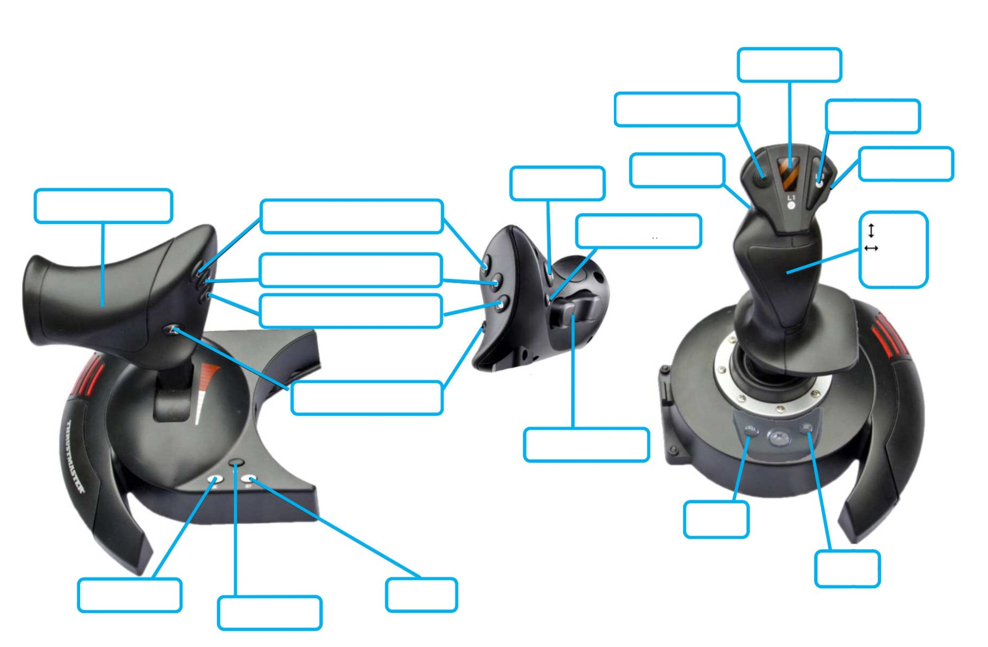
Sweeper up
Not used
Not used
High Gear
Auto Align
Auto Align
Climb
Sweeper intake
Climb safety
forward
Conveyer (override)
turn
Short Shoot
Shoot
Adjust shooter range
Not used
Not used
Unlock Climb
Lock climb
Not used

