Slide 1
CAN ID
---- FX ----
Drive Right 1 = 1
Drive Right 2 = 2
Drive Left 1 = 3
Drive left 2 = 4
Shooter Top = 5
Shooter Bottom 6
--- Victor -----
Elevator = 7
Intake = 8
Conveyer = 9
Light= 10
Climber winch lock = 11
--- FX ----
Climber = 12
Pneumatics ShootGate = 2;
Pneumatics ShootPush = 3;
Pneumatics Intake = 1;
Pneumatics Shift = 0;

Slide 2
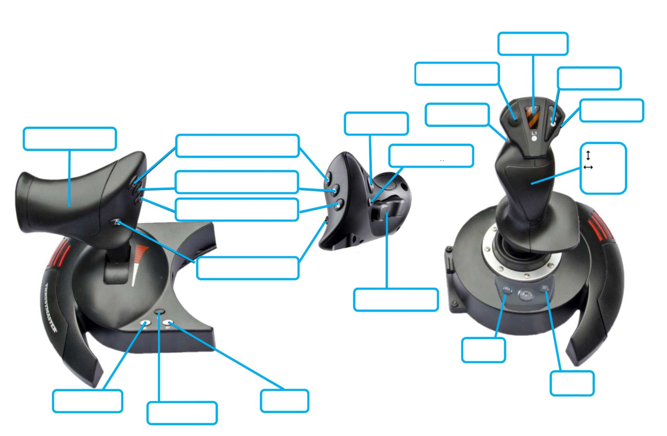

Not used
Not used
Not used
Center arm
position
Field Centric
Not used
Arm rotate
Preset Arm L1
Not used
forward
turn
Preset Arm L2
spin
Not used
Shoot
Arm Extend/Retract
Not used
Not used
Not used
Not used
Not used

Slide 3
Front
Compressor
RoboRio
PCM
Ball shoot
sweep
VRM
Ball gate
shift
elevator
lock
sweep
conveyer
light
PDP
battery

