Slide 1
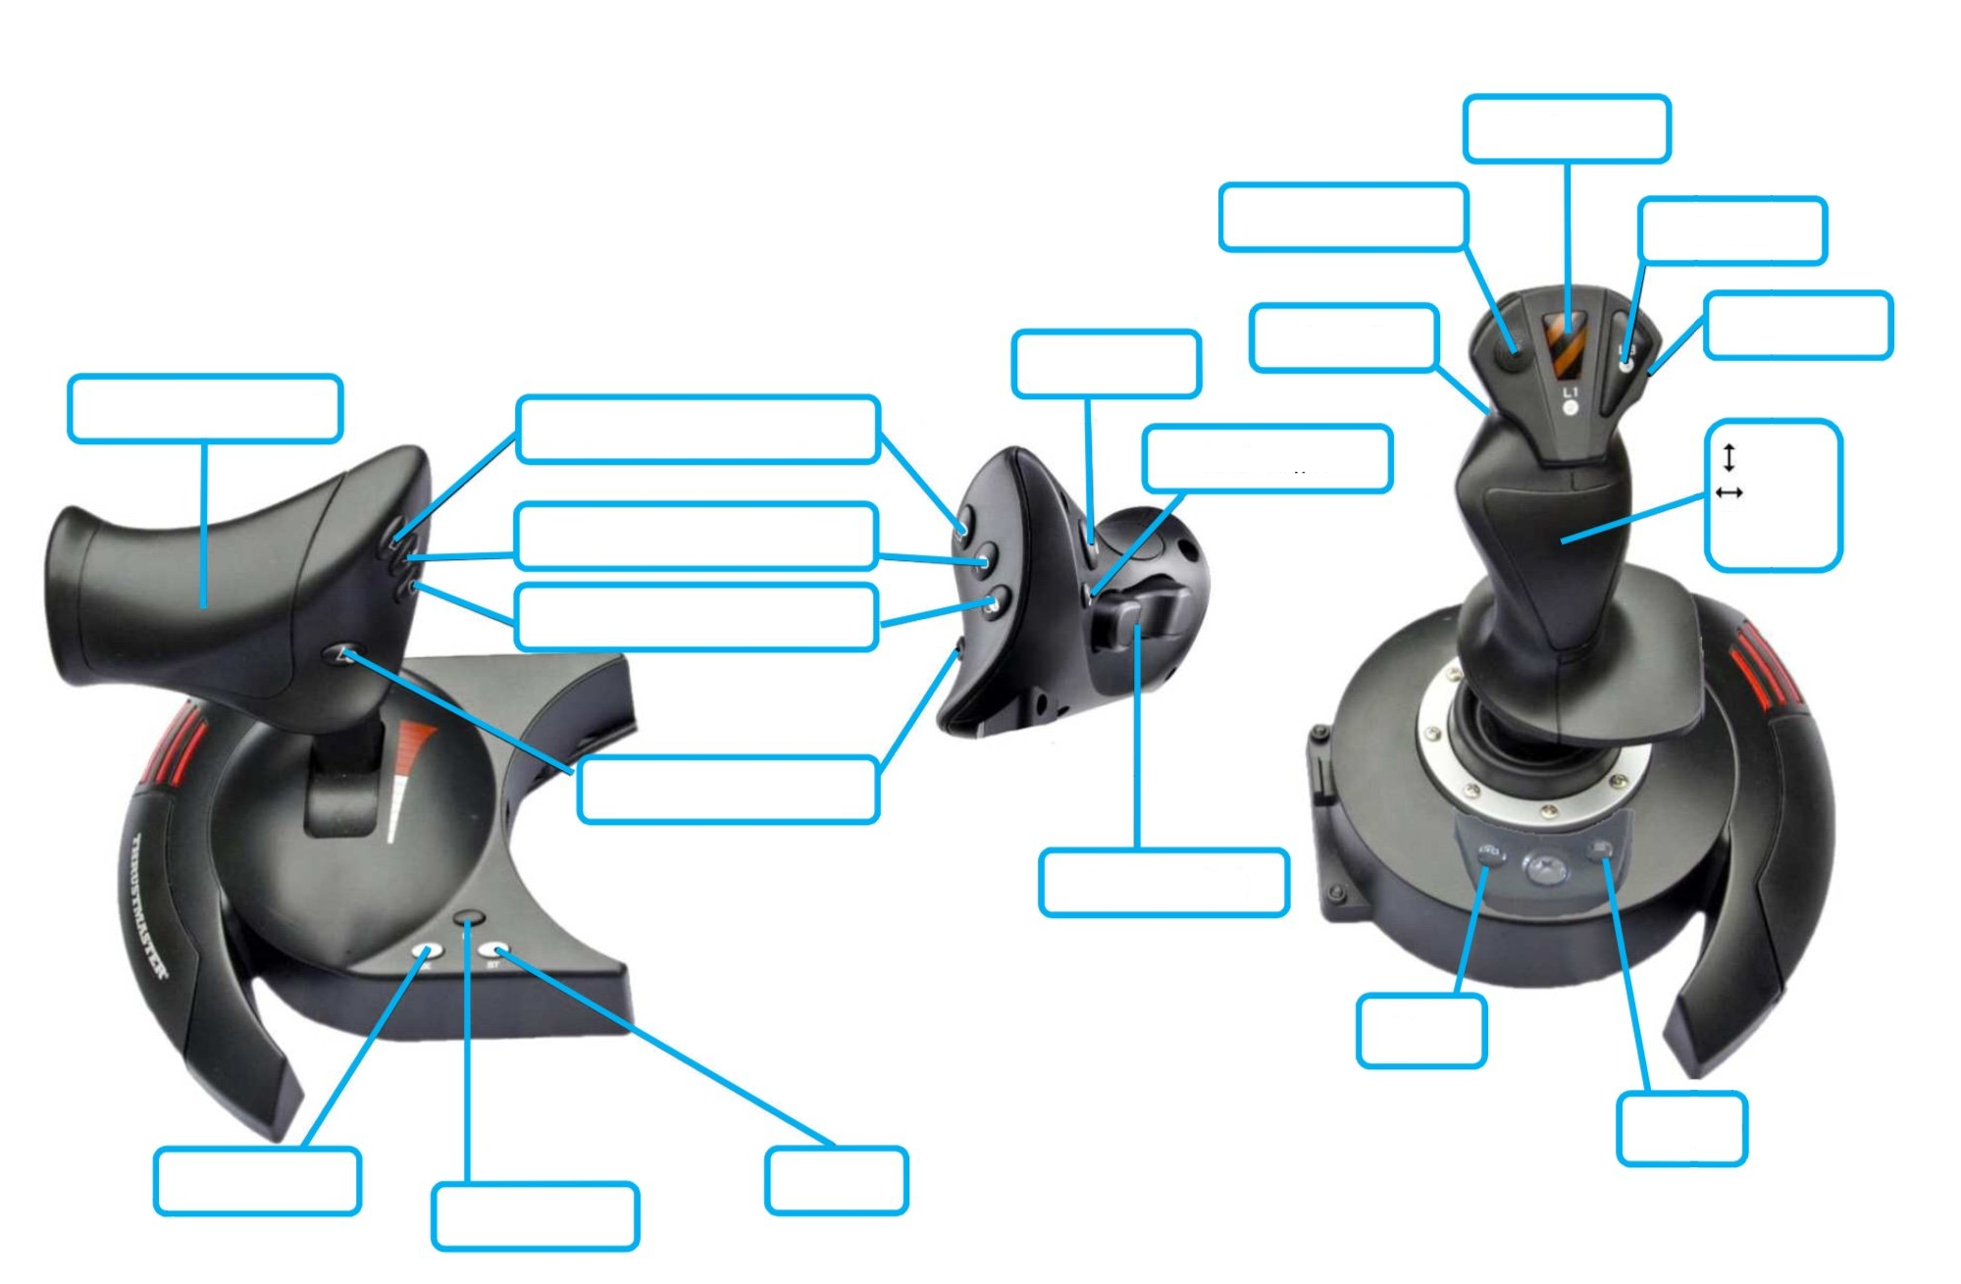

Intake on
Not used
Not used
Auto Level
Field Centric
Not used
Arm rotate
Intake on
Not used
forward
turn
Intake off
spin
Extend Shelf
Shoot
Not used
Not used
Not used
Not used
Not used
Not used

