Slide 1
Meet your robot
A signal and a first movement
Week 1 · MechaRAMS at the YMCA
Notes:
0–5 minutes: collect the individual baseline before discussing code. Use the hook to introduce the demonstration afterward. Where could a robot help at a community center? Accept practical or playful ideas. Ask what the robot must be told before it can help.
Learning goal: Each student changes a short Python message, predicts a short action sequence, and explains that a robot follows the order of its instructions.
Minimum success: The pair displays its chosen one-letter signal, runs one short forward movement, and both partners identify which instruction happened first.

Slide 2
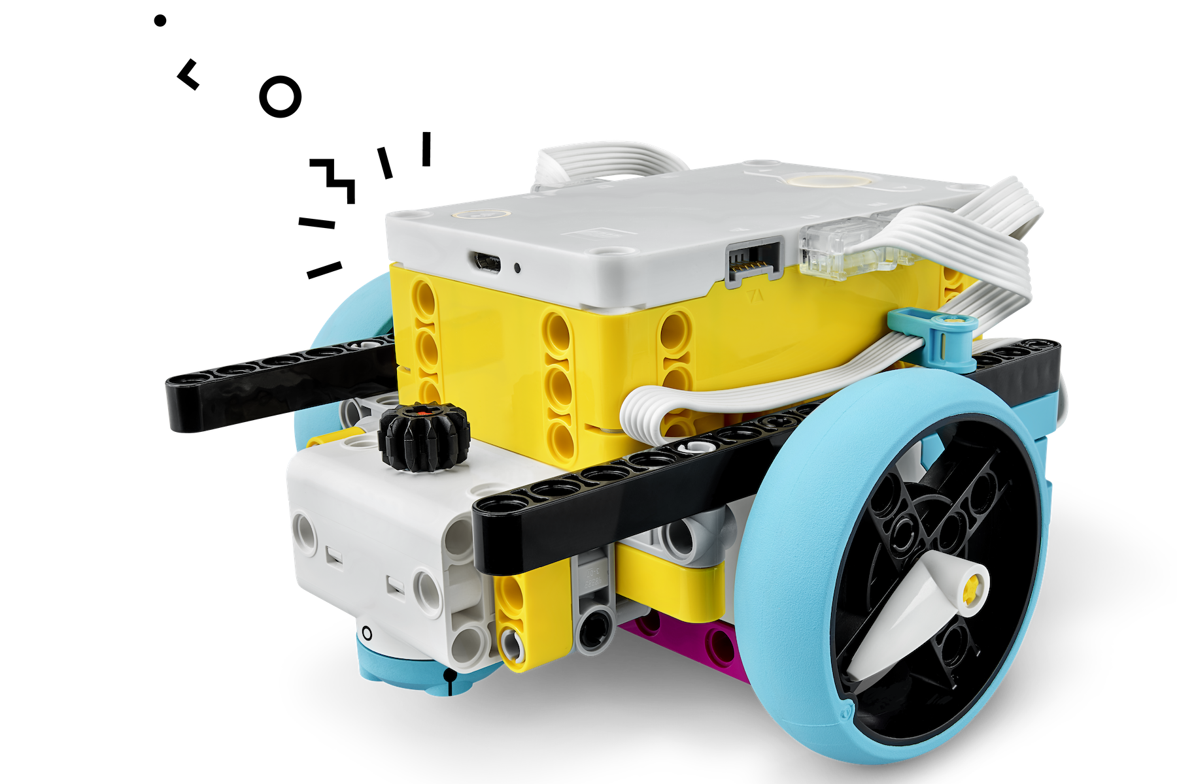
Today’s robot challenge
A one-letter welcome signal
A short forward move
A prediction about the order
Notes:
5–10 minutes, or 7–12 in week 8. Run a letter followed by a pause and a short move. Point at the matching line as each action occurs. Say: “Python is text that tells the robot what to do. Today you only change the recipe area.”
Preparation: Keep wheels raised for the first signal run. Open W01_signal.py in a SPIKE Prime Python project. Confirm the A/B motor mapping with the mentor smoke test. Hand out the baseline before explaining code.
The core challenge uses an assembled base and the supplied complete project.
Image credit: LEGO Education Training Camp 1: https://education.lego.com/en-us/lessons/prime-competition-ready/training-camp-1-driving-around/

Slide 3
Sequence and a function call
await signal("Y")
await pause(500)
await drive(90)
Reading fragment from a complete supplied Python project
Notes:
This is a discussion fragment. It belongs in the supplied project, not in an empty file. The student function is named student_recipe. Run a letter followed by a pause and a short move. Point at the matching line as each action occurs. Say: “Python is text that tells the robot what to do. Today you only change the recipe area.”
Expected reasoning: Show Y, wait, then drive. A longer pause changes waiting time, not the drive distance. A signal-only run still demonstrates sequence.
Technical references: https://spike.legoeducation.com/prime/modal/help/lls-help-python ; https://tuftsceeo.github.io/SPIKEPythonDocs/SPIKE3.html

Slide 4
A prediction before the run
Which instruction happens first?
What changes if the last line moves to the top?
Both partners explain a prediction before anyone presses Run.
Notes:
10–15 minutes in the standard lesson. Number these actions in run order: drive, show Y, wait. What changes if the first and last lines trade places?
Do not reveal the answer immediately. Ask students to point to a line or a measured value. Expected reasoning: Show Y, wait, then drive. A longer pause changes waiting time, not the drive distance. A signal-only run still demonstrates sequence.
Support: Mentor highlights only the three recipe lines. Students may point or dictate while their partner types, then swap the explanation role. Accept a correct light sequence if movement is delayed.

Slide 5
Your work with a partner
Driver: edit and start after the lane check.
Navigator: predict, check, and record.
Swap roles halfway through your robot turn.
Away from the robot: complete the worksheet task.
Notes:
Robot and planning rotations. 1. Name the hub and locate its ports. Point out the two motors, wheels, rechargeable hub, and display. Keep the chassis assembled. Add a removable paper name flag that clears wheels and ports.
2. Open the supplied project. Find STUDENT RECIPE inside student_recipe. Change Y to one letter chosen by the pair. Keep quotation marks. Run with wheels raised, then point to the changed line.
3. Place the robot at a taped start in a clear lane. Navigator checks that the lane is empty. Driver starts the program. Observe which action happens first and mark the endpoint.
4. Switch roles. Change the pause from 500 to 1000 milliseconds. Predict the difference and run again. Keep drive at 90 wheel degrees.
5. During the final five-minute turn, reorder signal and pause or choose a different letter. Each student explains one line without the mentor answering for them.
Off-robot task: Arrange the three action cards on paper. Draw the robot and label the program and movement or light output. Rehearse the sequence by acting it out. Complete the baseline in the opening five minutes, before the demonstration, not during this station.
Week 8 schedule: 12–24 rehearsals, 24–28 setup, 28–44 demos. Otherwise 15–27 first pair, 27–39 second pair.

Slide 6
Evidence from our test
We changed ____________________.
We predicted ____________________.
We observed ____________________.
Our next test would ____________________.
Notes:
39–49 minutes for improvement in standard lessons. Record the letter, pause value, predicted order, and observed order. Individual exit: “A program is ___, and the line I changed made ___ happen.”
Troubleshooting: No letter: check hub connection and that the program started. SyntaxError: check the quotation marks and indentation. Wrong motion: stop and check the A/B cables and base orientation before changing code.
Optional extension: Add a second signal and explain why its location in the sequence matters. No speed contest.
If Python becomes a barrier, preserve the concept using this fallback: New Word Blocks project: when program starts; display chosen text on hub; wait 0.5 seconds; move straight for 0.25 rotations at a mentor-tested slow speed. Set movement motors to A and B. Compare the same action order.

Slide 7
What you can explain now
Which line caused the robot to move? What would happen if the signal line came last?
Save your project. Reset the robot and parts for the next pair.
FRC robots also need clear status signals and ordered instructions.
Notes:
49–54 minutes: individual explanation. Reserve 54–60 for saving and reset. Show Y, wait, then drive. A longer pause changes waiting time, not the drive distance. A signal-only run still demonstrates sequence.
FRC robots also need clear status signals and ordered instructions.
Keep invitations to future activities optional and parent-mediated. Do not equate club attendance with FRC membership.

