Slide 1
Meet your robot
A signal and a first movement
Week 1 · MechaRAMS at the YMCA
Notes:
PREPARATION
Week 1 Meet your robot
Speaker notes for the six-slide class presentation. Use the slides as brief prompts and leave time for children to build, operate and explain. This is a robotics session with a small prepared Python recipe.
Class setup
12 children in grades 5–6 form four teams of three: T1/T2 share Kit A and T3/T4 share Kit B. Four student instructors cover two robot stations and two build tables; a fifth or sixth can float. The adult lead oversees the room and YMCA procedures. Bring four available laptops: two remain connected to robots and two show build references. Printed build cards make the build activity work with two laptops too.
Learning goal Each child changes a short robot message, predicts a short action sequence, and explains that a robot follows the order of its instructions.
Minimum success The team displays its chosen one-letter signal, runs one short forward movement, and all three teammates identify which instruction happened first.
Prepare Keep wheels raised for the first signal run. Open W01_signal.py in a SPIKE Prime Python project. Confirm the A/B motor mapping with the mentor smoke test. Start with names and a welcoming introduction; use no opening quiz or ability rating. Prepare two mentor examples and four labeled team build packs. Rehearse attachment clearance, a hand test and a quick swap. Show the hub color guide.
Materials and files Print and pack from the matching checklist in 01_Instructor/Class_Preparation. Use the team sheet and build card. Keep the original two bases assembled, A left/B right, auxiliary motor unplugged; add C/D only as the lessons require. Hardware rehearsal remains required.
Week 1 setup Build both official Practice Driving Bases before class. R3PTAR is separate and does not replace a teaching kit. The LEGO build PDF is in 06_References. Check the actual forward direction, stop controls, connection and save/export workflow on both teaching devices.
Slide 1 Meet your robot
Timing 0–5 minutes
Say Welcome to robotics at the YMCA. You will make a robot signal and move, and build its own mascot. Each of you gets a turn.
Do Introduce mentors and seat T1/T2 at Pod A, T3/T4 at Pod B. Invite children to share their names. Prior experience was already asked about; use no opening worksheet, quiz or ability rating. Say: Today you will make a robot move and build something for it. Everyone gets a turn, and we will help you with each step.
Say One driver starts after the navigator calls clear. Hands stay away while it moves. Anyone may call stop. Demonstrate the actual stop control before any robot moves.

Slide 2
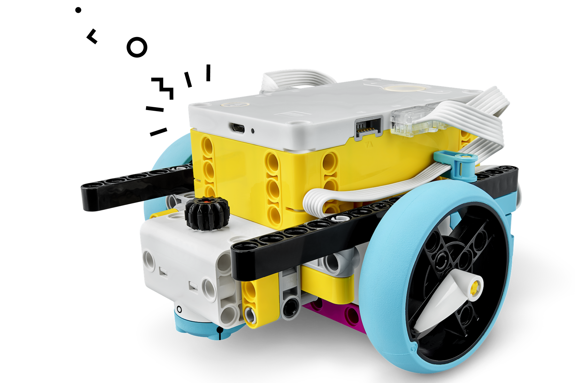
Today’s robot challenge
A one-letter welcome signal
A short forward move
A prediction about the order
GREEN steady: on
ORANGE flashing: charge
RED flashing: stop + mentor
Center button lights. A letter on the display is your program’s output.
Notes:
Slide 2 Todays robot challenge
Timing 5–10 minutes
Do At 5–8 minutes, demonstrate the separately assembled and rehearsed autonomous EV3 R3PTAR: creep, detect the cardboard target, hiss/strike, retract, retreat, turn and resume only if this whole behavior passed rehearsal. Keep people and hands outside its mechanism. A taped boundary does not stop this program automatically.
Ask What changed before the snake reacted? Listen for sensor reading, program decision and motor action. Nobody is steering it remotely.
Do At 8–10 minutes, stop and park R3PTAR. Identify the SPIKE hub, wheels, A/B motors and display. Run the prepared Y, pause, short move. Connect the robot’s behavior to instructions.
Recovery Allow one quick EV3 reset, then use SPIKE. If motion fails, show signal and pause with wheels safely raised. Do not spend the children’s activity time repairing the demo.
Hub check Read the light on the correct button: steady green center means powered on with a compatible OS and at least 20% battery; flashing orange center means charge; flashing red center means stop, power off and cool for 15 minutes. White center needs a compatible OS; flashing purple center means updating. Blue is the connection button: flashing means waiting for Bluetooth, steady means connected. A display letter is a program output, not a battery or connection status. See the full SPIKE Hub Color Guide.

Slide 3
Sequence and a function call
await signal("Y")
await pause(500)
await drive(90)
Our prediction
Which instruction happens first?
What changes if the last line moves to the top?
Reading fragment from the complete supplied project
Notes:
Slide 3 Sequence and a function call and prediction
Timing 10–14 minutes
await signal("Y")
await pause(500)
await drive(90)
Say We edit the small student_recipe in a complete project. signal("Y") shows a letter; keep its quotation marks. pause(500) waits half a second. drive(90) asks for a quarter rotation of the wheels. That is neither 90 cm nor a 90-degree heading change. Here await lets the current action finish before the next line.
Point Trace top to bottom: signal, wait, drive. Locate the recipe comments in the actual file. Leave drive(90) unchanged today.
Ask Which instruction happens first? What changes if we MOVE the last line to the top? Give ten seconds to think and each child a brief explanation turn.
Expected Original: show Y, pause, drive. Moving the last line to the top gives drive, show Y, pause. Swapping the first and last lines is a different operation: drive, pause, show Y. The requested wheel rotation stays 90 degrees.
Try First choose one letter. Later change pause from 500 to 1000; predict a longer wait, not a longer requested movement.

Slide 4
Our robot and build jobs
Driver edits and starts after “clear.”
Navigator predicts and resets the stopped robot.
Observer watches, measures and records.
Other team builds. Everyone rotates jobs.
Robot turns: rotate every 4 minutes. Retests: every 2 minutes.
Notes:
Slide 4 Our robot and build jobs
Timing 14–38 then retests minutes
Station map 14–26: T1/T3 use robots and T2/T4 build. 26–38: teams switch stations. 38–44: T1/T3 retest while the other teams finish builds. 44–50: T2/T4 retest. Rotate roles at 18, 22, 30, 34, 40, 42, 46 and 48 minutes. Each team has 18 robot minutes, giving each child about six minutes as driver plus handling, observing and building. Transitions occur within these blocks.
Jobs At the robot, the driver edits and starts after “clear.” The navigator reads the step, predicts, positions the stopped robot and payload, fits an approved attachment and checks the lane. The observer watches, measures and records one number, tick or phrase. Rotate all three jobs every four minutes in the first turn and every two minutes in the retest. At the build table, rotate builder, designer/parts manager and tester/reporter on the same timer. Everyone contributes hands-on work.
Robot steps 1. Name the hub and locate its ports. Point out the two motors, wheels, rechargeable hub, and display. Keep the chassis assembled. Add a removable paper name flag that clears wheels and ports. 2. Open the supplied project. Find STUDENT RECIPE inside student_recipe. Change Y to one letter chosen by the team. Keep quotation marks. Run with wheels raised, then point to the changed line. 3. Place the robot at a taped start in a clear lane. Navigator checks that the lane is empty. Driver starts the program. Observe which action happens first and mark the endpoint. 4. Switch roles. Change the pause from 500 to 1000 milliseconds. Predict the difference and run again. Keep drive at 90 wheel degrees. 5. During the final six-minute turn, reorder signal and pause or choose a different letter. Each student explains one line without the mentor answering for them.
Build A removable robot mascot. Make a name flag or face that stays upright and attaches without covering a wheel, port, button or cable. Choose a team name and lay out a lightweight mast or face. Build a wide or braced support using the mounting template. Gently tilt and tap the model by hand. Improve one weak connection. Test: Stands after a gentle tap; stays inside the clearance template; no loose parts.
Connection to robot Fit the approved mascot to the stopped base for the retest. The first robot teams use a mentor example or the bare base.
Coaching Ask for an observation before suggesting a change. Help with one connection or edit, then return control. Typing can be assisted; the child still chooses, predicts and starts the run.

Slide 5
Evidence from our test
We changed ____________________.
We predicted ____________________.
We observed ____________________.
Our next test would ____________________.
Notes:
Slide 5 Evidence from our test
Timing 38–50 minutes in two six-minute retests.
Evidence At the robot: each child makes a prediction and takes a driver turn. Keep one number, tick or short phrase per trial. At the build table: show the model and its hand-test result. Record the letter, pause value, predicted order, and observed order. Individual exit: “A program is ___, and the line I changed made ___ happen.”
Ask What changed? What stayed the same? What did the real run show? Record a tick, short phrase or number at the robot. The build table tests the model by hand rather than repeating a worksheet.
Troubleshooting No letter: check hub connection and that the program started. SyntaxError: check the quotation marks and indentation. Wrong motion: stop and check the A/B cables and base orientation before changing code.
Support Mentor highlights only the three recipe lines. Students may point or dictate while their partner types, then swap the explanation role. Accept a correct light sequence if movement is delayed.
Extension Add a second signal and explain why its location in the sequence matters. No speed contest.
If needed New Word Blocks project: when program starts; display chosen text on hub; wait 0.5 seconds; move straight for 0.25 rotations at a mentor-tested slow speed. Set movement motors to A and B. Compare the same action order.

Slide 6
What we learned and noticed
What did you learn about instruction order?
What did you notice when the robot ran?
What would you change or build next?
Save your team project. Store your build. Reset the robot and parts.
Notes:
Slide 6 What we learned and noticed
Timing 50–54 minutes for reflection; 54–60 for saving, packing and pickup.
Ask each child What did you learn about instruction order? What did you notice when the robot ran? What would you change or build next?
Facilitate Run two pod conversations in parallel. Give each of the six children about 20–30 seconds for one chosen prompt. Invite a concrete observation from the robot or build. Accept pointing, a demonstration or a short sentence.
Listen for Show Y, wait, then drive. A longer pause changes waiting time, not the drive distance. A signal-only run still demonstrates sequence.
Close Save T1–T4 projects, stop and park both robots, remove only approved temporary attachments, store four labeled builds and count parts. Follow YMCA pickup procedures.
Optional connection FRC robots also need clear status signals and ordered instructions.

