Slide 1
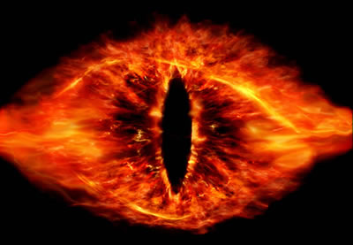
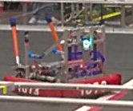
Robot Data Collection (Project HedenWare ,The Art of Listening)
Willie Wider
Integration/Software/Electrical
Team 1073

Slide 2
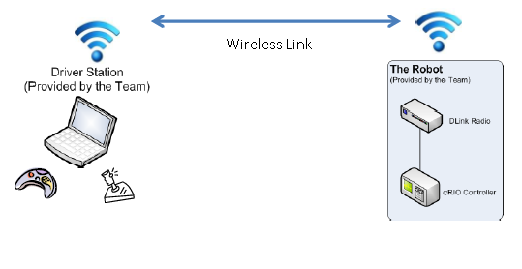
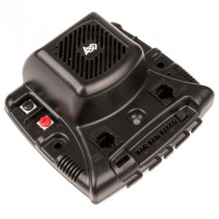
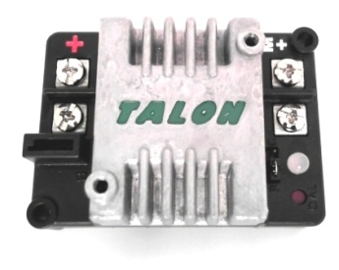
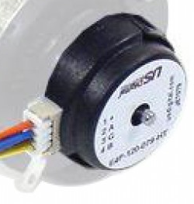
Robot Data
Collected through the process of Network Surveillance for Acquirable data.
All critical robot functions generate data on their condition and operation. Examples are:
Jaguar motor controllers, voltage in, voltage out, amount of current supplied to motors
Encoder values of position
Other sensors, solenoid modules, joystick positions, and several other key pieces of data from a variety of devices.
Data is gathered and sent to the driver station from the robot.
Information
Doesn't this take up bandwidth/CPU usage?
-Yes, but a lower priority.
Hardware (Jags, encoders, etc.)
It does take CPU time, but it can be adjusted. It does not take up bandwidth.
Full Seats
Empty Seats, where the collected robot data is put.

Slide 3
Robot Data
The data is stored on the driver station laptop in a USB flashdrive.
The data is received, and then parsed into a .csv file format for importing into spreadsheet and data base programs.
The first two columns show the date and time of each piece of data captured.
All data types (float, int boolean, etc.) are converted into String values and added to said file.
NetConsole window (the app with the green text) is stored as well (not shown here).

Slide 4
Robot Data
Table data is difficult to read and provide any analysis. What it does very well is provide the ability to chart the data to tell us in pictures what, and how the robot is doing throughout the match.
The charts on the right are an examples of overall Battery Voltage and Amperage throughout a single match.
Reading the charts, and reviewing key pieces of specific data to understand why the robot functioned the it did is called Data Analysis.
The outcome:
Conclusive analysis, and sometimes recommended action.

Slide 5
How is this data helpful?

Slide 6
“Why was the robot not moving properly?”
Front Left Speed | Front Left Current | Front Left Faults
0.14 | 11.367 | 0
0.32 | 26.992 | 0
0.579 | 41.305 | 0
0.761 | 48.922 | 0
0.946 | 45.902 | 0
1 | 60.871 | 0
1 | 61.789 | 0
1 | 61.922 | 0
1 | 65.465 | 0
1 | 67.586 | 0
1 | 68.152 | 0
1 | 68.102 | 0
1 | 67.985 | 0
1 | 67.566 | 0
.986 | 63.363 | 0
0 | 0 | 1
0 | 0 | 1
0 | 0 | 1
0 | 0 | 1
0 | 0 | 1
0 | 0 | 1
0 | 0 | 1

Slide 7
“Why was the shooter weak?”
Left Launcher Solenoid | Right Launcher Solenoid | High Transducer(PSI)
0 | 0 | 109.775
0 | 0 | 109.89
0 | 0 | 101.52
0 | 0 | 101.213
1 | 0 | 92.556
1 | 0 | 96.554
1 | 0 | 95.753
1 | 0 | 98.382
1 | 0 | 94.238
1 | 0 | 97.381
1 | 0 | 99.410
1 | 0 | 100.609
1 | 0 | 99.124
1 | 0 | 100.465
1 | 0 | 100.894

