Slide 1
Programming Tryouts
September 17, 2026

Slide 2
🛜LibBox
JitB-2910-Rebuilt

Slide 3
Welcome to Programming Tryouts!
01 | Introductions
02 | Learn what programming sub team does
03 | Understand how the tryout process will work
04 | Get setup with GitHub and Codepsaces
05 | Write and run some Java code
Learn. Build. Debug. Improve.

Slide 4





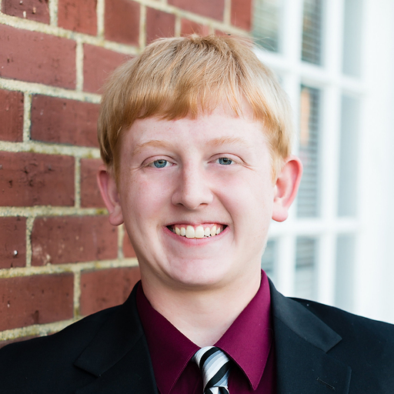


Introduction
Prog 1
Prog 2
Scouting
Support
Devang
Jonathan
Deepak
Kevin
Wen
Royce
Kate
Johan

Slide 5




About me
8
---
26
4
4
2

Slide 6
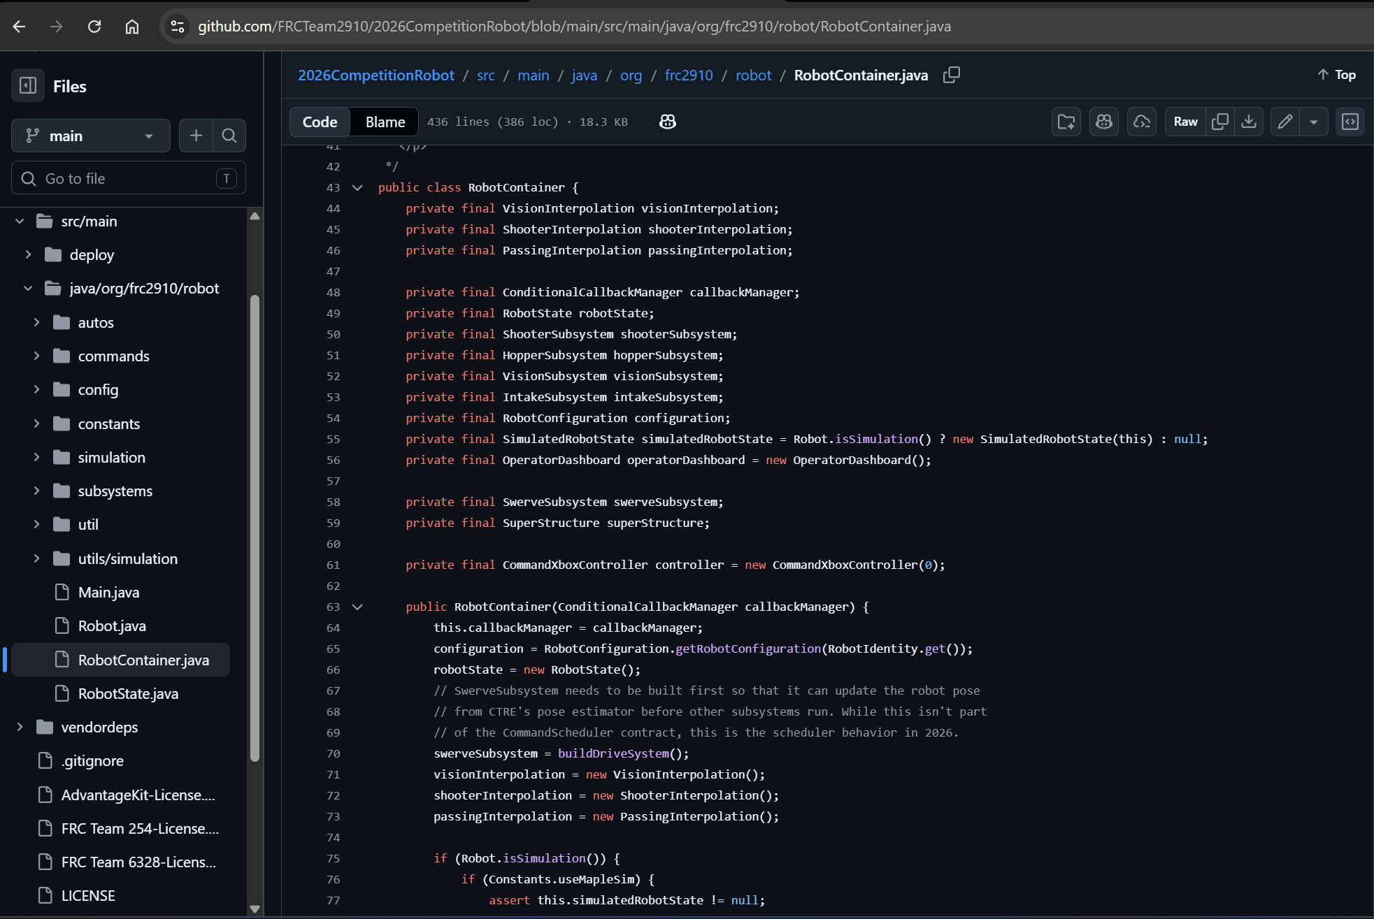
What does Programming do?
Control the drivetrain and robot mechanisms
Read and use sensors
Build autonomous routines
Work with vision and positioning systems
Support driver controls and match strategy
Test, debug, and improve robot behavior
Collaborate closely with other sub teams

Slide 7
What are we looking for?
Curiosity and willingness to learn
Logical thinking and problem-solving
Persistence when something does not work
Ability to ask good questions
Teamwork and communication
Attention to detail
Willingness to take feedback and improve
Ability to explain your thought process
Prior programming experience is helpful, but not required.
What matters most:
How you learn, think, collaborate, and improve.

Slide 8
Using AI during Programming Tryouts
AI can help you learn, but it should not replace your thinking.
You are responsible for every line of code you submit.
Good ways to use AI
Explain a programming concept
Help understand an error message
Give you hints when you are stuck
Show a similar example
Review or explain code you or others wrote
Not acceptable
Generate an entire assignment and submit it as your own
Copy code you do not understand
Be prepared to explain:
1. What your code does 2. Why you wrote it that way 3. How you solved or debugged the problem
Use AI to help you learn, not to avoid learning.

Slide 9
Programming Tryouts Schedule
Date | Focus
Thu, Sep 17 | Welcome, GitHub, Codespaces, Intro to Java
Mon, Sep 21 | Java Fundamentals
Thu, Sep 24 | Java + Troubleshooting
Mon, Sep 28 | Classes & Objects
Thu, Oct 1 | Programming Assessment
Between meetings
Complete assigned exercises
Submit your work through GitHub
Come prepared to build on what you learned previously
Important: Each session builds on the previous one, so attendance and completing assignments matter.

Slide 10
What to Bring?
A personal / non-school laptop is required for programming tryouts.
Bring a Windows PC or Mac
Do not rely on a school-issued laptop
  GitHub access is restricted on school devices
  We will use GitHub throughout the tryout process
Bring your laptop charger
Make sure your laptop:
  Can connect to Wi-Fi
  Has a modern browser such as Chrome, Edge, or Firefox
  Can access GitHub
You do not need to install Java, VS Code, or WPILib during the tryouts.
We will use GitHub Codespaces, which runs the development environment in your browser.

Slide 11
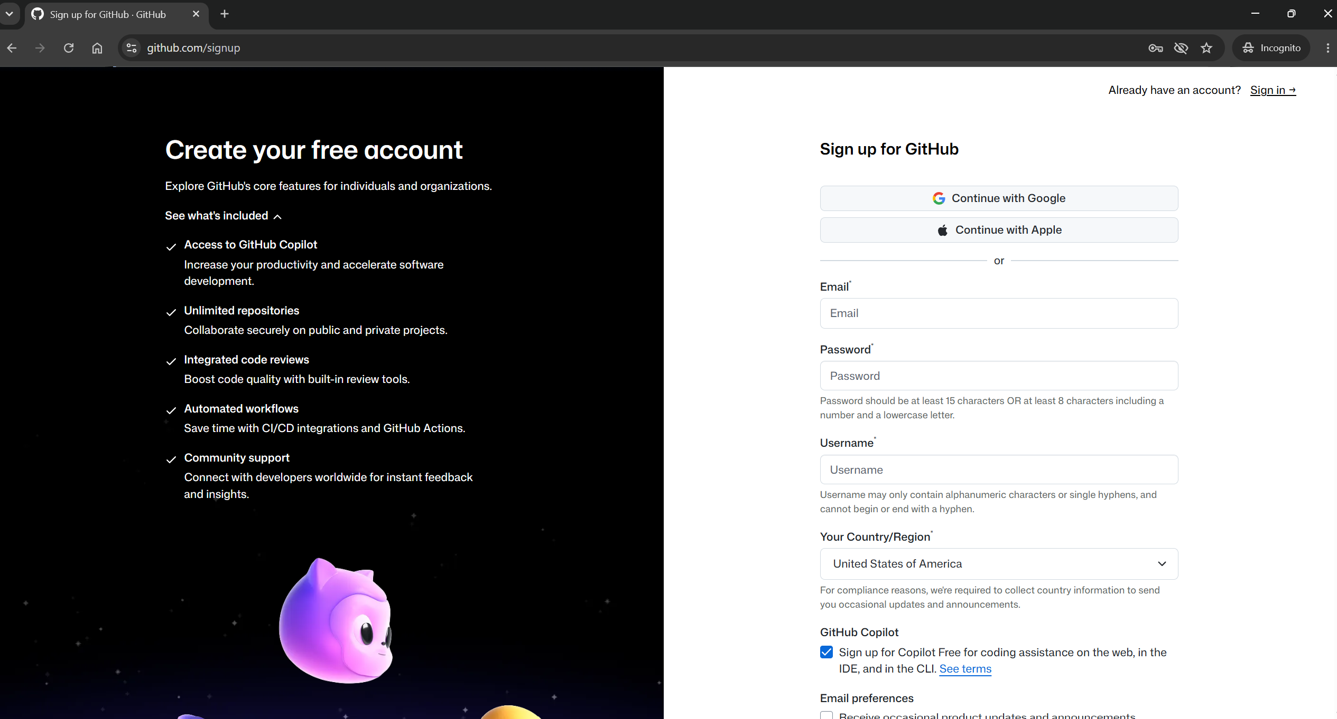
Create your GitHub Account
You need a free GitHub account for programming tryouts.
Sign up at: https://github.com/signup
When creating your account:
Use your school email address
Choose a username you will recognize and remember
Create a secure password
Remember your email, username, and password
Important
GitHub accounts are free
Do not enter any credit card or payment information
You do not need to purchase GitHub Pro or any paid plan

Slide 12
Tools of the Trade
These are the core tools we’ll use during programming tryouts.
Don’t worry if these terms are new.
We’ll introduce them step by step and use them throughout tryouts.
Java | the programming language we’ll use
Git | tracks changes to code over time
GitHub | stores code and helps us collaborate
Repository | where a project and its files live
Commit | a saved checkpoint of your changes
Pull Request | a way to submit changes for review
GitHub Codespaces | a browser-based development environment
VS Code | the editor in codespaces where we write code

Slide 13
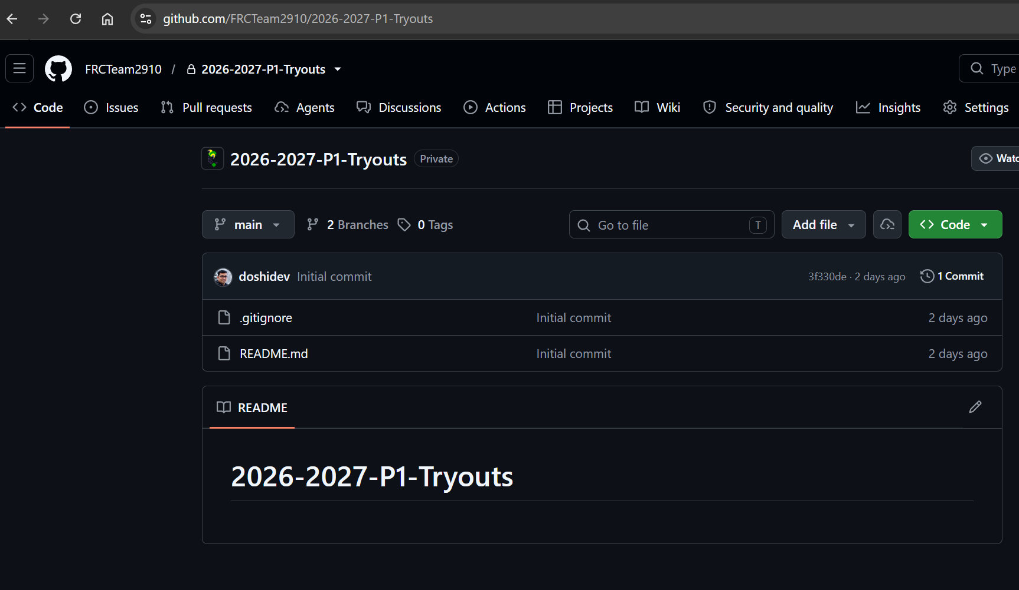
Programming Tryouts Repository
GitHub Repository: https://github.com/FRCTeam2910/2026-2027-P1-Tryouts
You’ll use it to:
Access coding examples and exercises
Find assignment instructions
Work in GitHub Codespaces
Submit your code
Track changes using Git
Ask questions through GitHub Discussions
Think of the repository as our shared programming workspace for tryouts.

Slide 14
GitHub Discussions
Stuck? Ask questions early.
Use GitHub Discussions to:
Ask programming or tryout-related questions
Share what you tried
Include relevant code or error messages
Get guidance from mentors
Learn from questions other students ask
When posting a question:
Start a new discussion
Be clear and specific
Explain what you already tried
Keep discussion focused on programming and tryouts
Be respectful and professional
Asking for help is encouraged.
A good rule for students:
Don’t just say “it doesn’t work”, tell us what you expected, what happened, and what you tried.

Slide 15
GitHub Workflow
Hands on lab.

Slide 16
Thank You!
See you next meeting.

