Slide 1
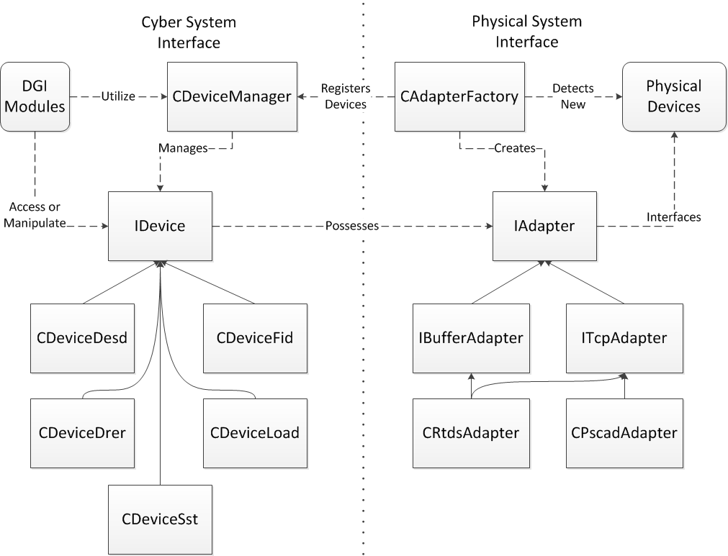
DGI Device Architecture

