Slide 1
GEH Communication

Slide 2
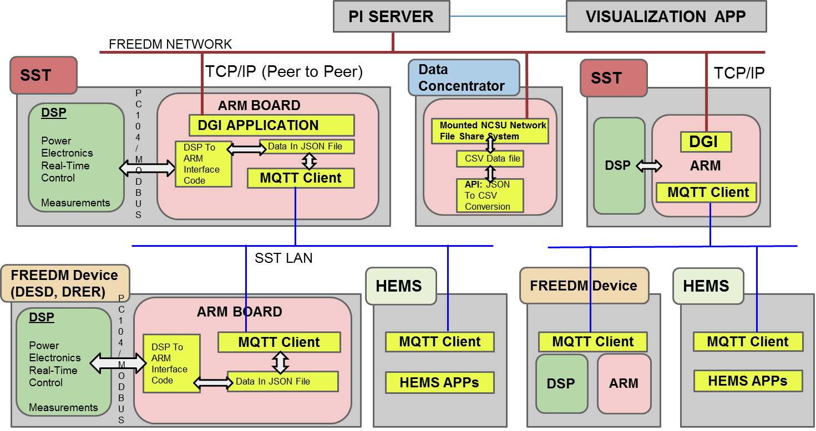
GEH Communication Overview Y7
Notes:
Pc104
Data concentrator
No dnp3 interface

Slide 3
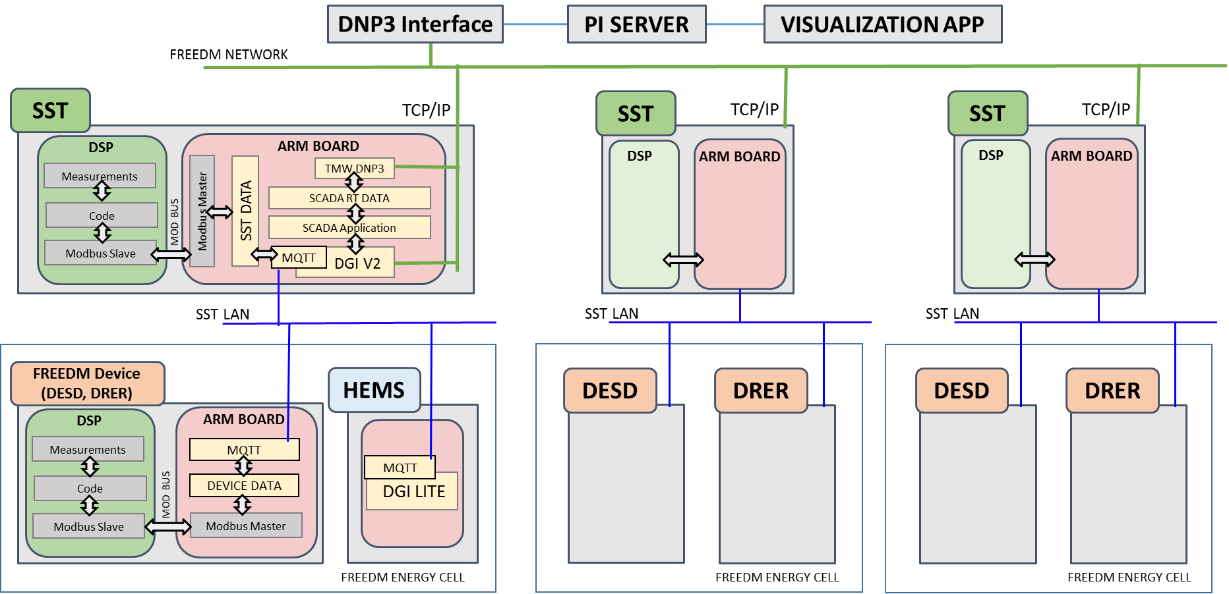
GEH Communication Overview Y8

Slide 4
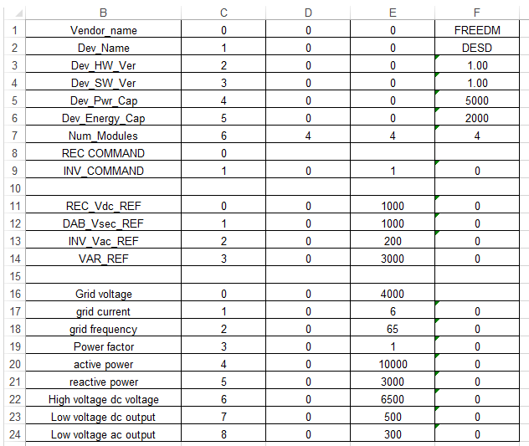
GEH Communication Overview Y8
DEVICE PROFILE(SST)

Slide 5
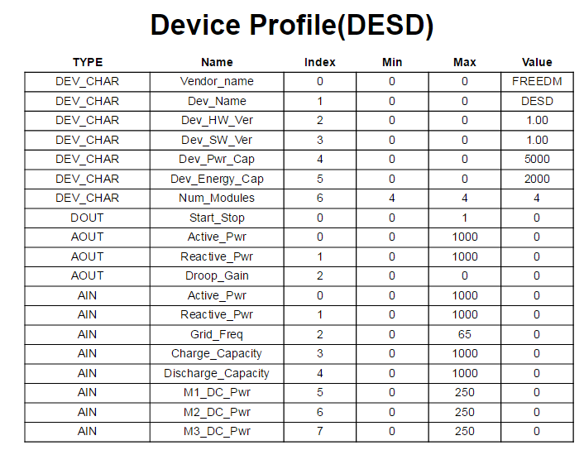
GEH Communication Overview Y8

Slide 6
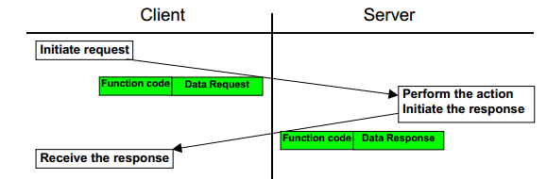
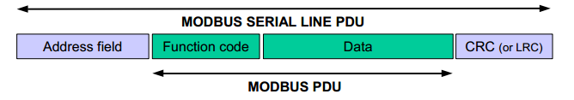
MODBUS over ZigBee
Application layer protocol for Client- Server type of communication
Helps standardize communication frames for ARM - DSP communication

Slide 7
DATA in JSON
{"py/object": "freedmqtt.DeviceProfile.DeviceProfile", "DIN": [{"py/object": "freedmqtt.DeviceProfile.din", "index": 0, "name": "Module1_start_stop", "maximum": 1.0, "value": 0.0, "minimum": 0.0}, {"py/object": "freedmqtt.DeviceProfile.din", "index": 1, "name": "Module2_start_stop", "maximum": 1.0, "value": 0.0, "minimum": 0.0}, {"py/object": "freedmqtt.DeviceProfile.din", "index": 2, "name": "Module3_start_stop", "maximum": 1.0, "value": 0.0, "minimum": 0.0}, {"py/object": "freedmqtt.DeviceProfile.din", "index": 3, "name": "Module4_start_stop", "maximum": 1.0, "value": 0.0, "minimum": 0.0}], "AOUT": [{"py/object": "freedmqtt.DeviceProfile.aout", "index": 0, "name": "Vlv1", "maximum": 16000.0, "value": 13214.0, "minimum": -16000.0}, {"py/object": "freedmqtt.DeviceProfile.aout", "index": 1, "name": "Vhv1", "maximum": 450.0, "value": 0.0, "minimum": -450.0}, {"py/object": "freedmqtt.DeviceProfile.aout", "index": 2, "name": "Ihv1", "maximum": 5000.0, "value": 5.0, "minimum": -5000.0}, {"py/object": "freedmqtt.DeviceProfile.aout", "index": 3, "name": "SOC1", "maximum": 100.0, "value": 51.0, "minimum": 0.0}, {"py/object": "freedmqtt.DeviceProfile.aout", "index": 4, "name": "Vlv2", "maximum": 16000.0, "value": 13181.0, "minimum": -16000.0}, {"py/object": "freedmqtt.DeviceProfile.aout", "index": 5, "name": "Vhv2", "maximum": 450.0, "value": 0.0, "minimum": -450.0}, {"py/object": "freedmqtt.DeviceProfile.aout", "index": 6, "name": "Ihv2", "maximum": 5000.0, "value": -10.0, "minimum": -5000.0}, {"py/object": "freedmqtt.DeviceProfile.aout", "index": 7, "name": "SOC2", "maximum": 100.0, "value": 51.0, "minimum": 0.0}, {"py/object": "freedmqtt.DeviceProfile.aout", "index": 8, "name": "Vlv3", "maximum": 16000.0, "value": 13200.0, "minimum": -16000.0}, {"py/object": "freedmqtt.DeviceProfile.aout", "index": 9, "name": "Vhv3", "maximum": 450.0, "value": 0.0, "minimum": -450.0}, {"py/object": "freedmqtt.DeviceProfile.aout", "index": 10, "name": "Ihv3", "maximum": 5000.0, "value": -7.0, "minimum": -5000.0}, {"py/object": "freedmqtt.DeviceProfile.aout", "index": 11, "name": "SOC3", "maximum": 100.0, "value": 51.0, "minimum": 0.0}, {"py/object": "freedmqtt.DeviceProfile.aout", "index": 12, "name": "Vlv4", "maximum": 16000.0, "value": 0.0, "minimum": -16000.0}, {"py/object": "freedmqtt.DeviceProfile.aout", "index": 13, "name": "Vhv4", "maximum": 450.0, "value": 0.0, "minimum": -450.0}, {"py/object": "freedmqtt.DeviceProfile.aout", "index": 14, "name": "Ihv4", "maximum": 5000.0, "value": 0.0, "minimum": -5000.0}, {"py/object": "freedmqtt.DeviceProfile.aout", "index": 15, "name": "SOC4", "maximum": 100.0, "value": 50.0, "minimum": 0.0}], "DOUT": [], "Name_Hash": {"Dev_Pwr_Cap": "DEV_CHAR/4", "Vhv2OUT": "AOUT/5", "Module3_start_stopIN": "DIN/2", "Ihv3OUT": "AOUT/10", "Module1_PIN": "AIN/0", "Ihv1OUT": "AOUT/2", "Module4_start_stopIN": "DIN/3", "Module1_start_stopIN": "DIN/0", "Vendor_name": "DEV_CHAR/0", "Dev_HW_Ver": "DEV_CHAR/2", "SOC1OUT": "AOUT/3", "Vhv3OUT": "AOUT/9", "SOC2OUT": "AOUT/7", "SOC4OUT": "AOUT/15", "Dev_Energy_Cap": "DEV_CHAR/5", "Ihv4OUT": "AOUT/14", "Dev_SW_Ver": "DEV_CHAR/3", "Module4_PIN": "AIN/3", "Num_Modules": "DEV_CHAR/6", "Vlv3OUT": "AOUT/8", "Vhv1OUT": "AOUT/1", "Vhv4OUT": "AOUT/13", "Dev_Name": "DEV_CHAR/1", "Vlv2OUT": "AOUT/4", "Ihv2OUT": "AOUT/6", "Module3_PIN": "AIN/2", "Vlv4OUT": "AOUT/12", "SOC3OUT": "AOUT/11", "Vlv1OUT": "AOUT/0", "Module2_start_stopIN": "DIN/1", "Module2_PIN": "AIN/1"}, "Topic_Hash": {"AIN/0": "Module1_P", "AIN/1": "Module2_P", "AIN/2": "Module3_P", "AIN/3": "Module4_P", "DEV_CHAR/3": "Dev_SW_Ver", "DEV_CHAR/2": "Dev_HW_Ver", "DEV_CHAR/1": "Dev_Name", "DEV_CHAR/0": "Vendor_name", "DEV_CHAR/6": "Num_Modules", "DEV_CHAR/5": "Dev_Energy_Cap", "DEV_CHAR/4": "Dev_Pwr_Cap", "AOUT/8": "Vlv3", "AOUT/9": "Vhv3", "AOUT/0": "Vlv1", "AOUT/1": "Vhv1", "AOUT/2": "Ihv1", "AOUT/3": "SOC1", "AOUT/4": "Vlv2", "AOUT/5": "Vhv2", "AOUT/6": "Ihv2", "AOUT/7": "SOC2", "AOUT/12": "Vlv4", "AOUT/13": "Vhv4", "AOUT/10": "Ihv3", "AOUT/11": "SOC3", "AOUT/14": "Ihv4", "AOUT/15": "SOC4", "DIN/1": "Module2_start_stop", "DIN/0": "Module1_start_stop", "DIN/3": "Module4_start_stop", "DIN/2": "Module3_start_stop"}, "file_1": "json/DCDESD_1.json", "flag": 12, "AIN": [{"py/object": "freedmqtt.DeviceProfile.ain", "index": 0, "name": "Module1_P", "maximum": 600.0, "value": 0.0, "minimum": -600.0}, {"py/object": "freedmqtt.DeviceProfile.ain", "index": 1, "name": "Module2_P", "maximum": 600.0, "value": 0.0, "minimum": -600.0}, {"py/object": "freedmqtt.DeviceProfile.ain", "index": 2, "name": "Module3_P", "maximum": 600.0, "value": 0.0, "minimum": -600.0}, {"py/object": "freedmqtt.DeviceProfile.ain", "index": 3, "name": "Module4_P", "maximum": 600.0, "value": 0.0, "minimum": -600.0}], "DEV_CHAR": [{"py/object": "freedmqtt.DeviceProfile.dev_char", "index": 0, "name": "Vendor_name", "value": "FREEDM"}, {"py/object": "freedmqtt.DeviceProfile.dev_char", "index": 1, "name": "Dev_Name", "value": "DCDESD"}, {"py/object": "freedmqtt.DeviceProfile.dev_char", "index": 2, "name": "Dev_HW_Ver", "value": 1.0}, {"py/object": "freedmqtt.DeviceProfile.dev_char", "index": 3, "name": "Dev_SW_Ver", "value": "1.00"}, {"py/object": "freedmqtt.DeviceProfile.dev_char", "index": 4, "name": "Dev_Pwr_Cap", "value": 1500.0}, {"py/object": "freedmqtt.DeviceProfile.dev_char", "index": 5, "name": "Dev_Energy_Cap", "value": 3000.0}, {"py/object": "freedmqtt.DeviceProfile.dev_char", "index": 6, "name": "Num_Modules", "value": "4"}], "write_time": {"py/object": "datetime.datetime", "__reduce__": [{"py/type": "datetime.datetime"}, ["B98FHBYUMAWGJw=="]]}, "initialized": 1, "start_time": {"py/object": "datetime.datetime", "__reduce__": [{"py/type": "datetime.datetime"}, ["B98FHBUyNAuS0g=="]]}, "change": ["Error", "AOUT/0", "AOUT/1", "AOUT/2", "AOUT/3", "AOUT/4", "AOUT/5", "AOUT/6", "AOUT/7", "AOUT/8", "AOUT/9", "AOUT/10", "AOUT/11"], "native": 1}Implementation

Slide 8
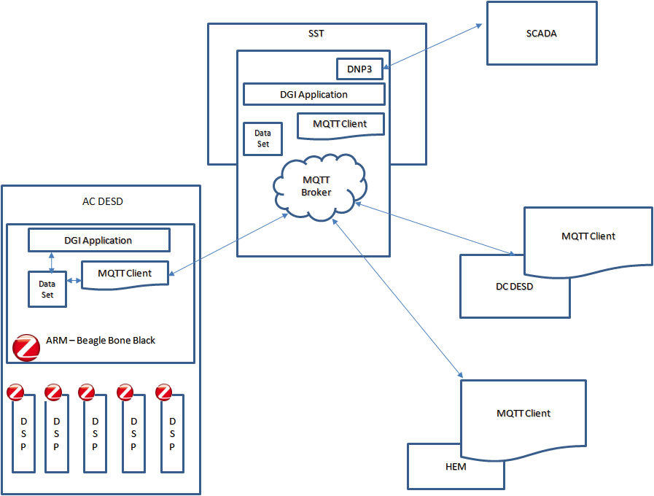
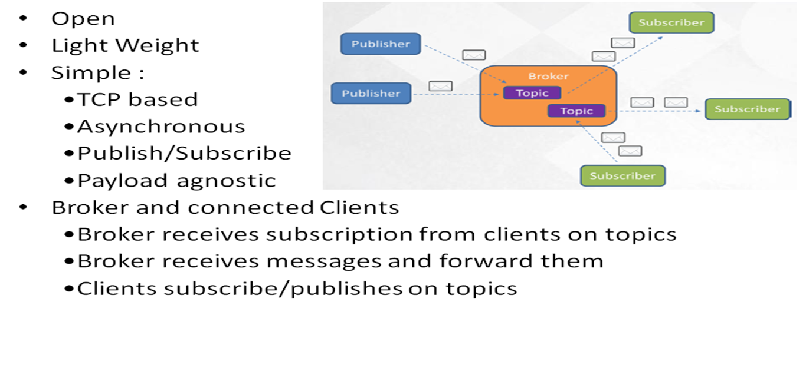
MQTT : Message Queue Telemetry Transport
Communication Framework

Slide 9


Implementation
Device Profile, which is nothing but a standardized Excel sheet, shall list all the data points.
It would be parsed to create an object for each device at initialization.
JSON file is a simple, standard file format to represent object attributes.
Applications can read from/ write into JSON files (APIs shall be provided with Rd/Wr protection)
MQTT shall maintain concurrency across JSON files representing a unique object.
MODBUS communication with the DSPs is conducted over the Xbee network.
PI SERVER
SST or HEM
File Transfer
DATA
DGI or MATLAB APP
MQTT
TCP/IP
JSON
COMMAND/STATUS
DESD
DSP
MQTT
DATA
Beagle Bone
APP
MODBUS

Slide 10
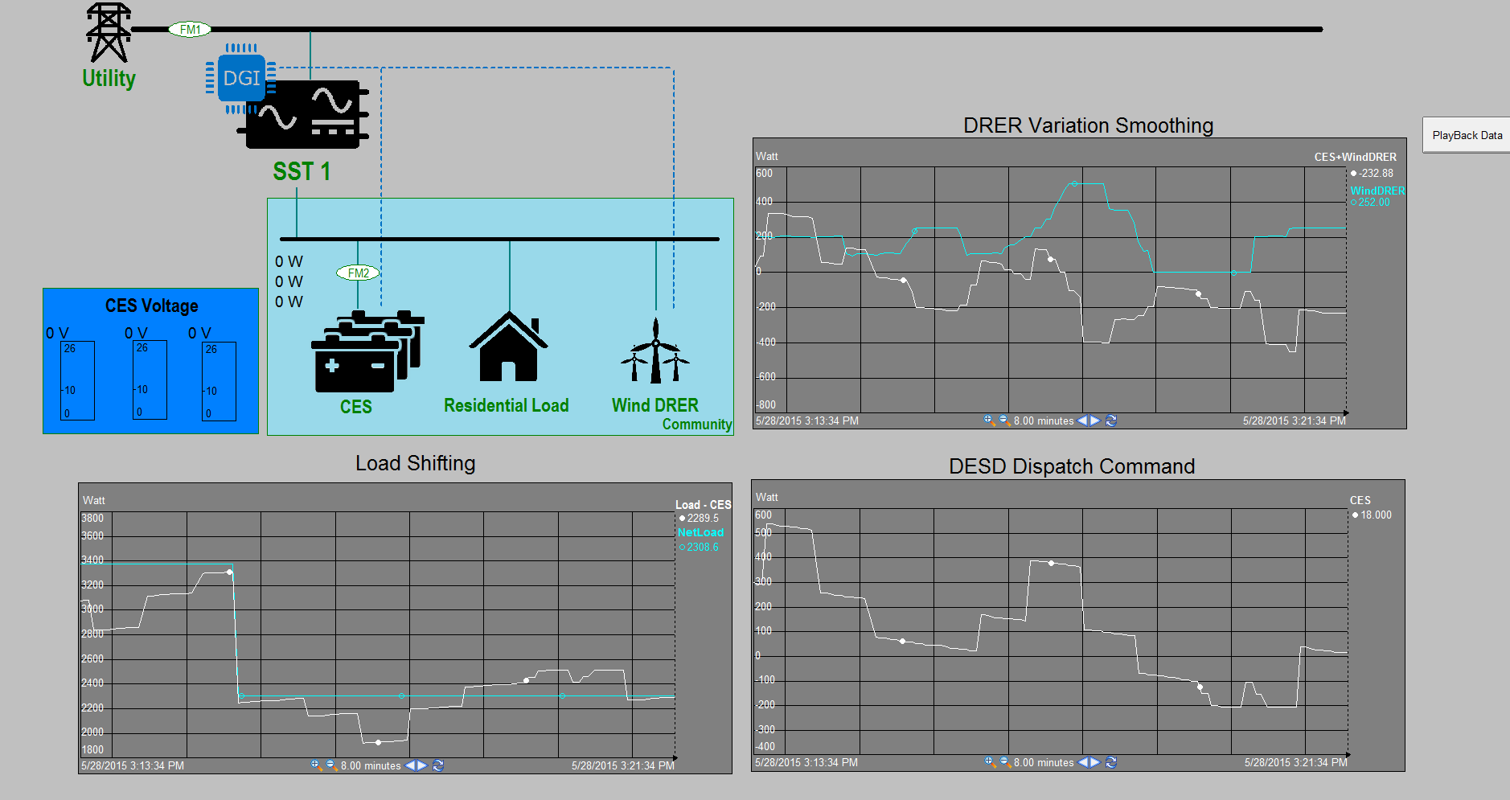
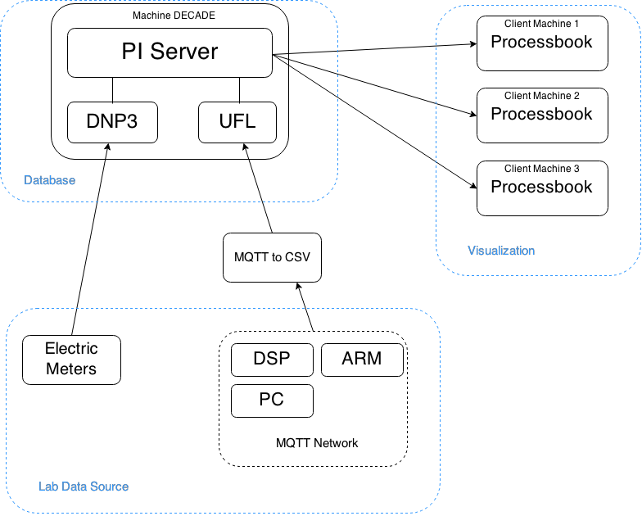
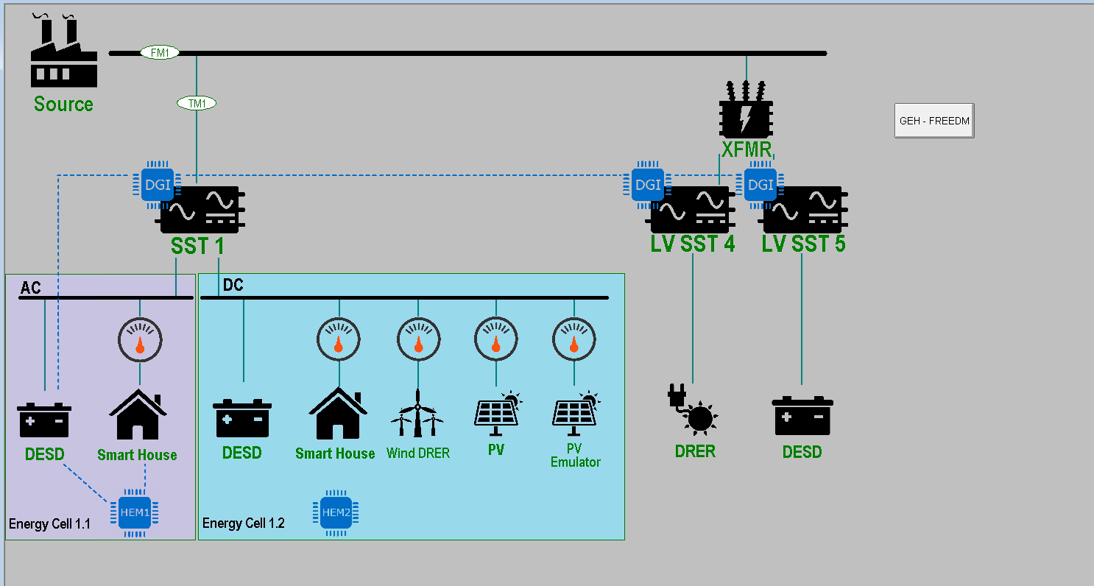
PI SERVER

Slide 11
SCADA APPLICATION and RT DATA
Why do we need it?
Which data will be stored here?
How will it be managed ?
How TMW DNP3 interface will use it?

Slide 12

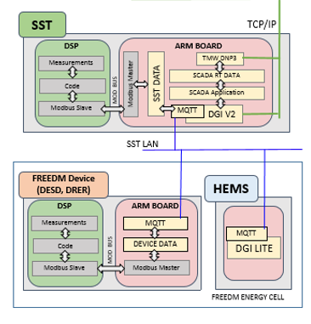
All those datas will be send to the PI system using dnp3 interface
DEVICE PROFILE(SST)
DATAs from SST and FREEDM device’s and HEMS APP will be saved here.
It will also bring and save DATAs from other SST nodes after certain interval
DATA IN JSON FORMAT

Slide 13
Thank You

