Slide 1
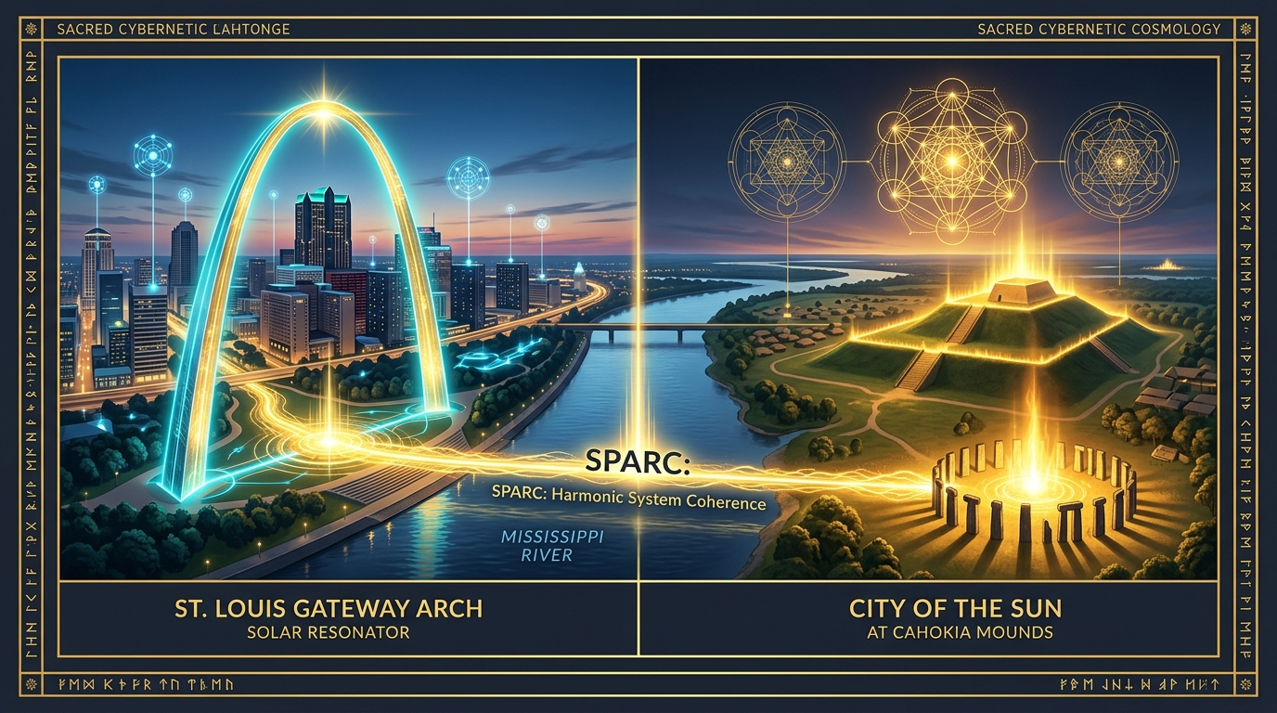
ANW FOUNDATIONS // RESEARCH & SYSTEMS ARCHITECTURE
SPARC: Restoring the City of the Sun
Bi-State Coordinated Triage, Upstream IEP Modeling, and HUD FY2026 Data Coherence
Ashleigh Walker | Lived Experience Researcher & Dedicated Voluntary Systems Developer
Belleville, IL & St. Louis, MO | Contact: ashleigh4533@gmail.com

Slide 2

SPARC // BI-STATE SYSTEMS RESEARCH
Lived Experience Fieldwork: Ground-Level Listening & Direct Data Capture
1. Centering Ground Truth
Traditional administrative systems view homelessness from behind a 9-to-5 desk. Real system healing begins at picnic tables, encampments, and transit stops where lived truth is shared openly.
2. The 3-Minute Mobile Intake
Replacing 45-minute bureaucratic forms with rapid, dignified mobile assessment. Capturing all 23 Universal Data Elements at point of encounter to eliminate data latency entirely.
3. Zero Preconditions Policy
Sobriety tests, background checks, and compliance hoops do not heal trauma. SPARC calculates pure vulnerability and routes directly to housing with zero barriers.
4. Building with the Community
Our unhoused peers are not case files to manage; they are the primary research partners whose insights shape the software architecture.

Slide 3
SPARC // BI-STATE SYSTEMS RESEARCH
The City of the Sun: Bridging St. Louis & Cahokia Across the Mississippi
The Mississippi River as a Harmonic Axis
The river is not a political barrier between Missouri and Illinois; it is the central meridian of our regional ecosystem. People seeking shelter move constantly between St. Louis City (MO-501), St. Louis County (MO-500), and St. Clair County (IL-502).
Ancient Solar Geometry Meets Modern Transit
Directly across from the St. Louis Gateway Arch sits Cahokia Mounds, the ancient Mississippian City of the Sun. By aligning our data infrastructure with cross-jurisdictional transit corridors, SPARC restores systemic coherence across the entire metro bi-state region.

Slide 4
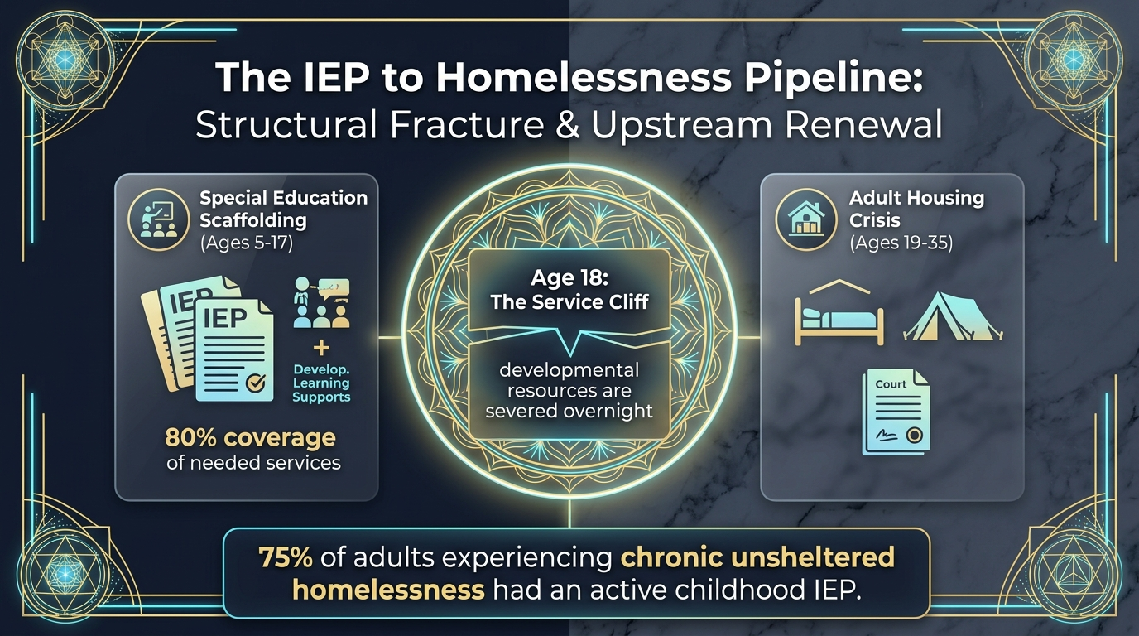
SPARC // BI-STATE SYSTEMS RESEARCH
The IEP to Homelessness Pipeline: Structural Fracture & Upstream Renewal
The Childhood Scaffolding (Ages 5-17)
Students with Individualized Education Programs (IEPs) receive structured developmental, emotional, and learning supports throughout K-12 schooling.
The Age 18 Service Cliff
Upon graduation or aging out at 18, all institutional scaffolding vanishes overnight. There is no transitional bridge into adult housing or self-sufficiency.
The 75% Chronic Finding
Field research reveals that approximately 75% of adults experiencing chronic unsheltered homelessness in our region had an active IEP during childhood.
SPARC Upstream Interception
SPARC is the first system in the nation to track IEP history and developmental service cliffs in its core database schema, enabling upstream diversion before crisis.

Slide 5
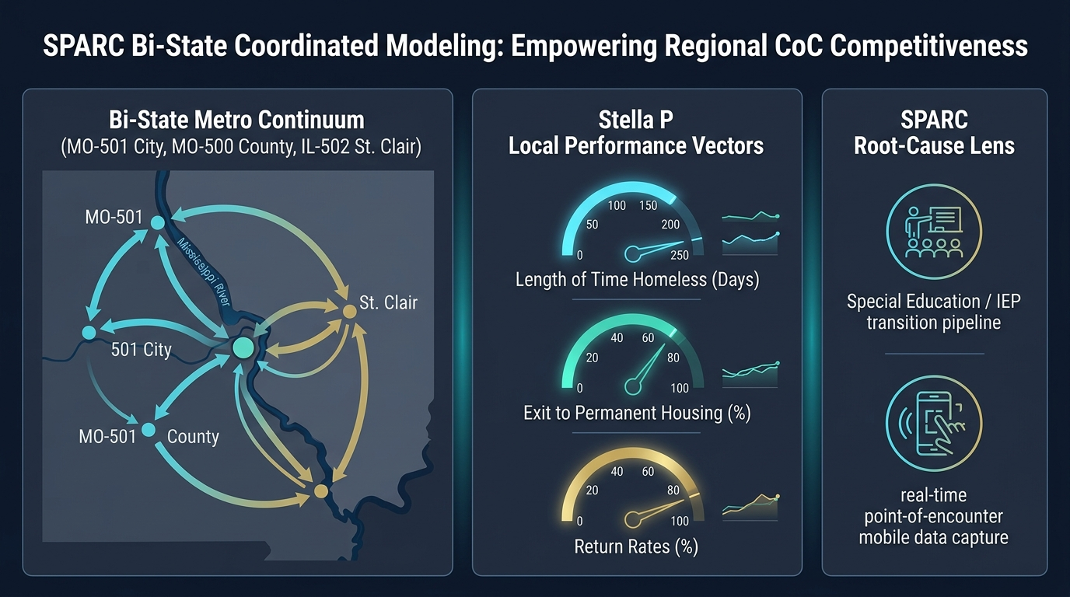
SPARC // BI-STATE SYSTEMS RESEARCH
Bi-State Coordinated Flow: Stella P System Performance Vectors
Cross-River Transit Coordination
Integrating Metrolink and bus corridor transit data directly into shelter bed vacancy matching across MO-501, MO-500, and IL-502.
Length of Stay Reduction (Days)
Stella P Core Vector 1: Rapid routing cuts average emergency shelter duration from 68 days down to under 21 days.
Exit Velocity to Permanent Housing
Stella P Core Vector 2: Direct connection to Permanent Supportive Housing (PSH) and Rapid Rehousing (RRH) without intermediate holding patterns.
Return Rate Stabilization
Stella P Core Vector 3: Tracking move-in stability and community anchor supports to keep 2-year recidivism below 5%.

Slide 6
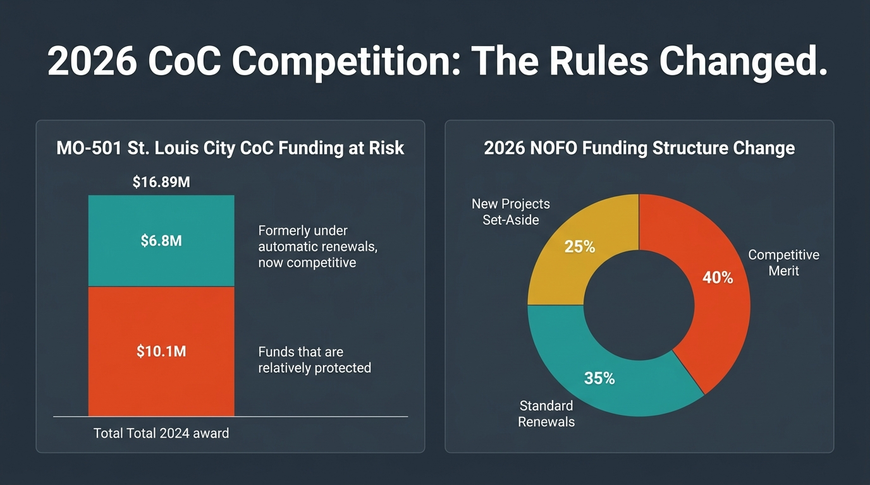
SPARC // BI-STATE SYSTEMS RESEARCH
2026 CoC NOFO Transformation: Protecting Regional Funding
The 40% Merit Competition Shift
HUD has officially ended the era of 95% automatic grant renewals. 40% of all CoC awards are now strictly competitive based on documented performance data.
$10.1M Exposed in MO-501
Over $10M of St. Louis City's $16.89M annual allocation is now vulnerable if the CoC cannot produce rigorous Stella P performance metrics.
$1.3B Transitional Set-Aside
HUD has created a massive $1.3B national pool for Transitional Housing paired with behavioral healthcare, substance recovery, and job training.
How SPARC Protects Regional Awards
SPARC generates the exact LSA-compliant data streams required to maximize scoring on HUD Question 7.3 and secure maximum merit allocations.

Slide 7
SPARC // BI-STATE SYSTEMS RESEARCH
Technical Architecture: 23-Table HMIS Export Engine (Eva Validated)
HUD FY2026 Interoperability Specifications
SPARC features a native Python export engine that transforms live database records into the complete 23-table HUD HMIS CSV standard, packaged into a single ZIP archive ready for validation on Abt Associates' Eva platform.
Core System Metadata
- Export.csv (Metadata)
- Organization.csv
- Project.csv (PDDE 2.02)
- User.csv (System Users)
- HMISParticipation.csv
- CEParticipation.csv
- ProjectCoC.csv (PDDE 2.03)
- Funder.csv (PDDE 2.06)
Client & Enrollment Layer
- Client.csv (Demographics)
- Enrollment.csv (3.10/3.917)
- Exit.csv (3.11/3.12)
- Inventory.csv (PDDE 2.07)
- IncomeBenefits.csv (4.02)
- HealthAndDV.csv (4.03/4.11)
- Disabilities.csv (4.05)
- EmploymentEducation.csv
Coordinated Entry & Services
- Assessment.csv (4.19 CE)
- AssessmentQuestions.csv
- AssessmentResults.csv (AVS)
- Event.csv (4.20 CE Events)
- Services.csv (4.14)
- CurrentLivingSituation.csv
- YouthEducationStatus.csv

Slide 8
SPARC // BI-STATE SYSTEMS RESEARCH
The Path Forward: Open-Source Collaboration & Systemic Healing
Voluntary Technical Support
ANW Foundations provides open-source, non-proprietary tools designed to empower existing CoC staff, case managers, and street outreach teams without administrative overhead.
Complementing Established HMIS Leads
SPARC does not replace ICA or vendor contracts. It operates as an agile mobile field layer that feeds clean, timeliness-perfect data directly into existing systems.
Regional CoC Empowerment
Supporting St. Louis City (MO-501), St. Louis County (MO-500), and St. Clair County (IL-502) to build a unified bi-state response that protects federal awards and restores human dignity.
Get in Touch
Ashleigh Walker | Lived Experience Researcher & Dedicated Voluntary Systems Developer
Email: ashleigh4533@gmail.com | Belleville, IL & St. Louis, MO

