Slide 1
ANW FOUNDATIONS | RESEARCH & SYSTEMS HEALING
SPARC: Coordinated Triage & System Healing
Bridging Lived Experience Fieldwork with HUD's 2026 Merit-Based Funding Architecture
Ashleigh Walker
Lived Experience Researcher & Dedicated Voluntary Systems Developer

Slide 2

EMPIRICAL FOUNDATION
Research Grounded in Real Encampments
The Street Reality:
Traditional CoC policies are designed in air-conditioned conference rooms. Real triage happens in the woods, along railroad tracks, and in makeshift camps.
Lived Experience Authority:
Personal navigation through two years of homelessness in St. Louis and recent displacement in Belleville informed every line of code.
Documenting the Gaps:
Observational fieldwork reveals the exact failure points where public policies collapse into street trauma.
Dignity of Community:
Unsheltered people are not 'service resistant.' They are surviving an adversarial bureaucracy that expects neurotypical perfection without support.

Slide 3

LIVED REALITIES
The Roadblocks to Dignity: Surviving the Spiral
Ruined Identification Documents:
Birth certificates and IDs get waterlogged in the rain or stolen from encampments. Without physical ID, shelters and housing programs turn people away at the door.
Criminalization of Basic Survival:
Seeking warmth in an abandoned building leads to trespassing charges. A criminal record then instantly disqualifies individuals from subsidized housing vouchers.
Social Exclusion & Appearance Profiling:
Trying to stay presentable while living out of suitcases is an exhausting battle. Individuals get turned away from restrooms, businesses, and transit simply for 'looking homeless.'
The Desperation Trap:
When every legal avenue to food, warmth, and shelter is blocked by bureaucracy, individuals are pushed into illegal or dangerous survival options just to make it through the night.

Slide 4

INSTITUTIONAL BARRIERS
The Bureaucratic Wall: When Aid Lines Don't Answer
The Endless Hold Tone:
Assistance hotlines (2-1-1, Coordinated Entry queues) frequently leave callers on hold until prepaid minutes expire or calls disconnect without resolution.
Hostile Intake Encounters:
When someone finally reaches an intake worker, they are often met with cold exhaustion and impatience, treated as a case number rather than a human in crisis.
The Unreasonable Knowledge Expectation:
Intake workers expect people in acute survival mode to already know complex program jargon (ESG, PSH, rapid rehousing, prioritization criteria) before receiving guidance.
SPARC's Human-Centered Antidote:
SPARC eliminates multi-page phone hurdles by enabling field navigators to conduct 3-minute plain-language intake on mobile devices directly in encampments.

Slide 5

ECONOMIC EXPLOITATION
The Shadow Economy: Underpaid Labor & Slumlord Traps
Off-the-Books Labor Exploitation:
Predatory landlords and business owners use unhoused workers for grueling demolition, construction, and cleanup, paying pennies on the dollar under the table.
Conditional 'Shelter' Leverage:
Workers are coerced into dangerous, unregulated labor under the threat of having their makeshift shelter or storage corner revoked at a moment's notice.
No Legal Recourse:
Without a permanent address or formal contract, unhoused workers cannot report wage theft, code violations, or abusive treatment to labor boards.
Breaking the Exploitation Loop:
By pairing housing allocation with legitimate CSBG/ESG workforce pathways, SPARC transitions workers from predatory informal labor into legal, dignified self-sufficiency.

Slide 6
SYSTEMIC DISCOVERY
The Missing Root Cause: The IEP-to-Homelessness Pipeline
The School-to-Street Reality
- A major percentage of unhoused adults were once children on an Individualized Education Program (IEP).
- At age 18 to 21, students hit the transition cliff: structured educational accommodations terminate abruptly.
- Adult disability systems are hyper-adversarial, requiring immense executive functioning to navigate.
- When cognitive accommodations vanish, individuals crash directly into couch-surfing and homelessness.
How SPARC Solves the Blind Spot
- First system in the nation with native fields for had_childhood_iep and experienced_service_cliff_at_18.
- Eliminates false 'service resistance' labels by identifying unaccommodated neurodivergence and sensory overload.
- Proactively triggers plain-language paperwork, peer navigators, and low-barrier transitional environments.
- Directly qualifies local projects for HUD's $1.3B Root Causes and Behavioral Health funding pools.

Slide 7
FEDERAL POLICY TRANSFORMATION
The 2026 CoC NOFO: End of the Status Quo
$4.04 Billion
Historic Funding Pool
Highest funding in program history, shifting from automatic renewal to competitive merit.
40% Competitive
Merit-Based Awards
Ending the 90-95% automatic renewal regime. CoCs must now compete on verifiable outcomes.
$1.3 Billion
Transitional Housing
Set aside specifically for new projects prioritizing recovery, behavioral health, and job training.

Slide 8
REGIONAL IMPACT
Missouri Continuums of Care Under New Federal Scrutiny
MO-501 (St. Louis City): $16.89M at Stake
Historically, millions were awarded almost entirely in automatic PSH renewals (Depaul USA, DOORWAYS, Gateway 180). Under the new 40% competitive rule, millions in annual renewals are exposed to performance ranking.
MO-500 (St. Louis County) & Balance of State (MO-604)
County programs reliant on legacy Shelter Plus Care contracts must demonstrate active transition pipelines and recovery coordination.
The Immediate Challenge for Missouri Leadership
Without modernized Coordinated Entry that models transitional pathways and outcome tracking, Missouri CoCs risk losing millions to competing states.
The Strategic Opportunity
Deploying SPARC gives Missouri CoCs the exact data engine needed to win the 2026 NOFO competitive scoring without disrupting existing HMIS operations.

Slide 9

TECHNICAL ARCHITECTURE
SPARC: Real-Time Algorithmic Coordinated Entry
Absolute Vulnerability Score (AVS)
Calculates real-time mortality and crisis risk, re-ranking community priority queues dynamically rather than waiting weeks for manual case conferences.
Automated Bed & Unit Matching
Tracks real-time inventory across Emergency Shelter, Transitional Housing, and PSH with zero precondition barriers.
Zero-Knowledge Hashing Engine
Fully abstracts client identity via anonymized_id, providing complete HIPAA and VAWA isolation for domestic violence providers.
Full HUD FY 2026 Compliance
Native data columns for HMIS Universal Elements (3.01-3.20), Project Descriptors (PDDE 2.0x), and CE Events (4.19-4.20).

Slide 10

SYSTEM MODELING & REPORTING
Closing the Loop: Real-Time Triage to Stella P Modeling
Automated LSA Generation
SPARC continuously structures data so local CoCs can export pristine Longitudinal Systems Analysis (LSA) files ready for HDX 2.0.
Local Use Only 'Stellavising'
Enables communities to upload local quarterly datasets into Stella P to model Days Homeless, Exit Velocity, and Returns before official submission.
Solving the Missing Documentation
ANW Foundations authored and published the Community Stella P Quick Start Guide, resolving HUD's unavailable documentation bottleneck.
Predictive System Harmony
Transforms chaotic street-level crisis data into balanced housing pathways that maximize federal merit scoring.

Slide 11
COLLABORATIVE ACTION
A Voluntary Partnership for Missouri & Illinois
Our Voluntary Proposal to CoC Leadership:
1. Zero-Cost Open Source Infrastructure: We are not a corporate software vendor. We offer SPARC as an open-source tool to strengthen local Missouri and Metro East capacity.
2. Pilot Testing via Eva & Local Use LSA: Run a test cohort through the Eva validation platform and Stellavise a local use file without touching live federal submissions.
3. Co-Designing the 2026 Competitive Strategy: Utilize SPARC's transitional recovery tracking to construct high-scoring merit applications for the $1.3B new project set-aside.
4. Institutionalizing Lived Experience: Establish a model of genuine, compensated PLEE collaboration that bridges encampment realities with systems design.
Contact: Ashleigh Walker | ANW Foundations | Belleville, IL / St. Louis, MO

Slide 12
SPARC Platform Framework
Automated HMIS Export Validation & Coordinated Entry Optimization

Slide 13
HUD + ANW Foundations – Shared Values
Housing First: Immediate access to permanent housing without preconditions, mandatory sobriety, or service compliance requirements.
Trauma-Informed Care: Participant choice, physical and emotional safety, transparent governance, and voluntary supportive care.
Cryptographic Integrity: Immutable SHA-256 hashing of HMIS records for privacy preservation and verified provider outcome tracking.
Community Partnership: Direct collaboration with CoC leadership, HUD Exchange guidance, and local service providers.

Slide 14
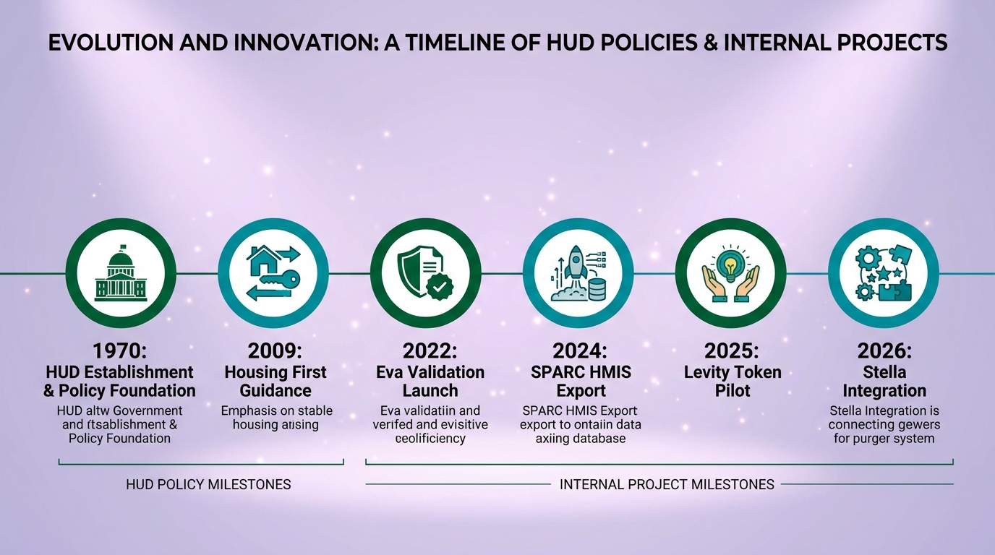
Milestone Timeline – Policy & Project

Slide 15
Trauma-Informed Care Support Logic Flow
Immediate Triage & Engagement: Low-barrier intake focused on participant safety and immediate shelter/housing needs.
Participant-Driven Housing Plan: Voluntary goal setting, safety planning, and community resource connections.
Integrated Community Referrals: Warm handoffs to voluntary health, mental health, and employment services.
Housing Retention Support: Ongoing check-ins to prevent returns to homelessness and maintain lease stability.
Cryptographic Audit Trail: Each engagement milestone is hashed locally to ensure HMIS data integrity without exposing PII.

Slide 16
Housing-First Service Flow
Coordinated Entry Assessment: Standardized prioritization based on vulnerability and length of homelessness (UDE 4.19).
Direct Permanent Placement: Rapid Re-Housing (RRH) or Permanent Supportive Housing (PSH) identification without preconditions.
Subsidy & Unit Administration: Streamlined rental assistance processing and landlord relationship management.
Destination & Retention Verification: Automated tracking of successful exits to permanent housing destinations (UDE 3.12).
Automated Validation: Eva checks record structure, while Stella policy routing optimizes regional housing resource allocation.

Slide 17

Data-Intelligence Loop

Slide 18
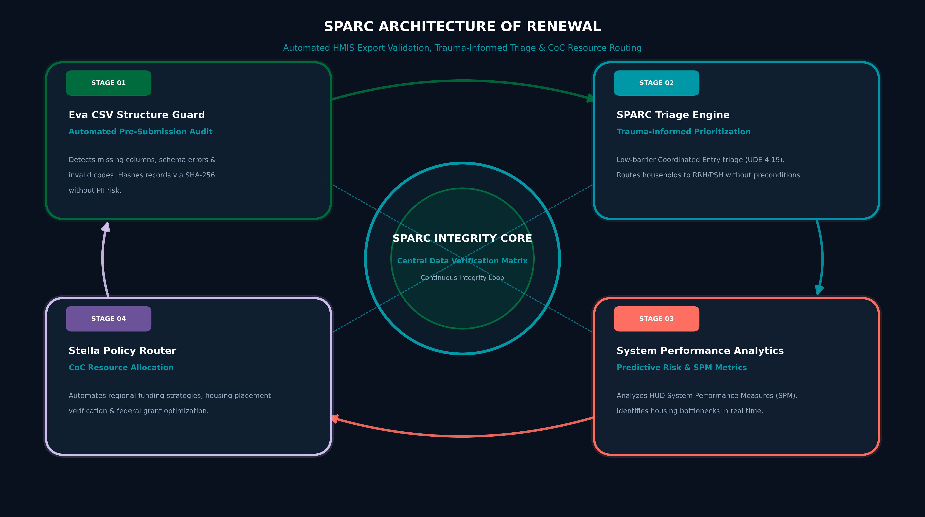
System Architecture Overview

Slide 19
Impact Snapshot (FY-2026)

Slide 20
Next Steps & Call-to-Action
Secure FY-2026 funding for continued provider outcome verification pilot.
Scale Stella policy engine across regional HUD partners and CoC networks.
Launch public dashboard for real-time homelessness metrics and SPM reporting.
Deepen integration with ANW Foundations community services and regional care providers.

Slide 21
Thank You
Ashleigh Walker – Web Development & Creative Software Engineering
Email: ashleigh4533@gmail.com
QR: (link to Levity token dashboard)

