Slide 1
CLASSES AND OBJECTS
Object-Oriented Programming (OOP)

Slide 2
Chapter Topics
Chapter discusses the following main topics:
  Objects and Classes
  Writing a Simple Class, Step by Step
  Instance Fields and Methods
  Constructors
  Passing Objects as Arguments
  Overloading Methods and Constructors
  Scope of Instance Fields
  Packages and import Statements
6-<number>

Slide 3
Objects and Classes
An object exists in memory, and performs a specific task.
Objects have two general capabilities:
  Objects can store data. The pieces of data stored in an object are known as fields.
  Objects can perform operations. The operations that an object can perform are known as methods.
6-<number>
Notes:
Definition: In object-oriented programming (OOP), an object is an instance of a class. A class serves as a blueprint that defines attributes (variables) and behaviors (functions) shared by objects of the same type.

Slide 4
Objects and Classes
You have already used the following objects:
  Scanner objects, for reading input
  Random objects, for generating random numbers
  PrintWriter objects, for writing data to files
When a program needs the services of a particular type of object, it creates that object in memory, and then calls that object's methods as necessary.

Slide 5
Objects and Classes
Classes: Where Objects Come From
  A class is code that describes a particular type of object. It specifies the data that an object can hold (the object's fields), and the actions that an object can perform (the object's methods).
  You can think of a class as a code "blueprint" that can be used to create a particular type of object.

Slide 6
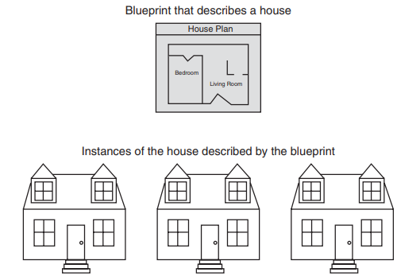

Slide 7
Objects and Classes
When a program is running, it can use the class to create, in memory, as many objects of a specific type as needed.
Each object that is created from a class is called an instance of the class.

Slide 8
Objects and Classes
This expression creates a Scanner object in memory.
Example:
Scanner keyboard = new Scanner(System.in);
The object's memory address is assigned to the keyboard variable.
Scanner
object
keyboard
variable

Slide 9
Objects and Classes
This expression creates a Random object in memory.
Example:
Random rand = new Random();
The object's memory address is assigned to the rand variable.
Random
object
rand
variable

Slide 10
Objects and Classes
This expression creates a PrintWriter object in memory.
Example:
PrintWriter outputFile = new PrintWriter("numbers.txt");
The object's memory address is assigned to the outputFile variable.
PrintWriter
object
outputFile
variable

Slide 11
Objects and Classes
The Java API provides many classes
  So far, the classes that you have created objects from are provided by the Java API.
  Examples:
    Scanner
    Random
    PrintWriter
See ObjectDemo.java

Slide 12
Writing a Class, Step by Step
A Rectangle object will have the following fields:
  length. The length field will hold the rectangle’s length.
  width. The width field will hold the rectangle’s width.
6-<number>

Slide 13
Writing a Class, Step by Step
The Rectangle class will also have the following methods:
  setLength. The setLength method will store a value in an object’s length field.
  setWidth. The setWidth method will store a value in an object’s width field.
  getLength. The getLength method will return the value in an object’s length field.
  getWidth. The getWidth method will return the value in an object’s width field.
  getArea. The getArea method will return the area of the rectangle, which is the result of the object’s length multiplied by its width.
6-<number>

Slide 14
UML Diagram
Unified Modeling Language (UML) provides a set of standard diagrams for graphically depicting object-oriented systems.
Class name goes here
Fields are listed here
Methods are listed here
6-<number>

Slide 15
UML Diagram for
Rectangle class
Rectangle
length width
setLength() setWidth() getLength() getWidth() getArea()
6-<number>

Slide 16
Writing the Code for the Class Fields
public class Rectangle
{
private double length;
private double width;
}
6-<number>

Slide 17
Access Specifiers
An access specifier is a Java keyword that indicates how a field or method can be accessed.
public
  When the public access specifier is applied to a class member, the member can be accessed by code inside the class or outside.
private
  When the private access specifier is applied to a class member, the member cannot be accessed by code outside the class. The member can be accessed only by methods that are members of the same class.
6-<number>
Notes:
In general terms, the fields and methods that belong to a class are referred to as the class’s members.

Slide 18
Header for the setLength Method
Return Type
Notice the word static does not appear in the method header designed to work on an instance of a class (instance method).
Access specifier
Method Name
public void setLength (double len)
Parameter variable declaration
6-<number>

Slide 19
Writing and Demonstrating the setLength Method
/**
The setLength method stores a value in the
length field.
@param len The value to store in length.
*/
public void setLength(double len)
{
length = len;
}
Examples: Rectangle.java, LengthDemo.java
6-<number>

Slide 20
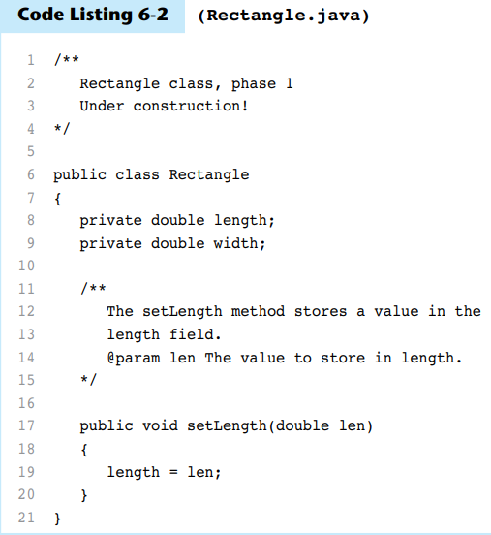

Slide 21
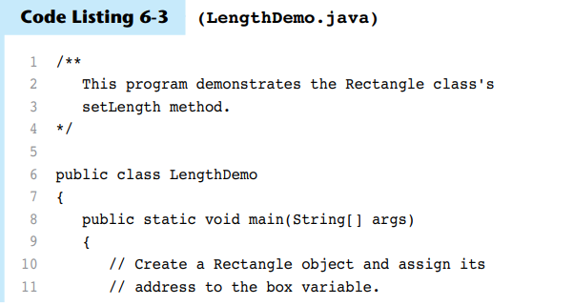
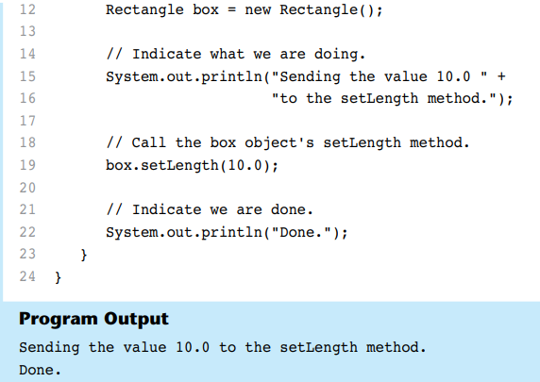

Slide 22
Creating a Rectangle object
Rectangle box = new Rectangle ();
A Rectangle object
The box variable holds the address of the Rectangle object.
length:
0.0
address
width:
0.0
6-<number>

Slide 23
Calling the setLength Method
box.setLength(10.0);
The box variable holds the address of the Rectangle object.
A Rectangle object
length:
10.0
address
width:
0.0
This is the state of the box object after the setLength method executes.
6-<number>

Slide 24
Writing the getLength Method
/**
The getLength method returns a Rectangle
object's length.
@return The value in the length field.
*/
public double getLength()
{
return length;
}
Similarly, the setWidth and getWidth methods can be created.
6-<number>

Slide 25
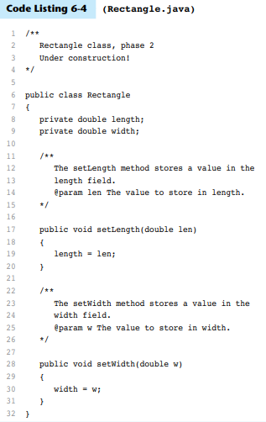

Slide 26
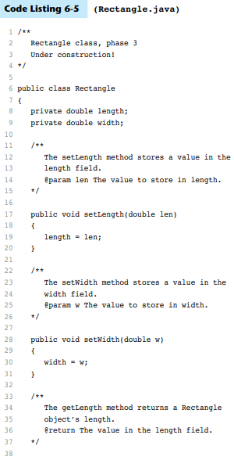
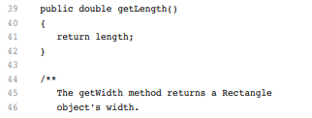
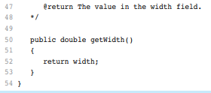

Slide 27
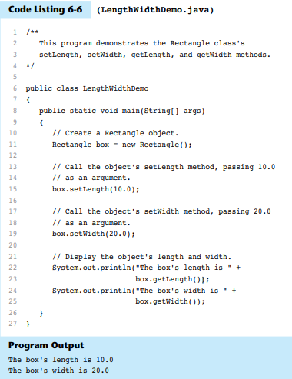

Slide 28
Writing and Demonstrating the getArea Method
/**
The getArea method returns a Rectangle
object's area.
@return The product of length times width.
*/
public double getArea()
{
return length * width;
}
6-<number>

Slide 29
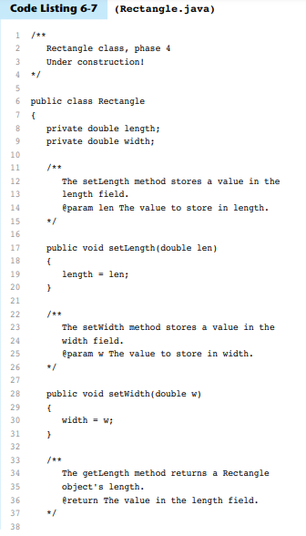
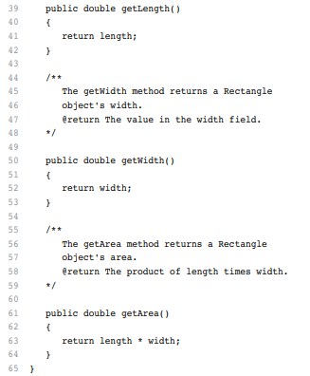

Slide 30
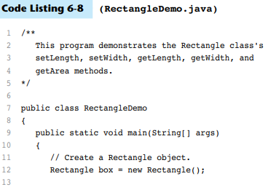

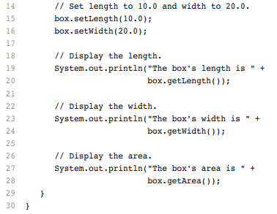

Slide 31
Accessor and Mutator Methods
Because of the concept of data hiding, fields in a class are private.
The methods that retrieve the data of fields are called accessors.
The methods that modify the data of fields are called mutators.
Each field that the programmer wishes to be viewed by other classes needs an accessor.
Each field that the programmer wishes to be modified by other classes needs a mutator.
6-<number>

Slide 32
Accessors and Mutators
For the Rectangle example, the accessors and mutators are:
  setLength : Sets the value of the length field.
    public void setLength(double len) …
  setWidth : Sets the value of the width field.
    public void setLength(double w) …
  getLength : Returns the value of the length field.
    public double getLength() …
  getWidth : Returns the value of the width field.
    public double getWidth() …
Other names for these methods are getters and setters.
6-<number>

Slide 33
Data Hiding
An object hides its internal, private fields from code that is outside the class that the object is an instance of.
Only the class's methods may directly access and make changes to the object’s internal data.
Code outside the class must use the class's public methods to operate on an object's private fields.

Slide 34
Data Hiding
Data hiding is important because classes are typically used as components in large software systems, involving a team of programmers.
Data hiding helps enforce the integrity of an object's internal data.

Slide 35
Stale Data
Some data is the result of a calculation.
Consider the area of a rectangle.
  length × width
It would be impractical to use an area variable here.
Data that requires the calculation of various factors has the potential to become stale.
When the value of an item is dependent on other data and that item is not updated when the other data is changed, it is said that the item has become stale.
To avoid stale data, it is best to calculate the value of that data within a method rather than store it in a variable.
6-<number>

Slide 36
Stale Data
Rather than use an area variable in a Rectangle class:
  public double getArea()
  {
  return length * width;
  }
This dynamically calculates the value of the rectangle’s area when the method is called.
Now, any change to the length or width variables will not leave the area of the rectangle stale.
6-<number>

Slide 37
UML Data Type and Parameter Notation
UML diagrams are language independent.
UML diagrams use an independent notation to show return types, access modifiers, etc.
Rectangle
Access modifiers are denoted as:
  + public
  - private
- width : double
+ setWidth(w : double) : void
6-<number>

Slide 38
UML Data Type and Parameter Notation
UML diagrams are language independent.
UML diagrams use an independent notation to show return types, access modifiers, etc.
Variable types are placed after the variable name, separated by a colon.
Rectangle
- width : double
+ setWidth(w : double) : void
6-<number>

Slide 39
UML Data Type and Parameter Notation
UML diagrams are language independent.
UML diagrams use an independent notation to show return types, access modifiers, etc.
Rectangle
Method return types are placed after the method declaration name, separated by a colon.
- width : double
+ setWidth(w : double) : void
6-<number>

Slide 40
UML Data Type and Parameter Notation
UML diagrams are language independent.
UML diagrams use an independent notation to show return types, access modifiers, etc.
Method parameters are shown inside the parentheses using the same notation as variables.
Rectangle
- width : double
+ setWidth(w : double) : void
6-<number>

Slide 41
Converting the UML Diagram to Code
Putting all of this information together, a Java class file can be built easily using the UML diagram.
The UML diagram parts match the Java class file structure.
class header
{
Fields
Methods
}
ClassName
Fields
Methods
6-<number>

Slide 42
Converting the UML Diagram to Code
The structure of the class can be compiled and tested without having bodies for the methods. Just be sure to put in dummy return values for methods that have a return type other than void.
public class Rectangle
{
private double width;
private double length;
public void setWidth(double w)
{
}
public void setLength(double len)
{
}
public double getWidth()
{ return 0.0;
}
public double getLength()
{ return 0.0;
}
public double getArea()
{ return 0.0;
}
}
Rectangle
width : double
length : double
+ setWidth(w : double) : void
+ setLength(len : double): void
+ getWidth() : double
+ getLength() : double
+ getArea() : double
6-<number>

Slide 43
Converting the UML Diagram to Code
public class Rectangle
{
private double width;
private double length;
public void setWidth(double w)
{ width = w;
}
public void setLength(double len)
{ length = len;
}
public double getWidth()
{ return width;
}
public double getLength()
{ return length;
}
public double getArea()
{ return length * width;
}
}
Once the class structure has been tested, the method bodies can be written and tested.
Rectangle
width : double
length : double
+ setWidth(w : double) : void
+ setLength(len : double): void
+ getWidth() : double
+ getLength() : double
+ getArea() : double
6-<number>

Slide 44
Class Layout Conventions
The layout of a source code file can vary by employer or instructor.
A common layout is:
  Fields listed first
  Methods listed second
    Accessors and mutators are typically grouped.
There are tools that can help in formatting layout to specific standards.
6-<number>

Slide 45
Checkpoint #

