Slide 1
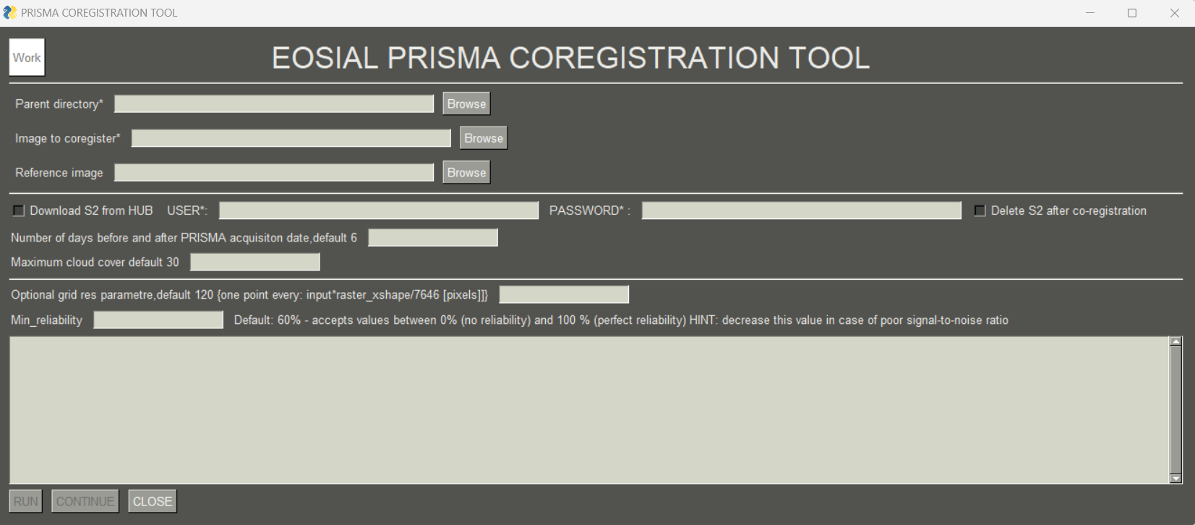
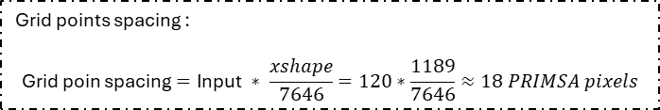
PRISMA L1/L2C/L2D .zip
Download S2
Pancomatic/VNIRcube/SWIRcube ->Tiff
Band information
Other metadata
Footprint
Date of acquisition
Number of days
Cloud cover percentage
Nearest neighborhoods resampling
Raster's grids aligned
Copernicus Data Space Ecosystem catalogue: OData
Copernicus Dataspace Ecosistem Credentials
Grid Points spacing Reliability
AROSICS
CoReg_Local
Mosaic of sentinels
Sentinel L2A
Coregistered Pancomatic/VNIRcube/SWIRcube ->Tiff
Sentinel 2 .zip format
Rasters reference shift calculation:
Pan: S2 B3-PRISMA Pan
VNIR/SWIR: S2 B8-PRISMA VNIR 17 (≈849.20 nm)
Radiance/Reflectance L1/L2C/L2D Envi format
Grid points spacing :
$$\text{Grid} \text{poin} \text{spacing}=\text{Input} ∗ \frac{xshape}{7646}=120∗\frac{1189}{7646}≈18 PRIMSA pixels$$

