Slide 1
MIT Course 18.S096, IAP 2017 Performance Computing in a High-Level Language
Alan Edelman & Steven G. Johnson, MIT Appl. Math
David P. Sanders, UNAM
Jeff Bezanson, Julia Computing
https://math.mit.edu/classes/18.S096/iap17/

Slide 2
Administrivia
Lectures Tues/Wed/Fri at 2pm
“Lab” Thursday 2pm: Programming practice
Weekly psets, due Monday
We give you slow code, you give us fast code
Token prize (unrelated to grade) for fastest code
4 units, A–F grading

Slide 3
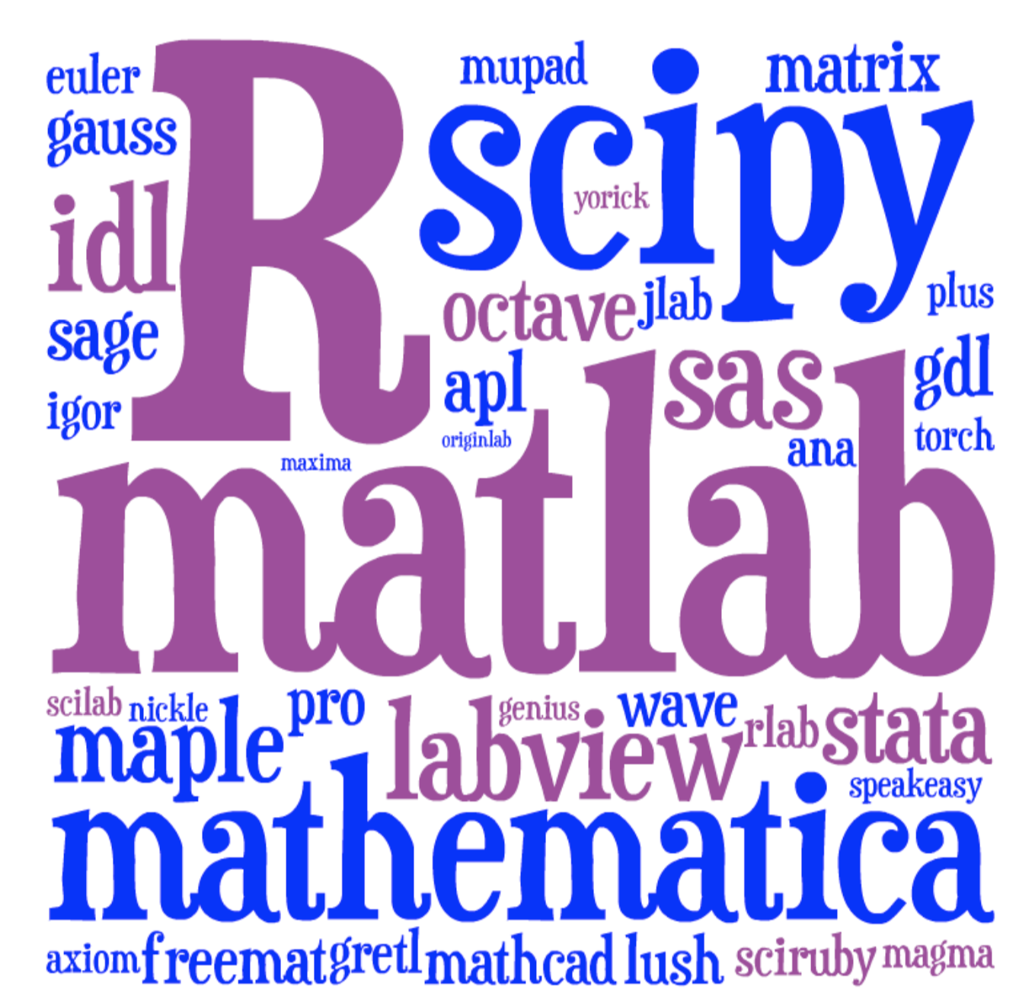
Lots of choices for interactive math…
[ image: Viral Shah ]

Slide 4
Course goals
Understand the connection between the low-level architecture of the computer and the performance characteristics of high-level languages.
Learn how to write and optimize your own performance-critical code
Have fun!

Slide 5
Need a language for all three
Matlab/Python/R: Too slow
C/C++/Fortran: Too low-level/insane
Go/Rust/Haskell: Not interactive enough (statically typed, not dynamically typed)
… ?

Slide 6
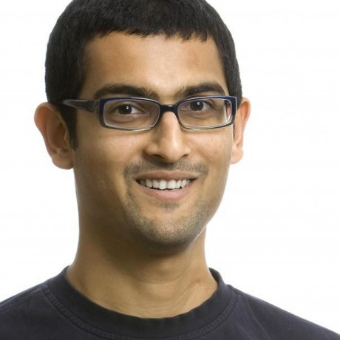


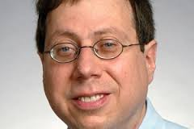

A new programming language?
Viral Shah
Jeff Bezanson
Alan Edelman
[ MIT ]
julialang.org
Stefan Karpinski
[begun 2009, “0.1” in 2013, ~30k commits,
“0.5” release in Fall 2016 ]
[ 30+ developers with 100+ commits,
800+ external packages, 2nd JuliaCon in 2015 ]
As high-level and interactive as Matlab or Python+IPython,
as general-purpose as Python,
as productive for technical work as Matlab or Python+SciPy,
but as fast as C.

Slide 7
Installing Julia
Quick start: run it “in the cloud”: juliabox.com
Install it on your own machine:
Download Julia 0.5 from julialang.org
Launch julia
Install IJulia/Jupyter notebook interface
Run:
ENV["JUPYTER"] = ""
Pkg.add("IJulia")
using IJulia
notebook()

