Slide 1

Face to Cartoon using cycleGAN
G. Zeng, B. Fankhauser, J. Segessenmann, G. Ilango
Advanced Topics of Machine Learning FS2019
by Prof. Dr. Paolo Favaro

Slide 2

Introduction to the Project
Goal and Scope […]
Materials and Methods […]

Slide 3
Introduction to cycleGAN
Some easy high level stuff […]

Slide 4
Landmarks Loss

Slide 5
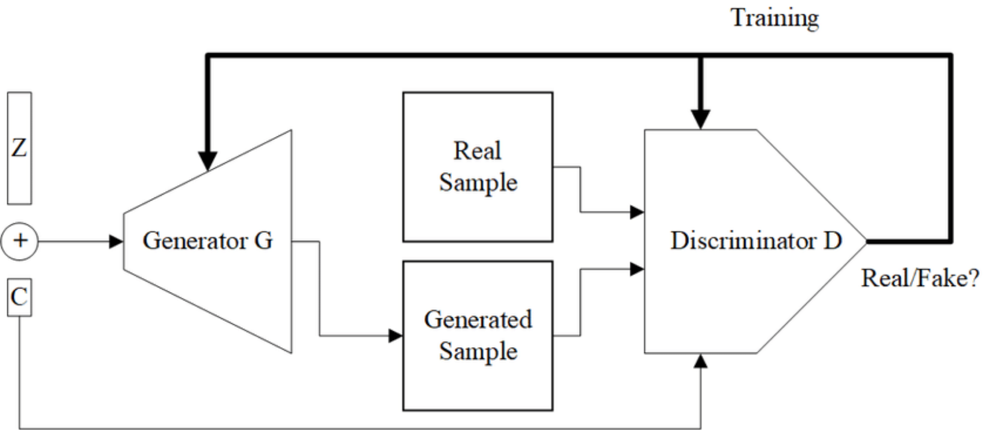
Conditional cycleGAN
Conditional GAN uses a class label to condition on to both the generator and discriminator, which shows that the model can generate MNIST digits conditioned on class labels.
Mirza M, Osindero S. Conditional generative adversarial nets. arXiv preprint arXiv:1411.1784. 2014 Nov 6.

Slide 6
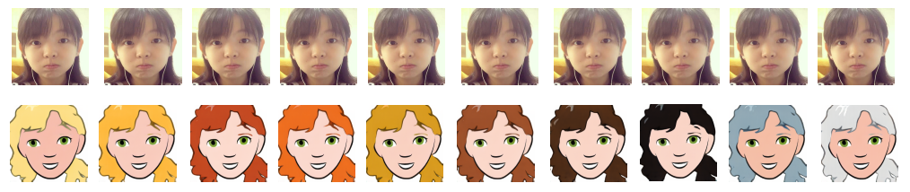
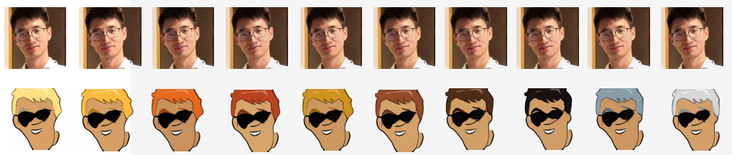
Conditional cycleGAN Results
Mirza M, Osindero S. Conditional generative adversarial nets. arXiv preprint arXiv:1411.1784. 2014 Nov 6.

Slide 7
An Example

Slide 8
Conclusion and Outlook

Slide 9
Questions?

