Slide 1

Face to Cartoon using cycleGAN
G. Zeng, B. Fankhauser, J. Segessenmann, G. Ilango
Advanced Topics of Machine Learning FS2019
by Prof. Dr. Paolo Favaro

Slide 2

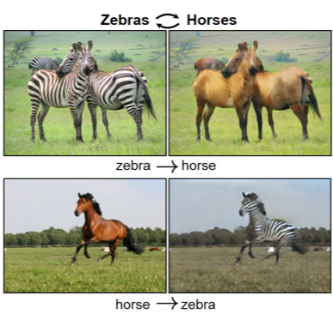
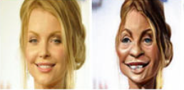
Introduction to the Project
Goal: Switch image styles from real faces to cartoon faces using unpaired data only.
Approach: Use and modify CycleGAN (Jun-Yan Zhu et al.)
https://www.zdnet.com/article/how-microsofts-caricature-ai-turns-photos-into-portrait-cartoons/

Slide 3

Datasets
Cartoon: These cartoons helped develop the technology behind the personalized stickers in Google Allo. Around 10^13 possible combinations of styles and colors.
Real Faces:
https://google.github.io/cartoonset/index.html

Slide 4
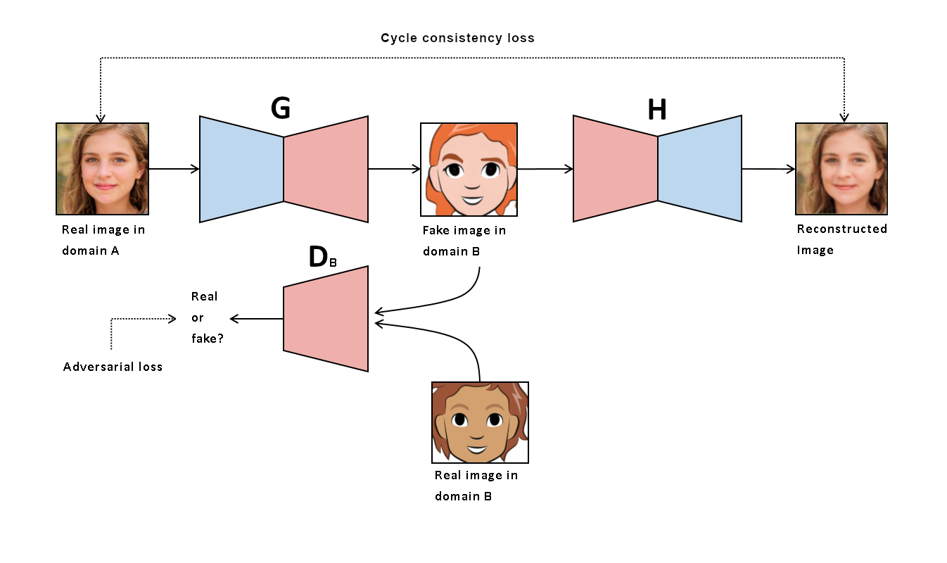
Introduction to cycleGAN

Slide 5
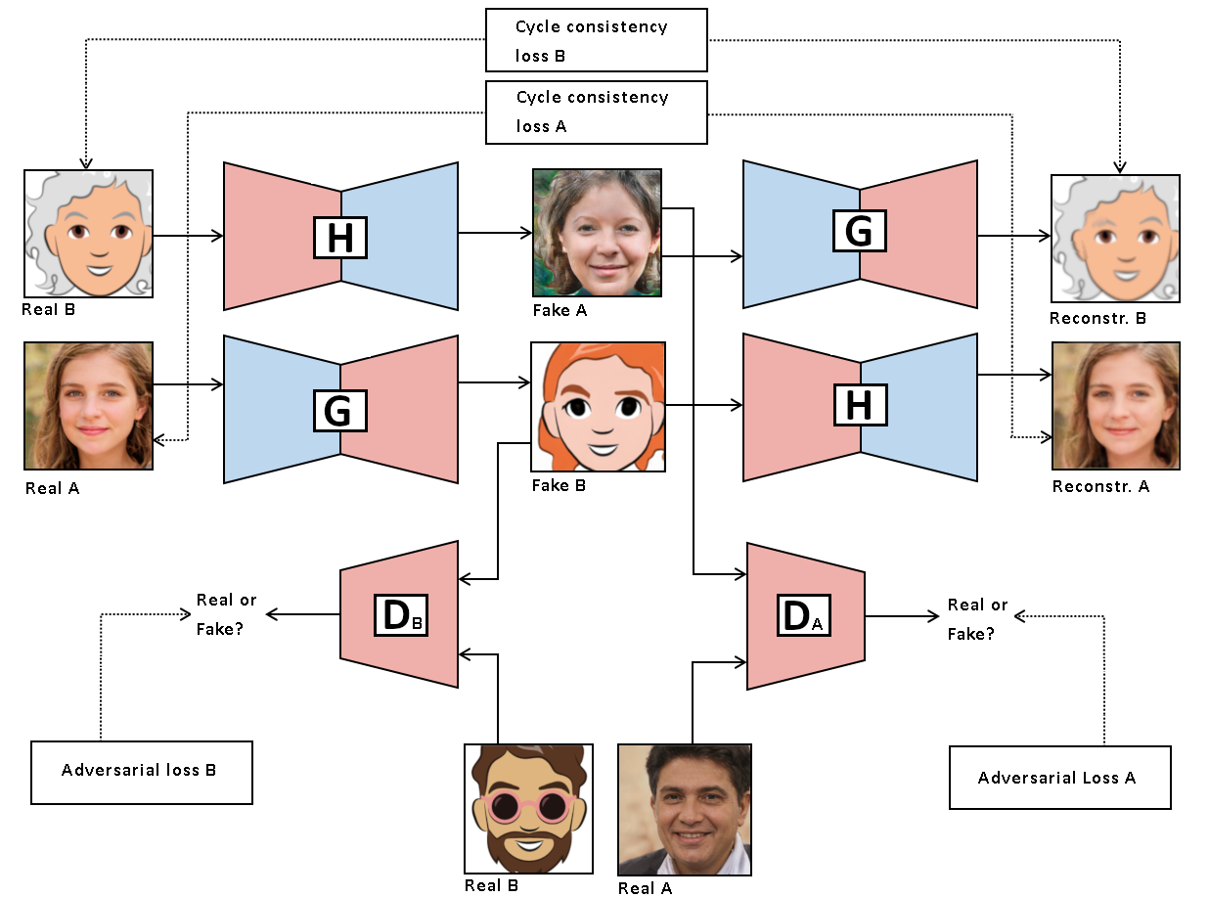
Introduction to cycleGAN

Slide 6
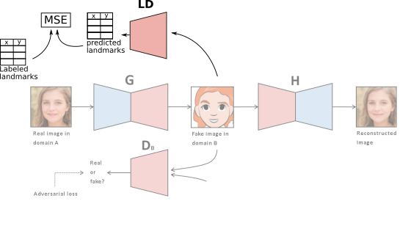
Landmarks Loss

Slide 7
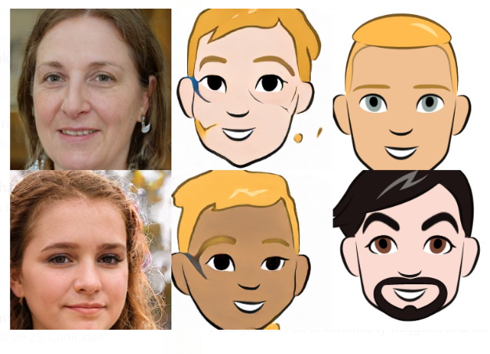
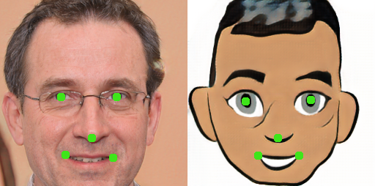
Landmarks Loss

Slide 8
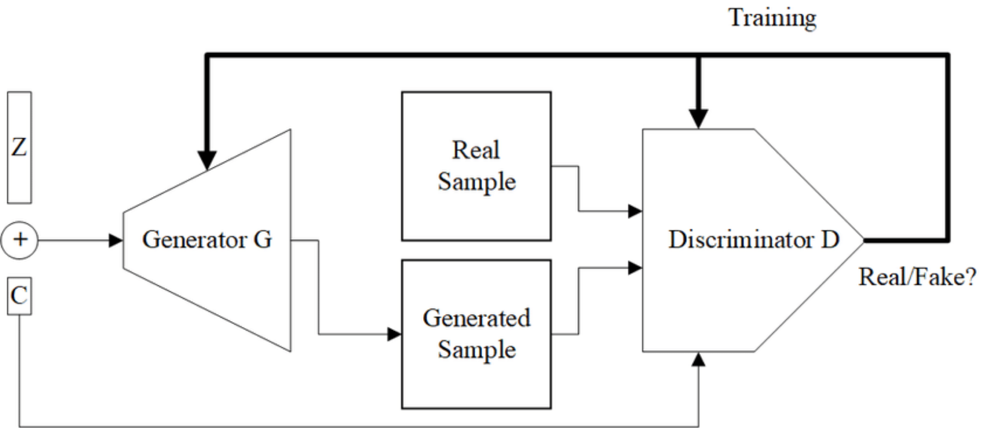
Conditional cycleGAN
Conditional GAN uses a class label to condition on to both the generator and discriminator, which shows that the model can generate MNIST digits conditioned on class labels.
Mirza M, Osindero S. Conditional generative adversarial nets. arXiv preprint arXiv:1411.1784. 2014 Nov 6.

Slide 9
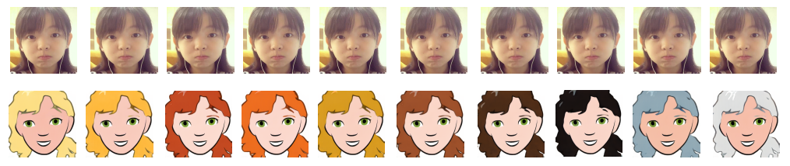
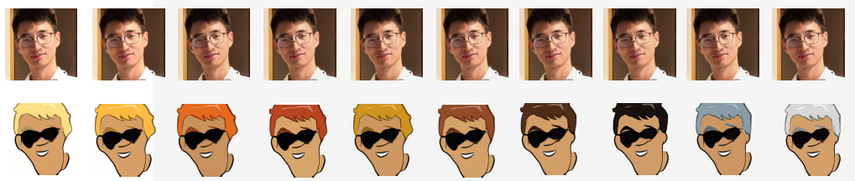
Conditional cycleGAN Results
Mirza M, Osindero S. Conditional generative adversarial nets. arXiv preprint arXiv:1411.1784. 2014 Nov 6.

Slide 10
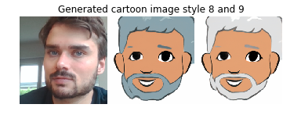
Results and demo

Slide 11
Conclusion and Outlook
Preserved some important features
CycleGAN can be extended in a natural way
Problems with:
Background (identify and neglect background)
Illumination
Viewpoint (augmentation on cartoonset)

Slide 12
Questions?

