Slide 1

Face to Cartoon using cycleGAN
G. Zeng, B. Fankhauser, J. Segessenmann, G. Ilango
Advanced Topics of Machine Learning FS2019
by Prof. Dr. Paolo Favaro

Slide 2



Introduction to the Project
Goal: Switch image styles from real faces to cartoon faces using unpaired data only.
Approach: Use and modify CycleGAN (Jun-Yan Zhu et al.)

Slide 3

Datasets
Cartoon: These cartoons helped develop the technology behind the personalized stickers in Google Allo. Around 10^13 possible combinations of styles and colors.
Real Faces: 1000 real face images from the FFHQ dataset, which is from Style GAN
https://google.github.io/cartoonset/index.html

Slide 4
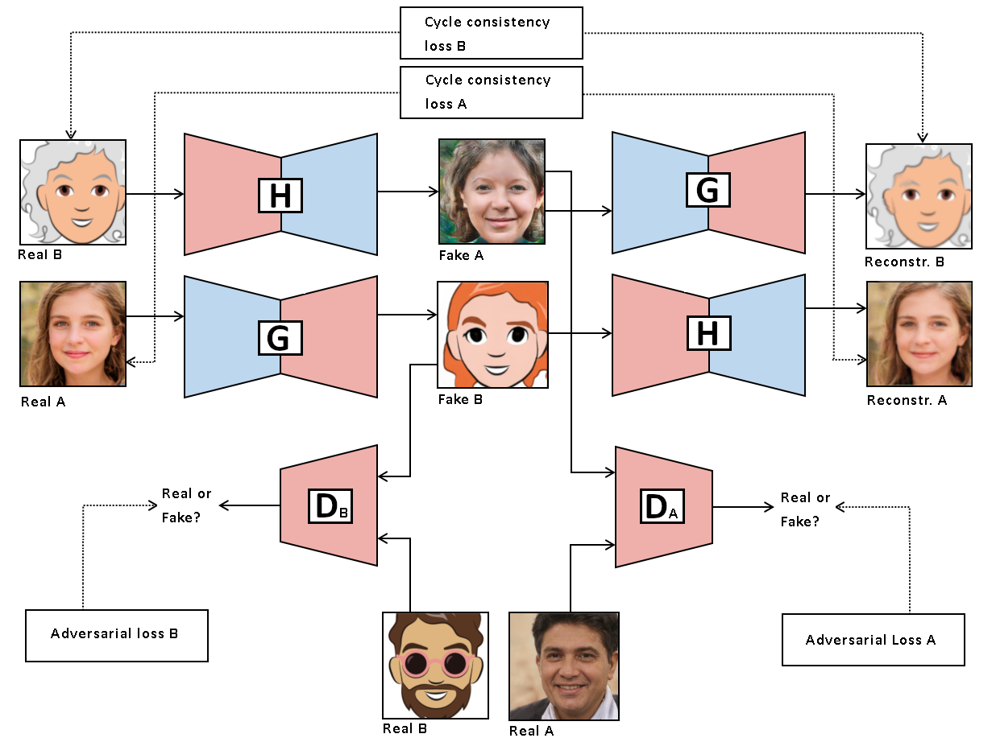
Approach: CycleGAN
Jun-Yan Zhu et al.

Slide 5
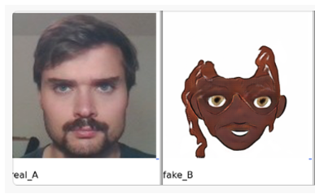
First results with CycleGAN
There is no real correspondence between the faces
We have no control over the generation of e.g. the color

Slide 6
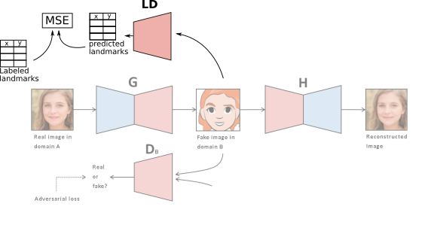
Landmarks Loss

Slide 7
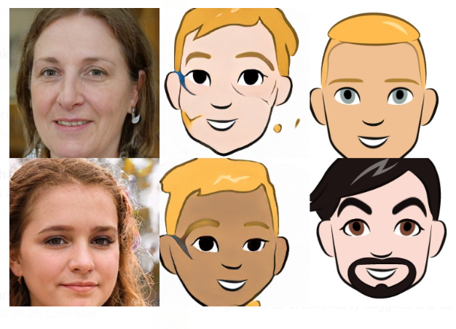
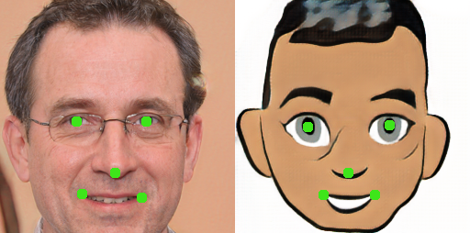
Landmarks Loss

Slide 8
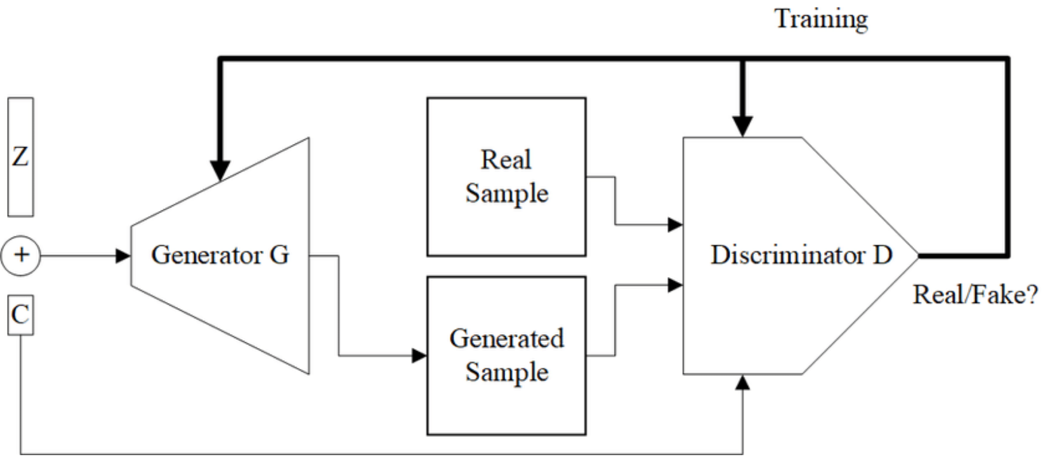
Conditional CycleGAN
Conditional GAN uses a class label to condition on to both the generator and discriminator, which shows that the model can generate MNIST digits conditioned on class labels.
Mirza M, Osindero S. Conditional generative adversarial nets. arXiv preprint arXiv:1411.1784. 2014 Nov 6.

Slide 9
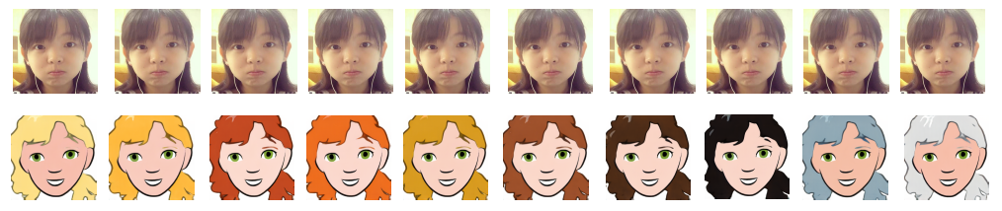
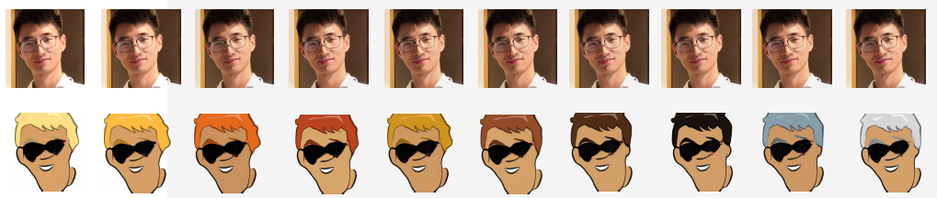
Conditional CycleGAN Results
Mirza M, Osindero S. Conditional generative adversarial nets. arXiv preprint arXiv:1411.1784. 2014 Nov 6.

Slide 10
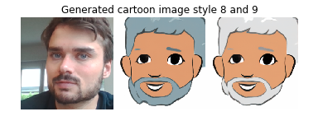
Results: Ben or Jan?

Slide 11
Results: Ben or Jan?

Slide 12
Conclusion and Outlook
Preserved some important features
CycleGAN can be extended in a natural way
Problems with:
Background (identify and neglect background)
Illumination
Viewpoint (augmentation on cartoonset)

Slide 13
Questions?

