Slide 1

Face to Cartoon using cycleGAN
G. Zeng, B. Fankhauser, J. Segessenmann, G. Ilango
Advanced Topics of Machine Learning FS2019
by Prof. Dr. Paolo Favaro

Slide 2

Introduction to the Project
Goal and Scope […]
Materials and Methods […]

Slide 3
Introduction to cycleGAN
Some easy high level stuff […]

Slide 4
Landmarks Loss

Slide 5
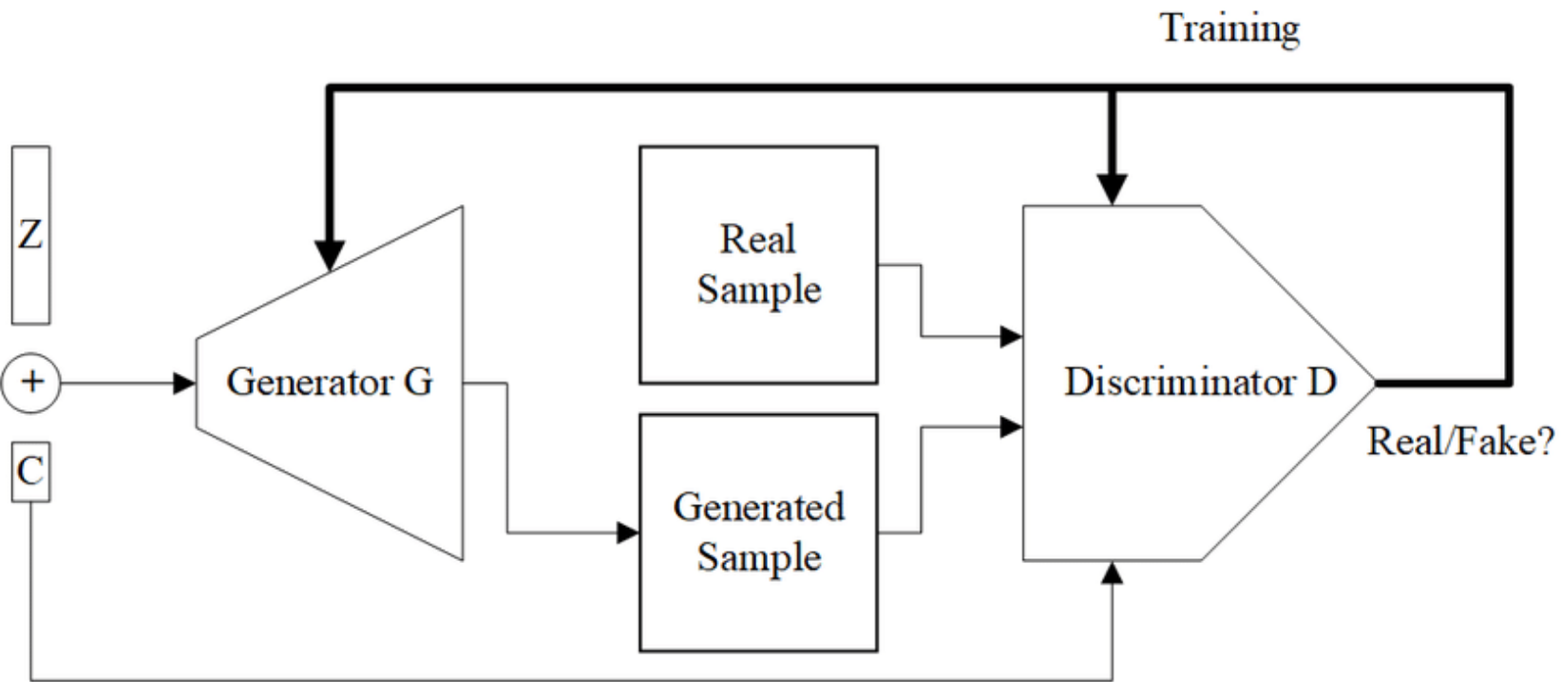
Conditional cycleGAN
Conditional GAN uses a class label to condition on to both the generator and discriminator, which shows that the model can generate MNIST digits conditioned on class labels.
Mirza M, Osindero S. Conditional generative adversarial nets. arXiv preprint arXiv:1411.1784. 2014 Nov 6.

Slide 6
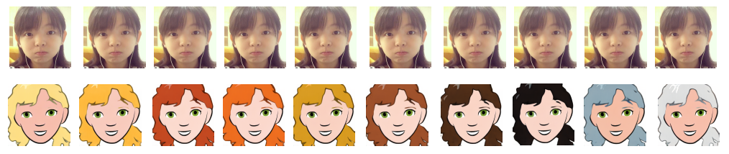
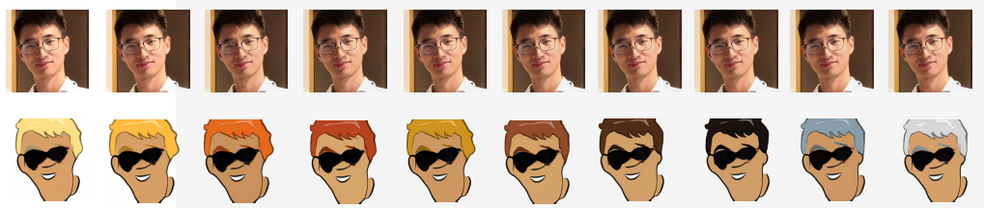
Conditional cycleGAN Results
Mirza M, Osindero S. Conditional generative adversarial nets. arXiv preprint arXiv:1411.1784. 2014 Nov 6.

Slide 7
Demo

Slide 8
Conclusion
features are preserved: e.g. beards and glasses
with Landmark losses, CycleGAN was extended in a natural way
for meaningful results training of 24 – 36 hours were required
Notes:
Some features are preserved: beards, glasses
With landmark losses, can be extended in a natural way -> although some limitations
For meaningful results training of 24 to 36 hours were required -> each result had to be analyzed and discussed

Slide 9
Outlook
more landmarks
sensitive to background and illumination and view point
identify background in the real images and set it to white
augmentation of dataset
Extend conditional architecture to differentiate between skin colours
Notes:
More landmarks -> for ear and hair
Background sensitive to illumination and view point
Another way to increase performance: identify background in the real images and set it to white
Augmentation of dataset, rotation on the cartoon images, one might also achieve better results in viewpoint and illumination
Extend conditional architecture such that the skin colour is also considered

Slide 10
Questions?

