Slide 1
Control System Training
MODULE 4 – Combinatorial Boolean Logic

Slide 2
Copyright Notice
These training materials, including the samples, exercises, and solutions, are copyrighted materials. Any reproduction, or use of any kind without the specific written approval of the author is strictly prohibited.
Permission for extra-curricular use by First FRC teams for FRC related training is granted, provided the original copyright and acknowledgements are retained.
© Jim Simpson, 2018

Slide 3
Combinatorial Boolean Logic
Definitions:
  Boolean – Only values are: ZERO / ONE or TRUE/FALSE
  Combinatorial Logic – Outcome depends only on the current value of the inputs. Nothing depends on time (or previous values of the inputs or outputs).
    Sometimes called Combinational Logic

Slide 4
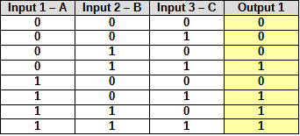
Truth Table
Table of all possible input values and the resulting output values.
For “n” inputs, the table will have 2^{n} rows. (A 3 input table will have 8 rows.)
A table can have multiple outputs for the same inputs if needed.

Slide 5
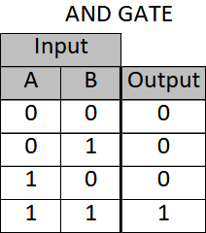
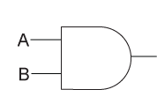

AND Gate
Output is true when all inputs are true.
Boolean algebra written as AB or A • B or A * B

Slide 6
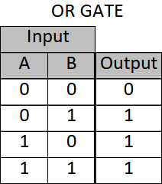
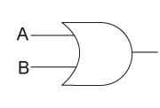

OR Gate
Output is true when any input is true
Boolean algebra written as A+B

Slide 7
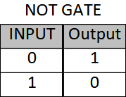
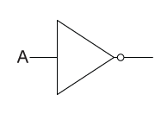

NOT Gate
Output is the opposite of the input.
Boolean algebra written as ^A or A

Slide 8
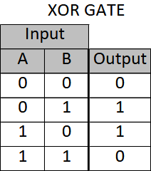
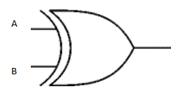
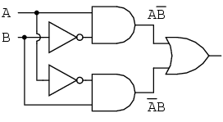
XOR (Exclusive OR) Gate
Output is true when inputs are different.
Boolean algebra written as A + B
Equivalent to:

Slide 9
Other Gates
NAND – Not And
NOR – Not Or
Not XOR – Not Exclusive OR

Slide 10
Boolean Algebra
Write out as regular algebra. Similar to numeric expression
Symbols
  + means OR
  * means AND
  • means AND
  Line over term or ^ means NOT
  + means XOR (exclusive OR)
  = means equals
Parenthesis can be used for grouping, similar to regular algebra
Examples:
  OUT = PERM • INPUT
  H = A • B + C • D • ( E + F + G )

Slide 11
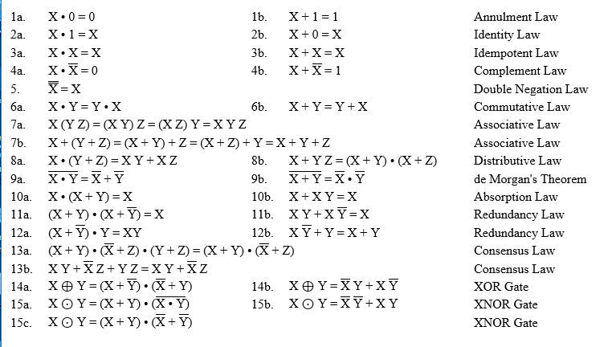
Boolean Algebra - Rules
There are other rules.

Slide 12
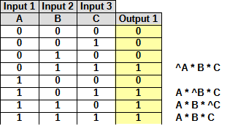
Boolean Algebra – Creation from Truth Table
Step 1: Create Truth Table for all possible states
Step 2: For each 1 output write the equations:
Step 3: Write complete output equation as “sum of products”

Slide 13

Boolean Algebra – Creation from Truth Table
Step 4 (optional): Use boolean algebra and rules to simplify

Slide 14
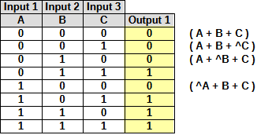
Boolean Algebra – Creation from Truth Table
A similar process can be used to create a “product of sums”. 1) Write equations for each of the 0 outputs. 2) AND these equations together.
This yields:

Slide 15


Converting Numeric To Boolean
The output of a comparison of two numeric values is a boolean.
Examples:
  Equal – True when A = B
  Not Equal – True when A <> B
  Greater or Equal – True when A >= B
  Less or Equal – True when B <= A
  In Range – True when C >= A and C <= B. For the output to ever be true B must be > A.
Enhanced comparison functions often have a deadband value to reduce chatter and eliminate insignificant differences.

Slide 16
Sample 4.1 – System Definition
A system is defined as follows:
  System has two modes of operation “manual” and “automatic”. A user operated switch selects “automatic” mode.
  An external program generates a “start command” for use when in “automatic” mode.
  A user operated button “start command” is used when in “manual” mode.
  A user operated “stop” switch stops the output in either mode.
  An external sensor provides “permissive” for the system to operate.
Calculate the system operate (run) output from the defined inputs.

Slide 17
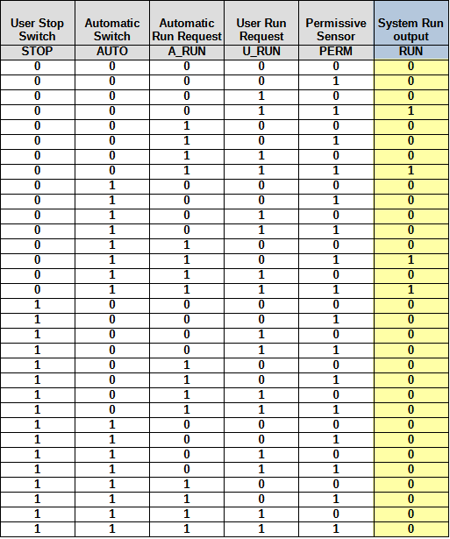
Sample 4.1 – Create Truth Table
From the system definition and operation description:
  List all the inputs and outputs
  Create a truth table (or write the equations directly if possible).

Slide 18
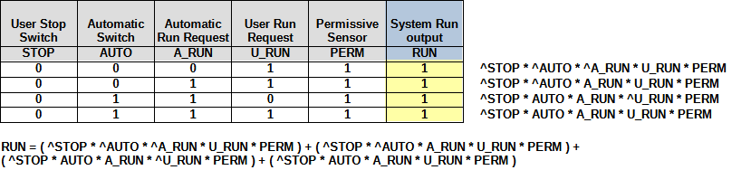
Sample 4.1 – Create Sum of Products
For each True output in the truth table create the equation and combine
Optionally, use boolean algebra rules to simplify

Slide 19
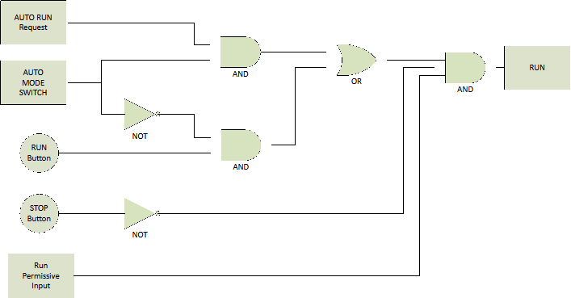
Sample 4.1 – Draw Logic Diagram
Draw Logic Diagram

Slide 20
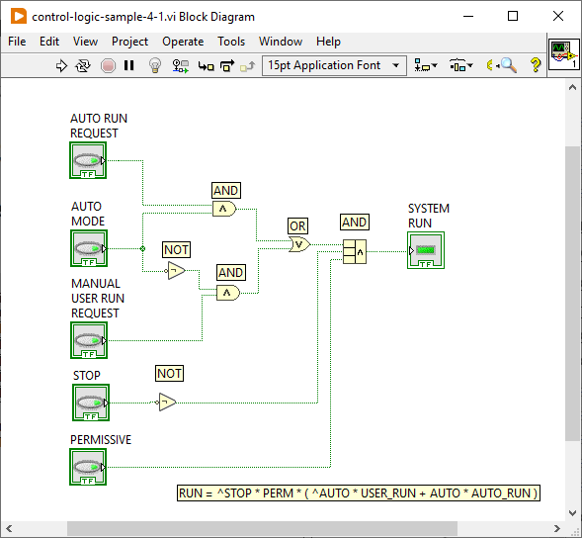
Sample 4.1 – LabVIEW Code
LabVIEW Block Diagram

Slide 21
Exercise 4.1 – Ball shooter size detector
Floor contains 3 sizes of balls. Only the middle size can be shot correctly.
  The small balls have 80% the diameter of the middle ball
  The large balls have 120% the diameter of the middle ball.
The robot picks up any size balls and they roll along a belt. The belt is always on. When the balls reach the “front” sensor either “reject” the ball back onto the floor, or “shoot” the ball.
Boolean Inputs (sensors):
  1) Front of ball 2) 97% diameter of middle ball
  3) 103% diameter of middle ball 4) Robot enabled (simulate with a sensor)
Boolean Outputs (actuators):
  1) Reject ball 2) Shoot ball
When a ball is picked up it first encounters the 103% sensor, then the 97% sensor, then the front of ball sensor. Based on the size of the ball, multiple sensors may indicate true at the same time. When the front of ball sensor is TRUE either reject or shoot the ball based on its size. If the robot is not enabled, always reject the ball. Draw the logic and write the equation.

Slide 22
Robot Training 01
Complete Robot Training 01 presentation

Slide 23
Exercise 4.2 – Ball shooter size detector
Implement the solution to 4.1 on a robot.
The limit switch inputs use:
  Front of ball limit switch – DIO 0
  97% of ball limit switch – DIO 1
  103% of ball limit switch – DIO 2
  Robot enabled limit switch – DIO 3
The DIO outputs (digital outputs) use:
  Shoot ball – DIO 8
  Ball Detected – DIO 7
Use the robot project “put-name-here”. The only VI that need to be modified are in the “BallDetectShoot” sub-directory. They are:
  BallDetectShoot_Open - One time initialization goes here
  BallDetectShoot_Execute - Code to periodically execute goes here

