Slide 1
Control System Training
MODULE 7 – Finite State Machines

Slide 2
Copyright Notice
These training materials, including the samples, exercises, and solutions, are copyrighted materials. Any reproduction, or use of any kind without the specific written approval of the author is strictly prohibited.
Permission for extra-curricular use by First FRC teams for FRC related training is granted, provided the original copyright and acknowledgements are retained.
© Jim Simpson, 2018

Slide 3
Finite State Machine - Definition
Definitions:
  Finite State Machine - A computational model consisting of a predefined number of states. Only one state can be active at a time. The active state performs some action, which could be nothing, then decides which state, including itself, becomes the next active state.
    States cannot be dynamically added or removed
    One state is defined as the starting state.
    A state machine may have an end (exit) state or may be defined to execute perpetually.
    Can be used to process Sequential Boolean Logic
    There are many other uses such as language processing, and compilers.

Slide 4
How the machine works
The machine:
  Executes code for the initial state
  Loops forever executing the code for whatever state is designated to be next, or until a state requests it to stop
Recommendation for FRC robots:
  During each robot control system “scan” cycle, 20 milliseconds, a single “state” is executed.
  In some cases, this will mean that a 20 millisecond delay will be performed to get to the next state. Generally, 20 milliseconds is too small to be concerned with. If it is, then the state design should be reconsidered to avoid this delay.

Slide 5
What each “State” Does
Each state:
  1) Performs some computation, or initiates some action. The action could be:
    Starting or stopping a motor
    Opening or closing a solenoid
    Setting a variable for another part of the code to use
    A combination of things
  Doing nothing is a valid action.
  2) Decides which state should execute next. The next state could be:
    The same state
    A known state determined during design
    One of several states determined by logic

Slide 6
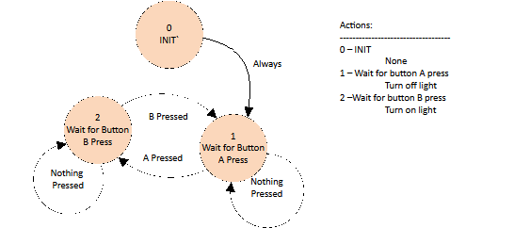
Drawing State Machines
Each State is a circle. Define each state with a unique name and/or state number.
Lines between states are transitions. Document the conditional causing each state transition.
Document actions taken by each state. This can be done in the circle defining the state. However, a separate list allows for more detailed description of the actions.

Slide 7
Defining States
Define a separate initialization state – State 0
  If somehow there is an error, and the state is set to zero, then this will cause initialization.
Include an error recovery state
  Recycle system, wait, and allow system to try again.
Keep states simple
Keep states simple
If possible, join common sequences of actions together to reduce the number of states
Actions of states should not need to include conditionals.

Slide 8
Designing Finite State Machine - 1/3
Sample Problem – Cube Capture
  Robot has a “hand” with positions:
    Opened = false
    Closed = true
  Robot has an “arm” with positions:
    Retracted = false
    Extended = true
  System is “ready” when “hand” is opened and “arm” is retracted
  User pushes button to initiate “capture cube”. Auto repeat of cube capture is not allowed. Ensure user pushed button for 60 milliseconds.
  Sequence of cube capture is:
    Close “arm” extension solenoid. Wait 1 second for arm to extend.
    Close “hand” solenoid. Wait 2.0 seconds for “hand” to settle.
    Open “arm” extension solenoid. Wait 1.3 seconds for arm to retract.
    Open “hand” solenoid to release potential cube into bin. Wait 1.5 seconds for cube to drop before allowing next “grab” action.

Slide 9
Designing Finite State Machine 2/3
List:
  Inputs
  Outputs
  Individual actions, and sequence of actions
Optionally, draw a Logic Diagram Graph similar to sequential logic.
Draw the state diagram:
  Start with an “initialization” state
  Add states waiting for events that start sequences of actions – sensor inputs, user button press, autonomous request.
  Add states for sequences of actions. Often this occur in pairs – 1) take action, start timer, 2) wait for timer to expire before selecting next action.
Define for each state:
  Actions performed, if any
  Tests used to determine next state

Slide 10
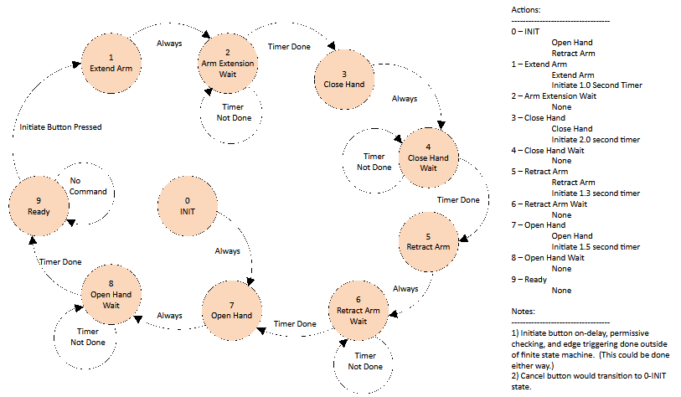
Designing Finite State Machine 3/3

Slide 11
Sequential Logic or State Machine
Many problems can be solved either by sequential logic or state machines. How to choose between them:
  Simple machines are probably implemented more easily using sequential logic.
  More complex machines are probably easier to implement using a finite state machine.

Slide 12
Exercise 7.1 – Shoot Flying Disc
Flying Disc shooter system has two outputs:
  Shooting motor (on/off)
  Solenoid to push flying disc into shooter wheel.
Flying Disc shooter system has one sensor:
  Limit switch indicating shooting system contains a flying disc.
User pushes a button to shoot flying disc. Ensure user meant to push button. Button must be pressed for 0.060 seconds before initiating action. (Robot cycle time is 0.020 seconds).
Only shoot a flying disc if system contains a disc. Also battery voltage must be > 11.5 volts. Only one disc can be shot at a time.
Shooting motor takes 3 seconds to spin up to speed. Engage solenoid for 2 second to push flying disc into shooting wheel. Allow 2 more seconds for shooting to complete. After shooting is complete, stop motor. (For now, don’t allow continuous shooting.) It takes 5 seconds after shooting for the next flying disc to be in place ready to shoot.
Allow user to press a Cancel button. The cancel button must be pressed for at least 0.060 seconds before becoming active. After the Cancel, force a 5 second reset before allowing a new shot.
Design shooting logic. Also provide “ready to shoot” digital for dashboard display. Use a finite state machine and perhaps combinatorial logic from module 4.

Slide 13
Robot Programming 03
Complete Robot Programming Training 03

Slide 14
Exercise 7.2 – Shoot Flying Disc Robot Code
Implement the solution to 7.1 on a robot.
The limit switch inputs use:
  Shooting system contains a flying disc – DIO 0
  Battery voltage > 11.5 volts – DIO 1 (Alternatively find a library VI that provides battery voltage.
  Shoot button – DIO 2 (Alternatively use a joystick button.)
The outputs are:
  Run motor – Relay 0 – (Forward only)
  Shoot disc cylinder – dual solenoid –
  PCM 0, channel 0 – shoot disc, channel 1 – normal position
Use the robot project “put-name-here”. The only VIs that need to be modified are in the “FlyingDiscShoot” sub-directory. They are:
  FlyingDiscShoot_Open - One time initialization goes here
  FlyingDiscShoot_Execute - Code to periodically execute goes here
FRC Control System Training – © 2019 – J.A. Simpson
10/30/2023

