Slide 1
LabVIEW Training
MODULE 1 – LabVIEW VI Basics

Slide 2
Programming Language Elements
Representing Data
Expressions
Assignment
Testing and Branching
Looping
Separation of code into components (sub-programs)
Notes:
- Representing data
LabVIEW - controls, indicators, function outputs.
text languages - named variables
- Expressions
- labview - concatenated functions, equation window, c window,
python window
- text languages - arithmetic expressions
- Assignments
- labview - wire from one function, control, indicator to
another
- text languages - =, memory copy, etc.
- conditionals
- labview - case structure
- text languages - if/then/else, case
- flow control (looping)
- labview - while loop, for loop
- text languages - while loop, until loop, for loop
- subroutines
- labview - any VI (directly or by reference)
- text languages

Slide 3
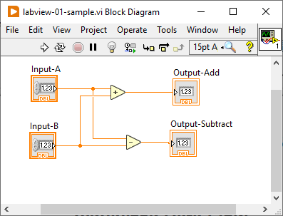
LabVIEW – Concepts
Visual rather than textual
Visualizes Data Flow
Execution is automatically ordered and parallelized based on date flow ! (Multi-threading is automatic.)

Slide 4
LabVIEW – Basic Building Blocks
VI – Virtual Instrument
Contains and code and user interface
Can be stand-alone program, or a sub-VI called by other Vis.
Saved as a separate file on disk. Optionally, file can belong to a project.
CTL – Custom Control
Can be a custom data type definition, or control.
More about this in future training.
Saved as a separate file on disk. Optionally, file can belong to a project.
There are others that we won’t cover at this time.

Slide 5
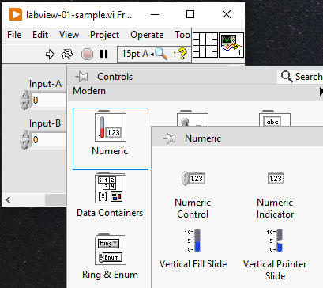
LabVIEW VI Front Panel
Right click to show Controls Pallete
Controls are inputs
Indicators are outputs
Demo
Notes:
- Open LabVIEW
- Create a Blank VI
- Save the VI file ---- Be VERY CAREFUL what directory you create the file in.
- Two windows -- Front Panel (FP) and Block Diagram (BD)
- Front Panel -- contains user interface. (also used to contain interface when
used from other VIs.--- called as a SubVI)
- contains buttons to run, continuosly run, stop, and pause execution
- this also shows the icon and connector pane --
- more about this next week.
- right click someplace on the block diagram. The controls
(and indicatros ) palette is shown.
- controls are grouped in categories. (numeric, boolean,
strings, arrays, etc.)
- place a numeric controls on the front panel.
Controls are the INPUTS from the user (or caller)
of this VI into the program.
- select the control -- move mouse, left click, control will display
differently when selected.
- copy the control a) use menu --> edit --> copy, or b) Ctrl-C
- paste a copy a) use menu --> edit --> paste, or b) ctrl-V
- move the controls a round on the front panel. Note that the
menu contains alignment and spacing helpers if needed.
- Rename each control. "Input 1", "Input 2"
- select a control. Copy and paste it.
- right click on the new control. Select
- change to indicator.
There are a LOT of different things that can be done
when right clicking on one (or more) controls.
- Note that this looks different. Indicators are OUTPUTS to the
user (or calling VI) that are calculated by the VI.
- Rename this indicator to "Output"
- Save VI... Notice the "*" at the end of the file name in
the window title bar. This indicates unsaved changes.
- Now switch to block diagram. a) Menu WIndow -> show block
diagram or, b) ctrl-E

Slide 6
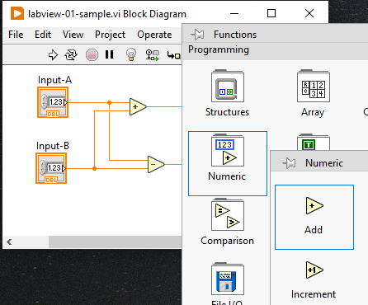
LabVIEW VI Block Diagram
Right click to show Function Pallete
Ctrl-H to show help for function
Wiring
Adding comments
Cut, Copy, Paste, Move, Delete, Undo
How code error are displayed and diagnosed
Demo
Notes:
- block diagram (Mya or Zeke -- switch ??)
- This is where the code goes.
- notice that there are icons for the conttrols and indicators on the front panel
- the control and indicator icons can be moved. moving them on the block diagram
does NOT move them on the front panel.
- normally (by convention -- code flows from left to right (controls on left,
indicators on the right.)
- code is made up of controls, indicators, function blocks and the wires that
connect them.
- On a blank space on the block diagram, right click your mouse. The function
pallete menu will be displayed.
- To keep the function pallete visible, it can optionally be pinned. In the upper
left corner of the pallete, click on the pin to pin the pallete.
- If you cant find a function but you know part of its name you can use search
in the upper left menu.
- When pinned, the pallete can be displayed differently if desired.
THis is changed by thecustomize menu. Generally -- Category (icons and text)
works best. Alternately - icons and text -- might be desirable.
- THe pallete is organized in categories by function --
- "structures" contains programming elements. We will use this a lot.
- "numeric" contains math and other items to use with numbers.
- "boolean" contains math and other items to use with boolean (on/off) values
- explore these on your own. We will talk about the rest of these
more at later trainings.
- Lets have our program (VI) add the two inputs together and display the result.
- open the numeric pallete.
- find the "add" function. while hovering over the function, left click
the function to select it. The cursor will change shape.
Move the mouse to place the selected function on the block
diagram.
- To see how to use a function, help is available. Hover over the add
function. Press Ctrl-H. Help will be displayed. (Ctrl-H is a
toggle. Press Ctrl-H again to turn off the help display.
- Note that inputs to the function are on the left and outputs are on the
right.
- Note that the "run arrow" in the upper left of the menu shows a broken
arrow. This indicates that there is an error that needs to be
fixed before the VI can be executed.
- Left click on the broken arrow to show a window describing the errors.
Click on the particular error to highlight the function where
the error exists.
- Lets wire the first input icon to the first input on the add function.
1) move mouse to input 1 icon. The wire terminal is on the right.
move the mouse to the input 1 terminal. The cursor will change shape
(to a wire spool) when it is in position.
2) Left click to start a wire. Move the mouse. This drags the wire.
3) To create a bend in the wire along the way, left click. (One bend
is automatic, to make more than one bend, use the left click.)
4) Move the mouse to the top left input terminal on the "add" function.
when in position the terminals will be shown and the input name will be
displayed.
5) Finish the wire by left clicking.
Notice that the wire is a color. The color indicates the data type
of the value. More about this later.
- wire input 2 to the 2nd input of the add function.
- note that after the second input is wired, the broken run arrow changes to
a normal run arrow.
- wire the add output to the input of the output indicator.
- remember to save what you have done.

Slide 7
LabVIEW VI Run Menu
Review the Run, Continuous Run, Stop, and Pause buttons on the Front Panel menu.
Notes:
- lets run our program. switvh to the front panel
- enter two numbers in the input boxes.
- press the run arrow.
- the VI runs once and displays the result.
- If we type another value into the input nothing happens because the VI
is finished running.
- The circular arrow icon in the menu is "run continuously" This will run
the program over and over again. While this is not how a normal VI
executes it allows for easier testing. Lets try it.
- To stop execution, press the "stop" button. This is to the right of the
run continuously button. (It looks like a circular stop button.)
- lets add a second calculation to subtract 2 from "input 1".
- add a subtract block.
- wire from input 1 to the first input of the of the subtract blovk. This wire
can start from ANY place along the existing wire connected to input 1.
Move the mouse until it changes shape. Left click to start this new
wire segment. Finish it just like the other wires we created.
- To create a constant, move the mouse to the second input of the subract function.
Right click to show the menu. There are a lot of things in this menu.
Some of the important ones are "create constant", "create control",
"replace", but there are many others. Click on the new constant and enter
the value 2.
- To create the new indicator, place the mouse on the output of the subtract function.
right click and select "create indicator". Click on the indicator icon name
and change it to something meaningful.
- save your work.
- to create a comment, left click on a blank space on the block diagram. An entry box will
appear. Type your comment in this box.
- things can be moved around the screen similar to many other windows applications. Left
click on something and drag. Draw a "rectangle" around a set of code and move.
- things can be deleted in the same way by selecting and pressing the delete key.
- Ctrl-Z is a VERY helpful "undo" key.
- SAVE code, go to front panel and test.
- IF THERE IS TIME HERE WE COULD SHOW THEM THE CASE STRUCTURE....

Slide 8
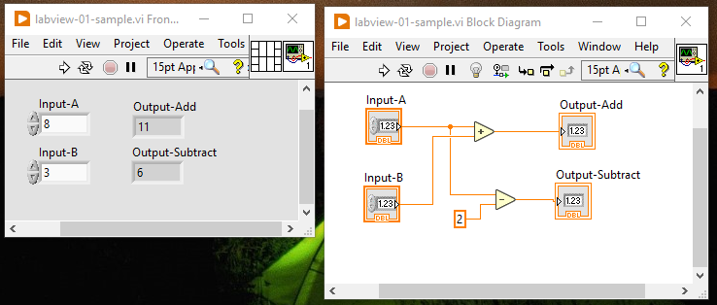
Sample 1.1
Demo of creating a simple VI to add two numbers.
Modify to add an additional output that subtracts 2 from the first input.

Slide 9
Exercise 1.1 – Calculate Encoder Ft/Count
An encoder counts up as a motor or other device rotates
An encoder has a specific number of counts per rotation.
Depending on the type of encoder this sometimes has to be multiplied by 2 or 4 to get the number of edge counts per rotation.
This encoder is being used on our robot drive. The encoder is connected directly to the wheels (gear ratio of 1:1 [input:output]). The encoder has 1440 edge counts/rotation.
The wheels have a diameter of 6 inches.
Based on user entered – counts/rotation, wheel diameter, and gear ratio, calculate and display the constant to convert counts to feet. (The units of the conversion factor will be Ft/Count).
Add an input for the number of encoder counts traveled. Calculate and display the number of feet traveled.
Todo:
Write the list of inputs and outputs
Write a VI to perform these calulations and display the results

