Slide 1
FRC Robot Programming
MODULE 2 – Relay / Solenoid Output

Slide 2
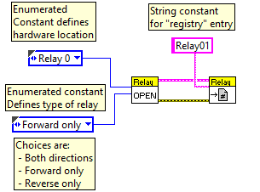
Boolean Output – Relay - Initialization
Initialization code
Initialize hardware I/O
Assign created data structure to “registry” for use by continuous execution routine.
Relays can optionally be “bi-directional” (forward, reverse, off), or uni-directional (on, off).
In other words a relay is really two separate boolean outputs, “forward”, and “reverse”

Slide 3
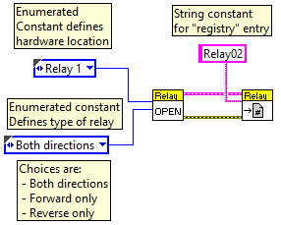
Boolean Output – Relay - Initialization
Bi-Directional initialization sample

Slide 4
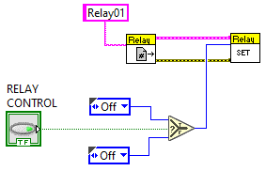
Boolean Output – Relay - Execution
Execution code -- uni-directional
Get “registry” entry for desired output
Write desired value to hardware.
This code needs to be used every 20 milliseconds

Slide 5
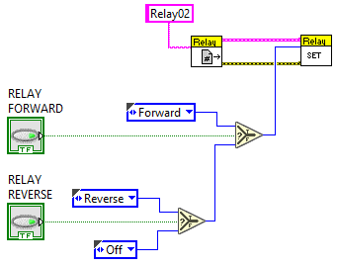
Boolean Output – Relay - Execution
Execution code -- bi-directional
Get “registry” entry for desired output
Write desired value to hardware.
This code needs to be used every 20 milliseconds

Slide 6

Compressor - Initialization
Initialization code
Initialize hardware I/O
Assign created data structure to “registry” for use by continuous execution routine.
Starts compressor (after robot is enabled).
If compressor code isn’t added, it is automatically loaded when first solenoid is initialized

Slide 7
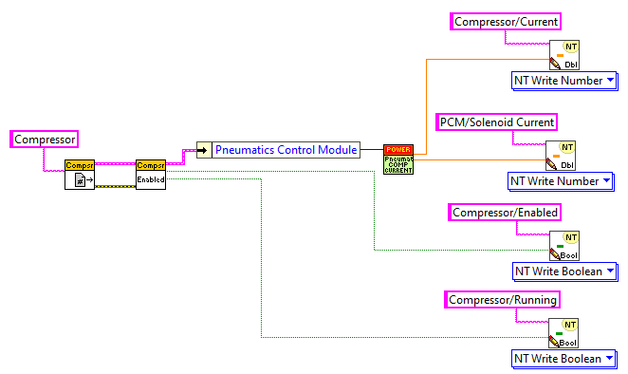
Compressor – Get Status
Execution code
Get “registry” entry for desired output
Read compressor status
This code isn’t mandatory. If desired it can be periodically executed.

Slide 8
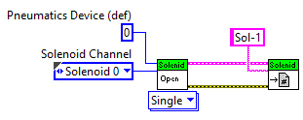
Single Solenoid Output – Initialization
Initialization code
Initialize hardware I/O
Assign created data structure to “registry” for use by continuous execution routine.
Relays can optionally be “single” (on, off), or “double” (forward, reverse, off).

Slide 9
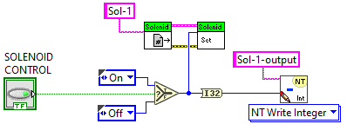
Single Solenoid - Execution
Execution code
Get “registry” entry for desired output
Write desired value to hardware.
This code needs to be used every 20 milliseconds

Slide 10
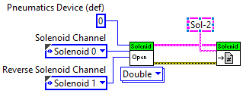
Double Solenoid Output – Initialization
Initialization code
Initialize hardware I/O
Assign created data structure to “registry” for use by continuous execution routine.
Relays can optionally be “single” (on, off), or “double” (forward, reverse, off).

Slide 11
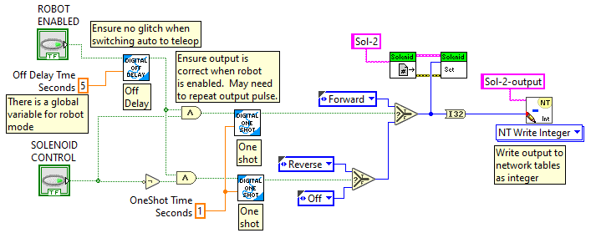
Double Solenoid - Execution
Execution code
Get “registry” entry for desired output
Write desired value to hardware.
This code needs to be used every 20 milliseconds

