Slide 1
Control System Training
MODULE 5 – Sequential Boolean Logic

Slide 2
Copyright Notice
These training materials, including the samples, exercises, and solutions, are copyrighted materials. Any reproduction, or use of any kind without the specific written approval of the author is strictly prohibited.
Permission for extra-curricular use by First FRC teams for FRC related training is granted, provided the original copyright and acknowledgements are retained.
© Jim Simpson, 2018

Slide 3
Sequential Boolean Logic
Definitions:
  Boolean – Only values are: ZERO / ONE or TRUE/FALSE
  Sequential Logic -- Outcome depends on both current values of the inputs and previous values of the inputs and output.

Slide 4
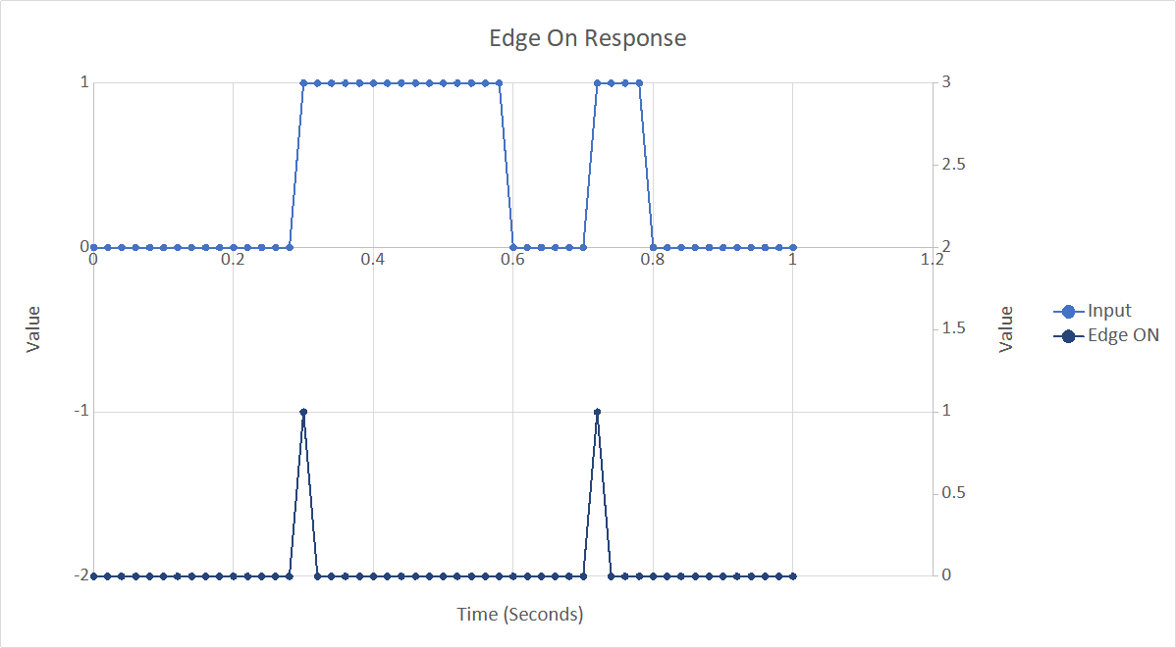
Edge Triggered – ON
Only true for a single scan.

Slide 5
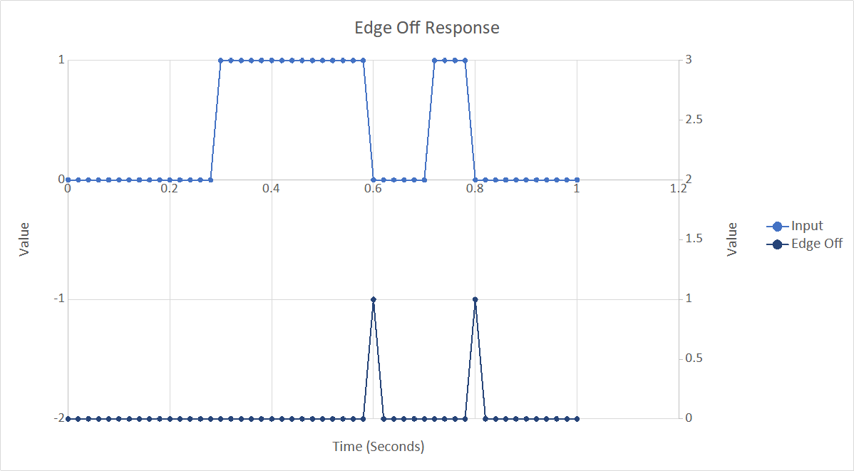
Edge Triggered - OFF
Only true for a single scan

Slide 6
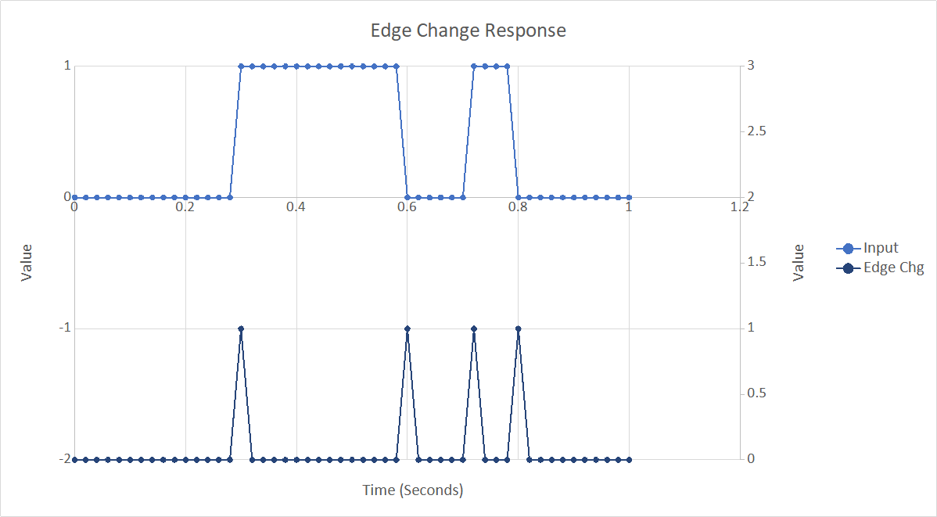
Edge Triggered - CHANGE
Only true for a single scan

Slide 7
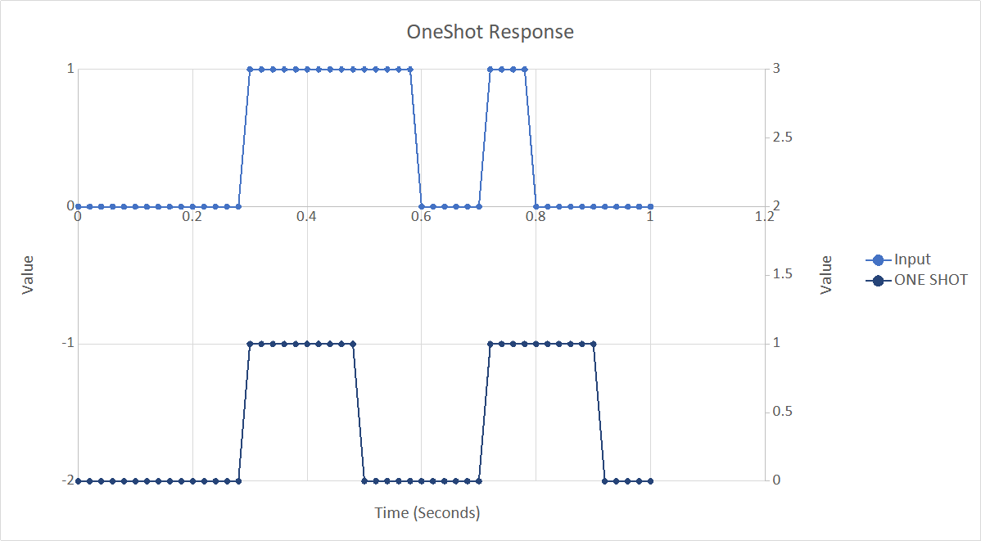
One Shot
Oneshot time is 0.200 seconds

Slide 8
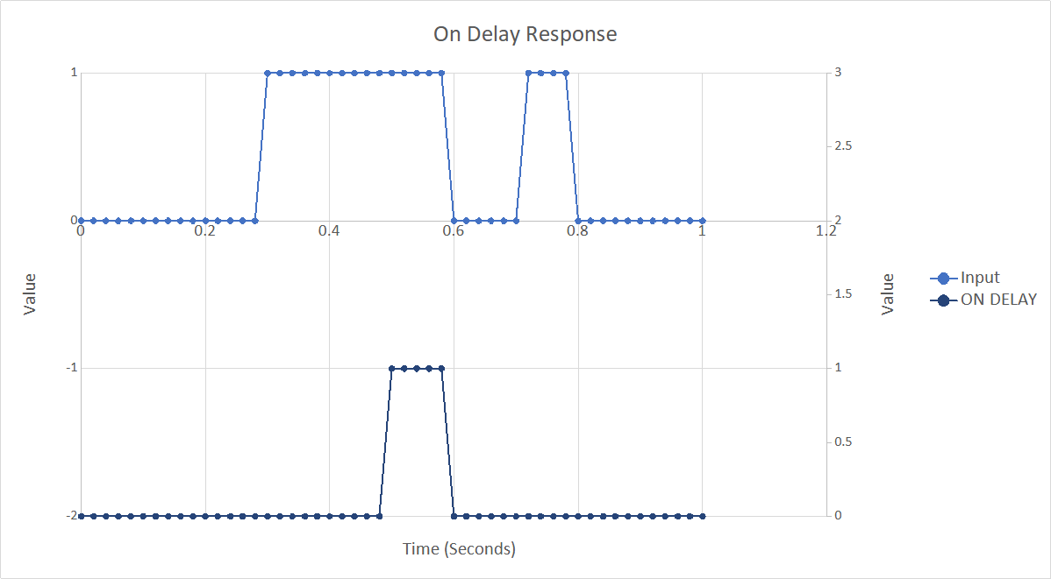
On Delay
Delay is 0.200 Seconds
If input goes false before delay expires, output is never true.

Slide 9
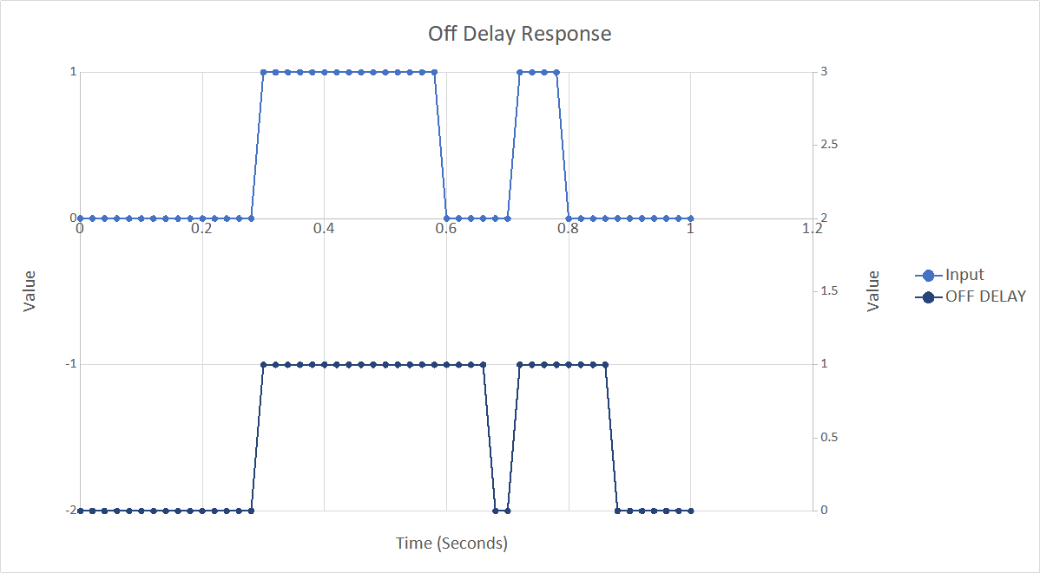
Off Delay
Off delay time is 0.080 seconds.

Slide 10
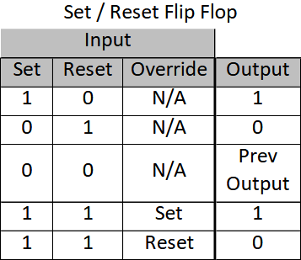
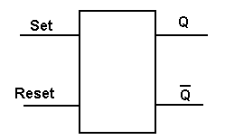
Set / Reset Flip Flop
Can think of this as “Boolean memory”. This is the building block of all computers.
If both are true at the same time, one overrides the other. This is usually selectable.

Slide 11
Designing Sequential Logic 1/4
Sample Problem – Cube Capture
  Control system uses a 20 msec loop time
  System is ready when “hand” is opened and “arm” is retracted
  Users pushes button to initiate “cube capture”. Auto repeat of cube capture is not allowed.
  Ensure user pushed button for 60 msec
  Close “arm” extension solenoid. Wait 1 second for arm to extend.
  Close “hand” solenoid. Wait 2.0 seconds for “hand” to settle.
  Open “arm” extension solenoid. Wait 1.3 seconds for arm to retract.
  Open “hand” solenoid to release potential cube into bin. Wait 1.5 seconds for cube to drop before allowing next “capture” action.
Enhancement – Add a cancel button

Slide 12
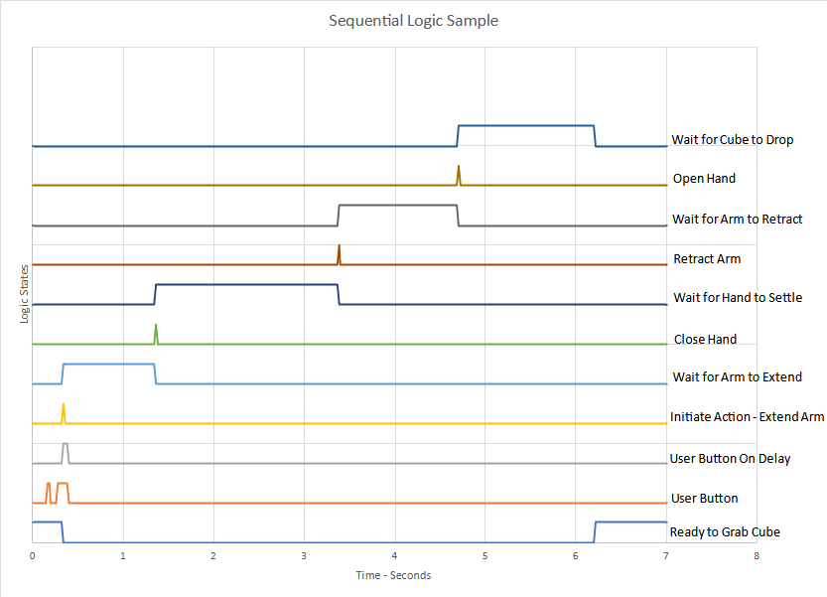
Designing Sequential Logic 2/4
Draw the Logic Diagram Graph

Slide 13
Designing Sequential Logic 3/4
Start with inputs
Determine relationships
  What inputs does an output relate to
Draw Logic Diagram
Add intermediate Logic to Graph
Repeat last two steps if needed to refine logic

Slide 14
Designing Sequential Logic 4/4
Final Logic Diagram

Slide 15
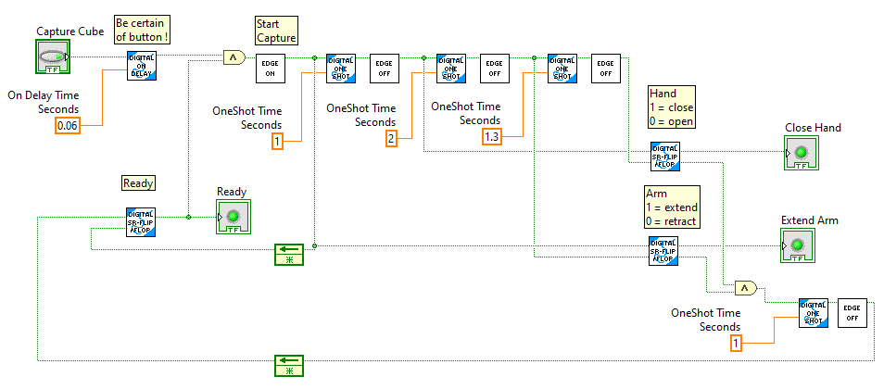
Designing Sequential Logic 4/4 - LabVIEW
Sample LabVIEW logic

Slide 16
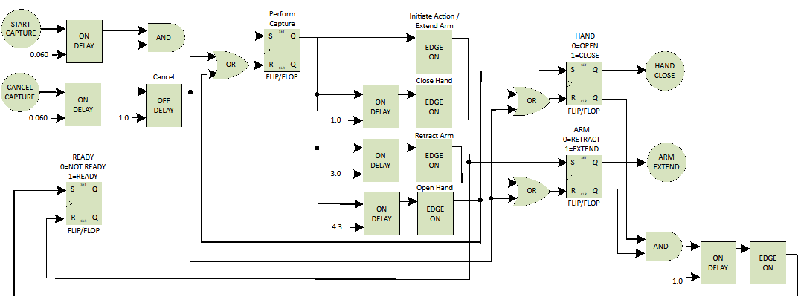
Designing Sequential Logic 4/4 - LabVIEW
Alternate logic diagram – With Cancel

Slide 17
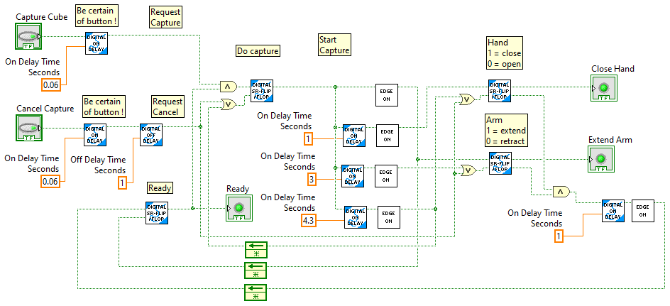
Designing Sequential Logic 4/4 - LabVIEW
Alternate sample LabVIEW logic – With Cancel

Slide 18
Exercise 5.1 – Shoot Flying Disc
User pushes a button to shoot frisbee.
Ensure user meant to push button. Button must be pressed for three cycles before initiating action. (Cycle time is 0.020 seconds).
Can only shoot a frisbee if we have one. A limit switch indicates this. Also battery voltage must be > 11.5 volts. Can only shoot one frisbee at a time.
Motors take 3 seconds to spin up to speed.
Engage solenoid for 2 second to push frisbee into shooting wheel.
Allow 2 more seconds for shooting to occur.
After shooting is done, stop motor. (For now, don’t allow continuous shooting.)
Allow user to press a Cancel button. The cancel button must be pressed for at least 3 cycles before becoming active. After the Cancel, force a 5 second reset before allowing a new shot.
It takes 5 seconds after shooting for a new frisbee to be in place ready to shoot.
Design shooting logic. Also provide “ready to shoot” digital for dashboard display. Use ONLY the algorithms discussed in this module, and perhaps module 4.

Slide 19
Robot Programming 02
Complete Robot Programming Training 02

Slide 20
Exercise 5.2 – Shoot Flying Disc Robot Code
Implement Exercise 5.1 in robot code.

