Slide 1
LabVIEW Training
MODULE 2 – LabVIEW DataTypes / While Loop

Slide 2
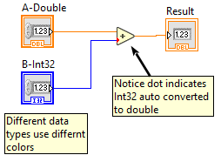
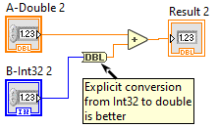
Numeric Data Types
Floating Point / Integers
Float can have fractions, integers are whole numbers
Each has different sizes indicating how much memory they consume and the range of values they store
Robot programming most often uses
Int32 (32 bit integer +/- 2^31)
Double (floating 64bit, approx 15 dig precision, exponent approx +/- 308)
LabVIEW
Uses different wire colors for different types
Does automatic conversion, shown by “dot”. This is not always your friend!
Use “right click” menu to change type.
Notes:
- Representing data
LabVIEW - controls, indicators, function outputs.
text languages - named variables
- Expressions
- labview - concatenated functions, equation window, c window,
python window
- text languages - arithmetic expressions
- Assignments
- labview - wire from one function, control, indicator to
another
- text languages - =, memory copy, etc.
- conditionals
- labview - case structure
- text languages - if/then/else, case
- flow control (looping)
- labview - while loop, for loop
- text languages - while loop, until loop, for loop
- subroutines
- labview - any VI (directly or by reference)
- text languages

Slide 3
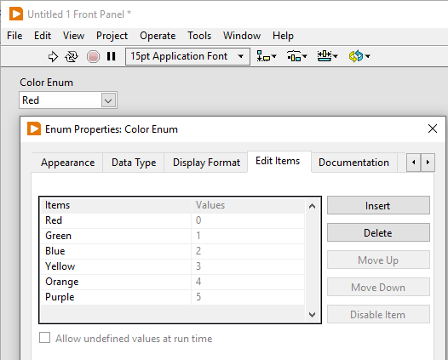
Enumerated Values
A special numeric data type that associates names with particular values
This type is called - Enum
To create
Add Enum control to front panel
The Enum under the System style palette allows drop down.
Right click, then select “Edit Items”
Notes:
- Open LabVIEW
- Create a Blank VI
- Save the VI file ---- Be VERY CAREFUL what directory you create the file in.
- Two windows -- Front Panel (FP) and Block Diagram (BD)
- Front Panel -- contains user interface. (also used to contain interface when
used from other VIs.--- called as a SubVI)
- contains buttons to run, continuosly run, stop, and pause execution
- this also shows the icon and connector pane --
- more about this next week.
- right click someplace on the block diagram. The controls
(and indicatros ) palette is shown.
- controls are grouped in categories. (numeric, boolean,
strings, arrays, etc.)
- place a numeric controls on the front panel.
Controls are the INPUTS from the user (or caller)
of this VI into the program.
- select the control -- move mouse, left click, control will display
differently when selected.
- copy the control a) use menu --> edit --> copy, or b) Ctrl-C
- paste a copy a) use menu --> edit --> paste, or b) ctrl-V
- move the controls a round on the front panel. Note that the
menu contains alignment and spacing helpers if needed.
- Rename each control. "Input 1", "Input 2"
- select a control. Copy and paste it.
- right click on the new control. Select
- change to indicator.
There are a LOT of different things that can be done
when right clicking on one (or more) controls.
- Note that this looks different. Indicators are OUTPUTS to the
user (or calling VI) that are calculated by the VI.
- Rename this indicator to "Output"
- Save VI... Notice the "*" at the end of the file name in
the window title bar. This indicates unsaved changes.
- Now switch to block diagram. a) Menu WIndow -> show block
diagram or, b) ctrl-E

Slide 4
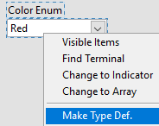
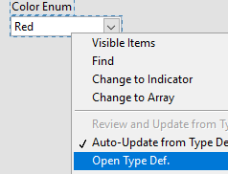
Custom Type Definition
Custom type definitions, TypeDef, allow customized controls to be used in more than one place
Especially useful for
Enumerated types
Clusters (more on clusters later)
To Create:
Create custom control
Right click then “Make TypeDef”
Right click again then “Open TypeDef
Save the newly opened. This file can now be used as a custom control, indicator, or constant.
Notes:
- block diagram (Mya or Zeke -- switch ??)
- This is where the code goes.
- notice that there are icons for the conttrols and indicators on the front panel
- the control and indicator icons can be moved. moving them on the block diagram
does NOT move them on the front panel.
- normally (by convention -- code flows from left to right (controls on left,
indicators on the right.)
- code is made up of controls, indicators, function blocks and the wires that
connect them.
- On a blank space on the block diagram, right click your mouse. The function
pallete menu will be displayed.
- To keep the function pallete visible, it can optionally be pinned. In the upper
left corner of the pallete, click on the pin to pin the pallete.
- If you cant find a function but you know part of its name you can use search
in the upper left menu.
- When pinned, the pallete can be displayed differently if desired.
THis is changed by thecustomize menu. Generally -- Category (icons and text)
works best. Alternately - icons and text -- might be desirable.
- THe pallete is organized in categories by function --
- "structures" contains programming elements. We will use this a lot.
- "numeric" contains math and other items to use with numbers.
- "boolean" contains math and other items to use with boolean (on/off) values
- explore these on your own. We will talk about the rest of these
more at later trainings.
- Lets have our program (VI) add the two inputs together and display the result.
- open the numeric pallete.
- find the "add" function. while hovering over the function, left click
the function to select it. The cursor will change shape.
Move the mouse to place the selected function on the block
diagram.
- To see how to use a function, help is available. Hover over the add
function. Press Ctrl-H. Help will be displayed. (Ctrl-H is a
toggle. Press Ctrl-H again to turn off the help display.
- Note that inputs to the function are on the left and outputs are on the
right.
- Note that the "run arrow" in the upper left of the menu shows a broken
arrow. This indicates that there is an error that needs to be
fixed before the VI can be executed.
- Left click on the broken arrow to show a window describing the errors.
Click on the particular error to highlight the function where
the error exists.
- Lets wire the first input icon to the first input on the add function.
1) move mouse to input 1 icon. The wire terminal is on the right.
move the mouse to the input 1 terminal. The cursor will change shape
(to a wire spool) when it is in position.
2) Left click to start a wire. Move the mouse. This drags the wire.
3) To create a bend in the wire along the way, left click. (One bend
is automatic, to make more than one bend, use the left click.)
4) Move the mouse to the top left input terminal on the "add" function.
when in position the terminals will be shown and the input name will be
displayed.
5) Finish the wire by left clicking.
Notice that the wire is a color. The color indicates the data type
of the value. More about this later.
- wire input 2 to the 2nd input of the add function.
- note that after the second input is wired, the broken run arrow changes to
a normal run arrow.
- wire the add output to the input of the output indicator.
- remember to save what you have done.

Slide 5
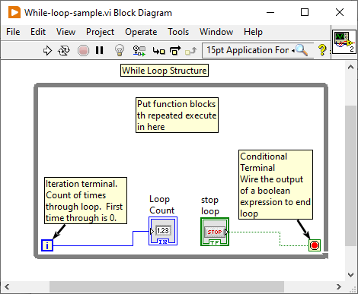
While Loop Structure
Executes code repeatedly until the termination condition is TRUE.
Loop can be made to always execute once or forever if desired

Slide 6
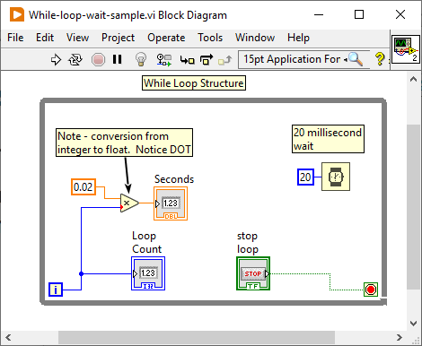
Wait Inside a Loop
Loops normally run as fast as possible
To make a loop run at a particular rate, use the “Wait” function.

Slide 7
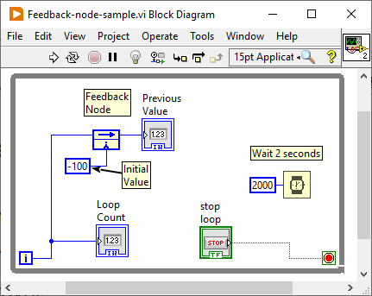
Remembering Past Data – Feedback Node
Use “Feedback Node” function to remember data from the last execution
Can be used anywhere. Inside or outside of loop
Works with ANY data type
To reverse icon, right click then select “Change Direction” (This is visual, not function.)
Has optional initialize value

Slide 8
Exercise 2.1 – Calculate Speed from Distance
Create a new VI
Add a while loop that loops once per second
Add a control that allows entry of feet traveled.
Calculate and display
Number of feet traveled in the last second.
Average speed of travel over the last second in feet/second.

