Slide 1
FRC Robot Programming
MODULE 1 – Basics / Boolean In / Out

Slide 2
Basic Robot Program
One time initialization actions
Continuous execution code cycles every 20 milliseconds.
Faster or slower loops can be added if needed
Much more about this subject later

Slide 3
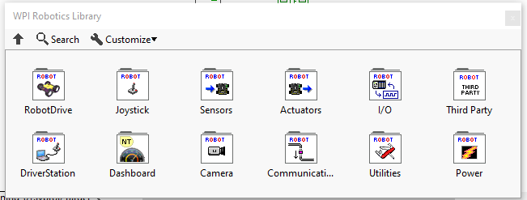
WPILIB Robot Programming Palette
Function palette for all robot functions.

Slide 4
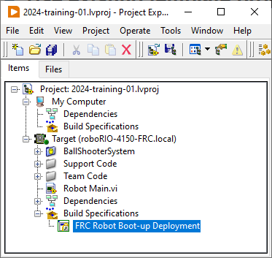
Template Robot Project
Use existing template projects as the starting point for all robot code. (More about projects later.)
For the exercises there is already a project created ready for use.

Slide 5
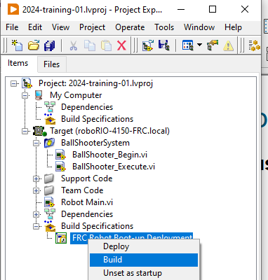
Compiling Robot Project
Robot Project must be compiled, “built”, before deploying to robot. Ensure code builds without errors!

Slide 6
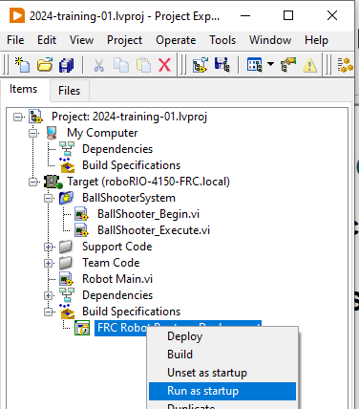
Deploying code to robot
Built robot project must be deployed to robot by selecting “run as startup”. Ensure this completes!
Then use Driver Station software to enable and test.

Slide 7
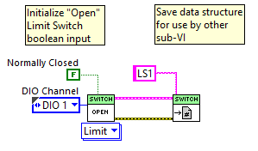
Boolean Input – Limit Switch - Initialization
Initialization code
Initialize hardware I/O
Assign created data structure to “registry” for use by continuous execution routine.
Note that this will be similar for ALL Input/Output (I/O) performed by the robot.
Limit Switch found under “sensors” sub palette

Slide 8
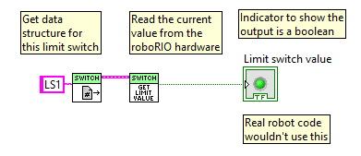
Boolean Input – Limit Switch - Execution
Execution code
Get “registry” entry for desired input
Read current value from hardware.
This code needs to be used every 20 milliseconds

Slide 9
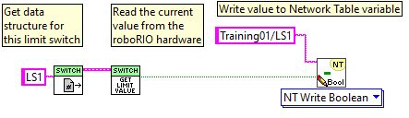
Network Table Variables
Network Table Variables
Write values for use by:
Display to drivers
Trending operational performance and tuning
Debugging
Can both read and write values
Sample write

Slide 10
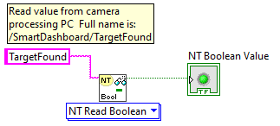
Network Table Variables
Network tables uses “outline” style for naming variables.
Variable names that start with “/” start at the top level.
Variable names that start without a “/” start under “/SmartDashboard”
Names must be exact – Case is different, spaces are different
This includes trailing spaces !!
Sample read

Slide 11

Boolean Output – Digital Out - Initialization
Initialization code
Initialize hardware I/O
Assign created data structure to “registry” for use by continuous execution routine.
Digital Output found under I/O sub-palette

Slide 12
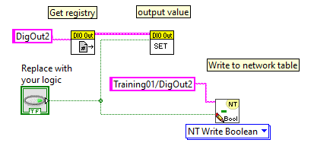
Boolean Output – Digital Out - Execution
Execution code
Get “registry” entry for desired output
Write desired value to hardware.
This code needs to be used every 20 milliseconds

Slide 13
Exercise
Do Exercise 4.2 from Control Logic Training Module 4

