Slide 1
FRC Robot Programming
MODULE 2 – Relay / Solenoid Output

Slide 2
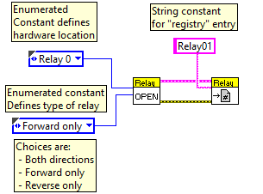
Boolean Output – Relay - Initialization
Initialization code
Initialize hardware I/O
Assign created data structure to “registry” for use by continuous execution routine.
Relays can optionally be “bi-directional” (forward, backward), or uni-directional (on, off).
In other words a relay is really two separate boolean outputs, “forward”, and “reverse”

Slide 3
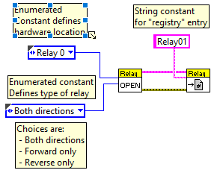
Boolean Output – Relay - Initialization
Bi-Directional sample

Slide 4
Boolean Output – Relay - Execution
Execution code
Get “registry” entry for desired output
Write desired value to hardware.
This code needs to be used every 20 milliseconds

Slide 5
Boolean Output – Relay - Execution
Execution code
Get “registry” entry for desired output
Write desired value to hardware.
This code needs to be used every 20 milliseconds

Slide 6
Boolean Output – Single Solenoid - Initialization
Initialization code
Initialize hardware I/O. Note that the first solenoid open will enable the compressor if not done separately.
Assign created data structure to “registry” for use by continuous execution routine.
There are two types of solenoids: single (on, off); and double (forward, reverse, off).
In other words a double solenoid is really two separate boolean outputs, “forward”, and “reverse”

Slide 7
Boolean Output – Double Solenoid - Initialization
Initialization code
Initialize hardware I/O. Note that the first solenoid open will enable the compressor if not done separately.
Assign created data structure to “registry” for use by continuous execution routine.
There are two types of solenoids: single (on, off); and double (forward, reverse, off).
In other words a double solenoid is really two separate boolean outputs, “forward”, and “reverse”

Slide 8
Boolean Output – Single Solenoid - Execution
Execution code
Get “registry” entry for desired output
Write desired value to hardware.
This code needs to be used every 20 milliseconds

Slide 9
Boolean Output – Double Solenoid - Execution
Execution code
Get “registry” entry for desired output
Write desired value to hardware.
This code needs to be used every 20 milliseconds

Slide 10
Exercise
Do Exercise 5.2 from Control Logic Training Module 5

