Slide 1


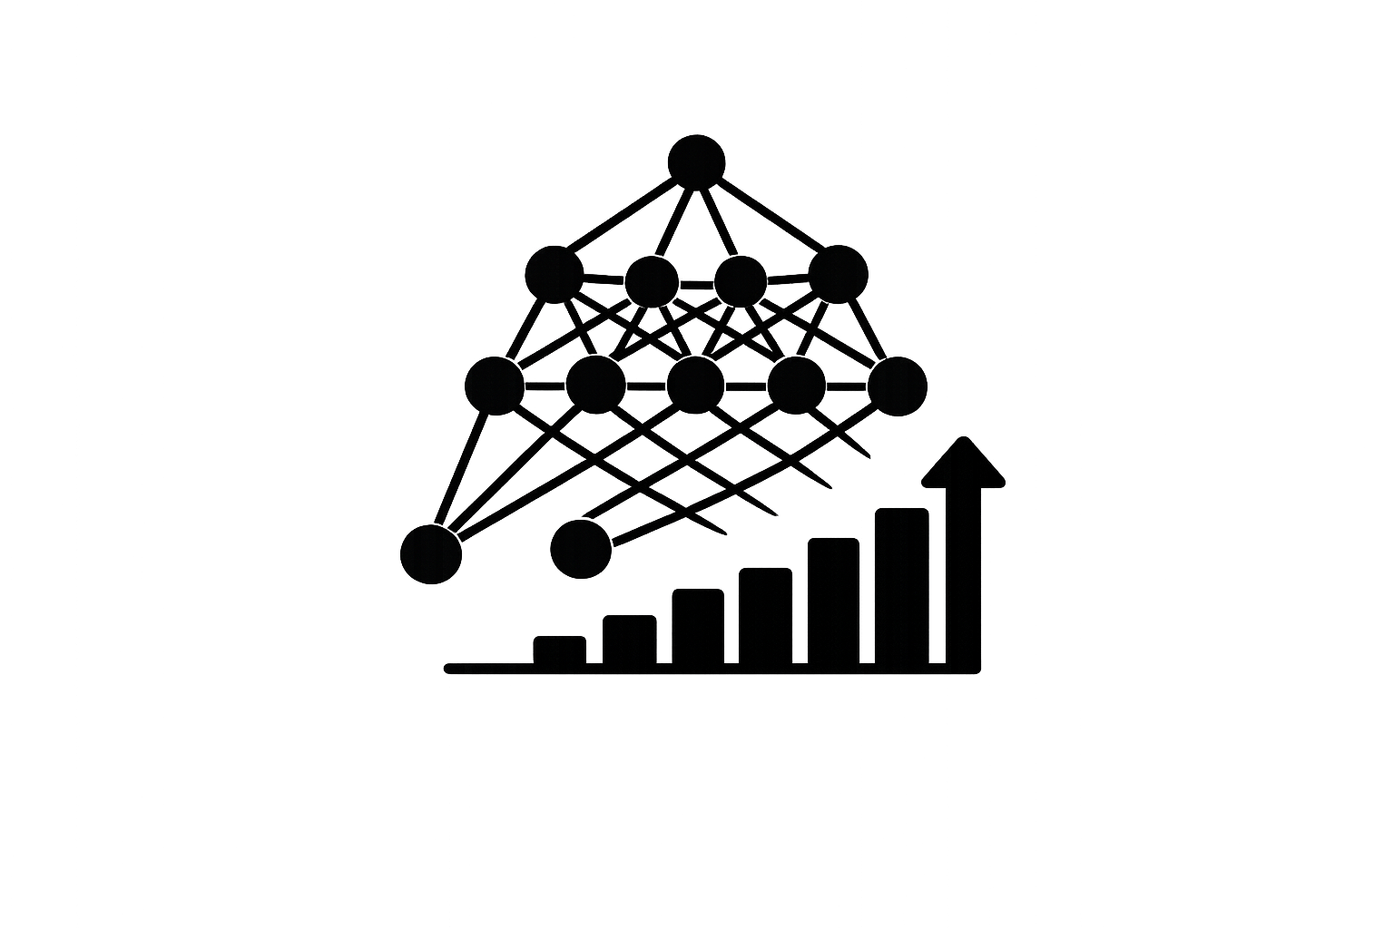
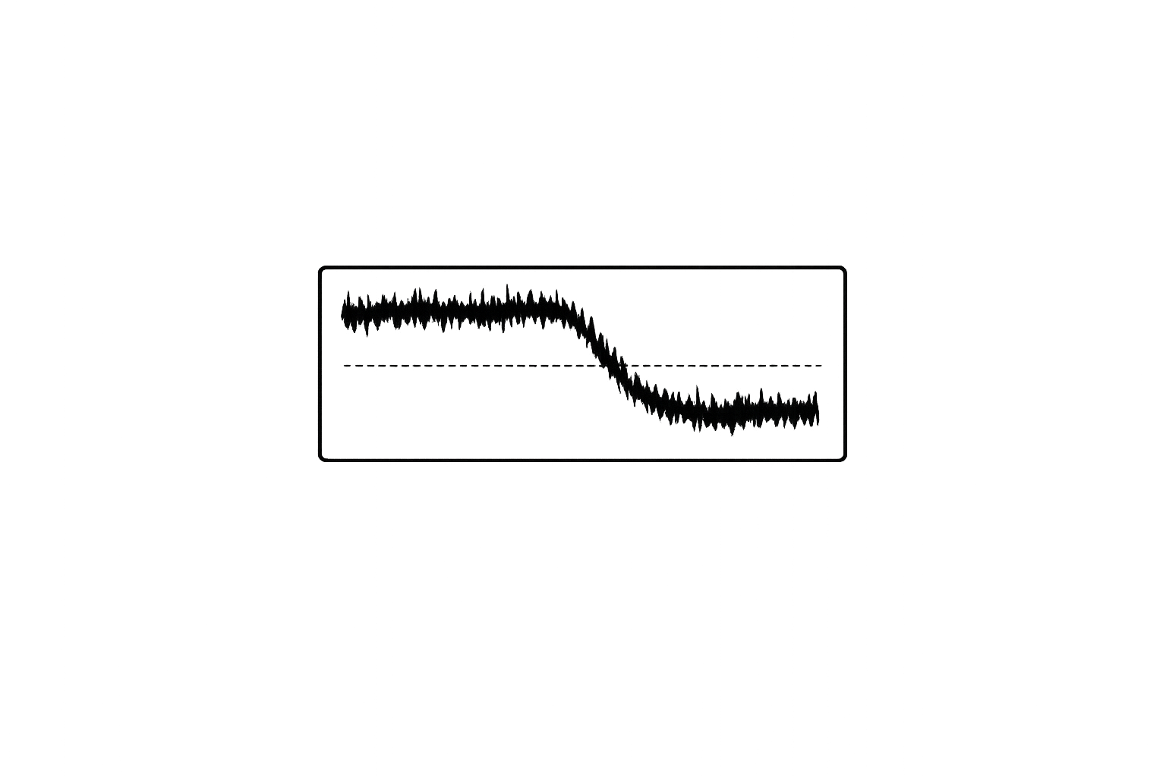





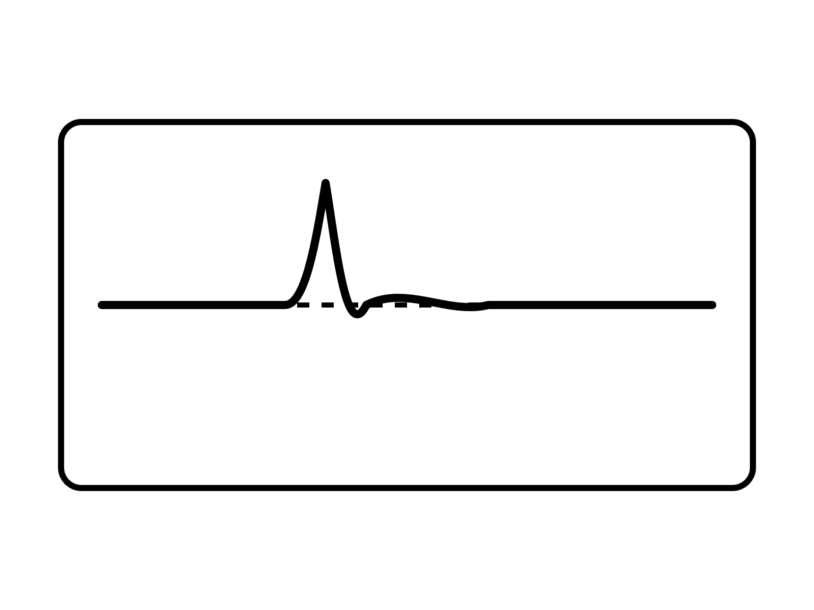
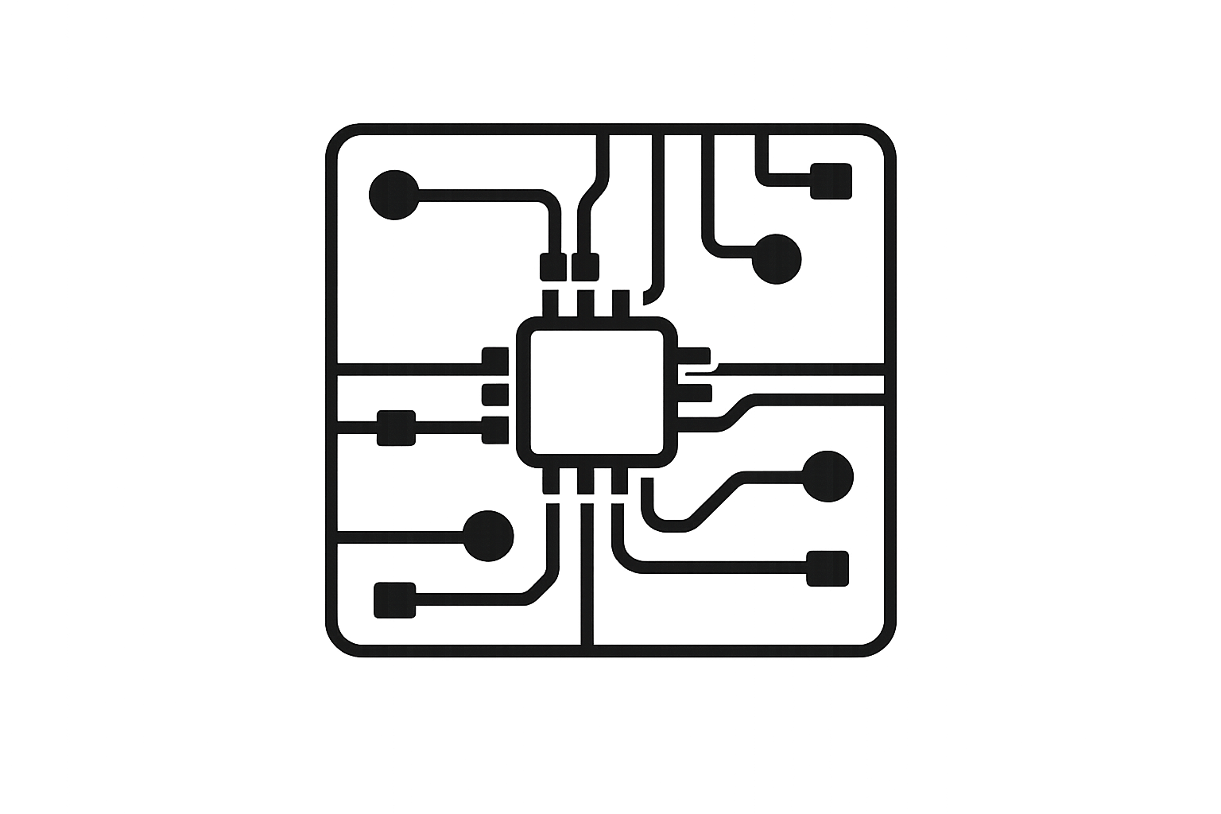



Model
complexity
DEPLOYMENT
Adaptability
Scalability
PERFORMANCE
RAM usage
Robustness
HARDWARE
Flash usage
Convergence behavior
Inference Time
Accuracy
BATTERY MANAGEMENT REQUIREMENTS

Slide 2
Model
complexity
DEPLOYMENT
Adaptability
Scalability
PERFORMANCE
RAM usage
Robustness
HARDWARE
Flash usage
Convergence behavior
Inference Time
Accuracy
BATTERY MANAGEMENT REQUIREMENTS

Slide 3
Model
complexity
DEPLOYMENT
Adaptability
Scalability
PERFORMANCE
RAM usage
Robustness
HARDWARE
Flash usage
Convergence behavior
Inference Time
Accuracy
BATTERY MANAGEMENT REQUIREMENTS

