Slide 1
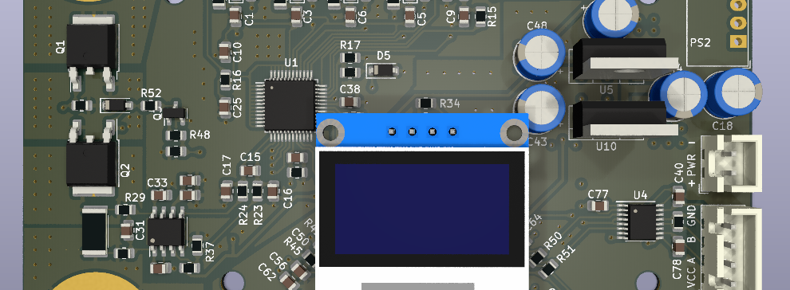

Deployment-Oriented Neural Network State Estimation for Battery Management Systems
Florian Rzepka | Technische Universität Berlin | 2026
Seite 1
Florian Rzepka | Doctoral Defense | 2026

Slide 2
Structure
Motivation and research questions
Evaluation framework and experimental basis
Compact neural ageing estimation
Robustness benchmarking
Embedded AI and model compression
Integrated findings and outlook
Seite 2
Florian Rzepka | Doctoral Defense | 2026

Slide 3
Motivation and Research Questions
Seite 3
Florian Rzepka | Doctoral Defense | 2026

Slide 4
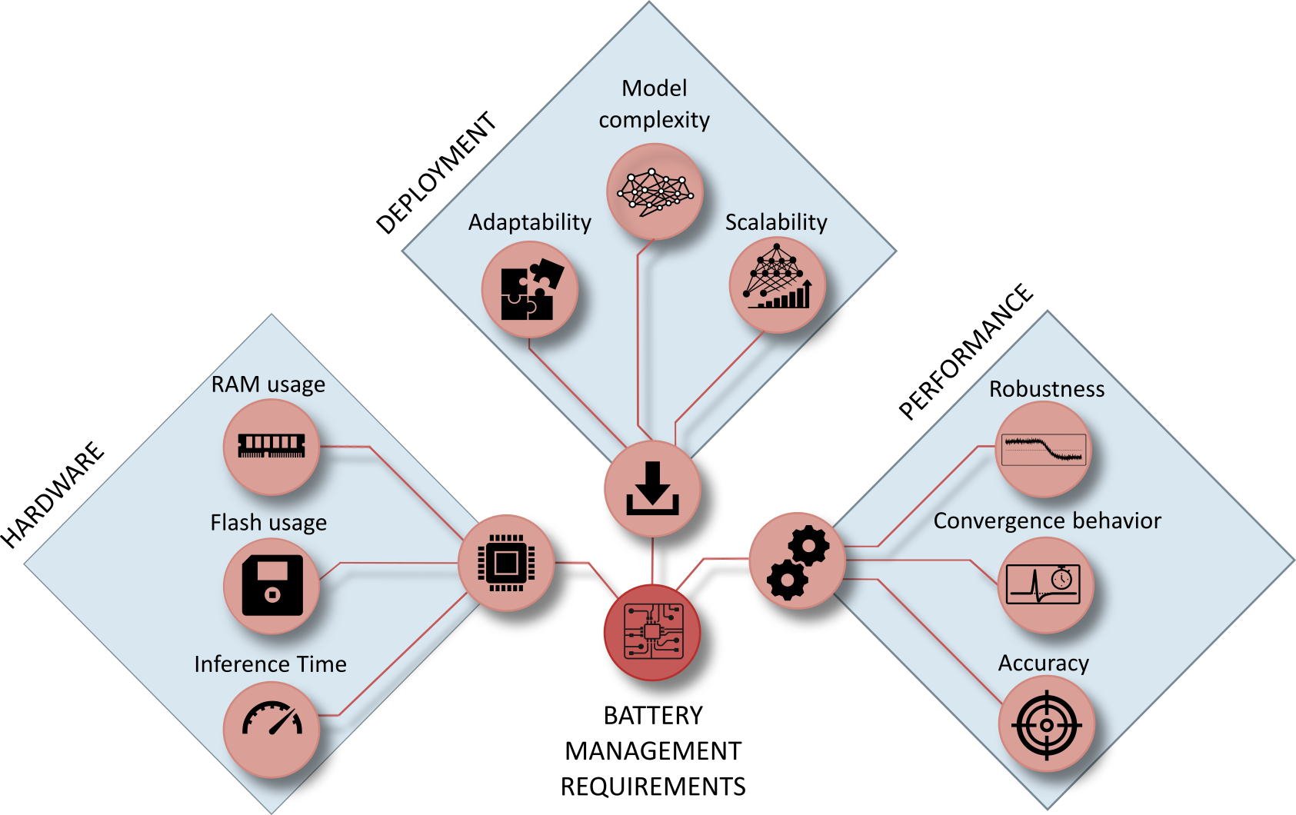
Why Deployment-Oriented State Estimation?
• SOC and SOH as non-measurable internal battery states
• Field signals with bias, noise, missing data, and timing irregularities
• Embedded limits in flash, RAM, latency, and energy
• Accuracy alone as an incomplete deployment criterion
1. Motivation
2. Framework
3. Ageing
4. Robustness
5. Embedded AI
6. Synthesis
One estimator path
Data representation to MCU execution
Seite 4
Florian Rzepka | Doctoral Defense | 2026

Slide 5
Research Questions and Contribution Path
1. Motivation
2. Framework
3. Ageing
4. Robustness
5. Embedded AI
6. Synthesis
1
Representation
2
Robustness
3
Deployment
Ageing-relevant history in compact neural estimators
Matched disturbances across estimator families
Compression, firmware transfer, and MCU measurement
• RQ1: Which input representation captures battery ageing?
• RQ2: Which estimator remains reliable under disturbed measurements?
• RQ3: Which compression route preserves accuracy within embedded limits?
Seite 5
Florian Rzepka | Doctoral Defense | 2026

Slide 6
Evaluation Framework and Experimental Basis
Seite 6
Florian Rzepka | Doctoral Defense | 2026

Slide 7
Three Coupled BMS Requirement Dimensions
Joint evaluation
1. Motivation
2. Framework
3. Ageing
4. Robustness
5. Embedded AI
6. Synthesis
• Performance: accuracy, recovery, disturbance response
• Hardware: flash, RAM, latency, energy
• Deployment: features, export, firmware, repeatability
3 dimensions
No single metric as a substitute
Seite 7
Florian Rzepka | Doctoral Defense | 2026

Slide 8
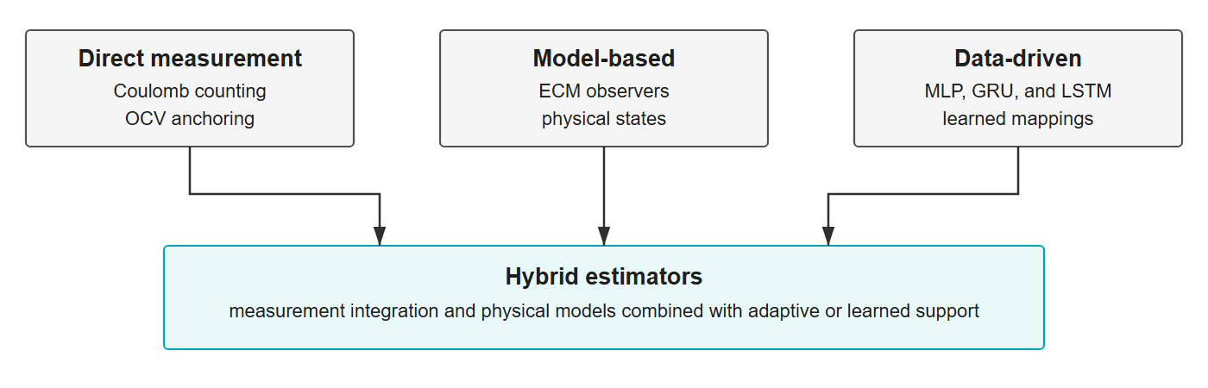
Estimator Families and Evaluation Logic
1. Motivation
2. Framework
3. Ageing
4. Robustness
5. Embedded AI
6. Synthesis
• Direct-measurement: low complexity, accumulated drift
• Model-based and hybrid: physical correction paths
• Data-driven: flexible nonlinear mapping and temporal context
• Matched assessment: baseline, disturbance sensitivity, recovery
Seite 8
Florian Rzepka | Doctoral Defense | 2026

Slide 9
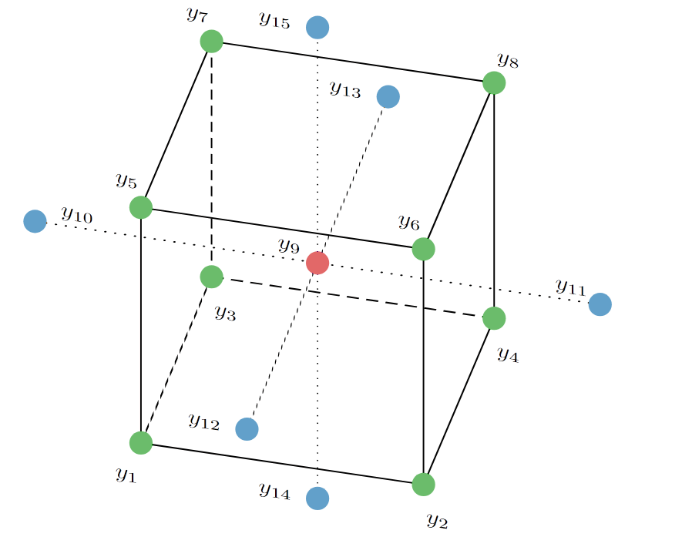
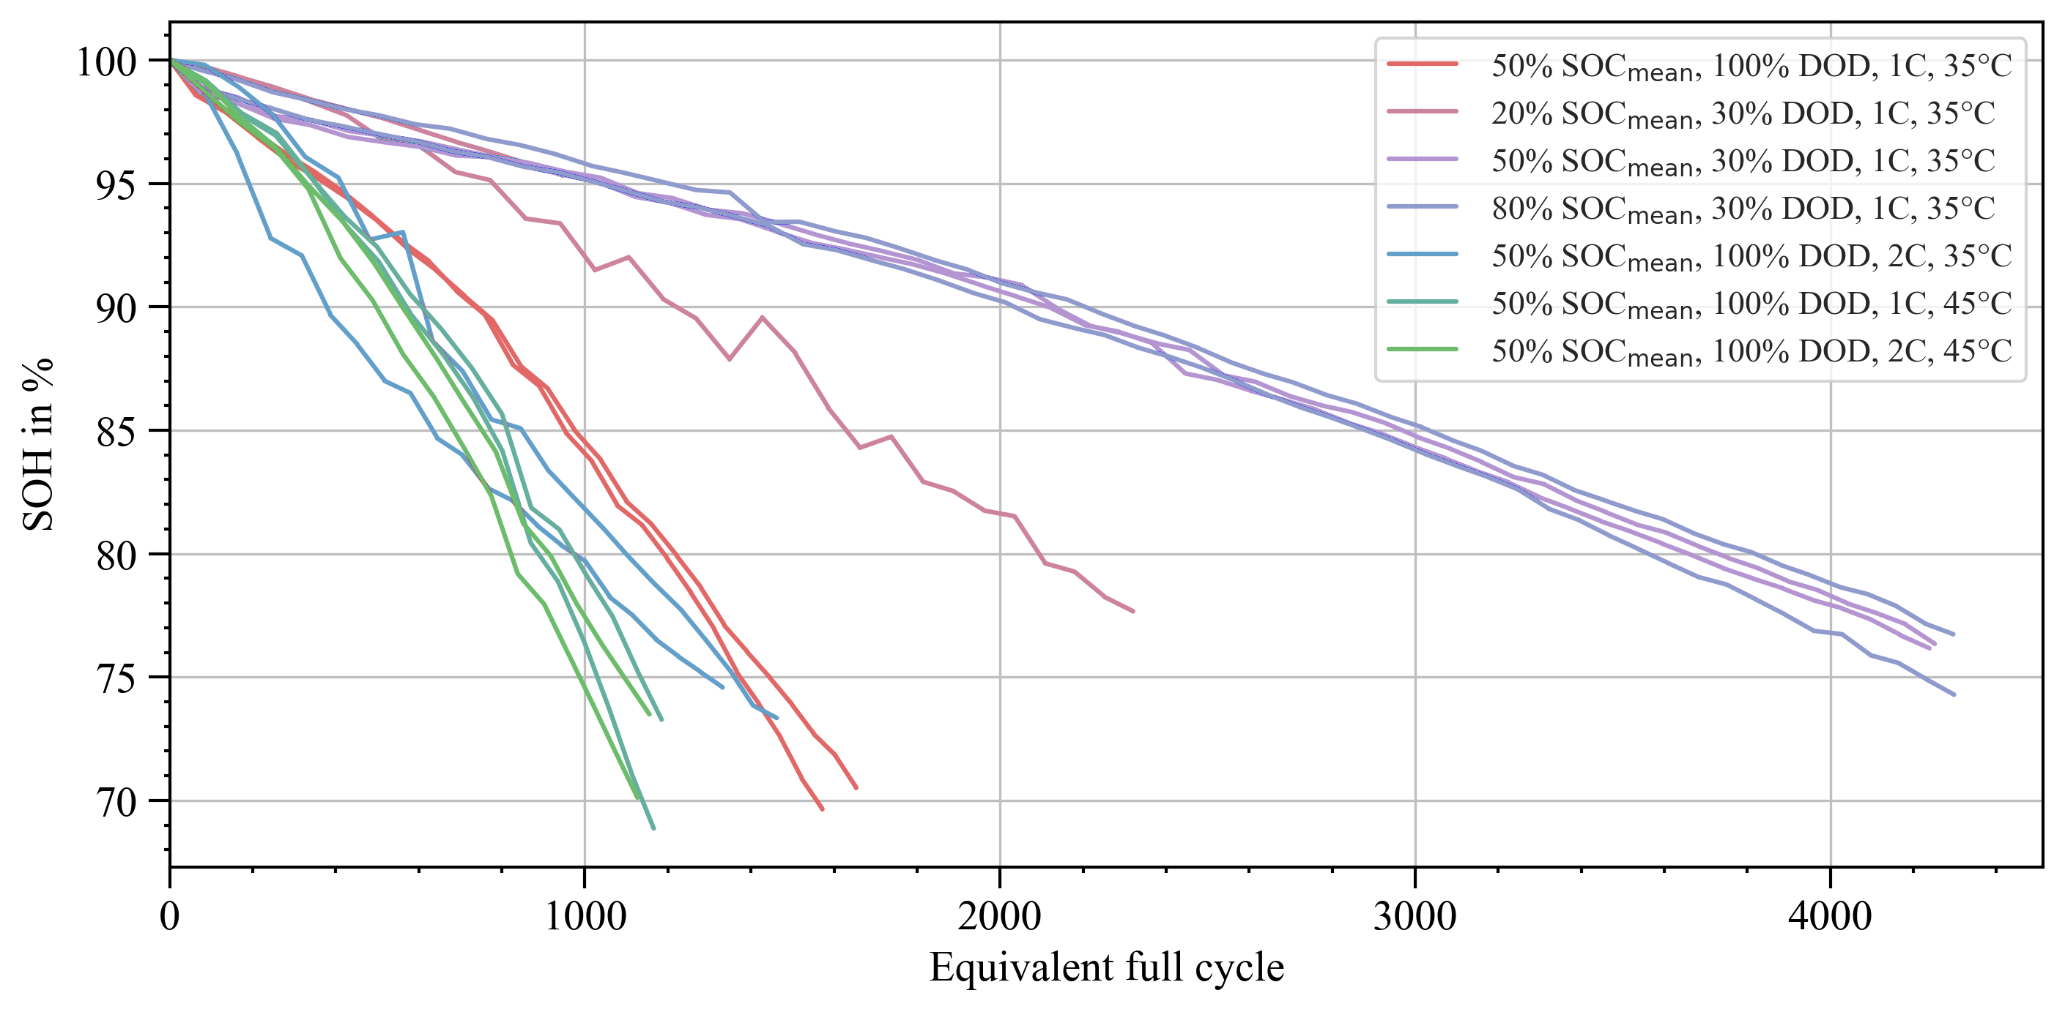
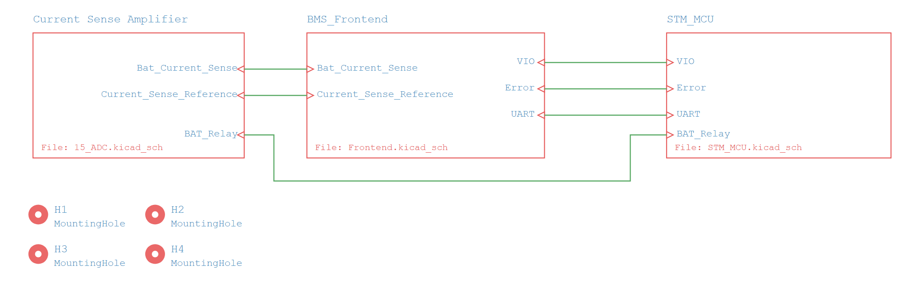
Experimental Basis and Embedded Execution Chain
NMC ageing study
LFP DoE campaign
Embedded chain
1. Motivation
2. Framework
3. Ageing
4. Robustness
5. Embedded AI
6. Synthesis
• Custom 4s BMS platform
• STM32H7 execution
• Common sensing and firmware basis
• 14 cells
• 7 ageing scenarios
• Capacity-based SOH labels
• 15 cells
• 8 operating points
• 1 Hz measurement stream
Seite 9
Florian Rzepka | Doctoral Defense | 2026

Slide 10
Compact Neural Ageing Estimation
Seite 10
Florian Rzepka | Doctoral Defense | 2026

Slide 11
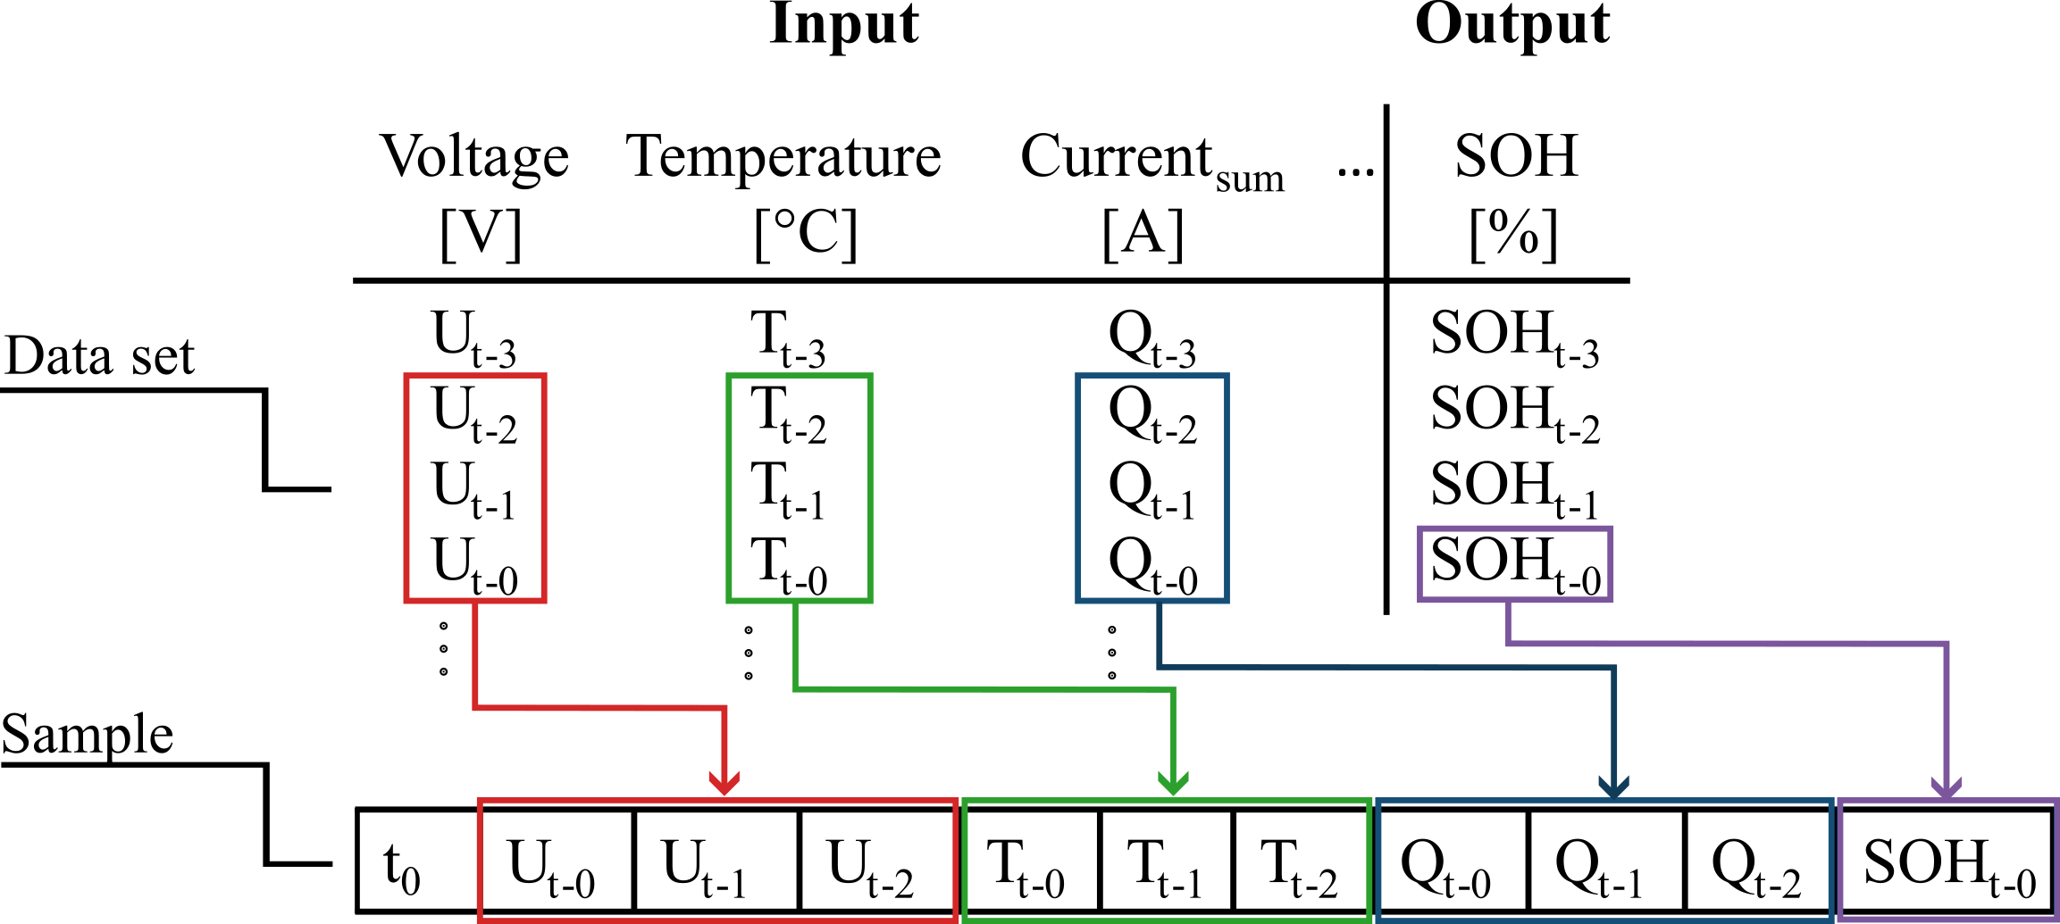
Time-Aware Features for a Feedforward Model
Engineered temporal context
1. Motivation
2. Framework
3. Ageing
4. Robustness
5. Embedded AI
6. Synthesis
• Voltage, current, and temperature measurements
• Cumulative-current throughput features
• 16 lag steps at 10 min resolution
• 160 min effective history
Seite 11
Florian Rzepka | Doctoral Defense | 2026

Slide 12
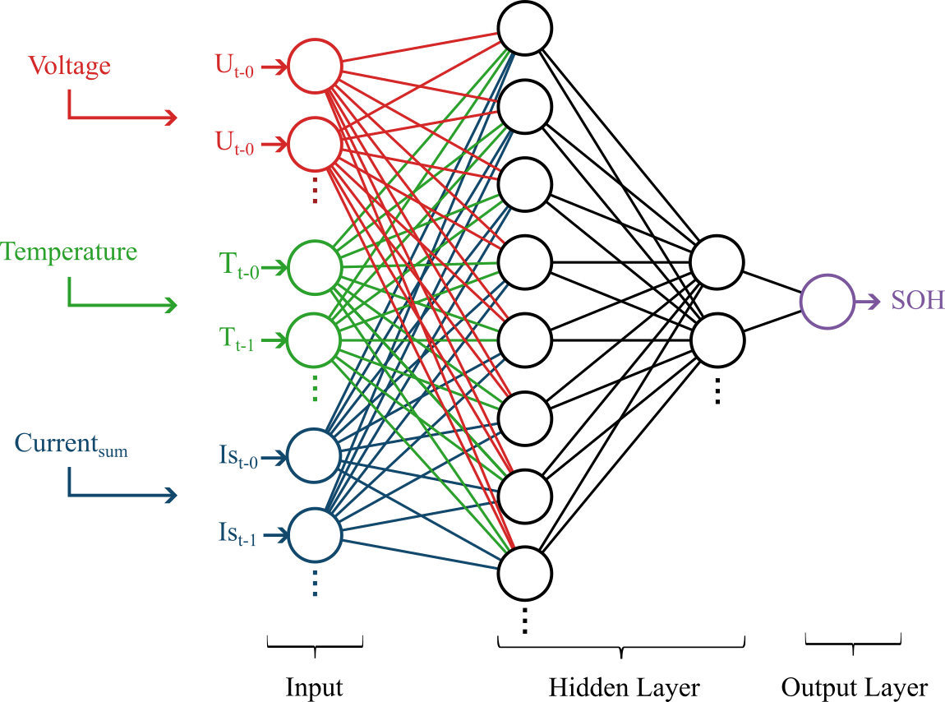
Compact MLP Architecture for SOH Estimation
1. Motivation
2. Framework
3. Ageing
4. Robustness
5. Embedded AI
6. Synthesis
• Compact feedforward architecture
• Time dependence encoded in engineered inputs
• SOH output from operational measurements
• Low architectural complexity
Seite 12
Florian Rzepka | Doctoral Defense | 2026

Slide 13
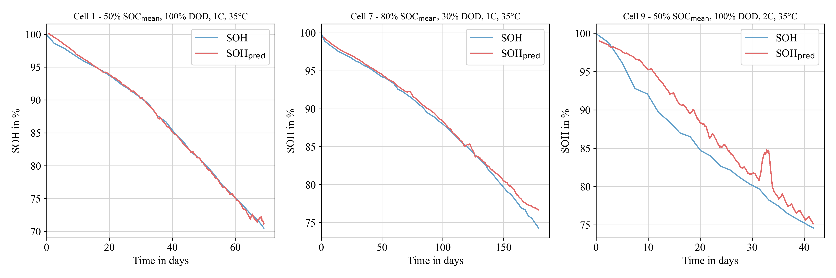
Ageing-Estimation Results
1. Motivation
2. Framework
3. Ageing
4. Robustness
5. Embedded AI
6. Synthesis
1.10 pp
16 x 10 min
Cell 9
Average SOH MAE
Best lag configuration
Reduced transfer to atypical ageing
Seite 13
Florian Rzepka | Doctoral Defense | 2026

Slide 14
Robustness Benchmarking
Seite 14
Florian Rzepka | Doctoral Defense | 2026

Slide 15
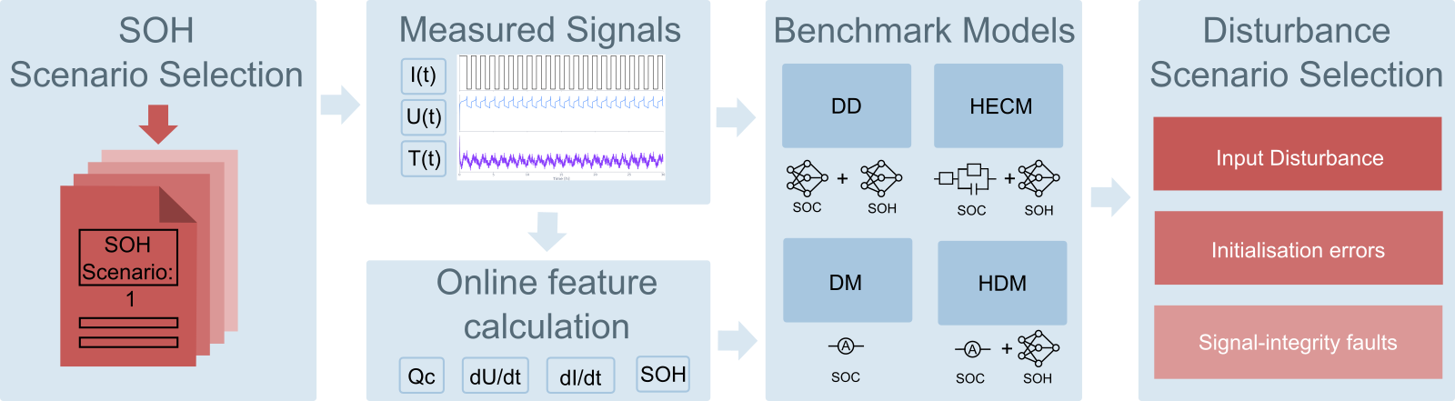
Matched Benchmark Across Four Estimator Classes
1. Motivation
2. Framework
3. Ageing
4. Robustness
5. Embedded AI
6. Synthesis
• DM: direct Coulomb-counting path
• HDM: direct path with shared SOH context
• HECM: equivalent-circuit observer with SOH context
• DD: recurrent data-driven SOC estimator
• Identical online stream and matched disturbance protocols
Seite 15
Florian Rzepka | Doctoral Defense | 2026

Slide 16
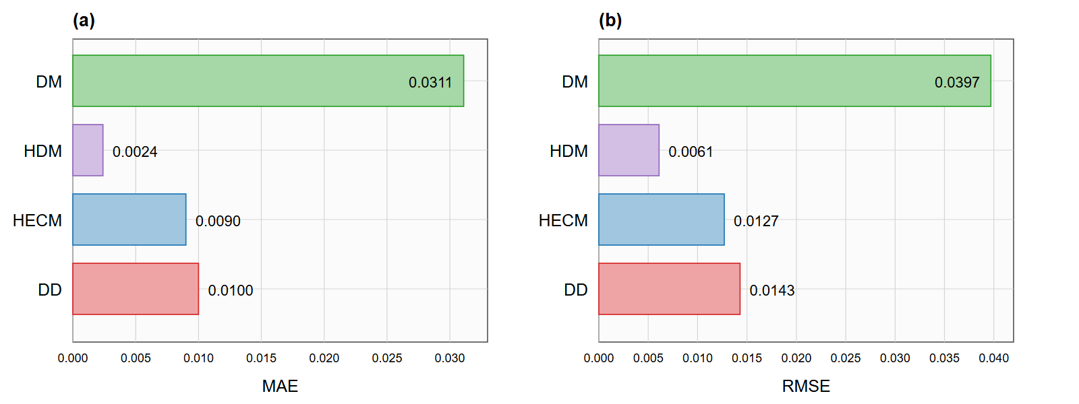
Clean Accuracy Is Only the Starting Point
1. Motivation
2. Framework
3. Ageing
4. Robustness
5. Embedded AI
6. Synthesis
0.24 pp
0.90 pp
1.00 pp
3.11 pp
HDM baseline MAE
HECM baseline MAE
DD baseline MAE
DM baseline MAE
Seite 16
Florian Rzepka | Doctoral Defense | 2026

Slide 17
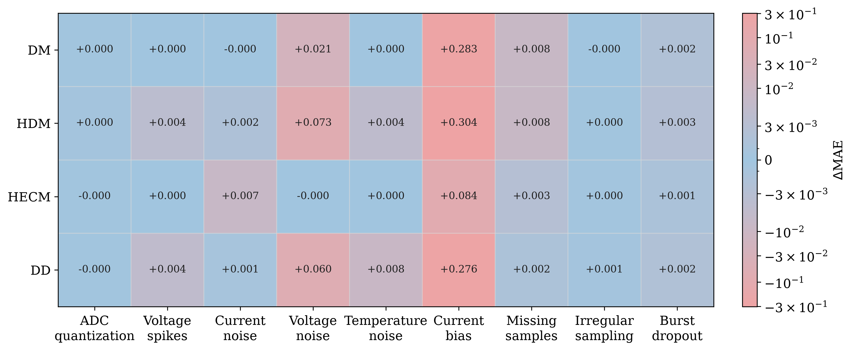
Disturbances Change the Estimator Ranking
1. Motivation
2. Framework
3. Ageing
4. Robustness
5. Embedded AI
6. Synthesis
• Current bias: HECM strongest
• Missing samples: DD strongest
• Initialization mismatch: DD fastest strict recovery
• Noise and spikes: estimator-specific propagation paths
Ranking shift
Fault type as decisive context
Seite 17
Florian Rzepka | Doctoral Defense | 2026

Slide 18
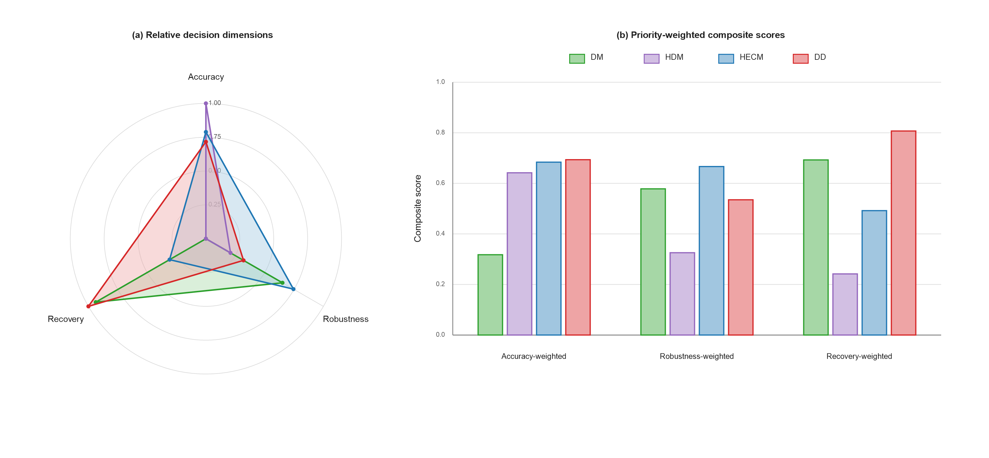
Robustness Result: No Universal Winner
1. Motivation
2. Framework
3. Ageing
4. Robustness
5. Embedded AI
6. Synthesis
Selection target: acceptable accuracy, recovery, and disturbance response for the intended operating profile
Seite 18
Florian Rzepka | Doctoral Defense | 2026

Slide 19
Embedded AI and Model Compression
Seite 19
Florian Rzepka | Doctoral Defense | 2026

Slide 20
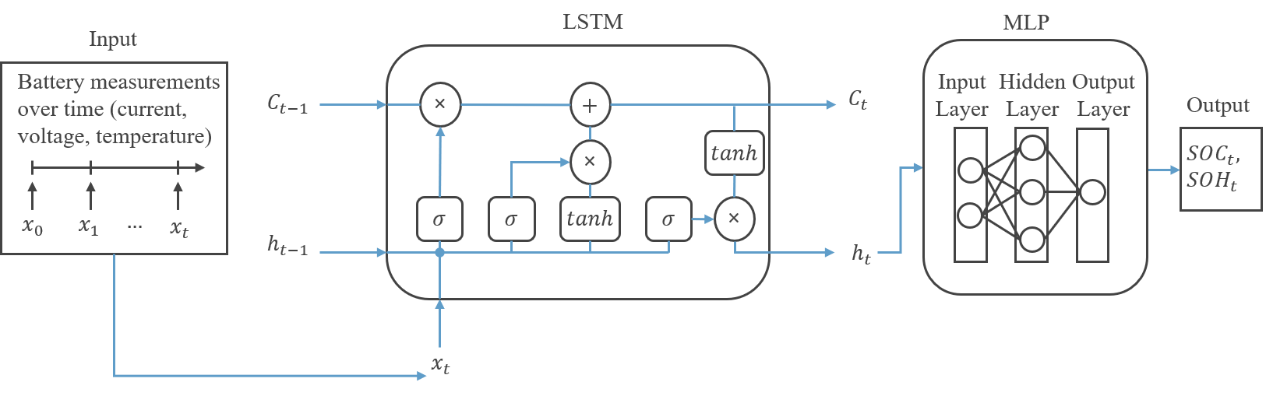
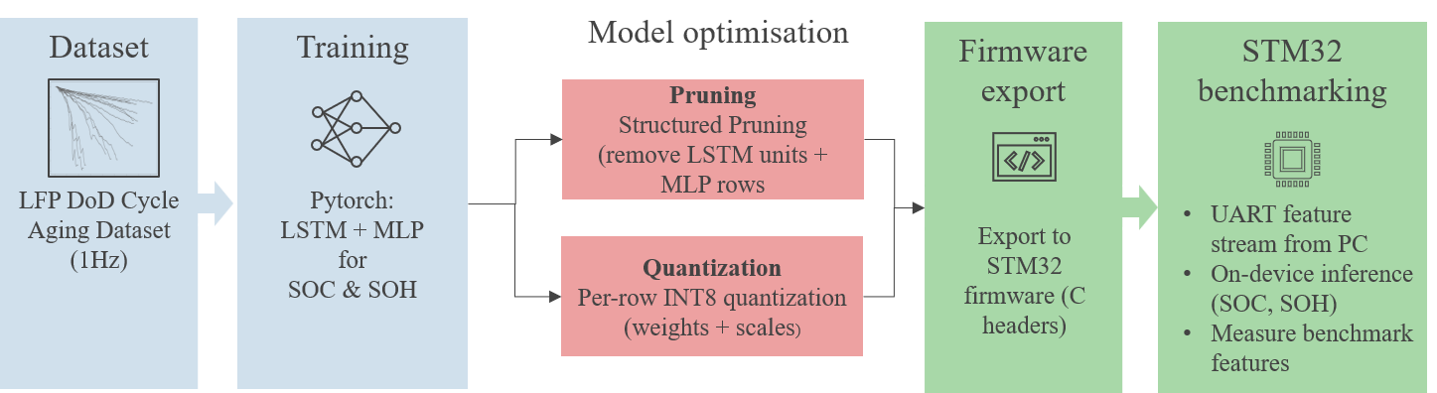
Stateful Estimation from Training to STM32
1. Motivation
2. Framework
3. Ageing
4. Robustness
5. Embedded AI
6. Synthesis
Stateful 1 Hz replay | Explicit recurrent states | PyTorch-to-C export | STM32 measurements
Seite 20
Florian Rzepka | Doctoral Defense | 2026

Slide 21
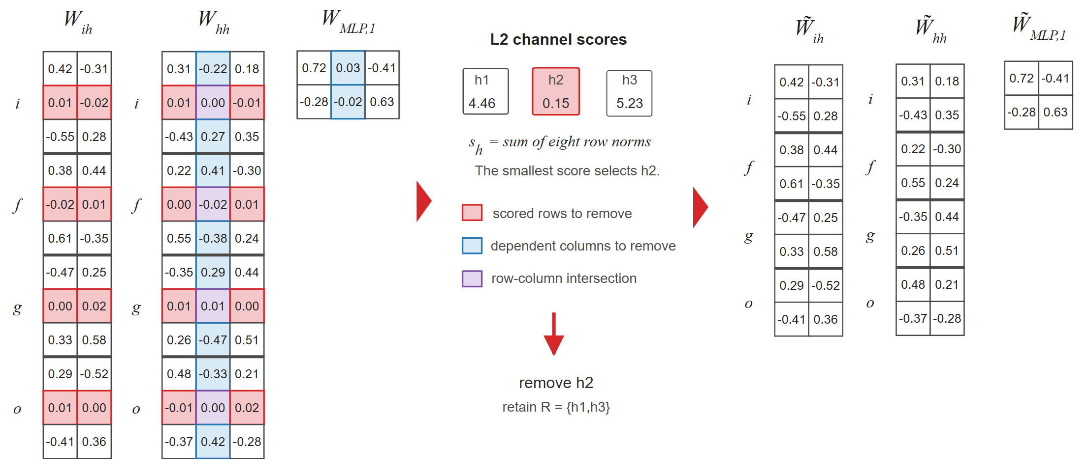
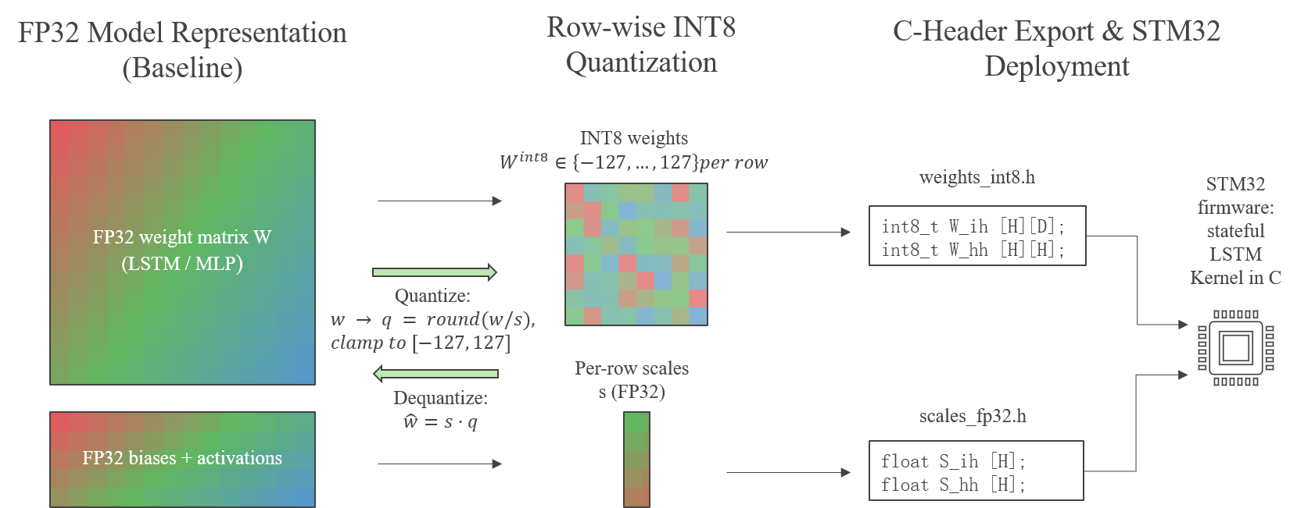
Two Compression Routes
Structured pruning
INT8 weight quantization
1. Motivation
2. Framework
3. Ageing
4. Robustness
5. Embedded AI
6. Synthesis
• 30% hidden-channel reduction
• Smaller dense tensors
• Post-pruning fine-tuning
• Row-wise signed symmetric mapping
• Recurrent weights in INT8
• Scales, states, and MLP in FP32
Seite 21
Florian Rzepka | Doctoral Defense | 2026

Slide 22
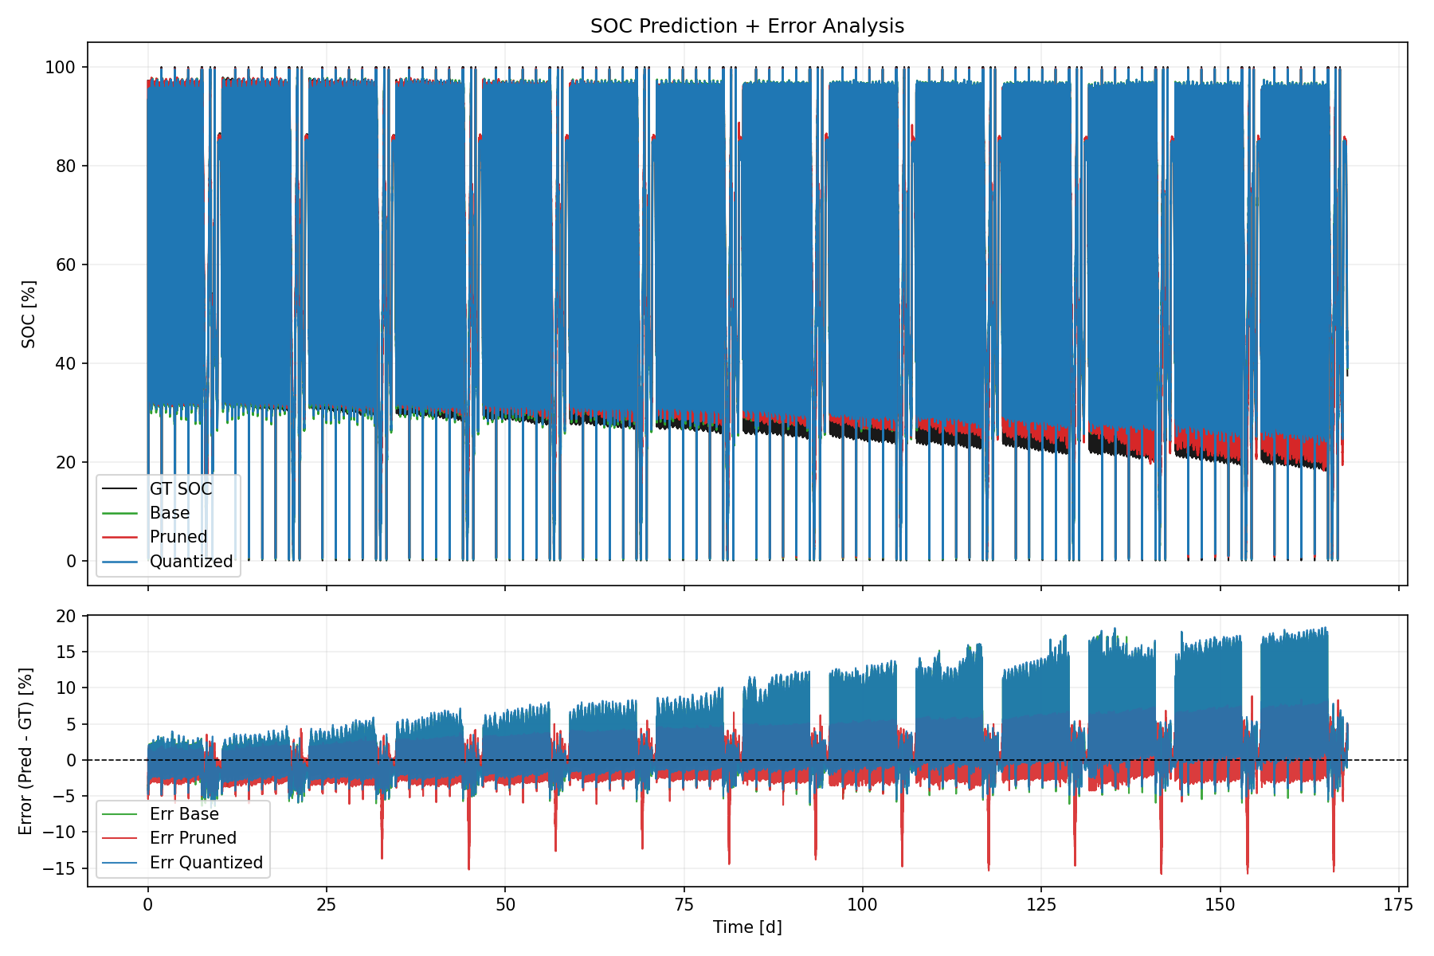
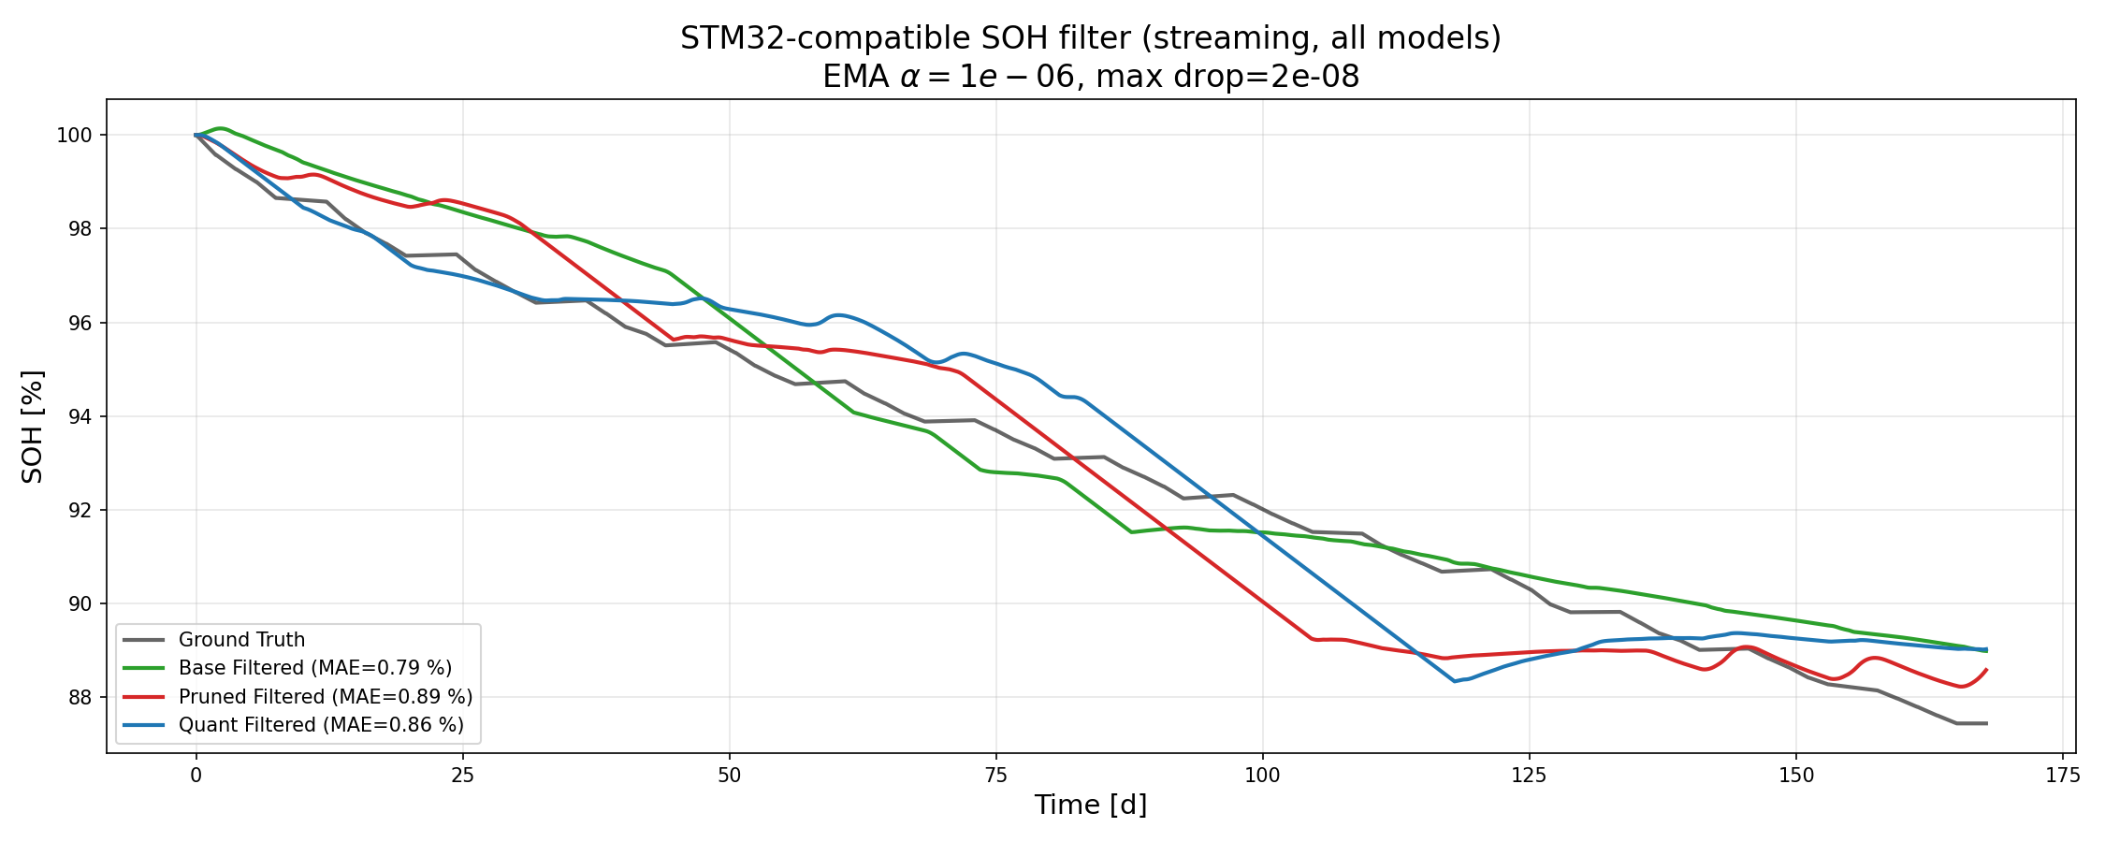
Accuracy and Long-Horizon Stability
SOC streaming replay
SOH streaming replay
1. Motivation
2. Framework
3. Ageing
4. Robustness
5. Embedded AI
6. Synthesis
• SOC MAE: 2.68 / 2.34 / 2.79 pp
• SOH MAE: 0.85 / 1.46 / 1.41 pp
• Order: Base / Pruned / Quantized
• No increasing Quantized-to-Base divergence
Seite 22
Florian Rzepka | Doctoral Defense | 2026

Slide 23
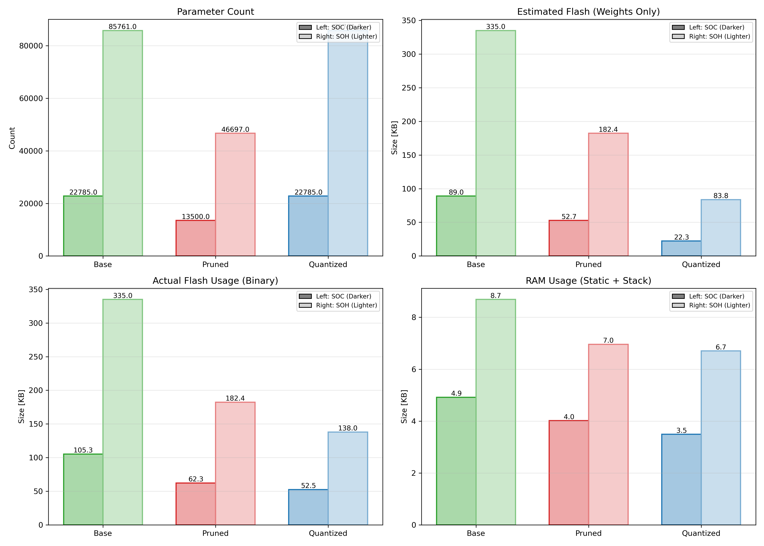
Resource, Latency, and Utility Trade-Offs
SOC operating points
1. Motivation
2. Framework
3. Ageing
4. Robustness
5. Embedded AI
6. Synthesis
• Pruned: -41% flash, -43% kernel time
• Quantized: -50% flash, +399% kernel time
• Utility: 0.71 Pruned / 1.83 Quantized
SOH operating points
• Pruned: -46% flash, -44% kernel time
• Quantized: -59% flash, +29% kernel time
• Constraint-dependent optimum
Seite 23
Florian Rzepka | Doctoral Defense | 2026

Slide 24
Integrated Findings and Outlook
Seite 24
Florian Rzepka | Doctoral Defense | 2026

Slide 25
Integrated Findings Across the Three Studies
1. Motivation
2. Framework
3. Ageing
4. Robustness
5. Embedded AI
6. Synthesis
1
Representation
2
Validation
3
Implementation
Cumulative-current and lag features enable compact ageing estimation
Nominal accuracy, recovery, and disturbances require separate evidence
Compression choice depends on the active hardware constraint
• Model class alone does not determine deployment suitability
• Feature pipeline, estimator, compression, firmware, and hardware as one design system
• Transferable evaluation logic instead of one universal estimator ranking
Seite 25
Florian Rzepka | Doctoral Defense | 2026

Slide 26
Design Rules, Limitations, and Outlook
Design rules
Next steps
1. Motivation
2. Framework
3. Ageing
4. Robustness
5. Embedded AI
6. Synthesis
• Representative features before model complexity
• Disturbance testing beyond clean MAE
• Compression matched to flash, RAM, or latency bottleneck
• Target-hardware validation before deployment
• Additional cells, chemistries, and operating profiles
• Live disturbance injection in firmware and sensing chain
• Joint pruning and quantization
• Larger packs and longer autonomous operation
Main conclusion
Deployment readiness as a system property
Seite 26
Florian Rzepka | Doctoral Defense | 2026

Slide 27
Thank You | Questions
Seite 27
Florian Rzepka | Doctoral Defense | 2026

