Slide 1
CSS Animation & Angular Animation

Slide 2
Agenda
CSS Animation - Transforms CSS Animation - Transitions CSS Animation - Keyframes CSS Animation - Animation Angular4 Animation
Copyright © 2017 Accenture All rights reserved.
1

Slide 3
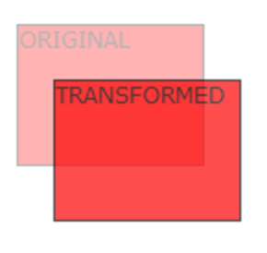


Transforms
Translate The translate() method moves an element from its current position (according to the parameters given for the X-axis and the Y-axis). Scale The scale() method increases or decreases the size of an element Rotate The rotate() method rotates an element clockwise or counter-clockwise according to a given degree.
Copyright © 2017 Accenture All rights reserved.
2
Notes:
Focus
Distributed Agile
Notes to Faculty:
Discuss why distributed agile is required and what ADM for DA offers
Agile University Delivery School
D01-M02-P01_ADM for Distributed Agile Overview
Copyright © 2012 Accenture All Rights Reserved.
2

Slide 4
Transitions
Syntax: transition: property duration timing-function delay; transition-property transition-duration transition-timing-function Linear | ease | ease-in | ease-out | ease-in-out | cubic-bezier(n,n,n,n); transition-delay Example: transition: background 1s linear 2s;
Copyright © 2017 Accenture All rights reserved.
3
Notes:
Focus
Distributed Agile
Notes to Faculty:
Discuss why distributed agile is required and what ADM for DA offers
Agile University Delivery School
D01-M02-P01_ADM for Distributed Agile Overview
Copyright © 2012 Accenture All Rights Reserved.
3

Slide 5
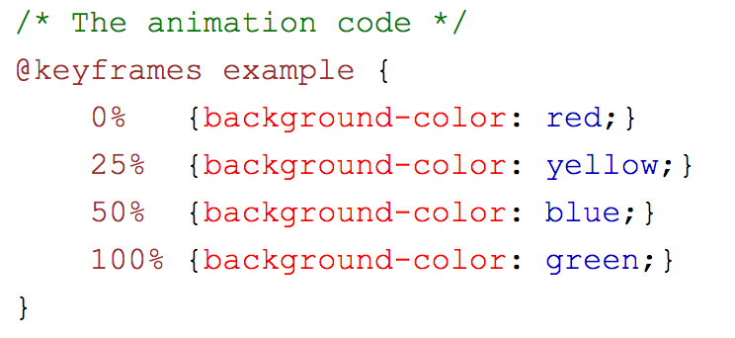
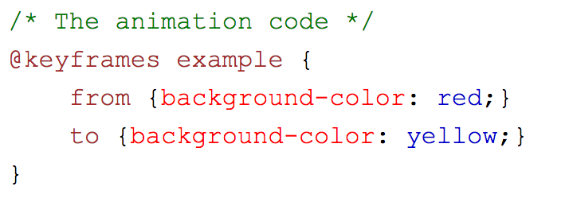
Keyframes
Syntax: @keyframes animationname {keyframes-selector {css-styles;}} animationname keyframes-selector 0% - 100% From(0%) - to(100%) css-styles Example:
Copyright © 2017 Accenture All rights reserved.
4

Slide 6
Animation
Syntax: animation: name duration timing-function delay iteration-count direction fill-mode play-state; animation-name animation-duration animation-timing-function animation-delay animation-iteration-count animation-direction animation-fill-mode animation-play-state
Copyright © 2017 Accenture All rights reserved.
5

Slide 7
Angular4 Animation
npm install @angular/animation@latest --save import { BrowserAnimationsModule } from '@angular/platform-browser/animations'; improts: […, BrowserAnimationsModule ] import { trigger, style, transition, animate, keyframes, query, stagger } from '@angular/animations’;
Copyright © 2017 Accenture All rights reserved.
6

Slide 8
Questions & Answers
Q & A
Copyright © 2014 Accenture All rights reserved.
7
Notes:
Agile University Delivery School
D01-M02-P01_ADM for Distributed Agile Overview
Copyright © 2012 Accenture All Rights Reserved.
7

