Slide 1
CSS Animation

Slide 2
Agenda
动画介绍 Transforms Transitions Keyframes Animation basics Angular4 Animation
Copyright © 2017 Accenture All rights reserved.
1

Slide 3
什么是Reactive Programming
http://caniuse.com/#search=css-animation
Works with asynchronous data streams Data streams can be created from many thing
UI Events Http Requests Array-like objects
Copyright © 2017 Accenture All rights reserved.
2

Slide 4
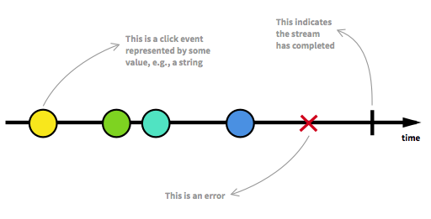
流
A sequence Get value、 error and complete signal
Copyright © 2017 Accenture All rights reserved.
3

Slide 5
Angular4 Animation
Required You probably need to install the new animations package: npm install --save @angular/animations Add the BrowserAnimationsModule to your imports[] array in AppModule import { BrowserAnimationsModule } from '@angular/platform-browser/animations' You then import trigger , state , style etc from @angular/animations instead of @angular/core
Copyright © 2017 Accenture All rights reserved.
4

Slide 6
Observables & Stream & Observer
Observable
Various Data Sources
UI Events Http Request, Array-like objects..
Handle Data
Handle Error
Handle Completion
Observer
Copyright © 2017 Accenture All rights reserved.
5
Notes:
Focus
Distributed Agile
Notes to Faculty:
Discuss why distributed agile is required and what ADM for DA offers
Agile University Delivery School
D01-M02-P01_ADM for Distributed Agile Overview
Copyright © 2012 Accenture All Rights Reserved.
5

Slide 7
Rx 实现
Java: RxJava JavaScript: RxJS C++: RxCpp Python: RxPY Swift: RxSwift Kotlin: RxKotlin … http://reactivex.io/languages.html
Copyright © 2017 Accenture All rights reserved.
6

Slide 8
Observables常用方法
Data streams from UI events Creating observables from array-like objects Creating observables from scratch Promise & Creating observables Promise Many operators (timer, range, interval, map, pluck, merge, MergeMap, SwitchMap)
http://reactivex.io/rxjs/class/es6/Observable.js~Observable.html
Copyright © 2017 Accenture All rights reserved.
7

Slide 9
环境搭建
Three ways
Reference CDN (https://cdnjs.cloudflare.com/ajax/libs/rxjs/5.4.2/Rx.js) Download RxJS Library Webpack & Babel (https://babeljs.io/) ES6 (http://es6.ruanyifeng.com/)
Copyright © 2017 Accenture All rights reserved.
8

Slide 10
Angular Observables
Copyright © 2017 Accenture All rights reserved.
9

Slide 11
作业与练习
内容 | 说明 | 完成条件
Create Directive | Create a Structural/Attribute Directive and call it.

Slide 12
Questions & Answers
Q & A
Copyright © 2014 Accenture All rights reserved.
11
Notes:
Agile University Delivery School
D01-M02-P01_ADM for Distributed Agile Overview
Copyright © 2012 Accenture All Rights Reserved.
11

