Slide 1
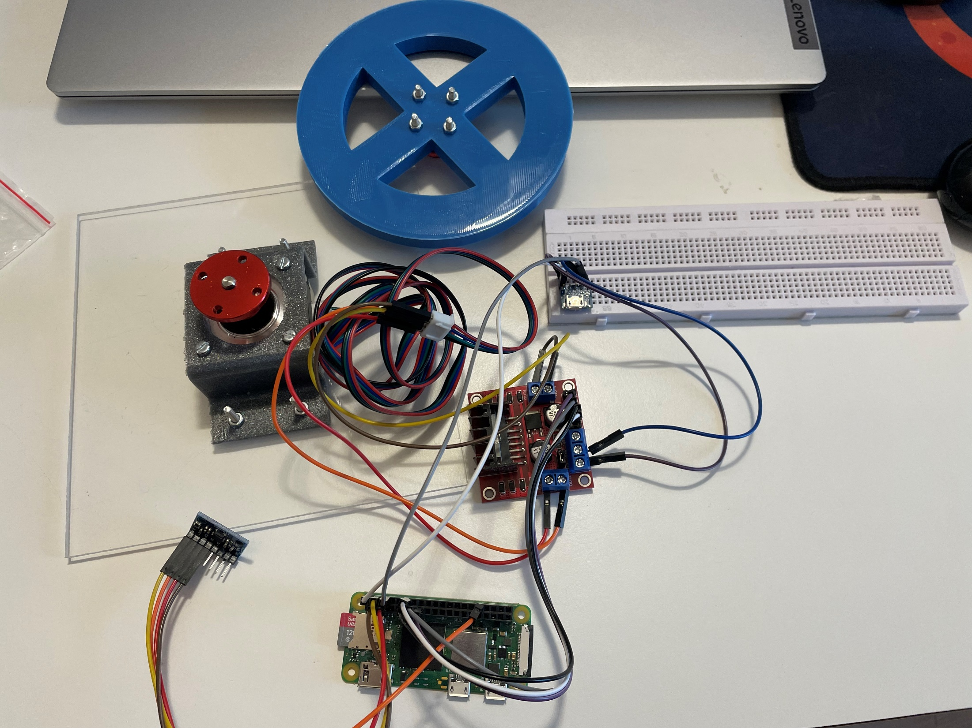
Momentum wheel
Stepper Motor
USB power
Motor control unit
Gyroscope
Raspberry Pi

Slide 2
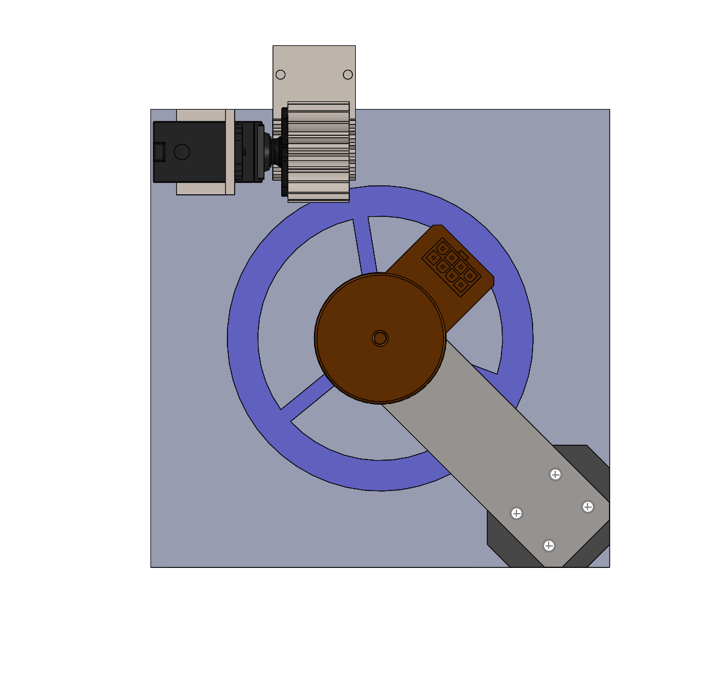
Braking system
Momentum wheel
Motor
Supports

Slide 3
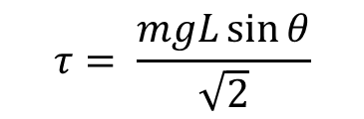



$$θ$$
Centre of mass
$$L$$
$$F=mg$$
$$τ= \frac{mgL\sin{θ}}{\sqrt{2}}$$

Slide 4
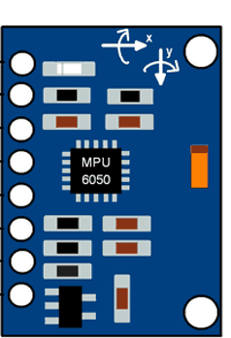
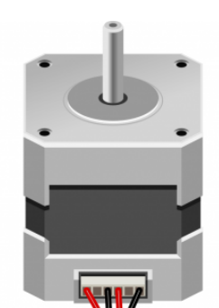
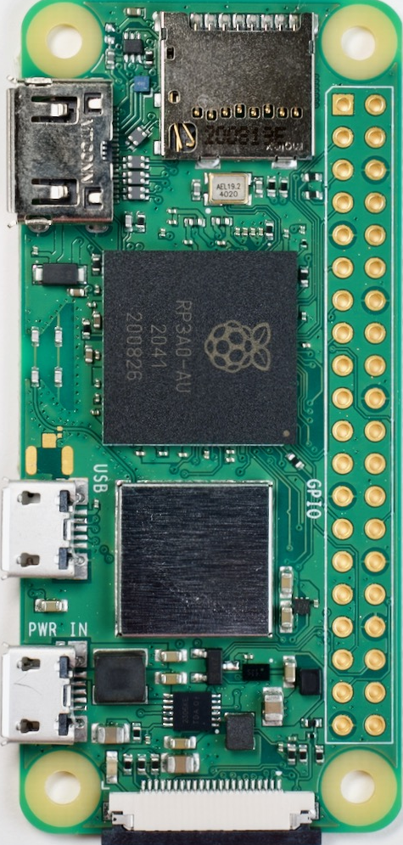
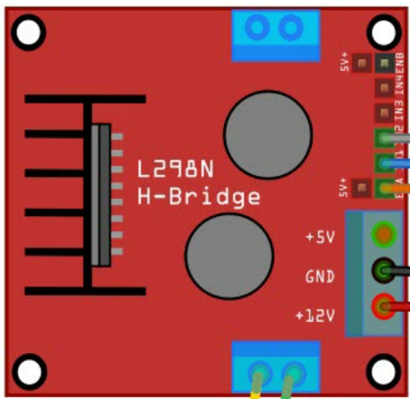
5V USB

