Slide 1
Deep Learning and Convolution Neural Networks

Slide 2
Deep Learning
Notes:
https://adamharley.com/nn_vis/

Slide 3
Artificial Neural Networks (ANNs)
Introduction to ANNs:
Computational models inspired by the human brain.
Consist of interconnected nodes for data processing and predictions.
Used in machine learning and deep learning.
Historical Background:
Perceptrons (1950s): Early neural network model for binary classification.

Slide 4
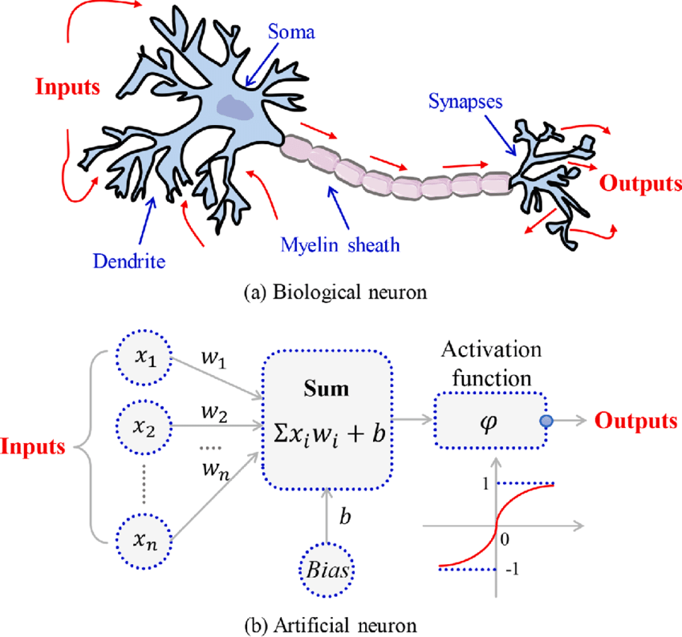
Comparison with Biological Neurons
ANNs are simplified models inspired by biological neurons.
Biological neurons are more complex, communicate differently, and adapt through synaptic plasticity.
ANNs use mathematical algorithms and structured connections, lacking the parallelism and complexity of biological brains.

Slide 5
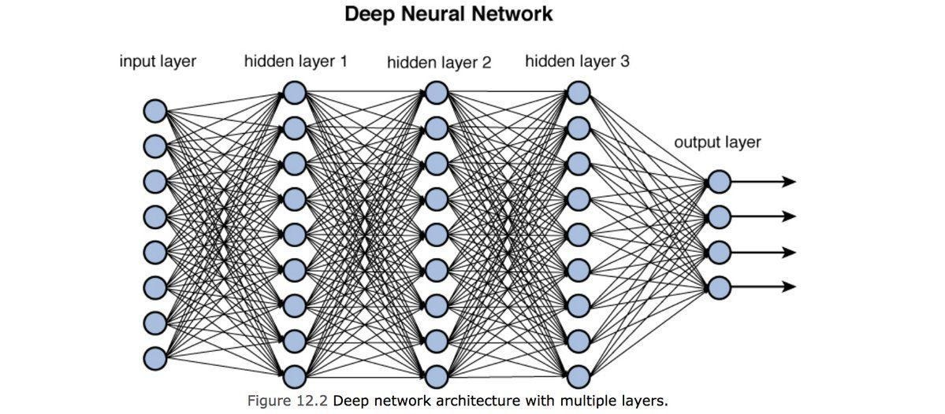
Basics of Deep Neural Nets

Slide 6
Basics of Deep Neural Nets
Neurons
What They Are: Neurons are the basic units of a neural network, similar to nerve cells in the human brain.
How They Work: Each neuron receives input, processes it, and passes it to the next layer of neurons.
They have weights and biases that adjust the importance of the inputs.

Slide 7
Basics of Deep Neural Nets
Layers
Neural networks are organized into layers, and each layer has a specific role.
Input Layer:
What It Does: This is where the network receives its initial data. For example, if the network is processing images, the input layer will receive pixel values.
Structure: Each neuron in this layer represents one feature of the input data.
Hidden Layers:
What They Do: These layers perform the actual processing and transformation of the data. They are called "hidden" because we don't see their outputs directly; they help process and refine the data.
Structure: Each hidden layer can have many neurons, and each neuron is connected to neurons in the previous and next layers.
Output Layer:
What It Does: This layer produces the final output of the network. For example, in a classification task, the output layer might produce probabilities for different classes.
Structure: The number of neurons in this layer corresponds to the number of classes or predictions we want.

Slide 8
Basics of Deep Neural Nets
Weights and Biases
Weights:
What They Are: Weights are parameters that determine the strength of connections between neurons. They adjust during training to minimize errors in predictions.
How They Work: Each connection between neurons has an associated weight that influences how much the input affects the output.
Biases:
What They Are: Biases are additional parameters added to the input of neurons. They help the model make better predictions by shifting the activation function.
How They Work: Each neuron has a bias that adjusts the output independently of the input values.

Slide 9
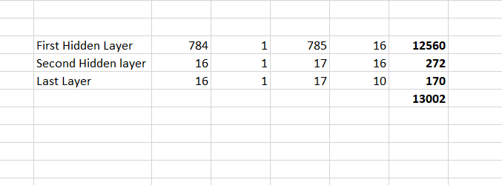
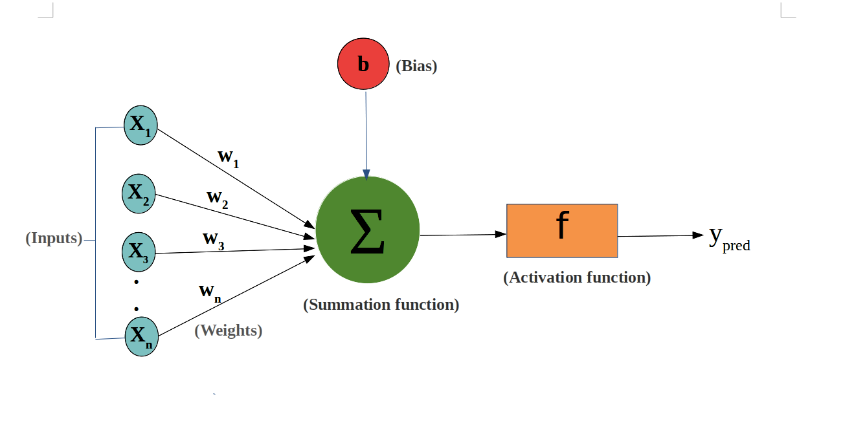
Basics of Deep Neural Nets

Slide 10
Basics of Deep Neural Nets
Activation Functions
What They Are: They introduce non-linearity into the model, allowing it to learn complex patterns.
Common Types:
ReLU (Rectified Linear Unit): Outputs the input directly if it's positive; otherwise, it outputs zero. It’s simple and effective for many tasks.
Sigmoid: Outputs a value between 0 and 1, making it useful for binary classification.
Tanh (Hyperbolic Tangent): Outputs values between -1 and 1, which can be better than sigmoid for some tasks.

Slide 11
Basics of Deep Neural Nets
Why activation functions?
Without activation functions, a neural network would only be able to learn linear relationships, which limits its capability to solve problems like image recognition or language translation.
For example, consider trying to classify images of cats and dogs. If the network only used linear functions, it could only draw straight lines to separate the two classes, which wouldn’t work well if the images are very different.
Activation functions like ReLU or sigmoid allow the network to create curved decision boundaries, making it possible to correctly classify even complex images where the boundaries between classes are not straight lines.

Slide 12
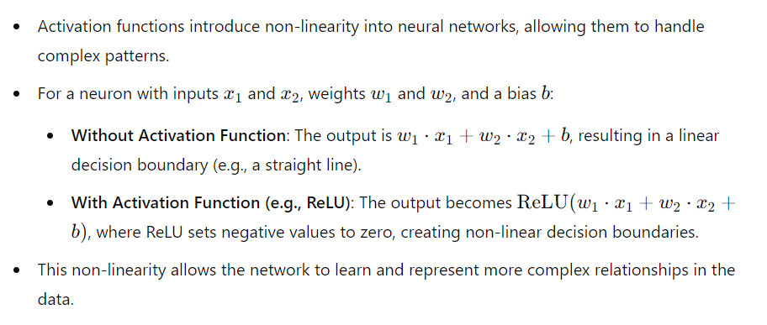
Basics of Deep Neural Nets
Why activation functions?

Slide 13
Basics of Deep Neural Nets
activation functions?
Sigmoid:
Purpose: Used for binary classification.
Output: Between 0 and 1.
Drawback: Suffers from vanishing gradients.
ReLU (Rectified Linear Unit):
Purpose: Most common, learns complex patterns.
Output: 0 or positive values.
Issue: Can suffer from the "dying ReLU" problem.
Tanh (Hyperbolic Tangent):
Purpose: Used in hidden layers.
Output: Between -1 and 1.
Benefit: Zero-centered, mitigates vanishing gradient.

Slide 14
Basics of Deep Neural Nets
activation functions?
Leaky ReLU:
Purpose: Addresses the "dying ReLU" issue.
Output: 0 or a small gradient.
Hyperparameter: α (slope).
Softmax:
Purpose: Used for multi-class classification.
Output: Normalized probabilities.
Converts scores to probabilities.

Slide 15
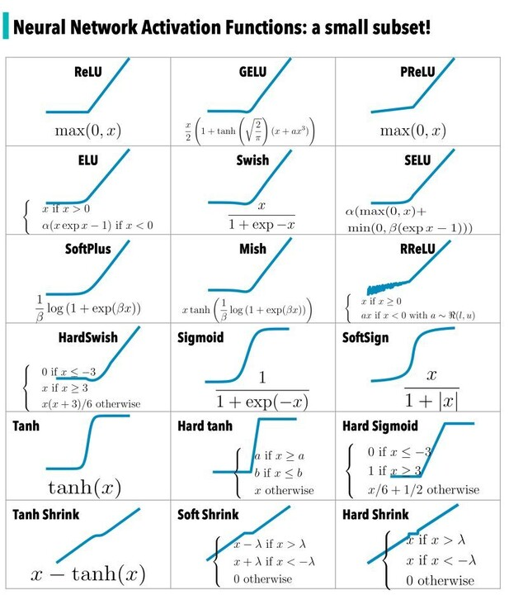
Basics of Deep Neural Nets

Slide 16
Basics of Deep Neural Nets
Loss Function
What It Is: The loss function measures how well the network's predictions match the actual outcomes. It tells us how "off" the model is.
How It Works: During training, the network aims to minimize this loss by adjusting weights and biases.

Slide 17
Basics of Deep Neural Nets
Loss Function
Mean Squared Error (MSE):
Measures the average squared difference between predicted and actual values.
Commonly used in regression tasks. Other regression related loss functions include MAE, MAPE etc.
Cross-Entropy Loss:
Measures the difference between two probability distributions, used for classification.
Binary Cross-Entropy:
For binary classification.
Categorical Cross-Entropy:
For multi-class classification.

Slide 18
Basics of Deep Neural Nets
Loss Function
Sparse Categorical Cross-Entropy:
Use When: Your classification task involves multiple classes and your labels are integers (e.g., class indices) rather than one-hot encoded vectors.
Suitable For: Multi-class classification problems where each sample belongs to one of several classes, and the labels are represented as integers (e.g., 0, 1, 2, etc.).
If your labels are one-hot encoded, use categorical_crossentropy. Examples (for a 3-class classification): [1,0,0] , [0,1,0], [0,0,1]
But if your labels are integers, use sparse_categorical_crossentropy. Examples for above 3-class classification problem: [1] , [2], [3]

Slide 19
Basics of Deep Neural Nets
Optimizer
What It Is: An optimizer is an algorithm used to update the weights and biases based on the loss function. It helps the model learn by improving its accuracy.
Common Optimizers:
Gradient Descent: Updates weights by moving them in the direction that reduces the loss.
Adam (Adaptive Moment Estimation): A more advanced optimizer that adapts learning rates for different weights.

Slide 20
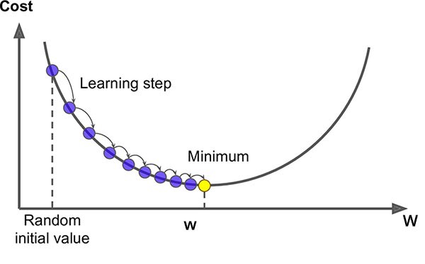
Basics of Deep Neural Nets
Optimizer
Gradient descent
Gradient descent is an optimization technique used to minimize the error in a model's predictions by adjusting its parameters.
Imagine you are on a hilly landscape and want to find the lowest point (the minimum error). To do this, you take small steps in the direction where the slope is steepest downhill, adjusting your position with each step.
Similarly, in gradient descent, the algorithm calculates the gradient (or slope) of the error function with respect to each parameter, and then updates the parameters in the direction that reduces the error. This process is repeated iteratively until the model's predictions are as accurate as possible.

Slide 21
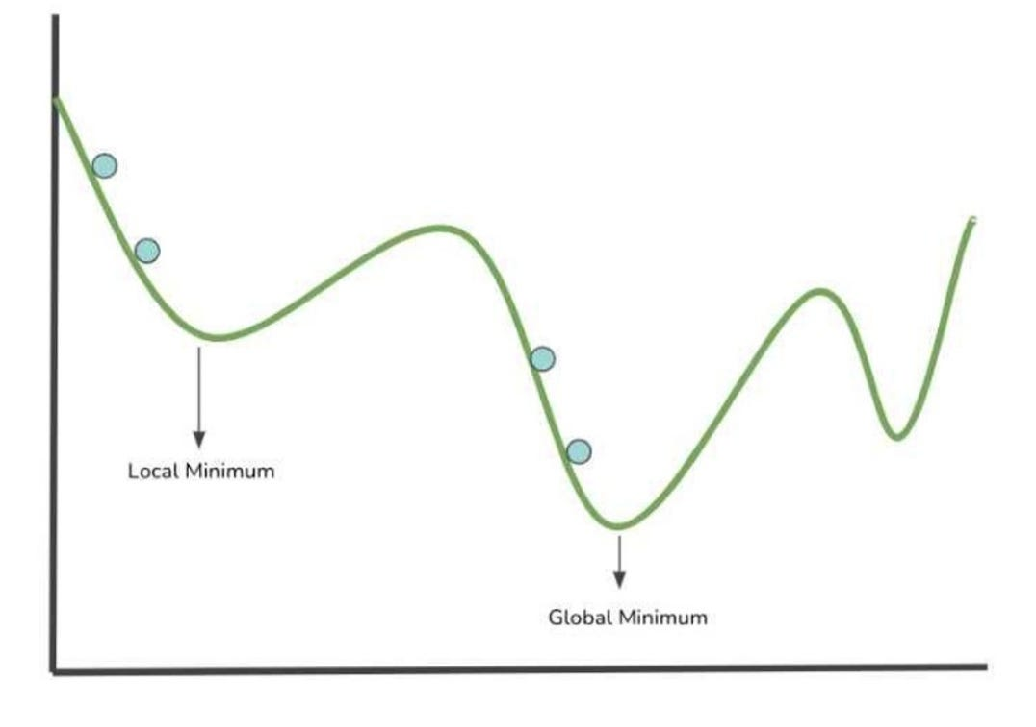
Basics of Deep Neural Nets
Optimizer
Gradient descent
In gradient descent, the learning rate controls how big each step is when adjusting the model's parameters.
A high learning rate might cause the steps to be too large, potentially overshooting the minimum error, while a low learning rate could make the process too slow and get stuck in local minima—points where the error is lower than surrounding areas but not the absolute lowest.
The goal is to find the global minimum, the absolute lowest point of error across the entire landscape. Balancing the learning rate and navigating around local minima are crucial for effectively finding the global minimum and achieving the best possible model performance.

Slide 22
Basics of Deep Neural Nets
Training Process
What It Is: Training is the process of teaching the network to make accurate predictions. It involves feeding data into the network, calculating the loss, and adjusting weights using the optimizer.

Slide 23
Basics of Deep Neural Nets
Training Process
Steps:
Forward Pass: Input data passes through the network, and predictions are made.
Loss Calculation: The loss function calculates how far off the predictions are from the actual outcomes.
Backward Pass: Gradients are computed to understand how much each weight contributed to the loss.
Weight Update: The optimizer adjusts the weights based on these gradients to reduce the loss.

Slide 24
Basics of Deep Neural Nets
Backpropagation
During the training process of a neural network, backpropagation is used to calculate how much each weight in the network contributed to the error by computing gradients.
These gradients indicate how to adjust the weights to reduce the error.
The optimizer then takes these gradients and updates the weights accordingly.
Essentially, backpropagation provides the information on how to change the weights, and the optimizer uses this information to make the adjustments, ensuring that the network gradually improves its predictions by minimizing the error through iterative updates.

Slide 25
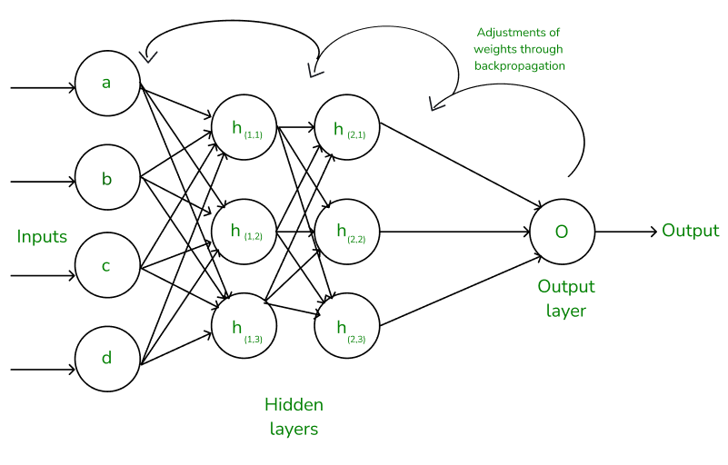
Basics of Deep Neural Nets
Back Propagation

Slide 26
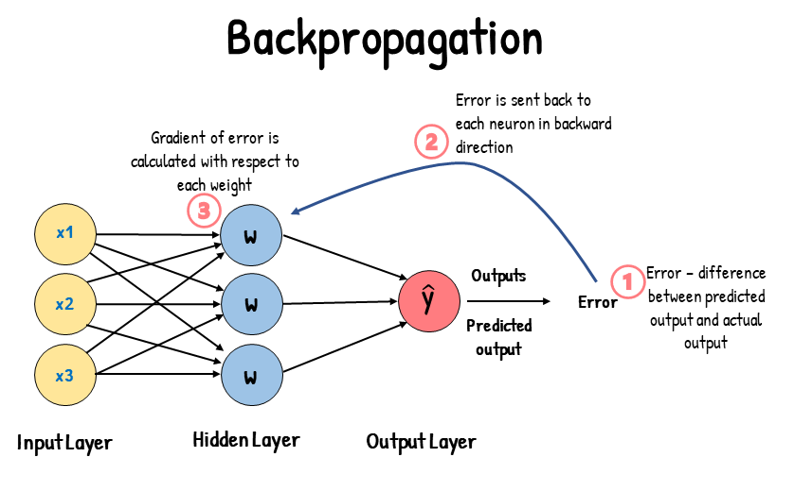
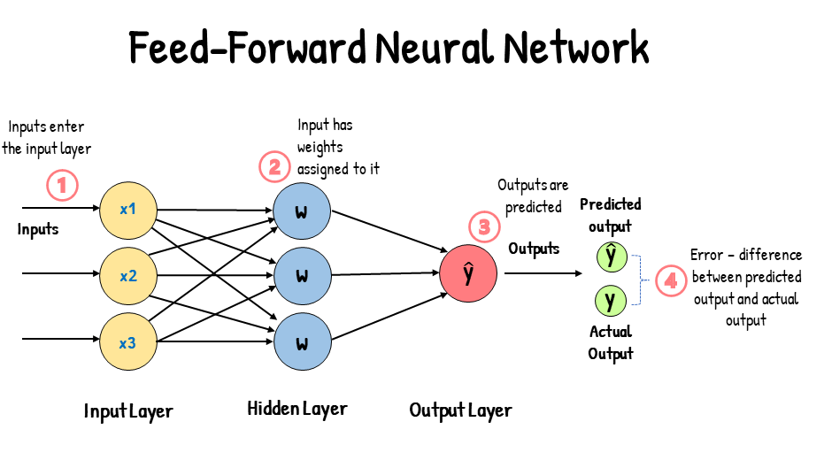
Basics of Deep Neural Nets
Feedforward and Backpropagation:
Feedforward: Data flows from input through hidden layers to output for predictions.
Backpropagation: Training process involving error calculation, error propagation, and weight/bias adjustment using optimization methods like gradient descent to refine the model.

Slide 27
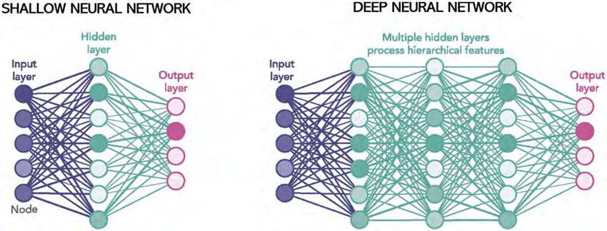
Basics of Deep Neural Nets
Deep vs. Shallow Networks:
Deep Networks: Have multiple hidden layers for learning complex, hierarchical features. Ideal for complex tasks like image and speech recognition.
Shallow Networks: Lack hidden layers, suited for simpler tasks or when dealing with low-dimensional data.

Slide 28
Basics of Deep Neural Nets
Normalization Techniques
Normalization and regularization techniques play key roles in improving the performance and stability of deep learning models. Here’s an overview of several important methods:
L1 and L2 Regularization:
L1 Regularization (Lasso):
What It Does: Adds a penalty proportional to the absolute value of the weights to the loss function.
Effect: Encourages sparsity in the model by driving some weights to zero, effectively performing feature selection and simplifying the model.
L2 Regularization (Ridge):
What It Does: Adds a penalty proportional to the square of the weights to the loss function.
Effect: Discourages large weights by shrinking them, which helps to prevent overfitting and stabilizes the learning process.

Slide 29
Basics of Deep Neural Nets
Normalization Techniques
Dropout:
What It Does: Randomly deactivates a subset of neurons during each training iteration.
Effect: Prevents the network from becoming overly reliant on specific neurons, which helps to reduce overfitting and improves generalization by making the model robust to different subsets of neurons.
Batch Normalization:
What It Does: Normalizes the input of each layer by adjusting the mean and variance across the mini-batch of data.
Effect: Stabilizes and speeds up training by ensuring that inputs to each layer are on a similar scale, which helps to mitigate issues related to internal covariate shift and allows for higher learning rates.

Slide 30
Convolution Neural Networks (CNN)

Slide 31
Convolutional Neural Networks (CNNs)
Convolutional Neural Networks (CNNs) are particularly well-suited for image processing compared to simple neural networks due to their ability to capture spatial hierarchies and patterns in images more effectively.

Slide 32
Why CNNs Are Better for Images
Spatial Hierarchies: CNNs leverage the spatial structure of images by applying filters that capture local patterns and features, such as edges, textures, and shapes. This allows them to build hierarchical representations, where lower layers detect simple features and higher layers combine them into more complex structures.
Parameter Sharing: Unlike fully connected networks where each neuron is connected to every neuron in the previous layer, CNNs use shared weights (filters) across different regions of the image. This reduces the number of parameters and computational complexity, making the model more efficient.
Local Connectivity: CNNs use convolutional layers to apply filters to small regions (receptive fields) of the image, preserving the spatial relationships between pixels. This helps in recognizing patterns and objects regardless of their position in the image.

Slide 33
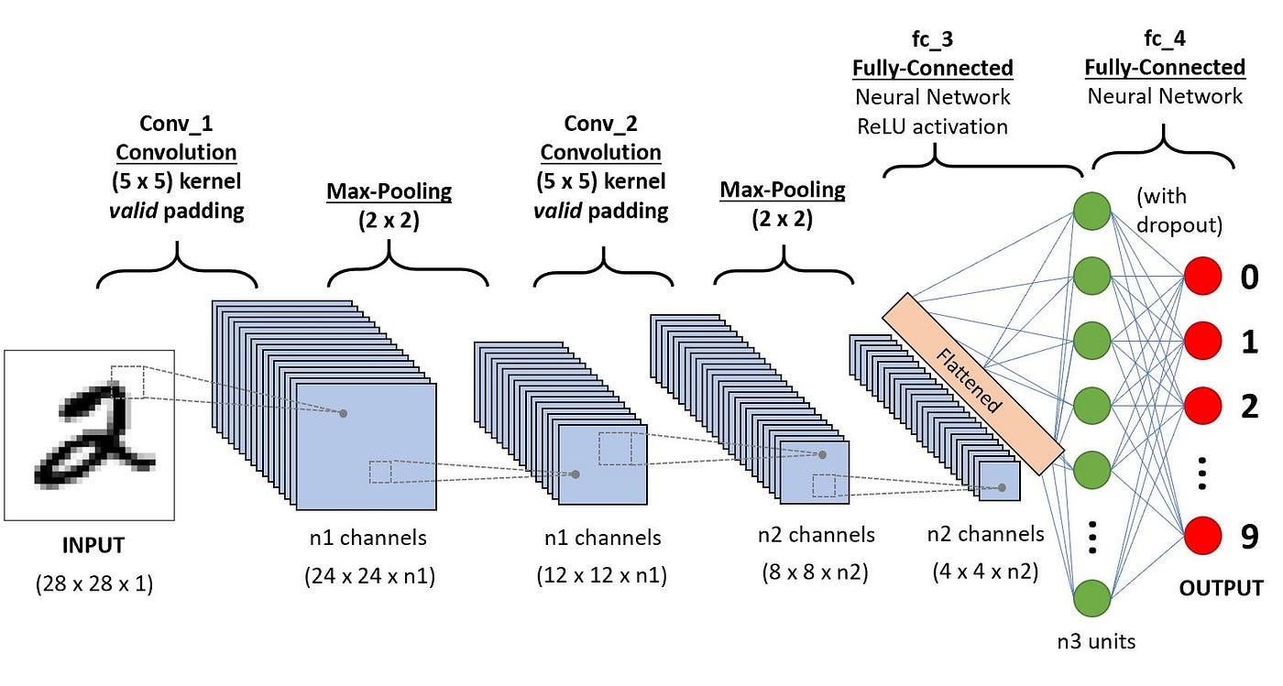
Architecture of Convolutional Neural Networks

Slide 34
Architecture of Convolutional Neural Networks
Input Layer:
What It Is: The layer where the raw image data is fed into the network.
Structure: Typically consists of pixel values, where an image might be represented as a 3D array (height × width × channels), with channels corresponding to color channels (e.g., RGB).
Convolutional Layers:
What They Do: Apply convolutional filters (kernels) to the input image to detect features such as edges, textures, and patterns.
Structure: Each filter is a small matrix that slides over the input image, performing element-wise multiplication and summing up the results to produce a feature map. Multiple filters create multiple feature maps, capturing various features.
Key Parameters:
Filter Size: Defines the dimensions of the convolutional kernel (e.g., 3x3, 5x5).
Stride: The step size with which the filter moves across the image.
Padding: Adds extra pixels around the border of the image to control the size of the output feature map.

Slide 35
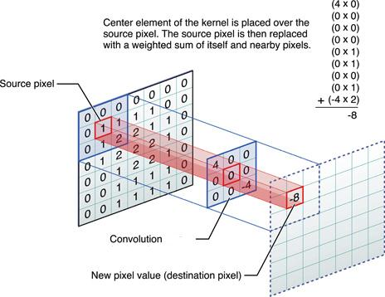
Architecture of Convolutional Neural Networks

Slide 36
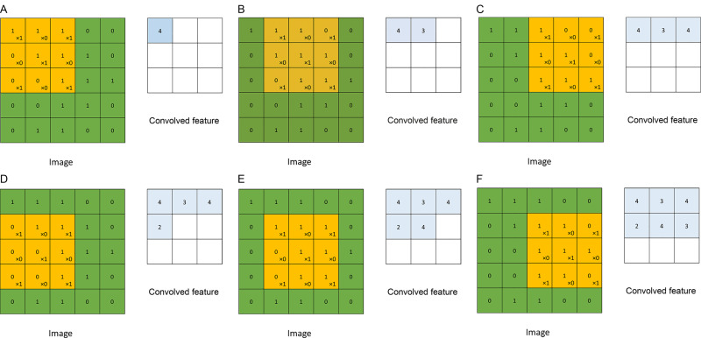
Architecture of Convolutional Neural Networks

Slide 37
Architecture of Convolutional Neural Networks
Convolutional Layers:
Filter Stride: The stride refers to the number of pixels by which the convolutional filter moves across the input image. A stride of 1 means the filter shifts one pixel at a time, resulting in a larger output feature map. A larger stride reduces the spatial dimensions of the output, as the filter skips over pixels. Adjusting the stride impacts both the size of the feature map and the computational load.
Padding: Padding involves adding extra pixels around the borders of the input image. This technique helps control the size of the output feature map and can be used to maintain spatial dimensions or enhance feature detection at the edges of the image. Common types of padding include 'valid' (no padding) and 'same' (padding to ensure the output size matches the input size). Proper padding can prevent the loss of information near the edges and ensure the convolution operation is applied uniformly across the entire image.

Slide 38
Architecture of Convolutional Neural Networks
Activation Functions:
What They Do: Introduce non-linearity into the model to enable it to learn complex patterns.
Common Types:
ReLU (Rectified Linear Unit): Applies the function ReLU(x)=max⁡(0,x), which is widely used due to its simplicity and effectiveness in speeding up training.
Pooling Layers:
What They Do: Reduce the spatial dimensions of the feature maps, decreasing the computational load and helping to control overfitting.
Structure: Typically uses operations like max pooling or average pooling.
Max Pooling: Takes the maximum value from a set of values in the feature map (e.g., 2x2 region).
Average Pooling: Computes the average value from a set of values in the feature map.

Slide 39
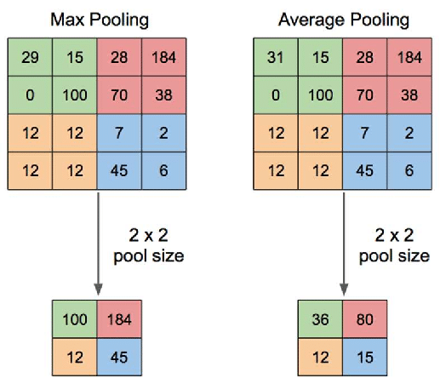
Architecture of Convolutional Neural Networks
Pooling Layers:

Slide 40
Architecture of Convolutional Neural Networks
Fully Connected Layers:
What They Do: Perform classification or regression tasks by combining the features extracted by previous layers.
Structure: Each neuron is connected to every neuron in the previous layer, allowing the network to learn complex combinations of features.
Fully connected layers in Convolutional Neural Networks (CNNs) are essential for integrating the high-level features extracted by convolutional and pooling layers into a final decision or classification.
They transform the 2D feature maps into a 1D vector, allowing the network to combine and interpret the features comprehensively to produce accurate predictions or classifications.

Slide 41
Architecture of Convolutional Neural Networks
Output Layer:
What It Does: Produces the final prediction or classification.
Structure: The number of neurons in this layer corresponds to the number of classes for classification or a single neuron for regression tasks. Activation functions like softmax (for classification) are used to generate the final output.

Slide 42
Architecture of Convolutional Neural Networks
Normalization Layers (Optional):
Batch Normalization: Normalizes activations within a batch to stabilize and accelerate training.
Layer Normalization: Normalizes across the features of each sample, often used in RNNs and transformers.
Regularization Techniques (Optional):
Dropout: Randomly deactivates neurons during training to prevent overfitting.
L1/L2 Regularization: Adds penalties to the loss function to discourage large weights and prevent overfitting.

