Slide 1
Advanced Generative AI

Slide 2
Generation Quality Evaluation

Slide 3
Text Generation Quality Evaluation
A well-trained text generation system can make it really hard to distinguish between human and machine-written text pieces. Some of the popular real-world use cases where text generation is seen in action are Gmail’s Smart Reply, a smartphone’s Auto-completion, etc.
Evaluating these systems can get tricky.
Most of the systems available these days are probabilistic in nature and are often seen to hallucinate factual information when generating text.
So, one of the best ways to perform the evaluation is to do it with the help of humans, but this might not always be feasible as it is a costly and time-consuming process.
It also does not guarantee re-producibility because of the sampling bias.
Also, evaluating at scale is not an option when doing manually.
Hence, for the above-mentioned reasons, automatic metrics are usually preferred when evaluating text generation systems.

Slide 4
Text Generation Quality Evaluation
Automatic metrics could be both trained and untrained.
As expected, trained metrics try to take into account the task specifics when doing the evaluation but at the cost of learning this function with relevant data,
whereas, untrained metrics are generic, require no training, are language-independent, and faster to calculate.
Untrained metrics are popular and widely used to measure the quality of generated text in both the industry and academia spanning over many use cases like machine translation, text summarization, story generation, image captioning, etc.

Slide 5
ROUGE
ROUGE (Recall-Oriented Understudy for Gisting Evaluation) is a way to measure how well a computer-generated text, like a summary or an answer, matches a reference text written by a human.
It works by comparing the words or phrases in the generated text to those in the reference text, focusing on how much of the important content from the reference is captured.
ROUGE looks at overlaps of words, sequences of words (like short phrases), and even the overall meaning.
The idea is that the more the computer-generated text overlaps with the human version, the better it is.
It's commonly used to evaluate tasks like summarizing articles or answering questions, where it's important to capture the right information, even if the wording is a bit different.

Slide 6
ROGUE
Rouge-1 calculates the overlap of unigram_(individual word)_ between the candidate and reference text pieces.
Rouge-2 calculates the overlap of bigrams_(word pairs)_ between the candidate and reference text pieces.
Rouge-L calculates the overlap of the longest co-occurring in sequence n-grams between candidate and reference text pieces.
Rouge-S calculates the overlap of Skip-bigram(of any pair of words in their sentence order) between the candidate and reference text pieces.

Slide 7
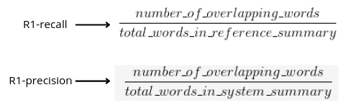
ROGUE

Slide 8
ROGUE
!pip install rouge-score
from rouge_score import rouge_scorer
scorer = rouge_scorer.RougeScorer(['rouge1', 'rougeL'], use_stemmer=True)
scores = scorer.score('The quick brown fox jumps over the lazy dog',
'The quick brown dog jumps on the log.')
scores

Slide 9
BLEU
BLEU stands for Bilingual Evaluation Understudy.
This is a really popular metric that you’ll definitely find in the literature around machine translation and was proposed in this paper in 2002.
The metric used in comparing a candidate translation to one or more reference translations.
And the output lies in the range of 0-1, where a score closer to 1 indicates good quality translations.
BLEU-1, BLEU-2, BLEU-3, and BLEU-4 are some commonly calculated numbers that you’ll often find mentioned in the literature.
Here, each of 1, 2, 3, and 4 represent the precision of the n-gram sequence that is taken into consideration while calculating the BLEU score.

Slide 10
BLEU
import nltk
from nltk.translate.bleu_score import sentence_bleu, SmoothingFunction
# Download NLTK data (if not already downloaded)
nltk.download('punkt')
# Reference sentence (list of lists of words) - a list of one or more correct translations
reference = [['the', 'cat', 'is', 'on', 'the', 'mat']]
# Generated sentence (list of words) - the machine-generated sentence
candidate = ['the', 'cat', 'is', 'on', 'mat']
# Calculate BLEU score using sentence_bleu
# SmoothingFunction helps avoid precision issues with short sentences or when there are no matches
smooth = SmoothingFunction().method1
bleu_score = sentence_bleu(reference, candidate, smoothing_function=smooth)
print(f"BLEU Score: {bleu_score}")

Slide 11
BERTScore
BERTScore uses BERT for calculating the quality of text generated by NLG systems.
It was proposed pretty recently in this paper in 2020.
Unlike most of the methods that majorly make use of token or phrasal level syntactic overlaps between hypothesis and reference text pieces, BERTScore on the other hand captures the semantic aspect by using the contextualized embeddings generated by the BERT model.

Slide 12
METEOR
METEOR stands for The Metric for Evaluation of Translation with Explicit Ordering.
It can be used to evaluate output across various spectrums of tasks like Machine Translation, Text Summarization, Image Captioning, etc.
But you’ll often find it being used in the literature on machine translation. It also claims to have a high correlation with human judgment.
It comes with some obvious goodness compared to the BLEU metric (a popular one when it comes to evaluating o/p from Machine Translation systems) that focuses on majorly capturing the precision aspect of the generation against the ground truth.
METEOR on the other hand is based on the idea of calculating the Harmonic mean of the unigram precision and recall, where recall is given more weight over precision.
Giving greater weight to recall allows us to understand more about how much of the ground truth have we produced as a part of output during the generation process.

Slide 13
Self-BLEU
Self-BLEU is a smart use of the traditional BLEU metric for capturing and quantifying diversity in the generated text.
The lower the value of the self-bleu score, the higher the diversity in the generated text.
Long text generation tasks like story generation, news generation, etc could be a good fit to keep an eye on such metrics, helping evaluate the redundancy and monotonicity in the model.
This metric can be complemented with other text generation evaluation metrics that account for the goodness and relevance of the generated text.
A sweet spot of relevance and diversity would make a perfectly blended output.

Slide 14
Some real world evaluation measures
IFEval: This stand for Instruction Following Evaluation. It tests how well a model follows user instructions when given specific tasks. High scores indicate good instruction adherence and usefulness.
BBH: The Big-Bench Hard (BBH) dataset is a collection of difficult, open-ended tasks that challenge a model’s reasoning and general knowledge capabilities.
MATH Lvl 5: This refers to the model’s performance on advanced mathematical tasks (Level 5 difficulty), testing its capability to handle complex mathematical reasoning.
GPQA (General Purpose Question Answering): This benchmark tests a model’s ability to answer general-purpose questions, assessing the breadth of knowledge and comprehension.
MMLU-PRO: The Massive Multitask Language Understanding benchmark, focusing on professional-level exams (like law, medicine), tests a model’s domain knowledge and understanding across various fields.

Slide 15
LLM Evaluation boards
https://huggingface.co/spaces/lmsys/chatbot-arena-leaderboard
Includes all LLMs both open source and propriety
https://huggingface.co/spaces/open-llm-leaderboard/open_llm_leaderboard
Includes only opensource LLMs

Slide 16
Google Gemni API Overview for Generative AI Projects

Slide 17
Google Gemni API Overview
https://aistudio.google.com/
https://ai.google.dev/gemini-api/docs

Slide 18
Fine-tuning

Slide 19
Fine-tuning
Training behemoths like GPT-4 demands immense resources, often running into millions of dollars, making it impractical for widespread use in production settings.
Consequently, smaller models are employed, tailored to specific tasks to mitigate costs.
However, this approach introduces its own set of challenges, notably a lack of generalizability across diverse tasks, leading to a proliferation of models catering to the nuanced needs of different users.

Slide 20
Fine-tuning
This is where Parameter Efficient Fine Tuning (PEFT) techniques such as LoRA (Low-Rank Adaptation) and QLoRA (Quantized LoRA) come into play, offering a beacon of efficiency in the fine-tuning process.
By enabling significant modifications to a model's behavior with minimal adjustments to its architecture, PEFT techniques allow for the efficient training of large models, addressing the pivotal challenges of cost and computational resource requirements.

Slide 21
What is PEFT Finetuning?
PEFT Finetuning stands for Parameter Efficient Fine Tuning, a suite of techniques designed to fine-tune and train models more efficiently than traditional methods.
By reducing the number of trainable parameters in a neural network, PEFT techniques, including Prefix Tuning, P-tuning, LoRA, and others, enhance training efficiency.
LoRA, in particular, has gained prominence for its effectiveness and has spawned various adaptations like QLoRA and LongLoRA, each tailored for specific applications.

Slide 22
The Rationale Behind PEFT Finetuning
The adoption of PEFT techniques is driven by several compelling benefits, particularly for enterprises and large businesses seeking to fine-tune LLMs:
  Saves Time: By decreasing the number of trainable parameters, models can be trained and tested more rapidly, freeing up valuable time for exploring different models, datasets, and techniques.
  Saves Money: PEFT's memory optimizations allow for the use of less powerful computational resources, reducing the costs associated with training on large datasets.

Slide 23
LoRA
In traditional fine-tuning, we modify a pre-trained neural network’s weights to adapt to a new task.
This adjustment involves altering the original weight matrix ( W ) of the network.
The changes made to ( W ) during fine-tuning are collectively represented by ( Δ W ), such that the updated weights can be expressed as:
W’ = ( W + Δ W ).

Slide 24
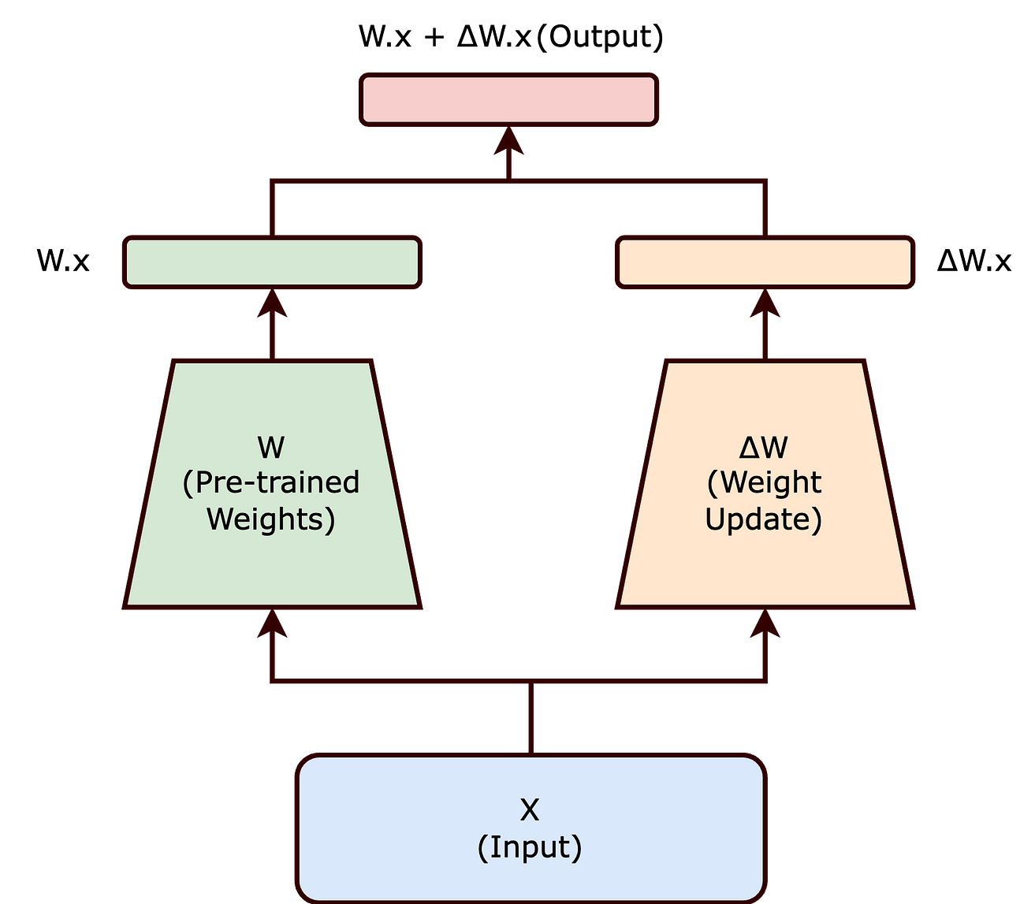
Traditional View

Slide 25
LoRA
https://arxiv.org/abs/2106.09685
Rather than modifying ( W ) directly, the LoRA approach seeks to decompose ( Δ W ).
This decomposition is a crucial step in reducing the computational overhead associated with fine-tuning large models.
LoRA proposes representing ( Δ W ) as the product of two smaller matrices, ( A ) and ( B ), with a lower rank. The updated weight matrix ( W’ ) thus becomes:
[ W’ = W + BA ]

Slide 26
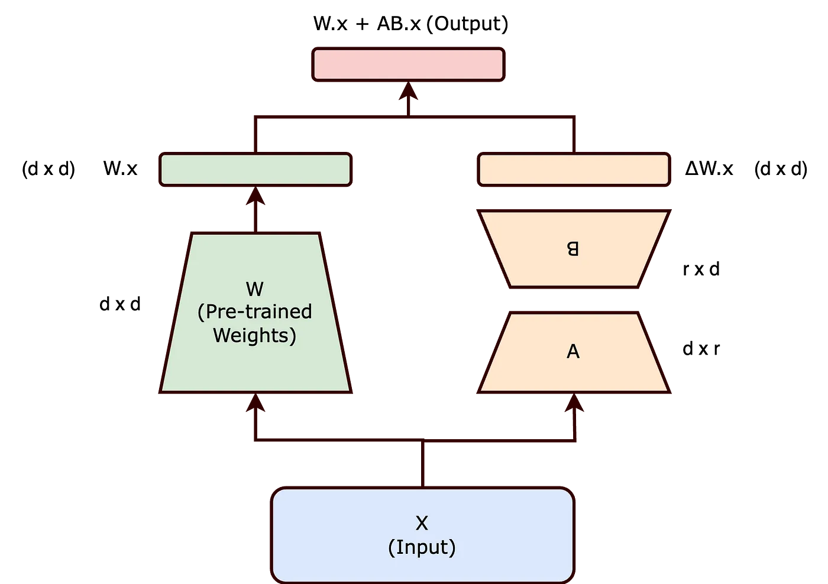
LoRA
The product of matrices 𝐴 of shape 𝑑×𝑟 and 𝐵 of shape 𝑟×𝑑 will have the shape 𝑑×𝑑.

Slide 27
LoRA
By choosing matrices ( A ) and ( B ) to have a lower rank ( r ), the number of trainable parameters is significantly reduced.
For example, if ( W ) is a ( d x d ) matrix, traditionally, updating ( W ) would involve ( d² ) parameters.
However, with ( B ) and ( A ) of sizes ( d x r ) and ( r x d ) respectively, the total number of parameters reduces to ( 2dr ), which is much smaller when ( r << d ).
For example, if you multiply matrix 𝐴 with shape 1000×10 and matrix 𝐵 with shape 10×1000, the resulting product will have a shape of 1000×1000.
  Matrix A and B together have a total of 20000 parameters (since A has 1000×10 and B has 10×1000 elements). This is equivalent to 2dr.
  However, the resulting product matrix (𝐴 × 𝐵) will have 1000000 parameters (which is 1000×1000 or d²).

Slide 28
LoRA
The reduction in the number of trainable parameters, as achieved through the Low-Rank Adaptation (LoRA) method, offers several significant benefits, particularly when fine-tuning large-scale neural networks:
Reduced Memory Footprint: LoRA decreases memory needs by lowering the number of parameters to update, aiding in the management of large-scale models.
Faster Training and Adaptation: By simplifying computational demands, LoRA accelerates the training and fine-tuning of large models for new tasks.
Feasibility for Smaller Hardware: LoRA’s lower parameter count enables the fine-tuning of substantial models on less powerful hardware, like modest GPUs or CPUs.

Slide 29
QLoRA
https://arxiv.org/abs/2305.14314
QLoRA is the extended version of LoRA which works by quantizing the precision of the weight parameters in the pre trained LLM.
Typically, parameters of trained models are stored in a 32-bit format, but QLoRA compresses them to a 4-bit format.
This reduces the memory footprint of the LLM, making it possible to finetune it on a single GPU.
This method significantly reduces the memory footprint, making it feasible to run LLM models on less powerful hardware, including consumer GPUs.

Slide 30
QLoRA
A 32-bit float is a data type used in computer programming to represent decimal numbers with a high degree of precision, using 32 bits to store the value, which typically includes
  1 bit for the sign,
  8 bits for the exponent,
  and 23 bits for the mantissa (the significant digits of the number).
A 4-bit NormalFloat is a significantly smaller representation, using only 4 bits to encode a number, which limits its range and precision. The 4-bit format may sacrifice accuracy for memory efficiency and is typically used in scenarios where low precision is acceptable.

Slide 31
QLoRA
According to QLoRA paper QLORA introduces multiple innovations designed to reduce memory use without sacrificing performance:
  4-bit NormalFloat, an information theoretically optimal quantization data type for normally distributed data that yields better empirical results than 4-bit Integers.

