Slide 1
COP2073C
Introduction to Statistical Programming with R
Module 8: Advanced Statistics in R:
Hypothesis Testing
Reading (Book of R):
Ch. 17 Sampling Distributions and Confidence
Ch. 18 Hypothesis Testing
Ch. 19 Analysis of Variance

Slide 2
Ch. 17 Sampling Distributions and Confidence

Slide 3
Sampling Distributions
A sampling distribution is a probability distribution that accounts for variability when population parameters are estimated using sample statistics.
Modeling variability in an estimated sample statistic is a key part of many statistical analyses.
The sampling mean (X̅, or "X-bar") is calculated using a smaller number of observations, so variability can decrease compared to a population mean.
The sampling standard deviation is referred to as the standard error, (σ_{X̅} , or sigma-X-bar") reflecting the fact that the probabilities are calculated from a sample.
The formulas for sampling distributions depend upon the probability distributions that generated the raw data, availability of measures of the population mean and standard deviation, and the size of the sample itself.

Slide 4
Calculating Probabilities using Sample Distributions
The formula to calculate the standard error for a sample distribution of size n given a known standard deviation σ is
σ_{X̅} = σ / sqrt(n)

Slide 5
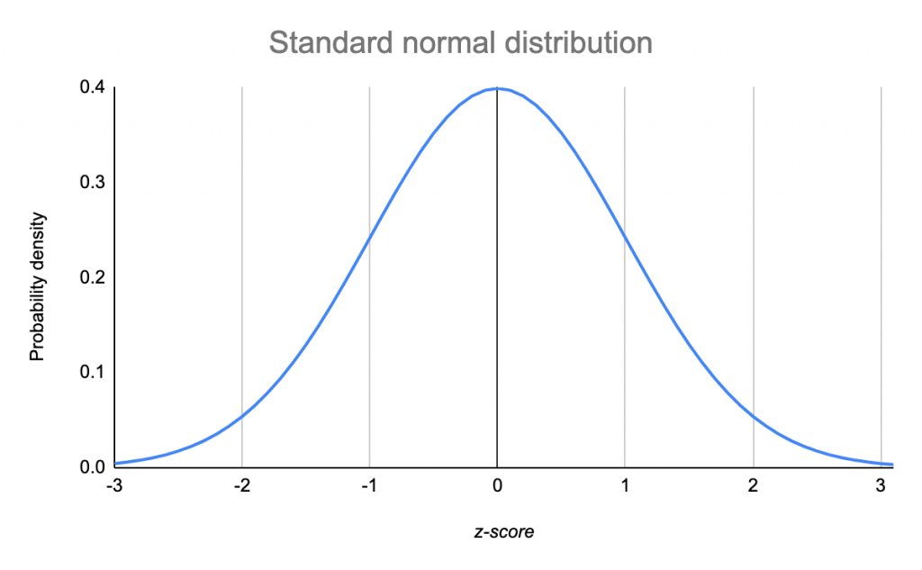
Normal Distributions
Normal distributions follow a bell-curve, with consistent percentages of the data falling within (plus or minus) 1, 2 and 3 standard deviations of the mean.

Slide 6
R Functions for Normal Distributions
?Normal to show this help page
The Normal Distribution
Description
Density, distribution function, quantile function and random generation for the normal distribution with mean equal to mean and standard deviation equal to sd.
Usage
dnorm(x, mean = 0, sd = 1, log = FALSE)
pnorm(q, mean = 0, sd = 1, lower.tail = TRUE, log.p = FALSE)
qnorm(p, mean = 0, sd = 1, lower.tail = TRUE, log.p = FALSE)
rnorm(n, mean = 0, sd = 1

Slide 7
Sample Distribution Probability Example
Problem Statement: Suppose that the daily maximum temperature in the month of January in Dunedin, New Zealand, follows a normal distribution, with a mean of 22 degrees Celsius and a standard deviation of 1.5 degrees
- What is the probability that a randomly chosen day in January has a maximum temperature of less than 21.5 degrees?
- What is the probability if the day is chosen from a random sampling of 5 days? (n = 5)
# Pr(X < 21.5) /// population
> pnorm(21.5, mean=22, sd=1.5) [1] 0.3694413
# Pr(Xbar < 21.5) /// sample
> pnorm(21.5, mean=22, sd=1.5/sqrt(5))
[1] 0.2280283

Slide 8
17.2 Confidence Intervals
A confidence interval (CI) defines a range of values with a specified probability that the value of a parameter lies within them.
A CI allows you to state a “level of confidence” that the parameter falls between an lower and upper limit, often expressed as a percentage.
The confidence interval is defined using a value α, which represents the likelihood that the parameter lies outside the confidence interval
The three most common intervals are α = 0.1 (90 percent interval), α = 0.05 (95 percent interval), or α = 0.01 (99 percent interval)
The interpretation of a confidence interval (l, u) is stated as "there is a ((1- α) * 100)% confidence level that the parameter value lies somewhere between l and u."

Slide 9
Finding Confidence Intervals with R
Suppose we’ve collected a random sample of 10 recently graduated students and collected their annual salary :
> salaries <- c(44617,7066,17594,2726,1178,18898,5033,37151,4514,4000)
Estimate the mean salary of all recently graduated students. Find a 90% and a 95% confidence interval for the mean.
Assume that incomes are normally distributed with an unknown mean and a standard deviation of $15,000
Xbar is the sample mean
To calculate a confidence interval use
Xbar +- (plus or minus) the Z-score of α /2 times the standard error
Given n = 10 and σ = 15000, this is
CI(α) = Xbar +- z(α/2) * (15000 /sqrt(10))
http://www.stat.ucla.edu/~rgould/110as02/bsci

Slide 10
Finding Confidence Intervals with R
CI(α) = Xbar +- z(α/2) * (15000 /sqrt(10))
90% CI
α = 0.10
Use qnorm to calculate the Z-score of
α/2 = z(0.05)
> z <- qnorm(.05)
> z
[1] -1.644854
The sample mean xbar is:
> xbar <- mean(salaries)
> xbar
[1] 14277.7
The standard error is
> sterr <- (15000 /sqrt(10))
> sterr
[1] 4743.416
Lower and upper CI bounds are:
> xbar + z * sterr
[1] 6479.523
> xbar - z * sterr
[1] 22075.88
The 90% CI is ($6479, $22076)

Slide 11
Finding Confidence Intervals with R
95% CI
For a 95% CI, α = 0.05.
All of the steps are the same, except replace z(.05) with z(.025)
> z <- qnorm(.025)
> z
[1] -1.959964
Lower and upper CI bounds are:
> xbar + z * sterr
[1] 4980.775
> xbar - z * sterr
[1] 23574.63
The 95% CI is ($4981, $23575)
Note that the range is larger, a tradeoff for the higher CI

Slide 12
Ch. 18 Hypothesis Testing

Slide 13
Components of a Hypothesis Test
Hypothesis testing defines a null and an alternative hypothesis
The null and alternative hypotheses are denoted H0 and HA, respectively (sometimes H0 and H1, or H₀ and H₁)
The null hypothesis is interpreted as the baseline and is assumed to be true
The alternative hypothesis is the item that you’re testing against the null hypothesis and is determined before any data are collected
The alternative hypothesis takes the form of either an upper-tailed, lower-tailed, or two-tailed test

Slide 14
Components of a Hypothesis Test
When HA is defined in terms of a "less-than" statement, it is one-sided and lower-tailed.
H0 is rejected if the test statistic is smaller than the critical value.
When HA is defined in terms of a "greater-than" statement, it is one-sided and upper-tailed.
H0 is rejected if the test statistic is larger than the critical value.
When HA is defined in terms of a "not-equal" statement, it is two-sided, or two-tailed.
H0 is rejected if the test statistic is smaller or larger than the critical value.

Slide 15
Hypothesis Test Example
The null hypothesis is usually a hypothesis of "there is no difference"
H0 = "there is no difference between blood pressures in group A and group B if we give group A the test drug and group B a sugar pill."
Always define a null hypothesis for each question clearly before the start of a study.
The alternative hypothesis (HA) is the opposite of the null hypothesis; this is usually the hypothesis you set out to investigate
HA = "there is a difference in blood pressures between groups A and B if we give group A the test drug and group B a sugar pill".
https://www.statsdirect.com/help/basics/p_values.htm

Slide 16
The p-value
The p-value, or calculated probability, is the probability of finding results when the null hypothesis (H0) of a study question is true
The p-value is used to quantify the amount of evidence, if any, against the null hypothesis
The exact nature of calculating a p-value is dictated by the type of statistics being tested and the nature of the alternative hypothesis
A lower-tailed test implies the p-value is the left-hand tail probability from the sampling distribution of interest
For an upper-tailed test, the p-value is the right-hand tail probability
For a two-sided test, the p-value is the sum of a left-hand tail probability and right-hand tail probability (2x the area in either tail for symmetric distributions)

Slide 17
The Test Statistic
The test statistic is compared to the appropriate standardized sampling distribution to yield the p-value
Test statistics frequently use Z-scores for normal distributions, or t-scores using t-distributions for small sample sizes (usually less than 30) or when the population standard deviation is unknown
The distribution and distance from zero of the test statistic determine the size of the p-value
The more extreme the test statistic, the smaller the p-value
The smaller the p-value, the greater the amount of statistical evidence against the assumed truth of H0

Slide 18
Significance Level
For every hypothesis test, a significance level α is assumed.
The significance level defines a cutoff point, at which you decide whether there is sufficient evidence to view H0 as incorrect and favor HA instead.
If the p-value is greater than or equal to α, then you conclude there is insufficient evidence against the null hypothesis, and therefore you retain H0 when compared to HA
If the p-value is less than α, then the result of the test is statistically significant. This implies there is sufficient evidence against the null hypothesis, and therefore you reject H0 in favor of HA

Slide 19
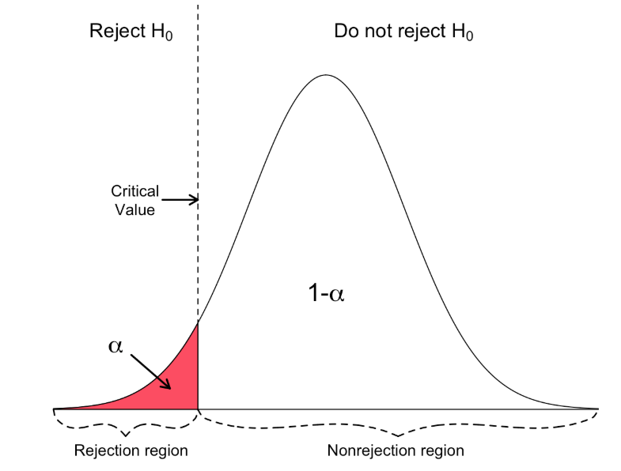
Lower-Tailed Tests
The rejection region consists of one part, left from the center.
https://www.geo.fu-berlin.de/en/v/soga/Basics-of-statistics/Hypothesis-Tests/Introduction-to-Hypothesis-Testing/Critical-Value-and-the-p-Value-Approach/index.html

Slide 20
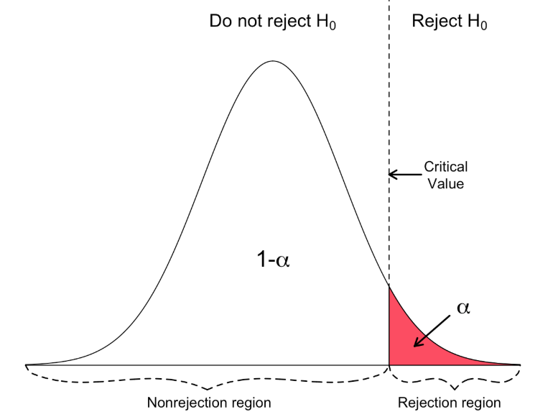
Upper-Tailed Tests
The rejection region consists of one part, right of center.
https://www.geo.fu-berlin.de/en/v/soga/Basics-of-statistics/Hypothesis-Tests/Introduction-to-Hypothesis-Testing/Critical-Value-and-the-p-Value-Approach/index.html

Slide 21
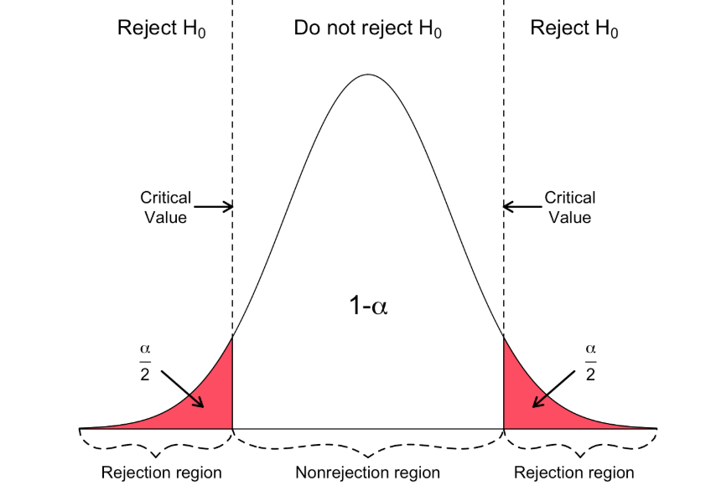
Two-Tailed Tests
The rejection region consists of two parts, one on the left and one on the right.
https://www.geo.fu-berlin.de/en/v/soga/Basics-of-statistics/Hypothesis-Tests/Introduction-to-Hypothesis-Testing/Critical-Value-and-the-p-Value-Approach/index.html

Slide 22
Practice: Single Mean Test Using pt Function
A manufacturer of a snack advertises a package of snacks has a mean net weight of 80 grams.
A consumer calls in with a complaint—over time they have bought and precisely weighed the contents of 44 randomly selected 80-gram packs from different stores and recorded the weights as follows:
> snacks <- c(87.7,80.01,77.28,78.76,81.52,74.2,80.71,79.5,77.87,81.94,80.7,
82.32,75.78,80.19,83.91,79.4,77.52,77.62,81.4,74.89,82.95,
73.59,77.92,77.18,79.83,81.23,79.28,78.44,79.01,80.47,76.23,
78.89,77.14,69.94,78.54,79.7,82.45,77.29,75.52,77.21,75.99,
81.94,80.41,77.7)
The customer claims that they’ve been shortchanged because their data cannot have arisen from a distribution with mean μ = 80, so the true mean weight must be less than 80.
To investigate this claim, the manufacturer conducts a hypothesis test using a significance level of α = 0.05.

Slide 23
Practice: Single Mean Test
First, the hypotheses must be defined.
The null hypothesis H0, is that the mean net weight μ is 80 grams.
The alternative hypothesis HA, or “what you’re testing for”, is that μ is smaller than 80.
These hypotheses are formalized as
H0: μ = 80
HA: μ < 80
Second, the mean and standard deviation must be estimated from the sample.

Slide 24
Practice: Single Mean Test
> n <- length(snacks)
# calculate the mean
> snack.mean <- mean(snacks)
> snack.mean
[1] 78.91068
# calculate the standard deviation
> snack.sd <- sd(snacks)
> snack.sd
[1] 3.056023

Slide 25
Practice: Single Mean Test
Given the estimated standard deviation, what is the probability of observing a sample mean (n = 44) of 78.91 (the calculated sample mean) grams or less if the true (advertised) mean is 80 grams?
To answer this, you need to calculate the relevant test statistic:
T = Xbar – (claimed mean)
----------------------------------
std dev / sqrt(n)

Slide 26
Practice: Single Mean Test
T = Xbar – (claimed mean)
________________________________________
std dev / sqrt(n)
> snack.se <- snack.sd / sqrt(n) > snack.se [1] 0.4607128
> snack.T <- (mean(snacks)- 80) / snack.se
> snack.T
[1] -2.364419

Slide 27
Practice: Single Mean Test
# use the test statistic to calculate the p-value
# with the pt function (use n − 1 degrees of freedom)
> pt(snack.T,df=n-1)
[1] 0.01132175
This p-value is smaller than the predefined significance level of α = 0.05
The manufacturer can conclude that there is sufficient evidence to reject the null hypothesis in favor of the alternative, suggesting the true value of μ is in fact less than 80 grams

Slide 28
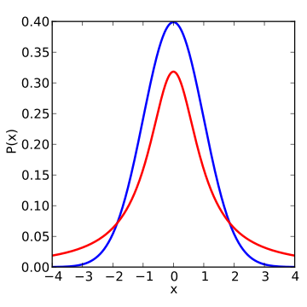
The t-Distribution
A t-distribution is any member of a family of continuous probability distributions that arises when estimating the mean of a normally distributed population in situations where the sample size is small and the population standard deviation is unknown
Developed by William Sealy Gosset under the pseudonym Student
The t-distribution is symmetric and bell-shaped, like the normal distribution, but has "heavier" tails
t-distribution (red) normal distribution (blue)

Slide 29
Student's t-Test using t.test()
Student's t-test compares two samples to determine if they are different using the means of both samples
goal is evidence of a significant difference between population means (2-sample t) or between the population mean and a hypothesized value (1-sample t)
t-value measures the size of the difference relative to the variation in your sample data
t.test() is another (simpler) way to calculate a confidence interval

Slide 30
Student's t-Test using t.test()
Usage: t.test(x, ...)
t.test(x, y = NULL, alternative = c("two.sided", "less", "greater"),
mu = 0, paired = FALSE, var.equal = FALSE,
conf.level = 0.95, ...)
Arguments
x a (non-empty) numeric vector of data values.
y an optional (non-empty) numeric vector of data values.
alternative a character string specifying the alternative hypothesis, must be one of "two.sided" (default), "greater" or "less". You can specify just the initial letter.
mu a number indicating the true value of the mean (or difference in means if you are performing a two sample test).
paired a logical indicating whether you want a paired t-test.
var.equal a logical variable indicating whether to treat the two variances as being equal. If TRUE then the pooled variance is used to estimate the variance otherwise the Welch (or Satterthwaite) approximation to the degrees of freedom is used.
conf.level confidence level of the interval

Slide 31
t.test() Example
> data2
[1] 3 5 7 5 3 2 6 8 5 6 9 4 5 7 3 4
> data3
[1] 6 7 8 7 6 3 8 9 10 7 6 9
> t.test(data2,data3)
Welch Two Sample t-test
data: data2 and data3
t = -2.8151, df = 24.564, p-value = 0.009462
alternative hypothesis: true difference in means is not equal to 0
95 percent confidence interval:
-3.5366789 -0.5466544
sample estimates:
mean of x mean of y
5.125000 7.166667
t-value measures the size of the difference relative to the variation in sample data. The greater the magnitude of t (either positive or negative), the greater the evidence against the null hypothesis that there is no significant difference. The closer t is to 0, the more likely there isn't a significant difference.
degrees of freedom (df): estimate values of unknown population parameters, and calculates the variability of the estimates. Determined by the number of observations in sample. As df increases, distribution becomes more tightly clustered around the central value
p-value < 0.05: reject null hypothesis
confidence interval: expected interval (difference of means) for sample obtained 95% of the time

Slide 32
Using t.test() to Analyze Movies
It's Friday night and you want to watch a movie. There are three movies that caught your eye, but you're not really sure if they're good or not.
In this modern day and age, you're that kind of person that still relies on family and friends for recommendations. So, you ask them to rate those movies and get ready to crunch the data.
Movie Ratings (1-5 stars) | 1-star | 2-stars | 3-stars | 4-stars | 5-stars
Interstellar |  |  | 8 | 13 | 24
Star Wars: Last Jedi |  |  | 3 | 14 | 27
The Emoji Movie | 5 | 27 | 12
Ratings for Interstellar (unit = stars)
median: 4.355
mean: 4.355
standard deviation: 0.773
Ratings for Star Wars: Last Jedi
median : 5
mean: 4.545
standard deviation: .627
Ratings for The Emoji Movie
median: 2.16
mean: 2
standard deviation: .608
https://towardsdatascience.com/hypothesis-testing-in-real-life-47f42420b1f7

Slide 33
Using t.test() to Analyze Movies
# set up the data, calculate summary stats
> m_in <- c(rep(3,8), rep(4,13), rep(5,24))
> m_sw <- c(rep(3,3), rep(4,14), rep(5,27))
> m_em <- c(rep(1,5), rep(2,27), rep(3,12))
> mean_in <- mean(m_in)
> mean_sw <- mean(m_sw)
> mean_em <- mean(m_em)
> median_in <- mean(m_in)
> median_sw <- median(m_sw)
> median_em <- median(m_em)
> sd_in <- sd(m_in)
> sd_sw <- sd(m_sw)
> sd_em <- sd(m_em)
Ratings for Interstellar (unit = stars)
median: 4.355
mean: 4.355
standard deviation: 0.773
Ratings for Star Wars: Last Jedi
median : 5
mean: 4.545
standard deviation: .627
Ratings for The Emoji Movie
median: 2.16
mean: 2
standard deviation: .608
https://towardsdatascience.com/hypothesis-testing-in-real-life-47f42420b1f7

Slide 34
Define the Hypothesis
The null hypothesis (H0) states that all things remain equal. No phenomena is observed or there is not relationship between what you are comparing
The alternative hypothesis (HA): states the opposite of the null Hypothesis. That there was some change, or observed relationship between what you are comparing
For your movie choices, you want to know if one movie is significantly better than the others.
In this case, you can build your hypothesis on the difference between the average rating your friends gave to each movie.

Slide 35
Define the Hypothesis
Null hypothesis (H0): The mean of movie A is equal to the mean of movie B
Alternative hypothesis (HA): The mean of movie A is not equal to the mean of movie B
H0: μA = μB
HA: μA ≠ μB
The goal of the test is to reject the null hypothesis with confidence
The Welch's t-test (default for t.test) is also called the unequal variances t-test
Requires data to be normally distributed but takes into account differences in standard deviations

Slide 36
Specify the Significance Level
α (alpha) specifies the probability of rejecting the null hypothesis when it was actually true
The significance levels that are normally used are 1% and 5%
Confidence interval of 95% indicates 5% significance level
t.test() uses a default confidence interval of 95%
conf.level = 0.95
also defaults to non-equal standard deviations
var.equal = FALSE

Slide 37
Test 1
Compare "Interstellar" to "Star Wars: Last Jedi"
t.test(m_in,m_sw)
Welch Two Sample t-test
data: m_i and m_sw
t = -1.2738, df = 84.142, p-value = 0.2062
alternative hypothesis: true difference in means is not equal to 0
95 percent confidence interval:
-0.4863586 0.1065606
sample estimates:
mean of x mean of y
4.355556 4.545455
From these results (low t-value, p-value > 0.05) you cannot prove a statistically significant difference between reviews of the two movies.
We cannot say the Null Hypothesis is true, so we say there is not enough evidence to reject the Null hypothesis

Slide 38
Test 2
Compare "Interstellar" to "The Emoji Movie"
> t.test(m_in,m_em)
Welch Two Sample t-test
data: m_in and m_em
t = 14.916, df = 83.187, p-value < 2.2e-16
alternative hypothesis: true difference in means is not equal to 0
95 percent confidence interval:
1.903583 2.489346
sample estimates:
mean of x mean of y
4.355556 2.159091
From these results (higher t-value, very small p-value) you can claim that there is a statistically significant difference between reviews of the two movies.
We can safely reject the null hypothesis (stating there is no statistically significant difference in the ratings of the movies).

Slide 39
Criticisms of Hypothesis Testing
The end result of any hypothesis test is dependent upon the arbitrary choice of α, usually set at one of the conventionally used values
A p-value never provides “proof” of either H0 or HA being truly correct
The p-value indicates the strength of this preference of HA over H0
It can only quantify evidence against the null hypothesis
Rejecting a null hypothesis is not the same as disproving it.
The best way to improve the use and interpretation of hypothesis testing is to understand what it can and cannot tell you

Slide 40
Ch. 19 Analysis of Variance

Slide 41
ANOVA
Analysis of variance (ANOVA) is used to compare multiple means in a test for equivalence.
Measures variation between groups
Similar to t-test for two groups, but more conservative
Null hypothesis: the mean is the same for all groups
ANOVA testing reveals that either
H0: cannot be rejected -- no significant difference exists
or
HA: H0 can be rejected -- a significant difference exists
but it does not reveal where the difference comes from

Slide 42
The F-test
An F-test is used in ANOVA to compare overall deviation from the observed population mean.
F-tests are named after the test statistic, F, which was named in honor of Sir Ronald Fisher.
The F-statistic is a ratio of two variances as a measure of dispersion, or how far the data are scattered from the mean.
Larger values represent greater dispersion.
As values of F increase above 1, the evidence is increasingly inconsistent with the null hypothesis.
The probability (p-value) of a value of F greater than or equal to the observed value is calculated. The null hypothesis is rejected if this probability is less than or equal to the significance level (α).

Slide 43
One-Way ANOVA
The simplest version of ANOVA is referred to as one-way or one-factor analysis.
The one-way ANOVA is used to test two or more means for equality.
Example:
PlantGrowth (dataset included with the base-R distribution)
Results from an experiment to compare yields (as measured by dried weight of plants) obtained under a control and two different treatment conditions.
Format
A data frame of 30 cases on 2 variables
[, 1] weight (numeric)
[, 2] group (factor)
The levels of group are 'ctrl', 'trt1', and 'trt2'

Slide 44
One-Way ANOVA
Summarize the data
> str(PlantGrowth)
'data.frame': 30 obs. of 2 variables:
$ weight: num 4.17 5.58 5.18 6.11 4.5 4.61 5.17 4.53 5.33 5.14 ...
$ group : Factor w/ 3 levels "ctrl","trt1",..: 1 1 1 1 1 1 1 1 1 1 ...
> head(PlantGrowth)
weight group
1 4.17 ctrl
2 5.58 ctrl
3 5.18 ctrl
4 6.11 ctrl
5 4.50 ctrl
6 4.61 ctrl
> summary(PlantGrowth)
weight group
Min. :3.590 ctrl:10
1st Qu.:4.550 trt1:10
Median :5.155 trt2:10
Mean :5.073
3rd Qu.:5.530
Max. :6.310

Slide 45
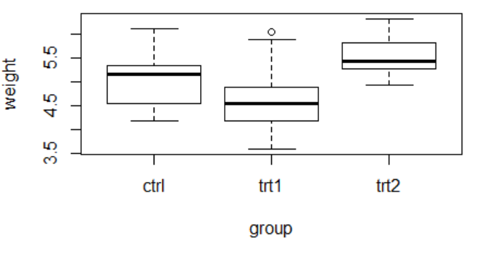
One-Way ANOVA
Plot the data; what do you think? Does Treatment 1 or Treatment 2 have a statistically relevant effect on the weight of the plants?
> boxplot(weight ~ group, data = PlantGrowth)

Slide 46
One-Way ANOVA
We want to know if there is a significant statistical difference between the average weights of the plants in the 3 experimental conditions
Before doing the analysis we need to take a detour and look at formula notation so we understand how it is used in the steps we will take
> boxplot(weight ~ group, data = PlantGrowth)

Slide 47
Formula Notation
Formula notation in R allows complicated expressions to be specified.
Allows values of variables to be captured ("quoted") without evaluation.
Allows variables inside data frames to be easily accessible.
Basic syntax allows flexibility:
y ~ x1 + x2 + ..., data = data
y = response variable
x1... = predictor variables
data = the data object that holds the variables
the names for y and xN variables change depending on the context.
y = response = dependent = controlled = feature
xN = predictor = independent = outcome = label

Slide 48
Formulas Are Objects in R
> f <- y ~ x
> f
y ~ x
> class(f)
[1] "formula"
> typeof(f)
[1] "language"
> attributes(f)
$`class`
[1] "formula"
$.Environment
<environment: R_GlobalEnv>

Slide 49
One-sided vs. Two-Sided Formulas
Depending on the context within a function, a one-sided or two-sided formula may be used
> e <- ~ x + y # one-sided
> f <- y ~ x + b # two-sided
> e
~x + y
> f
y ~ x + b

Slide 50
One-Way ANOVA
Continuing our analysis…
We want to know if there is any significant difference between the average weights of plants in the 3 experimental conditions.
The aov() function can be used to answer to this question
This function will create a regression object, which in its raw form isn't that interesting to us, see the next slide for how to use it
> aov(weight ~ group, data=PlantGrowth)
Call:
aov(formula = weight ~ group, data = PlantGrowth)
Terms:
group Residuals
Sum of Squares 3.76634 10.49209
Deg. of Freedom 2 27
Residual standard error: 0.6233746
Estimated effects may be unbalanced

Slide 51
One-Way ANOVA
The regression object created by the aov() function can be passed to the summary function to give us the desired results (note the F value and p-value)
> pg.aov <- aov(formula = weight ~ group, data = PlantGrowth)
> summary(pg.aov)
Df Sum Sq Mean Sq F value Pr(>F)
group 2 3.766 1.8832 4.846 0.0159 *
Residuals 27 10.492 0.3886
---
Signif. codes:
0 ‘***’ 0.001 ‘**’ 0.01 ‘*’ 0.05 ‘.’ 0.1 ‘ ’ 1
Remember that according to the "F-test", as values of F increase above 1, the evidence is increasingly inconsistent with the null hypothesis.
Since the p-value (labeled "Pf(>F)" in this data) is less than the significance level (0.05 in this example), we have evidence against the null hypothesis H0 (there is no significant difference between the groups).

Slide 52
Two-Way ANOVA
In many studies, the numeric outcome variable you’re interested in will be categorized by more than just one grouping variable.
In these cases, you would use a "multiple-factor" ANOVA rather than the one-way ANOVA.
This technique is directly referred to by the number of grouping variables used, with two- and three-way ANOVA being the next and most common extensions.
Increasing the number of grouping variables complicates matters, but performing just a one-way ANOVA for each variable separately is inadequate.

