Slide 1
COP2073C
Introduction to Statistical Programming with R
Module 10: Introduction to the Tidyverse
Reading (R for Data Science):
Ch. 1 Data Visualization with ggplot2
Ch. 2 Workflow: Basics
Ch. 3 Data Transformation with dplyr

Slide 2
Ch. 1 (R for Data Science) Data Visualization with ggplot2

Slide 3

Introduction to the Tidyverse

Slide 4
Introduction to the Tidyverse
"The tidyverse is an opinionated collection of R packages designed for data science. All packages share an underlying design philosophy, grammar, and data structures."
tidyverse.org
core packages are ggplot2, dplyr, tidyr, readr, purrr, tibble, stringr, and forcats, which provide functionality to model, transform, and visualize data.
The package emphasizes functional programming, a programming strategy which uses mathematical functions and expressions
While popular, the tidyverse is not without its critics
In particular, the functional programming emphasis makes it difficult for non-programmers to use
httmatloff/TidyverseSkeptic

Slide 5
Loading the Tidyverse
Load the tidyverse by running this code:
> install.packages("tidyverse")
> library(tidyverse)
You only need to install a package once, but you need to reload it (via library) every time you start a new session

Slide 6
Version Warnings and Updating Base R
When you load packages you may see warnings about your version of R.
If the library fails to load you can use the following commands from within RStudio to update your baseR version:
> install.packages("installr")
> library(installr)
> updateR()
Be sure to check package documentation before upgrading in case your package doesn't support a more recent version of R.

Slide 7
Answering Questions with Visualization
Do cars with big engines use more fuel than cars with small engines?
The answer is intuitive but visualization of the data can make it precise
What does the relationship between engine size and fuel efficiency look like?
The mpg Data Frame
Test your intuition using the mpg data frame found in the ggplot2 package (ggplot2::mpg).
A data frame is a rectangular collection of variables (in the columns) and observations (in the rows)
A tibble is a "modern reimagining" of a data frame (Wickham)
mpg contains observations collected by the US Environment Protection Agency on 38 models of cars

Slide 8
The ggplot2::mpg Data Frame
> mpg
# A tibble: 234 × 11
manufacturer model displ year cyl trans drv
<chr> <chr> <dbl> <int> <int> <chr> <chr>
1 audi a4 1.8 1999 4 auto(l5) f
2 audi a4 1.8 1999 4 manual(m5) f
3 audi a4 2.0 2008 4 manual(m6) f
4 audi a4 2.0 2008 4 auto(av) f
5 audi a4 2.8 1999 6 auto(l5) f
6 audi a4 2.8 1999 6 manual(m5) f
# ... with 228 more rows, and 4 more variables:
# cty <int>, hwy <int>, fl <chr>, class <chr>

Slide 9
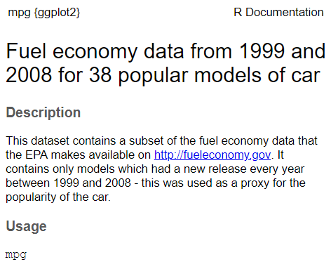
The ggplot2::mpg Data Frame
Among the variables in mpg are:
displ, a car’s engine size, in liters
hwy, a car’s fuel efficiency on the highway, in miles per gallon (mpg)
A car with a low fuel efficiency consumes more fuel than a car with a high fuel efficiency when they travel the same distance
enter ?mpg to learn more

Slide 10
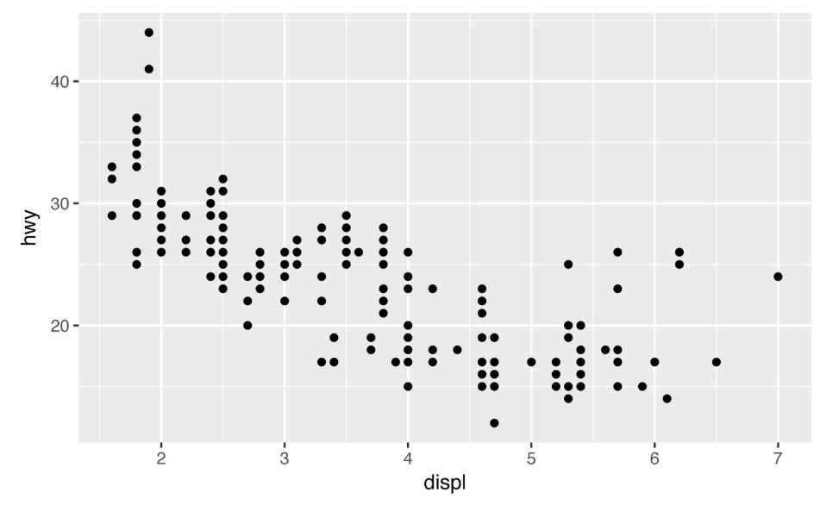
Creating a ggplot
To put displ on the x-axis and hwy on the y-axis:
> ggplot(data = mpg) +
geom_point(mapping = aes(x = displ, y = hwy))

Slide 11
ggplot Basics
> ggplot(data = mpg) +
geom_point(mapping = aes(x = displ, y = hwy))
ggplot() creates a coordinate system to which layers can be added.
The first argument of ggplot() is the dataset to use in the graph
ggplot(data = mpg) creates an empty graph, but it’s not very interesting
Complete the graph by adding one or more layers to ggplot()
The geom_point() function adds a layer of points, which creates a scatterplot.
ggplot2 comes with many geom functions that add a different type of layer to a plot

Slide 12
ggplot Mapping Argument
> ggplot(data = mpg) +
geom_point(mapping = aes(x = displ, y = hwy))
The mapping argument defines how variables in your dataset are mapped to visual properties
The aes() function adds "aesthetic mappings" which map to variables in the data
The x and y arguments of aes() specify which variables to map to the x- and y-axes
ggplot() looks for the mapped variables in the data argument (e.g. the mpg data frame)

Slide 13
The mpg Plot
We can move the aesthetic mapping of the variables into the ggplot function, then the point layer specification is simpler.
We can also add a trendline using the lm function.
> ggplot(data = mpg, aes(displ,hwy)) +
geom_point() + geom_smooth(method = "lm")
The plot shows a negative relationship (downward trendline) between engine size (displ) and fuel efficiency (hwy). In other words, cars with big engines use more fuel.

Slide 14
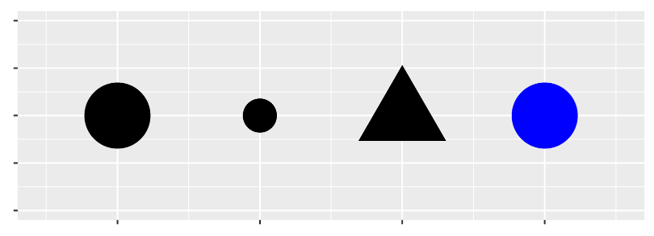
Aesthetic Mappings
An aesthetic is a visual property of the objects in your plot
Aesthetics include things like the size, the shape, or the color of your points.
You can display a point in different ways by changing the values of its aesthetic properties, called "levels".
For instance, changing the levels of a point’s size, shape, and color can make the point small, triangular, or blue:

Slide 15
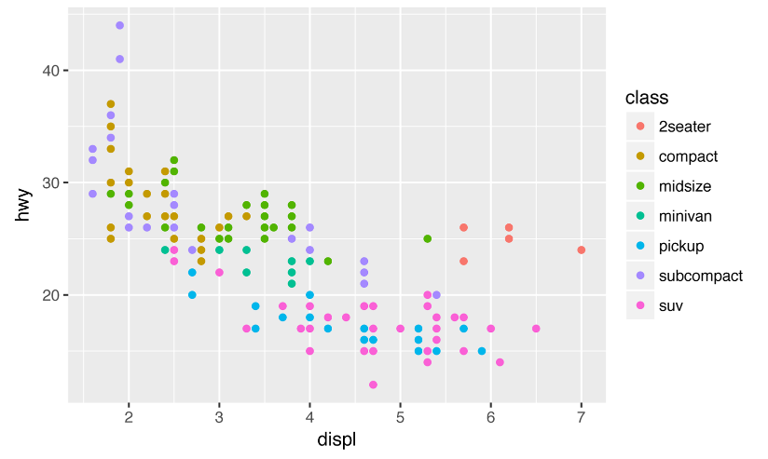
Aesthetic Mappings (cont)
You can add a third variable to a two-dimensional scatterplot by mapping it to an aesthetic
map the colors of your points to a third variable "class" to reveal the class of each car:
> ggplot(data = mpg) + geom_point(
mapping = aes(x = displ, y = hwy, color = class))

Slide 16
Aesthetic Mappings (cont)
To map an aesthetic to a variable, associate the name of the aesthetic to the name of the variable inside aes()
ggplot() will automatically assign a unique level of the aesthetic (e.g. a unique color) to each unique value of the variable, a process known as scaling
ggplot() will also add a legend that explains which levels correspond to which values
We can map class to the size aesthetic in the same way.
In this case, the exact size of each point would reveal its class affiliation.
Note: mapping an unordered variable (class) to an ordered aesthetic (size, e.g. smallest to largest) is not a good idea

Slide 17
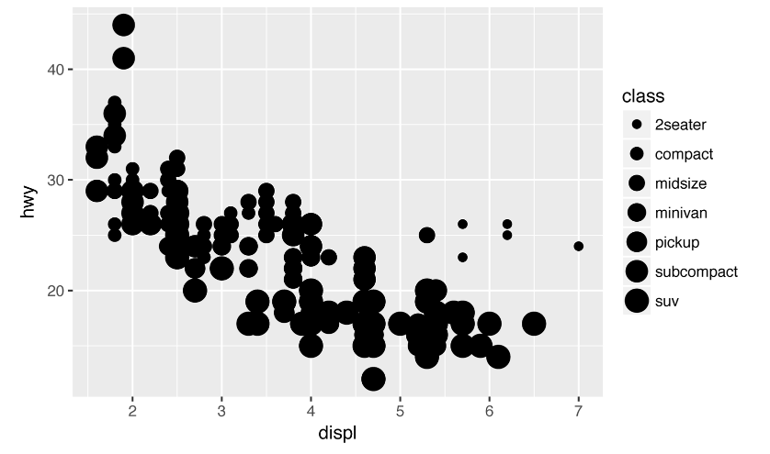
Aesthetic Mappings (cont)
> ggplot(data = mpg) + geom_point(
mapping = aes(x = displ, y = hwy, size = class))
Warning: Using size for a discrete variable is not advised

Slide 18
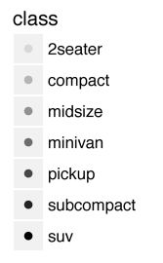
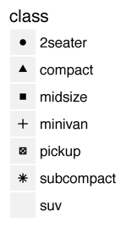
Other Aesthetic Mappings
alpha (transparency)
shape
(note that by default, only 6 shapes are used, additional points are unmapped)

Slide 19
x and y Aesthetics
Once you map an aesthetic, ggplot() selects a reasonable scale to use with the aesthetic, and constructs a legend that explains the mapping between levels and values
For x and y aesthetics, ggplot() does not create a legend, but it creates an axis line with tick marks and a label
The axis line acts as a legend; it explains the mapping between locations and values
You can also set the geom aesthetic properties manually
For example, to make all of the points in the mpg plot blue:
> ggplot(data = mpg) + geom_point(
mapping = aes(x = displ, y = hwy), color = "blue")

Slide 20
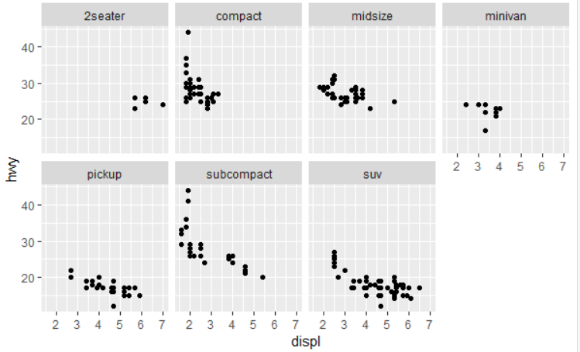
Facets
Another way to add variables, particularly useful for categorical variables, is to split your plot into facets
facets are subplots that each display one subset of the data
> ggplot(data = mpg) +
geom_point(mapping = aes(x = displ, y = hwy)) +
facet_wrap(~ class, nrow = 2)

Slide 21
The facet_wrap Function
> ggplot(data = mpg) +
geom_point(mapping = aes(x = displ, y = hwy)) +
facet_wrap(~ class, nrow = 2)
facet_wrap wraps a 1 dimensional sequence of panels into 2 dimensions
The first argument of facet_wrap() should be a formula
The variable that you pass to facet_wrap() should be discrete (not continuous)

Slide 22
The R Formula Operator ~
> ggplot(data = mpg) +
geom_point(mapping = aes(x = displ, y = hwy)) +
facet_wrap(~ class, nrow = 2)
The tilde operator ~ characterizes formulas in R
The variable on the left-hand side of a tilde (~) is the dependent variable, while (one or more) variables on the right-hand side are independent variables
If there are more than one independent variable they are joined by plus signs +
A left-hand side variable is not required, as shown in the above example

Slide 23
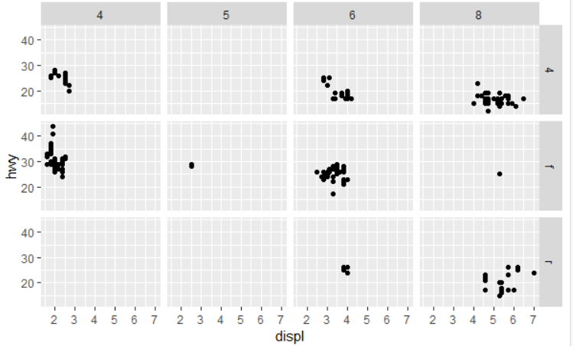
Two-Variable Faceting with facet_grid()
To facet your plot with a combination of two variables, add facet_grid() to your plot call
The first argument of facet_grid() is also a formula. This time the formula should contain two variable names separated by ~
> ggplot(data = mpg) +
geom_point(mapping = aes(x = displ, y = hwy)) +
facet_grid(drv ~ cyl)

Slide 24
Geometric Objects
A geom is the geometrical object that a plot uses to represent data
Plots are often described by the type of geom that the plot uses
e.g. bar charts use bar geoms, line charts use line geoms, boxplots use boxplot geoms
scatterplots use the point geom
Different geoms can be used to plot the same data
To change the geom in your plot, change the geom function that you add to ggplot()
# use point geom
> ggplot(data = mpg) +
geom_point(mapping = aes(x = displ, y = hwy))
# use smooth geom
> ggplot(data = mpg) +
geom_smooth(mapping = aes(x = displ, y = hwy))

Slide 25
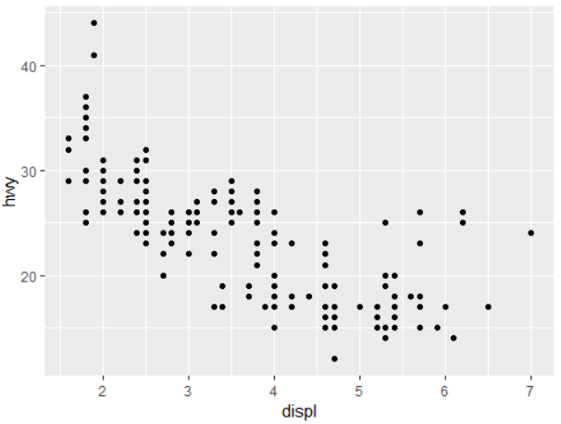
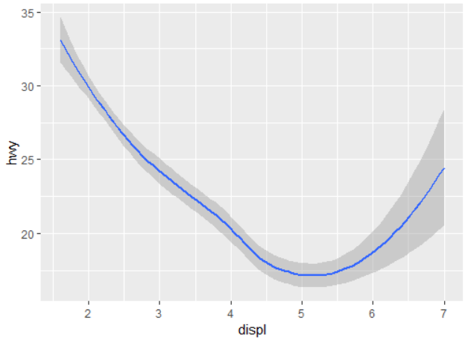
Geometric Objects (cont)
# use point geom
> ggplot(data = mpg) +
geom_point(mapping = aes(x = displ, y = hwy))
# use smooth geom
> ggplot(data = mpg) +
geom_smooth(mapping = aes(x = displ, y = hwy))

Slide 26
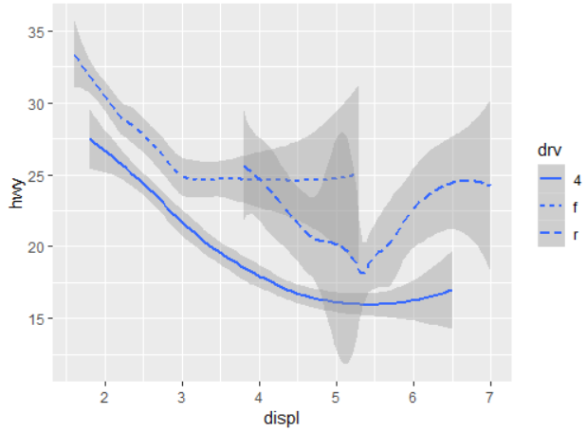
Using Appropriate Aesthetics
Not every aesthetic applies to every geom; setting the shape for a line geom doesn't make sense. Line types, however, do make sense for the line geom
e.g. use ggplot() to map a different line type to each drive train value (f = front-wheel drive, r = rear-wheel drive, 4 = 4-wheel drive)
> ggplot(data = mpg) +
geom_smooth(mapping =
aes(x = displ, y = hwy,
linetype = drv))

Slide 27
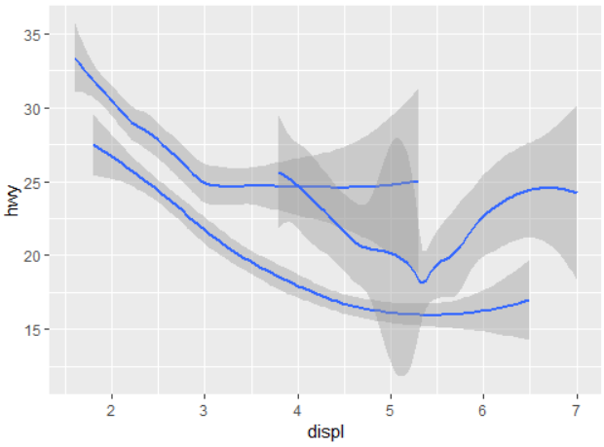
Using the Group Aesthetic
The group aesthetic groups the display of multiple objects for a categorical variable
> ggplot(data = mpg) +
geom_smooth(mapping = aes(x = displ, y = hwy, group = drv))

Slide 28
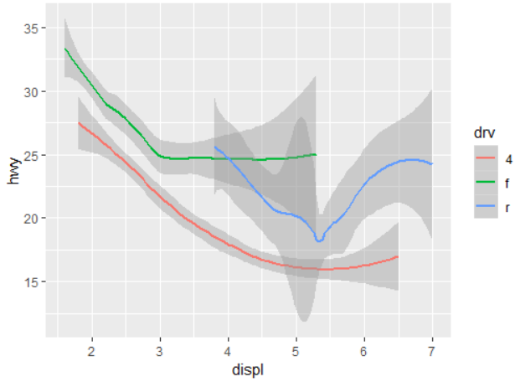
R Does Automatic Grouping
ggplot() will automatically group the data when you map an aesthetic to a discrete variable
> ggplot(data = mpg) + geom_smooth(mapping =
aes(x = displ, y = hwy, color = drv))

Slide 29
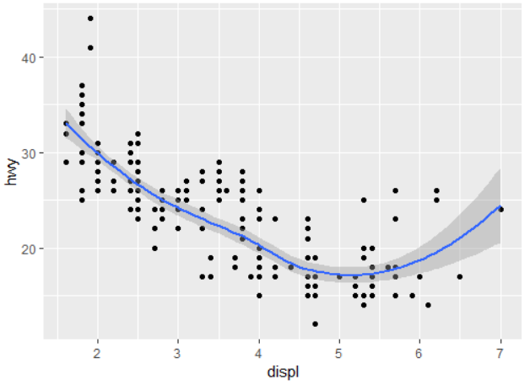
Display Multiple geoms in One Plot - Shortcut
ggplot2 provides a + operator to plot multiple geoms
It works similar to the 'pipe' operator (see next module's modelr package)
"...if I'd discovered the pipe earlier, there never would've been a ggplot2" – Hadley Wickham
Here's a shortcut to display multiple geoms in the same plot
> ggplot(data = mpg,
mapping = aes(x = displ,y = hwy)) +
geom_point() + geom_smooth()

Slide 30
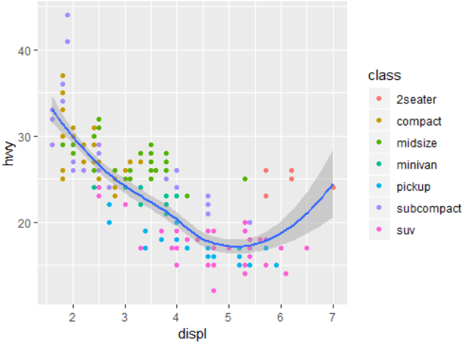
Display Multiple Aesthetics
If you place mappings in a geom function, ggplot() will treat them as local mappings for the specific layer
ggplot() will use these mappings to extend or overwrite the global mappings for that layer only. This makes it possible to display different aesthetics in different layers
ggplot(data = mpg, mapping = aes(x = displ, y = hwy)) +
geom_point(mapping = aes(color = class)) +
geom_smooth()

Slide 31
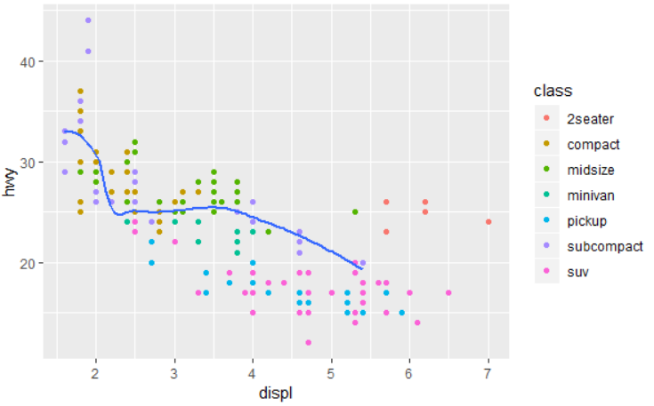
Layer-Specific Data
Use the filter function to isolate data components
Here the smooth line displays a subset of the mpg dataset, the subcompact cars
The local data argument in geom_smooth() overrides the global data argument in ggplot() for that layer only
ggplot(data = mpg, mapping = aes(x = displ, y = hwy)) +
geom_point(mapping = aes(color = class)) +
geom_smooth(data = filter(mpg, class == "subcompact"),
se = FALSE)
Note: se = FALSE refers to the display of the confidence interval. This results in a "shadowed" line, which we avoid here by using se = FALSE

Slide 32
Chapter 2. (R for Data Science) Workflow: Basics

Slide 33
Basic R Concepts and Shortcuts
Chapter 2 in R for Data Science is a short review of some basic R concepts, read through the content to be sure you're caught up on those basics before continuing on to Ch. 3

Slide 34
Ch. 3 (R for Data Science) Data Transformation with dplyr

Slide 35
Introduction to dplyr
dplyr provides a set of tools for efficiently manipulating datasets in R
https://blog.rstudio.com/2014/01/17/introducing-dplyr/
dplyr uses data frames and tibbles
Three underlying concepts:
performance
cross-compatibility: anything you can do to a local data frame you can also do to a remote database table
PostgreSQL, MySQL, SQLite and Google bigquery support is built-in
Individual functions that correspond to the most common operations
Each function does one only thing, but does it well

Slide 36
nycflights13 Dataset
nycflights13 contains airline on-time data for all flights departing NYC in 2013
Also includes useful 'metadata' on airlines, airports, weather, and planes.
> install.packages("dplyr")
> library(dplyr)
> library(nycflights13)

Slide 37
Library Conflicts
Loading dplyr masks some basic R functions:
-- Conflicts ----------------------------
tidyverse_conflicts() --
x dplyr::filter() masks stats::filter()
x .GlobalEnv::first() masks dplyr::first()
x dplyr::lag() masks stats::lag()
In order to use the masked functions, use the qualified :: name:
e.g stats::filter(), stats::lag()

Slide 38
nycflights13 - Flight Data
> flights
# A tibble: 336,776 x 19
year month day dep_time sched_dep_time
<int> <int> <int> <int> <int>
1 2013 1 1 517 515
2 2013 1 1 533 529
3 2013 1 1 542 540
4 2013 1 1 544 545
5 2013 1 1 554 600
6 2013 1 1 554 558
7 2013 1 1 555 600
8 2013 1 1 557 600
9 2013 1 1 557 600
10 2013 1 1 558 600
# ... with 336,766 more rows, and 14 more
# variables: dep_delay <dbl>, arr_time <int>,
# sched_arr_time <int>, arr_delay <dbl>,
# carrier <chr>, flight <int>, tailnum <chr>,
# origin <chr>, dest <chr>, air_time <dbl>,
# distance <dbl>, hour <dbl>, minute <dbl>,
# time_hour <dttm>

Slide 39
Flight Data – Data Types
int refers to integers
dbl refers to for doubles, or real numbers
chr is used for character vectors, or strings
dttm is date-time (a date + a time)
R refers to these as POSIXct
There are three other common types of variables that aren’t used in this dataset:
lgl refers to logical, vectors that contain only TRUE or FALSE.
fctr is factors, which R uses to represent categorical variables with fixed possible values
date refers to dates

Slide 40
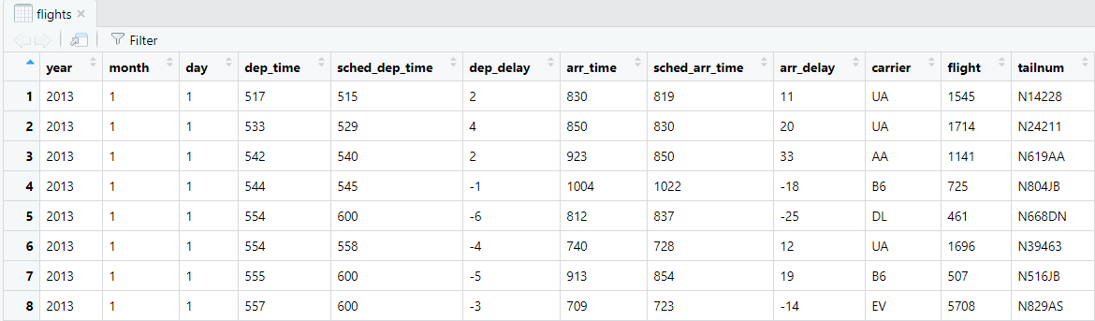
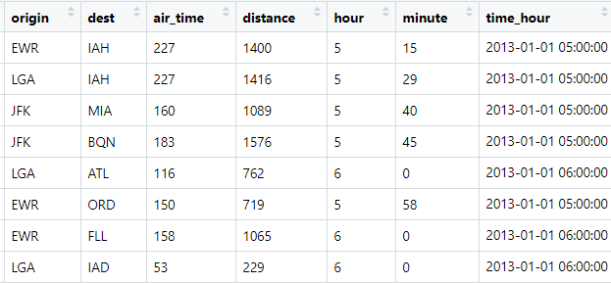
nycflights13 Flight Data – Full Dataset
> View(flights)
…
…

Slide 41
Basic dplyr Functions
There are 6 basic functions used in dplyr:
pick observations by their values: filter()
reorder the rows: arrange()
pick variables by their names: select()
create new variables with functions of existing variables: mutate()
collapse many values down to a single summary: summarize()
apply functions on a group-by-group basis: group_by()
group_by() is used with the above five functions

Slide 42
filter()
filter() allows you to subset observations based on their values
The first argument is the name of the data frame
The second and subsequent arguments are the expressions that filter the data frame
Select all flights on January 1st:
> filter(flights, month == 1, day == 1)
# A tibble: 842 x 19
year month day dep_time sched_dep_time
<int> <int> <int> <int> <int>
1 2013 1 1 517 515
2 2013 1 1 533 529
...
9 2013 1 1 557 600
10 2013 1 1 558 600
# ... with 832 more rows, and 14 more
# variables: dep_delay <dbl>,
...

Slide 43
filter() Results are Immutable
dplyr functions never modify their inputs; to save the result use the assignment operator
> jan1 <- filter(flights, month == 1, day == 1)
To both print results and save them, wrap the expression in parentheses:
> (dec25 <- filter(flights, month == 12, day == 25))

Slide 44
Floating Point Representation
As with most programming languages, R uses IEEE 754 as the basis for representation of floating point numbers
# square root of 2 squared should be 2
> sqrt(2) ^ 2 == 2
[1] FALSE
# 1/49 * 49 should be 1
> 1/49 * 49 == 1
[1] FALSE
Instead of relying on ==, use near():
> near(sqrt(2) ^ 2, 2)
[1] TRUE
> near(1 / 49 * 49, 1)
[1] TRUE

Slide 45
Missing Values
NA represents an unknown value so missing values are “contagious”; almost any operation involving an unknown value will also be unknown:
> NA > 5
[1] NA
> 10 == NA
[1] NA
> NA + 10
[1] NA
> NA / 2
[1] NA
> NA == NA
[1] NA
# Let x be Mary's age. We don't know how old she is.
x <- NA
# Let y be John's age. We don't know how old he is.
y <- NA
# Are John and Mary the same age?
x == y
#> [1] NA
# We don't know!

Slide 46
filter() and Missing Values
If you want to determine if a value is missing, use is.na():
> is.na(x)
[1] FALSE
filter() only includes rows where the condition is TRUE; it excludes both FALSE and NA values. If you want to preserve missing values, ask for them explicitly:
> df <- tibble(x = c(1, NA, 3))
> df
# A tibble: 3 x 1
x
<dbl>
1 1
2 NA
3 3
> filter(df, x > 1)
# A tibble: 1 x 1
x
<dbl>
1 3
> filter(df, is.na(x) | x > 1)
# A tibble: 2 x 1
x
<dbl>
1 NA
2 3

Slide 47
arrange()
arrange() works similarly to filter() except that instead of selecting rows, it changes their order
If you provide more than one column name, each additional column will be used to break ties in the values of preceding columns
> arrange(flights, sched_dep_time, year, month, day)
# A tibble: 336,776 x 19
year month day dep_time sched_dep_time dep_delay arr_time
<int> <int> <int> <int> <int> <dbl> <int>
1 2013 7 27 NA 106 NA NA
2 2013 1 2 458 500 -2 703
3 2013 1 3 458 500 -2 650
4 2013 1 4 456 500 -4 631
5 2013 1 5 458 500 -2 640
…

Slide 48
arrange()
Use desc() to reorder by a column in descending order:
> arrange(flights, desc(dep_delay))
# A tibble: 336,776 x 19
year month day dep_time sched_dep_time dep_delay
<int> <int> <int> <int> <int> <dbl>
1 2013 1 9 641 900 1301
2 2013 6 15 1432 1935 1137
...
10 2013 12 5 756 1700 896
... with 336,766 more rows, and 13 more variables:…

Slide 49
arrange()
Missing values are always sorted at the end:
> df <- tibble(x = c(5, 2, NA))
> df
# A tibble: 3 x 1
x
<dbl>
1 5
2 2
3 NA
> arrange(df, x)
# A tibble: 3 x 1
x
<dbl>
1 2
2 5
3 NA
> arrange(df, desc(x))
# A tibble: 3 x 1
x
<dbl>
1 5
2 2
3 NA

Slide 50
select()
select() allows you to rapidly zoom in on a useful subset using operations based on the names of the variables
# Select columns by name
> select(flights, year, month, day)
# A tibble: 336,776 x 3
year month day
<int> <int> <int>
1 2013 1 1
2 2013 1 1
3 2013 1 1
4 2013 1 1
5 2013 1 1

Slide 51
select()
select() also allows exclusion of columns
# Select all columns except those from year to day
> select(flights, -(year:day))
# A tibble: 336,776 x 16
dep_time sched_dep_time dep_delay arr_time sched_arr_time
<int> <int> <dbl> <int> <int>
1 517 515 2 830 819
2 533 529 4 850 830
3 542 540 2 923 850
4 544 545 -1 1004 1022
5 554 600 -6 812 837

Slide 52
select()
There are a number of helper functions you can use within select():
starts_with("abc") matches names that begin with “abc”
ends_with("xyz") matches names that end with “xyz”
contains("ijk") matches names that contain “ijk”
Another option is to use select() in conjunction with the everything() helper. This is useful if you have a handful of variables you’d like to move to the start of the data frame:
> select(flights, time_hour, air_time, everything())
# A tibble: 336,776 x 19
time_hour air_time year month day dep_time
<dttm> <dbl> <int> <int> <int> <int>
1 2013-01-01 05:00:00 227 2013 1 1 517
2 2013-01-01 05:00:00 227 2013 1 1 533
3 2013-01-01 05:00:00 160 2013 1 1 542
4 2013-01-01 05:00:00 183 2013 1 1 544
5 2013-01-01 06:00:00 116 2013 1 1 554

Slide 53
summarize()
summarize() is an aggregation function
aggregation functions apply a single function to multiple rows or groups of rows
summarize() can collapse a data frame to a single row:
> summarize(flights, delay =
mean(dep_delay, na.rm = TRUE))
# A tibble: 1 x 1
delay
<dbl>
1 12.6 # overall average of delays

Slide 54
group_by()
group_by() changes the unit of analysis from the complete dataset to individual groups
> by_day <- group_by(flights, year, month, day)
> summarize(by_day, delay = mean(dep_delay, na.rm = TRUE))
# A tibble: 365 x 4
# Groups: year, month [12]
year month day delay
<int> <int> <int> <dbl>
1 2013 1 1 11.5 # average delay per date
2 2013 1 2 13.9
3 2013 1 3 11.0
4 2013 1 4 8.95
5 2013 1 5 5.73
6 2013 1 6 7.15
7 2013 1 7 5.42
8 2013 1 8 2.55
9 2013 1 9 2.28
10 2013 1 10 2.84
# ... with 355 more rows

Slide 55
The Pipe Operator %>%
The pipe operator forwards a value, or the result of an expression, into the next function call/expression
A function to filter data can be written as:
filter(data, variable == numeric_value)
-or-
data %>% filter(variable == numeric_value)
Both functions complete the same task and the benefit of using %>% may not be immediately evident; however, when you desire to perform multiple functions its advantage becomes obvious

Slide 56
The Pipe Operator %>% (cont)
If we want to filter some data, group it by categories, summarize it, and then order the summarized results we could write it out using multiple objects:
or using pipes:
> a <- filter(mtcars, carb > 1)
> b <- group_by(a, cyl)
> c <- summarize(b, Avg_mpg = mean(mpg))
> d <- arrange(c, desc(Avg_mpg))
> print(d)
> mtcars %>%
filter(carb > 1) %>%
group_by(cyl) %>%
summarize(Avg_mpg = mean(mpg)) %>%
arrange(desc(Avg_mpg))

Slide 57
The Pipe Operator %>% (cont)
Behind the scenes, x %>% f(y) turns into f(x, y), and x %>% f(y) %>% g(z) turns into g(f(x, y), z), and so on
You can use the pipe to rewrite multiple operations in a way that you can read left-to-right, top-to-bottom
Pipes are used frequently in R because they improve the readability of code

Slide 58
Missing Values
aggregation functions obey the rule of missing values: if there are any missing values in the input, the output will be a missing value
> flights %>%
group_by(year, month, day) %>%
summarize(mean = mean(dep_delay))
# A tibble: 365 x 4
# Groups: year, month [12]
year month day mean
<int> <int> <int> <dbl>
1 2013 1 1 NA
2 2013 1 2 NA
3 2013 1 3 NA
4 2013 1 4 NA
…

Slide 59
Missing Values (cont)
All aggregation functions have an na.rm argument which removes missing values prior to computation:
> flights %>%
group_by(year, month, day) %>%
summarize(mean = mean(dep_delay, na.rm = TRUE))
# A tibble: 365 x 4
# Groups: year, month [12]
year month day mean
<int> <int> <int> <dbl>
1 2013 1 1 11.5
2 2013 1 2 13.9
3 2013 1 3 11.0
4 2013 1 4 8.95
…

