Slide 1
COP2073C
Introduction to Statistical Programming with R
Module 1
Overview of Statistical Programming Concepts Introduction to the R Programming Language

Slide 2
Ch. 1 Getting Started

Slide 3
What is Statistical Programming?
The application of a programming language to traditional statistical analysis techniques
encoding of statistical methods
descriptive
inferential
visualization

Slide 4
Why Statistical Programming?
Simplify and automate use of complex statistical formulas
Perform complex data analysis over very large datasets
Perform a variety of operations in a single program
Reproduceable/verifiable results
Automate visualization tasks

Slide 5
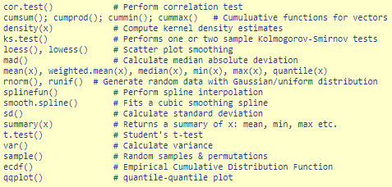





Why Statistical Programming?

Slide 6
Descriptive Statistics
Describe a sample group
Summarize and graph group properties
Presented using numbers and graphs
No uncertainty, no inferences about larger populations
Common tools:
mean/median - the center ("central tendency"); where most values occur
range/standard deviation - how far from center does data extend
skewness - whether a distribution is symmetric or skewed

Slide 7
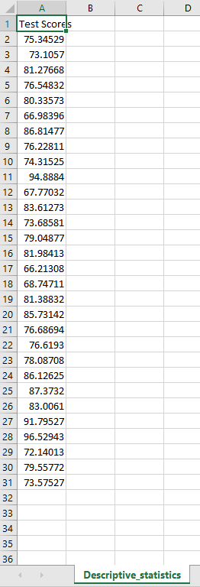
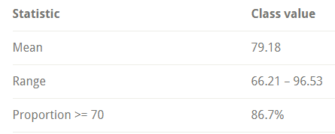
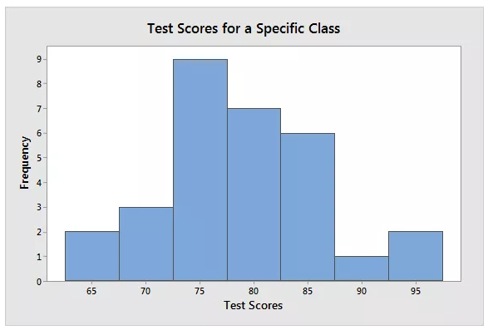
Example of Descriptive Statistics
Describe test scores of 30 students in a class
http://statisticsbyjim.com/basics/descriptive-inferential-statistics/

Slide 8
Inferential Statistics
Makes inferences about larger populations using sample group
(Random) sample must accurately reflect population
Process can be complicated:
Define population
Draw representative sample from population
Analyze and infer (sampling error must be considered)
Common tools:
hypothesis tests: two alternate theories, which is supported?
confidence intervals: range of likely values
regression analysis: validate observed relationships

Slide 9
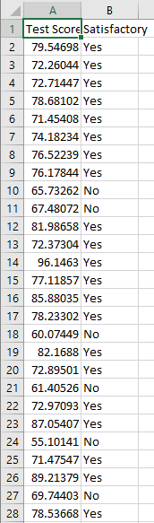
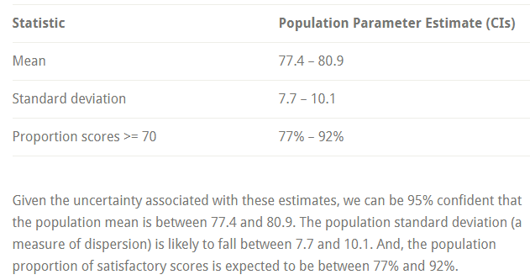
Example of Inferential Statistics
http://statisticsbyjim.com/basics/descriptive-inferential-statistics/

Slide 10
Why R?
Sophisticated statistical programming language
"Tailored" for data science
Free, open source
Runs on any operating system
Produces high quality graphics
Diverse community
https://twitter.com/search?q=%23rstats
https://meetup.com/topics/r-programming-language
https://rweekly.org
http://r-ladies.org
Huge inventory of packages for modelling, machine learning, visualization, data manipulation

Slide 11
Why NOT R?
Lack of elegant or well-maintained code base
Result-focused, not process-focused
Many R programmers do not reliably incorporate established software engineering practices (e.g. code control, automated testing)
Some R functions are obscure and some are inconsistent or unreliable
Contributed packages are inconsistent
Poor performance (particularly for poorly written code) and high memory usage

Slide 12
R and the Data Lifecycle
The data lifecycle represents stages of data as it progresses through collection and extraction of useful information
Collection - Cleaning - Filtering
Processing
- Manipulation - Transformation
Analysis - Modeling - Visualization
Reporting

Slide 13
Components of the Data Lifecycle in R
The R language ("BaseR") and R community-contributed libraries make R an ideal candidate for implementing components of the data lifecycle
Data Collection
R can access remote data sources, both structured and unstructured, and efficiently collect and clean it for processing
Cleaning tasks include fixing malformed data, removing empty entries
BaseR can handle many of these functions, but other packages offer enhanced behavior:
readxl
readr
vroom
rio
tidyxl

Slide 14
Components of the Data Lifecycle in R
Data Processing
Data processing includes manipulating and transforming data
Manipulation tasks include sorting, formatting
Transformation tasks include enhancing (e.g. add timestamps), converting from one format to another (e.g. Excel table to XML)
Some processing packages also serve as analysis tools
Some packages designed for this purpose:
dplyr
tidyr
data.table
lubridate
XML
rjson

Slide 15
Components of the Data Lifecycle in R
Data Analysis
Packages are provided by the R community for performing data analysis
Modeling
Visualization
Some of these are used for data processing and reporting as well
Some packages designed for this purpose:
modelr
tidyverse
ggplot2
bayess
RSentiment

Slide 16
Components of the Data Lifecycle in R
Reporting
Reporting includes publishing visuals, tables, and analysis results, frequently as components of a dashboard or web page
Some reporting tools are also used for data analysis
Some packages designed for reporting:
ggplot2
shiny
flexdashboard

Slide 17
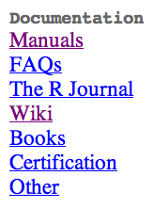
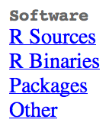
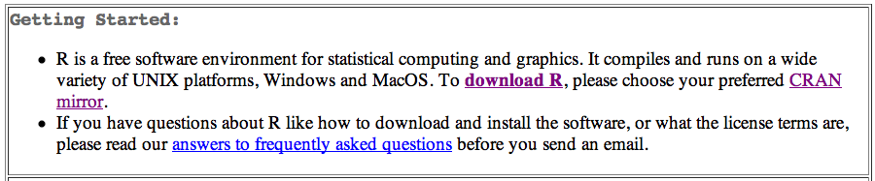
The R Project Website
Download program versions for any OS at
www.r-project.org
Website contains:
Documentation
Help
Additional packages of analytical routines

Slide 18
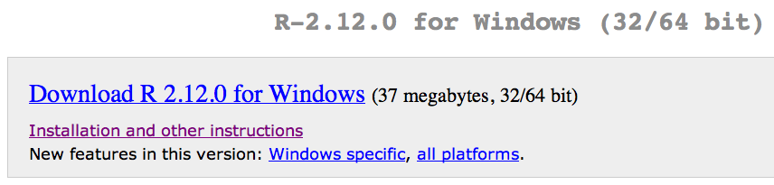
Installing R
Visit R Project website at www.r-project.org.
Click the download R link and select the appropriate CRAN (Comprehensive R Archive Network) mirror site
Choose your Operating System and click the link.
Follow the links for the appropriate version.
Download the installation file to your computer.
Run the installation file to install the program.
Install Rtools if desired (build custom packages).

Slide 19
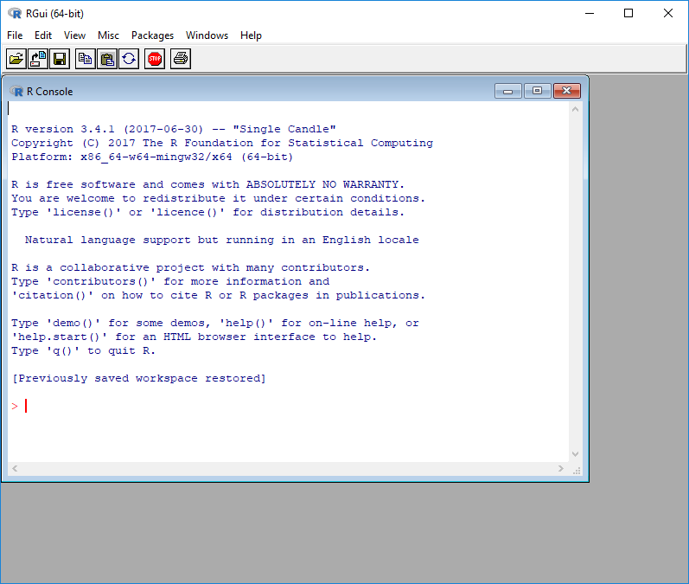
Running R
On Windows or Mac run the program using the icon.
On Linux open the Terminal program and type R.
The opening display is sparse compared to most Windows/Mac programs.

Slide 20
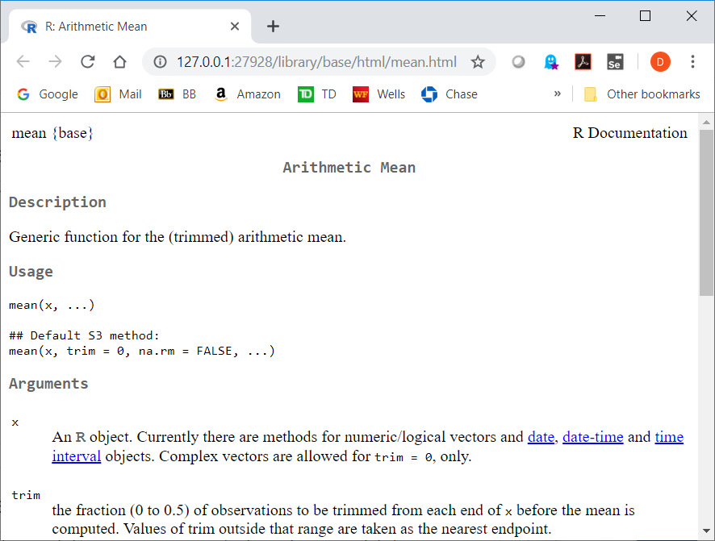
Finding Help
There are manuals and documentation on the R website.
R has extensive built-in help for commands
?topic to invoke help on a topic
brings up a local HTML file containing the help information
> ?mean

Slide 21
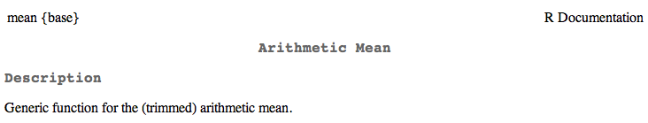
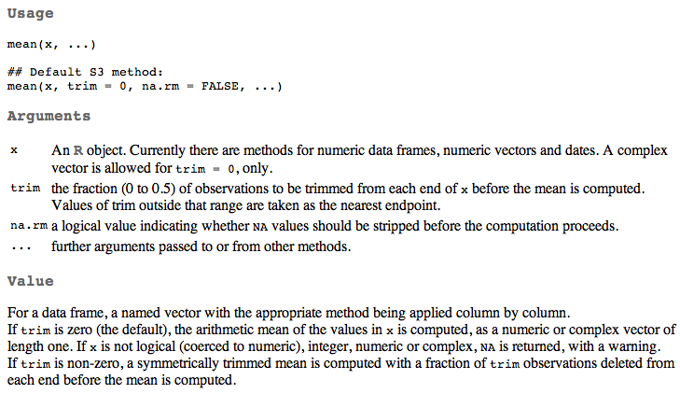
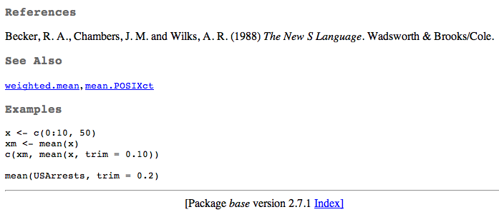
Anatomy of a Help Entry
Similar to unix manual ("man") pages
Top shows command name and description.
Middle shows common usage and instructions/
parameters.
Bottom shows references and examples.

Slide 22

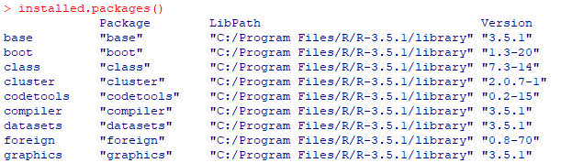
Command Packages
The R program is split into packages.
A package is a collection of functions, data, and compiled code
The standard installation contains various packages.
Additional packages of analytical routines and utilities can be downloaded from the R website.
To see currently installed and loaded packages:
search()
To list all downloaded packages:
> installed.packages()

Slide 23
Typing into R
The > symbol shows where to type into R console window.
Commands can spread over more than one line.
If cursor displays + then some additional typing is required (usually a closing parenthesis).
Spaces are usually ignored.
R can work like a simple calculator.
Type the math into the R console.
Results are displayed immediately.
Remember standard order of calculation so division and multiplication evaluated before subtraction and addition.
Use parentheses to ensure correct evaluation order:
> (12 + 17/2 -3/4) * 2.5
[1] 49.375
Spaces are ignored.

Slide 24
Save Your Results in a Variable (named objects)
R works on named objects ("everything is an object"); these objects are also known as variables
Assign a name to a calculation to create or overwrite the named object.
If a name is specified the result is not shown:
> ans1 <- 23 + 14/2 - 18 + (7 * pi/2)
> ans2 <- 13 + 11 + (17 - 4/7)
> ans3 <- ans2 + 9 - 2 + pi
Type the object name to see the result:
> ans1
[1] 22.99557

Slide 25
Object Assignment
Objects can be assigned using a left-pointing arrow <-
> ans4 <- 3 + 5
> ans5 <- ans1 * ans2
The equal sign = also assigns a value, but is not preferred:
> ans3 = ans2 + 9 - 2 + pi
You must use the arrow for assignment in this course. There are some subtle differences between the <- and = that we will look at later in these slides
See https://renkun.me/2014/01/28/difference-between-assignment-operators-in-r/
The arrow can be reversed (but this syntax is also not recommended and must not be used in this course):
> ans3 + pi / ans4 -> ans6

Slide 26
Language Specifics
https://cran.r-project.org/doc/manuals/r-release/R-intro.html#R-commands_003b-case-sensitivity-etc
R is case sensitive
The set of symbols which can be used in R names depends on the operating system and country within which R is being run (technically, it depends on the locale in use on the system)
Normally all alphanumeric symbols are allowed (and in some countries this includes accented letters) plus ‘.’ and ‘_’,
Names are effectively unlimited in length

Slide 27
More Language Specifics
Elementary commands consist of either expressions or assignments
If an expression is given as a command, it is evaluated, printed (unless specifically made invisible), and the value is lost.
An assignment also evaluates an expression and passes the value to a variable; the result is not automatically printed
Comments can be put almost anywhere, starting with a hashmark (‘#’), everything to the end of the line is a comment

Slide 28
More Language Specifics
If a command is not complete at the end of a line, R will give a different prompt (a plus sign +) on second and subsequent lines and continue to read input until the command is syntactically complete.
> grid <- mtcars_t %>%
+ data_grid(cyl) %>%
+ add_predictions(mtcars_t_mod)
Continue typing after the plus sign

Slide 29
Numeric Data
Numeric data in R is generically described as "numeric" but it has a type of either integer or double precision ("double")
R's default preference is to use double precision
R will convert integer values to double unless you specify otherwise
# R converts to 5 double
# Use typeof to view internal representation
> typeof(5)
[1] "double"
> typeof(5.5)
[1] "double"
# explicitly convert to integer
> as.integer(5)
[1] 5
> as.integer(5.5)
[1] 5
>
[1] "integer"
> typeof(as.integer(5.5))
[1] "integer"

Slide 30
Arithmetic
Standard arithmetic rules apply in R
Left-to-right evaluation
PEMDAS precedence
Parentheses, Exponents, Multiplication, Division, Addition, Subtraction
Very large (and very small) numbers will display using scientific notation (e-notation)
> 2342151012900
[1] 2.342151e+12
> 0.000000002533
[1] 2.533e-09

Slide 31
Functions
R has many built-in functions
The syntax of a function is
name(argument1, argument2, …)
where name is the name of the function (usually) describes what it does, e.g.
>round(3.1415)
[1] 3
and argument1, argument2, etc. are 0 or more function arguments passed to the function to determine its behavior

Slide 32
Functions (cont)
More function examples:
> seq(1,5)
[1] 1 2 3 4 5
> toupper("convert this to upper case")
[1] "CONVERT THIS TO UPPER CASE"
We can assign the result of a function to a named object:
> roundedPi <- round(3.1415)

Slide 33
Viewing Your Objects
To see the value of an object, just type its name
> roundedPi
[1] 3
To list objects you have created (assigned) you can use the ls() function.
> ls()
[1] "roundedPi"
Don't forget the parentheses, otherwise R will display the function's source code!

Slide 34
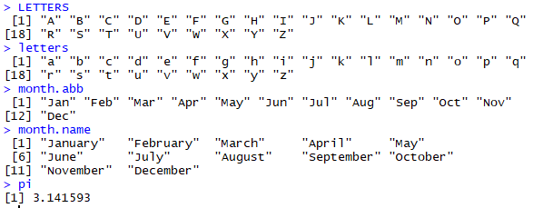
Built-in Constants
https://stat.ethz.ch/R-manual/R-devel/library/base/html/Constants.html
R has a small number of built-in constants:
LETTERS: the 26 upper-case letters of the Roman alphabet
letters: the 26 lower-case letters of the Roman alphabet
month.abb: the three-letter abbreviations for the English month names
month.name: the English names for the months of the year
pi: the ratio of the circumference of a circle to its diameter

Slide 35
Creating Simple Data Objects
A vector is a collection of primitive data types
Simple vectors of ordered sequences can be created using the : (colon) operator
die <- 1:6
You can also create a vector using the c() function ("combine"):
odds <- c(1, 3, 5, 7, 9)

Slide 36
Creating Text Data
Text data is surrounded by quotes:
day1 <- c('Mon', 'Tue', 'Wed', 'Thu')
You can use single ' ' or double " " quotes as long as each pair matches
there is no char (single character) type
the data type of strings is referred to as character

Slide 37
Seeing Your Data
Named objects are not shown unless you type the object name:
> # create a vector of random values
> data1 <- c(3, 5, 7, 5, 3, 2, 6, 8, 5, 6, 9)
> # display the vector
> data1
[1] 3 5 7 5 3 2 6 8 5 6 9

Slide 38
Seeing Your Data
Each line begins with an index value (first element in object), even for single values:
> # assign 3 to x and display its value
> x <- 3
> x
[1] 3
Text values are reported within quotes:
> day1
[1] "Mon" "Tue" "Wed" "Thu”

Slide 39
Seeing Your Data
You can print an object using the print() function:
> x <- c(1,2,3,4,5)
> x
[1] 1 2 3 4 5
> print(x)
[1] 1 2 3 4 5
print() doesn't deal with multiple arguments, though; use cat() for this:
> print("x=", x)
[1] "x="
> cat("x=", x, "\n") # "\n" appends a newline
x= 1 2 3 4 5

Slide 40
Seeing Your Data
You can examine the internal structure of your data using the str() (structure) function
> data1 <- c(3, 5, 7, 5, 3, 2, 6, 8, 5, 6, 9)
> data1
[1] 3 5 7 5 3 2 6 8 5 6 9
> str(data1)
num [1:11] 3 5 7 5 3 2 6 8 5 6 ...

Slide 41
Function Parameters
R passes function arguments by value, which means any changes you make to the arguments inside of a function are not seen by the caller of the function
Function calls can be nested; the calls are processed from the "inside-out", which means the "inner" calls become arguments to the "outer" calls:
> die <- 1:6
> die
[1] 1 2 3 4 5 6
> mean(die)
[1] 3.5
> round(mean(die))
[1] 4
Note on the round() function: If the first digit that is dropped is exactly 5, R uses a rule that’s common in many programming languages: Always round to the nearest even number. For instance, round(1.5) and round(2.5) both return 2. On the negative side of the number scale, round(-4.5) returns -4.

Slide 42
Example: Roll a Die
We can write R code which simulates the roll of a single die
Given the "die" vector created on the previous slides, use the sample function:
sample(die, 1)
sample() will take a (pseudo-) random sample of size 1 from the die vector
> sample(die, 1)
[1] 4
> sample(die, 1)
[1] 3
> sample(die, 1)
[1] 2
> sample(die, 1)
[1] 5

Slide 43
Named Function Arguments
Arguments for R functions have names, which we can specify using the = sign:
> sample(x=die, size=1)
[1] 6
This allows us to pass arguments in any order:
> # calling with size argument first
> sample(size=1, x=die)
[1] 1

Slide 44
Named Function Arguments
If you do not specify the argument names, you must be sure to pass the arguments in the correct order. Try
sample(1, die)
and see what happens -- the normal order is sample(die, 1)
> [1] 1
We get 1, repeatedly – sample() is taking a sample from a "vector" containing only the number 1, so that's all it can produce
As of Rv4, we now get an error – the arguments must be passed in the correct, "die" is not a numeric type so it is not accepted as the size parameter

Slide 45
Viewing Function Arguments
If you aren't sure of the argument ordering or argument names, you can call the args() function with the function name to find out:
> args(sample)
function (x, size, replace = FALSE, prob = NULL)
Notice that there are additional arguments for the sample function (replace and prob).
These are optional arguments, if not provided, they are assigned default values as shown above.

Slide 46
Viewing Function Arguments
You can also type the function name without parentheses and look at the first line:
> sample # view the function arguments
function (x, size, replace = FALSE, prob = NULL)
(source code for the sample function follows this line)

Slide 47

RStudio
https://www.rstudio.com/
IDE for R development
Source editing, console (commands/input/output), environment, help, file management, package management
Install R first
-> then download Rstudio Desktop (the free version)

Slide 48
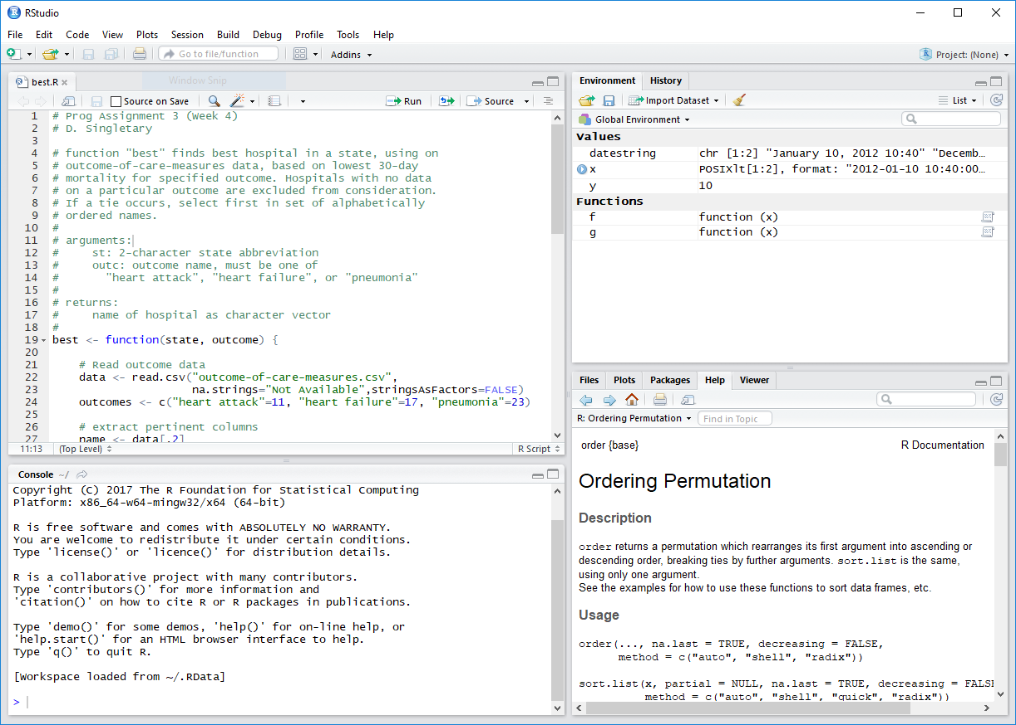
Using R Studio
CustomizablePane Layout
Source/Edit
Pane
Environment
Pane
Help
Pane
Console
Pane

Slide 49
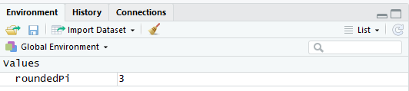
Viewing Your Objects
In R Studio, you can view your objects in the environment pane (upper right corner)

Slide 50
Clearing Your Objects
We sometimes need to "clean the slate" and clear our environment after creating many objects
From the command line:
rm(list=ls())
In R Studio, you can clear objects from your environment by clicking on the "broom" icon in the environment pane (upper right corner)

Slide 51
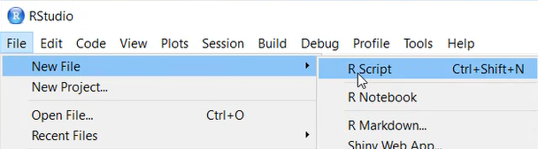
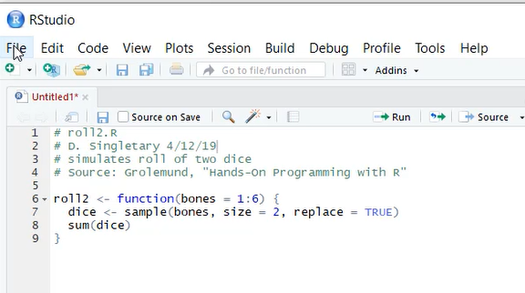
Writing R Scripts
Create a script by using a text editor or R studio:

Slide 52
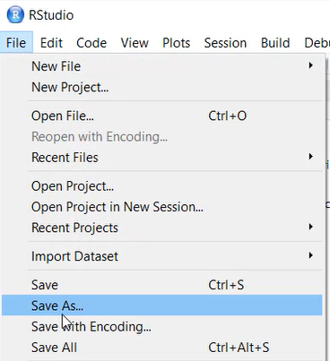
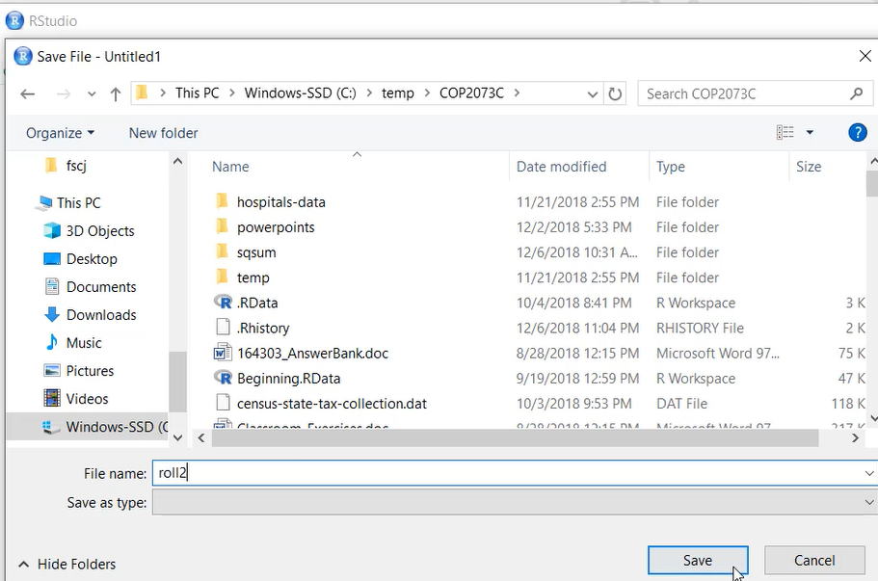
Saving R Scripts
Save the script file as plain text, use .R extension (extension will automatically apply in RStudio)
Check/set working directory with getwd()/setwd() before saving!
> getwd()
[1] "C:/Users/Documents"
> setwd("/temp/COP2073C")
> getwd()
[1] "C:/temp/COP2073C"

Slide 53
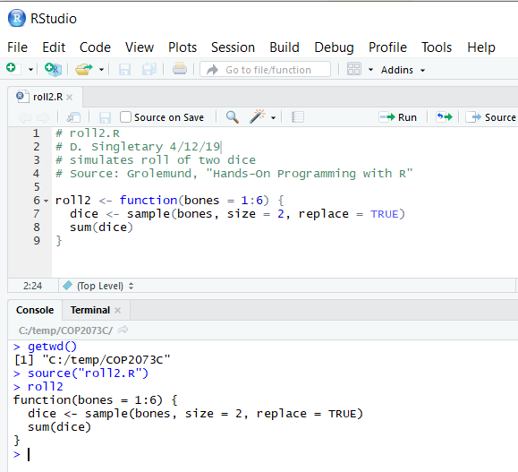
Opening R Scripts
To edit, in RStudio, use File/Open File
Use the source function (Luke) to source contents into environment
As with saving, first verify your working directory.
> getwd()
[1] "C:/temp/COP2073C"
> source("roll2.R")
or provide a full path name
> source("c:/temp/COP2073C/roll2.R")

Slide 54
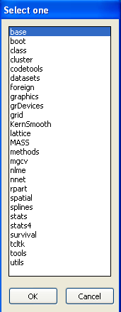
Installing Additional Packages
Use the Packages menu in Windows or Mac.
Download a zip file from the R Project website.
Use the install.packages command in the R console:
install.packages("name")
CRAN packages by name:
cran.r-project.org/web/packages/available_packages_by_name.html
To uninstall a package:
uninstall.packages("name")

Slide 55
Loading and Running Additional Packages
Once downloaded and installed packages need to be loaded into R before use:
library(name)
To unload a package:
detach(package:name)

Slide 56
Citing R
Recognition of R contributors and attribution of R and contributed packages is expected when publishing research and results
R provides a citation() function which will provide this information for your use
calling this function with no arguments provides citation information for R in general:
> citation()
To cite R in publications use:
R Core Team (2019). R: A language and environment for
statistical computing. R Foundation for Statistical
Computing, Vienna, Austria. URL https://www.R-project.org/
calling citation with a package name will provide citation information for that packages:
> citation("tidyverse")
To cite package ‘tidyverse’ in publications use:
Hadley Wickham (2017). tidyverse: Easily Install and Load
the 'Tidyverse'. R package version 1.2.1.
https://CRAN.R-project.org/package=tidyverse

