Slide 1
COP2073C
Introduction to Statistical Programming with R
Module 12: Visualizing Data with the Tidyverse
Reading (R for Data Science):
Ch. 5 Exploratory Data Analysis
Ch. 22 Graphics for Communication with ggplot2

Slide 2
Ch. 5 (R for Data Science) Exploratory Data Analysis

Slide 3
Introduction to EDA
Exploratory data analysis (EDA) is a process of investigating data that is analogous to detective work
Oxford Bibliographies: Exploratory Data Analysis
Data is systematically investigated from different perspectives until a "story" emerges
A working hypothesis is generated
"outliers" (extreme values) and invalid assumptions are identified
"Let the data speak for themselves" – use visualizations to construct the story and then communicate it to stakeholders
Harvard Business Review: How to Tell a Story with Data

Slide 4
The EDA Process
EDA is an iterative process
Generate questions about data
Search for answers by visualizing, transforming, and modeling the data
Refine the questions and generate new ones
Questions may lead to useful information, but not always

Slide 5
EDA Terminology
Two types of questions will always be useful for making discoveries within your data:
What type of variation occurs within my variables?
What type of covariation occurs between my variables?
Terminology
A variable is a quantity, quality, or property that you can measure
A value is the state of a variable when you measure it
The value of a variable may change from measurement to measurement

Slide 6
EDA Terminology (cont)
An observation, or a case, is a set of measurements made under similar conditions
An observation will contain several values, each associated with a different variable.
Tabular data is a set of values, each associated with a variable and an observation
In tidy data*:
Each variable forms a column.
Each observation forms a row.
Each type of observational unit forms a table.
* Wickham, Journal of Statistical Software

Slide 7
Variance
Variance ("variation" is used the text) is the tendency of the values of a variable to change from measurement to measurement
You can see variation easily in real life; if you measure any continuous variable twice, you will usually get two different results
Categorical variables can vary if you measure across different subjects (e.g., the eye colors of different people), or different times (e.g., the energy levels of an electron at different moments)
Every variable has its own pattern of variation, which can reveal interesting information
The best way to understand that pattern is to visualize the distribution of the values

Slide 8
Diamonds
ggplot2 contains a dataset (tibble) named "diamonds"
Description
A dataset containing the prices and other attributes of almost 54,000 diamonds
Format
A data frame with 53940 rows and 10 variables:
price
price in US dollars ($326–$18,823)
carat
weight of the diamond (0.2–5.01)
cut
quality of the cut (Fair, Good, Very Good, Premium, Ideal)
color
diamond colour, from D (best) to J (worst)
clarity
a measurement of how clear the diamond is (I1 (worst), SI2, SI1, VS2, VS1, VVS2, VVS1, IF (best))
x
length in mm (0–10.74)
y
width in mm (0–58.9)
z
depth in mm (0–31.8)
...

Slide 9
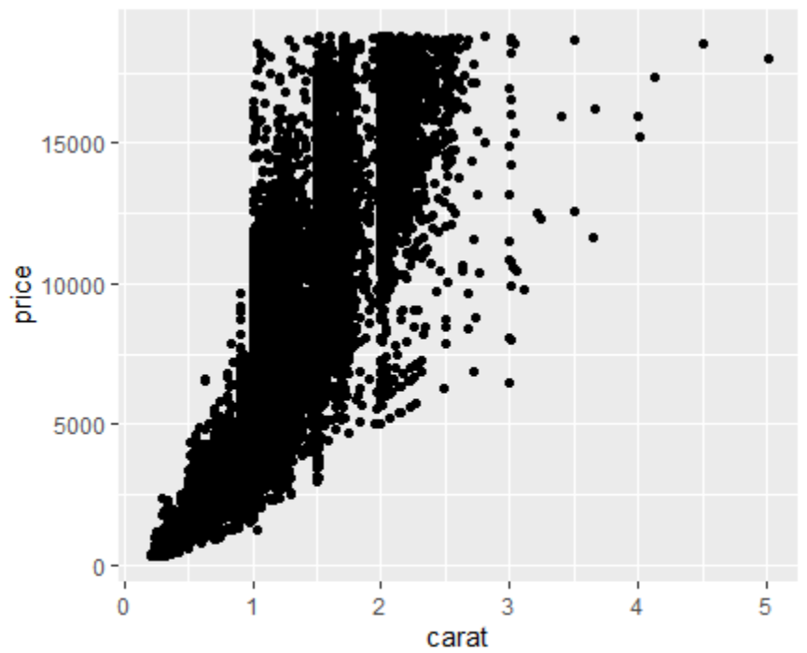
Visualizing Distributions: Diamonds
(note: this may take awhile to run)
ggplot(data=diamonds, aes(x=carat, y=price)) + geom_point()

Slide 10
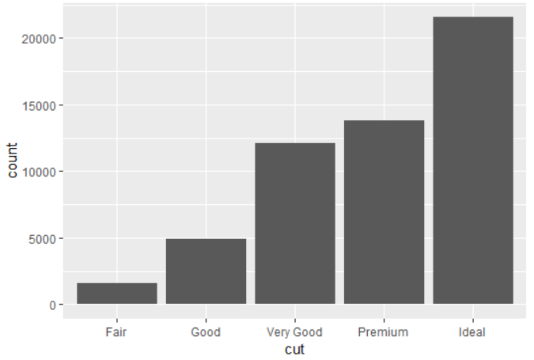
Visualizing Distributions: count per cut
Remember the difference between continuous and categorical variables:
A variable is categorical if it can only take one of a small set of values
Categorical variables are usually saved as factors or character vectors
Use a bar chart to visualize the categorical cut variable distribution
> ggplot(data = diamonds) +
geom_bar(mapping = aes(x = cut))

Slide 11
Visualizing Distributions (cont)
> ggplot(data = diamonds) +
geom_bar(mapping = aes(x = cut))
The height of the bars displays how many observations occurred with each x value. You can compute these values manually with dplyr::count():
> diamonds %>% count(cut)
# A tibble: 5 x 2
cut n
<ord> <int>
1 Fair 1610
2 Good 4906
3 Very Good 12082
4 Premium 13791
5 Ideal 21551

Slide 12
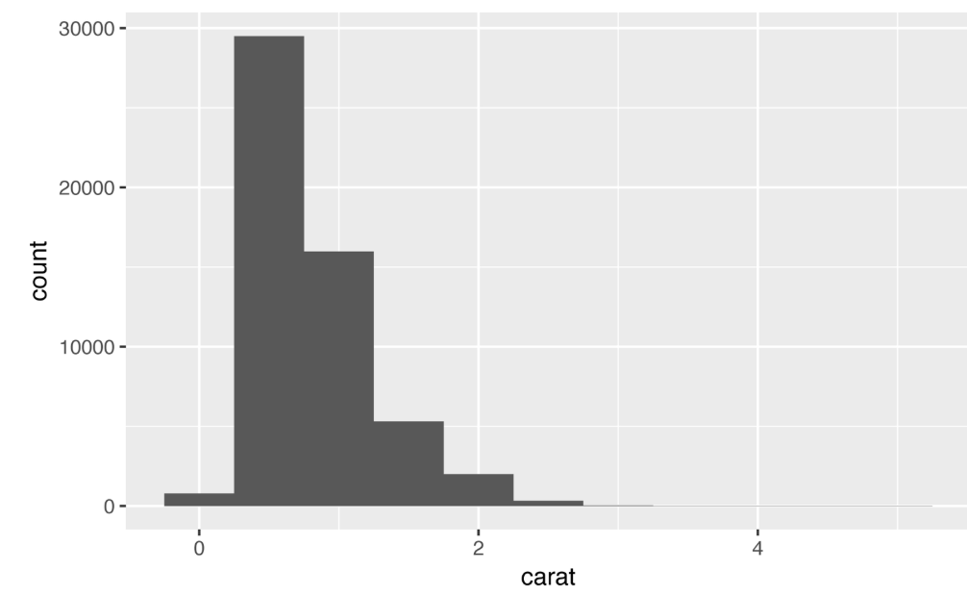
Visualizing Distributions (cont)
A continuous variable can take any of an infinite set of ordered values
Numbers and date-times are two examples of continuous variables.
To examine the distribution of a continuous variable, use a histogram:
> ggplot(data = diamonds) + geom_histogram(
mapping = aes(x = carat), binwidth = 0.5)

Slide 13
Visualizing Distributions (cont)
> ggplot(data = diamonds) + geom_histogram(
mapping = aes(x = carat), binwidth = 0.5)
A histogram divides the x-axis into equally spaced bins and then uses the height of each bar to display the number of observations that fall in each bin
In the graph shown at left, the tallest bar shows that almost 30,000 observations have a carat value between 0.25 and 0.75, which are the left and right edges of the bar

Slide 14
Typical Values
In both bar charts and histograms, tall bars show the common values of a variable, and shorter bars show less-common values
Places that do not have bars reveal values that were not seen in your data
Visualizing our data can help us formulate useful questions, looking for anything unexpected.
Which values are the most common? Why?
Which values are rare? Why? Does that match your expectations?
Can you see any unusual patterns? What might explain them?

Slide 15
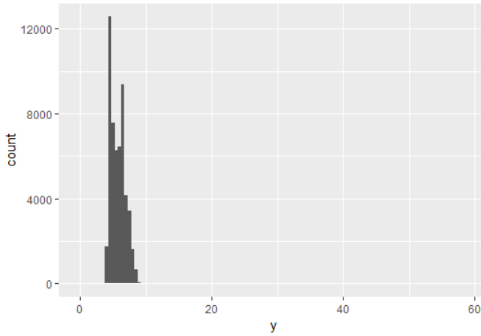
Unusual Values: Outliers
Outliers are observations that are unusual; data points that don’t seem to fit the pattern
Sometimes outliers are data entry errors; other times outliers suggest important new science
When you have a lot of data, outliers are sometimes difficult to see in a histogram
ggplot(diamonds) + geom_histogram(
mapping = aes(x = y), binwidth = 0.5)
The only evidence of outliers in this chart is the extent of the y values (plotted on the x-axis). There are so many observations in the common bins that the rare bins are so short that you can’t see them.

Slide 16
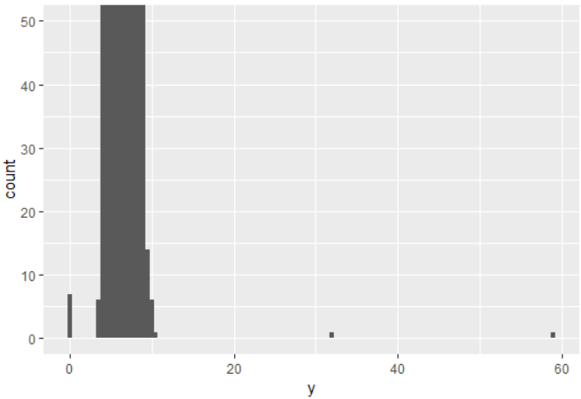
Unusual Values (cont)
To see the small values in this chart, use coord_cartesian (from the ggplot2 package) to limit the y-axis:
> ggplot(diamonds) +
geom_histogram(mapping = aes(x = y), binwidth = 0.5) +
coord_cartesian(ylim = c(0, 50))

Slide 17
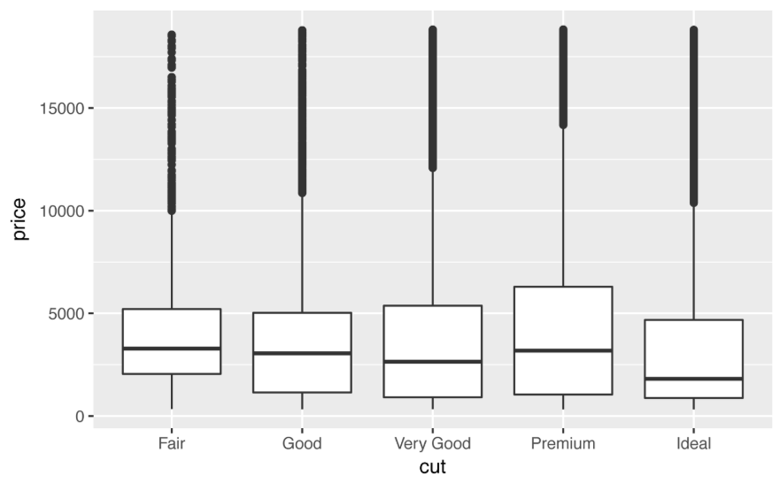
Covariance and Boxplots
Covariance (covariation in the text) is the tendency for the values of two or more variables to vary together in a related way
The best way to spot covariance is to visualize the relationship between two or more variables
This depends on the type of variables involved
To display the distribution of a continuous variable broken down by a categorical variable use a boxplot
A boxplot is a type of visual shorthand for a distribution of values that is popular among statisticians

Slide 18
Boxplots
A boxplot consists of:
A box that stretches from the 25th percentile of the distribution to the 75th percentile, a distance known as the interquartile range (IQR)
In the middle of the box is a line that displays the median, i.e., 50th percentile, of the distribution
The lines forming the boxes give you a sense of the spread of the distribution and whether or not the distribution is symmetric or skewed
Outliers are plotted individually
A line (or whisker) extends from each end of the box and goes to the farthest nonoutlier point in the distribution (determined by a calculation knows as the "IQR", or interquartile range)

Slide 19
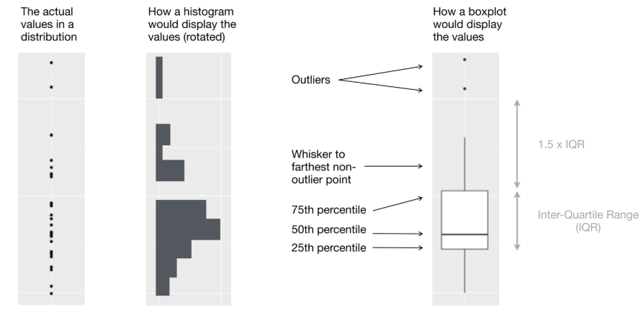
Boxplots (cont)
boxplots are much more compact so we can more easily compare them (and fit more on one plot)

Slide 20
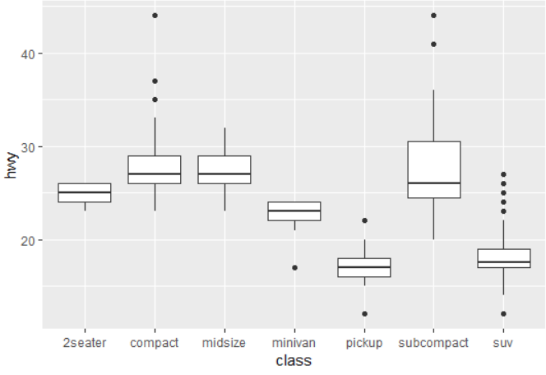
Boxplots (cont)
Compare highway mileage (continuous) to classes (categorical):
> ggplot(data = mpg,
mapping = aes(x = class, y = hwy)) + geom_boxplot()
geom_boxplot(
mapping = NULL,
data = NULL,
stat = "boxplot",
position = "dodge2",
...,
outlier.colour = NULL,
outlier.color = NULL,
outlier.fill = NULL,
outlier.shape = 19,
outlier.size = 1.5,
outlier.stroke = 0.5,
outlier.alpha = NULL,
notch = FALSE,
notchwidth = 0.5,
varwidth = FALSE,
na.rm = FALSE,
orientation = NA,
show.legend = NA,
inherit.aes = TRUE)

Slide 21
Ch. 22 (R for Data Science) Graphics for Communication with ggplot2

Slide 22
Communicating Data
In the course of most analyses, you can produce tens or hundreds of plots, most of which are immediately thrown away.
Once you understand your data, you need to communicate it to others.
Your audience will likely not share your background knowledge and will not be deeply invested.
To help others quickly build up a good mental model of the data, make your plots as self-explanatory as possible.

Slide 23
Labeling
Add a title with the labs() function:
ggplot(mpg, aes(displ, hwy)) +
geom_point(aes(color = class)) +
geom_smooth(se = FALSE) +
labs(
title = paste(
"Fuel efficiency generally decreases with",
"engine size"))
(plot displayed on next slide)

Slide 24
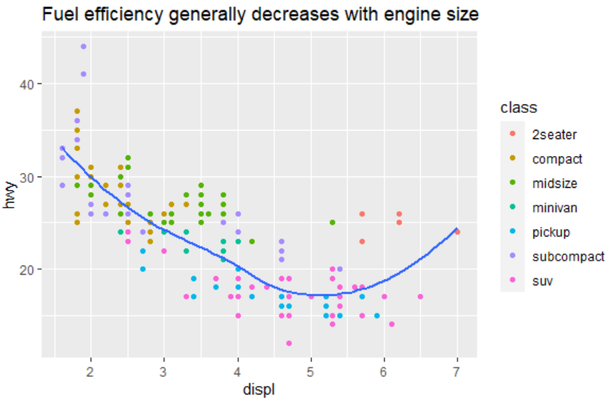
Labeling (cont)

Slide 25
Subtitles and Captions
The subtitle and caption arguments can be included in the labs() function:
ggplot(mpg, aes(displ, hwy)) +
geom_point(aes(color = class)) +
geom_smooth(se = FALSE) +
labs(
title = paste(
"Fuel efficiency generally decreases with",
"engine size"
),
subtitle = paste(
"Two seaters (sports cars) are an exception",
"because of their light weight"
),
caption = "Data from fueleconomy.gov")
(plot displayed on next slide)

Slide 26
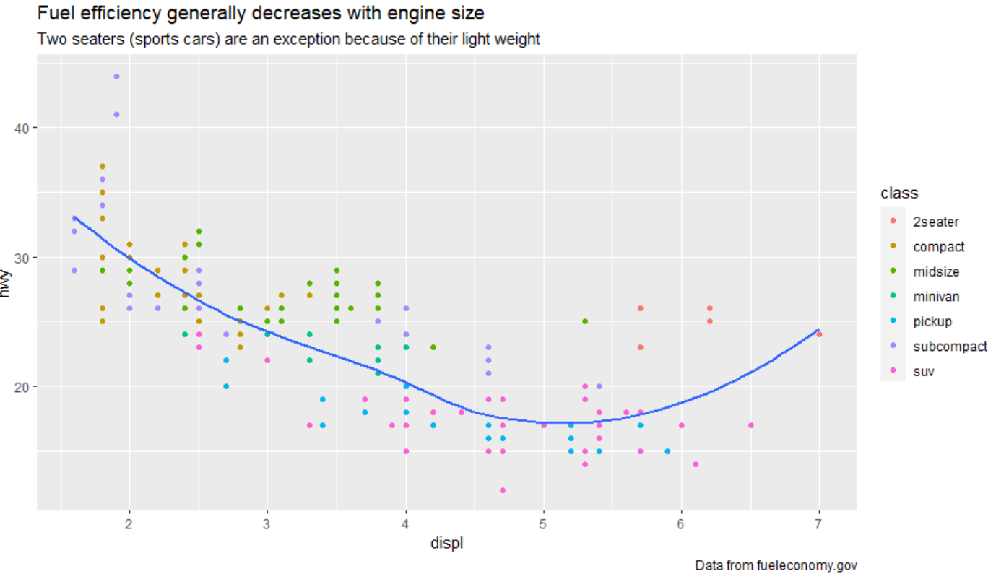
Subtitles and Captions (cont)

Slide 27
Replacing Axis and Legend Titles
You can also use labs() to replace the axis and legend titles.
It’s usually a good idea to replace short variable names with more detailed descriptions, and to include the units:
ggplot(mpg, aes(displ, hwy)) +
geom_point(aes(color = class)) +
geom_smooth(se = FALSE) +
labs(
x = "Engine displacement (L)",
y = "Highway fuel economy (mpg)",
colour = "Car type"
)
(plot displayed on next slide)

Slide 28
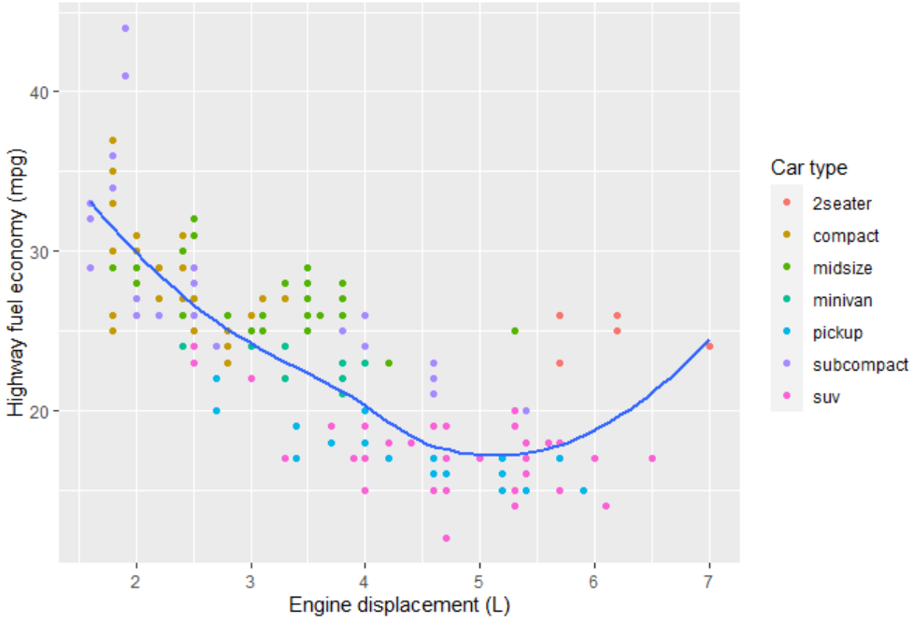
Replacing Axis and Legend Titles (cont)

