Slide 1
COP2073C
Introduction to Statistical Programming with R
Module 4
Visualizing Data

Slide 2
Ch. 6 Special Values and Coercion

Slide 3
Special Values
Many scenarios in R, and data science in general, call for special values
missing data
incorrect data
corrupt data
Special values include
Infinity: Inf is reserved for numbers too large to represent in R
NaN ("not a number"): invalid numerical values, e.g. 0 / 0
NA ("not available"): missing or invalid values (all types)
NULL: an empty entity (vs. not available)

Slide 4
Infinity (Inf)
The Inf keyword is case-sensitive
Positive and negative (-Inf) values supported
Actual value varies based on platform / available memory
Inf can be used in arithmetic operations
> 9000^100
[1] Inf
> 9000^100 * -1
[1] -Inf
> Inf + 1
[1] Inf
> Inf - 10000
[1] Inf
> 20000 / Inf
[1] 0
> Inf / 50
[1] Inf

Slide 5
Testing for Special Values
is.finite() and is.infinite() will test for finite/infinite values in vectors and matrices (but does not work with lists or data frames)
> x1 <- c(10, Inf, -50, -Inf, 9000^100)
> is.finite(x1)
[1] TRUE FALSE TRUE FALSE FALSE
> is.infinite(x1)
[1] FALSE TRUE FALSE TRUE TRUE
> m <- matrix(c(1,2,3,NA,5,6,NaN,8,Inf),nrow=3)
> is.infinite(m)
[,1] [,2] [,3]
[1,] FALSE FALSE FALSE
[2,] FALSE FALSE FALSE
[3,] FALSE FALSE TRUE
> df <- data.frame(col1=c(7,8,9),col2=c(10,11,Inf))
> is.infinite(df)
Error in is.infinite(df) : default method not implemented for type 'list'

Slide 6
Testing for Special Values
is.na() and is.nan() will test for NA and NaN, respectively, although is.na will also include NaN values
is.na works with lists and data frames, is.nan does not
> x1 <- c(10, NA, -50, NaN, 9000^100)
> is.na(x1)
[1] FALSE TRUE FALSE TRUE FALSE
> is.nan(x1)
[1] FALSE FALSE FALSE TRUE FALSE
> df <- data.frame(col1=c(7,8,NaN),col2=c(10,11,NA))
> is.na(df)
col1 col2
[1,] FALSE FALSE
[2,] FALSE FALSE
[3,] TRUE TRUE
> is.nan(df)
Error in is.nan(df) : default method not implemented for type 'list'

Slide 7
Object Attributes
Objects created in R can possess self-referential information known as attributes
e.g. dimensions, levels, names
The attributes() function displays the attributes of an object
> m <- matrix(
c('hello','world',
'goodbye','charlotte'),
nrow= 2,ncol=2,
byrow=TRUE)
> m
[,1] [,2]
[1,] "hello" "world"
[2,] "goodbye" "charlotte"
> attributes(m)
$dim
[1] 2 2

Slide 8
Object Attributes (cont)
If you know the name of an attribute, you can also extract it with the attr() function
> dfm <- data.frame(
word1=c('hello','goodbye'),
word2=c('world','charlotte'))
> dfm
word1 word2
1 hello world
2 goodbye charlotte
> attributes(dfm)
$names
[1] "word1" "word2"
$class
[1] "data.frame"
$row.names
[1] 1 2
> attr(x=dfm,which='names')
[1] "word1" "word2"

Slide 9
Unspecified Attributes
Attributes vary by object type
Some attributes are NULL if not specified
> m <- matrix(c('hello','world','goodbye','charlotte'),
nrow= 2,ncol=2,byrow=TRUE)
> attributes(m)
$dim
[1] 2 2
> attr(x=m,which='dimnames')
NULL

Slide 10
Setting Attributes
Attributes can be set by name when an object is created
> m <- matrix(
c('hello','world','goodbye','charlotte'),
nrow=2,ncol=2,byrow=TRUE,
dimnames=list(c('phrase1','phrase2'),
c('word1','word2')))
> m
word1 word2
phrase1 "hello" "world"
phrase2 "goodbye" "charlotte"
> attributes(m)
$dim
[1] 2 2
$dimnames
$dimnames[[1]]
[1] "phrase1" "phrase2"
$dimnames[[2]]
[1] "word1" "word2"

Slide 11
Creating Attributes
New attributes can be created using the attr() function
> attr(m, "values") <- c("letters", "numbers")
> attributes(m)
$dim
[1] 2 2
…
$values
[1] "letters" "numbers"

Slide 12
Object Class
R is an object-oriented language
Each object has at least one class attribute used to describe it
The class() function will report the class attribute value
For vectors (only), class() reports the type of data stored
> v <- c("hello", "world")
> v
[1] "hello" "world"
> class(v)
[1] "character"
> dfm
word1 word2
1 hello world
2 goodbye charlotte
> class(dfm)
[1] "data.frame"
> m2 <- matrix(1:9, nrow=3)
> dimnames(m2) <- list(c("A", "B","C"), c( "D", "E", "F"))
> m2
D E F
A 1 4 7
B 2 5 8
C 3 6 9
> class(m2)
[1] "matrix" "array"

Slide 13
The S3 System
S3 refers to a class system built into R. The system governs how R handles objects of different classes
Certain R functions will look up an object’s S3 class, and then behave differently in response. When you print a numeric vector, print will display a number:
> num <- 1000000000
> print(num)
[1] 1e+09 # scientific notation
But if you apply the S3 classes POSIXct and POSIXt to num, print will now display a time:
> class(num) <- c("POSIXct", "POSIXt")
> print(num)
[1] "2001-09-08 21:46:40 EDT"
R’s S4 system is similar to S3 but uses a more formal set of rules (not within the scope of this course)

Slide 14
Type-Checking Functions
is-dot functions identify the class or data type of an object
> num.vec <- 1:4
> is.integer(num.vec)
[1] TRUE
> is.numeric(num.vec)
[1] TRUE
> is.matrix(num.vec)
[1] FALSE
> is.data.frame(num.vec)
[1] FALSE
> is.vector(num.vec)
[1] TRUE
> is.logical(num.vec)
[1] FALSE

Slide 15
Coercion Functions
Coercion functions allow conversion from one object or data type to another
Implicit coercion occurs automatically when elements need to be converted to another type in order for an operation to complete, e.g. using numeric values for logical values (one for TRUE, 0 for FALSE)
Implicit coercion occurs in the following statement:
> 1:4 + c(T, F, F, T)
[1] 2 2 3 5
Explicit coercion is performed by applying as-dot functions
> as.numeric(c(T, F, F, T))
[1] 1 0 0 1

Slide 16
Coercion Functions (cont)
Coercions are possible in cases where the conversion "makes sense"
> as.numeric("32.4")
[1] 32.4
R warns when it doesn't like a coercion
> as.numeric("g'day mate")
[1] NA
Warning message:
NAs introduced by coercion

Slide 17
Chaining Coercion Functions
Some coercions require multiple steps
> as.logical(as.numeric(c("1", "0", "1", "0","0")))
[1] TRUE FALSE TRUE FALSE FALSE
Levels of factors are assigned numeric values internally (alphabetically by default); this can be demonstrated by converting them to a numeric type
> xfactor <- factor(x=c("plum", "pear", "plum", "plum", "apple", "apple", "plum"))
> xfactor
[1] plum pear plum plum apple apple plum
Levels: apple pear plum
> as.numeric(xfactor)
[1] 3 2 3 3 1 1 3

Slide 18
Coercing Higher Level Objects: Failure
Consistent characteristics (e.g. length) are required to coerce higher level objects
> foo <- matrix(c(1,2,3,4),ncol=2)
> baz <- list(var1=foo,var2=c(T,F,T),var3=factor(x=c(2,3,4,4,2)))
> baz
$var1
[,1] [,2]
[1,] 1 3
[2,] 2 4
$var2
[1] TRUE FALSE TRUE
$var3
[1] 2 3 4 4 2
Levels: 2 3 4
> as.data.frame(baz) # list variables have varied lengths
Error in (function (..., row.names = NULL, check.rows = FALSE, check.names = TRUE, :
arguments imply differing number of rows: 2, 3, 5

Slide 19
Coercing Higher Level Objects: Success
If all elements have the same length, the coercion works
> foo <- list(var1=c(3,4,5,1), var2=c(T,F,T,T), var3=factor(x=c(4,4,2,1)))
> foo
$var1
[1] 3 4 5 1
$var2
[1] TRUE FALSE TRUE TRUE
$var3
[1] 4 4 2 1
Levels: 1 2 4
> as.data.frame(foo)
var1 var2 var3
1 3 TRUE 4
2 4 FALSE 4
3 5 TRUE 2
4 1 TRUE 1

Slide 20
Ch. 7 Basic Plotting

Slide 21
How to Build a Plot
"When creating a plot we start with data."
Wickham, Hadley: "A Layered Grammar of Graphics"

Slide 22
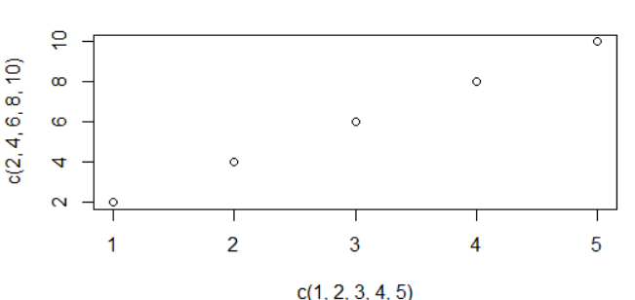
The plot() Function
The plot() function takes a vector of x values and a vector of y values as parameters
Length of both vectors must be the same
If only one vector is provided, a sequential index serves as the x-axis
> plot(x=c(1,2,3,4,5), y=c(2,4,6,8,10))

Slide 23
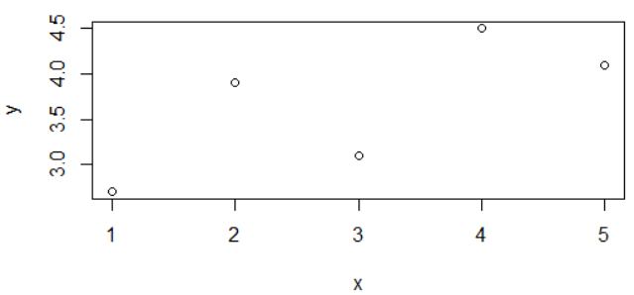
The plot() Function
plot() also takes a matrix (and other structures, e.g. data frames) as a parameter
> m <- matrix(c(1.0, 2.0, 3.0, 4.0, 5.0, 2.7, 3.9, 3.1, 4.5, 4.1),
ncol=2,dimnames=list(NULL,c('x','y')))
> m
x y
[1,] 1 2.7
[2,] 2 3.9
[3,] 3 3.1
[4,] 4 4.5
[5,] 5 4.1
> plot(m)

Slide 24
Graphical Parameters
Graphical parameters can be added to the plot command for visual enhancement
Parameter | Description
type | plot type (point, connected points, etc.)
main, xlab, ylab | plot title, horizontal label, vertical label
col | point and line color
pch | character representing individual points
cex | (character expansion) size of point character
lty | line type (solid, dotted, dashed, etc.)
lwd | line width
xlim, ylim | limits for horizontal and vertical ranges

Slide 25
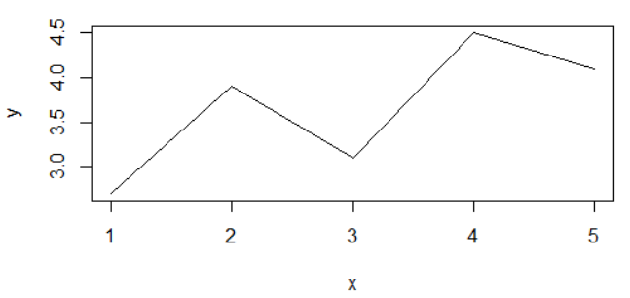
Automatic Plot Types
By default, plot() plots individual data points
Varying the type argument produces different plot types
> m
x y
[1,] 1 2.7
[2,] 2 3.9
[3,] 3 3.1
[4,] 4 4.5
[5,] 5 4.1
> plot(m,type="l") # line plot (lower case L)

Slide 26
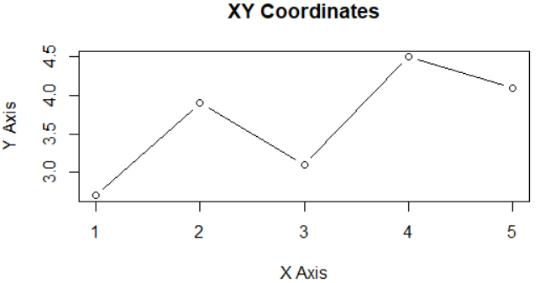
Title and Axis Labels
main, xlab, ylab options are used to add a title and axis labels
# type 'b' is line and point
plot(m,type='b', main="XY Coordinates",
xlab="X Axis", ylab="Y Axis")

Slide 27
Color
Color can be added to plots using various methods, one of which is a character string
colors() will display the available color string representations
> colors()
[1] "white" "aliceblue"
[3] "antiquewhite" "antiquewhite1"
[5] "antiquewhite2" "antiquewhite3"
[7] "antiquewhite4" "aquamarine"
[9] "aquamarine1" "aquamarine2"
… (many more)

Slide 28
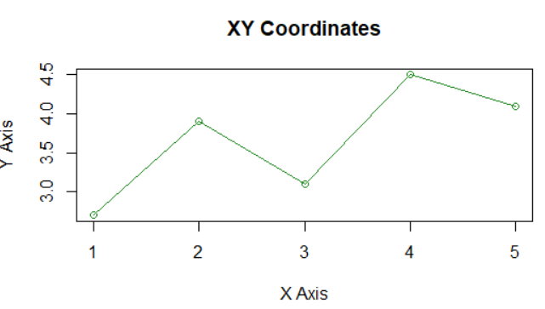
Adding Color With a Character String
> # type 'o' is "overplot" to avoid gaps between points and lines
> plot(m,type="o", col='forestgreen',
main="XY Coordinates", xlab="X Axis", ylab="Y Axis")

Slide 29
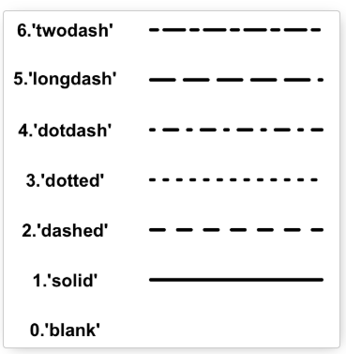
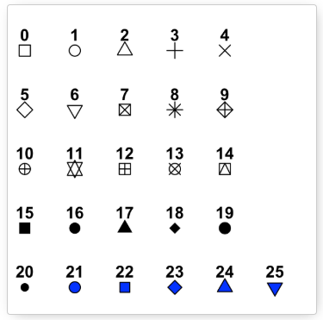
Line and Point Appearances
lty modifies line types
one of a range between 0 and 6
The pch argument modifies point types
Point types can be a specific character (e.g. 'p' or '!') or one of a range of predefined numbered symbols between 0 and 25
http://www.sthda.com/english/wiki/line-types-in-r-lty
http://www.sthda.com/english/wiki/r-plot-pch-symbols-the-different-point-shapes-available-in-r

Slide 30
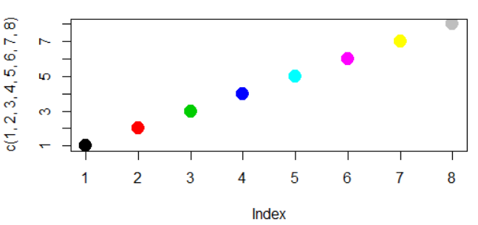
Using cex to Change Point Size
The value of the cex argument indicates the scaling factor for text and symbols relative to the default value of 1.
e.g. 1.5 is 50% larger, 0.5 is 50% smaller, etc.
Following example also demonstrates numeric color values
> plot(c(1,2,3,4,5,6,7,8),pch=19,cex=2,col=c(1,2,3,4,5,6,7,8))

Slide 31
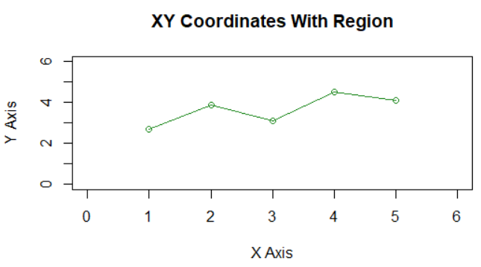
Plot Region Limits
Extra space is sometimes needed to annotate plots or add additional components
xlim and ylim provide custom plot area limits
both require a vector of length 2 as c(lower, upper)
> plot(m,type="o", col='forestgreen',
main="XY Coordinates With Region",
xlab="X Axis", ylab="Y Axis", xlim=c(0,6), ylim=c(0,6))

Slide 32
Adding Points, Lines, and Text
By default, plot() will reset the plot device
Plot components can be added progressively using the following functions:
points() – add points
lines() – add lines using coordinates
abline() – add straight lines
segments() – add line segments between points
text() – add text components
arrows() – add arrows between pairs of points
legend() – add a plot legend

Slide 33
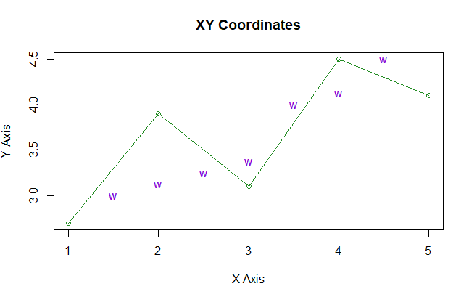
Adding Points
> plot(m,type="o", col='forestgreen',main="XY Coordinates",
xlab="X Axis", ylab="Y Axis")
> points(pch='w',c(1.5, 2.0, 2.5, 3.0, 3.5, 4.0, 4.5),
c(3.0, 3.125, 3.25, 3.375, 4.0, 4.125, 4.5),
col='darkviolet')

Slide 34
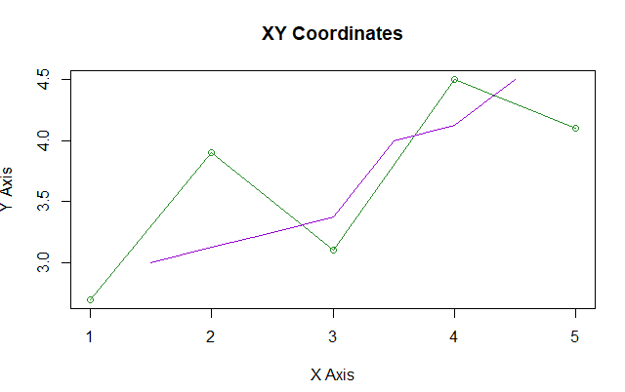
Adding Lines
> plot(m,type="o", col='forestgreen',
main="XY Coordinates", xlab="X Axis", ylab="Y Axis")
> lines(c(1.5, 2.0, 2.5, 3.0, 3.5, 4.0, 4.5),
c(3.0, 3.125, 3.25, 3.375, 4.0, 4.125, 4.5),
col='darkviolet')

Slide 35
The ggplot2 Package
ggplot2 is one of the primary packages provided by the tidyverse
gg stands for "grammar of graphics"
standardizes the production of different plot and graph types
streamlines aspects of adding to existing plots
allows plots to be built by defining and manipulating layers
To install:
>install.packages('ggplot2')
> library(ggplot2)
(or install/load the entire tidyverse package)

Slide 36
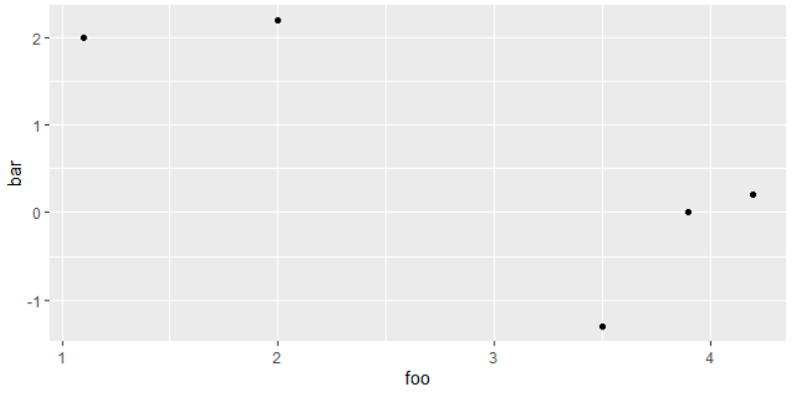
qplot (Quick Plot)
ggplot2's primary plotting tool is qplot (quick plot)
> foo <- c(1.1, 2, 3.5, 3.9, 4.2)
> bar <- c(2, 2.2, -1.3, 0, 0.2)
> qplot(foo, bar)

Slide 37
Plots as Objects Using qplot
ggplot2 graphics are stored as objects
objects can be manipulated
> # using base R, result of plot is not an object
> baz <- plot(foo, bar)
> baz # no associated object
NULL
# using ggplot2, result of qplot is an object
> qux <- qplot(foo, bar)
> qux # displays plot, object can be manipulated

Slide 38
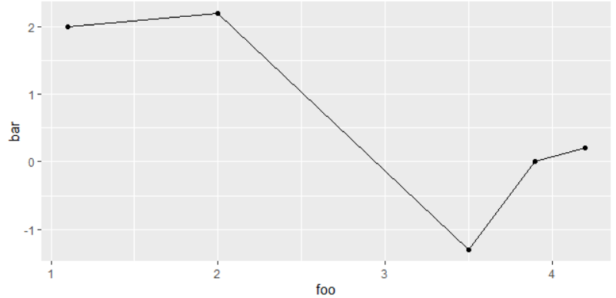
Geoms
Geometric modifiers (geoms) are used to modify ggplot2 plot objects
> foo
[1] 1.1 2.0 3.5 3.9 4.2
> bar
[1] 2.0 2.2 -1.3 0.0 0.2
> qplot(foo,bar,geom='blank') + geom_point() + geom_line()

Slide 39
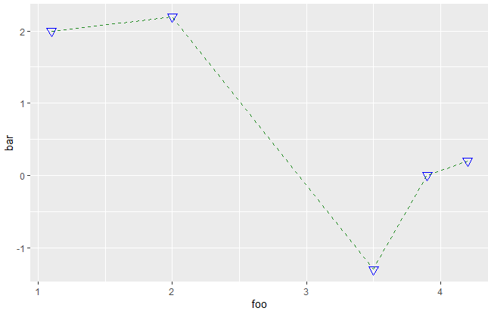
Geometric Modifier Arguments
The base-R plot arguments (e.g. cex, pch) can be used to modify geoms, but ggplot2 also provides simpler/clearer argument options
> qplot(foo,bar,geom='blank') +
geom_point(size=3, shape=6,color='blue') +
geom_line(color='forestgreen',linetype=2)

Slide 40
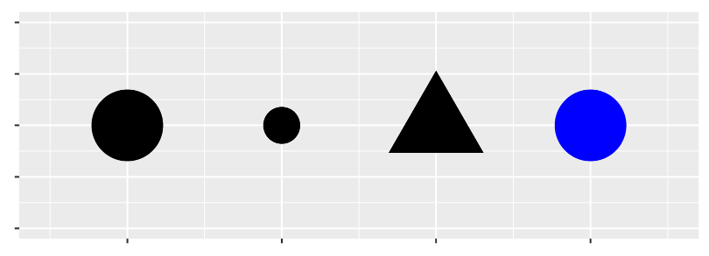
Aesthetic Mappings
An aesthetic is a visual property of the objects in your plot
Aesthetics include characteristics like the size, the shape, or the color of your points.
You can use aesthetics to map geometric modifiers to levels
e.g. changing the levels of a point’s size, shape, and color can make the point small, triangular, or blue:

