Slide 1
COP2073C
Introduction to Statistical Programming with R
Module 6
Control Structures

Slide 2
Ch. 10 Conditions and Loops

Slide 3
If Statements
The if statement allows for conditional execution of code
if (condition) {
# statements executed if condition is true
}
a <- 3
myNumber <- 4
if (a <= myNumber) {
a <- a^2
}
> a
[1] 9
indent

Slide 4
Braces and Programming Style
End of Line or Next Line brace style is acceptable
but be consistent
if (condition) // next line style
{
# statements executed if condition is true
}
if (a <= myNumber)
{
a <- a^2
}
> a
[1] 9
don't indent
indent

Slide 5
Braces and Programming Style
For a single-line if statement body, braces are not required, but it doesn't hurt to use them anyway
Using them can prevent subsequent defects when code is added to the body later
# this works:
if (a <= myNumber)
a <- a^2
# but this is recommended:
if (a <= myNumber) {
a <- a^2
}

Slide 6
If Statements (cont)
Conditions may be relational or logical expressions
> myvec <- c(2.73, 5.40, 2.15, 5.29, 1.36, 2.16, 1.41, 6.97, 7.99, 9.52)
> mymatrix <- matrix(c(2,0,1,2,3,0,3,0,1,1), nrow=5, ncol=2)
> myvec
[1] 2.73 5.40 2.15 5.29 1.36 2.16 1.41 6.97 7.99 9.52
> mymatrix
[,1] [,2]
[1,] 2 0
[2,] 0 3
[3,] 1 0
[4,] 2 1
[5,] 3 1
> if (any((myvec - 1) > 9) || matrix(myvec, 2, 5)[2,1] <= 6) {
new.myvec <- myvec
new.myvec[seq(1,9,2)] <- NA
mylist <- list(aa=new.myvec, bb=mymatrix + 0.05)
cat("new list:\n")
mylist
}

Slide 7
If Statements (cont)
# subtract 1 from each myvec element and compare to 9 (FALSE)
# || (logical OR)
# construct a 2 row, 5 column matrix using myvec and check the
# second row, first column for <= 6 (TRUE)
# FALSE TRUE
if (any((myvec - 1) > 9) || matrix(myvec, 2, 5)[2,1] <= 6) {
new list:
$aa
[1] NA 5.40 NA 5.29 NA 2.16 NA 6.97 NA 9.52
$bb
[,1] [,2]
[1,] 2.05 0.05
[2,] 0.05 3.05
[3,] 1.05 0.05
[4,] 2.05 1.05
[5,] 3.05 1.05

Slide 8
Else Statements
Else statements provide an alternative path for code to follow if an If condition is FALSE
if (condition) {
# statements executed if condition is true
} else {
# statements executed if condition is false
}

Slide 9
Else Statements (cont)
> a <- 5
> myNumber <- 4
> if (a <= myNumber) {
a <- a^2
} else {
a <- a - 3.5
}
> a
[1] 1.5

Slide 10
Limitations of If in R
An if statement can check the condition of only a single logical value.
If you pass in a vector of logicals for the condition, the if statement will only check the very first element
a warning is displayed, e.g.
> if (c(FALSE,TRUE,FALSE,TRUE,TRUE)) { }
Warning message:
In if (c(FALSE, TRUE, FALSE, TRUE, TRUE)) { :
the condition has length > 1 and only the first element will be used

Slide 11
ifelse for Logical Vectors
ifelse is a function which performs vector-oriented checks
Description
ifelse returns a value with the same shape as test which is filled with elements selected from either yes or no depending on whether the element of test is TRUE or FALSE.
Usage
ifelse(test, yes, no)
Arguments
test
an object which can be coerced to a logical value
yes
return values for true elements of test.
no
return values for false elements of test.

Slide 12
ifelse for Logical Vectors
> x <- 5
> y <- -5:5
> y
[1] -5 -4 -3 -2 -1 0 1 2 3 4 5
> result <- ifelse(test= y == 0, yes = NA, no = x)
> result
[1] 5 5 5 5 5 NA 5 5 5 5 5

Slide 13
Nesting If Statements
An if statement can be placed within another if statement:
> if(a<=mynumber) {
cat("First condition is TRUE\n")
a <- a^2
if(mynumber>3) {
cat("Second condition is TRUE")
b <- seq(1,a,length=mynumber)
} else {
cat("Second condition is FALSE")
b <- a*mynumber
}
} else { …

Slide 14
Stacking If Statements
If statements can be sequentially stacked:
> if (a<=mynumber && mynumber>3) {
a <- a^2
b <- seq(1,a,length=mynumber)
} else if (a<=mynumber && mynumber<=3) {
a <- a^2
b <- a*mynumber
} else if (mynumber>=4) {
a <- a-3.5
b <- a^(3-mynumber)
} else {
a <- a-3.5
b <- rep(a+mynumber, times=3)
}

Slide 15
The Switch Statement
switch() provides an alternative to complex stacked sequences
> foo <- switch(EXPR=mystring,
Homer=12,
Marge=34,
Bart=56,
Lisa=78,
Maggie=90,
NA
)
> if(mystring=="Homer") {
foo <- 12
} else if(mystring=="Marge") {
foo <- 34
} else if(mystring=="Bart") {
foo <- 56
} else if(mystring=="Lisa") {
foo <- 78
} else if(mystring=="Maggie") {
foo <- 90
} else {
foo <- NA
}
is equivalent to

Slide 16
For Loops
The for loop iterates through elements in an object
> for(myitem in 5:7) { cat("the current item is",myitem,"\n") }
the current item is 5
the current item is 6
the current item is 7

Slide 17
For Loops (cont)
Vector elements in a for loop can be accessed by a variable named in the loop header or by an index
The following examples are equivalent:
myvec <- c(0.4,1.1,0.34,0.55)
for(i in myvec) {
print(2 * i)
}
[1] 0.8
[1] 2.2
[1] 0.68
[1] 1.1
for(i in 1:length(myvec)) {
print(2 * myvec[i])
}
[1] 0.8
[1] 2.2
[1] 0.68
[1] 1.1

Slide 18
Preallocate Objects Before Looping
Preallocating output objects makes loop processing much more efficient
Time the following operations and compare their performance
> system.time({
output <- rep(NA, 10000000); # preallocate output object
for (i in 1:10000000) {
output[i] <- i + 1
}
})
user system elapsed
0.44 0.00 0.44
system.time({
output <- NA; # dynamically resize output object
for (i in 1:10000000) {
output[i] <- i + 1
}
})
user system elapsed
3.27 0.52 3.78

Slide 19
For Loops (cont)
Design a for loop which analyzes a list of various data types and characterizes the elements in a data frame
Create the list
Obtain some preliminary information and preallocate
> foo <- list(aa=c(3.4,1), bb=matrix(1:4,2,2),
cc=matrix(c(T,T,F,T,F,F),3,2),
dd="string here",
ee=matrix(c("red","green","blue","yellow")))
> name <- names(foo) # get element names
> is.mat <- rep(NA,length(foo)) # preallocate for testing for matrices
> nr <- is.mat # preallocate for number of rows
> nc <- is.mat # preallocate for number of columns
> data.type <- is.mat # preallocate for data type of each

Slide 20
For Loops (cont)
Loop implementation
> for (i in 1:length(foo)) {
member <- foo[[i]]
if(is.matrix(member)) {
is.mat[i] <- "Yes"
nr[i] <- nrow(member)
nc[i] <- ncol(member)
data.type[i] <- class(as.vector(member))
} else {
is.mat[i] <- "No"
}
}
> # create a data frame from the collected data items
> bar <- data.frame(name,is.mat,nr,nc,data.type)
> bar
name is.mat nr nc data.type
1 aa No NA NA <NA>
2 bb Yes 2 2 integer
3 cc Yes 3 2 logical
4 dd No NA NA <NA>
5 ee Yes 4 1 character

Slide 21
Nested For Loops
For loops can be nested
Align/indent for readability
Variable used in header must be unique
> loopvec1 <- c(1, 2, 3)
loopvec2 <- c(5, 10, 15)
result <- NULL
count <- 1
for (i in 1:length(loopvec1)) {
for (j in 1:length(loopvec2)) {
result[count] <- loopvec1[i]*loopvec2[j]
count <- count + 1
}
}
result

Slide 22
While Loops
The while loop runs code while a certain condition remains TRUE
while (condition) {
code
}
i <- 1
while (i < 6) {
print(i)
i <- i + 1
}

Slide 23
Repeat Loops
The repeat loop will run code until the Escape key is pressed or the code encounters a break command
repeat {
code
if (condition) {
break
}
}
x <- 1
# Repeat loop
repeat {
print(x)
# break statement to terminate if x > 4
# comment out for infinite version,
# <Esc> required to terminate
if (x > 4) {
break
}
# Increment x by 1
x <- x + 1
}

Slide 24
Computational Cost of Loops
Any number of loops can be nested
Computational cost can become a problem if done unwisely
Many loops can also be replaced by vector operations
The following function uses a loop that is not vectorized, the loop manipulates each element of the vector one at a time
abs_loop <- function(vec) { # create a function to set abs value
for (i in 1:length(vec)) {
if (vec[i] < 0) {
vec[i] <- -vec[i]
}
}
vec
}
abs_loop(-10000:-1) # call the function

Slide 25
Vectorize Instead of Loop
abs_vec (below) is vectorized
It uses logical subsetting to manipulate every number in the vector at the same time
This is much faster than abs_loop because it relies on operations that R does quickly: logical tests, subsetting, and element-wise execution
abs_vec <- function(vec) { # create a function to set abs value
negs <- vec < 0
vec[negs] <- vec[negs] * -1
vec
}
abs_vec(-10000:-1) # call the function

Slide 26
The <- Assignment Operator is Vectorized
You can use R’s <- assignment operator, which is also vectorized, to save a new set of values over an old set:
> vec
[1] 1 -2 3 -4 5 -6 7 -8 9 -10
> vec[vec < 0] <- vec[vec < 0] * -1
> vec
[1] 1 2 3 4 5 6 7 8 9 10
The elements of the new set will be paired up to the elements of the old set, in order, and then element-wise assignment will occur

Slide 27
Loop Guidelines
If you can avoid loops using vectorization, you should do so
A good way to spot loops that could be vectorized is to look for combinations of if and a loop
if can only be applied to one value at a time
This combination can usually be replaced with logical subsetting, which will do the same thing but run much faster
There are operations that cannot be vectorized and require loops
You can dramatically increase the speed of your loops by
doing as much as you can outside of the loop
making sure that any storage objects that you use with the loop are preallocated

Slide 28
Implicit Looping with Apply()
In some situations, especially for relatively routine loops (such as executing some function on each member of a list), you can avoid some of the details associated with explicit looping by using the apply function
The apply function is the most basic form of implicit looping—it takes a function and applies it to each element of an collection
foo <- matrix(1:12,4,3)
foo
[,1] [,2] [,3]
[1,] 1 5 9
[2,] 2 6 10
[3,] 3 7 11
[4,] 4 8 12
find the sum of each row
(see next slide)

Slide 29
Implicit Looping with Apply() (cont)
foo <- matrix(1:12,4,3)
foo
[,1] [,2] [,3]
[1,] 1 5 9
[2,] 2 6 10
[3,] 3 7 11
[4,] 4 8 12
for loop approach:
find the sum of each row
row.totals <- rep(NA,times=nrow(foo))
for(i in 1:nrow(foo)) {
row.totals[i] <- sum(foo[i,])
}

Slide 30
Implicit Looping with Apply() (cont)
apply() requires least three arguments:
X is the object to cycle through
MARGIN is an integer that indicates which margin of X to operate on (rows, columns, etc.)
for a matrix, 1 indicates rows, 2 indicates columns,
FUN provides the function you want to perform on each margin
foo <- matrix(1:12,4,3)
foo
[,1] [,2] [,3]
[1,] 1 5 9
[2,] 2 6 10
[3,] 3 7 11
[4,] 4 8 12
> row.totals2 <- apply(X=foo, MARGIN=1, FUN=sum)

Slide 31
Apply Variations
There are different flavors of the basic apply function
The tapply function performs operations on subsets of the object of interest, where those subsets are defined in terms of one or more factor vectors
lapply operates member by member on a list
sapply returns the same results as lapply but in an array form
All apply functions allow for additional arguments to be passed to FUN; most via an ellipsis

Slide 32
Ch. 11 Writing Functions

Slide 33
R Function Fundamentals
Functions have 3 parts: an argument list (i.e. the "formals"), a body, and an environment
Functions in R are objects, just as vectors and data frames are objects
This property is often referred to as "first-class functions"
f <- function(x, y) {
# descriptive comment
x + y
}

Slide 34
Writing Custom Functions
Functions are defined using the function() function (really!)
function_name <- function(arg1,arg2,arg3,...) {
# descriptive comment
local_var <- some_value
# executable statements
return(return_object) # or just return_object
}
Arguments, tags, and the use of ellipsis depend on the function being defined
If the function does not require any arguments, use empty parentheses ( )
variables created in a function are local to that function
explicit return statements are usually not required, the last evaluated expression is returned

Slide 35
To Return … or Not to Return
Return values
The last expression evaluated in a function becomes the return value, the result of invoking the function.
> f <- function(x) {
if (x < 10) {
0
} else {
10
}
}
> f(5)
> [1] 0
> f(15)
> [1] 10

Slide 36
To Return … or Not to Return (cont)
"Generally, I think it’s good style to reserve the use of an explicit return() for when you are returning early, such as for an error, or a simple case of the function. This style of programming can also reduce the level of indentation, and generally make functions easier to understand because you can reason about them locally."
Hadley Wickham, "Advanced R", http://adv-r.had.co.nz/Functions.html
f <- function(x, y) {
if (!x) return(y)
# other complicated
# processing here
}

Slide 37
Managing Custom Functions
Use save() to store custom functions as R-encoded binary files on the disk.
Use load() to read files and load custom functions into R
save(my_function, file = 'My Functions.R')
load('My Functions.R')
Use dump() to write custom functions to the disk as plain text
dump(c('my_function'), file = 'My Functions.R')
Use source() to read a text file from the disk and execute it as if it were typed from a console
source(file = 'My Functions.R')

Slide 38
R Packages
The fundamental unit of shareable code in R is the package.
A package bundles together code, data, documentation, and tests, and is easy to share with others.
When you load a package, R checks whether any objects in the package clash with other objects that are accessible in the present session
This indicates that the two packages each have an object with the same name of "ellipse".
R notifies you that the object masked (aka shadowed"), use package::object to access it
library("spatstat")
spatstat 1.40-0 (nickname: 'Do The Maths')
For an introduction to spatstat, type 'beginner'
library("car")
Attaching package: 'car'
The following object is masked from 'package:spatstat':
ellipse

Slide 39
Creating a Custom Package
Building packages involves taking a source directory and creating a "tarball" ready for distribution, including cleaning it up and creating PDF documentation from any vignettes
A vignette (pronounced "vinyet") is a descriptive guide to the package
The sources of an R package consist of a subfolder containing files named DESCRIPTION and NAMESPACE, and the subfolders R, data, demo, exec, inst, man, po, src, tests, tools and vignettes.
These subfolders may be omitted; if included they should not be empty.
The package subfolder may also contain files named INDEX, configure, cleanup, LICENSE, LICENCE and NEWS.
Other files such as INSTALL (for non-standard installation instructions), README/README.md2, or ChangeLog will be ignored by R, but may be useful to end users.
https://cran.r-project.org/doc/manuals/R-exts.html#Creating-R-packages

Slide 40
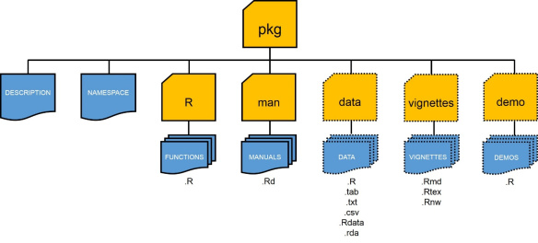
Structure of an R Package
https://methodsblog.com/2015/11/30/building-your-first-r-package/

Slide 41
DESCRIPTION File
The DESCRIPTION file contains basic information about the package in the following format:
Package: pkgname
Version: 0.5-1
Date: 2015-01-01
Title: My First Collection of Functions
Authors@R: c(person("Joe", "Developer", role = c("aut", "cre"),
email = "Joe.Developer@some.domain.net"),
person("Pat", "Developer", role = "aut"),
person("A.", "User", role = "ctb",
email = "A.User@whereever.net"))
Author: Joe Developer [aut, cre],
Pat Developer [aut],
A. User [ctb]
Maintainer: Joe Developer <Joe.Developer@some.domain.net>
Depends: R (>= 3.1.0), nlme
Suggests: MASS
Description: A (one paragraph) description of what
the package does and why it may be useful.
License: GPL (>= 2)
URL: https://www.r-project.org, http://www.another.url
BugReports: https://pkgname.bugtracker.url

Slide 42
Licensing
Licensing for a package which might be distributed is an important but potentially complex subject.
It is very important that you include license information! Otherwise, it may not even be legally correct for others to distribute copies of the package, let alone use it.
The package management tools use the concept of ‘free or open source software’ (FOSS) licenses: the idea being that some users of R and its packages want to restrict themselves to such software. Others need to ensure that there are no restrictions stopping them using a package, e.g. forbidding commercial or military use.
It is a central tenet of FOSS software that there are no restrictions on users nor usage.
Do not use the ‘License’ field for information on copyright holders: if needed, use a ‘Copyright’ field.

Slide 43
Step-By-Step
Download supplemental packages
Create package directory
Add functions
Add documentation
Process documentation
Install and Test
Unloading a Package
detach("package:pkgname", unload=TRUE)
https://hilaryparker.com/2014/04/29/writing-an-r-package-from-scratch/

Slide 44
Ch. 12 Exceptions and Timing

Slide 45
Debugging R Code
Debugging tools are built in to R
Indications:
message: A generic notiﬁcation/diagnostic message produced by the message function; execution of the code continues. Not necessarily a problem.
warning: An indication that something unexpected happened but not necessarily fatal; execution of the code continues; generated by the warning function
error: An indication that a fatal problem has occurred; code execution stops; produced by the stop function
condition: A generic concept for indicating that something unexpected can occur; programmers can create their own conditions

Slide 46
Warnings and Errors
R provides warnings and errors to indicate problems
Warnings allow execution to continue
Warnings are invoked by the warning() function
> warn_test <- function(x) {
if (x <= 0) {
warning("x is 0 or negative, setting to 1")
x <- 1
}
return(5/x)
}
> warn_test(-1)
[1] 5
Warning message:
In warn_test(-1) : x is 0 or negative, setting to 1

Slide 47
Warnings and Errors (cont)
Errors cause immediate termination of the function
Errors are invoked by the stop() function
> error_test <- function(x) {
if (x <= 0) {
stop("x is 0 or negative, TERMINATED!")
x <- 1
}
return(5/x)
}
> error_test(0)
Error in error_test(0) : x is 0 or negative, TERMINATED!

Slide 48
Diagnosing
Questions to ask:
What was your input?
How did you call the code?
What were you expecting?
Output, messages, other results?
What did you get?
How does what you get differ from what you were expecting?
Were your expectations correct in the ﬁrst place?
Can you reproduce the problem?

Slide 49
Debugging Tools
traceback: prints stack trace if error occurs, nothing otherwise
debug: flags a function for debugging, allows step-through of code
browser: suspends execution of a function and puts it in debug mode
trace: insert debugging code in specific places. Useful when you don't have the source code.
there's always print & cat
https://adv-r.hadley.nz/debugging.html

Slide 50
traceback
traceback() can be used to print a summary of how your program arrived at an error.
This is also called a call stack, stack trace or backtrace.
In R this displays each function call and associated argument(s) that lead up to the error, which can be very useful for determining what lead to the error.
> mean(x)
Error in mean(x) : object 'x' not found
> traceback()

Slide 51
traceback
> mean(x)
Error in mean(x) : object 'x' not found
> traceback()
1: mean(x) # not very exciting, but this is the # function where the error occurred
> lm(y ~ x)
Error in eval(predvars, data, env) : object 'y' not found
> traceback()
7: eval(predvars, data, env) # here's where the error occurred
6: eval(predvars, data, env)
5: model.frame.default(formula = y ~ x, drop.unused.levels = TRUE)
4: stats::model.frame(formula = y ~ x, drop.unused.levels = TRUE)
3: eval(mf, parent.frame())
2: eval(mf, parent.frame())
1: lm(y ~ x)

Slide 52
debug
debug() allows the user to step through the execution of a function, line by line.
Values of variables or graphs of the results within the function can be displayed at any time.
Type “c” to continue to the end of the current section of code
To start debugging: debug(function_name)
To stop debugging: undebug(function_name)
debug(lm)
lm(y ~ x)
debugging in: lm(y ~ x)
debug: {

Slide 53
debug
debug(lm)
lm(y ~ x)
debugging in: lm(y ~ x)
debug: {
ret.x <- x
ret.y <- y
cl <- match.call()
mf <- match.call(expand.dots = FALSE)
…
if (ret.y)
z$y <- y
if (!qr)
z$qr <- NULL
z
}
Browse[2]>

Slide 54
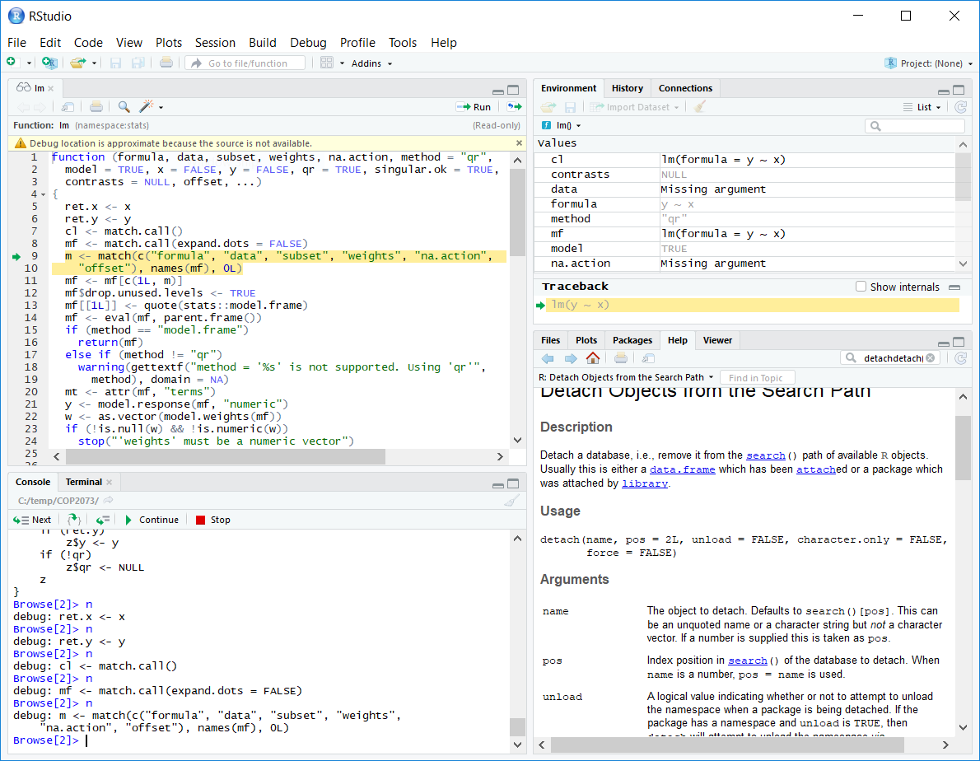

Slide 55
browser
browser() halts execution and invokes an environment browser when it is called.
browser() can be inserted anywhere in your code to stop at that point in the code for debugging.
http://rfunction.com/archives/2633

Slide 56
browser
> fcn <- function(x, y){
+ z <- x*y
+ browser()
+ return(z*exp(z))
+ }
> val <- fcn(2, 1.3)
Called from: fcn(2, 1.3)
Browse[1]> x
[1] 2
Browse[1]> y
[1] 1.3
Browse[1]> z
[1] 2.6
Browse[1]> c
http://rfunction.com/archives/2633

Slide 57
Using Try to Catch Exceptions
When a function terminates from an error, it also terminates any parent functions
If function A calls function B and function B halts because of an error, this halts execution of A at the same point.
To avoid this, use a try statement to attempt a function call and check whether it produces an error
attempt1 <- try(myfibrec2(0),silent=TRUE)
attempt1
[1] "Error in myfibrec2(0) : 'n' is uninterpretable at 0\n"
attr(,"class")
[1] "try-error"
attr(,"condition")
<simpleError in myfibrec2(0): 'n' is uninterpretable at 0>

Slide 58
Using Try in a Function Body
myfibvectorTRY <- function(nvec) {
nterms <- length(nvec)
result <- rep(0,nterms)
for (i in 1:nterms) {
attempt <- try(myfibrec2(nvec[i]),silent=T)
if (class(attempt)=="try-error") {
result[i] <- NA
} else {
result[i] <- attempt
}
}
return(result)
}

Slide 59
System.time
The system.time function can be used to see just how fast R code runs
system.time takes an R expression, runs it, and then displays how much time elapsed while the expression ran
Compare abs_loop and abs_set (slides 22/23) by making a long vector of 100 million positive and negative numbers
long <- rep(c(-1, 1), 50000000)

Slide 60
Timing with System.time
> long <- rep(c(-1, 1), 50000000)
> system.time(abs_loop(long))
user system elapsed
11.23 0.27 11.50
> system.time(abs_sets(long))
user system elapsed
1.67 0.43 2.11

Slide 61
Timing with System.time (cont)
user system elapsed
1.67 0.43 2.11
The first two columns (user, system) of the output report how many seconds your computer spent executing the call in "user mode" and "system mode"
The last column displays how many seconds elapsed while R ran the expression.
The results show that abs_set calculated the absolute value 5 times faster than abs_loop when applied to a vector of 100 million numbers
You can expect similar speed-ups whenever you write vectorized code.

Slide 62
Timing a Built-in R Function
You can measure the speed of the built-in function abs with system.time
It takes abs 0.26 seconds to calculate the absolute value of 100 million numbers
> system.time(abs(long))
user system elapsed
0.20 0.06 0.26
Built-in functions are optimized in R and should be used when available for the best performance

